Slide 1
Networking and Health Information Exchange
Privacy, Confidentiality, and Security Issues and Standards
Lecture b
This material Comp9_Unit9b was developed by Duke University, funded by the Department of Health and Human Services, Office of the National Coordinator for Health Information Technology under Award Number IU24OC000024.
Notes:
Welcome to Networking and Health Information Exchange, Privacy, Confidentiality, and Security Issues and Standards. This is lecture b.

Slide 2
Privacy, Confidentiality, and Security Issues and Standards Learning Objectives
Define access control methods.
Analyze access restrictions to data storage and retrieval (physical and software).
Notes:
Objectives for this unit, Privacy, Confidentiality, and Security Issues and Standards, are to:
Define access control methods, and
Analyze access restrictions to data storage and retrieval (physical and software).

Slide 3
Access Control
Who or what is allowed access to a particular resource and what level of access are they allowed.
Terminology
Identification
Authentication
Authorization
Notes:
Access control is: who, or what is allowed access to a particular resource and what level of access is allowed. For example, which users can have access to a patient record? A doctor may have access to all of the information, including contact information, medical history, and medications. The doctor would probably be allowed to read the information, and make changes to it. A receptionist would have access to the patient’s contact information, but nothing else. Access control involves three steps – identification, authentication, and authorization.
Identification requires that a user present identification, like a username. Once the identification has been provided, the system must authenticate the user. This makes sure that the identification is true, and has not been forged. Authentication is something you know, something you have, or something you are. A password would be an example of authentication. Authorization is the process of allowing the user to perform the actions that he has permission to do. For example, being able to read a file.

Slide 4
Access Control Best Practices
Separation of duties
Require more than 1 person to perform an action
Least privilege
Only give user the access needed
Notes:
There are a couple of things to keep in mind as you are providing access to users. The first is separation of duties. No one person should have access to perform an action that could lead to fraudulent activity. For example, there should be multiple people involved in the payroll process. There should be an individual who verifies an employee’s hours, another who issues the paycheck and a third who signs the check. If only one individual were involved in the process, we could have a person paid for hours that he didn’t work. Another best practice is to only give users the access they need to perform their jobs. This is called least privilege. While it is easy for the system administrator to allow everyone to do everything on a system, and assume they will not do anything they shouldn’t, often this isn’t the case. Do you know the saying, “give them an inch, and they’ll take a mile?” Users will do things they shouldn’t -- either intentionally or unintentionally, so we only give them access to do the things they should be doing.

Slide 5
Access Control Models
Discretionary Access Control (DAC)
Mandatory Access Control (MAC)
Role Based Access Control (RBAC)
Notes:
There are three primary models for access control: Discretionary Access Control (DAC) means that it is completely up to the owner of the objects who has access to them, and what access they have. For example, if I create a file, I can decide who has access to it, and what permissions or rights they have: read, write, delete, etc. It is up to the discretion of the owner or administrator of a system who has access to what.
With Mandatory Access Control (MAC), an owner or administrator cannot decide who has what access. Access is controlled by a numeric access level. This is used in the military. For example, if a document is classified as “top secret,” only those users with clearance to top secret documents will be able to access the document. Even if the creator of a document, or an administrator, thinks that someone without top secret clearance should have access to that document, they cannot give this authorization.
Role Based Access Control (RBAC) is access based on the role a person plays in an organization. Access is given to a particular role inside of an organization, and then users are associated with those roles. They inherit the access from that role. For example, we might create a role of receptionist in a medical practice. We would figure out what access to what resources a receptionist needs, and assign that access to the role. Then, we would associate all of our receptionists with that role, and they would now have all of the access that we gave that role. If a receptionist leaves the practice, we simply disassociate her user account with the role, and she now has no access.

Slide 6
Access Control Types
Logical
Access to data files, programs and networks
Access Control Lists (ACLs)
Account Restrictions
Passwords
Physical
Access to physical locations
Locks
Badges
Mantraps
Notes:
There are two types of access control: logical and physical. Logical access control is managing access to data files, programs, and networks. Methods for controlling logical access include: Access Controls Lists (ACLs), account restrictions, and authentication methods. Physical access control is managing who has access to physical locations. Methods include locks, ID badges, and mantraps. Mantraps will be explained later in the unit.

Slide 7
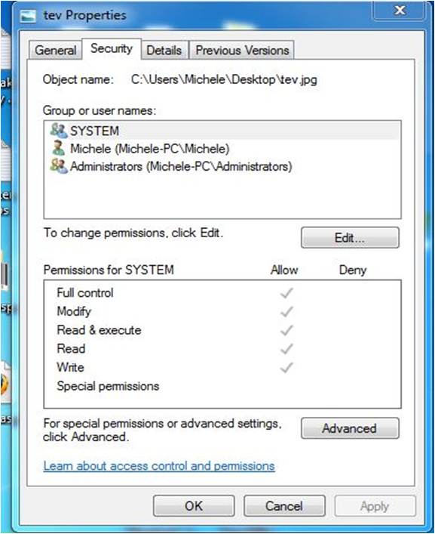
Access Control List (ACL)
An ACL is a list that
is associated with
file, directory or
object that lists who
has access to it and
what access
they have.
Image courtesy of Michele Parrish
Notes:
An Access Control List (ACL) is a list that is associated with a file, directory or object that lists who has access to it, and the type of access. ACLs are created by the owner of the object. The person who creates a file or directory would be the owner of that file or directory. On the slide, you see the ACL for the file named tev.jpg. There are 3 objects that have access to the file: System, Michele, and Administrators. System and Administrators are group accounts – note the icon that depicts a group. Michele is a user account. The ACL shows the permissions, or access, that SYSTEM has to the file. The checks indicate what permissions the object has. All users that are part of a group will inherit the permissions that are given to that group. Access control is easier to administrator through groups than individual user accounts.

Slide 8
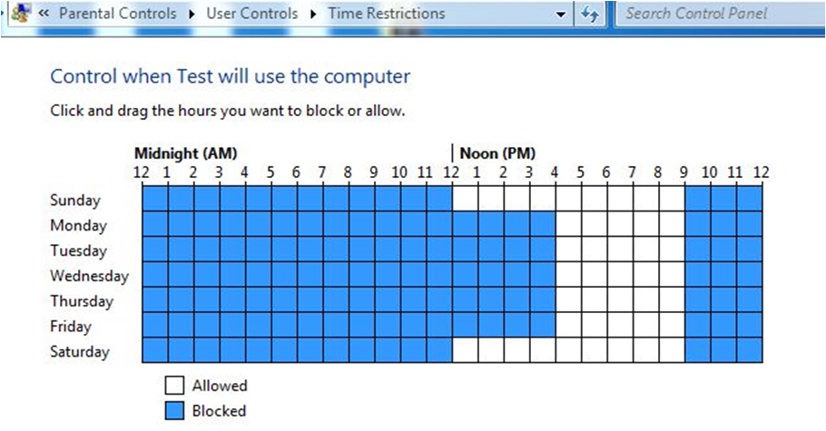
Account Restrictions
Account expiration
Time of day
Login location
Image courtesy of Michele Parrish
Notes:
For each account that is created, there are associated properties: Username, First Name, Last Name, Phone number, etc. Other properties control how the account functions. One restriction that can be put on an account is account expiration. This automatically disables an account at a given date. This would be a good thing to do if you know you are creating an account for a temporary worker. If the worker is only going to be employed for three months, chances are that you may forget at the end of the three months to disable the account. This would be a security vulnerability, because that employee could still access resources, even though he is no longer employed by the company. If you were to go ahead and set up an expiration date three months in the future, when you create the account, you wouldn’t have to worry about disabling the account. You may also want to set up restrictions on what time of day a user can login, and where they can login from (if applicable with your system). If business hours are from 8 am to 5 pm, there is no need for a user to be logging in at 9 pm. Who is usually at a company after hours? Janitorial staff. We want to make sure they are not able to get into the system. The graphic on the slide shows the time restrictions that can be put on an account as part of the parental controls in Windows 7. Some systems will allow you to limit the address (IP or MAC) that a user can login from. A user can only login from his machine. This limits someone from illegally accessing the system.

Slide 9
Passwords
Combination of letters, numbers and special characters
Recommend upper and lower case characters
The more characters the better
Should be changed frequently
Notes:
Remember from earlier in the lecture, authentication is something you know, something you have or something you are. A password is a type of authentication: it’s something you know. Passwords are the most commonly-used method for accessing a system. Ideally, a password is a combination of letters, numbers and special characters. It should contain upper and lower case characters. The more characters you have in your password, the harder it will be for the password to be compromised; more than 8 characters and a combination of lower case, uppercase, numbers, and special characters is best. Many organizations enforce periodic password changes, while others enforce very strict passwords and carefully watch for suspicious activity.

Slide 10
Passwords Should Never
Be default passwords
Should never be written down
Should never be a word in a dictionary, words spelled backwards, common misspellings, and abbreviations (English or other languages)
Notes:
You should never use the default passwords that are set by the vendor for hardware or software. For example, many routers come with the default password set to the word, “password.” Hackers will try the typical default passwords, so these should be changed immediately. Passwords should never be written down. They should never be a word that can be found in a dictionary, a word spelled backwards, common misspelling or abbreviations. This includes English words and words in other languages.

Slide 11
Passwords Should Never (Continued)
Be used for more than one account
Contain personal information
Social engineering
Notes:
The same password should never be used for more than one login. For example, you should not use the same password for your email, Facebook and bank account. If your password is compromised for your email the hacker now has your password to access your bank account also. You should use a different password for every account. Passwords should never contain personal information like a birthdate, pet, children’s name, favorite team, etc. This is information that people can learn from you. Hackers may try to use social engineering – pretending to be your friend – to find out this information so they can access your accounts.

Slide 12
One-Time Passwords (OTP)
Change frequently
Only used once
Synchronized with authentication server
Notes:
One-time passwords (OTP) are passwords that change frequently and can only be used once. Users have a token that is synchronized with an authentication server. When a user wants to access a system he obtains the password from the token. The password must match the one on the authentication server in order for the user to have access.

Slide 13
Physical Access Control
Location
Doors
Video surveillance
Access log
Mantrap
Notes:
The primary element in securing physical access is location. Servers and connectivity devices like routers, switches, and firewalls should be in a place that is not easily accessed. We commonly refer to the rooms that house these devices as server or telecommunication rooms. These rooms should have limited access and have at least one of the physical access control methods we will discuss next.
One way of controlling access to physical locations is to lock the door. A door can be secured with a key-in-knob lock, or a deadbolt. These locks require a user to have a key. A cipher lock can also be used. A cipher lock requires a user to know the code. Codes should be changed frequently and especially after an employee leaves. RFID, or radio frequency ID cards, or badges are being used more frequently. These cards have an RFID that transmits a radio signal to a receiver. A database is checked to make sure the user can have access to the location. RFID access and electronic cipher locks are able to keep a record of the people who have accessed the physical locations.
Some physical locations may have video surveillance that records anyone entering or leaving a location. There are still locations that have access logs that require a person to sign in and out. Mantraps are an area between two locked doors that are used to connect an unsecure area to a secure area. You may have seen this in jails in movies or on TV. Initially, both doors would be closed. Someone would enter one door and it would close behind them. The second door would then open, allowing them to enter the restricted area.

Slide 14
Biometrics
Fingerprints
Faces
Hands
Irises/Retinas
Behavioral
Keystroke
Voice
Cognitive
Notes:
Biometrics are unique to an individual. Typical biometrics are fingerprints, faces, hands, irises, or retinas. These are scanned by a system and compared to the image on file. If they match, the user is authenticated and granted the appropriate access. Another type of biometrics is behavioral biometrics. An example is looking at how a person types. The system measures the amount of time a user dwells on a key and the time it takes them to move between keys. This behavior is compared to the stored behavior. If it matches, the user is given access. Another behavioral biometric is someone’s voice. The system “listens” to the way a user says a particular phrase. A new form of biometrics is cognitive biometrics. This type of biometrics looks at how a user responds to a situation or his thought process.

Slide 15
Authentication Practices
Layering
Multi-factor
Single Sign-On (SSO)
Image courtesy of Michele Parrish
Notes:
Layering is a best practice for authentication. This requires users to have multiple authentications to have access. The authentications should be of different types. For example, in order to have access to a secure area, they have to have a key to unlock the door and then enter into a mantrap. To get into the second locked door, they must know the code for the cipher lock and have a fingerprint scan. In this scenario, they are required to have something (a key), know something (a code), and be something (as identified by their fingerprint). There are also systems that only require a user to login once and then they are able to access other resources. Their authentication credentials are passed between systems. Microsoft’s Windows Live ID is an example of single sign-on. You sign in once, and you can access your email, Messenger, Xbox Live and other Microsoft services.

Slide 16
Virtual Private Networks (VPNs)
Internet technology to transmit data between sites
Data is encrypted
Notes:
Virtual private networks (VPNs) use Internet technology to transmit data between sites. The data is encrypted as it travels from site to site. This data is kept separate from the other data traveling on the Internet. Think of it as an HOV (High Occupancy Vehicle) lane on a four-lane highway.

Slide 17
Security Policies
A collection of policies that lay out specific
rules and requirements that must be followed in
order to provide a secure environment.
Notes:
Security policies are a collection of policies that lay out specific rules and requirements that must be followed in order to provide a secure environment. Some common security policies are: Acceptable Use Policy (AUP), Password Policy, and Ethics Policy.
An AUP would lay out what a user can and cannot do on a computer system.

Slide 18
Privacy, Confidentiality, and Security Issues and Standards Summary
Concepts of privacy and confidentiality
How to secure data
Access control methods
Access restrictions to data storage and retrieval
Notes:
This concludes Privacy, Confidentiality, and Security Issues and Standards. This unit has covered concepts of privacy and confidentiality and how to secure data. In addition it has covered access control methods and access restrictions to data storage and retrieval.

Slide 19
Privacy, Confidentiality, and Security Issues and Standards References – Lecture b
References
References were not used for this lecture
Images
Slide 7: ACLs. Courtesy Michele Parrish. Used with permission.
Slide 8: Time Restrictions. Courtesy Michele Parrish. Used with permission.
Slide 15: Single Sign-On. Courtesy Michele Parrish. Used with permission.
Notes:
No audio.

Slide 20
Privacy, Confidentiality, and Security Issues and Standards Lecture b
This material was developed by Duke University, funded by the Department of Health and Human Services, Office of the National Coordinator for Health Information Technology under Award Number IU24OC000024. This material was updated by Normandale Community College, funded under Award Number 90WT0003.
Notes:
No audio.

