Slide 1
Networking and Health Information Exchange
Privacy, Confidentiality, and Security Issues and Standards
Lecture a
This material (Comp 9 Unit 9) was developed by Duke University, funded by the Department of Health and Human Services, Office of the National Coordinator for Health Information Technology under Award Number IU24OC000024. This material was updated by Normandale Community College, funded under Award Number 90WT0003.
This work is licensed under the Creative Commons Attribution-NonCommercial-ShareAlike 4.0 International License. To view a copy of this license, visit http://creativecommons.org/licenses/by-nc-sa/4.0/
Notes:
Welcome to Networking and Health Information Exchange, Privacy, Confidentiality, and Security Issues and Standards. This is lecture a.

Slide 2
Privacy, Confidentiality, and Security Issues and Standards Learning Objectives
Explain the concepts of privacy and confidentiality requirements and policies and learn how to implement the requirements.
Describe how to secure data storage and transmission using data encryption, signatures, validation, non-repudiation, and integrity. (PKI, certificates, and security protocols).
Notes:
Objectives for lecture a of Privacy, Confidentiality, and Security Issues and Standards, are to:
Explain the concepts of privacy and confidentiality requirements and policies and learn how to implement the requirements, and
Describe how to secure data storage and transmission using data encryption, signatures, validation, non-repudiation, and integrity. (PKI, certificates, and security protocols).

Slide 3
Security Defined
The quality or state of being secure
Freedom from danger
Freedom from fear or anxiety
Measures taken to guard against espionage or sabotage, crime, attack, or escape
Notes:
Security is defined by the Merriam-Webster Dictionary as the quality or state of being secure, freedom from danger, freedom from fear or anxiety, and measures taken to guard against espionage or sabotage, crime, attack, or escape.

Slide 4
Information Security
Protecting information and information systems (including computers, computing devices and networks) from:
Unauthorized access
Unauthorized use
Unauthorized alterations
Unauthorized interruptions
Devastation
Notes:
Information security is protecting information and information systems (including computers, computing devices and networks) from unauthorized access, unauthorized use, unauthorized alterations, unauthorized interruptions and devastation.

Slide 5
Key Security Concepts
Confidentiality
Integrity
Availability
Accountability
Nonrepudiation
Notes:
There are five key concepts to understand when talking about information security. They are: confidentiality, integrity, availability, accountability, and nonrepudiation. Confidentiality, integrity and availability are commonly referred to as the CIA of security.

Slide 6
Confidentiality
Confidentiality is making sure that only authorized individuals have access to information.
It is also making sure that individuals with access keep the information private and do not share with others.
There are Federal and State laws in place to protect patient confidentiality, and punish those who abuse confidentiality.
Notes:
Confidentiality is making sure that only authorized individuals have access to information. For example, in a doctor’s office, a nurse may have access to a patient’s records which contain the patient’s age, weight, past and present medical conditions, and medications the individual is taking. The receptionist in the doctor’s office should not have access to that information. She does not need any of that information to do her job, for example, scheduling an appointment for the patient. Confidentiality is also making sure that individuals with that access keep the information private, and do not share with others. The nurse is not allowed to share any of the information in the patient’s medical record, or anything that is said or done during the appointment, with the receptionist or any other individual. That information must be kept private. There are Federal and State laws in place to protect patient confidentiality, and to punish those who abuse confidentiality.

Slide 7
The Health Insurance Portability and Accountability Act (HIPAA)
Protects health insurance coverage for workers and their families when they change or lose their jobs.
Requires the establishment of national standards for electronic health care transactions and national identifiers for providers, health insurance plans, and employers.
Notes:
One of those federal laws is The Health Insurance Portability and Accountability Act (HIPAA) of 1996. It protects health insurance coverage for workers and their families when they change -- or lose -- their jobs, and requires the establishment of national standards for electronic health care transactions and national identifiers for providers, health insurance plans, and employers.

Slide 8
HIPAA Continued
Addresses the security and privacy of health data.
Encourages the widespread use of electronic data interchange (EDI) in the U.S. health care system.
Notes:
It also addresses the security and privacy of health data, and encourages the widespread use of electronic data interchange (EDI) in the U.S. health care system. HIPAA gives you rights over your health information, and sets rules and limits on who can look at, and receive, your health information. The rules apply to all forms of individuals' protected health information: whether electronic, written, or oral.

Slide 9
Integrity
Integrity means that the data in a system is the same as the data from the original source.
The data has not been altered or destroyed, intentionally or unintentionally.
Notes:
Integrity means that the data on a system is the same as the data from the original source. The data has not been altered or destroyed. For example, if a nurse writes in a patient’s chart that a child weighs 15 pounds, but when putting it in the computer they accidentally enter 25 pounds, the integrity of the data has been compromised. The data was altered. This could have a significant effect on the patient’s treatment. The 10 pound difference could make a difference in a dosage of medicine.

Slide 10
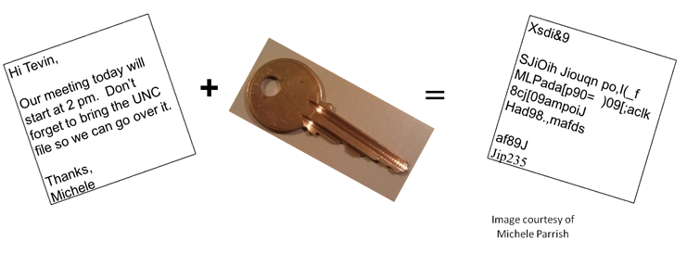
Encryption
Plaintext + Cipher = Ciphertext
Notes:
A tool that can be used to ensure the integrity of data is encryption. Encryption is the process of taking data, referred to as plaintext, and applying an encryption algorithm, called cipher, to create ciphertext. This ciphertext is unreadable by anyone that intercepts the data as it is being transferred. In order to decrypt the data a receiver must have the same cipher and the key that was used to encrypt the data.

Slide 11
Example
Cipher = Shift characters x amount to the y
Plaintext = Hospital
X= 3, y = right
Ciphertext = KRVSLWDO
X=4, y=left
Ciphertext = DKOLEPWH
Notes:
For a simple example of encryption, let’s use a cipher that would use the characters of the alphabet, but would shift the characters a specific number (x), to the left or right (y). The x and y values are called keys. Lots of people could use the same algorithm, or cipher, of shifting characters of the alphabet, but what would make each specific cipher different is the number of characters we shift, and in which direction we shift them. If we chose to shift all characters three to the right the plaintext of hospital would be encrypted to KRVSLWDO. If anyone intercepted this data, he would not know what it was. If we shifted four characters to the left, then hospital would be encrypted as DKOLEPWH. The same cipher with different keys will create different ciphertext.

Slide 12
Types of Encryption
Symmetric
Same key used to encrypt and decrypt
Shared key
Asymmetric
One key used to encrypt and another key used to decrypt
Public key encryption
Notes:
The example on the previous slide was an example of symmetric encryption – the same key was used to encrypt and decrypt. Symmetric encryption is also referred to as shared key encryption. Asymmetric key encryption uses two keys: One to encrypt the data, and another to decrypt. Typically the key to encrypt, called the public key, is made available so that anyone can send an encrypted message to the receiver. The receiver is the only one with the private key that is used to decrypt the ciphertext.

Slide 13
Hashes
A number that is generated based on the data
If the data has been altered in any way then the hash will be different
Also called a message digest or simply a digest
Notes:
A hash or hash value is a number that is generated based on the data that is being sent. If there is any alteration to the data, then the hash value will change. A sender runs a program to create a hash value, and encrypts the hash value along with the data, and sends it to the receiver. The receiver unencrypts the data and hash, creates a hash value for the received data, and should receive the same hash value as the sender. If not, the data has been altered in some way: its integrity has been compromised.

Slide 14
Availability
Means that the system/data is available when needed
Fault-tolerance
Denial of service (DoS)
Notes:
Availability means that the system or data is available when needed. If someone defaces a website that website is no longer available. While a user could still access the page, the page’s integrity has been compromised, and the information they want to receive from that site is no longer available. Availability is important in a patient’s care. For example, if a patient comes into the ER, it is important that the physician can very quickly obtain his medical records, so that the physician has all the information needed to treat the patient.
One thing that can be done to help ensure availability is to create fault-tolerant systems and infrastructures. Fault-tolerant computer systems would be ones that have redundant components such as fans, processors, or RAID (redundant array of inexpensive disks). If one component fails, the other one still remains so that the system doesn’t stop working. The Internet is an excellent example of fault-tolerant infrastructures. There are multiple pathways between different networks on the Internet. From your school’s network or LAN (local area network), and the server that hosts www.amazon.com, there are multiple routes or paths data can take. If one route goes down another route will automatically be taken.
Denial of service (DoS) attacks can make systems unavailable. DoS attacks are when a target system is so busy responding to bogus requests from other systems that it is unable to perform the work it is supposed to do. For example, many machines can ping www.amazon.com at the same time, and the server for Amazon would be so busy responding to those pings that it could not respond to users’ searches for books on Amazon. The system itself is not down, but is unavailable to do the job it is supposed to do.

Slide 15
Accountability
Accountability is the process of holding a
person/entity responsible for his actions.
System must
Identify users
Maintain audit trail of actions
Notes:
Accountability is the process of holding a person or entity responsible for his actions. In order to have accountability, a system must identify users and maintain an audit trail of actions. For example, if someone has access to drugs at the hospital, there has to be a way to see who accessed the drugs, and what he did. We need to know that Nurse Betty opened the medicine cabinet at 9:30 pm on September 20, 2010 and took Vicodin to give to patient Al Jones. We also need to go back and make sure that the doctor actually prescribed the Vicodin for Al Jones.

Slide 16
Nonrepudiation
Provides Proof
Origin
Digital signatures
Private keys (asymmetric encryption)
Delivery
Return receipts
Notes:
Nonrepudiation provides proof that a certain action has taken place, or that something or someone is what it claims to be. If I want to know who you are, I will ask you for a driver’s license. I believe that my state’s driver’s license bureau uses enough security measures and checks to make sure that an individual is who he says he is before the license bureau gives him a license, so therefore, I trust the license and will use it as a form of ID. However, I don’t believe that your local library puts you through a thorough check before issuing you a library card, so I will not accept a library card as proof of identity.
In information systems, the way we identify the origin of data is through a digital signature. Digital signatures are created by using private key encryption. Only the originator has the key, so the data couldn’t have been created by anyone else. Return receipts are used for delivery of data. They ensure that the data is delivered to the intended recipient. Nonrepudiation stops someone from saying that he didn’t do that, or he didn’t receive information. There are other methods that can be used for nonrepudiation. For example, let’s go back to Nurse Betty and the medicine cabinet: Let’s say that in order for Nurse Betty to access the drug cabinet, she must do a fingerprint scan. There is no way that Betty can deny that she was the one that accessed the cabinet, because she is the only one who has that fingerprint.

Slide 17
Public Key Infrastructure (PKI)
Certificates
Also called digital or identity certificates
Public keys
Certificate Authority (CA)
Registration Authority (RA)
Revocation
Certificate Revocation List (CRL)
Notes:
Public Key Infrastructure (PKI) is the hardware, software, and procedures needed to manage certificates. Certificates are used to bind a public key with a person, an organization, his address, contact information, and other relevant information. Certificates are used to verify the identity of the source. Certificates are issued by certificate authorities (CA). Before a source receives a certificate it must undergo a review process by a registration authority (RA). The registration authority investigates the source and makes sure that it is who it says it is. It’s kind of like a background check. Once the source has been verified by the RA, the RA will let the CA know that it is ok to issue a certificate to the source. The certificate is valid for a given period of time, and after that time, a source must apply for a new certificate. If a source’s key has been compromised, then the certificate can be revoked. The certificate would be placed on a certificate revocation list (CRL). If a certificate has expired or is on the CRL, web browsers and other software would provide a warning message to the user before allowing a webpage to be viewed or software delivered.

Slide 18
Certificates
Image courtesy of Tracy Mastel
Notes:
In a webpage browser you will know there is a certificate when the URL has HTTPS instead of HTTP. HTTPS uses SSL (Secure Socket Layer) which means that the information being transmitted between the website and the client’s system is being encrypted. Web browsers will also show a lock when there is a certificate. This is a webpage for eBay. Notice the HTTPS in the URL.

Slide 19
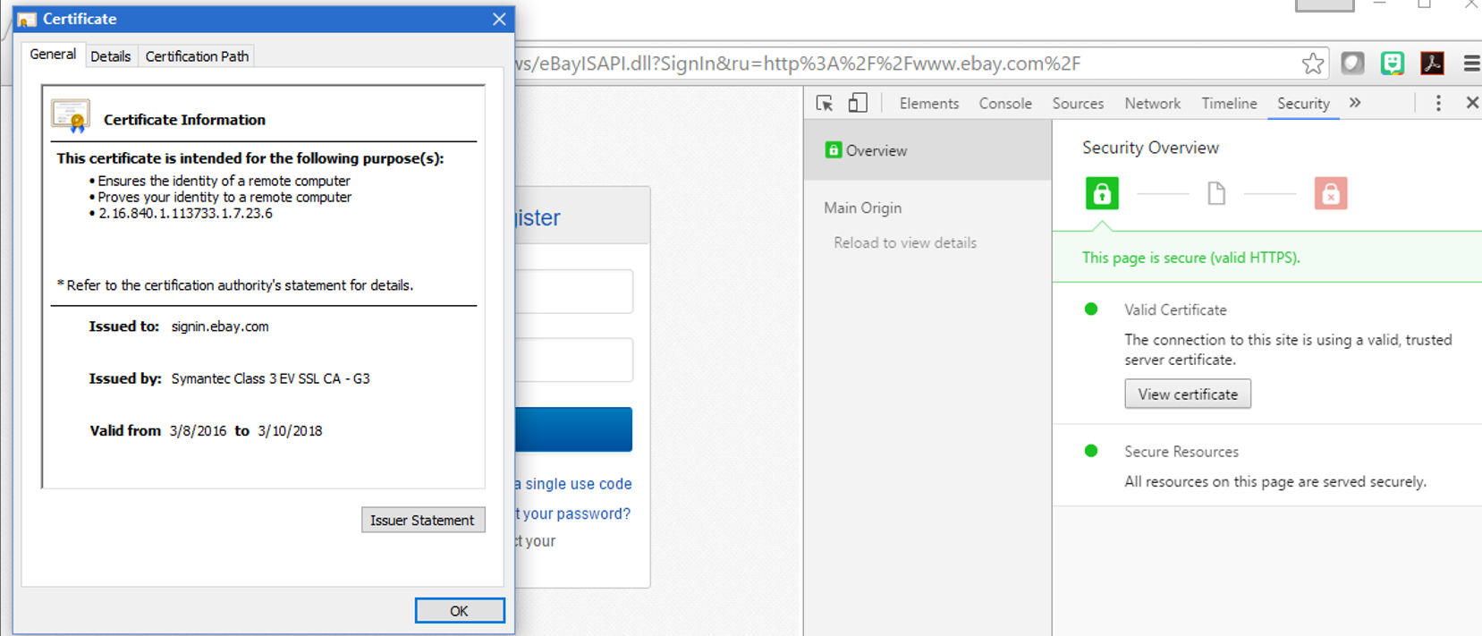
Certificates Continued
Image courtesy of Tracy Mastel
Notes:
When you click on the lock in the webpage browser you can see information about the certificate. This certificate was issued to eBay by Symantec. In the view certificate window, to the left in this graphic you will notice that this certificate was issued on 3/8/2016 and expires on 3/10/2018, so eBay needs to get a new certificate in March of 2018.

Slide 20
Privacy, Confidentiality, and Security Issues and Standards Lecture Summary
Concepts of privacy and confidentiality
How to secure data
Notes:
This concludes lecture a of Privacy, Confidentiality, and Security Issues and Standards. We have covered concepts of privacy and confidentiality and how to secure data.

Slide 21
Privacy, Confidentiality, and Security Issues and Standards References – Lecture a
References
References were not used for this lecture.
Images
Slide 10: Encryption. Courtesy Michele Parrish. Used with permission.
Slide 18: Certificate. Courtesy Tracy Mastel. Used with permission.
Slide 19: Certificate Info. Courtesy Tracy Mastel. Used with permission.
Notes:
No audio.

Slide 22
Privacy, Confidentiality, and Security Issues and Standards Lecture a
This material was developed by Duke University, funded by the Department of Health and Human Services, Office of the National Coordinator for Health Information Technology under Award Number IU24OC000024. This material was updated by Normandale Community College, funded under Award Number 90WT0003.
Notes:
No audio.

