Slide 1
Networking and Health Information Exchange
Health Data Interchange Standards :
Lecture a
This material (Comp 9 Unit 5) was developed by Duke University, funded by the Department of Health and Human Services, Office of the National Coordinator for Health Information Technology under Award Number IU24OC000024. This material was updated by Normandale Community College, funded under Award Number 90WT0003.
This work is licensed under the Creative Commons Attribution-NonCommercial-ShareAlike 4.0 International License. To view a copy of this license, visit http://creativecommons.org/licenses/by-nc-sa/4.0/
Notes:
Welcome to Networking and Health Information Exchange, Health Data Interchange Standards. This is lecture a.
In this unit we will talk about the different standards that may be used to share health data among disparate groups, frequently identified as “messaging standards”.
Lecture a focuses on Health Level 7’s v2.n messaging standard.

Slide 2
Health Data Interchange Standards Learning Objectives
Understand the need to have data standards
Understand the standards that are in place today, or are being adopted
Learn about HL7 standards and implementation
Understand HL7 messaging standards and the basic HL7 transaction types
Notes:
The Objectives for this unit, Health Data Interchange Standards, are to:
Understand the need to have data standards,
Understand the Standards that are in place today, or are being adopted
Learn about HL7 standards and implementation, and
Understand HL7 messaging standards and the basic HL7 transaction types.

Slide 3
Why Use Data Interchange Standards?
Concept of patient-centric EHR requires aggregation of data from across all sites of care
Secondary use of data likely requires the movement of data
When sender and receiver are not known in advance of data exchange, standard is mandatory
Notes:
Why use data interchange standards? If we need to create a patient-centric EHR, then we must aggregate data from all sites of care. Persons see many different doctors in different places for a variety of reasons. In many cases, the person is likely to be taking medications prescribed by more than one doctor. Clearly, it is desirable to be able to aggregate this data. Further, multiple uses of the data, referred to as secondary uses of data, require the exchange of data. For many reasons, the sender and receiver of data may not be predictable or known in advance. In this case, a data interchange standard is a necessity.

Slide 4
Core Requirements for Data Exchange
Nouns:
Items we wish to communicate
Typically physical things (persons, places) and actions
Phrases:
Essential bindings between nouns
An action happens to a person
One action causes another
A person performs an action
Vocabulary & model:
Common definitions
Assume common perspective
Prescribe the nouns and phrases we can use
Notes:
Similar to any communication, the data exchange will include physical things – such as persons, lab tests, medications, appointments, diagnoses, etc. – nouns that are the subject of the interchange. Next are the relationships between nouns, such as a doctor ordering a lab test for a patient, or the results of a lab test, or an admission or a patient encounter. These relationships are expressed as phrases, and represent a binding between nouns. Examples include an action that happens to a person, an action that causes another action, or a person performs an action.
The language of communication included in the message is most critical. We must prescribe the nouns and phrases that we can use and what they mean. The data model and the terminology are used to define the nouns and phrases. These terms must be generally understandable in order for the exchanged messages to be understood and used.

Slide 5
Choices for Data Interchange
HL7 v2.n and v3 messaging standards for clinical data
Document standards
HL7 Clinical Document Architecture
HL7 Continuity of Care Document
ASTM Continuity of Care Record
DICOM for images and other media
Claims standards
Prescription standards
Notes:
There are several choices for the exchange of data. The most commonly-used data interchange or messaging standard used in the US today is a Health Level Seven (HL7) messaging standard known as version 2.n, where n is the current version. Many versions are in use today, but current standards specified by meaningful-use criteria are versions 2.5 or 2.5.1. The latest version from HL7 is v2.7, with v2.8 in ballot. All version 2 standards are backwards compatible, so, basically, newer versions add functionality to the standard. We will discuss the v2.n standard in detail in this lecture.
Data may be exchanged as a document, where the content of the document is defined by a schema. A common document exchange standard is the HL7 Clinical Data Architecture, which we explored in Unit 4. A constrained version of the CDA, defined to accommodate the exchange of summary clinical data (adapted from ASTM CCR) is the Continuity of Care Document – basically an implementation manual based on the CDA.
ASTM has produced a similar standard called the Continuity of Care Record, which can also be used to exchange a patient summary record. The contents of the CCD and the CCR are similar, and both use XML syntax.
For the exchange of images and other media such as waveforms, the DICOM standard is used; ASC X12 produces a family of standards to support the claims/reimbursement data exchange.
NCPDP has a set of standards that support the exchange of prescription data for ePrescribing as well as for reimbursement of medication products.

Slide 6
HL7 v2.n Messaging Standard
Easy to use and understand
Based on an implicit information model
Focused initially on needs of HIS
Later versions expanded horizontally into other areas
Including ambulatory care
Most widely used data exchange standard
>95% provider organizations
Saves money on cost of interfaces
Events not tightly coupled to profiles
Makes no formal attempt to define process
Notes:
Since it is likely that you will be using the HL7 v2.n standard in your health care environment, it will be presented in detail in this lecture.
The popularity of v2.n is that it is easy to use and understand and easy to implement. The standard is based on an implicit information model: the messages are defined to support certain data elements that are defined through the experience of the designers for a particular event. This standard was initially created to support building a hospital information system from components from different, multiple vendors. This approach has been referred to as “best of breed,” but it actually supports the approach of most settings in buying whatever systems they like and connecting them together. Without a standard, the required interfaces between systems would be cost-prohibitive. This cost is reduced by several orders of magnitude, through the use of standards.
Messages in v2.n are organized around events, and the messages are divided into subsets that convey information about the event, the patient, the encounter, the act, the results, and other functions. V2.n messages make no attempt to define process. Further, as the standard evolved, additional data elements were added to the appropriate components in sequence, as the need for that data element was discovered.

Slide 7
HL7 v2.n Messaging Standard - 2
Works well within a single enterprise
Where both sender and receiver are tightly coupled
Does not work well when sender and receiver are not connected
Available with delimiter or with XML syntax
Messages initiated by trigger events
Clinical data sent as name-value pairs
Notes:
The simplicity of v2.n messages is its popularity. Within a single enterprise or in an environment in which sender and receiver are known, business agreements – including what data elements will be exchanged, what terminologies will be used, and when the data will be exchanged (a tightly coupled environment) -- works very well. Today, most exchanges fit this specification, even with large geographical areas.
However, as we expand data exchange across boundaries – nationally or even globally -- these agreements are not in place, and a messaging standard based on an explicit model must be used to achieve interoperability. Hence, the v3 standard to be discussed in the next lecture. V2.n is not an interoperable standard.
The original v2.n standard specified what data elements were to be exchanged, by defining the position of that data element in a specific message component, and the data elements were separated by delimiters. The data exchange structure is hierarchical, with repeating segments accommodated. Delimiters were chosen to reduce the number of characters necessary to be transmitted, since at the time of the creation of the standard, available bandwidth was very limited. The result of the delimiter syntax is that the overhead of a v2.n message is about 5%.
To take advantage of XML tools, v2.n has been modified to accept an XML syntax. This construct will be discussed in a later slide.
When and what data is exchanged is defined by a trigger event -- such as patient admission, patient discharge, patient transfer, lab test order, lab result reporting, etc.
Clinical data is sent by the name of the data element and the result of value of the test – so-called name-value pairs.

Slide 8
HL7 v2.n Messaging Standard - 3
Message composed of segments whose content is defined by position
Segments are made up of data fields which are made up of data elements
Fields may be repeating
Accommodates HL7 registered terminology expressed as code, name, terminology ID triplet
Local tailoring using Z-segments
Notes:
HL7 Messages are composed of reusable components called segments. Each segment is identified by a three-letter mnemonic. Segments are content-oriented – that is, focused on such things as the patient, the visit, the act or event or activity or the “thing”. Which segments are used in a message depends on the message type. The message type is associated with a trigger event. Fields may be repeating. For example, if more than one provider is identified, all may be included by using the repeating field construct.
A segment is made up of data fields – we will learn more about this construction in the following slides. HL7 has not chosen a specific terminology, but maintains a registry of controlled vocabularies, and the terminology is expressed as a triplet – code, text name, and controlled vocabulary identity. For example, LOINC is represented by LN; SNOMED is represented by SM.
As v2.n developed, the standard was unable to stay ahead of the user requirements. Consequently, a provision was made for user defined segments identified by the first letter Z in the mnemonic name. The good part of Z, or, local segments, was that the user could send anything; the bad thing was that users never reverted from the Z-segment to an actual HL7-standard segment when the standard caught up with the requirements.
Obviously the Z-segment is a tradeoff between accommodating local needs and true interoperability.

Slide 9
Version 2
Messages composed of
Segments composed of
Fields composed of
Components
Delimiters
Field separator: |
Component separator: ^
Repetition separator: ~
Escape character: \
Subcomponent: &
Segment terminator: <cr>
Notes:
There are messages for specific events. The HL7 v2 messages are hierarchical, starting with the message composed of segments. The segments in turn are composed of data fields, which in turn are composed of components, which are further subdivided into subcomponents. This construct was delimited by a defined set of delimiters.
The data fields were separated by the filter bar “|”; components were separated by the carrot, or up arrow “^”; and subcomponents by the ampersand “&”. The squiggly bar “~” was used as the repetition separator. The back slash “\” indicated that an escape character followed, which would be an ASCII code. This permits sending special characters, such as bold or italics or tabs, etc. Every segment must be terminated by a carriage return. Segments are limited by length as are data fields.

Slide 10
HL7 Messages
Composed of reusable segments, each identified by a 3-letter mnemonic
All messages must start with header segment MSH which includes sender, receiver, date-time, message identifier, message type, and trigger event
Segments used in a message are determined by message type
Notes:
Messages are composed of reusable segments, each identified by a three-letter mnemonic. All messages must start with a header MSH – much like the addressing of an envelope in regular mail. The header segment tells us who is the sender and who is the receiver, the date and time, a unique message identifier, the message type, and the trigger event, and the version of HL7 v2.n being used. Segments used in a message are determined by message type.

Slide 11
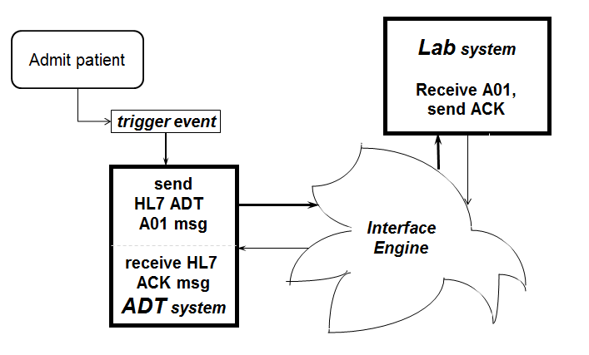
HL7 Basic Transaction Model
Source: W. Ed Hammond, PhD
Notes:
This graphic illustrates the basic HL7 transaction model. A patient is to be admitted to the hospital. It is important to make a number of service systems within the hospital become aware of the admission, along with the identifying characteristics of the patient. This example illustrates informing the Lab System of the event. The admission process is a trigger event and activates the sending of a specific message type to one or more receivers. In many cases, the message is sent to an interface engine which knows the set of receivers to receive the message, and sends the message to each of them.
The example shown here is the admission of a patient, and we want to notify the lab of the admission, along with data about the patient and the admission so they can start a record for the patient in the lab system. An admit message (ADT) is triggered by the trigger event (A01), and sent through the network to the lab system. The lab system acknowledges the receipt of the ADT message by sending an acknowledge ACK message to the sender. This acknowledgement is simply a communications receipt, and not an indication that the lab will fulfill the request. That acknowledgement is a separate acknowledgement that says “message received” and “understood,” and would be carried out.

Slide 12
Patient Admission Scenario, Inform Lab System
Trigger event is admission : A01
Message type is: ADT
Messages composed of:
MSH (message header)
PID (patient identification)
PV1 (visit data)
Notes:
Summarizing the previous slide, the trigger event is A01, the message type is ADT, and the message includes data about the patient – the PID or patient identification segment and the patient visit segment PV1.
Additional segments may be included, for example, an admitting lab order could be included or other information could be included.

Slide 13
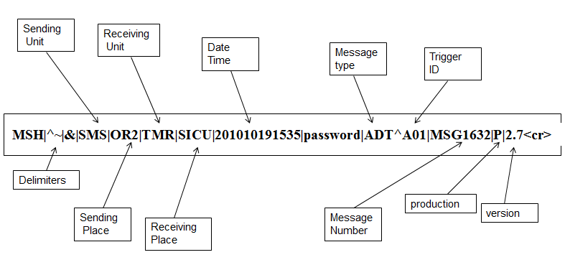
Message Header Segment - MSH
Source: W. Ed Hammond, PhD
Notes:
This slide shows the composition of the message header segment, MSH. Note that the delimiters are included as part of this segment, in a specified order. In an attempt to provide total freedom, HL7 permitted the definition of the delimiters. In practice, all uses of HL7 v2.n use this standard set of delimiters. The other components are the sending unit and sending place; the receiving unit and receiving place; the date time following the date time data type standard YYYYDDMMHRMN. Next, a password is included; then the message type and trigger event as a component; the message number; the “P” indicating a production message (in contrast to a test message); and finally, an indication this is version 2.7. The carriage return terminates the message.
Note the use of the filter bar to separate the data fields, and the “up” arrow to separate the components.

Slide 14
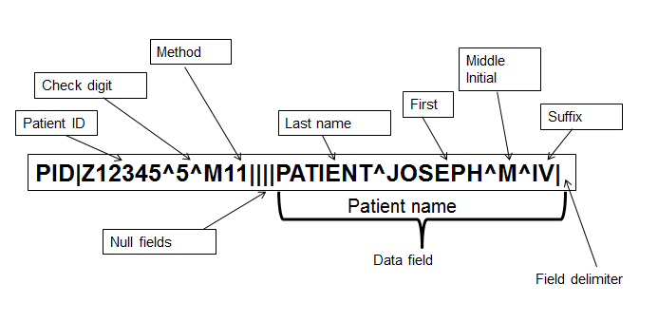
PID Segment – 1/3
Source: W. Ed Hammond, PhD
Notes:
This segment is the patient identification segment, starting with the segment identifier PID. This slide shows the first third of the segment. The patient identifier is the first data field, with additional components of a check digit, “5”, and the method for calculating the check digit: modulo 11. The second field is for an external identifier, the third field is for an internal identifier, and the fourth field is for an alternate identifier. None of these fields are used, so each data field is made null.
The delimiters must be included to keep the positioning of the data fields in the correct order. Next is the data field patient name. The patient name is expressed by four components: last name, first name, middle name, and suffix. The standard also allows for a prefix component, but it is not used in this example. Note that the delimiter is not required, since it is not necessary to retain the sequence of fields.
What would you do if the patient had two middle names? In this case, sender and receiver would need to reach an agreement as to how that would be accommodated. In most cases, the middle name is assumed to mean all other names. Is the last name the family name or surname? Depends on nationality or country of the individual. These issues have been resolved through the use of data types.

Slide 15
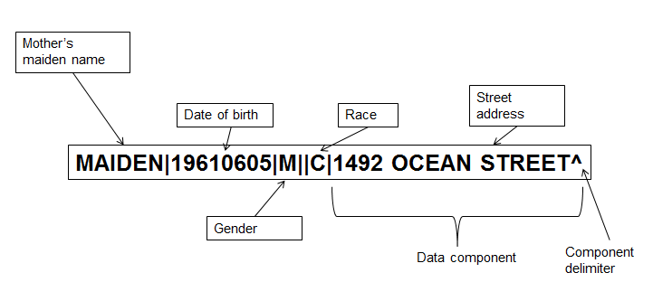
PID Segment – 2/3
Source: W. Ed Hammond, PhD
Notes:
The PID segment continues with mother’s maiden name; date of birth, using the date-time data type; gender, patient alias (which is null); race, and the first part of the address data field – the street address. The address data field continues on the next slide.

Slide 16
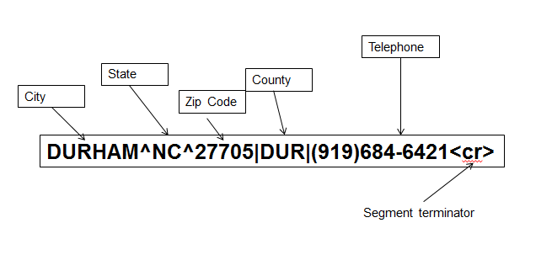
PID Segment – 3/3
Source: W. Ed Hammond, PhD
Notes:
Finally, the last part of the PID segment continues with components city, state and zip code. County is next, followed by the telephone number (whose format is also defined by a data type). Finally the carriage return terminator ends the segment.
The PID segment has many additional fields and even accommodates animals. You will need to obtain a copy of the HL7 v2.n standard to see the complete definitions.
A simple way to implement this standard is to create a matrix which maps the HL7 data fields to your own database.

Slide 17
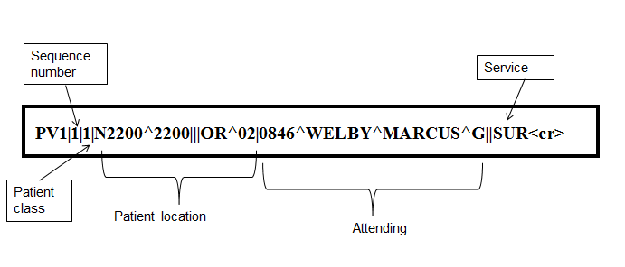
PV1 Segment
Source: W. Ed Hammond, PhD
Notes:
Next is the patient visit segment PV1. There is also an additional segment to extend data about the encounter, called PV2. The data field following the segment identifier is known as the sequence number, and permits the contents of this segment to be sent as multiple lines (but no carriage return except on the last). These lines are numbered in sequence 1, 2, 3 etc.
Next is a coded patient class, followed by patient location: ward and room, followed by admission type (null), admission number (null). Position 6 is prior patient location, and data field 7 is the attending doctor field, broken down into components: provider code, last name, first name and middle initial. The next field is referring MD (null), followed by the service of the attending.
The segment is terminated with the carriage return.
Again, many additional fields as well as a second segment provide the opportunity to include a large amount of data about the visit.
By now, you should begin to understand the v2 messaging standard – how easy it is to use by just filling in the blanks. On the receiving end, you pick up the pieces you want, and put them into your own database.

Slide 18
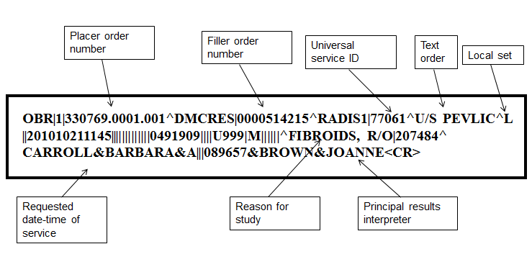
OBR Segment
Source: W. Ed Hammond, PhD
Notes:
The next few slides show some other segments to give you an idea of how the messages and data exchange work. In this case, we see the observation request segment (OBR). Its contents include the placer order number and the filler order number so either can trace the message. There is a universal service ID, which includes the components of ID, text name, and L for local terminology (the triplet previously mentioned).
Priority data field is null, followed by date time of the request. Next are a series of data fields that are null. Other data fields include: reason for the study, and the principal, and assistant, results interpreter.

Slide 19
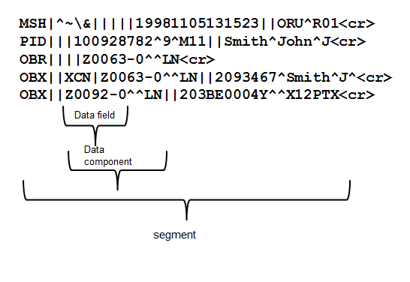
Typical Result Message - ORU
Source: W. Ed Hammond, PhD
Notes:
Again, this slide shows a typical order result message. In this case, the segments include the header, the patient identifier, the order request, and two result segments. The OBX segment is examined in detail in the next slide. The last OBX shows the hierarchical nature of the segment. The test ID data field is broken into the triplet of code (with check-digit), text name, and vocabulary source (LOINC).

Slide 20
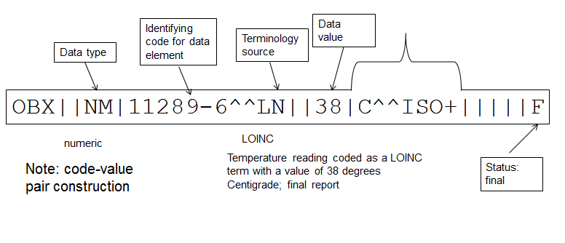
OBX – The Flexible Segment
Other data fields include: date of observation, identity of provider giving observation, normal ranges, abnormal flags
Source: W. Ed Hammond, PhD
Notes:
OBX is the most flexible segment and can be used to send almost any data. With this segment, supported by other segments, the entire contents of a medical record can be sent.
The third data field is for data type – in this case numeric (NM) – so the results can be properly interpreted. Again, the test name is the triplet of code, name and vocabulary source. The numeric data value is in position 5 and the units are specified in position 6. So the interpretation is 38 degrees centigrade. The “F” in position 11 indicates that it is a final result.
Also note the name-value pair construct.
Other data fields include date of observation, identity of provider making the observation, normal ranges, and abnormal flag. It is indeed a powerful segment.
Messages can include any number of these segments.

Slide 21
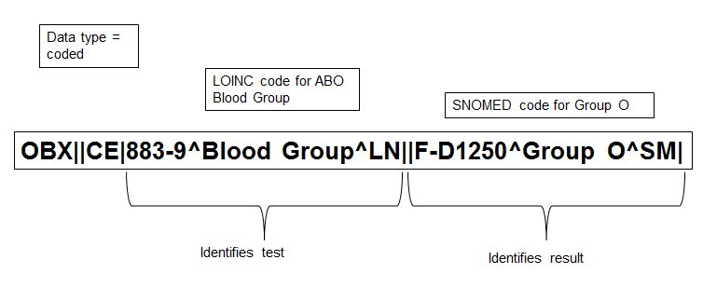
OBX with Coded Value
Source: W. Ed Hammond, PhD
Notes:
This OBX segment example shows a data type of coded (CE). In this example, the test name is specified by a LOINC code (883-9), and the result is a coded value from SNOMED. This test is for Blood Group, and the value is Group O – a SNOMED code of F-D1250.
Note this construct is referred to as a name-value pair.

Slide 22
V2.4 Delimiter Based (1/2)
MSH|^~\&|REGADT|MCM|IFENG||199112311501||ADT^A04^ADT_A01|000001|P|2.4|||
EVN|A04|199901101500|199901101400|01||199901101410
PID|||191919^^GENHOS^MR~371-66-9256^^^USSSA^SS|253763|MASSIE^JAMES^A||19560129|M|||171 ZOBERLEIN^^ ISHPEMING^MI^49849^""^||(900)485-5344|(900)485-5344||S^^HL70002| C^^ HL70006|10199925^^^GENHOS^AN|371-66-9256||
NK1|1|MASSIE^ELLEN|SPOUSE^^HL70063|171OBERLEIN^^ISHPEMING^MI^49849^"“^|(900)485-5344| (900)545-1234~(900)545-1200|EC1^FIRST EMERGENCY CONTACT^HL70131
NK1|2|MASSIE^MARYLOU|MOTHER^^HL70063|300 OBERLEIN^^ISHPEMING ^MI^49849^"“^|(900)485-5344|(900)545-1234~(900)545-1200|EC2^SECOND EMERGENCY CONTACT^HL70131
NK1|3|||123 INDUSTRY WAY^^ISHPEMING^MI^49849^""^||(900)545-1200
|EM^EMPLOYER^HL70131|19940605||PROGRAMMER|||ACME SOFTWARE COMPANY
Notes:
This message shows a typical v2.4 message. The segments illustrated are:
MSH – message header
EVN – event segment
PID – patient identifier segment
NK1 – Next of kin. This segment illustrates the use of the sequence numbers 1, 2, and 3.
This message continues on the next slide.

Slide 23
V2.4 Delimiter-Based (2/2)
PV1||O|O/R||||0148^ADDISON,JAMES|0148^ADDISON,JAMES||AMB||||||
|0148^ADDISON,JAMES|S|1400|A|||||||||||||||||||GENHOS|||||199501101410|
PV2||||||||199901101400|||||||||||||||||||||||||199901101400
ROL||AD|CP^^HL70443|0148^ADDISON,JAMES
OBX||NM|3141-9^BODY WEIGHT^LN||62|kg|||||F
OBX||NM|3137-7^HEIGHT^LN||190|cm|||||F
DG1|1|19||0815^BIOPSY^ACODE||00|
GT1|1||MASSIE^JAMES^""^""^""^""^||171 ZOBERLEIN^^ISHPEMING^MI^49849^"“^|(900)485-5344|(900)485-5344 ||||SE^SELF^HL70063|371-66-925||||MOOSES AUTO CLINIC|
171 ZOBERLEIN^^ISHPEMING^MI^49849^""|(900)485-5344|
IN1|0|0^HL70072|BC1|BLUE CROSS|171 OBERLEIN^^ ISHPEMING^M149849^""^||(900)485-5344|90||||||50 OK|<cr>
Notes:
Here we see some additional segments – including patient visit segments PV1 and PV2, result segments OBX, diagnostic procedure DG1, guarantor GT1, and insurance IN. The richness of this standard can be appreciated. Note the segment terminators <cr> are not shown.

Slide 24
V2.n XML-Based
xmlns="urn:hl7-org:v2xml"
xmlns:xsi="http://www.w3.org/2001/XMLSchema-instance"
xsi:schemaLocation="urn:hl7-org:v2xml ADT_A01.xsd">
<MSH>
<MSH.1>|</MSH.1>
<MSH.2>^~\&amp;</MSH.2>
<MSH.3>
<HD.1>REGADT</HD.1>
</MSH.3>
<MSH.4>
<HD.1>MCM</HD.1>
</MSH.4>
<MSH.7>
<TS.1>201010191501</TS.1>
</MSH.7>
<MSH.9>
<CM_MSG.1>ADT</CM_MSG.1>
<CM_MSG.2>A04</CM_MSG.2>
<CM_MSG.3>ADT_A01</CM_MSG.3>
</MSH.9>
</MSH>
Source: W. Ed Hammond, PhD
Notes:
With the popularity of XML and is wide-spread use, HL7 developed an XML based version of v2 messages. In this case, XML syntax replaces the delimiters.
This example shows the use of the XML delimiter. In contrast with v3.0 messages, which have XML tags that identify the data elements, these tags only identify the segment and position in the v2.n segment. This method permits the use of XML tools to display and process the messages.

Slide 25
v2 Functional Areas
ADT
Registration
Orders
Results
Patient financial
Query language
Immunization reporting
Clinical trials
Adverse drug reactions
Scheduling
Referrals
Medical records
Patient care
Problem lists and goals
Waveforms
Personnel management
Clinical lab automation transactions
Master files
Notes:
This slide shows functional areas covered by v2 - ADT, registration, orders, results, patient financial, query language, immunization reporting, clinical trials, adverse drug reactions, scheduling, referrals, medical records, patient care, problem lists and goals, waveforms, personnel management, clinical lab automation transactions, and master files.

Slide 26
Health Data Interchange Standards Summary – Lecture a
Data exchange standard, HL7 v2.n
It is based on an implicit model, and therefore is not, in itself, interoperable.
Most used in US because of its simplicity, ease of use, and flexibility
This standard works very well in an enclosed environment (sender and receiver known and use business agreements)
Requires cooperation and agreement between vendors
Notes:
This concludes Lecture a of Health Data Interchange Standards.
HL7 v2.n messages are used in over 90% of the hospitals in the US. Different places use different versions, but they are backwards compatible. You should now feel comfortable if you were asked to create an HL7 v2 message. Of course, you would need to obtain a copy of the standard to see all of the segments and data fields. Use of the HL7 standards requires joining HL7 or buying the standard.
Clearly, if sender and receiver are in communication, v2 gets the job done.

Slide 27
Health Data Interchange Standards References – Lecture a
References
Acknowledgement: Material used in this lecture comes from the following source
Introduction to HL7 Standards. (n.d.). Retrieved January 18, 2012, from Health Level Seven International website: http://www.hl7.org/implement/standards/index.cfm
Images
Slide 11: Source: W. Ed Hammond, PhD
Slide 13: Source: W. Ed Hammond, PhD
Slide 14: Source: W. Ed Hammond, PhD
Slide 15: Source: W. Ed Hammond, PhD
Slide 16: Source: W. Ed Hammond, PhD
Slide 17: Source: W. Ed Hammond, PhD
Slide 17: Source: W. Ed Hammond, PhD
Slide 18: Source: W. Ed Hammond, PhD
Slide 19: Source: W. Ed Hammond, PhD
Slide 20: Source: W. Ed Hammond, PhD
Slide 21: Source: W. Ed Hammond, PhD
Slide 24: Source: W. Ed Hammond, PhD
Notes:
No audio.

Slide 28
Health Data Interchange Standards Lecture a
This material was developed by Duke University, funded by the Department of Health and Human Services, Office of the National Coordinator for Health Information Technology under Award Number IU24OC000024. This material was updated by Normandale Community College, funded under Award Number 90WT0003.
Notes:
No audio

