Slide 1
Networking and Health
Information Exchange
Basic Health Data Standards
Lecture b
This material (Comp 9 Unit 4) was developed by Duke University, funded by the Department of Health and Human Services, Office of the National Coordinator for Health Information Technology under Award Number IU24OC000024. This material was updated by Normandale Community College, funded under Award Number 90WT0003.
This work is licensed under the Creative Commons Attribution-NonCommercial-ShareAlike 4.0 International License. To view a copy of this license, visit http://creativecommons.org/licenses/by-nc-sa/4.0/
Notes:
Welcome to Networking and Health Information Exchange, Basic Health Data Standards. This is Lecture b.
This component, Networking and Health Information Exchange, addresses what is required to accomplish networking across and among disparate organizations who have heterogeneous systems. As one might imagine, this topic covers a lot of territory fraught with new topics and a lot of acronyms. Our apologies, but that’s what it is. We suggest you keep your glossary beside you as you study this material.
Unit 4 covers Basic Health Data Standards and consists of six lectures. Over these 6 lectures, we will identify the set of standards necessary to establish semantic interoperability.
In lecture b we begin a discussion on the more popular set of terminologies in use today.

Slide 2
Basic Health Data Standards
Learning Objectives
Understand why it is necessary to use a common set of data elements with common names to be able to exchange and understand data from other places
Understand what is meant by semantic interoperability
Understand many of the sets of controlled vocabularies in use today – how they are used and who requires their use
Notes:
The Objectives for this unit, Basic Health Data Standards, are to:
Understand why it is necessary to use a common set of data elements with common names to be able to exchange and understand data from other places,
Understand what is meant by semantic interoperability,
Understand many of the sets of controlled vocabularies in use today – how they are used and who requires their use,

Slide 3
Basic Health Data Standards
Learning Objectives (2)
Understand the use, purpose and interrelation among sets of controlled vocabularies in use today
Identify the more common controlled vocabularies in use today: ICD, CPT, DRG, NDC, RxNorm, and LOINC,
identify the more common controlled vocabularies in use today: SNOMED, MEDCIN, MedDRA, Nursing terminologies, MeSH and UMLS,
Understand data elements; attributes of data elements
Notes:
Additional Objectives for this unit, Basic Health Data Standards, are to:
Understand the use, purpose and interrelation among sets of controlled vocabularies in use today,
Identify the more common controlled vocabularies in use today: ICD, CPT, DRG, NDC, RxNorm, and LOINC,
Identify the more common controlled vocabularies in use today: SNOMED, MEDCIN, MedDRA, Nursing terminologies, MeSH and UMLS,
Understand data elements; attributes of data elements,

Slide 4
Basic Health Data Standards
Learning Objectives (3)
Understand contribution of master meta-dictionary of data elements to semantic interoperability
Explain how data structures can be built from basic data components
Explain how templates and archetypes facilitate networking and information interchange and
Discuss Clinical Data Architecture (CDA), Continuity of Care Document (CCD), and Continuity of Care Record (CCR) Standards
Notes:
Additional Objectives for this unit, Basic Health Data Standards, are to:
Understand contribution of master meta-dictionary of data elements to semantic interoperability,
Explain how data structures can be built from basic data components,
Explain how templates and archetypes facilitate networking and information interchange, and
Discuss Clinical Data Architecture (CDA), Continuity of Care Document (CCD), and Continuity of Care Record (CCR) Standards.

Slide 5
Common Controlled Vocabularies
ICD – International Classification of Disease
CPT – Common Procedural Terminology
DRG – Diagnostic Related Group
NDC – National Drug Codes
RxNorm - a standardized nomenclature for clinical drugs and drug delivery devices
LOINC - Logical Observations Identifiers Observations and Codes
Notes:
Some of the terminologies address only some small component of the total requirements. Most controlled vocabularies were originally designed for a specific purpose but, over time, expanded the scope. None were designed as a clinical communication language.
The terminologies covered in this lecture include:
ICD-9 and ICD-10 (International Classification of Disease), created by the World Health Organization,
Common Procedural Terminology owned by the American Medical Association,
Diagnostic Related Group – used by CMS,
NDC – National Drug Codes – used by the FDA,
RxNorm – Created jointly by NLM and others,
Logical Observations Identifiers Observations and Codes (LOINC) created by a consortium led by Dr. Clem McDonald, then of the Regenstrief Institute, now the head of Lister Hill Center at the NLM.

Slide 6
International Classification of Disease
ICD–10 (ICD-10-CM and ICD-10-PCS)
  US switched to ICD-10 from ICD-9 in 2015
  US was one of the last countries to switch
  Significant change from ICD-9
ICD-11
  Dr. Chris Chute of Mayo Clinic is chief editor
  Includes SNOMED, DRG
  Target date for completion – 2018
Sponsored by World Health Organization
Notes:
ICD is sponsored by WHO. ICD is the most commonly use controlled terminology, world-wide, and it is used mostly for diagnoses. Centers for Medicare and Medicaid (CMS) requires its use for claims. The CM is for clinical modification and is defined by the US to extend the code set for billable items.
This slide shows the progression from ICD-9 to ICD-10 and beyond
ICD – 10 (ICD-10-CM and ICD-10-PCS). PCS is procedural coding system.
ICD 10 is used by most of the world. The US switched from ICD-9 to ICD-10 in 2015.
ICD-11
Dr. Chris Chute of Mayo Clinic is chief editor of ICD-11. It includes SNOMED and DRG. The target date for completion is 2018.
ICD is sponsored by WHO.
ICD is the most commonly use controlled terminology, world-wide, and it is used mostly for diagnoses. CMS requires its use on billing claims. The CM is for clinical modification, and is defined by the US to extend the code set for billable items.

Slide 7
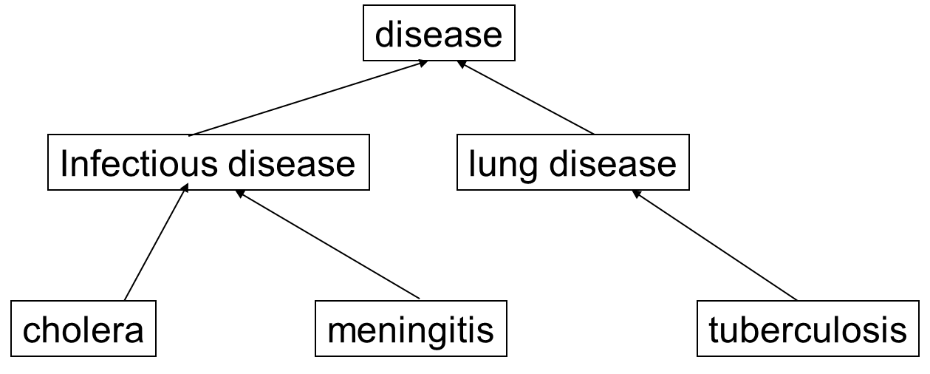
Strict hierarchy
Source: Dr. James J. Cimino, NIH Clinical Center
Notes:
Most controlled vocabularies are more than a list of words. The next two slides illustrate approaches to a terminology model. Vocabulary sets use different models which sometimes make it difficult to map from one vocabulary set to another. Many coding systems are based on a strict hierarchy, in which a term can only be linked to a higher order term. In other words, a child can have only one parent. In this example, cholera is an infectious disease which is a disease. Tuberculosis is a form of lung disease which, in turn, is a disease. The advantage of a strict hierarchy is that the diagnostic process can move from a higher level, less precise term to a more precise term. Queries can be directed at any level. So a query for infectious disease would yield both cholera and meningitis.

Slide 8
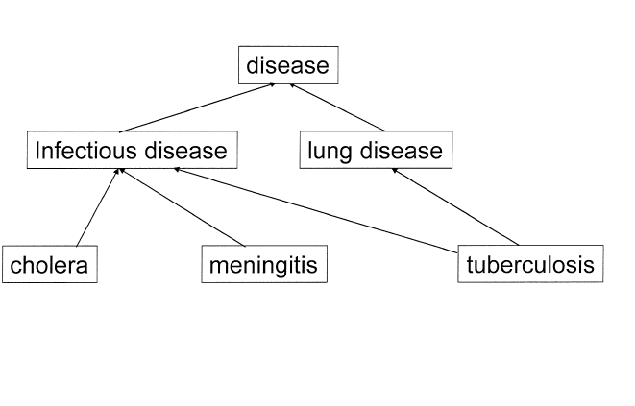
Polyhierarchy
Source: Dr. James J. Cimino, NIH Clinical Center
Notes:
In a polyhierarchy, a term can have more than one parent. In this case, tuberculosis is noted both as a lung disease and an infectious disease. Both pathways lead to the top level of disease. In this structure, if we queried for infectious disease, we would get tuberculosis. If we queried for lung disease, we would also get tuberculosis.

Slide 9
ICD10-CM examples: tuberculosis codes
A15. Respiratory tuberculosis, bacteriologically and histologically confirmed
A15.0 Tuberculosis of lung, confirmed by sputum microscopy with or without culture
A15.1 Tuberculosis of lung, confirmed by culture only
A15.2 Tuberculosis of lung, confirmed histologically
A15.3 Tuberculosis of lung, confirmed by unspecified means
A15.4 Tuberculosis of intrathoraciclymph nodes, confirmed bacteriologically and histologically
A15.5 Tuberculosis of larynx, trachea and bronchus, confirmed bacteriologically and histologically
A15.7 Primary respiratory tuberculosis, confirmed bacteriologically and histologically
A15.8 Other respiratory tuberculosis, confirmed bacteriologically and histologically
A15.9 Respiratory tuberculosis unspecified, confirmed bacteriologically and histologically
Source: ICD10 Code View http://www0.sun.ac.za/aotc/icd10
Notes:
This slide shows some of the ICD-10 codes that can be used to represent tuberculosis biased with adjectives that relate to other things beyond the actual disease. Many of these codes are really billing codes, not medical. Some of these codes are compound and mix a physiological condition with a process or procedure. These codes work for reimbursement, but many are not good for clinical coding. Some of the problems that ICD-9 had, including increasing the granularity needed for clinical decision support, were partially resolved in ICD-10.

Slide 10
The Diagnostic and Statistical Manual of Mental Disorders
(DSM-IV)
Created to standardize diagnoses in psychiatry or mental health disorders
Includes diagnostic definitional criteria
Published by American Psychiatric Association
Not free for use
Notes:
The Diagnostic and Statistical Manual of Mental Disorders (DSM-IV) codes are similar in structure to ICD. It was created by the psychiatric community because ICD did not provide the level of specificity and completeness that the psychiatric community felt it needed. It is a reasonably stable vocabulary. It is more a list of words than it is knowledge based. It was not created for use in database infrastructures and does not have the richness of hierarchal linkages.
The DSM–IV is published by American Psychiatric Association, and it is not free for use.

Slide 11
Current Procedural Terminology
(CPT)
Developed and owned by AMA
Required for procedure reimbursement
Required for physician visit reimbursement (E&M Coding)
Licensing fee per application, per seat
Notes:
Current Procedural Terminology (CPT) was developed by the American Medical Association. CPT codes are required by CMS. The licensing fee can range from hundreds of dollars to thousands of dollars, depending on the size of the institution. CPT codes are redundant with other coding systems, but are an important source of revenue to the AMA, and continue to be required. CPT codes are used to define, for purposes of billing, the nature of the visit – initial, routine, complicated – and the extent of activity by the provider.

Slide 12
CPT examples
76090: Unilateral mammography
76091: Bilateral mammography
76092: Screening mammography, bilateral (two view film study of each breast)
76096: Mammographic guidance for needle placement, breast (e.g., for wire localization or for injection), each lesion, radiological supervision and interpretation
76645: Ultrasound, breast(s) (unilateral or bilateral), B-scan and/or real time with image documentation
Source: Dr. James J. Cimino, NIH Clinical Center
Notes:
Here are some examples of CPT codes.
76090: Unilateral mammography
76091: Bilateral mammography
76092: Screening mammography, bilateral (two view film study of each breast)
76096: Mammographic guidance for needle placement, breast (e.g., for wire localization or for injection), each lesion, radiological supervision and interpretation
76645: Ultrasound, breast(s) (unilateral or bilateral), B-scan and/or real time with image documentation
Note how specific some of the codes are. These codes have much significance related to billing. The reimbursement may differ greatly, depending on the code used. A method to determine how providers should be paid related to effort is based on the CPT codes. That process, called the Relative Value Scale (RVS) assigns a relative value which is adjusted by geographic region. The scale is based on physician work, practice expense, and malpractice expense. It does not include outcome, quality of service, severity or demand – hence a criticism.

Slide 13
Diagnosis Related Groups
DRG
Diagnoses, procedures, age, complications and other factors expected to have similar hospital resource use
CMS codes for prospective payment
Notes:
Diagnosis Related Groups (DRG) Codes are used to group hospital cases into approximately 500 diagnosis-related groups. Each group includes diagnoses, procedures and other factors (age, severity, complications, co-morbidities). These codes are grouped based on the expectation that a group of items would use similar hospital resources.
DRGs have been adopted by most payers and have been used in other countries.

Slide 14
DRG examples: pneumonia
75 Respiratory disease with major chest operating room procedure, no major complication or comorbidity
76 Respiratory disease with major chest operating room procedure, minor complication or comorbidity
77 Respiratory disease with other respiratory system operating procedure, no complication or comorbidity
79 Respiratory infection with minor complication, age greater than 17
80 Respiratory infection with no minor complication, age greater than 17
89 Simple Pneumonia with minor complication, age greater than 17
90 Simple Pneumonia with no minor complication, age greater than 17
Source: Dr. James J. Cimino, NIH Clinical Center
Notes:
The slide shows examples of DRG coding. The patterns for reimbursement can be clearly seen. Coding skill and interpretation of DRG codes can also play a big factor in reimbursement. Again, this set does not work for clinical documentation; it is for billing only. These codes show the grouping of diagnoses, procedures, and other factors noted in the previous slide.

Slide 15
National Drug Codes (NDC)
US Food and Drug Administration
Identifiers for labeled, regulated products
Labelers get 4- or 5-digit code
Product code set by labeler: 3 or 4 digits
Package code set by labeler: 2 digits
Notes:
NDC codes are used by the FDA. It is a list of all drugs manufactured for commercial distribution. An NDC code is a ten-digit, three-segment number which serves as a product identifier for human drugs and is also for reimbursement. It identifies the labeler, product, and trade package size. Codes may be reused and are limited in representation of drugs. The code for Aspirin with Codeine is 54868-0385. Note the listing includes dosage form, routes of administration, active ingredients, strength and units. NDC codes are used for reimbursement.

Slide 16
RxNorm
Food and Drug Administration
Veterans Health Administration
National Library of Medicine
Drug knowledge base vendors
Standards Task Force. (2011)
Notes:
“RxNorm provides normalized names for clinical drugs and links its names to many of the drug vocabularies commonly used in pharmacy management and drug interaction software, including those of First Databank, Micromedex, MediSpan, Gold Standard Alchemy, and Multum. By providing links between these vocabularies, RxNorm can mediate messages between systems not using the same software and vocabulary.
RxNorm now includes the National Drug File - Reference Terminology (NDF-RT) from the Veterans Health Administration. NDF-RT is a terminology used to code clinical drug properties, including mechanism of action, physiologic effect, and therapeutic category.”
RxNorm is produced by the NLM and is included in the Unified Medical Language System.

Slide 17
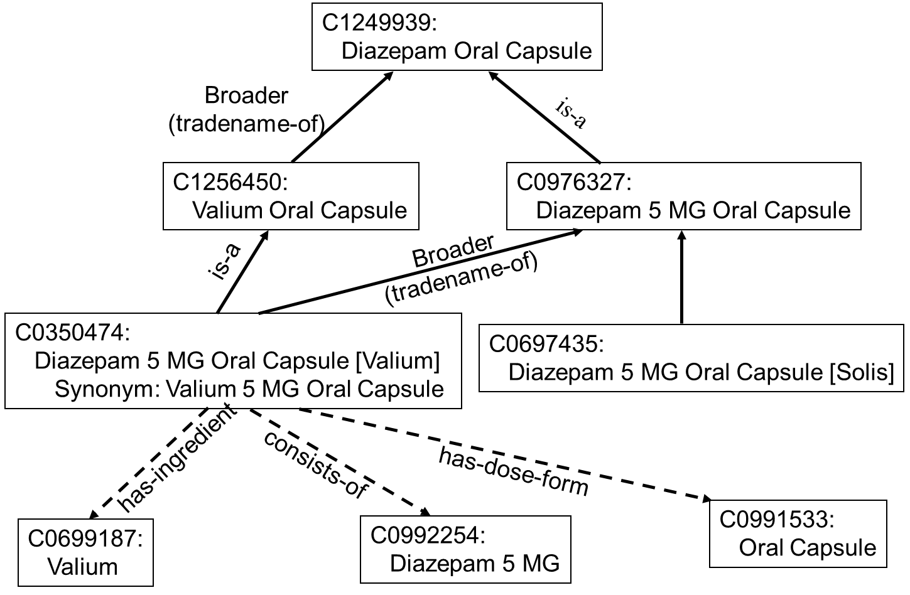
RxNorm: Diagram
Source: Dr. James J. Cimino, NIH Clinical Center.
Notes:
This slide illustrates the components and relationships that make up RxNorm. It is likely that RxNorm will become the preferred coding scheme for drugs in the U.S. It includes ingredients, composition, form, dosages, packaging, generic name, and brand name.
For example, C0350474 is Diazepam 5 MG Oral Capsule has ingredient C0699187 (Valium) and consists of C0992254 – Diazepam 5 MG. It has dose-form C0991533, Oral Capsule. It is a C1256450 Valium Oral Capsule that has the trade name of C1249939 – Diazepam Oral Capsule.

Slide 18
VA NDF-RT
Is a reference terminology for medications
Formal description logic ontological representation
Concept-model designed to reduce ambiguity and to enhance building patient-centric medication histories
Generic ingredients (or combinations) are described in terms of active ingredients, mechanisms of action, physiologic effects, and indications and contraindications
Source: Brown SH, Elkin ST, Rosenbloom ST, etc
Notes:
The Department of Veterans Affairs Veterans Health Administration began the creation of an Enterprise Reference Terminology that has evolved into a most valuable natural resource. This resource – named the VA National Drug File – Reference Terminology is a reference terminology for medications and uses a formal description logic ontological representation of medications. The NDF-RT is a concept model that is organized into hierarchies of concepts that provides useful groupings of drugs into various attributes.
Generic ingredients or combinations of ingredients are described in terms of active ingredients, mechanisms of action, physiologic effects, and therapeutics (indications and contraindications). Orderable drug products (clinical drug) are built on the generic descriptions detailed in the NDF. The NDF-RT works with the Structured product labeling standard to provide for unambiguous management of a patient’s medication profile.

Slide 19
Structured Product Labeling
Defines the content of human prescription drug labeling in XML format
Displayed in web browser using SPL style sheet
Contains labeling plus machine readable information
It is an HL7 standard and has been submitted to ISO
Notes:
Structured Product Labeling (SPL) is the data contained on the small print sheets in the packing of a medication. SPL defines the content of prescription drug labeling in XML format. SPL has this data as structured data that can be read and used by a computer. This feature is important for ePrescribing systems and for clinical decision support systems.

Slide 20
The DailyMed
Derived from Structured Product Labeling
Medication information in computer readable form
  Easily imported into information system
Comprehensive
  Includes all marketed products
Reliable
  Information directly from labeling
Up-to-date
  New information or changes added daily
Free
Source: http://dailymed.nlm.nih.gov/dailymed/
Notes:
“DailyMed provides high quality information about marketed drugs. This information includes FDA labels (package inserts). This Web site provides health information providers and the public with a standard, comprehensive, up-to-date, look-up and download resource of medication content and labeling as found in medication package inserts.” The DailyMed formats the data of SPL into a human readable and understandable form. This database is the source of the information sheet typically given to patients.

Slide 21
Logical Observation Identifiers Names and Codes (LOINC®)
Laboratory portion
  Standard test names and codes
  Includes chemistry, hematology, serology, microbiology (including parasitology and virology), toxicology
  Drugs and cell counts for blood smears and cerebrospinal fluids
  Antibiotic susceptibilities
Clinical portion
  Vitals signs, hemodynamics, intake/output, ECG, obstetric ultrasound, cardio echo, urologic imaging, pulmonary ventilator management, and survey instruments
Source: W. Ed Hammond
Notes:
LOINC is used in the US primarily for the name of laboratory tests. Its use in the US is quite wide-spread. It is available without charge. Clinical LOINC is less frequently used.
Laboratory portion of LOINC contains:
Standard test names and codes,
Includes chemistry, hematology, serology, microbiology (including parasitology and virology), toxicology,
Drugs and cell counts for blood smears and cerebrospinal fluids, and
Antibiotic susceptibilities.
Clinical portion of LOINC includes vital signs, hemodynamics, intake/output, ECG, obstetric ultrasound, cardio echo, urologic imaging, pulmonary ventilator management, survey instruments, and other.

Slide 22
LOINC code
Codes are unique and have no meaning
Format is nnnnn-n where the last n is a mod 10 check digit
Typical code: 4764-5
Each LOINC record corresponds to a single test or panel
Includes long names, short names and synonyms
Notes:
LOINC codes are used by many of the commercial clinical laboratories. New codes can be added quickly to the set with simple processes. LOINC has been defined by experts working in the field. Its roots came from major health centers and the commercial laboratories.
LOINC codes are unique and have no meaning. The format is nnnnn-n where the last n is a mod 10 check digit. A typical code: 4764-5.
Each LOINC record corresponds to a single test or panel, and includes long names, short names and synonyms.

Slide 23
Definition Axes
Component name (analytic)
Property measured
Timing
Type of sample
Type of scale
Method (where relevant)
“:” is used to separate axes
Notes:
These axes were defined by asking the question – what are the minimum characteristics we need to know to uniquely identify lab tests?
The definition axes are:
(1) Component: What is measured, evaluated or observed
Examples: Potassium, Hemoglobin, Hepatitis C antigen
(2) Property Measured: Characteristics of what is measured
Examples: length, mass, volume, time stamp, enzyme activity
(3) Timing: Interval of time over which the observation or measurement was made
Examples: Point in time (PT)
Observation integrated over an extended duration of time - 24-hour urine
(4) Type of sample
Context or specimen type on which observation is made
Examples: urine, blood, serum
(5) Type of scale
Quantitative (true measurement), ordinal (ranked set of options), nominal (e.g. e.coli), narrative (dictation from x-ray)
(6) Method - Procedure used to make measurement or observation
Examples: Cuff method for blood pressure and Automated BP measurement

Slide 24
Examples
SODIUM:SCNC:PT:SER/PLAS:QN
SODIUM:SRAT:24H:UR:QN
GLUCOSE:3H POST 100 G GLUCOSE PO:SCNC:PT:SER/PLAS:QN
Notes:
For the 1st example, SODIUM:SCNC:PT:SER/PLAS:QN, component is sodium, property measured is substance concentration, timing is point-in-time, specimen is serum/plasma, and measurement is quantity.
For the 2nd example, SODIUM:SRAT:24H:UR:QN, the component is sodium, property measured is substance rate, timing is 24-hour, specimen is urine, and measure in quantitative.
For the 3rd sample, GLUCOSE:3H POST 100 G GLUCOSE PO:SCNC:PT:SER/PLAS:QN, component is glucose, done as a three-hour, post-100 gm glucose load-by-mouth; property measured is substance concentration; timing is point-in-time; specimen is serum/plasma; and measurement is quantity.

Slide 25
LOINC today
The current version of LOINC is v2.5.4 and was released in December 2015. The database contains over 58,000 terms. It is free and may be downloaded from www.loinc.org
Mapping Assistant (RELMA) available for free
Notes:
LOINC continues to evolve with new codes. New direction includes terminology for genomics. LOINC has a defined process for submitting new terms; the process can be done by anyone. The submitted term goes through a validation procedure. LOINC is the fastest controlled vocabulary to adopt new codes. LOINC includes clinical codes that overlap with SNOMED. LOINC also has codes for HL7 documents, and for standardized questions that can be included on standard questionnaires.

Slide 26
RELMA
Regenstrief LOINC Mapping Assistant (RELMA)
Free mapping utility to facilitate searches through the LOINC database and to assist efforts to map local codes to LOINC codes.
Notes:
The Regenstreif Institute provides the free mapping utility called RELMA – (Regenstreif LOINC Mapping Assistant) to facilitate searching and working with LOINC codes. A Web-based version of that tool is also available. In addition to funding by the Regenstrief Foundation, this work has been funded by the Robert Wood Johnson Foundation and the National Library of Medicine. As noted, LOINC is available at no charge.

Slide 27
Example of LOINC’s Use in Data Exchange
HL7 Message:
  OBX|…|Observation|…|Result|…|
Observation = Code^Name^Coding System
Logical Objects, Identifiers, Names and Codes
Self-defining names for lab tests
Notes:
There is a close relationship between LOINC and HL7 messages. LOINC codes can be interoperably used to identify the laboratory test. OBX is the HL7 message segment for observation and result. The data element is identified by a triplet: the LOINC code, the test name, and an LN to indicate that the code comes from LOINC. The names (text) are self-defining.

Slide 28
Basic Health Data Standards
Summary – Lecture b
In this section, you have learned some of the more common controlled vocabularies. In many cases, a particular terminology is used for a specific purpose. In most cases, the doctor enters a textual term and a coder does the actual coding.
Notes:
This concludes Lecture b of Basic Health Data Standards.
In this lecture you have learned some of the more common controlled vocabularies. In many cases, a particular terminology is used for a specific purpose. In most cases, the doctor enters a textual term and a coder does the actual coding. You will be exposed to many of these vocabulary sets.
You will hear much conversation about free text or narrative and structured data. Free text means that the source enters/writes the documentation in free form without control or structure. That narrative is subject to all of the problems we have discussed. It is difficult to use that text to drive clinical guidelines, decision support systems, queries and analyses. Terminology/data elements are one of the most important enablers to achieve semantic interoperability. The next lecture will continue to discuss other commonly controlled terminology sets.

Slide 29
Basic Health Data Standards
References – Lecture b
References
Cimino, JJ. Desiderata for controlled medical vocabularies in the Twenty-First Century. Methods of Information in Medicine, 1998; 37(4-5); 394-403.
Standards Task Force. (2011). Healthcare Informatics Organizations Participating in Standards Activities. Retrieved from Healthcare Information and Management Systems (HIMSS) website: http://himss.org/content/files/HealthcareInformaticsOrganizationsSDOJAN2011.pdf
Brown SH, Elkin ST, Rosenbloom ST, etc. VA National Drug File Reference Terminology: a cross-institutional content coverage study. Stud Health Technol Inform. 2004;107(Pt 1):477-81.
About DailyMed. (n.d.). Retrieved January 12, 2012, from US National Library of Medicine, National Institutes of Health, Health & Human Services website: http://dailymed.nlm.nih.gov/dailymed/about.cfm?CFID=22312512&CFTOKEN=586f234f58295f23-D2B4FA2C-B960-FECD-06EEEBDF69260A36&jsessionid=ca30bb9945e02b1a6f29
RELMA Regenstrief LOINC Mapping Assistant. (n.d.). Retrieved January 12, 2012, from Regenstrief Institute, Inc. website: http://loinc.org/relma/index_html/?searchterm=Windows-based%20mapping
Images
Slide 5: Courtesy of Dr. James J. Cimino, NIH Clinical Center
Slide 6: Courtesy of Dr. James J. Cimino, NIH Clinical Center
Slide 15: Courtesy of Dr. James J. Cimino, NIH Clinical Center
Notes:
No audio.

Slide 30
Basic Health Data Standards
Lecture b
This material was developed by Duke University, funded by the Department of Health and Human Services, Office of the National Coordinator for Health Information Technology under Award Number IU24OC000024. This material was updated by Normandale Community College, funded under Award Number 90WT0003.
Notes:
No audio.

