Slide 1
Networking and Health Information Exchange
Network Media and Hardware Communication Devices
Lecture b
This material (Comp 9 Unit 2) was developed by Duke University, funded by the Department of Health and Human Services, Office of the National Coordinator for Health Information Technology under Award Number IU24OC000024. This material was updated by Normandale Community College, funded under Award Number 90WT0003.
This work is licensed under the Creative Commons Attribution-NonCommercial-ShareAlike 4.0 International License. To view a copy of this license, visit http://creativecommons.org/licenses/by-nc-sa/4.0/
Notes:
Welcome to Networking and Health Information Exchange, Network Media and Hardware Communication Devices. This is lecture b.

Slide 2
Network Media and Hardware Communication Devices Learning Objective
Select appropriate network media types (such as Ethernet and Wireless) to facilitate networking and data exchange, taking into account access and regulatory requirements.
Notes:
The objective for this lecture, Network Media and Hardware Communication Devices lecture b are to:
Select appropriate hardware devices (such as routers, switches, and access points) to facilitate networking and data exchange, taking into account access and regulatory requirements.

Slide 3
Considerations When Selecting Media
Throughput
Cost
Installation
Maintenance
Lower transmission rate
Distance
Size/Scalability
Noise immunity
Security
Notes:
When selecting the media to use on your network there are many things to consider.
First, you need to consider bandwidth. You have to make sure you have a big enough “pipe” for your data to flow through. Remember the greater the bandwidth the more data you can transmit.
You need to consider cost. This includes the cost of installation including cost of media, media connectors, and cost to install (can your IT department install the media or will you have to hire a contractor). You also have to consider the cost of maintaining the media. If a cable breaks how easily can you fix it? How long would it take to fix it? Can your IT staff fix it or will you have to call the contractor back in? You also have to consider that one media may cost less to install and maintain but it may not give you the transmission rate you need so employees’ work is slowed down because it takes a long time to download a file. It may be worth having more expensive media installed and maintained in order to increase productivity.
You have to consider size and scalability. Different media have different maximum segment and network lengths and support for different numbers of nodes. You have to think about both current and future needs. How many nodes do you need to connect? How far apart are they? Do you anticipate needing to add more nodes? Would the media support the addition of those new nodes?
You have to worry about noise. Copper cables are affected by EMI and wireless by RFI. Fiber is not affected by either. Conduit can be used to help protect copper cables from EMI.
Security is also an issue. Wireless is more susceptible to security problems like eavesdropping than copper or fiber optic. Steps can be taken to make wireless networks as secure as wired networks.

Slide 4
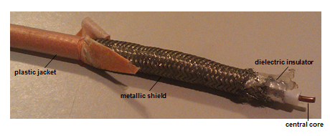
Coaxial Cable
Image courtesy of Michele Parrish.
Notes:
Image of coaxial cable showing the plastic jacket, metallic shield, dielectric insulator and central core. Image courtesy of Michele Parrish.
Copper cables include coaxial (coax) and twisted-pair. Both transmit electrical signals.
Coax cable consists of a central copper core surrounded by an insulator, braiding or metallic shield, and an outer cover called a sheath. The center core carries the signal. If the core is broken the network is “down” and data cannot be transmitted. A type of coaxial cable is used for cable TV.
Coax isn’t used much in modern networks. If you encounter coax in a network today it will be thin coax called Thinnet. The image on the slide is thick coax. The image is used because it is easier to see the “pieces” of a coax cable.

Slide 5
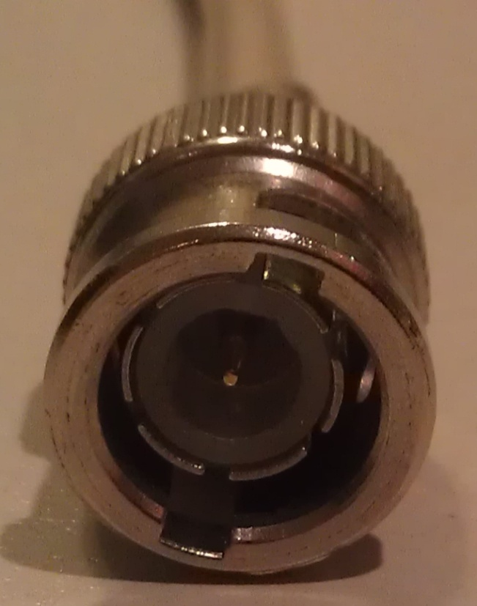
Bayonet Neill-Concelman (BNC) Connector
Image courtesy of Michele Parrish.
Notes:
The connector used for Thinnet is called a Bayonet Neill-Concelman (BNC) connector. This connects the coax cable to the NIC card in a node.

Slide 6
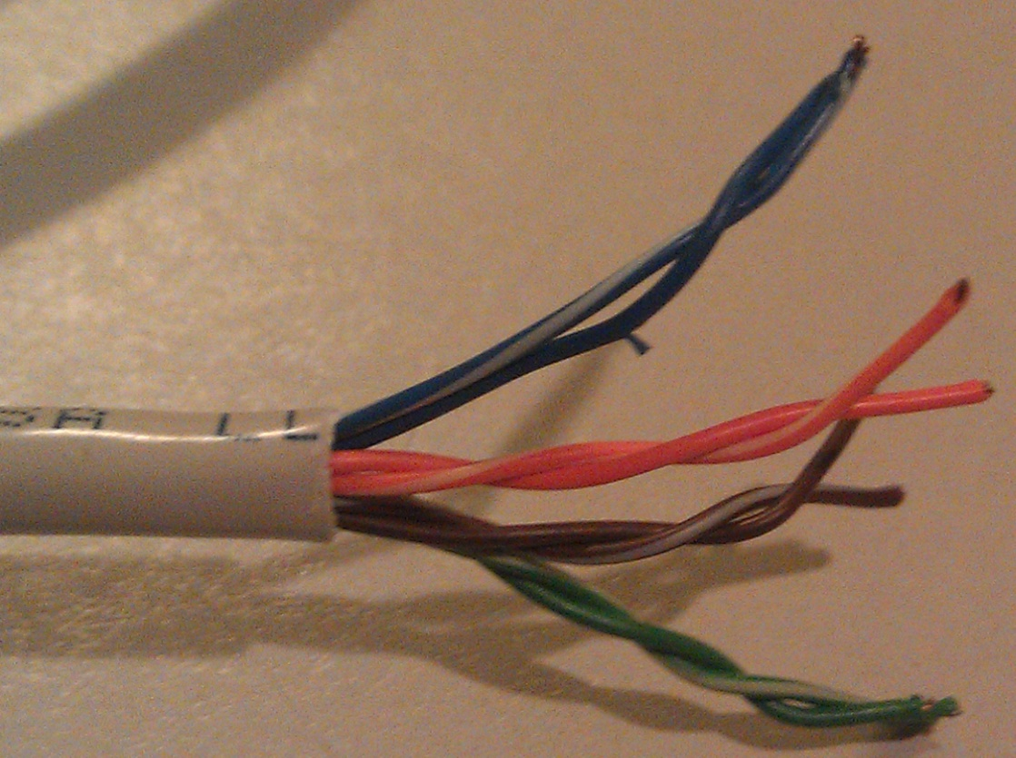
Twisted-Pair (TP) Cable
Image courtesy of Michele Parrish.
Notes:
The majority of modern networks use twisted-pair cable. There are two types of twisted-pair (TP): unshielded twisted-pair (UTP) and shielded twisted-pair (STP). Both contain color-coded pairs of insulated copper wires twisted around each other and encased in a plastic coating. There are typically 8 wires twisted into 4 pairs and all 4 pairs are twisted around each other. The twists in the wire help reduce the effects of EMI. The number of twists per meter or foot is known as the twist ratio.
TP also comes in different categories. Current networks use Category 5 or 6 (Cat 5 or Cat 6). The different categories allow for different bandwidths.
STP cable consists of twisted wire pairs that are insulated and surrounded by a shielding made of a metallic substance – notice the blue shielding in the graphic. This extra shielding provides more protection against EMI. It is more expensive than UTP.
A word that you may encounter when dealing with TP is plenum. If TP cable is non-plenum it will give off a toxic gas when it burns. Plenum cable will not, so it is required if the cable is run in ceilings or air ducts.

Slide 7
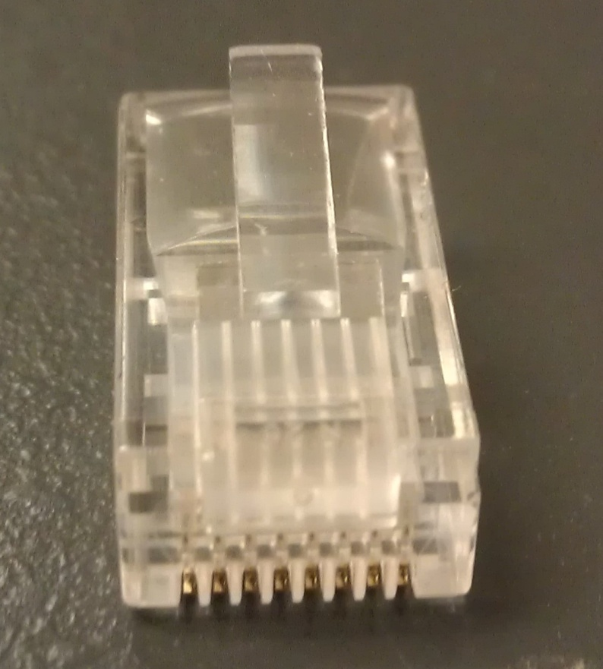
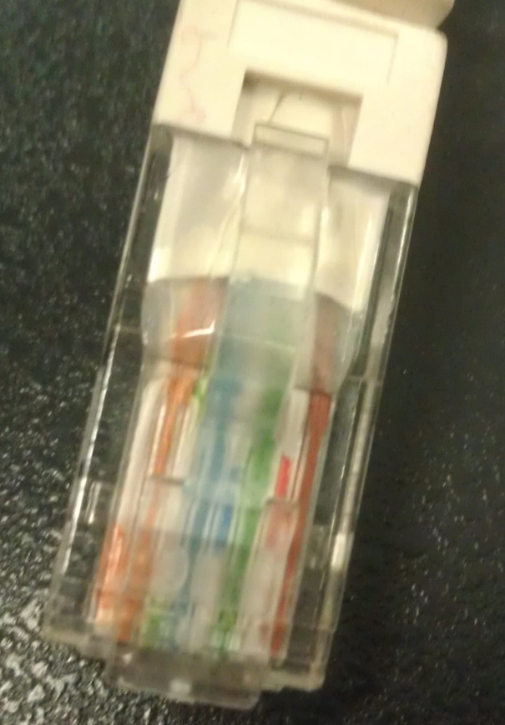
RJ-45
Image courtesy of Michele Parrish.
Notes:
The connector for TP is an RJ45. It is like telephone connectors (RJ-11) except bigger. Notice the PIN layout in the graphic because we will be coming back to it.

Slide 8
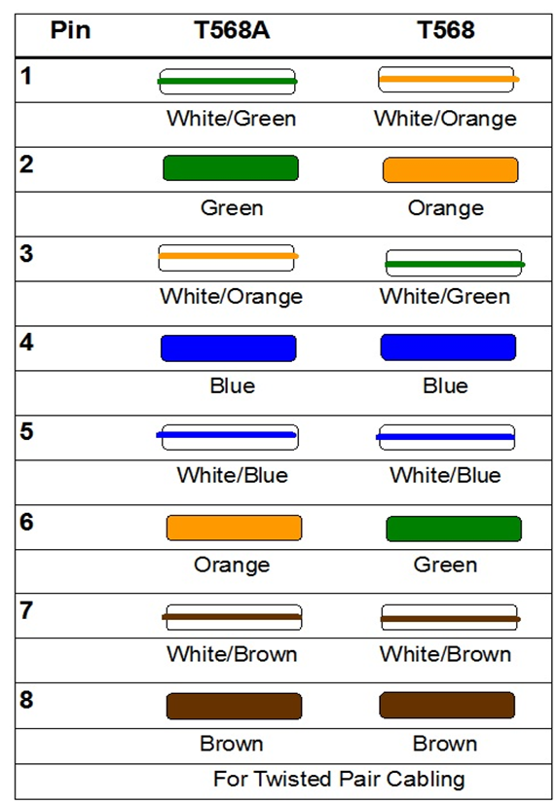
T568A & T568B Standards
Image courtesy of Michele Parrish.
Notes:
If you are going to make your own twisted-pair cables you should follow the T568A or T568B standards as shown in the slide. The pin out for T568A standard with is starting with pin 1, white/green, green, white/orange, blue, white/blue, orange, white/brown and ending with pin 8, brown. For the T568B standard starting with pin 1, white/orange, orange, white/green, blue, white/blue, green, white/brown, and ending with pin 8, brown.

Slide 9
Type of Cables for Connecting Devices
Straight-through
Both ends the same, either T568A or T568B
Connect dissimilar devices
Cross-over
One end T568A and other end T568B
Connect similar devices
Notes:
Certain types of twisted-pair cables are used for making connections between devices. Straight-through cables are used to connect dissimilar devices like a computer to a hub/switch. Both ends are the same-either T568A or T568B. Cross-over cables are used to connect similar devices like a computer to a computer. One end is T568A and the other end T568B where pins 1 & 3 and 2 & 6 are swapped.

Slide 10
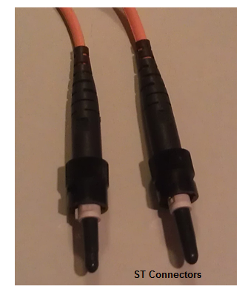
Fiber Optic Cable
Image courtesy of Michele Parrish.
Notes:
Fiber optic cables transmit light signals instead of electrical signals. Fiber optic cables are made up of the core that carries the light pulses, the cladding that reflects the light pulses back into the core and the buffer coating that protects the core -- and cladding -- from moisture, damage, etc. The fibers are the size of a human hair. It is faster and more expensive than copper cables. Signals transmitted over fiber can experience optical loss (which is similar to attenuation for copper cables). Many different types of connectors are used for fiber optic cable. Two of the more commonly used are Straight Tip (ST) and Subscriber Connector (SC) connectors.

Slide 11
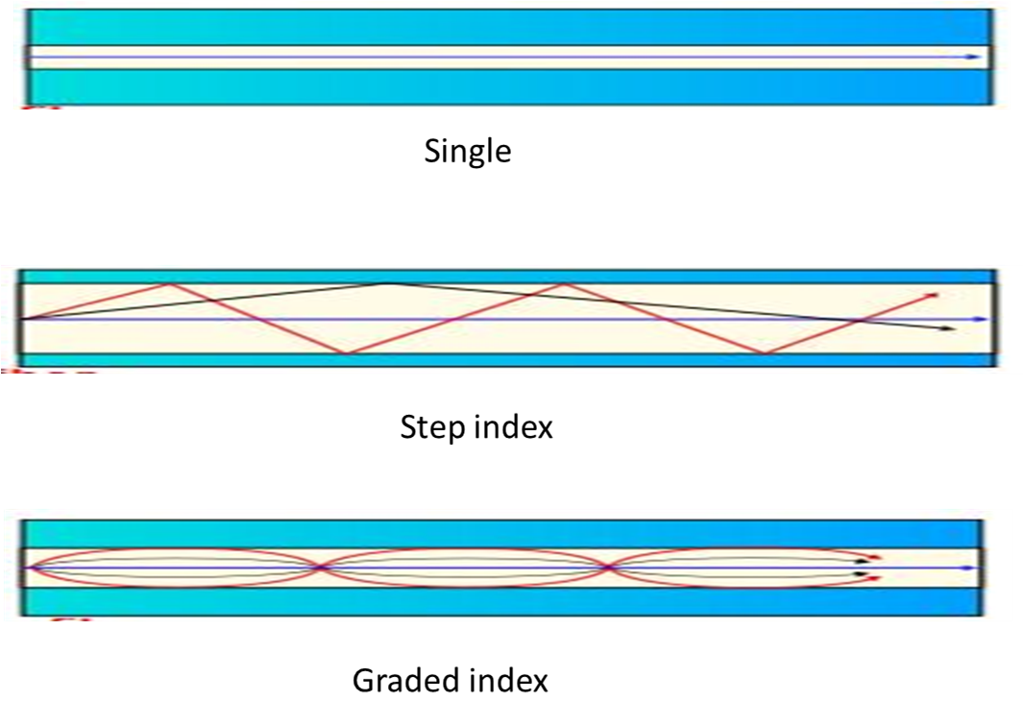
Single mode vs. Multimode
Copyright(c) Mrzeon and made available under Creative Commons Attribution-Share Alike 3.0 Unported, 2.5 Generic, 2.0 Generic, and 1.0 Generic (http://en.wikipedia.org/wiki/File:Optical_fiber_types.svg)
Notes:
Image showing examples of single-mode fiber and 2 types of multimode fibers, step index and graded index.
Fiber transmits signals in two ways: Single-mode and multimode. Single-mode fiber carries light pulses along a single path. Only one signal can be transmitted at a time. Multimode fiber carries many pulses of light at one time. There are 2 types of multimode fiber, step index and graded index. With step index, rays of light are guided along the fiber core by total internal reflection: angle in equals angle out. In graded index multimode, a change in the density of the glass makes the light bend and travel down the fiber.

Slide 12
TIA/EIA Structured Cabling System
Six Subsystems of a Structured Cabling System
Building Entrance
Equipment Room
Backbone Cabling
Telecommunications Closet
Horizontal Cabling
Work Area
Notes:
With more and more companies using networks, there was a need for a standard for network cabling. In the early 90s, the Telecommunications Industry Association/Electronics Industry Association (TIA/EIA) developed the 568-A standard for structured cabling systems.
There are six subsystems of a structured cabling system.
Building Entrance – This is the point at which outside cabling interfaces with the intrabuilding backbone cabling; it may also be referred to as the demarcation point, a term left over from telephone networks (telephone company network ends and connects with the wiring at the customer premises).
Equipment Room – where the equipment to provide the connection between the intrabuilding network and external network resides.
Backbone cabling - interconnection between telecommunication closets, equipment rooms and entrance facilities.
Telecommunications Closet - houses the telecommunications cabling system equipment.
Horizontal Cabling - extends from the work area telecommunications (information) outlet to the telecommunications closet.
Work Area – where work is done – where pc, server, printer, etc., are located.
http://www.connsolutions.com/TIA.html

Slide 13
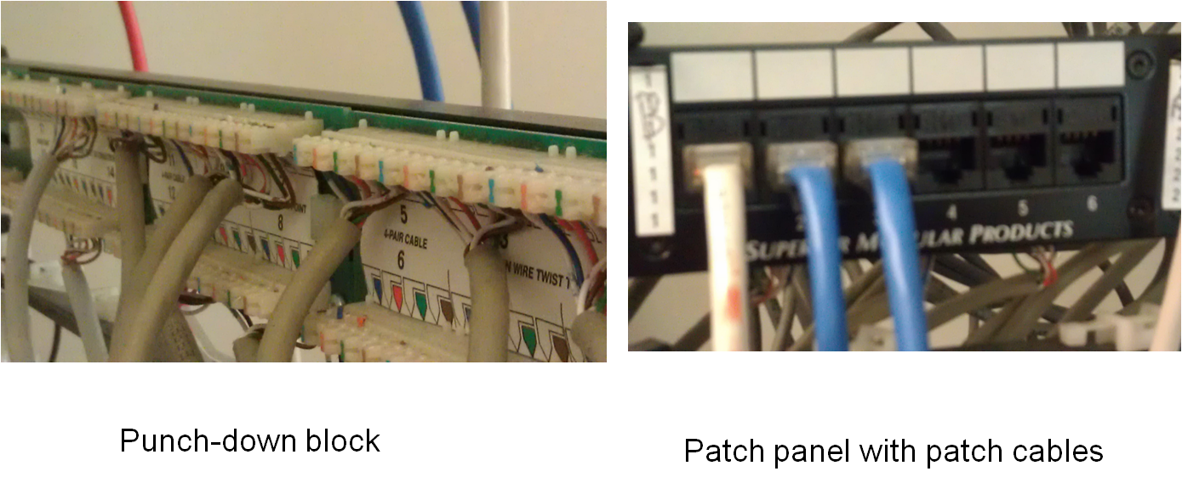
Equipment Room and Backbone Cabling
Images courtesy of Michele Parrish
Notes:
Some common equipment found in an equipment room are the punch-down block, patch panel and switch/hub. A punch-down block is a panel where the TP is brought to and literally all 8 wires are “punched down” into the block. In the front of the punch down block is a patch panel that contains RJ45 ports. Patch cables are a relatively short section of twisted-pair cabling with connectors on both ends that connect the port in the patch panel with a port on a switch, hub, or router. The difference between these devices will be explained later in the unit.
Backbone cabling includes the vertical connection between floors (risers), cables between an equipment room and building cable entrance facilities, and cables between buildings (interbuilding). The cables between floors and between equipment rooms are typically TP or fiber with the cables between buildings being fiber.
The image on left is licensed under Creative Commons Attribution-NonCommercial 2.0 Generic by Oliebollen http://www.flickr.com/photos/oliebol/5364643366/sizes/s/in/photostream/.
The image on right is licensed under Creative Commons Attribution 2.0 Generic by hywell http://www.flickr.com/photos/hywell/12609467.

Slide 14
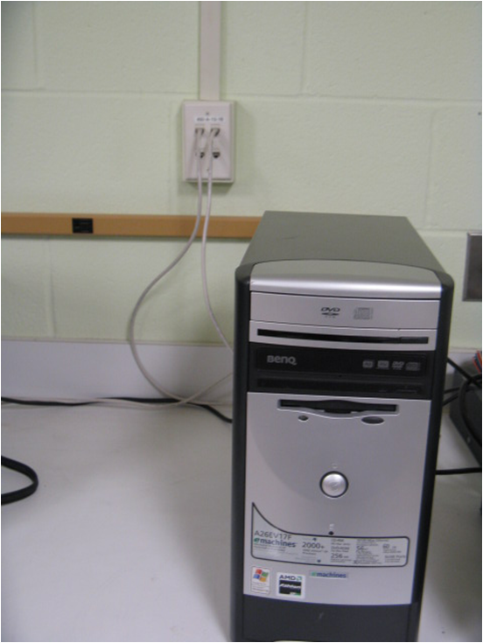
Horizontal Wiring
Image courtesy of Michele Parrish.
Notes:
Horizontal wiring extends from the work area telecommunications (information) outlet to the telecommunications closet. This wiring is generally run in the walls, floor or ceiling. An example would be a multi-floor hospital with a telecommunications closet on every floor, wired to an equipment room on the ground floor.

Slide 15
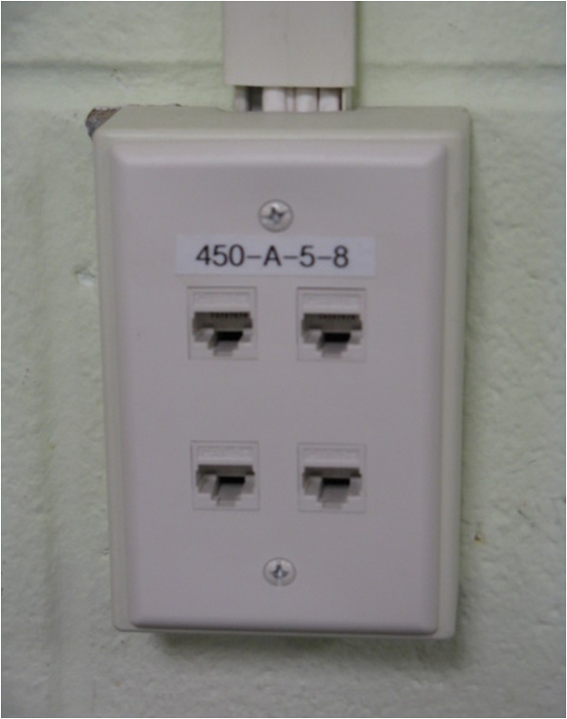
Work Area Outlet
Image courtesy of Michele Parrish.
Notes:
Each work area must have a minimum of 2 information outlet ports, one for voice and one for data. A patch cable is used to connect the outlet to the node.

Slide 16
Wireless
Radio frequency (RF)
Infrared transmission
Direct
Indirect
Notes:
In addition to using copper or fiber optic cables, we can use wireless to connect our network devices. There are two types of wireless transmissions: Radio frequency (RF), and infrared. Radio frequency transmits a series of radio waves across a set frequency. RF is used by cellphones, radios, and walkie-talkies. Infrared networks use infrared light signals to transmit data through space. Examples are remote controls, UPC scanners at stores, and infrared mice, keyboards, etc. for computers.
Direct infrared transmission depends on the transmitter and receiver remaining within line of sight. An example is trying to change the TV station when someone is standing in front of the TV set. Because the person is preventing the direct infrared transmission from reaching the TV set, the station won’t change.
In indirect infrared transmission, signals can bounce off of walls, ceilings, and any other objects in their path so that the signals can be sent from the transmitter to the receiver. For example, you can point the remote control at the wall, and the signal will bounce off the wall, and change the TV station (angle-in equals angle-out).

Slide 17
Wireless LAN (Wi-Fi) 802.11x Standards
Characteristic | 802.11a | 802.11b | 802.11g | 802.11n
Frequency | 5 GHz | 2.4 GHz | 2.4 GHz | 2.5/5 GHz
Bandwidth | 54 Mbps | 11 Mbps | 54 Mbps | Up to 600 Mbps
2.1 Table: 802.11x standards (Parrish, Michele. 2011).
Notes:
Four standards for wireless technology are used today: 802.11 b, g, a, and, recently introduced, n. b and g are compatible. You will see equipment that says b/g. Your equipment (wireless access point) and NIC must use the same standard in order to communicate with each other.

Slide 18
Network Media and Hardware Communication Devices Summary – Lecture b
Media Types
Standards for Structured Cabling
Notes:
This concludes Lecture b of Network Media and Hardware Communication Devices. In this lecture, we covered the different media types and standards for structured cabling.

Slide 19
Network Media and Hardware Communication Devices References – Lecture b
Charts, Tables, Figures
2.1 Table: Parrish, Michele. 2011.
Images
Slide 4: Coaxial cable. Courtesy Michele Parrish. Used with permission.
Slide 5: Bayonet Neill-Concelman (BNC) connector. Courtesy Michele Parrish. Used with permission.
Slide 6: Twisted Pair (TP) Cable. Courtesy Michele Parrish. Used with permission.
Slide 7: RJ-45. Courtesy Michele Parrish. Used with permission.
Slide 8: T568A or T568B standards. Courtesy Michele Parrish. Used with permission.
Slide 10: Fiber Optic Cable. Courtesy Michele Parrish. Used with permission.
Slide 11: Copyright(c) Mrzeon and made available under Creative Commons Attribution-Share Alike 3.0 Unported, 2.5 Generic, 2.0 Generic, and 1.0 Generic http://en.wikipedia.org/wiki/File:Optical_fiber_types.svg
Slide 13: Patch. Courtesy Michele Parrish. Used with permission
Slide 14: Horizontal Wiring. Courtesy Michele Parrish. Used with permission.
Slide 15: Work Area Outlet. Courtesy Michele Parrish. Used with permission.
Notes:
No audio

Slide 20
Network Media and Hardware Communication Devices Lecture b
This material was developed by Duke University, funded by the Department of Health and Human Services, Office of the National Coordinator for Health Information Technology under Award Number IU24OC000024. This material was updated by Normandale Community College, funded under Award Number 90WT0003.
Notes:
No audio

