Slide 1
Networking and Health Information Exchange
ISO Open Systems
Interconnection (OSI)
Lecture b
This material (Comp 9 Unit 1) was developed by Duke University, funded by the Department of Health and Human Services, Office of the National Coordinator for Health Information Technology under Award Number IU24OC000024. This material was updated by Normandale Community College, funded under Award Number 90WT0003.
This work is licensed under the Creative Commons Attribution-NonCommercial-ShareAlike 4.0 International License. To view a copy of this license, visit http://creativecommons.org/licenses/by-nc-sa/4.0/
Notes:
Welcome to Networking and Health Information Exchange, ISO Open Systems Interconnection (ISO). This is lecture b.

Slide 2
ISO Open System Interconnection (OSI) Objectives
Explain the concept of the Network Layer
Explain the concept of the Data Link Layer
Explain the concept of the Physical Layer
Explain connection-oriented versus connectionless communication
Explain the use of network addressing including security considerations and vulnerabilities
Notes:
The objectives for this lecture, ISO Open System Interconnection (OSI) lecture b, are to:
Explain the concept of the Network layer
Explain the concept of the Data Link layer
Explain the concept of the Physical layer
Explain connection-oriented versus connectionless communication
Explain the use of network addressing including security considerations and vulnerabilities

Slide 3
Network Layer
Internet Protocol (IP) is used to assign IP addresses to network devices.
Connectionless
Best effort delivery
Relies on TCP for reliable, error free delivery
Notes:
The network layer routes packets through the network using network addresses. Internet Protocol (IP) is used to assign IP addresses to network devices. These addresses are used to identify the network devices so that packets can be delivered to the correct device. IP is a connectionless, best effort delivery protocol. It relies on TCP for reliable, error free delivery.

Slide 4
IP Addresses
Two Current Versions
IPv4
32 bits
Dotted-quad
Binary example: 11000000.00101000.01101110.11100001
Decimal example: 192.40.110.225
IPv6
128 bits
Example: 3eef:1800:4625:7:100:c8fd:ae21:57bf
Notes:
There are two current versions of IP addresses, version 4 and version 6. IPv4 is the most popular version in use but IPv6 is starting to be implemented. IPv4 addresses use 32 bits and IPv6 uses 128 bits. Remember that computers use binary numbers, just 0s and 1s. Version 4 addresses are referred to as dotted-quad addresses because the 32 bits are broken down into four 8-bit groups called octets, separated by a dot. An example of an IP address using only 0s and 1s would be 11000000.00101000.01101110.11100001. If we convert the binary to decimal the address would be 192.40.110.225. The IPv4 examples shown in the rest of the presentation are in decimal format because they are easier for us to deal with. An example of an IPv6 address would be 3eef:1800:4625:7:100:c8fd:ae21:57bf. IPv6 addresses use the hexadecimal number system.

Slide 5
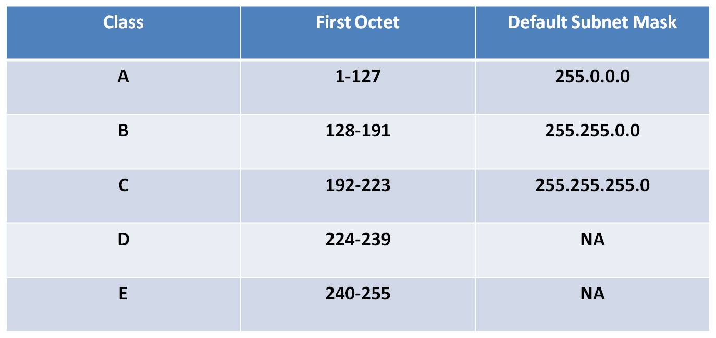
IPv4 Addresses
Source: Parrish, Michele. 2011
Notes:
IPv4 addresses are broken into five classes, A, B, C, D and E. Classes A, B and C are assigned to networks. Class D addresses are used for multicasting. Multicasting will be explained in a little while. Class E is for experimental purposes. We don’t know what’s going on with those addresses! The first octet or first 8 bits of an IPv4 address determines what class the address belongs to. If the 1st octet falls between 0-127, it is a class A address. If it falls between 128-191 it is a class B address, 192-223, class C, 224-239, class D and 240-255, class E.

Slide 6
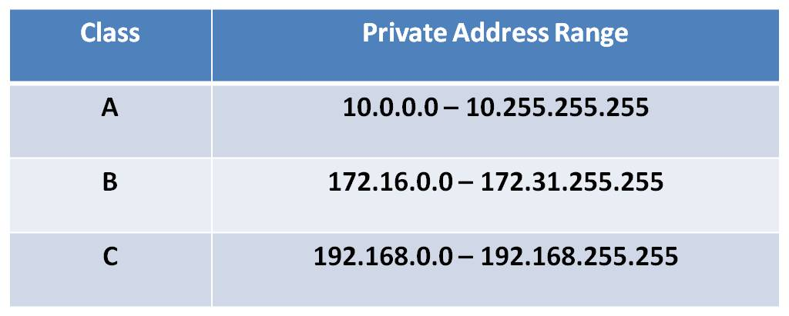
Special IP Addresses
127.0.0.1 – reserved for loopback
Private Addresses
Source: Parrish, Michele. 2011
Notes:
Addresses that have 127 in the 1st octet are reserved for testing and can not be assigned to devices. In particular 127.0.0.1 is reserved for the loopback test. This allows a user to test the TCP/IP settings on a device. Private addresses are addresses that can be used in home, office, or LANs where the packets do not have to be sent out across the Internet. The Internet uses public addresses. If such a private network needs to connect to the Internet, it must use either network address translation (NAT) or a proxy server.

Slide 7
Forms of Transmission
Unicast
Broadcast
Multicast
Notes:
As mentioned Class D addresses are for multicast. We can classify transmission in one of three ways, unicast, broadcast or multicast. Unicast transmissions are from one source to one receiver. An example would be if you were having a one-on-one conversation with another person. Broadcast is one source sending out a transmission to all devices that are on the same network. For example a teacher in a classroom is broadcasting their lecture to all the students in the classroom. Multicast transmission is when one sender sends out a message to a group of devices and that group is identified by a class D address. For example, if an announcement was made at your college that was addressed to all students in the Networking and Health Information Exchange class you would pay attention because you are part of the group. Devices are programmed to know what multicast addresses they should respond to.

Slide 8
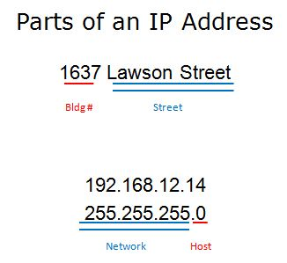
Parts of an IP Address
Image courtesy of
Michele Parrish
Notes:
An IP address has two parts. The first part identifies the network that the host with that IP address belongs to and the second part uniquely identifies that device on that network. For example if you were driving to 1637 Lawson Street you would know that the street is named Lawson and once you got to that street you would need to look for building 1637. We knew the scheme for addresses because we have learned it.
In networking the subnet mask is what tells us which part of the address is the network and which part is the host. Wherever there are 1s in the subnet mask, that is the network portion of the address, and where there are 0s that is the host portion. 255 in decimal is 8 1’s or 11111111 in binary. In our example 192.168.12.14 is a class C address so the default subnet mask is 255.255.255.0. The first 3 octets identify the network and the last octet identifies the host.

Slide 9
Subnetting
172.16.0.0 >1 network
255.255.0.0 >65,000 hosts
255.255.240.0 16 networks
>4,000 hosts
Notes:
172.16.0.0 is a class B address. The default subnet mask is 255.255.0.0. The first 2 octets identify the network and the last 2 octets identify the hosts on that network. There are 16 bits that can be used to identify hosts on the 172.16.0.0 network. This means we can have over 65,000 hosts on that 1 network. Not many networks need over 65 thousand hosts. We can take the 1 network and subdivide it, or subnet it, into more networks. We take some of the host bits (0s) and change them to network bits (1s). If we have a new subnet mask of 255.255.240.0 and we apply to that same address 172.16.0.0 we can create 16 networks with 4,000 hosts on each network.

Slide 10
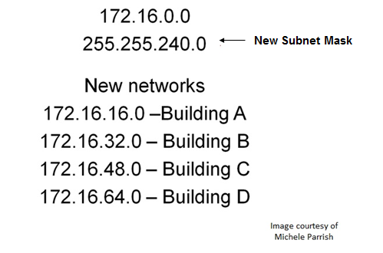
Subnetting Continued
Notes:
We can then take those subnets and use them for different buildings. For example, if we get a virus on a computer with an IP address of 172.16.32.10 we immediately know it is on a PC in building B. We could also “cut off” that subnet from the rest of the network therefore isolating the virus to just that subnet instead of allowing it to spread to the entire network.

Slide 11
Routers
Image courtesy of
Michele Parrish
Notes:
Routers operate at the Network layer of the OSI Model. Routers are multiport connectivity devices that connect different networks (LANs, WANs, different transmission speeds, media, and protocols) to each other. They move packets from one network to another (route packets).

Slide 12
Routing Protocols
Two types:
Static routing
Dynamic routing
Hop
Term used to describe the movement of data from one router to another
Time to Live (TTL)
Notes:
Routers choose the best route for a packet to take to arrive at its destination. There are two ways that the router knows what the best path is: static routing and dynamic routing.
In static routing a network administrator programs a router to use a specified path to move data between two nodes.
In dynamic routing routers automatically calculate the best path between nodes and accumulate this information in a routing table. Routers share information about the routes with each other. A router will look at the destination IP address of a packet, calculate what network it is located on and based on the information in the routing table about that network, forward the packet to its next hop.
A hop is a term used to describe the movement of data from one router to another. For example if a packet travels across 3 routers from its source to its destination it is said to have taken 3 hops.
As a packet crosses across a router the Time to Live (TTL) field in the IP packet is decreased by 1. When the TTL reaches 0 that router will discard the packet and send a message to the sender to let it know that the packet was undeliverable.

Slide 13
Internet Control Message Protocol (ICMP)
Used to send some messages back to sender in case of a delivery error
Common messages
Unreachable destination or service
Time exceeded
Route redirection
Source quench
Used with PING and TRACERT
Notes:
Internet Control Message Protocol (ICMP) is another protocol that operates at the Network layer of the OSI model. Even though IP is an unreliable protocol it does allow some messages to be sent back to the sender, in case there is an error in delivery. Some common ICMP messages are Unreachable destination or service, Time exceeded, Route redirection and Source quench. ICMP is also used with the PING and TRACERT (or TRACEROUTE) utilities.

Slide 14
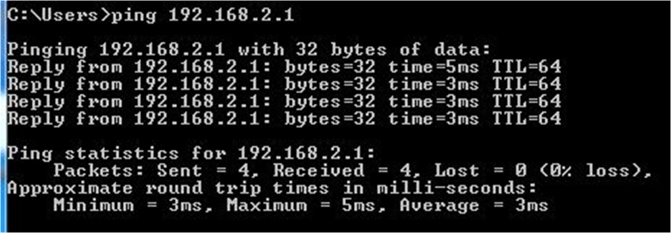
PING
Image courtesy of
Michele Parrish
Notes:
Ping is used to test if a particular host is reachable on a network and to measure the round trip time for packets sent from the local host to a destination computer. Ping uses ICMP Echo Request and Echo Reply packets. You can ping a device’s IP address or its host name.

Slide 15
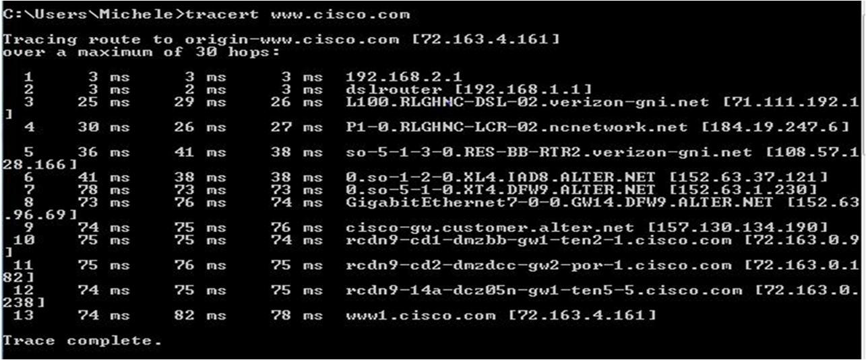
TRACERT
Image courtesy of
Michele Parrish
Notes:
Tracert or Traceroute is a utility that is used to trace the route that a packet takes from source to destination. The destination can be referenced by its IP address or name. The output from the command shows the IP address and sometimes the host name of the routers that are traversed as the packet is sent from one device to the other.

Slide 16
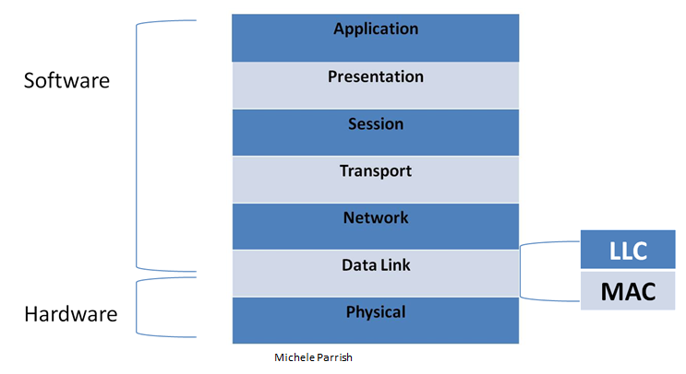
Data Link Layer
Notes:
The Data Link layer moves frames through the network using physical addresses. The Data Link layer is the layer where the software and hardware come together. The layer contains two sublayers, the Logical Link Control (LLC) and the Media Access Control (MAC). The LLC sublayer interacts with the Network layer and identifies what network layer protocol is being used. This information allows different network layer protocols to use the same network interface and media. The MAC sublayer interacts with the Physical layer. It provides data link layer addressing.

Slide 17
MAC addresses
Source: Parrish, Michele. 2011
Notes:
A MAC address is a unique address assigned to most network interface cards (NICs) by the manufacturer for identification. This is also known as the physical address. MAC addresses are in hexadecimal format. It contains 48 bits or 12 hex digits. The 1st 24 bits or 6 hex digits are called the organizational unique identifier (OUI). Each vendor that produces NICs is assigned their OUIs by the Institute of Electrical and Electronics Engineers (IEEE). The remaining bits are unique for each OUI and are assigned by the vendor.

Slide 18
Media Access Control
Controlled
Also called deterministic
Every device has to wait its turn
Only 1 device can transmit data at a time
No collisions
Examples
Token Ring
Fiber Data Distributed Interface (FDDI)
Notes:
The MAC sublayer determines how data frames are placed onto the network media, which device gets to “talk”. There can be multiple devices sharing the same media and there has to be a system in place to decide which device gets to place its data on the network. The two MAC methods for allowing access to shared media are controlled and contention-based. Controlled access is also referred to as deterministic access. There is some mechanism that determines when a device can transmit. Each device must wait its turn to transmit its data on the network. Only one device can communicate at a time, and because of this there are no collisions. Collisions occur when multiple data transmissions interfere with each other causing none of the transmissions to be good. Token Ring and FDDI (or fiddi) are technologies that use controlled access.

Slide 19
Media Access Control Continued
Contention-based
Also called non-deterministic
Devices can transmit at any time
Collisions can occur
Examples
Ethernet
Wireless
Notes:
In contention-based systems, devices can transmit at any time. Collisions may occur. This method is also called non-deterministic. There is no mechanism to decide when a device can transmit data but the devices have to contend with each other to access the media. Ethernet and wireless are technologies that use contention-based access.

Slide 20
Ethernet
Uses CSMA/CD
Carrier Sense Multiple Access (CSMA)
“Listens” to media to see if there are any signals
If media is busy, it will wait and try again
If media isn’t busy, the device will transmit its data
Collision Detection (CD)
If another device transmitted at the same time there would be a collision
Data from both devices are corrupt and will need to be resent
Notes:
Ethernet uses Carrier Sense Multiple Access/Collision Detection (CSMA/CD). The device that has data to send will listen to the media to see if there is any signal being carried on the media. Remember, media is the cable carrying the data. If there is a signal on the media, it means that a device is already transmitting data , and that device must wait and try to send its data later. If there is no signal the device can transmit the data by putting a signal on the media. It may happen that at the same time the device transmits its data, another device doesn’t hear a signal on the media and it transmits too. In that case there would be a collision, causing both signals to become corrupt. The devices would detect the collision and know that they need to send the data again. They would both start the process of CSMA/CD again.

Slide 21
Wireless
Uses CSMA/CA
Carrier Sense Multiple Access (CSMA)
“Listens” to media to see if there are any signals
If media is busy, it will wait and try again
Collision Avoidance (CA)
If the media is free the device will send out a signal letting other devices know that it is getting ready to use the media
The device then transmits data
Used by 802.11 standards
Notes:
Wireless technologies like the 802.11 standards use Carrier Sense Multiple Access/Collision Avoidance (CSMA/CA). The device that has data to send will listen to the media to see if there is any signal being carried on the media. If there is a signal on the media that device must wait and try to send its data later. If there is no signal, the device will send out a signal notifying the rest of the devices using that media that it is getting ready to send out data. This avoids a collision because other devices will not transmit. After issuing the notification the device then sends out its data.

Slide 22
Other Data Link Protocols
Frame Relay
Point-to-Point Protocol (PPP)
Asynchronous Transfer Mode (ATM)
Notes:
Frame Relay, PPP and ATM are data link layer protocols that are used on WANs. Switches operate at the Data Link layer.

Slide 23
Physical Layer
Hardware Specifications
Encoding
Non Return to Zero (NRZ)
Manchester
Transmits and Receives Data
Network Topology
Notes:
The physical layer transforms bits into signals to be sent across the network media. This is the layer at which data is actually transmitted across the network media. It is commonly referred to as PHY. At the physical layer we have the specifications for hardware like network cables, connectors, wireless radio transceivers, etc. This layer is also responsible for data encoding. This is the process of taking the data (0s and 1s) and turning it into an electrical, optical or wireless signal that is transmitted over the media. Popular encoding methods are Non Return to Zero and Manchester. Topologies are how network devices are connected to each other. Part of the topology involves the type of media that is used so the physical layer is concerned with this.

Slide 24
ISO Open Systems Interconnection (OSI) Summary
In this unit we covered
the TCP/IP model
the OSI model
the layers for each model and associated protocols
Notes:
This concludes lecture b of ISO Open Systems Interconnection (OSI). We have covered the TCP/IP and OSI models, the layers for each model and associated protocols.

Slide 25
ISO Open Systems Interconnection (OSI) References – Lecture b
Images
Slide 6: IPv4 Addresses. Courtesy Michele Parrish. Used with permission.
Slide 7: Special IP Addresses. Courtesy Michele Parrish. Used with permission.
Slide 9: IP Address Parts. Courtesy Michele Parrish. Used with permission.
Slide 11: Subnetting. Courtesy Michele Parrish. Used with permission.
Slide 12: Router. Courtesy Michele Parrish. Used with permission.
Slide 15: Ping. Courtesy Michele Parrish. Used with permission.
Slide 16: Tracert. Courtesy Michele Parrish. Used with permission.
Slide 17: Data Link. Courtesy Michele Parrish. Used with permission.
Slide 18: MAC Addresses. Courtesy Michele Parrish. Used with permission.
Notes:
No audio.

Slide 26
ISO Open Systems Interconnection (OSI) Lecture b
This material was developed by Duke University, funded by the Department of Health and Human Services, Office of the National Coordinator for Health Information Technology under Award Number IU24OC000024. This material was updated by Normandale Community College, funded under Award Number 90WT0003.
Notes:
No audio

