Slide 1
Networking and Health Information Exchange
ISO Open Systems Interconnection (OSI)
Lecture a
This material (Comp 9 Unit 1) was developed by Duke University, funded by the Department of Health and Human Services, Office of the National Coordinator for Health Information Technology under Award Number IU24OC000024. This material was updated by Normandale Community College, funded under Award Number 90WT0003.
This work is licensed under the Creative Commons Attribution-NonCommercial-ShareAlike 4.0 International License. To view a copy of this license, visit http://creativecommons.org/licenses/by-nc-sa/4.0/
Notes:
Welcome to Networking and Health Information Exchange, ISO Open System Interconnection (OSI). This is lecture a.

Slide 2
ISO Open System Interconnection (OSI) Objectives
Explain the OSI representation of the various layers involved in networking, including the general functions of each layer and their interconnections.
Explain the concept of the Application Layer
Explain the concept of the Presentation Layer
Explain the concept of the Session Layer
Explain the concept of the Transport Layer
Notes:
The objectives for this lecture, ISO Open System Interconnection (OSI) lecture a, are to:
Explain the OSI representation of the various layers involved in networking, including the general functions of each layer and their interconnections
Explain the concept of the Application Layer
Explain the concept of the Presentation Layer
Explain the concept of the Session Layer
Explain the concept of the Transport Layer

Slide 3
Terminology
A network is two or more devices that communicate with each other over some form of transmission media.
Types of networks
Local Area Network (LAN)
Wide Area Network (WAN)
Internet
Intranet
Extranet
Notes:
A network is two or more devices that communicate with each other over some form of transmission media. There are several different types of networks that are defined by size, who maintains the network and who has access to the network. A local area network (LAN) is a small network. It can be as small as two devices connected to each other and as big as a college campus. LANs are maintained by the organization that uses the network and it is responsible for creating and maintaining all the network hardware and software. Wide area networks (WANs) are big networks. The largest and oldest WAN in existence is the Internet. WANs span large geographic areas and are typically made up of many different LANs. For example, your school’s LAN is part of the Internet, your LAN at home is too. Parts of the Internet are owned by different people. Intranets make use of Internet technology, but there are differences. On the Internet the web pages are available to whoever navigates to them. But intranet sites limit who can view the pages that make up the site. For example, companies have Intranet sites that contain their human resource manuals, leave forms, employee news, etc. This information is not needed by the general public, only by employees of that company. An extranet is a combination of an Internet and intranet site. Extranets are set up so the access is limited to a company’s outside resources. For example, an extranet could be set up so that a retailer could use a company’s extranet to see if a certain part is available and if it is, the retailer can order it and then track the order online.

Slide 4
Terminology - 2
For communication to take place on a network we need
Source
Receiver
Medium
Notes:
For communication to take place on a network we need a source, a receiver and a medium to transmit data between the source and the receiver. The source and the receiver can be a desktop computer, server, laptop, printer, router, switch, cellphone, ATM machine, almost anything you can imagine! The medium or media is the wired or wireless method that is used to connect the source and receiver to each other and that carries the data from the endpoints.

Slide 5
Terminology - 3
Protocol – rules for communication
Examples:
TCP/IP-Transmission Control Protocol/Internet Protocol
HTTP-HyperText Transfer Protocol
NETBEUI-NetBios Extended User Interface
ICMP-Internet Control Message Protocol
Notes:
It is not enough for the devices to be connected to each other – they must also speak the same language. In networking we refer to this as the protocol. The protocol defines the processes and rules that devices will follow to communicate with each other. For example, we follow protocols all the time. In Asian cultures the protocol may be to bow when we greet each other and in Europe it may be to kiss each other on the cheek; where, in America, we shake hands. The protocols may be different but in the end we are accomplishing the same thing – greeting each other. Examples of network protocols are TCP/IP, HTTP, NETBEUI and ICMP.

Slide 6
TCP/IP Model
Application
Transport
Internetwork
Network Access
Table 1.1 TCP/IP Four-Layer Model for Internet Communications
Source: Parrish, Michele. 2011
Notes:
In the mid-60s, the United States wanted to have a computer network connecting their military sites to each other that could withstand an outside attack. This means that redundant paths were needed between the sites. A protocol was created that enabled the transmission of data to switch to another path in case one path was destroyed. This protocol was called TCP/IP – Transmission Control Protocol/Internet Protocol. The TCP/IP model, also called the Department of Defense or DoD model, was created in the 1970s as a four-layer model that described the functions that should take place at each layer as two devices communicated with each other. The TCP/IP layers were the Application Layer, which is closest to the user, the Transport Layer, Internetwork Layer and Network Access Layer.

Slide 7
OSI Model
Application
Presentation
Session
Transport
Network
Data Link
Physical
Table 1.2 OSI Seven-Layer Model for Internet Communications
Source: Parrish, Michele. 2011
Notes:
In the late 1970s the Open Systems Interconnection (OSI) model was created by the International Organization for Standardization. It is a seven-layer model that describes the processes that should take place for communication to occur between two devices on a network. The Application Layer is closest to the user and the Physical Layer is closest to the network media (or medium). The media is the wired or wireless method that is used to connect network devices to each other. There is a mnemonic that can be used to remember the layers. Starting at the Physical Layer, Please Do Not Throw Sausage Pizza Away. By taking the first letter of every word in the mnemonic you will have the first letter of the seven layers of the OSI model.

Slide 8
OSI Model - 2
Notes:
The Application Layer is the OSI layer closest to the end user. The user interacts with the application which uses services provided at the Application Layer. For example, a user uses Internet Explorer (IE) to surf the web. Hypertext Transfer Protocol (HTTP) is the protocol that works at the Application Layer that allows IE to work. The Presentation Layer prepares data to be passed to the next layer. It is at this layer that data encryption and compression takes place. The Session Layer manages sessions between end points. An example is the network client that exists on a computer system that allows you to login to the network. The Session Layer establishes, maintains, and ends the connection between the end points. The Transport Layer makes sure that data is received correctly at the destination. If the data isn’t received the Transport Layer makes sure that the data is re-sent. The Network Layer uses network addresses (an example is IP addresses) to move packets across a network from source to destination. The Data Link Layer uses physical (or Media Access Control (MAC) addresses) to move data across the network. The Physical Layer transforms bits into signals (either electrical or optical) that are then sent across the network media (wired or wireless).

Slide 9
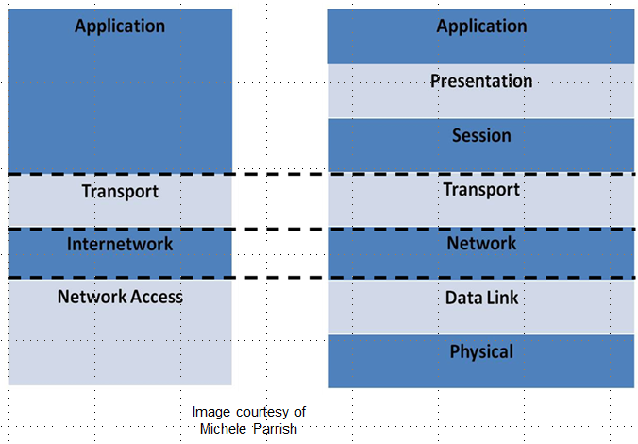
Two Models Compared
Notes:
The Application Layer of the TCP/IP model is equal to the Application, Presentation and Session Layers of the OSI model. The Transport Layers in both models are equal to each other. The Internetwork Layer of the TCP/IP model is equivalent to the Network Layer of the OSI model. The Network Access Layer of the TCP/IP model is the same as the Data Link and Physical Layers of the OSI model.

Slide 10
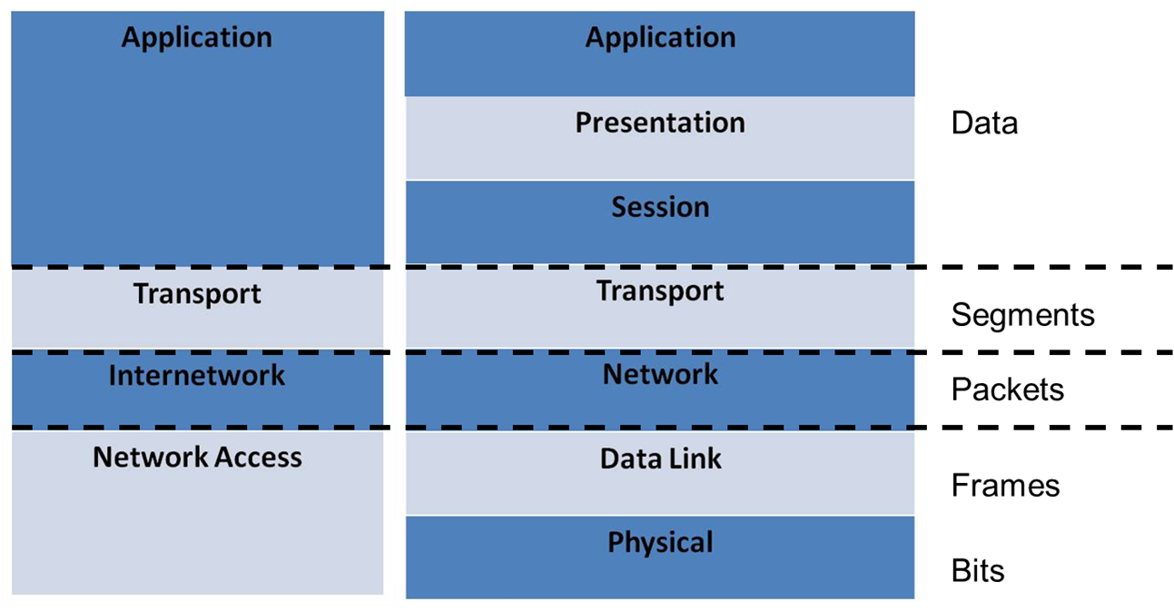
Protocol Data Units (PDUs)
Image courtesy of
Michele Parrish
Notes:
As data travels through the layers it is referred to with different names. This is known as the protocol data units (PDUs). As data travels through the Application, Presentation and Session Layers it is called data. At the Transport Layer it is called segments, at the Network Layer packets. As it passes through the Data Link Layer it is called frames and finally when it reaches the Physical Layer it is called bits.

Slide 11
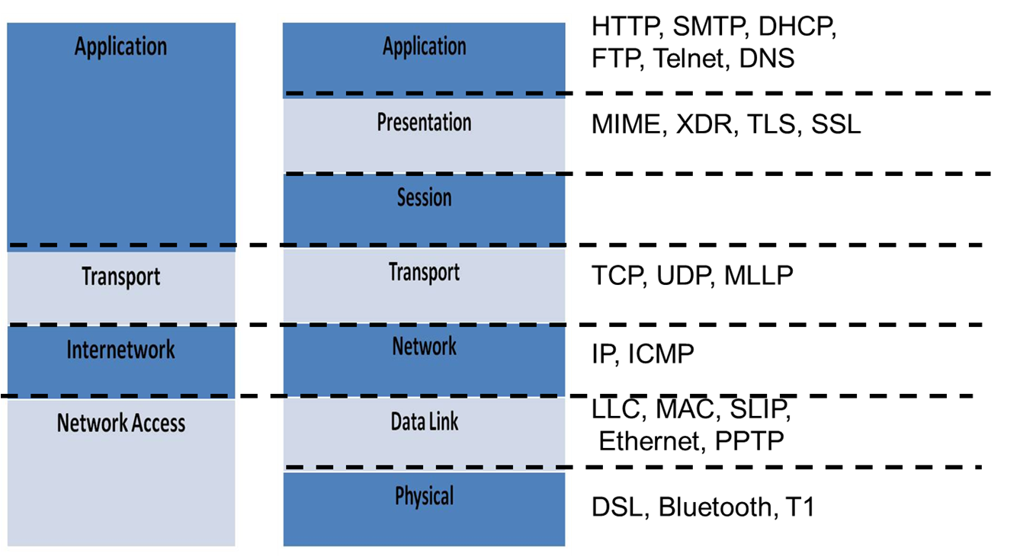
Protocols/Technologies Covered
Image courtesy of
Michele Parrish
Notes:
Transmission Control Protocol/Internet Protocol (TCP/IP) is actually a protocol suite. This means that it consists of multiple protocols. The 2 core protocols are TCP and IP but there are many other protocols like HTTP, DHCP and ICMP. TCP/IP is the protocol that is used by the majority of networks today. It is important to understand what these protocols do. The protocols and technologies we will cover in this lecture are shown on the diagram at the layer in which they function.

Slide 12
Application Layer Protocols
Hypertext Transfer Protocol (HTTP) is used by Web browsers and servers to communicate.
Domain Name Service (DNS) is used for converting host names and domain names into IP addresses.
Simple Mail Transport Protocol (SMTP) is used for email.
POP3
IMAP4
Notes:
Application Layer protocols provide services for user applications.
Hypertext Transfer Protocol (HTTP) is the standard used for Web browsers and servers to communicate. HTTP clients (like Web browsers) and servers communicate using HTTP request and response messages. GET, POST, and HEAD are the three main HTTP message types.
Domain Name Service (DNS) is a system for converting host names and domain names into IP addresses. For example, if you type www.cisco.com into a web browser, DNS is used to resolve the domain name (cisco.com) into an IP address. That IP address is what is used to connect to the server that hosts the web pages for cisco.com. When you use voice activation on your cell phone, and you ask it to call your mom, the phone has to translate “mom” into a phone number, and it dials that phone number.
Simple Mail Transport Protocol (SMTP) is used for email, especially the sending of email. SMTP is used to transport email from one email server to another. Post Office Protocol (POP, current version 3 is also referred to as POP3) and Internet Message Access Protocol (IMAP, current version 4 is also referred to as IMAP4) are the popular protocols that are used to deliver email. If you are sending an email using GMAIL to a friend that was using YAHOO, SMTP would be the protocol that would transfer the email between the GMAIL and YAHOO servers, and IMAP4 would be the protocol that would deliver the email to their mailbox.

Slide 13
Application Layer Protocols Continued
Dynamic Host Configuration Protocol (DHCP) is used to automatically configure network hosts with TCP/IP settings.
File Transfer Protocol (FTP) is used to copy files from one host to another.
Telnet allows a user to connect to a remote system and whatever action they perform on their local host happens on the remote system.
Notes:
Dynamic Host Configuration Protocol (DHCP) is used to automatically configure network clients with TCP/IP settings. The settings a device must have to get on to a network are: IP address, subnet mask and default gateway. Other settings are optional. When a client gets on the network, it sends out a broadcast message requesting IP settings. A DHCP server will respond offering the client an IP address and other TCP/IP settings. To finalize the process, the client will respond to the DHCP with a request to use those settings that were offered by the server. The server will make an entry into its database that those settings have been leased to that client. The lease will last for a defined period of time. When that time period has ended or the client manually breaks the lease, the TCP/IP settings are put back into the pool and can be offered to another client requesting TCP/IP settings. DHCP saves time by not requiring a network administrator to go to every client and type in all TCP/IP settings. It also eliminates the possibility of more than one client getting the same IP address since it will only lease it to one client. It is very easy for an administrator to make a mistake and assign the same IP address to multiple clients. DHCP can cause a security risk because any device connected to the network could receive an IP address on that network and be able to communicate. Physical security is important on networks that use DHCP.
File Transfer Protocol (FTP) is used to copy files from one host to another. Some systems require users to login to the host that they wish to upload or download a file to. Systems that don’t require usernames and/or passwords are called anonymous FTP sites. If you have ever downloaded an application, music or movie from the Internet then you have used FTP. Telnet allows a user to connect to a remote system and whatever action they perform on their local host happens on the remote system. For example, you may remember the old computerized library catalogs - the tan monitors with green or orange text. If you were searching for a book you entered the name of the book. The search was done on the server, and then displayed on the terminal where you entered the name of the book. Both FTP and Telnet are unsecure by default. The data that is being transmitted between the two systems is in plain-text which means that anything or anyone that intercepts the data being transferred can read the data. If you want the data to be secure you should run FTP and Telnet using a secure shell. This would encrypt the data being transferred.

Slide 14
Presentation Layer Protocols
Multipurpose Internet Mail Extensions (MIME) “specifies how messages must be formatted so that they can be exchanged between different email systems.”
External Data Representation (XDR) “is a standard for the description and encoding of data.”
Source for MIME: http://www.networkdictionary.com/protocols/mime.php
Source for XDR: http://tools.ietf.org/html/rfc1014
Notes:
Presentation Layer protocols supply data format information. Multipurpose Internet Mail Extensions (MIME) specifies how messages must be formatted so that they can be exchanged between different email systems. It defines mechanisms for sending other kinds of information besides just text in e-mail. These include text in languages other than English , graphics, audio, movies, and application files. External Data Representation (XDR) is a standard for the description and encoding of data.

Slide 15
Presentation Layer Protocols Continued
Transport Layer Security (TLS) and its predecessor, Secure Socket Layer (SSL) are used to encrypt/decrypt data.
Data Compression/Decompression is also done at this layer.
Notes:
Transport Layer Security (TLS) and its predecessor, Secure Socket Layer (SSL), are used to encrypt/decrypt data. SSL was developed by Netscape for their web browser and was improved upon, creating TLS. Today we use TLS but people still refer to it as SSL. Encryption means that the data or plaintext is encrypted using an algorithm and key to create ciphertext. Ciphertext cannot be read by anyone who intercepts the transmission. They would need to have the algorithm and key to decrypt the message so they could read it. When surfing the Internet, you can tell when you are using TLS when you see the "http" in the address line replaced with "https," and when you see a small padlock in the status bar at the bottom of the browser window, usually on the left-hand side. Data Compression is also done at this layer. This means that a device is able to transmit or store the same amount of data in fewer bits. In networking, this enables the data to be sent quicker. Decompression is done by the receiving device. The same algorithm and percentage must be used to decompress the data as was used to compress the data.

Slide 16
Session Layer
Establishes connections
Authentication
Type of communication that will take place
Protocols that will be used by the lower layers
Maintains connections
Synchronizes communications
Notes:
The Session Layer manages sessions between end points. It is responsible for establishing connections between two devices. This may involve authentication. Authentication is the process in which a user or device provides some information and the information is checked against a database to ensure that the user or device should have access to that particular resource. Typically in a network this is the process of logging into a resource by providing your username and password. As part of the session establishment the type of communication and protocols that will be used by the lower layers are also determined. The Session Layer maintains the connections and synchronizes communications.

Slide 17
Session Layer Continued
Control dialogues
Keeps track of which device is making requests and which device is making responses
Determines whether acknowledgments are required
Terminates connections
Notes:
The Session Layer is also responsible for keeping track of which device is requesting services and which device is providing that service. It also determines if acknowledgements are required for data transmissions. Finally, the Session Layer terminates the connection between two devices once the data transfer is complete.

Slide 18
Transport Layer Protocols
Transmission Control Protocol (TCP) maintains reliable, ordered delivery of segments.
Connection-oriented
Sequence Numbers
Acknowledgements
Window Sizing
Notes:
The Transport Layer provides end-to-end reliable delivery of segments. Transmission Control Protocol (TCP) maintains reliable, ordered delivery of segments between the sender and destination device. TCP makes a connection between the sending and receiving device before it actually transmits segments. Think about it like this: If I want to make sure you hear me telling you something. I will say your name, make sure you acknowledge me, and then tell you what I want to tell you. I have created a connection with you. TCP also uses sequence numbers, acknowledgements, and window sizing in order to make sure that segments are delivered correctly.

Slide 19
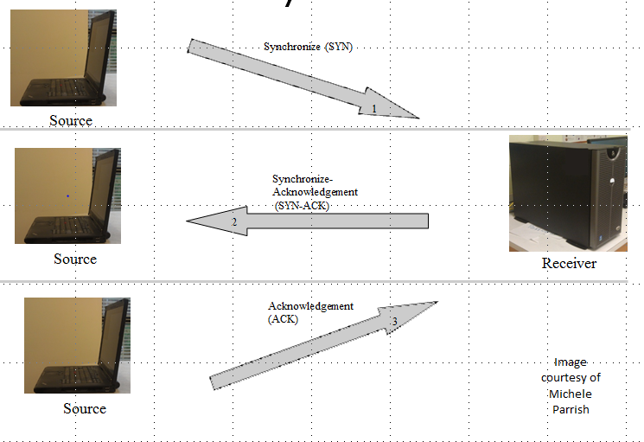
TCP 3-way Handshake
Notes:
The initial connection between two devices using TCP is called the 3-way handshake. The following is what happens in a TCP 3-way handshake:
The client that has data that it wants to transmit will send a Synchronize (S Y N or SYN) to the server. The segment's sequence number is set to a random value, A.
The server will respond with a Synchronize-Acknowledgement (SYN-ACK). The acknowledgment number is set to one more than the received sequence number (A + 1), and the sequence number that the server chooses for the packet is another random number, B.
Lastly, the client will send an ACK back to the server. The sequence number is set to the received acknowledgement value, i.e. A + 1, and the acknowledgement number is set to one more than the received sequence number, i.e., B + 1.
At this point, both the client and server have received an acknowledgment of the connection and data transmission will start.

Slide 20
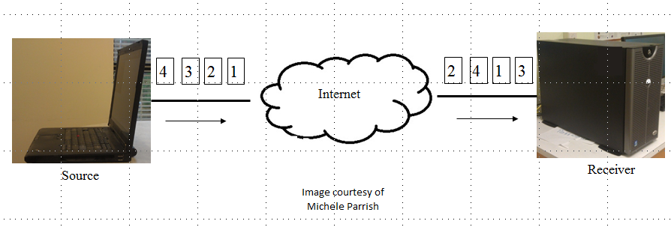
Sequence Numbers
Notes:
TCP also uses sequence numbers. When data is passed to the Transport Layer from the Session Layer, the Transport Layer divides the data into chunks called segments. Each segment is given a sequence number. The initial sequence number is a randomly assigned number. When the segments are sent to the destination device they may take different paths and arrive in a different order than the order in which they were sent. The sequence numbers are used by the receiving device’s Transport Layer to reassemble the segments back into the correct order before they are passed back up to the Session Layer. In the graphic you see that the client sent four segments but when they arrived at the server they are no longer in order. The server’s Transport Layer will use the sequence numbers to put the segments back into the correct order before passing them to the Session Layer.

Slide 21
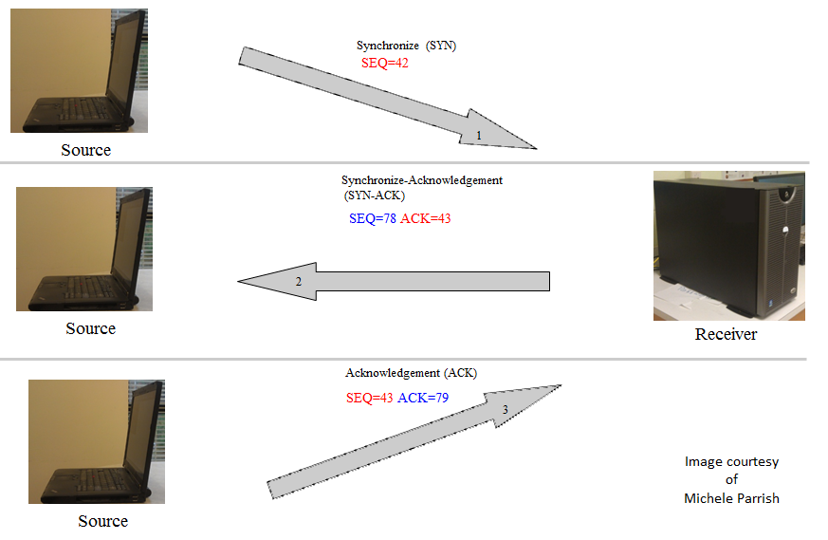
Acknowledgements
Notes:
Since some of the segments may be lost in transmission the receiving device sends acknowledgements for the segments it receives back to the sender. If the sender doesn’t receive an acknowledgment for a segment it will resend the segment.
Let’s revisit the 3-way handshake, but this time we will focus on sequence numbers and acknowledgements.
The client initiates the connection by sending a SYN. The segment's sequence number is set to a random value, A. In this case the number 42.
The server will respond with a SYN-ACK. The acknowledgment number is set to one more than the received sequence number (A + 1) so in this case 43. This is what is called an expectational acknowledgement. The sequence number that the server chooses for the packet is another random number, B. In our diagram 78.
Lastly, the client with send an ACK back to the server. The sequence number is set to the received acknowledgement value, i.e., A + 1 so 43, and the acknowledgement number is set to one more than the received sequence number, i.e., B + 1 or 79.
What would be the sequence number and acknowledgement numbers of the next segment coming from the server? You’re right! The sequence number would be 79 and the acknowledgement would be 44.

Slide 22
Window Sizing
Notes:
Sometimes the receiver is overwhelmed by the number of segments it is receiving at a time and has to drop some of the segments. The sender will adjust how many segments it sends to the receiver at a time. This is the process of window sizing or changing how many segments are sent at a time. TCP is like sending a certified letter via the US Postal Service. Establishing a connection, sequence numbers, acknowledgments, and window sizing takes time and resources. Sometimes we want to send data and while we hope it gets there we don’t guarantee it. This is when we use User Datagram Protocol (UDP).

Slide 23
Transport Layer Protocols Continued
User Datagram Protocol (UDP) provides best effort delivery of datagrams.
Connectionless
Errors may be handled by higher level protocols.
Minimal Lower Layer Protocol (MLLP) is an interface between HL7 applications and TCP.
Source: http://www.interfaceware.com/llp.html
Notes:
User Datagram Protocol (UDP) provides best effort delivery of datagrams. It does not create a connection between the sending and receiving devices before it sends datagrams. Errors may be handled by higher level protocols. If you are in a classroom the teacher is teaching you information and hopes that you receive that information. They can not take the time to make sure that every student understands everything they are teaching or take the time to re-teach everything that a student doesn’t understand. UDP is like sending a letter by regular postal service. We hope it gets there but we can’t be guaranteed delivery like we could with a certified letter (as we could with TCP). UDP is used for applications like streaming media, many online games and Voice over IP (VoIP). Minimal Lower Layer Protocol (MLLP) is an interface between HL7 Applications and TCP that uses minimal overhead.

Slide 24
TCP/UDP Ports
Assigned by the Internet Assigned Numbers Authority (IANA)
Three different types of port numbers
Well-known ports (0 to 1023)
Registered ports (1024 to 49151)
Dynamic or private ports (49152 to 65535)
Notes:
Applications and Application Layer services are identified by port numbers on a specific device. Some use TCP and others use UDP. Some can use either based on the implementation. The Internet Assigned Numbers Authority (IANA) assigns the port numbers. There are three different types of port numbers, Well-known ports (0 to 1023), registered ports (1024 to 49151) and dynamic or private ports (49152 to 65535).

Slide 25
TCP/UDP Ports - 2
Application | Protocol | Port Number
HTTP | TCP | 80
HTPS | TCP | 443
SMTP | TCP | 25
DHCP | UDP | 67
FTP | TCP | 20 (data) 21 (control)
Telnet | TCP | 23
DNS | TCP/UDP | 53
Table 1.3 Application, Protocol and Port Numbers
Source: Parrish, Michele. 2011
Notes:
The table shows some common applications, the protocol they use and their associated port number.

Slide 26
ISO Open Systems Interconnection (OSI) Summary
In this lecture we covered
the TCP/IP model
the OSI model
the Application layer
the Presentation layer
the Session layer and
the Transport layer.
Notes:
This concludes lecture a of ISO Open Systems Interconnection (OSI). In this lecture we covered the TCP/IP model, the OSI model and the Application, Presentation, Session, and Transport layers.

Slide 27
ISO Open Systems Interconnection (OSI) References – Lecture a
References
MIME: Multipurpose Internet Mail Extensions. (n.d.). Retrieved January 6, 2012, from Network Dictionary website: http://www.networkdictionary.com/protocols/mime.php
Network Working Group. (1987, June). XDR: External Data Representation Standard. Retrieved from Sun Microsystems website: http://tools.ietf.org/html/rfc1014
LLP - Lower Layer Protocol. (n.d.). Retrieved January 6, 2012, from iNTERFACEWARE™ Inc. website: http://www.interfaceware.com/llp.html
Charts, Tables, Figures
1.1 Table: Parrish, Michele. 2011.
1.2 Table: Parrish, Michele. 2011.
1.3 Table: Parrish, Michele. 2011.
Images
Slide 5: Source, Medium and Receiver. Courtesy Michele Parrish. Used with permission.
Slide 9: OSI Model showing layers and their functions. Courtesy Michele Parrish. Used with permission.
Slide 10: Model Comparison. Courtesy Michele Parrish. Used with permission.
Slide 11: PDU. Courtesy Michele Parrish. Used with permission.
Slide 12: Protocols. Courtesy Michele Parrish. Used with permission.
Slide 20: Handshake. Courtesy Michele Parrish. Used with permission.
Slide 21: Sequence. Courtesy Michele Parrish. Used with permission.
Slide 22: Acknowledgements. Courtesy Michele Parrish. Used with permission.
Slide 23: Window Sizing. Courtesy Michele Parrish. Used with permission.
Notes:
No audio

Slide 28
ISO Open Systems Interconnection (OSI) Lecture a
This material was developed by Duke University, funded by the Department of Health and Human Services, Office of the National Coordinator for Health Information Technology under Award Number IU24OC000024. This material was updated by Normandale Community College, funded under Award Number 90WT0003.
Notes:
No audio

