Slide 1
Installation and Maintenance of
Health IT Systems
System Interfaces and Integration
This material (Comp 8 Unit 7) was developed by Duke University, funded by the Department of Health and Human Services, Office of the National Coordinator for Health Information Technology under Award Number IU24OC000024. This material was updated in 2016 by The University of Texas Health Science Center at Houston under Award Number 90WT0006.
This work is licensed under the Creative Commons Attribution-NonCommercial-ShareAlike 4.0 International License. To view a copy of this license, visit http://creativecommons.org/licenses/by-nc-sa/4.0/.
Notes:
Welcome to Installation and Maintenance of Health IT Systems, System Interfaces and Integration.
The component, Installation and Maintenance of Health IT Systems, covers fundamentals of selection, installation, and maintenance of typical Electronic Health Records (EHR) systems.

Slide 2
System Interfaces and Integration
Learning Objectives
Determine and document system interfaces and integration requirements
Describe the pitfalls associated with installing a new application in an environment of pre-existing applications
Give examples of interfacing modalities
Notes:
The Objectives for this unit are to:
Determine and document system interfaces and integration requirements
Describe the pitfalls associated with installing a new application in an environment of pre-existing applications
Give examples of interfacing modalities
This unit will explore some of the issues and challenges involved in interfacing and integrating system dissimilar components, including understanding system requirements and the messaging and other techniques used between various systems.
In this unit we will define interface and integration and explain why integration is important to EHR systems, particularly to those with pre-existing systems already in place. We will discuss common interface methods point to point and interface engines and the types of protocols they use.
Next we will focus on HL7 as the protocol of choice in the industry. We will talk about how it simplifies the process of communicating between various dissimilar components and we will look at the various components of a typical HL7 message.
Lastly, we will talk about integration on a wider scale, such as connecting your EHR system to the outside world.

Slide 3
What are Interface and Integration?
Interface
  Point of interaction between components
  Mappings, translation tables
  Must be managed as systems get updated
  Example: Practice management system shares data with EHR via software interface.
Integration
  Process of combining various subsystems into larger system, ensuring that subsystems function together as a whole
  In IT: linking computing systems and software applications, physically or functionally
  (Adler, 2005)
Notes:
Hospitals and other healthcare provider organizations typically have many different computer systems used for everything from billing records to patient tracking. All of these systems should communicate, or “interface”, with each other when they receive new information, but not all do so.
Often, when we speak of interfaces, we are referring to the interface between user and the computer, or the “user interface” or “UI”. However, for today’s lecture, when we talk about interfaces, we are referring to connections between two distinct systems. A single interface consists of both source and target systems. Each interface uses a map to define where to send incoming data on the way back out of the interface. Additionally, translation tables can be used to map more than one value to a single output value.
For instance, your practice management system and EHR must be able to share data. This is typically done through a software interface. To build and maintain an interface requires the cooperation of personnel from both the practice management and EHR companies. Each time the EHR software is upgraded (and most good EHR products promise at least one upgrade per year), all interfaces have to be updated as well.
System integration is the combining of the various subsystems into one larger system and ensuring that the subsystems function together as a whole. Specifically, in information technology, systems integration is the process of linking together different computing systems and software applications physically or functionally.

Slide 4
Importance of Integration Capabilities
Healthcare often involves many isolated systems that increasingly need to be interfaced with EHR systems.
  Too expensive to replace: cost of purchase + manpower + training + lost productivity
  Tailored to meet specific departmental needs
Consider the complexity of your organization.
  Smaller groups may have fewer components.
Notes:
Today there are hundreds, if not thousands, of different medical tracking systems available and operational within institutions worldwide. Many departments within a single institution who have relied on their own tracking system to manage daily operations are now faced with the dilemma of replacing their system or finding some way for that system to integrate with these newer EHR systems now being adopted.
Replacement of these systems can be exceedingly costly. There’s the expense of purchasing the correct module or software, plus the added expense of manpower, training, and loss of productivity incurred while transitioning over to the new system. Perhaps the system was originally designed to meet specific departmental needs which cannot be easily duplicated in a new system. For whatever reason, that’s why it’s imperative for EHR systems to be able to fully integrate with any preexisting systems in your health environment which would be too time consuming or costly to replace.
As always, however, you should carefully consider the complexity of your organization, since smaller groups may have fewer components to integrate.

Slide 5
Pre-Existing Systems to Consider with an EHR
Clinical information
  Vital signs, intake & output
  Results reporting
  Clinical documentation
  Order management, computerized provider order entry (CPOE)
  Consults tracking
  Clinical rules engine, alerts, reminders
  Patient education
  Point-of-care devices
Patient management
  Patient registration
  Admission/discharge/transfer (ADT)
  Scheduling
Labs
  Chemistry
  Microbiology
  Anatomic pathology
Pharmacy/Medications
  Inpatient, outpatient
  Barcoding, electronic medication administration record (MAR)
  Adverse drug reactions (ADRs)
Radiology
  General radiology
  Nuclear medicine
  Clinical image viewing, PACS
Nutrition and food service
  Food service management
  Clinical nutrition
Notes:
Some of those pre-existing systems which may need scrutiny prior to the implementation process include:
Clinical information systems, such as: patient vital sign measurements and intake and output; results reporting; clinical documentation; order management and computerized provider order entry, or CPOE; consults tracking; clinical rules engine, alerts and reminders; patient education; point-of-care devices, such as portable machines that measure blood glucose from a fingerstick.
Patient Management, such as: patient registration; admission/discharge/transfer, or ADT; scheduling.
Labs, such as: chemistry; microbiology; anatomic pathology.
Pharmacy, such as: inpatient and outpatient; electronic medication administration record (MAR); barcode medication administration; adverse drug reaction, or ADR, tracking.
Radiology, such as: general radiology; nuclear medicine; clinical image viewing, generally known as PACS systems.
Nutrition and Food Service, such as: food service management; clinical nutrition.

Slide 6
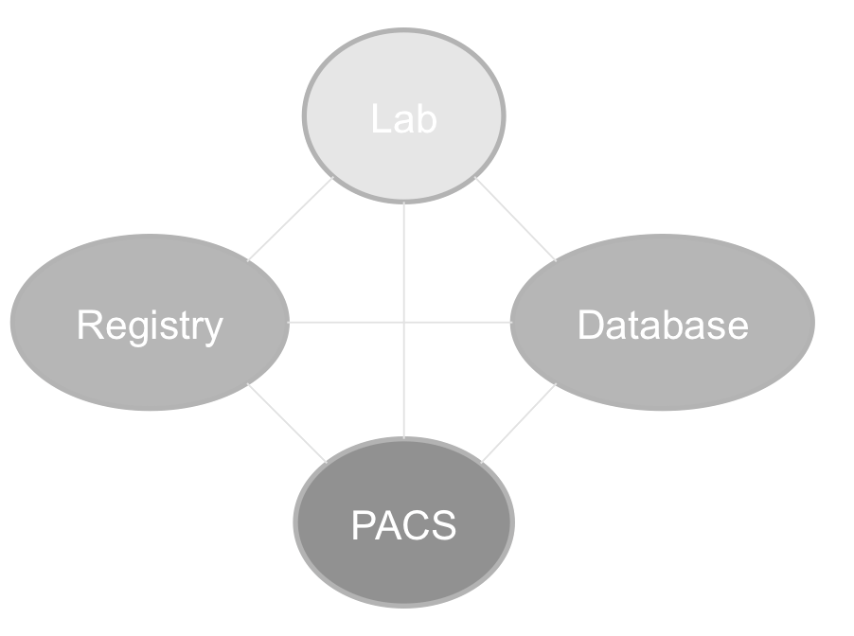
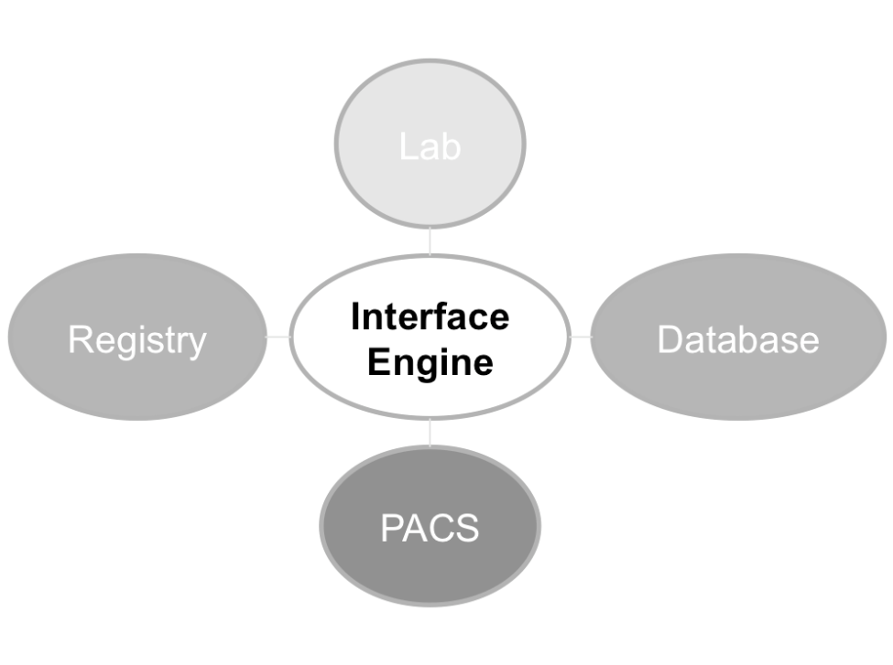
Common Interface Methods
Point-to-point
  Direct connection between each component
Interface engine
  Connected via centralized location
Images Courtesy of Scott Neal.
Notes:
There are two widely-used methods for connecting dissimilar systems in EHR systems: Point-to-Point, in which there is a direct connection between each component, and an interface engine, in which components are connected via a centralized location.
As the image on the left demonstrates, point-to-point integration means ensuring that each separate component can reliably and directly communicate with each other component in the system.
The image on the right illustrates how an interface engine acts as a liaison between each of the four separate components. The interface engine contains all the coding required to facilitate the communication between components.
Now let’s talk about both in more detail.

Slide 7
Interface Method:
Point-to-Point
Traditional method
Requires that each component have direct connection points to other components
Disadvantages: labor-intensive to set up and maintain; can require a large number of connections
Advantage: direct, secure linkage
Notes:
Point-to-point interfacing is the traditional method for integrating healthcare applications. As I just mentioned, it requires that each software component establish a separate and distinct connection to each other component it needs to communicate with.
Sometimes significant coding is required. Disadvantages of point-to-point integration can include high setup and maintenance costs, as well as the need to maintain an inordinate number of interface points. Despite the disadvantages of point-to-point integration, many hospitals use this method to compensate for a lack of EHR budget money. Point-to-point messaging has the advantage of working very well for ensuring secure transmission of a content package between two stakeholders.

Slide 8
Interface Method:
Interface Engine
Routes data through centralized location, reduces number of separate connectivity points
Advantages
  Flexible, scalable, easier to install and maintain, data consolidation, centralized management
Good option if unable to purchase full-featured EHR.
Older-generation interface engines had disadvantage of high cost
  Long time to build, extensive programming, scripting skills
(Corepoint Health, 2010)
Notes:
An interface engine, on the other hand, allows for the routing of data from dissimilar components through a centralized location. Interface engines bring with them numerous benefits, including flexibility, scalability, ease of installation and maintenance, data consolidation, and centralized management.
Healthcare institutions unable to purchase a full-blown EHR solution can use the interface engine as a launching point for migration to a completely digital computing environment.
Older generations of interface engines sometimes took a long time to build and required extensive programming to communicate effectively with each of the connected applications. This made interface engines costly to develop. Finding people with the particular skillsets to build interface engines to suit your particular needs could also be difficult.

Slide 9
Interface Protocols: Examples
Extensible Markup Language (XML)
Fixed-length formats
Variable-length delimited formats
Java
HL7 (Health Level 7) – widely used in healthcare systems
Notes:
Interface engines today use several different protocols. Some of those include:
Extensible Markup Language, or XML
Fixed-length formats
Variable-length delimited formats
Java
HL7, or Health Level 7
As we stated earlier, building interface engines often proved costly and required extensive programming to achieve. However, over the past decade or so, application integration using HL7 standards has gained wide acceptance and support. Before HL7, interfacing two healthcare applications involved a negotiation that had virtually no ground rules and often was contingent on vendor preference. Today, HL7 provides a common framework, architecture, and, to some extent, vocabulary to tie together the analysis and negotiation process between components within and beyond EHR systems. In today’s lecture, we will look more closely at HL7 as an integration standard since it is so widely used.

Slide 10
Why is HL7 Important?
First standard protocol for communication between EHR components.
Allows for open system architecture (rather than closed/proprietary)
  Interfacing between systems
  Independent of vendor
  New systems can be added without modifying original source code.
Notes:
So why is HL7 important? Largely because it was the first standard protocol for communication between EHR components.
"Closed" or "Proprietary" system coding is generally hidden by the vendor and promotes reliance on single vendors and specific applications and technologies to remain operational.
Following a standard protocol, however, provides you the advantage of being able to connect to any system that supports this particular part of the standard, both now and in the future. Adhering to a standard protocol is called "open system architecture". Open system architecture allows interfacing between systems using appropriate protocols, independent of vendor. When using HL7, the interface allows for numerous systems to be added to a single HL7 feed. New systems can be added without having to modify the original source code.

Slide 11
HL7 as a Protocol
Name “Health Level 7” refers to 7th layer of ISO OSI reference model: “application” layer.
HL7 represents ANSI (American National Standards Institute) at ISO (International Org. for Standardization) for health data.
HL7 messages, version 2 (most widely used)
  Based on messaging protocol.
  Body comprised of many purposed segments, each on own line.
  Segments denoted by 3-letter notation indicating purpose.
Version 3 messages: newer, more object-oriented, use XML to structure data
Notes:
The name "Health Level 7" refers to the seventh, or “application”, layer of the ISO OSI Reference Model. The name indicates that HL7 focuses on application layer protocols for the health care domain, and functions independently of lower levels. HL7 effectively considers all lower layers merely as tools.
HL7, as an organization, represents the American National Standards Institute, or ANSI, for standardizing health data interchange at the International Organization for Standardization, or ISO. The ISO is responsible for promoting international standardization to improve free exchange of goods and services.
To make it easier to send and receive health-care information, the HL7 organization has defined a standard that specifies what types of HL7 messages can be sent, what segments can be included in these messages, and what fields can be included in their segments.
HL7 version 2 messages, which are the most widely used format, are based on the messaging protocol and are comprised of a series of segments, each on its own line and each set up for a specific purpose. For instance, the segment in line 2 of an admission message may denote the patient’s demographic information. In HL7, there are over 100 of these predefined segments, each defined by a three letter acronym indicating that segment's purpose.
We should note that the newer Version 3 messages are more object-oriented and use XML to structure their data. Since Version 2 is most widely used, we will take a deeper look at how those messages work.

Slide 12
What is the HL7 Standard?
Method for moving clinical data between independent medical applications in near-real time
Structured, message-oriented framework for communicating between healthcare applications
Acknowledged healthcare industry standard
Not “plug and play”, but designed to be customizable; local vocabulary often used
(Chaffee, 2004)
Notes:
HL7 has devised a protocol for efficiently exchanging healthcare data between various software components. Named for the organization which developed it, HL7, with its version 2 and now newer version 3 messaging, has become the acknowledged healthcare industry standard, and it is considered the best protocol available for exchanging clinical data among disparate cooperating systems in a healthcare setting.
The HL7 standard defines a method of moving clinical data between independent medical applications in near-real time. HL7 is a structured, message-oriented protocol framework for computer communication between healthcare applications.
Unfortunately, adoption of the HL7 standard does not necessarily equate to “plug and play”, and vendors of healthcare applications more often than not must bend and customize HL7 to meet the needs of each customer and their systems in order to accurately exchange patient data. In fact, HL7 protocols used within an organization often reflect local, non-standard vocabulary, which increases the resources required for implementation and maintenance.

Slide 13
How do HL7 V2 Messages Work?
Sent & received by various EHR applications as requests and updates are made.
3-letter acronym at beginning of first line denotes message type.
Single segment (line) contains many different fields/sub fields separated by delimiters, e.g.:
Delimiter | Used As
Pipe | | Field delimiter
Caret | ^ Sub-field delimiter
Ampersand | & Sub-sub-field delimiter
Tilde | ~ Repeating field delimiter
Backslash | \ Escape character
Table 7.1 Delimiter Uses (Source: Neal, 2012)
Notes:
So how does HL7 work, anyway? Well, we could teach a whole course on understanding and configuring HL7 messages … however, here we will cover a few basic principles.
HL7 messages are sent and received by various EHR applications any time requests or updates are made in the EHR system.
In an HL7 message, the name of each segment is indicated in the first field of the segment, and is always three characters long. Some examples include MSH, PID, NK1, and PV1. Different types of HL7 messages contain different segments.
Dissecting a single segment reveals one to many different fields, or even sub-fields, each separated by a delimiter. Some delimiters include:
| Pipe, which denotes a field delimiter
^ Caret, which denotes a sub-field delimiter
& Ampersand, which denotes a sub-sub-field delimiter
~ Tilde, which denotes a repeating field delimiter
\ Backslash, which denotes an escape character

Slide 14
HL7 V2 Examples
NK1||Smith^John^^^^|SPO||(919)555-5555||EC||||||||||||||||||||
“NK1” = “Next of Kin” segment
“John” = subfield in third field of segment.
5 of first 8 fields of this segment contain data.
Notes:
Here is an example HL7 version 2 message segment. It starts with “NK1”, which is the segment name, followed by a pipe character, which is a delimiter that means the end of the field. “NK1” stands for next of kin, so this segment would denote a close family member and information about their relationship to the patient in question.
Then comes another pipe, indicating an empty field. Next we see a last name “Smith” and first name “John” separated by a caret, indicating that they are sub-fields of the name field, along with several more carets indicating empty sub-fields. After that are various other pipes indicating fields, one of which is obviously a phone number, and many of which are empty. Overall, 5 of the first 8 fields contain data.
Bear in mind this would be one segment in a message of many lines, as part of an admissions message.

Slide 15
Sample full HL7 message
  MSH|^~\&||GA0000||MA0000|199705221605||VXQ^V01|19970522GA40|T|2.3.1|||AL
  QRD|199705221605|R|I|19970522GA05|||25^RD|^SMITH^JOHN^FITZGERALD^JR|VXI^VACCINE INFORMATION^HL70048|^SIIS
  QRF|MA0000||||256946789~19900607~MA~MA99999999~88888888~SMITH^JACQUELINE^LEE~BOUVIER~898666725~SMITH^JOHN^FITZGERALD~822546618
A lot can be gleaned from the first line…
Notes:
Well, that was simple enough. Now let’s examine a sample full HL7 message; in this case, a vaccination history query message.
We see that there are 3 full segments, starting with the codes “MSH”, “QRD”, and “QRF”, and which contain many fields of data.
A lot of information can be determined in the first line of the message, which begins with the code “MSH”, so let’s take a closer look at that on the next slide.

Slide 16
Sample HL7 V2 message
MSH|^~\&||GA0000||MA0000|199705221605||VXQ^V01|19970522GA40|T|2.3.1|||AL
“MSH” denotes “New Message”.
9th field always tells what the message will be, with 2 subsets. “VXQ^V01” = vaccination history query.
Notes:
In an HL7 version 2 message, every new message starts with the three letter acronym “MSH”, so we know this is the first line of a message. There are 14 pipes, which indicate 15 fields overall.
Another characteristic of these messages is that the ninth field in the first line denotes what type of message it is. It always has two subsets, the first of which is a three-letter acronym - in this case, “VXQ”. “VXQ^V01” indicates that this is a vaccination history query.

Slide 17
HL7 V2 Examples (cont’d)
Rest of message:
  QRD|199705221605|R|I|19970522GA05|||25^RD|^SMITH^JOHN^FITZGERALD^JR|VXI^VACCINE INFORMATION^HL70048|^SIIS
  QRF|MA0000||||256946789~19900607~MA~MA99999999~88888888~SMITH^JACQUELINE^LEE~BOUVIER~898666725~SMITH^JOHN^FITZGERALD~822546618
“QRD” = Query definition segment
“QFR” = Segment query filter
Dozens of other segment headers
Notes:
In the subsequent lines, we can learn various characteristics of the query. These 2 lines start with the codes “QRD” and “QRF”.
The code “QRD” tells us this is a “query definition” segment. After the first pipe, the second field contains the date and time on which the query was made; a later field tells us the subject’s name is John Fitzgerald Smith; and so on across several other fields.
The next line is a “QRF”, or segment query filter, which may further provide information regarding the subject’s family, specifics about the type of vaccination history, and so on.
There are dozens of other segment headers that you will encounter as you work with HL7 messages.

Slide 18
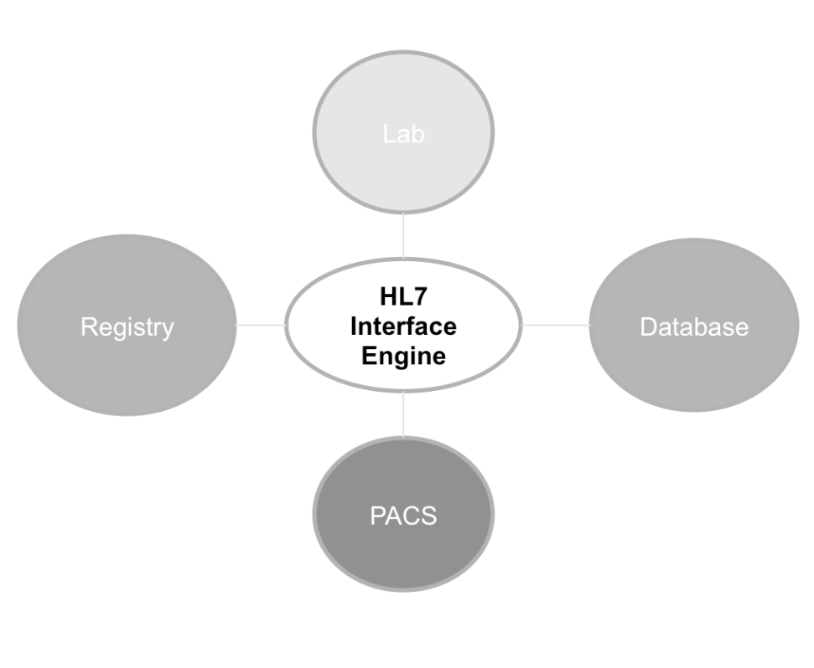
HL7 Interface Engine
Helpful for incorporating EHR into legacy environment.
Different standards: conceptual, document, application, messaging
Flexible, customizable
Image by Scott Neal
Notes:
Many EHR systems and other healthcare tracking systems have made the shift to integrate HL7 standards into their software coding. However, as stated earlier, some legacy systems still have no way to interpret HL7 messages. Incorporating a new EHR system into these environments necessitates an interface engine.
An HL7 interface engine, as we discussed before, is a piece of software which works as a go-between for different systems. Like any other interface engine, it works by monitoring different types of interfaces and communication points and performing actions according to predefined rules.
HL7 engines can be purchased by many vendors and each works with a number of standards (Conceptual Standards, Document Standards, Application Standards, and Messaging Standards). Messaging standards define how information is packaged and communicated from one system to another. Vendors often must customize these engines to the customer’s specific needs, which is why HL7 is such a flexible protocol.

Slide 19
Integration Between EHRs
EHR integration is growing trend.
  “Interoperability”: enabling healthcare entities to share patient information
  Enhancing billing/payment & reform initiatives
  Streamlining workflows between hospitals & clinics
  Meeting HITECH “meaningful use” criteria
Integration is still maturing. More standards and practices are being developed.
(Zywiak, 2010)
Notes:
Industry changes have forced a growing trend among U.S. hospitals to implement integrated electronic health records, or EHRs.
Integrated, or “interoperable”, EHRs are clinical information systems capable of sharing electronic patient information between different record systems.
Integrated systems allow healthcare entities to:
Adequately address billing and other health reform initiatives
Better coordinate care of patients who transition between hospital and ambulatory care venues
Streamline workflows
Meet new HITECH Act meaningful use criteria, which are needed to receive bonus Medicare and Medicaid payments and avoid subsequent payment penalties.
It’s important to note that integration is still maturing, and more standards and practices are currently being developed for integration, including those EHR “meaningful use” criteria being developed at the federal level.

Slide 20
Integration Between EHRs (cont’d)
To demonstrate “meaningful use”, EHRs must be able to exchange information with other certified EHR systems beyond their own environments.
  Also need to link hospital EHR to ambulatory EHRs.
Two methods for interfacing EHRs:
  Point-to-point
  Health Information Exchange (HIE)
Notes:
In order to comply with the latest meaningful use criteria, which stipulate that hospitals must enable their EHRs to exchange data with any certified EHR system, each hospital also needs a technical solution for linking its EHR system with separate ambulatory EHRs.
Currently, two options exist to allow this interconnectivity: point-to-point interfaces and health information exchanges (HIEs).

Slide 21
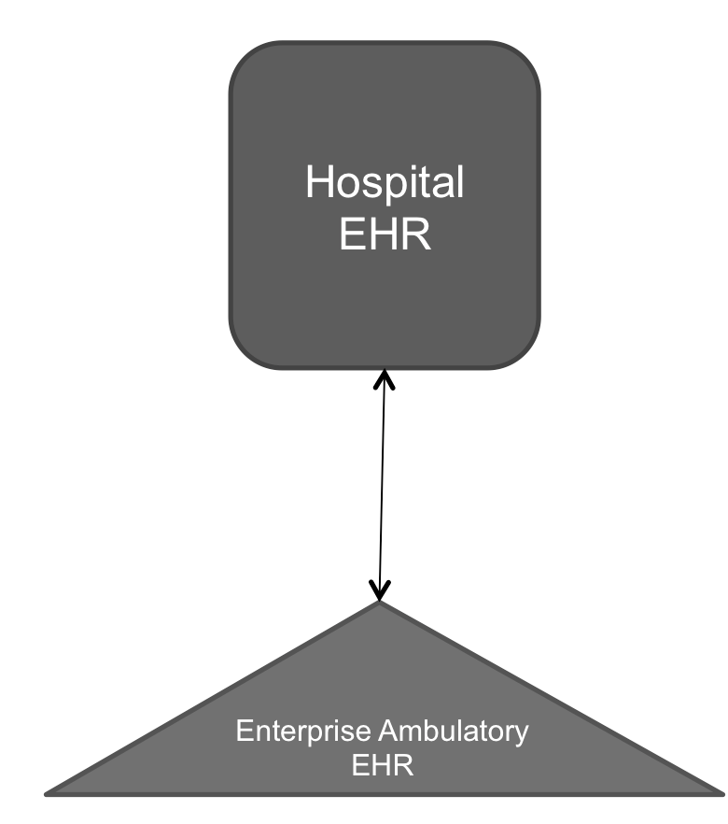
Point-to-Point EHR Interface
Traditional connection method
Connect via variety of media
Drawbacks: cost, customization, high maintenance
Image by Scott Neal
Notes:
Like connecting within EHR systems, point-to-point interfaces are the traditional method of connecting to systems outside the EHR environment as well. They are software-controlled hardware links between each integrated ambulatory or hospital EHRs and the hospital system. Point-to-point interfaces are an established and proven way to exchange data. They can utilize telephone lines for the remote connections, and they are a standard part of EHR vendor software and support product lines.
Difficulties typically include costs, need for custom programming, and the logistical challenge of maintaining point-to-point interfaces between multiple different system products.

Slide 22
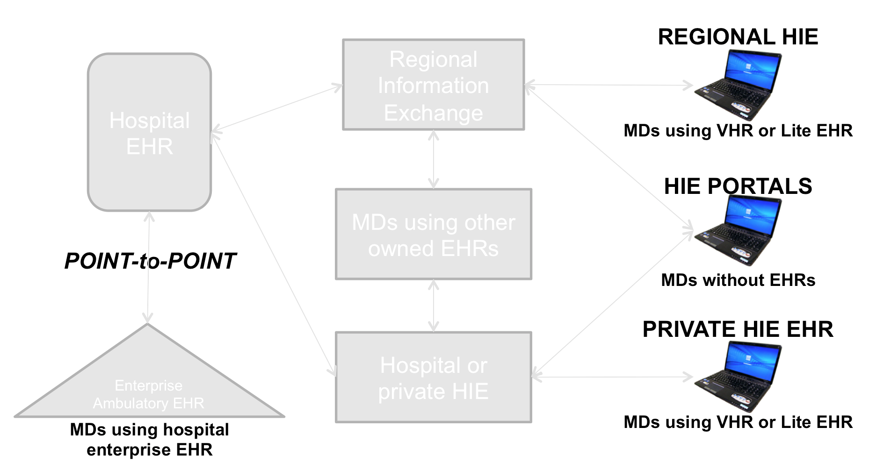
Point-to-Point vs. HIE Interface
Image by Scott Neal
Notes:
As this diagram denotes, Health Information Exchanges, or HIEs, provide the capability to electronically move clinical information among disparate health care information systems while maintaining the meaning of the information being exchanged. Health Information Exchanges act, in a sense, as an interface engine between whole groups of institutions, allowing them to share information more efficiently. The goal of an HIE is to facilitate access to and retrieval of clinical data, and to provide more timely, efficient, effective, equitable, safe, and patient-centered care.
Formal organizations are now emerging to provide both form and function for health information exchange efforts, on independent and governmental or regional levels. Regional Health Information Organizations, or RHIOs, are ordinarily geographically-defined entities which develop and manage a set of contractual conventions and terms, arrange for the means of electronic exchange of information, and develop and maintain HIE standards.

Slide 23
System Interfaces and Integration
Summary
Interface – A point of interaction between components.
Integration – Combining various subsystems into one larger system and ensuring subsystems function together as a whole.
Disparate systems require some way to connect to newer EHR systems to ensure interoperability.
Point-to-point connectivity – Traditional method requiring that each component have direct connection points to other components.
Interface Engines – Allow disparate systems to connect to each other more efficiently via interface that deciphers info from each component.
Notes:
This concludes System Interfaces and Integration
In this unit we learned that:
An interface is a point of interaction between components.
Integration is the process of combining various subsystems into one larger system and ensuring that the subsystems function together as a whole.
Disparate systems require some way to connect to newer EHR systems to ensure interoperability.
Point-to-point connectivity is the traditional method, requiring that each component have direct connection points to other components.
Interface engines allow disparate systems to connect to each other more efficiently through the use of an interface that can decipher information from each of the various components.

Slide 24
System Interfaces and Integration
Summary (cont’d)
HL7 messaging
  Standard of choice for communication between different EHR components.
  Based on messaging standard, uses groupings of segments to relay information throughout EHR system in near-real time.
  Promotes “open architecture”, which allows anyone to interface systems using appropriate protocols, independent of vendor.
Health Information Exchanges (HIE) acts as interface engine between healthcare institutions for an entire region.
Notes:
HL7 has emerged as the messaging standard of choice for communication between different EHR components. It is based on the messaging standard and uses groupings of segments to relay information throughout the EHR system in near real time. It promotes “open architecture”, which allows anyone to interface systems using appropriate protocols, independent of vendor.
A Health Information Exchange, or HIE, acts as an interface engine between healthcare institutions for an entire region.

Slide 25
System Interfaces and Integration
References
References
Adler, K. G. (2005). How to select an electronic health record system. Fam Pract Manag, 12(2), 55-62. http://www.aafp.org/fpm/2005/0200/p55.html
Chaffee, B. W., & Bonasso, J. (2004). Strategies for pharmacy integration and pharmacy information: Technical aspects of interfaces. Am J Health Syst Pharm. 61(5). http://www.medscape.com/viewarticle/471252
Corepoint Health. (2010). The role of an interface engine in modern healthcare. http://www.healthitoutcomes.com/doc/the-role-of-an-interface-engine-in-modern-0003
DeSonier, N. (2006). What is cardinality in HL7? HL7standards.com. http://www.hl7standards.com/blog/2006/11/02/what-is-hl7-cardinality/
Zywiak, W., & Drazen, E. (2010). Integrating EHRs: Hospital trends and strategies for initiating integrated EHRs within their communities. CSC.com. http://docplayer.net/2839160-Integrating-ehrs-hospital-trends-and-strategies-for-initiating-integrated-ehrs-within-their-communities.html
  Charts, Tables Figures
  7.1 Table: Neal, S., 2012.
Notes:
No audio.

Slide 26
System Interfaces and Integration
References – 2
Images
Slide 6: Illustrations of point-to-point & interface engine. Images courtesy of Scott Neal.
Slide 18: HL7 interface engine. Image courtesy of Scott Neal.
Slide 21: Point-to-point EHR interface. Image courtesy of Scott Neal.
Slide 22: Point-to-point vs. HIE EHR interfaces. Image courtesy of Scott Neal.
Notes:
No audio.

Slide 27
Installation and Maintenance of
Health IT Systems
System Security Procedures and Standards
Lecture a
This material was developed by Duke University, funded by the Department of Health and Human Services, Office of the National Coordinator for Health Information Technology under Award Number IU24OC000024. This material was updated in 2016 by The University of Texas Health Science Center at Houston under Award Number 90WT0006.
Notes:
No Audio.

