Slide 1
Installation and Maintenance of Health IT Systems
Elements of a Typical Electronic Health Record System
Lecture b
This material (Comp 8 Unit 1) was developed by Duke University, funded by the Department of Health and Human Services, Office of the National Coordinator for Health Information Technology under Award Number IU24OC000024. This material was updated in 2016 by The University of Texas Health Science Center at Houston under Award Number 90WT0006.
This work is licensed under the Creative Commons Attribution-NonCommercial-ShareAlike 4.0 International License. To view a copy of this license, visit http://creativecommons.org/licenses/by-nc-sa/4.0/.
Notes:
Welcome to Installation and Maintenance of Health IT Systems, Elements of a Typical EHR system, this is lecture b.
This component covers fundamentals of selection, installation and maintenance of typical Electronic Health Records (EHR) systems.

Slide 2
Installation and Maintenance of Health IT Systems
Learning Objectives
Identify the core elements that comprise an EHR system (Lecture a)
Describe the use of client and server hardware for access to and storage of EHRs (Lecture a, b)
Describe network needs for access to and storage of EHRs (Lecture b)
Identify the application software and back-end data storage software needed for a comprehensive, effective health IT System (Lecture a, b)
Notes:
The objectives for this unit are to:
Describe the use of client and server hardware for access to and storage of EHRs
Describe network needs for access to and storage of EHRs
Identify the application software and back-end data storage software needed for a comprehensive, effective health IT system
In lecture b, we will continue with outlining the types of network elements an EHR system needs to function, as well as its typical hardware and software components that are needed to make a typical EHR function.
We will also take a closer look at the client-server model and further define each of their respective roles.
Lastly, we will give a brief overview of a network and outline the network needs for a typical EHR.

Slide 3
Typical Server Elements
Types of servers:
  Application server: computer on which the EHR/PM (Practice Management) application resides
  Database server: computer on which the database software resides
  Citrix or terminal server: computer that supports thin client network
Application, database, and terminal services may reside on the same computer for small installations (<10 users)
(Kleaveland)
Notes:
Different types of server elements combine to make an EHR system. Typical server elements include:
An application server (or group of servers) which houses the EHR or patient management application.
A database server where compiled patient data is stored.
A Citrix or terminal server or servers which support thin clients. Thin clients are computers that require the server to fulfill much of the system’s functional role. A computer terminal is an example of a thin client. It holds no real computational programming. Instead, it is programmed only to focus on graphically displaying information requested from the server by the user.
In some cases, application, database, and terminals services may reside on the same computer system. However, due to the potential performance requirements of each service, this is not recommended except in the smallest of workplace environments.

Slide 4
Server Software Elements of the EHR
IOM: Eight Core Components
  Health information in database
  Results management
  Order entry and management
  Decision support
  Electronic communication/connectivity
  Patient support
  Administrative processes
  Reporting and population health management
(Torrey, 2011)
Notes:
The Institute of Medicine lists eight crucial core server elements for an EHR system. These include:
Health information and data storage component - that would be a database or a series of databases
Results management, which is, essentially, software that actively manages the results - particularly lab & radiology results - that come into the EHR to assure that they are seen & dealt with appropriately by the clinician.
Order entry and management, which is designed to effectively route clinician orders to the proper destinations.
Decision support, which is a computer logic that presents information to help clinicians make correct decisions, such as displaying relevant reference information on the screen while orders are written or popping up warnings if a drug order appears inappropriate based on a patient's known allergies.
Electronic communication and connectivity software, which allows the various applications to “talk” efficiently to one another over a network.
Patient support
Administrative processes and
Reporting and population health management software
Vendors often supply additional modules and components customized to meet the specific needs of individual organizations and practices.

Slide 5
EHR Clients
EHR systems make medical records available to multiple simultaneous users.
Tablets, laptops, and PCs allow instantaneous access by healthcare staff as they move around health centers.
Clients use application software to securely connect to and pull data from the EHR server to fulfill user requests.
Notes:
We’ve defined servers and their role. So what does a client do?
EHR systems make medical records available to multiple simultaneous users. Tablets, laptops, and PCs allow instantaneous access for the healthcare staff who move around in the health centers.
A client uses client application software to securely connect to and pull data from the EHR server to fulfill user requests. After receiving the requested data, the client software then organizes and displays the data in a manner that the user can efficiently view.
Using an EHR system to read and write to a patient's record not only is typically done through a workstation but, depending on the type of system and health care setting, may also be possible via mobile devices that are capable of interpreting handwriting.

Slide 6
EHR Hardware – Defined
Hardware is:
  the physical components that make up a computer system.
  necessary to make the computer work and run properly.
Notes:
Let’s talk briefly about hardware found in an EHR system.
As we defined in the previous half of the lecture, hardware can best be described as the nuts and bolts that make things work. The physical components of servers, workstations, laptops … the containers and all the components that reside inside them are all hardware, as are printers, scanners, routers, switches and even the cables that connect the devices themselves.
Having the proper hardware to run your EHR system is just as important as the software components. Without the proper hardware, the system may not run as efficiently and may exhibit compatibility issues.

Slide 7
EHR Hardware – Most Common
Servers
Workstations
Laptops
Tablets
PDAs/smartphones
Flat-panel monitors
Scanners
Printers
Storage and backup
Shredders
Medical diagnostic and treatment items
Notes:
Some of the hardware components most often attributed to EHR systems include:
Servers, workstations, laptops and tablets, PDAs (also known as Portable Digital Assistants) and smart phones, flat panel monitors, scanners, storage and backup devices (including tape drives), shredding devices, and medical diagnostic and treatment devices.
These are just some of the major hardware components you’ll find in an EHR system and the network it operates on.

Slide 8
EHR Hardware – Servers
The server(s) are the “home base” of the core EHR system, with components including:
  Storage of patient database (index)
  Real-time, dynamic compilation of patient information from varied sources
  Modules for parsing user requests
  User management tools
  Customization tools
Notes:
A server, in the hardware sense, is a computer designed to efficiently run server applications. In the EHR arena, that includes the patient index (where patient data resides), the patient management software, and various modules designed for the parsing of user requests. They also may house user management tools for making administrative changes to the software, including updates and error correction.

Slide 9
EHR Hardware – Servers (cont’d)
Picking the right server
  Consult your IT staff, hardware & EHR vendor(s), and/or consultant to determine the hardware specs required for your organization.
  Important items to consider include:
    Reliability
    Performance
    Scalability
Notes:
As stated earlier, a server essentially “serves” other computers on the network. It typically houses applications and databases required by desktops or laptops to access information or run centralized programs. Because servers are a critical infrastructure component, they are usually located in a protected environment not generally accessible to the general public. Servers are expected to run pretty much continuously throughout their entire life cycle.
Most enterprise-level servers are known to be very fault tolerant and come with built-in redundant hardware systems to ensure reliable operation. In many healthcare environments, even a short-term failure can be more costly than the purchase and installation of such a system. Most of these systems come with “hot swappable” accessories (parts that can be changed out without turning off the server) to minimize downtime due to failure or maintenance.
Servers come in all shapes and sizes. You should consult your IT staff, hardware & EHR vendor(s), and/or consultant to determine the hardware specs required for your organization. In general, your server should be extremely reliable, with as many built-in redundancies as possible to minimize system downtime. This is particularly important in acute-care settings.

Slide 10
EHR Hardware – Servers
(cont’d – 2)
Storage requirements depend on EHR/PM application, volume of scanned documents
  Check with your EHR vendor.
  Rule of thumb: 5 GB/year/provider
  (Kleaveland)
Notes:
Data storage is a critical component you will have to address when deciding on the installation of an EHR system.
The storage requirements of an EHR system are largely dependent on the specific EHR/PM (patient management) application and the volume of scanned documents. For a typical practice, a rule of thumb is to expect 5 GB per year per provider. It’s important to discuss your patient load with your vendor to determine your short- and long-term storage capacity needs.

Slide 11
EHR Hardware – Servers
(cont’d – 3)
Purchase considerations
  Brand
    e.g. Dell vs. “white box”
  Operating system (OS)
    e.g. Windows 8 or 10 or Linux
  Processors
    e.g. Intel® Core™ i7-7700 Processor
    (8M Cache, up to 4.20 GHz)
Notes:
Some things to consider when choosing a server include:
The brand: Is the brand of server considered reputable? How are the reviews for the particular model you are looking at? Do they provide a warranty consistent with the institution’s needs?
The Operating System (OS): Is the server designed to work well with the operating system needed to run the EHR software?
The processors and processing speed: The higher the processing speed, typically the faster the computer can make computations. Are the processor specs in line with the EHR requirements?

Slide 12
EHR Hardware – Servers
(cont’d – 4)
Purchase considerations (cont’d)
  RAM
    e.g. 8 GB
  Hard drive configuration
    e.g. RAID or network storage
  Network card
    e.g. 1 GB/second or higher
  Accessories: monitor, keyboard, CD/DVD drive, UPS (Uninterruptible Power Supply)
Notes:
Additional items to consider:
RAM (Random Access Memory) - that’s the “working memory” of the computer. Computers use RAM to store short term computations. Additional RAM allows a computer to work with more information at the same time which can have a dramatic improvement in total system performance.
The hard drive configuration is important too – Is there enough hard drive space to accommodate our expanding storage needs over the next year? How about the next 5 years? Will it support redundant hard drive configurations, such as RAID, bearing in mind that many RAID configurations dramatically increase the amount of hard drive space needed?
The network card – Does the network card adequately support the amount of network traffic expected on the server? Is there the capacity to add an additional network card or cards and options for load balancing?
Last but not least, think about other accessories for your server including the Monitor, keyboard, CD or DVD drives, and UPSs or Uninterruptible Power Supply in case of power outages.

Slide 13
EHR Hardware – Servers
(cont’d – 5)
Category | Internal | External/Hosted
Cost | Higher initial costs | Monthly fees
Management | Need staff to implement & manage server(s), perform software/hardware maintenance & backup | Dependent on vendor for scheduled maintenance
Power | Capable of utilizing full power of server | Often share resources with other institutions
Connectivity | Control speed & connectivity to server(s) | Remote locations, so connectivity may be shared with other customers, reducing speed
  1.1 Table: EHR Hardware-Servers (Neal, 2011)
Notes:
For smaller practices, the added costs of a server infrastructure may not be warranted. Hosted solutions are available for such situations. When considering a hosted solution, these variables should be considered:
The cost
Internal servers mean higher initial costs, but external or hosted servers means monthly fees. Consider whether monthly fees will outpace the costs of purchasing and maintaining an in-house infrastructure.
Management
Internal servers mean staff is needed to implement and manage them and perform software and hardware maintenance and backup duties. External or hosted servers means the customer is dependent on the vendor for scheduled maintenance.
Power
With internal servers, your organization is capable of utilizing the full power of the server, whereas with external or hosted solutions, customers often share resources, and
Connectivity
Internal servers give your institution ability to control the speed of and connectivity to the server(s). External or hosted servers are in remote locations, and connectivity means they may be shared with other customers, reducing the speed available to you.

Slide 14
EHR Hardware – Clients
Fixed workstations
  Connected to server via wired network
  Strategically positioned throughout work environment to facilitate convenient access
  Most commonly used and often already in place
  Economical
Notes:
Let’s take a couple minutes to discuss client hardware.
Fixed workstations are one of the most prevalent client systems in today's healthcare settings. A typical workstation is a high end microcomputer connected to the computer network via a wired (cabled) interface and intended primarily to be used by one person at a time. Workstations ( also known as desktops) can run a variety of operating systems, including Windows 2000, Windows XP, Windows Vista, Windows 7, and some flavors of Linux.

Slide 15
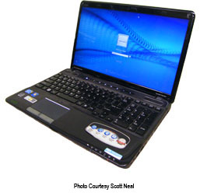
EHR Hardware – Clients (cont’d)
Mobile computers
  Laptops: physical keyboards; input generally via keyboard or mouse/touchpad, no touch option
  Tablets: data entry & navigation including touch input, via stylus / electronic pen or finger
    Slates
    Convertibles
    Booklets
  Connect wirelessly to the network
  Use rechargeable batteries
(Neal, 2011)
Notes:
Generally, a laptop, or notebook, is a portable computer with a traditional screen (without touch input) and physical keyboard, meaning input methods are similar to a fixed workstation and generally consist of keyboard and mouse/touchpad.
A tablet, on the other hand, is a portable computer equipped with a touch screen and, in some cases, a stylus and intended to offer an even more mobile computer for when laptops are impractical or unwieldy or do not provide the needed functionality. Tablets usually use a wireless interface to connect to the network.
There are three types of tablets available:
Slate tablets, which resemble writing slates, are tablets without a dedicated keyboard. For text input, users rely on handwriting recognition software via an active digitizer, or touching an on-screen keyboard using fingertips or a stylus.
Convertible tablets have a base body with an attached keyboard. Typically, the base of a convertible attaches to the display at a single joint called a swivel hinge or rotating hinge to allow for a 180 degree range of rotation. This type of tablet is pictured on this slide.
Booklet tablets have two separate screens and fold like a book.
Both laptops and tablets make use of rechargeable batteries to allow for several hours of extra mobility in the workplace without the use of a power cord.

Slide 16
EHR Hardware – Clients
(cont’d – 2)
Mobile computers (cont’d)
  Advantages
    Additional mobility compared to workstations
    Save time
    Can be cheaper if additional infrastructure such as ports are needed
  Disadvantages
    Typically more expensive than fixed workstations
    Subject to theft
    Easily broken
    Require additional support, cleaning, maintenance
Notes:
Tablets and laptops offer several advantages, as well as a few disadvantages, when compared to workstations.
Advantages of laptops and tablets include:
Additional mobility compared to workstations
Time savings by providing a data interface at the provider’s fingertips, negating the need for frequent trips to a workstation.
Cost savings if additional infrastructure such as ports are going to be needed for additional workstations.
Disadvantages of laptops and tablets include that they are:
Typically more expensive than workstations
Subject to theft given their small size
Likewise, easily broken – The average lifespan for a laptop or tablet is about three years.
And laptops and tablets generally need some sort of additional support, cleaning, and maintenance.

Slide 17
EHR Hardware –
PDAs and Smart Phones
Smart phones & Personal Digital Assistants (PDAs) combine computing and networking / cellular features into a personalized unit.
  Like tablets, mostly pen-based, using stylus for input rather than keyboard
  Allow users to access patient data remotely, from any location with network connectivity
  Similar advantages & disadvantages as laptops & tablets
  May require additional hardware/infrastructure resources
Notes:
Smart phones and Personal Digital Assistants (PDAs) are devices that combine computing, telephone, and networking features.
Like tablets, most PDAs are pen-based, using a stylus rather than a keyboard for input.
PDAs and smart phones allow users to remotely access patient data from any location with connectivity. They usually also contain other software specific to the user’s tastes.
They offer similar advantages & disadvantages to laptops & tablets. Many providers incur the expense of a mobile device since they support personal notes and applications, phone capabilities, and calendar.
Integrating PDA and Smart Phone support into the existing computer environment may require additional hardware and other infrastructure resources.

Slide 18
Network
Collection of computers and devices connected by communication channels
Allows users to communicate and share resources with other users
Important terms
  Network Medium; Ethernet; Wireless Access Point (WAP); LAN (Local Area Network); WLAN (Wireless Local Area Network); WiFi; WAN (Wide Area Network); Point-to-point or fractional T1; Bandwidth; VPN (Virtual Private Network); Firewall
Notes:
Let’s discuss briefly the network the EHR system will sit on and use to communicate with its users.
First, let’s define a network.
A network, quite simply, is a collection of computers and devices connected by communications channels that facilitates communications among users and allows users to share resources with each other.
Network devices (also known as nodes or resources) such as servers, desktops, printers or laptops must be connected through some sort of network medium. There are several types of media that can be used. The most commonly used media in today’s networks include unshielded twisted pair wiring for Ethernet networks, fiber channel (using fiber optic cabling) for network backbones, and radio signals…often referred to as RF or Radio Frequency for 802.11 wireless networks. Other frequently deployed devices used on a network to control network traffic would include hubs, switches, bridges, and/or routers.
Most of today’s local networks use wired cabling and a protocol called “Ethernet” to communicate between the various components. There are other protocols that could be used. “WiFi”- also known as” 802.11,” is another popular wireless protocol in use today. WiFi is used by laptops and other wireless LAN devices to send data through the air to connect to the wired network. Wireless networks must be connected to the wireless network using Wireless Access Points or WAPS. A WAP is basically a device capable of receiving and transmitting radio signals using the 802.11 protocol to connect to wireless devices. Many Access Points may be needed to ensure connectivity to a network.
Some additional terms to know include:
• LAN or Local Area Network – connects workstations and servers within a single demographic location
• WLAN or Wireless Local Area Network – current most common technology referred to as “WiFi”
• A WAN on the other hand, or Wide Area Network, connects workstations across multiple locations, often great distances
• Another term to be aware of is Point-to-point T1 and fractional T1. These are all dedicated broadband lines that connect locations in a WAN
• Bandwidth – That’s the rate of data transfer, usually measured in bits per second
• A VPN or Virtual Private Network is a way of securely accessing a specific network over the internet
• Firewall is software or hardware that prevents unauthorized access to a network; monitors network traffic; may include VPN, virus scanning

Slide 19
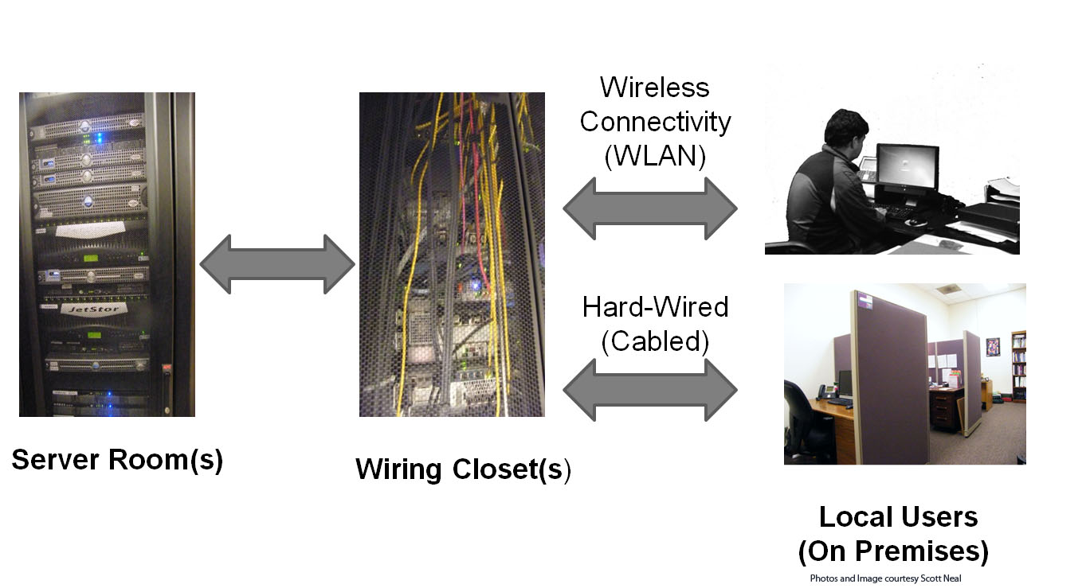
Local Area Network (LAN)
(Neal, 2011)
Notes:
As this slide illustrates, a local area network is defined by a single demographic location consisting of, typically, a building, or grouping of buildings which are supported by a single network. Here, server rooms, wiring closets and individual desktops and laptops are connected through a variety of methods to comprise a Local Area Network.

Slide 20
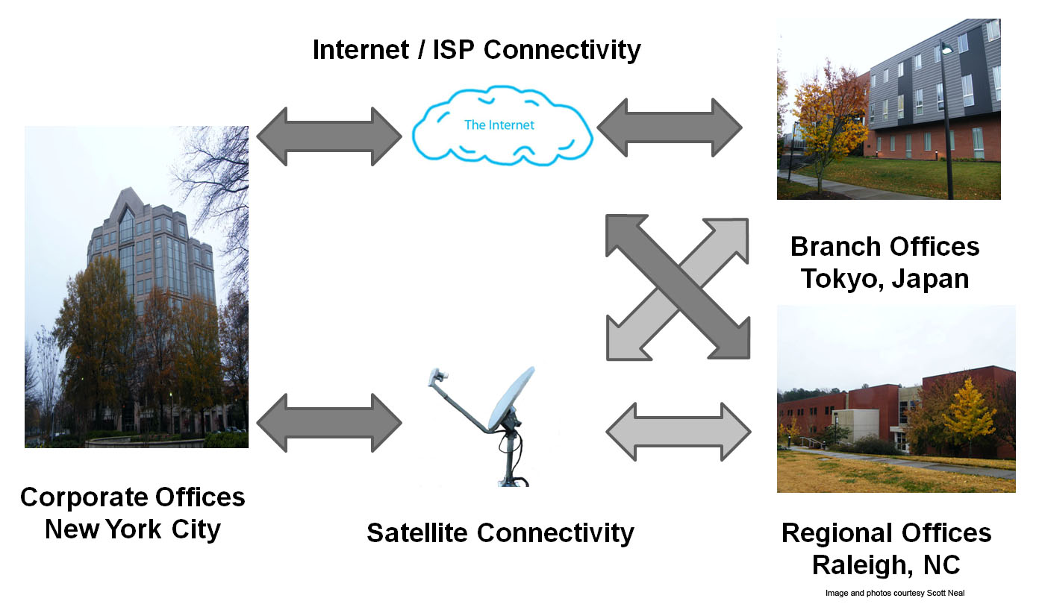
Wide Area Network (WAN)
(Neal, 2011)
Notes:
A wide area network (WAN) on the other hand is usually used for connecting computers and other network resources, spanning a wide geographical area. WANs can be used to connect cities, states, or even countries, often using a variety of methods to ensure redundancy or security. In this instance, the corporate offices are connected to both its regional offices in Raleigh, North Carolina, and its Tokyo branch office through its Wide Area Network.

Slide 21
Network – Assessing Usage
Must be able to support data requirements of EHR application
Insufficient capabilities will degrade application performance and increase risk of user rejection
Notes:
Your network infrastructure must be able to reliably support the data requirements of your EHR application.
Insufficient network capabilities will degrade application performance and increase the risk of user rejection.

Slide 22
Network – Assessing Usage
(cont’d)
Considerations
  How many users will need simultaneous access to the network?
  Bandwidth requirements of the EHR system (per vendor)
    Special bandwidth needs of scanning equipment or other medical equipment
  Sufficient connectivity between internal and remote resources such as satellite facilities
Notes:
Some things to consider when assessing network usage:
For instance, how many users will need simultaneous access to the network?
And, what are the bandwidth requirements (the flow of data that can traverse the network at a given moment) of the EHR system, per the vendor?
In particular, special bandwidth needs of scanning equipment and other medical equipment factor into this equation as well. This is a question for our vendor.
Also, sufficient connectivity between internal resources and remote resources such as satellite facilities

Slide 23
Network – Assessing Usage (cont’d – 2)
Conduct a wireless connectivity survey
Explore remote connectivity options, including VPN (Virtual Private Networks)
Notes:
In most healthcare settings today, the wireless network has become a prominent medium for connecting a wide range of devices to the EHR system, making access to patient records even more efficient.
Before adding additional wireless infrastructure to your system, be sure you have adequately addressed these wireless needs … for the short and long term. Because many IT departments have limited experience at deploying wireless systems in an enterprise environment, it’s important to have a consultant conduct a wireless connectivity survey to ensure adequate coverage throughout the entire facility and to adequately address any potential wireless bandwidth issues.
Also, as demand for remote off-site access continues to grow, be sure to explore with your vendor how efficiently the EHR system will integrate with your existing VPN network.

Slide 24
Elements of a Typical Electronic Health Record System
Summary
Hardware vs. Software
Servers – Securely Store patient data and parse requests.
Clients
  Desktops and laptops
  Mobile devices/ phones
LAN vs. WAN Networks
Notes:
Let’s summarize what we have learned so far:
Clients, servers and the network infrastructure all work in concert to provide functionality of a typical EHR system.
Hardware in the computing world represents the physical devices while software describes the written code used to create the various operating systems, applications and device drivers needed to input, compute, and output data.
A server is generally more robust than a typical client system and is designed for multiple user connections. Servers serve many functions but more often than not are warehouses for much if not all of the patient data retrieved by client applications. Client systems could be desktops, laptops, PDAs, or even smart phones.
A network could be defined in local terms (called a LAN) or encompassing a wide geographical area (called a WAN) and can use a variety of protocols to transmit data including popular protocols such as Ethernet and Wi-Fi. Network capacity and usage requirements should always be considered when considering integrating an EHR into an existing computing environment.

Slide 25
Elements of a Typical Electronic Health Record System
References – Lecture b
References
Kleaveland, B. EHR Implementation: What you need to know to have a successful project: Part 2. Retrieved from physicianspractice.com: http://www.physicianspractice.com/files/audioconference/pdfs/id_7.pdf?CFID=1675309&CFTOKEN=75588070
Torrey, T. (2011, April 11). What is an EMR (Electronic Medical Record) or EHR (Electronic Health Record)? Retrieved June, 2011, from patients.about.com: http://patients.about.com/od/electronicpatientrecords/a/emr.htm
Wikipedia. Thin Client. Retrieved from Wikipedia.com: http://en.wikipedia.org/wiki/Thin_client
Notes:
No audio

Slide 26
Elements of a Typical Electronic Health Record System
References – Lecture b (cont’d)
Images
Slide 15: Laptop. Courtesy Scott Neal. Used with permission.
Slide 19: Local Area Network (LAN). Courtesy Scott Neal. Used with permission.
Slide 20: Wide Area Network (WAN). Courtesy Scott Neal. Used with permission.
Charts, Tables, Figures
  1.1 Table: Neal, Scott. EHR Hardware – Servers. Used with permission.
Notes:
No audio

Slide 27
Installation and Maintenance of
Health IT Systems
Elements of a Typical Electronic
Health Record System
Lecture b
This material was developed by Duke University, funded by the Department of Health and Human Services, Office of the National Coordinator for Health Information Technology under Award Number IU24OC000024. This material was updated in 2016 by The University of Texas Health Science Center at Houston under Award Number 90WT0006.
Notes:
No Audio.

