Slide 1
Installation and Maintenance of Health IT Systems
Elements of a Typical Electronic Health Record System
Lecture a
This material (Comp 8 Unit 1a) was developed by Duke University, funded by the Department of Health and Human Services, Office of the National Coordinator for Health Information Technology under Award Number IU24OC000024. This material was updated in 2016 by The University of Texas Health Science Center at Houston under Award Number 90WT0006.
This work is licensed under the Creative Commons Attribution-NonCommercial-ShareAlike 4.0 International License. To view a copy of this license, visit http://creativecommons.org/licenses/by-nc-sa/4.0/.
Notes:
Welcome to Installation and Maintenance of Health IT Systems, Elements of a Typical EHR system, This is lecture a.
This component covers fundamentals of selection, installation and maintenance of typical Electronic Health Records (EHR) systems.

Slide 2
Elements of a Typical Electronic Health Record System
Learning Objectives
Identify the core elements that comprise an EHR system (Lecture a)
Describe the use of client and server hardware for access to and storage of EHRs (Lecture a, b)
Describe network needs for access to and storage of EHRs (Lecture b)
Identify the application software and back-end data storage software needed for a comprehensive, effective health IT system (Lecture a, b)
Notes:
Today’s first lecture, Health IT System Elements, is designed to give you a brief overview of a typical Electronic Health Record (or EHR) system. We will discuss the Institute of Medicine’s six aims for improving healthcare, what an EHR is, and how it has evolved. Additionally, we will outline the types of network elements an EHR system needs to function, as well as its typical hardware and software components.
The objectives for this unit are to:
Identify the core elements that comprise an EHR system
Describe the use of client and server hardware for access to and storage of EHRs
Describe network needs for access to and storage of EHRs
Identify the application software and back-end data storage software needed for a comprehensive, effective health IT system

Slide 3
Why Implement an EHR?
“Information technology … holds enormous potential for transforming the health care delivery system”
- Institute of Medicine (IOM), Crossing the Quality Chasm, 2001
Notes:
The Institute of Medicine, also referred to as the “IOM,” is an independent organization which works to improve healthcare at the national level by delivering unbiased, evidence-based healthcare advice.
According to a report completed by IOM In 2001, the United States ranked 37th worldwide for quality of healthcare. That same year, the Institute of Medicine compiled a report listing 13 recommendations designed to revamp the nation’s healthcare system. One of these core recommendations was a call for a renewed effort on the part of the government and private sectors to build an information infrastructure to support healthcare delivery, community health, quality measurement and improvement, public accountability, and improving research and clinical education.
The committee further noted that “information technology … holds enormous potential for transforming the healthcare delivery system” and challenged the healthcare arena to virtually eliminate handwritten clinical data by the end of the decade.
The Electronic Health Record, or EHR, system, though not born from this effort, certainly has seen renewed life and product evolution as the healthcare arena struggles to meet the IOM’s challenge to improve healthcare delivery on a national scale. In 2007-08, surveys of ambulatory practices indicated that only 4% had a “fully functional” electronic records system and another 13% had a “basic” system.
As of 2014, a majority of office-based physicians have adopted electronic health records (EHRs). By the end of 2014, about 8 in 10 (83%) of office-based physicians had adopted any EHR and about half (51%) adopted a "Basic EHR". Since 2008, office-based physician adoption of any EHRs has nearly doubled, from 42% to 83%, while adoption of Basic EHRs has nearly tripled from 17% to 51%.

Slide 4
A New Health System for the 21st Century
IOM (2001): Six aims for improving health care quality
  Safe
  Effective
  Patient-centered
  Timely
  Efficient
  Equitable
(IOM, 2001)
Notes:
The IOM listed six aims in improving health care quality:
1.To make healthcare environments safer for their patients
To provide more effective healthcare
To make healthcare more patient-centered - that is, to ensure that the patient is more involved in the decision-making process and has a better understanding of the healthcare choices available
To improve the timeliness of healthcare service
To make the process of providing healthcare, as a whole, more efficient
To work toward the elimination of healthcare disparities among diverse populations … ensuring that all patients have equal access to healthcare
Throughout the remainder of our course, think about each of the EHR systems you will be evaluating and ask yourself how each of them adequately addresses these six aims.

Slide 5
Patient Record System
IOM (1991): Any “patient record system” includes:
  People
  Data
  Rules and procedures
  Processing and storage devices
  Communication and support facilities
(Dickinson et al, 2003)
Notes:
So, what is an electronic health record anyway?
According to the Computerized Patient Record , published in 1991 by the Institute of Medicine, an electronic health record system is defined as “The set of components that form the mechanism by which patient records are created, used, stored, and retrieved.” A patient record system is usually located within a health care provider setting. It includes people, data, rules and procedures, processing and storage devices (e.g., paper and pen, hardware and software), and communication and support facilities.”

Slide 6
Core EHR Functions: US Government
Orders for therapies (e.g. medications)
Orders for tests
Reporting of test results
Physician notes
(Torrey, 2011)
Notes:
The federal government has defined a complete EHR system as containing four basic functions: computerized orders for prescriptions and other therapies, computerized orders for tests, reporting of test results, and physician notes.

Slide 7
Core EHR Functions: IOM
Provides longitudinal health data on individuals
Provides immediate, yet secure, electronic access
Provides knowledge to enhance quality, safety, and efficiency of care
Supports efficient processes of care
(Dickinson et al, 2003)
Notes:
Likewise, the Institute of Medicine has also listed the key capabilities any EHR system should address as “(1) a longitudinal collection of electronic health information for and about persons, where health information is defined as information pertaining to the health of an individual or the health care provided to an individual; (2) immediate electronic access to person and population-level information by authorized, and only authorized, users; (3) provision of knowledge and decision-support that enhance the quality, safety, and efficiency of patient care; and (4) support of efficient processes for health care delivery.”
It is important to note these definitions while evaluating your present and/or prospective EHR systems … since an effective EHR system will ultimately be judged by how well it can adequately address and satisfy all these objectives.
I will also note that when we talk about longitudinal data, collection involves repeated observations of the same items over long periods of time — often many decades.

Slide 8
EHR Systems: Then and Now
The early years
  Earlier EHR systems required extremely expensive computer hardware.
  Core components usually ran on UNIX and often incurred high training costs.
  Rapid progression of technology meant technology was outdated almost as soon as it was installed.
(Pawola, 2011; Medical Software Associates)
Notes:
The Electronic Health Record, or EHR, is just the latest chapter in an evolutionary process which can be traced as far back as the early 1960s.
The development of the electronic patient record began when El Camino Hospital, teamed up with Lockheed Corporation to create a new way and more effective method of tracking patient data. Together, they spent over two years analyzing their operational data flow in order to develop a way of electronically storing and updating patient information. This system began to go live in 1973 and the first computerized Patient Record (or CPR) system was born. These earlier versions of electronic health records required hospitals to invest in expensive computer hardware running UNIX. El Camino’s CPR ran on an IBM mainframe computer. Typically, these systems were powerful, but somewhat limited, and training costs associated with running these systems were prohibitively high.
Several institutions attempted their own versions of CPRs during the 70s and 80s, but overall, successful implementation was quite difficult and rarely achieved.

Slide 9
EHR Systems: Then and Now (cont’d)
The 1990s
  Improvements in computing power and connectivity spurred progress.
  EMRs began to be adopted by some practices.
  Rapid progression of technology meant technology was outdated almost as soon as it was installed.
(Pawola, 2011; Medical Software Associates)
Notes:
In the 1990s, however, computer technology was experiencing significant advances and processing power became more abundant. Additionally, the IT industry began moving toward large scale communication networks and distributed computing models, lifting many of the limitations seen in earlier CPR technology. Ambulatory clinics began utilizing Electronic Medical Records (or EMRs) during this time as well; however, despite software improvements, adoption rates were comparatively low. This was partly due to the rapid technological advancements in computer and software technologies which frequently made EMR systems obsolete right out of the box. Additionally, usability issues often made adoption very difficult, particularly for smaller institutions with limited resources.

Slide 10
EHR Systems: Then and Now (cont’d - 2)
Now
  Fast, low-cost PCs, tablets, and systems permeate the workplace, often less than $500 each.
  Improved network protocols make updating and maintenance easier and more cost-effective.
  Ubiquitous, easy to use graphical systems reduce training costs.
(Pawola, 2011; Medical Software Associates)
Notes:
By about 2000, however, PCs, as well as tablets and other hand-held computers low costs and ubiquity lowered barriers for adopting electronic systems with a sharp decline of startup costs. Today, an abundance of inexpensive and extremely powerful computer systems are available, making EHR adoption much cheaper. What's more, electronic health record systems are simply better thanks to the adoption & evolution of graphical user interfaces, most commonly on the Windows platform. Such interfaces make learning electronic health record systems extremely easy.
With training costs being dramatically cut, along with networking of computers making updating and fixes a breeze to install in comparison to the older models, the need for additional on-site IT staff has dramatically decreased.
Today the installation of an EHR system makes more sense than ever before.

Slide 11
CPR vs. EMR vs. EHR
Computerized Patient Record (CPR): Electronic record with full interoperability within an enterprise (hospital, clinic, practice)
Electronic Medical Record (EMR): Commonly found in ambulatory care and physicians practices
Electronic Health Record (EHR): Designed for interoperability and accessibility across disparate organizations
(Pawola, 2011; Garrett & Seidman, 2011)
Notes:
So what exactly is the difference between a CPR, an EMR, and an EHR, anyway?
Well, generally when we refer to a Computerized Patient Record, or CPR, we are referring to a record system designed for use in an acute care setting such as a hospital, while we generally think of Electronic Medical Records, or EMRs, as simplified versions of CPRs designed for use in ambulatory care and physicians’ practices. EMRs are designed to provide patient data recording and tracking and quality assurance functions within a practice. Both CPRs and EMRs are typically designed to provide interoperability only within the host enterprise, offering limited, if any real interoperability beyond the institution.
Electronic Health Records, or EHRs, on the other hand, are geared to provide a comprehensive healthcare record capable of moving with the patient. EHRs are designed for interoperability on a more regional or even global level. Since the industry shift is toward the implementation of EHR models, our component focuses on EHR implementation though many of the underlying principles apply regardless of how the system is categorized.

Slide 12
Potential Advantages of
EHR Systems
"Legacy" EHR systems have often fallen short for a variety of reasons, but overall potential benefits include:
  Better, more accurate documentation
  More efficient storage & retrieval of records
  Higher quality of care, fewer errors
  Lower insurance premiums and operating costs
(Dickinson et al, 2003; Gurley, 2004; Steele, 2009; Greenhalgh et al, 2009)
Notes:
It is true that many “legacy” EHR systems have been slow to be adopted. A research study has indicated a strong need for a more refined strategy by the industry to build more EHRs which don’t force medical staff to change the way they practice medicine but instead provides the flexibility physicians need to solve real world issues. With that said, EHR systems still offer many potential advantages to the typical clinical environment.
As an example, it’s well known in the industry that doctors tend to have illegible handwriting, which can often lead to inaccurate and costly data entry errors. With an EHR system, the physician enters the data directly into the system interface itself, thereby dramatically reducing handwriting errors.
With EHRs, massive amounts of data can now be stored digitally in a substantially smaller space, eliminating storage problems and virtually eliminating record search time. With an EHR system, healthcare staff can have critical patient information at their fingertips.
These realized efficiencies, combined with value-added software designed to minimize procedural and prescription errors, should, over time, improve overall patient safety in the healthcare environment. The increased ease of updating records while with the patient should equate to more time devoted to physician-patient interaction.
The introduction of EHR systems shows a huge potential for cost savings and decreasing workplace inefficiencies. It’s expected that these cost reductions, combined with a reduction in patient care errors, should eventually result in lower malpractice premiums and litigation fees.

Slide 13
Hardware and Software
Hardware
  Physical devices or components that make up a computer system.
Software
  Computer programs and accompanying data needed to tell the computer what to do and how to behave.
Notes:
Before we move on, let’s take a moment to define two terms you will hear throughout the component: “hardware” and “software”.
Hardware consists of all the physical computing devices or components that make up a computer system. Examples of hardware include desktop computers, laptops, servers, switches and routers…along with any internal components which make the devices function such as a hard drive, a keyboard, or a NIC Card.
Software consists of computer programs and any of their accompanying data which tell the computer what to do and how to behave. Programmers develop software by writing lines of programming code which is eventually compiled and stored on some sort of media in an electronic format.

Slide 14
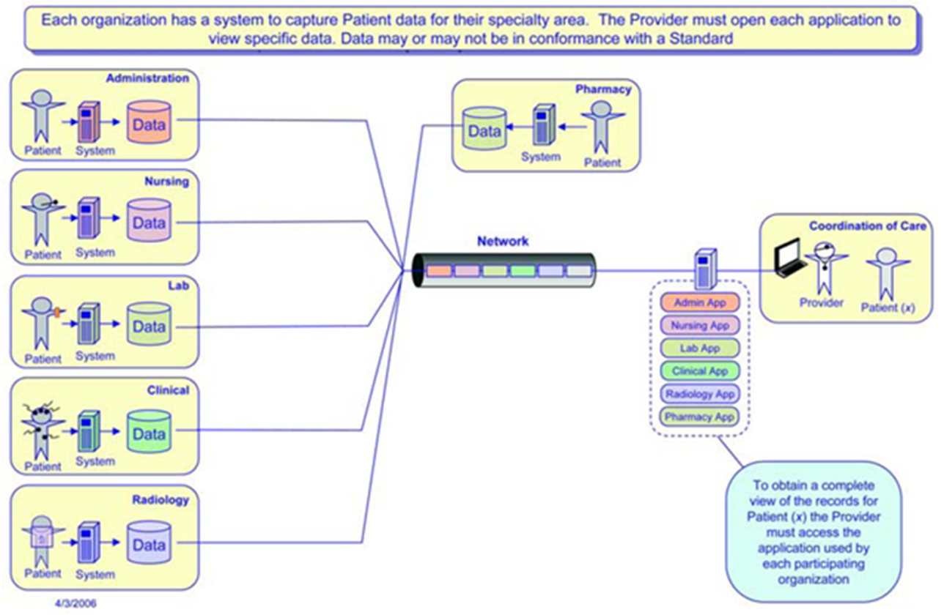
Software Elements – Pre-EHR
1.1 Figure: (MITRE, 2006)
Notes:
This illustration depicts that, prior to centralized EHR system management software, each organization or department maintain its own system and software designed to capture the data required for each specialty area. This meant that multiple databases and patient records existed and the healthcare provider was required to open a different client application for each department and compile the data using a manual process. Additionally, data may or may not have been in conformance with a standard.
Image courtesy of National Center for Research Resources. Printed with permission. All rights reserved.

Slide 15
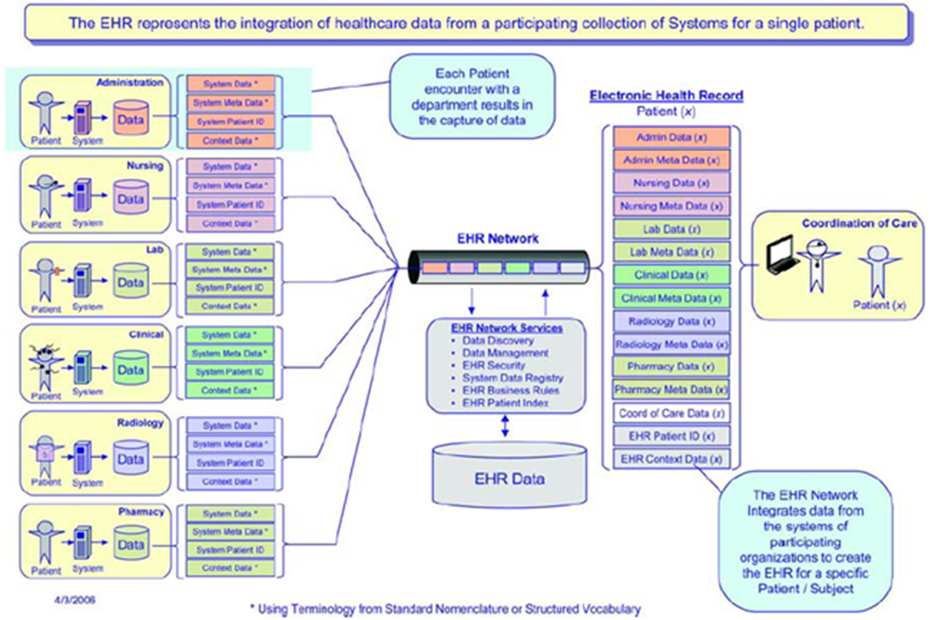
Software Elements – Post-EHR
1.2 Figure: (MITRE, 2006)
Notes:
This illustration depicts that EHR systems are designed to receive data from each of these organizational silos and compile them within a centralized database. EHR software is designed to compile the data in a more efficient manner, allowing the healthcare provider to access and cross-reference data from all available sources from one convenient client interface. This should allow the provider to more effectively manage patient care.
Image courtesy of National Center for Research Resources. Printed with permission. All rights reserved.

Slide 16
Client-Server Model
Most of today’s EHR systems are based on the client–server model.
Software: the collection of programs and related data that contain the instructions for what the computer should do
Servers: service providers
  Servers run “server application” software designed to meet client requests.
Clients: service requesters
  Client software is designed to “request” information from a server and then present it to the user in an efficient manner.
A server and client may reside on the same “box” but is generally not recommended.
(Wikipedia, 2010)
Notes:
Most of today’s in-house EHR systems are based on the client-server model. The client–server model in the computing world is a structure that separates tasks or workloads between service providers, called “servers”, and service requesters, called “clients”. Usually, a client computer and a server computer are two separate devices, each customized for their designed purpose and communicating over a computer network. For example, a Web client works best with a large screen display, while a Web server does not need any display at all to parse out requested web pages, and it can be located anywhere. In some rare instances, however, both client software and server software reside in the same system.
As we stated earlier, software can best be defined as the collection of computer programs and related data that provide the instructions for what a computer should do. EHRs use several different types of application software.
A server machine is a host that is running one or more server programs which share its resources with clients. Server software is usually installed and operated from dedicated “server” hardware designed to reliably and efficiently handle large numbers of client requests.
A client machine does not share any of its resources, but requests one or more server's content or service function. Client software therefore initiates communication sessions with servers which await (listen to) incoming requests.
Many business applications being written today use the client–server model.

Slide 17
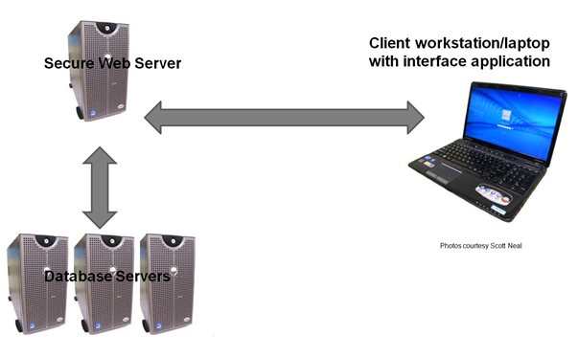
Image of Client-Server Model
1.3 Figure: (Neal, 2011)
Notes:
As this picture demonstrates, using a client-server architecture enables the roles and responsibilities of a computing system to be distributed throughout the network using several independent computers.

Slide 18
Advantages of Client-Server Model
Data resides on the server, which generally has safer controls
Easier to manage and update
Less resource-intensive for the client
Notes:
All data is stored on the servers, which generally have far greater security controls than most clients. Additionally, because the data is stored centrally, it is easier to manage and update. Using a client-server model also spreads the workload among multiple systems, generally easing the burden on client systems which would otherwise have to expend more resources for processing and storage of data.

Slide 19
Elements of a Typical Electronic Health Record System
Summary – Lecture a
EHRs offer potential long-term benefits over traditional methods.
EHRs require both hardware and software components.
Client-server model is predominant in EHR software models.
Notes:
Let’s summarize what we have learned so far:
Despite early set backs in implementation, EHRs hold great promise for improving safety and efficiency in the healthcare setting over the long term.
EHRs require both hardware - that is the devices, computers, and network infrastructure and software – which includes databases, applications, and device drivers, to name a few – in order to function…and that in today’s market, the “Client-Server” model is predominant in terms of EHR software strategies. The client-server model is a structure that separates tasks or workloads between service providers, called “servers”, and service requesters, called “clients”. Usually, a client computer and a server computer are two separate devices, each customized for their designed purpose and communicating over a computer network.
In part b of our lecture we will discuss in more detail these software and hardware elements commonly found in EHR systems.

Slide 20
Elements of a Typical Electronic Health Record System
References – Lecture a
References
DesRoches, C.M., et al. (2008). Electronic health records in ambulatory care: a national survey of physicians. N Engl J Med; 359:50-6. http://www.nejm.org/doi/full/10.1056/NEJMsa0802005
Electronic Health Records Working Group. (2014, April). HL7 EHR-System Functional Model, R2. Retrieved June 25, 2016, from http://www.hl7.org/implement/standards/product_brief.cfm?product_id=269
Garrett, P., & Seidman, J. (2011, January 4). EMR vs EHR: What is the difference. Heath IT Buzz. Retrieved December, 2011, from http://www.healthit.gov/buzz-blog/electronic-health-and-medical-records/emr-vs-ehr-difference/
Institute of Medicine (2001, March 1). Crossing the quality chasm: a new health system for the 21st century. Retrieved June 30, 2010, from http://www.nap.edu/catalog/10027.html
Maons, D. (2011, November11). EHRs are Inevitable, Experts Say. Heathcare IT News. Retrieved from http://www.healthcareitnews.com/news/ehrs-are-inevitable-experts-say
Scholl, Michael. An Introductory Resource Guide For Implementing The Health Insurance Portability And Accountability Act (HIPAA) Security Rule. 1st ed. National Institute of Standards and Technology, 2008. Web. 25 June 2016.
Notes:
No audio

Slide 21
Elements of a Typical Electronic Health Record System
References – Lecture a (cont’d)
References (cont’d)
Medical Associates. Electronic Medical Record. Retrieved September 2011 from http://www.medical-software.org/electronic-medical-record.html
Pawola, L. (2011, February 22). The history of the electronic health record. Health Informatics and Health Information Management. Retrieved December 2011 from http://healthinformatics.uic.edu/the-history-of-the-electronic-health-record/
Torrey, T. (2011, April 11). What is an EMR (Electronic Medical Record) or EHR (Electronic Health Record)? Retrieved June, 2011, from patients.about.com: http://patients.about.com/od/electronicpatientrecords/a/emr.htm
Torrieri, M. (2011, August 23). EHR adoption grows slowly, steadily at small practices. Retrieved from http://www.searchmedica.com/resource.html?rurl=http%3A%2F%2Fwww.physicianspractice.com%2Fblog%2Fcontent%2Farticle%2F1462168%2F1933985%3FCID%3Drss&q=Kleaveland&c=pm&ss=physiciansPractice&p=Convera&fr=true&ds=0&srid=3
Wikipedia. (2011, August). Client server model. Retrieved June 2011 from Wikipedia.com: http://en.wikipedia.org/wiki/Client%E2%80%93server
Notes:
No audio

Slide 22
Elements of a Typical Electronic Health Record System
References – Lecture a (cont’d 2)
Charts, Tables, Figures
1.1 Figure: Electronic Health Data — Pre-EHR. MITRE. (2006). Electronic Health Records Overview. Retrieved from: http://s3.amazonaws.com/rdcms-himss/files/production/public/HIMSSorg/Content/files/Code%20180%20MITRE%20Key%20Components%20of%20an%20EHR.pdf. Used with permission.
1.2 Figure: Electronic Health Data — Post-EHR. MITRE. (2006). Electronic Health Records Overview. Retrieved from:://s3.amazonaws.com/rdcms-himss/files/production/public/HIMSSorg/Content/files/Code%20180%20MITRE%20Key%20Components%20of%20an%20EHR.pdf. Used with permission.
1.3 Figure: Client Server Model. Neal, Scott. (2011). Used with permission.

Slide 23
Installation and Maintenance of
Health IT Systems
Elements of a Typical Electronic
Health Record System
Lecture a
This material was developed by Duke University, funded by the Department of Health and Human Services, Office of the National Coordinator for Health Information Technology under Award Number IU24OC000024. This material was updated in 2016 by The University of Texas Health Science Center at Houston under Award Number 90WT0006.
Notes:
No Audio.

