Slide 1
Installation and Maintenance of Health IT Systems
Developing a
Test Strategy and Test Plan
This material (Comp 8 Unit 10) was developed by Duke University, funded by the Department of Health and Human Services, Office of the National Coordinator for Health Information Technology under Award Number IU24OC000024. This material was updated in 2016 by The University of Texas Health Science Center at Houston under Award Number 90WT0006.
This work is licensed under the Creative Commons Attribution-NonCommercial-ShareAlike 4.0 International License. To view a copy of this license, visit http://creativecommons.org/licenses/by-nc-sa/4.0/.
Notes:
Welcome to Installation and Maintenance of Health IT Systems, Developing a Test Strategy and Test Plan.
This component, Installation and Maintenance of Health IT Systems, covers fundamentals of selection, installation, and maintenance of typical Electronic Health Records (EHR) systems.
In today’s lecture we will discuss the various elements required for developing a test strategy and plan for testing your EHR software prior to final acceptance.

Slide 2
Developing a Test Strategy and Test Plan Learning Objectives
Gather user feedback and performance baseline for system validation and testing
Document problems with their resolution status
Create, execute, and document a test plan
(What is Acceptance Testing, n.d.; Tucker, 2003; Wikipedia, 2011)
Notes:
The objectives for this unit, Developing a Test Strategy and Test Plan, are to:
Gather user feedback and performance baseline for system validation and testing
Document problems with their resolution status
Create, execute, and document a test plan
In the world of software development, there are two types of software acceptance testing: the first, by the system vendor, to ensure functionality, and the second, User Acceptance Testing or UAT, by the clients to ensure the functionality meets the acceptable institutional requirements. The UAT is the final stage of testing performed by the clients who will use the software product prior to software roll-out. The UAT is usually a contractual agreement between the client and the vendor during negotiations.
A “smoke test’” differs from UAT in the sense that smoke testing is considered a first “dry run” where critical components are tested prior to introducing a “build” ( or new version of software), to ensure more against catastrophic failure than the final details of its functionality.
User acceptance testing is vital for validation of the system functions. As part of your project plan, you should enlist your most skilled staff in developing a process for validating your software functionality. This unit briefly discusses developing a UAT strategy and test plan to suit your needs.
Some of the items to discuss in today’s lecture include:
Why do we need a test strategy?
What are the testing steps?
A typical testing strategy template
Test plans: utilizing resources
Test scenarios vs. test scripts
Creating test scenarios
Test scripts and
Random testing.

Slide 3
What is User Acceptance Testing (UAT)?
Usually performed as final step before rollout.
Ensures product meets client’s expectations
Ensures software meets project objectives
Provides opportunity for further debugging
Based on mutually agreed-upon deliverables
( Tucker, 2003; Turbit, 2006; What is Acceptance Testing, n.d.)
Notes:
User Acceptance Testing is performed by the end user or users prior to the rollout of a finished software product. It gives both the end users and the software manufacturer one last chance to be sure that the product being delivered fully meets their expectations, project objectives and is free of any defects (or bugs). UAT also provides another opportunity for further debugging, since the end user often uses the product from a perspective different from that of the manufacturer.
Early on in the project plan, a list of baseline requirements should have been generated and mutually agreed upon by your organization and the vendor as “must-haves” for your software implementation to be considered successful. Your testing strategy should be based, at least in part, on validation of these requirements

Slide 4
When to Test?
Prior to rollout
Always needed for critical software such as EHR systems
Focused on functionality, not technical issues. Most technical and integration bugs should have been worked out prior to testing.
( Tucker, 2003; Turbit, 2006; WikiPedia 2011)
Notes:
As stated earlier, UAT is usually the final step before the general rollout process begins. Therefore the software product should be fully completed. Because of the critical nature of health record systems, UAT should always be completed before initial rollout or any upgrade to the system.
Since the focus of user acceptance is on the system’s functionality, the vendor should have rectified a majority of the technical glitches in the product prior to UAT testing.
This would be the equivalent to a manufacturer doing product testing after a part comes off the assembly line to ensure the product functions to its specifications.

Slide 5
What are the Testing Steps?
Planning the UAT
Designing your test cases
Creating the UAT team
Executing test cases
Documenting defects
Resolving and debugging
Signing off
(Kumar, 2007)
Notes:
User acceptance testing for the software should be carried out in a test environment that mimics as closely as possible the actual work environment that the EHR will be installed in.
In general there are 7 steps when performing User Acceptance Testing:
“1) Planning your User Acceptance Testing 2) Designing User Acceptance Test Cases 3) Selecting a Team [to] execute the … Test Cases 4) Executing Test Cases 5) Documenting the Defects found during UAT 6) Resolving [and debugging] 7) Sign[ing] off” (Kumar, 2007)

Slide 6
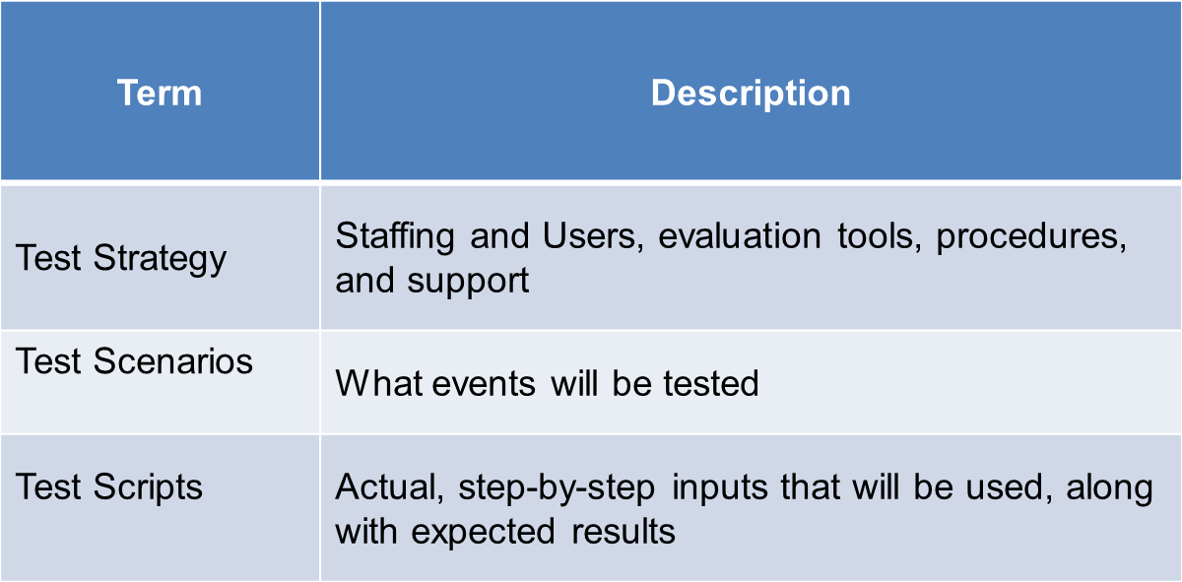
Testing Steps: Terms
10.1 Testing Steps (Turbit, 2006)
Notes:
Before we continue with a more detailed description of the steps, here are three terms you should be familiar with related to UAT:
Test Strategy – You will need to devise a test strategy this includes who will be involved, what special equipment or software will be needed, what procedures will be followed and what other support mechanisms will be needed to ensure successful testing.
Test Scenarios – You will need to decide what events will need to be tested.
Test Scripts – Once you have decided on the events to be tested, you will need to develop step-by-step instructions including specific inputs that will be used for each test as well as the expected results.

Slide 7
Test Scenarios vs. Test Scripts
Test scenarios
Broad interpretation of what you are testing
Example: “When you enter a prescription that could cause an adverse reaction for the patient, a warning message should appear.”
Test Scripts
Step-by-step details of running the tests
Example: “1. Select John Doe’s patient record. 2. Select ‘New Rx’. …”)
Notes:
Let’s take a moment to clarify the difference between test scenarios and test scripts.
Test Scenarios give a broad interpretation of what you are testing, while test scripts are the step by step instructions associated with running the actual test and recording outcomes.
For example, a ‘scenario’ could say “When you enter a prescription that could cause an adverse reaction for the patient, a warning message should appear.” Then the corresponding ‘script’ might say “1. Select John Doe’s patient record. 2. Select ‘New Rx’.” and so on.

Slide 8
UAT Planning Stage
Most important stage in the process
Testing strategy developed
Key focus areas defined
Based on expected overall product deliverables
Entry and exit criteria defined
(Kumar, 2007)
Notes:
Now let’s take a look at each of the stages in more detail, beginning with the planning stage.
Like many other topics discussed throughout this component, the planning stage is the most important, as creating an effective testing strategy is critical to a successful user acceptance testing process. The planning stage defines the key focus areas along with entry and exit criteria.
Since this is functionality, or “black box”, testing, focus areas targeted for testing should be roughly defined by the expected overall product deliverables.

Slide 9
Testing Strategy Template
A typical testing strategy addresses several categories:
Overview
Testing environment
Procedures
Software
The following slides show typical elements in a testing strategy.
Your strategy may include more or fewer variables.
Notes:
The following slides show typical elements in a testing strategy. Your strategy may include more or fewer variables.

Slide 10
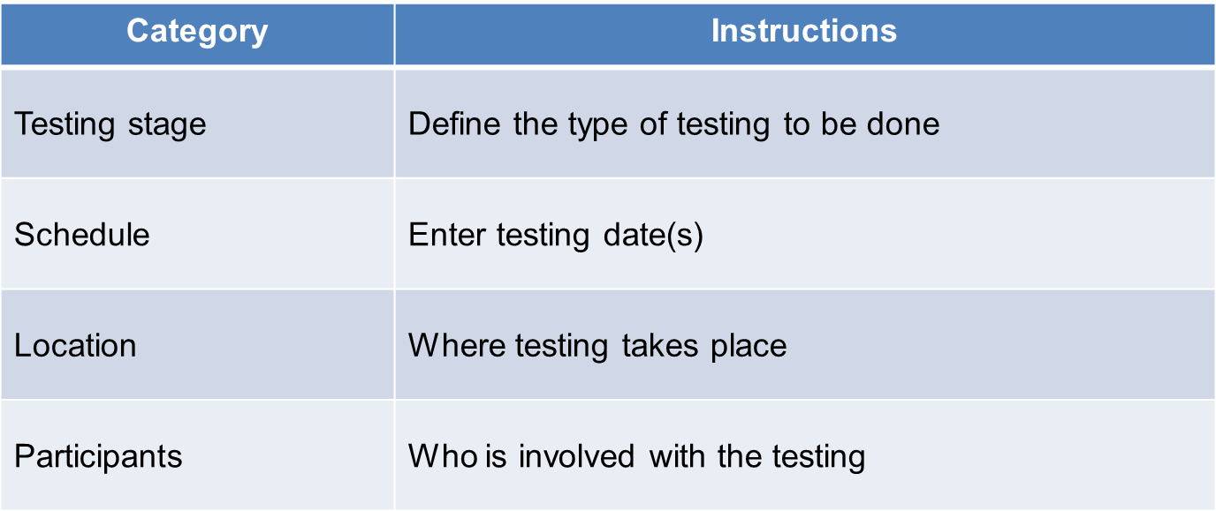
Testing Strategy Template: Overview
10.2 Overview of Testing Strategy Template (Turbit, 2006)
Notes:
Typical elements to address the overall testing strategy include:
The Testing Stage: Define the type of testing to be done.
Schedule: Enter testing date or range of dates.
Location: Where testing takes place.
Participants: Who is involved with the testing.

Slide 11
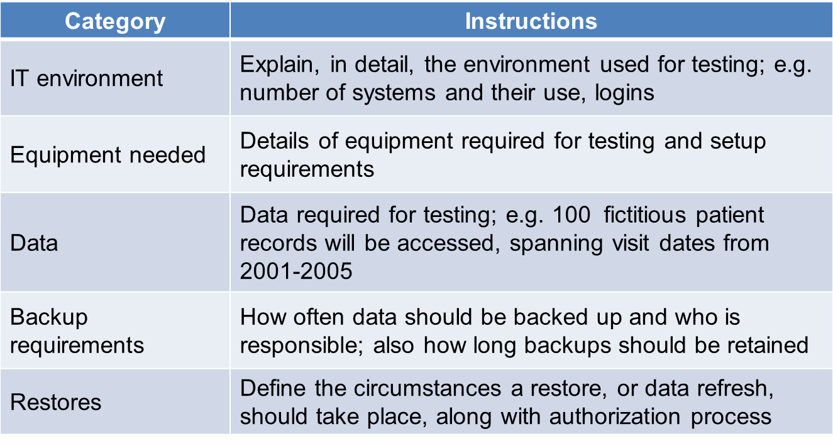
Testing Strategy Template: Testing Environment
10.3 Testing Environment (Turbit, 2006)
Notes:
To address the testing environment, typical elements include:
The IT Environment: You should explain, in detail, the environment used for testing (for example, the number of systems and their use, logins).
Equipment Needed: Identify, all of the equipment required for testing and its setup requirements.
Data: Identify the data required for the testing; for example, 100 fictitious patient records will be accessed spanning visit dates from 2001-2005
Backup Requirements: You should define when data backups should occur and who will be responsible for backups. Determine the duration needed for backup retention.
Restores: Additionally, you will need to determine what events warrant a restore or refreshing the test data along with who has the authority to authorize such restores and whose responsibility it will be to complete them.

Slide 12
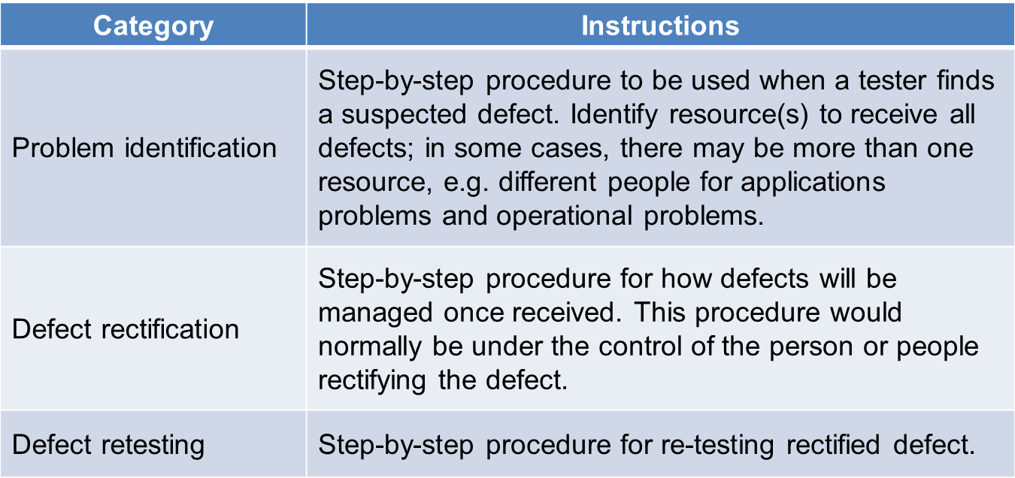
Testing Strategy Template: Procedures
10.4 Procedures (Turbit, 2006)
Notes:
To cover the procedures that are to be followed, typical elements of the strategy include:
Problem Identification: You will need to have a process in place to process errors once they are discovered by your testers. Identify who will be responsible for collecting identified errors and ensuring they are dealt with appropriately.
Defect Rectification: Along with assigning who will handle identified system defects, you should also have a step by step process to determine how the defect will be managed and rectified.
Defect Retesting: Once it has been determined that a defect has been fixed. You should have a method in place to retest the event to confirm the defect has been sufficiently mitigated.
It’s important to note that no software will be 100% perfect. Some issues may go unmitigated. This does not necessarily mean that the software as a whole will not be accepted, depending on the severity of the issue or issues raised during User testing.

Slide 13
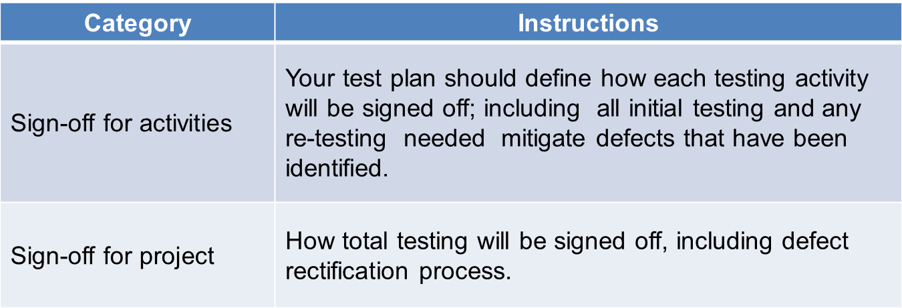
Testing Strategy Template: Procedures (cont’d)
10.5 Procedures (continued) (Turbit, 2006)
Notes:
More elements of the procedure include:
A “Sign-off” procedure for testing activities: For each event tested, a process should be in place to determine when it is appropriate to sign off (or accept) that element of the testing activity. Signing off usually occurs after retesting has been completed and it has been determined that any identified defects have been adequately mitigated.
Sign-off for the testing project: Lastly, who is responsible for signing off on the testing project as a whole once each individual element has been satisfactorily completed?

Slide 14
Testing Strategy Template: Software
10.6 Software (Turbit, 2006)
Notes:
To plan for software needs, typical elements include:
Test management and performance management software: List any specialized test management software to be used to document the testing, record discovered issues, and to manage the mitigation process.
Testing Software: This would include any specialized software needed to generate the testing environment or perhaps automate some repetitive testing functions. You will need to outline any software that will be used during the testing process.

Slide 15
Designing Test Cases
Used to test focus areas defined during planning process
Often defined during software requirements phase
Others created by business analysts or subject matter experts
Notes:
The next stage involves designing the test cases, or scenarios, and the corresponding scripts.
Once testing strategies and scenarios have been developed, the testing team begins working on user test cases, or scripts, to test the focus areas defined during the planning process. Often test cases are created at the time the software requirements were being ironed out or as part of the workflow analysis.

Slide 16
Testing Scenarios
Broadly define scope of each test, with expected output
Used to develop detailed scripts needed for end user testing
Best generated by experienced testers and subject matter experts
(Tucker, 2003; Turbit, 2006)
Notes:
Once the focus has been defined, the test team manager is often responsible for matching the skill sets of each team member to the specific tasks needing to be accomplished. This includes utilizing subject matter experts and more experienced testers to define testing scenarios.
Test scenarios broadly define the scope of each test along with the output expected upon completion. They are used to develop detailed scripts for end user testing.
In addition to test cases developed by the team, business analysts or other subject matter experts may be involved in developing testing scenarios or scripts for implementation.

Slide 17
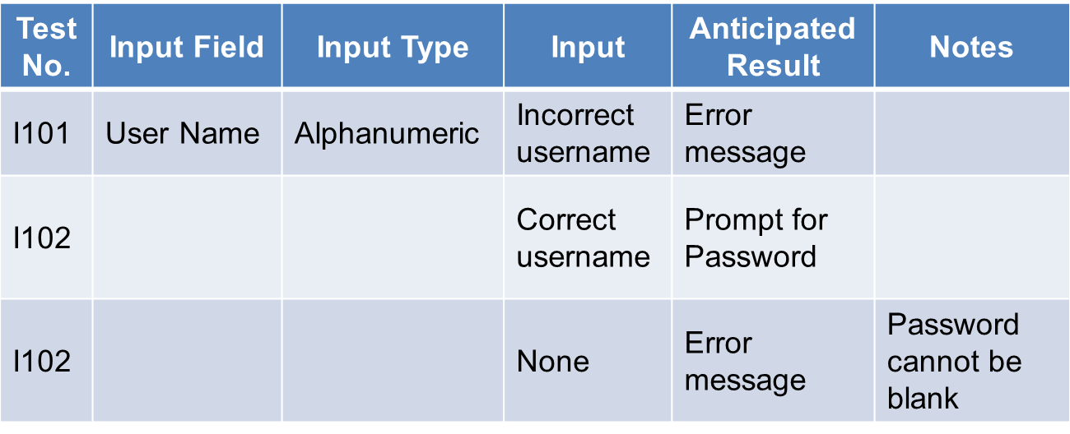
Creating Test Scenarios: Example
10.7 Data Input and Modification Validation Test (Kumar 2007; Turbit, 2006)
Notes:
The following is an example of a test scenario: The title for this test is “Data Input and Modification Validation Test.” This test will validate the Secure User Access field.
Here we outline the various types of tests associated with validating the data input and modification capabilities of the software. We outline, in broad terms, the type of input we will be testing and the anticipated results, along with a notes column to highlight any special features or messaging we should be looking for.

Slide 18
Test Scripts
Include:
Step-by-step instructions for end-user tester
Sections for recording actual output from tests
Instructions for passing along findings to appropriate team members for resolution
Last stage before end user tester selection and testing begin
(Turbit, 2006)
Notes:
As stated earlier, a test script is a step-by-step instruction set for running the actual test and recording outcomes. This also defines the data to be entered; provides a section for the tester to record, in detail, the output generated by the test; and contains instructions for forwarding any erroneous findings to the appropriate team members for resolution.
Once the scenarios have been completed, your testing team should go to work developing test scripts designed to put each of the scenarios through its paces and record the outcomes for analysis.
Once the scripts for each testing scenario have been completed, it’s time to move on to our next step.

Slide 19
End User Testing Team
Actual testing team should represent a cross-section of the end user environment.
Testing environment should closely mimic the real production environment.
(Turbit, 2006; Wikipedia)
Notes:
Once the scripts are completed, it’s time to build our end user testing team to run the test scripts. It’s important to draw your testers from an entire cross-section of the end user environment to ensure that all workplace elements have been represented. This diversity will help draw out any hidden workflow or functionality obstacles not previously discovered.
The actual testing environment should take place in the actual work environment when possible. When not feasible, the environment should be simulated as closely as possible to give the end user a similar experience.

Slide 20
Test Scripts (cont’d)
Test scripts can vary but usually include:
A column indicating the set number in the process
A column in the test script for the step by step instructions to perform
A column indicating the expected test result
A column for the tester to input the ACTUAL result
A comments field
Sometimes, test scripts can be coded and automated using a tool called an interpreter to mimic the user.
(Kumar 2007; Turbit, 2006)
Notes:
Creating specific test scripts can vary, however, more often than not a test script will contain:
A column indicating the set number in the process
A column in the test script for the step by step instructions to perform
A column indicating the expected test result...what output should be generated and what it should look like.
A column for the tester to input the ACTUAL result.
A comments field
The tester will use these scripts to perform the step-by-step analysis. Therefore, the script’s content must be detailed enough to eliminate errors or misinterpretation.
Sometimes, its advantageous for the testing team to go beyond manual user testing and actually create code to automatically perform some of the testing procedures. Programmers take the testing scripts and devise a program to run the input using a tool called an interpreter which mimics the end user’s input and records the result.

Slide 21
Executing the Tests
End users execute each of the test scripts, carefully documenting their findings.
Also allow testers “free range” on the system to perform relevant random testing to explore for errors.
Ensure all documentation is complete and forwarded quickly to proper team members for issue resolution.
(Turbit, 2006)
Notes:
Once the end users have been selected, testing begins in earnest. End users should execute each of the test scripts and document thoroughly the outcomes experienced.
Users can find all sorts of ways to break things if left to their own devices. Be sure to allow some “free range” time for the testers to randomly explore their environment. Often they will find errors on their own that will need resolution.
Once each tester has completed a testing cycle, the documentation should be quickly collected and forwarded so the resolution process can begin.

Slide 22
Issue Resolution
Issues discovered are discussed with the testing and project team &/or vendor.
Development team &/or vendor devises satisfactory solution
End user team retests.
(Kumar, 2007; Turbit, 2006)
Notes:
As functionality or technical issues arise, they should be forwarded to the testing team for resolution. The team meets with subject matter experts and the vendor to iron out a plan of attack for completing the necessary software revisions, and work commences to resolve the issues.
Once workarounds have been completed, the appropriate test scripts are re-analyzed by the end user testers to ensure each issue has been resolved satisfactorily. If not, the process continues until all issues are resolved.

Slide 23
Sign-Off
Acknowledgement that UAT team accepts the application
All known issues have been satisfactorily resolved.
Often represents pay-off point for vendor
(Kumar, 2007; Turbit, 2006)
Notes:
Once all issues are resolved and the client’s end users are confident in the product’s abilities, the team acknowledges acceptance of the application. This means both the client and end users are happy overall with the product in its current form and all known issues have been satisfactorily resolved. This often represents the point of pay out to the vendor.

Slide 24
Summary
Using talented resources to develop relevant test scenarios is critical to proper system validation and successful testing.
Once test scenarios have been conceived, devise test scripts for each scenario.
End users or automated programs perform the detailed step-by step testing and record the results.
Notes:
This concludes Developing a Test Strategy and Test Plan.
So, let’s take a moment to summarize key points about developing test strategies and test plans:
Using your most talented resources for developing relevant test scenarios is critical to proper system validation and successful testing.
Once test scenarios have been conceived, use a top-down approach to devise the test scripts for each scenario.
End users or automated programs perform the detailed step-by step testing and record the results.

Slide 25
Summary (cont’d)
Careful documentation and detailed defect resolution plans ensure kinks are worked out and retested.
Issues are brought to the test team’s attention to be forwarded to the programmers or vendor for resolution
Testing continues until all parties are confident in the software’s performance.
Once testing is complete, the client “takes delivery” and can begin implementing its “roll out” strategy
Notes:
Additional key points are
Careful documentation and detailed defect resolution plans should be followed to ensure kinks are worked out and retested.
Issues are brought to the test team’s attention to be forwarded to the programmers or vendor for resolution.
Testing continues until all parties are confident in the software’s performance and
Once testing is complete, the client “takes delivery” and can begin implementing its “roll out” strategy.

Slide 26
Developing a Test Strategy and Test Plan References
References:
“Acceptance testing” (2011).Wikipedia.[Internet] http://en.wikipedia.org/wiki/Acceptance_testing .
Kumar, K. (2007, May 18). Beginners Guide To Software Testing . Retrieved February 10, 2012, from KR Testing Solutions website: http://kuldeepse.wordpress.com/2007/05/18/beginners-guide-to-software-testing
Tucker, J. (2003, September). Definition - smoke testing. Retrieved February 10, 2012, from SearchWinDevelopment website: http://searchwindevelopment.techtarget.com/definition/smoke-testing
Turbit, N. (2006, January 30). Developing a Test Strategy. Retrieved from PROJECT PERFECT website: http://www.projectperfect.com.au/downloads/Info/info_test_strategy.pdf
What is Acceptance Testing. (n.d.). Retrieved February 10, 2012, from wiseGEEK - Conjecture Corporation website: http://www.wisegeek.com/what-is-acceptance-testing.htm.
Notes:
No Audio. Ten seconds of silence.

Slide 27
Developing a Test Strategy and Test Plan References (cont’d)
Charts, Tables, Figures
10.1 Table. Turbit, N. (2006, January 30). Developing a Test Strategy. Retrieved from PROJECT PERFECT website: http://www.projectperfect.com.au/downloads/Info/info_test_strategy.pdf
10.2 Table. Turbit, N. (2006, January 30). Developing a Test Strategy. Retrieved from PROJECT PERFECT website: http://www.projectperfect.com.au/downloads/Info/info_test_strategy.pdf
10.3 Table., N. (2006, January 30). Developing a Test Strategy. Retrieved from PROJECT PERFECT website: http://www.projectperfect.com.au/downloads/Info/info_test_strategy.pdf
10.4 Table. Turbit, N. (2006, January 30). Developing a Test Strategy. Retrieved from PROJECT PERFECT website: http://www.projectperfect.com.au/downloads/Info/info_test_strategy.pdf
10.5 Table. Turbit, N. (2006, January 30). Developing a Test Strategy. Retrieved from PROJECT PERFECT website: http://www.projectperfect.com.au/downloads/Info/info_test_strategy.pdf
10.6 Table. Turbit, N. (2006, January 30). Developing a Test Strategy. Retrieved from PROJECT PERFECT website: http://www.projectperfect.com.au/downloads/Info/info_test_strategy.pdf
10.7 Table. Kumar, K. (2007, May 18). Beginners Guide To Software Testing . Retrieved February 10, 2012, from KR Testing Solutions website: http://kuldeepse.wordpress.com/2007/05/18/beginners-guide-to-software-testing-i/ and
Turbit, N. (2006, January 30). Developing a Test Strategy. Retrieved from PROJECT PERFECT website: http://www.projectperfect.com.au/downloads/Info/info_test_strategy.pdf
Notes:
No Audio.

Slide 28
Installation and Maintenance of Health IT Systems Developing a Test Strategy and Test Plan
This material was developed by Duke University, funded by the Department of Health and Human Services, Office of the National Coordinator for Health Information Technology under Award Number IU24OC000024. This material was updated in 2016 by The University of Texas Health Science Center at Houston under Award Number 90WT0006.
Notes:
No Audio.

