Slide 1
Working with Health IT Systems
HIT System Planning, Acquisition, Installation, & Training: Practices to Support & Pitfalls to Avoid
Lecture a
This material (Comp 7 Unit 8) was developed by Johns Hopkins University, funded by the Department of Health and Human Services, Office of the National Coordinator for Health Information Technology under Award Number IU24OC000013. This material was updated in 2016 by The University of Texas Health Science Center at Houston under Award Number 90WT0006.
This work is licensed under the Creative Commons Attribution-NonCommercial-ShareAlike 4.0 International License. To view a copy of this license, visit http://creativecommons.org/licenses/by-nc-sa/4.0/.
Notes:
Welcome to Working with HIT Systems: HIT System Planning, Acquisition, Installation, & Training: Practices to Support & Pitfalls to Avoid. This is Lecture a.
In this unit, the core definitions and concepts of HIT systems planning, acquisition, installation, and training are presented. A variety of settings will be used as examples in the unit, including small office practices, community clinics, acute care facilities, and skilled nursing facilities. Students will conduct simulated user needs analysis, and using the lab Electronic Health Record System (EHRS), will identify gaps in meeting those needs. Students will develop training plans for a variety of settings.

Slide 2
HIT System Planning, Acquisition, Installation, & Training: Practices to Support & Pitfalls to Avoid Learning Objectives – Lecture a
Conduct a basic user needs analysis for a given example situation.
Create a plan for training users in a small office practice, a large community clinic, or a single unit in an ambulatory care setting.
Identify several potential challenges that may emerge during installation and generate a strategy to solve (lack of basic computer literacy in staff, etc.).
Notes:
The Objectives for HIT System Planning, Acquisition, Installation, & Training: Practices to Support & Pitfalls to Avoid are to:
Conduct a basic user needs analysis for a given example situation.
Create a plan for training users in a small office practice, a large community clinic, or a single unit in an ambulatory care setting. And.
Identify several potential challenges that may emerge during installation and generate a strategy to solve (for example, lack of basic computer literacy in staff.)
By the end of this unit, students will be able to apply concepts learned in the unit to be able to conduct a basic user needs analysis for an HIT systems implementation in various health care settings, ranging from a small office practice to a large community clinic, to a single unit in an ambulatory care setting. Students will also be able to create a training plan as part of the implementation, identify potential challenges that may emerge during the implementation (such as lack of computer literacy in staff), and generate strategies to overcome these challenges.

Slide 3
HIT System Acquisition
HIT acquisition = $$$
Careful planning
Notes:
Acquiring HIT systems in many cases requires an enormous financial commitment on the part of the healthcare organization or provider. Costs, including the initial investment in software, ongoing maintenance fees, consulting, support, and other long-term expenses, require that any HIT acquisition be carefully planned. This planning should be based on reliable and complete information about the needs of the organization and the capabilities of the system being considered. Many major HIT system implementations fail because of poor planning, incomplete information gathering, and failure to gain input from all stakeholders. If the organization is not prepared to dedicate time to the process of planning the HIT implementation, then it should wait to begin the process until time and resources are available. Once the decision has been made to proceed, and there is true commitment on the part of the organization to support the process, a systematic approach and careful planning will help ensure success.

Slide 4
The Systems Development Process
Image Courtesy of Michael Vaughn
Notes:
As you approach the process of acquiring and installing a new HIT system, it will be helpful to use a framework to guide you, to be sure that you don’t skip over important steps that should be considered. One helpful framework used in the IT field to help guide IT systems implementations is known as the software development life cycle, or systems development process. “Software” or “systems development” implies a process that is used to create new information systems, as opposed to acquiring a system that has already been developed. However, most of the steps of this process are applicable to both, either a project to create a new system or to acquire a new system. So in this sense, the “development” stage of this framework can refer to the process of creating the software or acquiring it.
There are four main steps that make up the software development life cycle. The planning and analysis step involves determining how work that will be impacted by a new HIT system is done now, determining what the desired future state is, and analyzing what it will take to reach the future state. The next step, design, is where solutions are examined and chosen, either by creating or acquiring an IT system to address the determined needs. After a system is created or acquired, it must be implemented. Implementation includes installing the system, or otherwise making the system available to the organization. With the increased use of hosted systems, such as the application service provider, or ASP, and cloud hosting options, installation may not be necessary. Implementation also includes important related activities, most importantly training. Finally, during the support and evaluation step, on-going support and training is continued, and the solution is evaluated to ensure that the needs identified during the planning and analysis step are being met. Unmet needs and newly identified requirements may be reason to return to the beginning and restart the process.

Slide 5
Systems Acquisition vs. Development
Availability of vendor solutions
Application Service Providers
Cloud computing
Many other options
Notes:
As was mentioned before, systems development does not necessarily mean coding by a dedicated team of computer programmers. The software development process has its origins in the early days of computers, when vendor provided solutions to complex business needs were uncommon, requiring organizations to build their own systems. Vendors with off-the-shelf solutions to a wide variety of business needs are now common, so it is at least as likely to be able to find an available commercial system to meet the needs of a healthcare organization as it would be necessary to develop such a system from scratch. In fact, in small practice settings, it is highly unlikely that such an organization would try to develop a custom solution.
The availability of hosted systems, including the ASP model of software delivery and the concept of “cloud” computing in which applications are hosted online and accessible from any location, means that even the notion of an off-the-shelf solution is beginning to be supplanted by an expectation of the always on, all online software system. The hosted option allows a healthcare organization to implement an HIT system without the need to support the IT infrastructure that would be required of an off-the-shelf, locally installed system.
Another option that small healthcare practices may want to consider is to partner with other healthcare organizations, either to share the effort to support the implementation of an HIT system, or to utilize HIT systems that are already in place from another organization that is willing to share access. It is not uncommon, for example, for hospitals to provide EHR software to provider practices in their region.

Slide 6
Implementation Steps Planning-Acquisition– Implementation-Evaluation
Image Courtesy of Michael Vaughn
Notes:
There are many steps to any medium-to-large scale HIT systems acquisition project that should be considered within each major stage of the systems implementation process, much of which is beyond the scope of what we can cover in this unit. For example, effective project management is of course important to the success of any project, and is a topic that by itself is often the subject of a semester-long college course. Fortunately, there are many resources that are available to you that can be used to guide your work, some of which are included at the end of this unit and in the suggested readings. We will focus on a few important steps, including the strategic planning processes that should be the first step in deciding to pursue any HIT system implementation, user needs analysis, and training.

Slide 7
The Role of Strategic Planning
Creating the vision
Vision should lead the implementation, not the technology
Work on vision fuels requirements gathering (needs analysis)
Notes:
A prerequisite to starting any HIT systems implementation project, especially a project on a large scale such as an EHR implementation, is to be sure that the organization has a good reason for pursuing new technologies. If the organization does not have a strategic plan in place that provides a vision for what the organization is about, what its goals and priorities are, then it will be difficult to determine whether a new HIT system will have a positive impact. The impetus to pursue new technologies should be driven by the goals of the organization, and should support the organization’s efforts to achieve those goals and fulfill its mission.
Assuming that the organization’s goals and mission are clear, then a vision for the new HIT system should be developed. This vision should make it clear how the HIT system will fit into the larger goals of the organization. For example, if one of the goals of an organization is to improve patient care, the vision for a new HIT system may include the reduction of medical errors.
A vision for the new system based on the strategic goals for the organization must be the impetus for looking at new HIT systems, NOT the technology itself. Too often healthcare practitioners may see a new technology system and become enamored with the “bells and whistles.” Don’t get caught up in the hype of a system and proceed with implementation without carefully considering whether the system makes sense for the organization—whether it helps the organization achieve its strategic goals.
Careful consideration of the vision for the new HIT system will also help fuel the requirements for the system. Most HIT systems will have many features and capabilities that an organization could choose to implement, and the temptation may be to implement everything that seems like a good idea. But again the vision for what is needed should drive the implementation, not the features of the system. A requirements gathering process based on the vision, which is in turn based on the mission and goals of the organization, will dictate the priorities for the features that must be included.

Slide 8
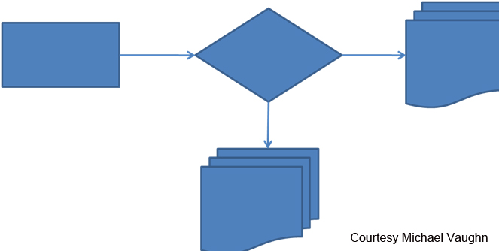
Business Process Modeling
Document current workflows
Anticipate workflow redesign
Notes:
Let’s turn our attention now to how you go about gathering requirements for a new HIT system. Ultimately what you need to create is a set of documents that describes in some detail exactly what you want a potential new HIT system to do for your organization. In most cases, implementation of a system is going to change the way your organization works. It will impact how work-related tasks are completed by some if not all of the employees in your organization. So it is critically important that you understand exactly how the work that will be impacted by the new HIT system is currently done.
The process of coming up with the requirements for a system is often referred to as “user needs analysis” or “business process modeling.” What you are trying to capture in this process is how you want the work in your organization to be done, incorporating the new functionality afforded by the new system. There are two important pieces to this process, the first of which is often overlooked. First, you need to understand in detail how the work is done currently, using a process we’ll call “business process analysis.” Secondly, you need to determine how the existing workflows can be streamlined and improved, using a process we’ll call “business process improvement.”
The first part of this process, analyzing the current workflows, is often overlooked because many within the organization think that they already understand how the work is currently done and that it doesn’t need to be documented. The problem, however, is that business processes in many organizations are not as well understood as many within the organization would like to believe. The process of documenting existing workflows very often uncovers steps that are a surprise to some. You don’t want the people responsible for determining functional requirements to make assumptions about how work is done—these assumptions could spell disaster in the HIT implementation, if a key step in a given workflow is missing because the system implementation team didn’t understand the existing process.

Slide 9
Business Process Analysis
Observe
Interview
Share
Notes:
The most obvious way to start documenting your existing business processes is to talk with those within the organization who are responsible for completing the work that you wish to document. It is also very beneficial to observe the work being done, and to share the documentation that you create with those you have interviewed and observed to be sure that you have it right. The more you are able to iterate through a cycle of observation, interview, and sharing of your analysis as the work process is executed multiple times, the more likely you are to understand exactly how the process is done.
It is also a good idea to seek out checklists, if any exist for the process that you are analyzing, that will help ensure that steps that are normally part of a process are included in your analysis. Having these checklists as guides can help you fully document a process more quickly.
As you start to conduct user needs analysis, you will discover that some people within an organization will find it very difficult to describe exactly how a given workflow is executed. That is why observation should be an important part of your analysis. It is also helpful to share how you have documented a process with a user to receive feedback; the best way to share this information is in the form of some kind of a visual representation of the business process, such as something as simple as a flow chart, or something more complex such as a UML (Unified Modeling Language) diagram. There are various tools that you can use to create these visual representations of a business process. If you are new to these kinds of tools, it is best to use something simple—even as simple as a piece of paper and pen.

Slide 10
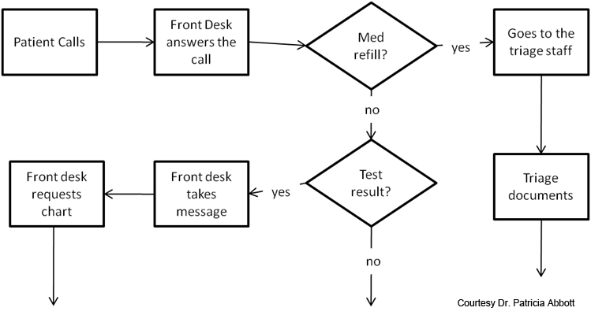
Business Process Flow Chart
Notes:
Here is an example flow chart snippet of a business process created quickly and easily with PowerPoint. There are other programs with very sophisticated capabilities, and more formal methods of documenting processes. But the process does not need to be complicated to be thorough. The important point is that you take the time to document the process in some form that is concise, complete, and easily followed.

Slide 11
Business Process Improvement
Redesigning workflows
New workflows could support:
Simplicity
Accessibility for patients
Safety
Comprehensiveness of documentation
Delegation
New system = improved workflows
Notes:
As you begin the process of documenting your existing business processes, you inevitably will begin to consider how these processes could be improved. This would likely happen whether or not you plan to implement a new HIT system. Business process improvement is the exercise of carefully looking at existing business processes and identifying how these processes could be changed to provide some benefit to the organization, such as improved staff productivity or increased patient satisfaction. Exactly what changes you will want to consider for a given workflow should be dependent on the vision that you set forth in the beginning of the HIT system implementation project, or should at least be tied to the goals of the organization or to local or national health care improvement priorities. In an EHR system implementation, for example, improved workflows could support simplification of the charting process, increased accessibility to healthcare data on the part of providers and patients, improved safety, more comprehensive documentation, and the ability to delegate tasks to make most efficient use of provider and staff time.
As you work to create new and improved workflows for your organization, it will of course be beneficial for you to at least have a general idea of the capabilities of the proposed HIT system and how these can be integrated into the new workflows. You can learn this information during the information gathering process, through various techniques such as attending training on various systems and contacting existing users of the systems you are investigating. As you develop the new workflows, if possible mock up these workflows within the HIT systems that you are considering, so that you can demonstrate to the staff as concretely as possible how the new system will impact the work of the organization.

Slide 12
HIT System Planning, Acquisition, Installation, & Training: Practices to Support & Pitfalls to Avoid Summary – Lecture a
Core concepts of HIT systems planning, acquisition, installation, and training
Apply core concepts to specific health care settings
Implementation challenges
Notes:
This concludes Lecture a of HIT System Planning, Acquisition, Installation, & Training: Practices to Support & Pitfalls to Avoid. In summary, we have covered the core concepts of HIT systems planning, acquisition, installation, and training. We looked in some detail how to strategically plan for the implementation and conduct user needs analysis. In the concluding half of this unit, we will discuss how to prepare for training. We will demonstrate how to implement the strategies introduced in this unit using some specific healthcare settings and the EHR system as an example, taking advantage of resources available online to help guide our work. Finally, we will cover some of the key success factors to an HIT systems implementation, and highlight how failure to address these factors could challenge the implementation.

Slide 13
HIT System Planning, Acquisition, Installation, & Training: Practices to Support and Pitfalls to Avoid References – Lecture a
Images
Slide 4: The Systems Development Process. Courtesy Michael Vaughn.
Slide 6: Implementation Steps. Courtesy Michael Vaughn.
Slide 8: Workflow Diagram. Courtesy Michael Vaughn.
Slide 10: Business Process Flow Chart. Courtesy Dr. Patricia Abbott.
Slide 12: Clinician Looking at Computer. Courtesy Centers for Disease Control. Available from: http://www.cdc.gov/.
Notes:
No Audio. Ten seconds of silence.

Slide 14
Working with Health IT Systems HIT Facilitated Error – Cause and Effect Lecture a
This material was developed by Johns Hopkins University, funded by the Department of Health and Human Services, Office of the National Coordinator for Health Information Technology under Award Number IU24OC00013. This material was updated by The University of Texas Health Science Center at Houston under Award Number 90WT0006.
Notes:
No Audio.

