Slide 1
Working with Health IT Systems
Protecting Privacy, Security, and Confidentiality in HIT Systems
Lecture b
This material (Comp 7 Unit 7) was developed by Johns Hopkins University, funded by the Department of Health and Human Services, Office of the National Coordinator for Health Information Technology under Award Number IU24OC00013. This material was updated by The University of Texas Health Science Center at Houston under Award Number 90WT0006.
This work is licensed under the Creative Commons Attribution-NonCommercial-ShareAlike 4.0 International License. To view a copy of this license, visit http://creativecommons.org/licenses/by-nc-sa/4.0
Notes:
Welcome to Working with Health IT Systems: Protecting Privacy, Security, and Confidentiality in HIT Systems. This is Lecture b.
This lecture continues the discussion of privacy, security, and confidentiality of protected health information (PHI) in relation to HIT systems. We will complete our look at the HIPAA security rule by discussing physical and technical safeguards. We will conclude with a discussion of formal risk analysis and management processes, and the meaningful use requirements related to privacy and security.

Slide 2
Protecting Privacy, Security, and Confidentiality in HIT Systems
Learning Objectives – Lecture b
Formulate strategies to minimize threats to privacy, security, and confidentiality in HIT systems
Notes:
The Objective for Protecting Privacy, Security, and Confidentiality in HIT Systems Lecture b are to:
Formulate strategies to minimize threats to privacy, security, and confidentiality in HIT systems.

Slide 3
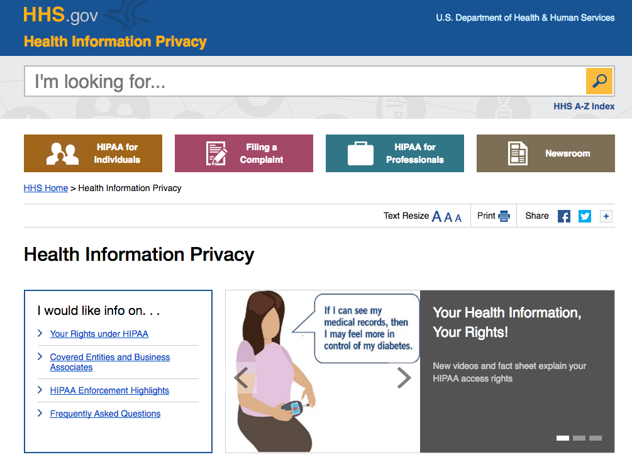
Physical Safeguards
Image Courtesy of U.S. Department of Health and Human Services
Notes:
The HIPAA Security Rule defines physical safeguards as, “physical measures, policies, and procedures to protect a covered entity’s electronic information systems and related buildings and equipment, from natural and environment hazards, and unauthorized intrusion.”
Let’s take a look at these safeguards in more detail.
It is important to limit physical access to systems that contain ePHI, as well as access to the facilities that house these systems. This must be done of course in a way that allows authorized access. Facility access controls are methods that could be used to control physical access, and may include controls such as door locks, electronic access control systems, alarms, private security service, video surveillance, and identification badges. The rationale used to determine who has access must be documented. This is an important point worth reiterating, as in fact the HIPAA regulations require that all security decisions be documented.

Slide 4
Physical Safeguards (Cont’d – 1)
Examples
Workstation Use
Workstation Security
Device and Media Controls (e.g., media disposal, access to backup and storage media)
Notes:
HIPAA defines a workstation as, “an electronic computing device, for example a laptop or desktop computer, or any other device that performs similar functions, and electronic media stored in its immediate environment.” Traditionally, we think of workstations as computing “boxes” that sit on someone’s desk, but we must be diligent to apply security safeguards to any electronic device that can access or store ePHI, including laptops, desktops, PDAs, smartphones, USB thumb drives, etc. Policies and procedures must be put in place to address what devices can be used with HIT systems, what functions these devices can perform, and in what environment (the physical attributes of the surroundings where the device is used). Because the nature of health care organizations’ business operations vary greatly, every electronic device and location where it is used must be carefully examined and controlled to ensure the privacy and security of ePHI in HIT systems.
Consider some examples:
Are the desktop computers at a nurses’ station positioned such that an unauthorized individual walking by cannot easily see ePHI? Are the workstations configured to automatically prevent access when a clinician steps away (e.g., password-protected screen savers)?
Are physicians permitted to access HIT systems containing ePHI from home? If so, what are the risks, do the benefits of access justify the risk, and are these being adequately mitigated?
Are employees allowed to bring USB thumb drives, phones with cameras (that could be used to take a picture of a workstation screen containing ePHI), and other electronic devices into the clinical setting?

Slide 5

Physical Safeguards (Cont’d – 2)
Examples
Device and Media Controls
  media disposal
  access to backup and storage media
Image Courtesy of Federal Trade Commission
Notes:
The final standard under Physical Safeguards we will cover is Device and Media Controls. A covered entity must have policies and procedures in place to control the acquisition, movement, and disposal of hardware and electronic media containing ePHI. Any media that is used to store ePHI, such as backup tapes, must be properly secured to prevent theft. If this media is disposed of, the organization must properly destroy all of the ePHI that it contains. Even if media is reused within the organization, steps must be taken to ensure that ePHI is properly destroyed. For example, a computer moved from a clinical area where ePHI is accessed to an administrative area where ePHI access is not appropriate must have the ePHI “wiped” from its hard drive. It’s important to note that simply deleting a file from a computer may not actually destroy the contents of the file. In fact, reformatting a hard drive does not necessarily rid the media of all ePHI. There are very specific technical procedures that need to be followed to ensure that information stored on media is properly destroyed, so it is important to seek help from a competent IT professional when doing this task.

Slide 6
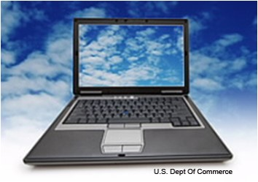
Technical Safeguards
Examples
Access Control
  Unique user identification
  Emergency access
  Automatic logoff
  Encryption/decryption
Image Courtesy of U.S. Dept. of Commerce
Notes:
The final category of HIPAA security safeguards we will examine is Technical Safeguards. The Security Rule defines technical safeguards as, “the technology and the policy and procedures for its use that protect electronic protected health information and control access to it.”
As we look at the standards in this area, we will include a few examples of types of specific technologies that can be used to help mitigate security risks. It’s important to note, however, that the HIPAA guidelines attempt to be technology neutral, and any security measure that could be used to mitigate a risk can be considered. Factors such as cost and feasibility to implement can and should be factored into the risk analysis and risk management implementation.
Access controls provide users with privileges to access functionality and data within an information system, which could include HIT systems, file servers, desktops, etc. These controls should be configured to provide the minimum level of access necessary for the user to perform job functions. These controls should be configured following the policies and procedures setup under the Administrative Safeguards section of the rule, which we covered earlier.
Access controls should include:
Unique user identification, with some mechanism (such as a username and password) that uniquely identifies users of an information system, and can be used to track user activity within information systems that contain ePHI
Emergency access procedures, which detail how someone would gain access to ePHI in the event of an emergency
Automatic logoff that ends an electronic session after a specified time of inactivity
Encryption and decryption of ePHI stored in information systems

Slide 7
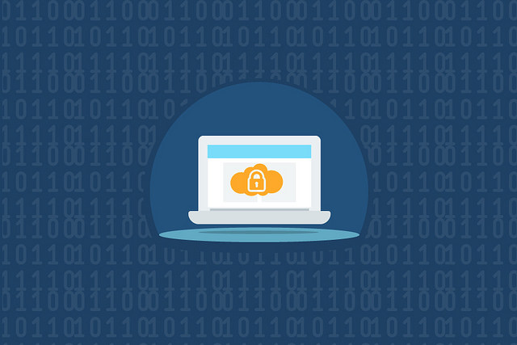
Technical Safeguards (Cont’d – 1)
Examples
Audit Controls
Integrity
Perspecsys Photos, 2015, CC BY-NC-SA 2.0
Notes:
The integrity standard requires the protection of ePHI from unauthorized or unintended alteration or destruction. There are many ways that ePHI might be unintentionally altered or destroyed, ranging from an employee accidentally or intentionally deleting data from an HIT system to the failure of an electronic component that leads to database corruption and altered data. There are technical controls that can be implemented to enable detection of alteration of data. For example, hashing algorithms can be used to calculate a “check sum” value for an ePHI document or record. If the document or record is altered, re-running the hashing algorithm against the document or record will detect the alteration because the check sum will change. The change can be assumed to be an integrity violation if there is no record of the change in an audit log.

Slide 8
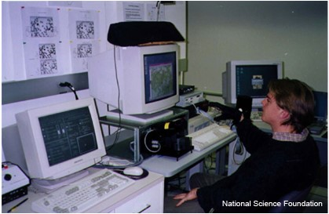
Technical Safeguards (Cont’d – 2)
Examples
Person or Entity Authentication
  Password/passphrase/PIN
  Smart card/token/key
  Biometrics
  Two factor
  authentication
Image Courtesy of National Science Foundation (NSF)
Notes:
The Person or Entity Authentication standard requires a covered entity to “implement procedures to verify that a person or entity seeking access to electronic protected health information is the one claimed.” In other words, authentication is the method by which an electronic system is able to confirm that users are who they claim to be. We’re all very familiar with the technical control that is most often used with electronic systems to verify the authenticity of a user, namely requiring someone to provide information that only they know, most commonly in the form of a password, passphrase, or PIN. There are other ways that identity can be confirmed, including requiring something that an individual possess (like a smart card, a token, or a key), or requiring something unique to the individual, namely the use of biometric authentication. Biometrics refers to devices that can scan features of an individual that are likely to be unique, such as fingerprints, voice patterns, facial patterns or iris patterns, and using the scan of these features to grant access to information systems.
Risk analysis will help determine which type of authentication mechanism is most appropriate to use. Password authentication is the easiest to implement, but may not be the most secure, given the ease with which users can share password information. If password complexity requirements are lax, passwords into critical systems potentially could be guessed. To improve the security of password authentication, complexity requirements should be enforced (for example, requiring that passwords be 8 or more characters long, contain a variety of alphabetic and numeric characters, etc.), automatically lock an account if a password is typed incorrectly after so many attempts (to prevent brute force guessing of passwords), and to require users to change passwords regularly.
These measures unfortunately have the side effect of making password authentication less convenient for the end user, which often results in the end user writing down her password, on a sticky note or some other insecure location that could be stolen—which is a HIPAA violation by the way. Administrative policies and procedures that prohibit writing down passwords could help prevent this, especially if there are serious sanctions that are enforced for violating the policies. However, most organizations will not rely exclusively on password authentication for access to systems containing sensitive ePHI. Using one of the other authentication techniques may be a better option, or combining the use of multiple mechanisms is an even better option. Using password authentication along with a smart card is an example of two-factor authentication, meaning that two authentication mechanisms are used to verify the identity of the user.

Slide 9
Technical Safeguards (Cont’d – 3)
Examples
Transmission Security
  Integrity controls
  Encryption
Notes:
The final technical safeguard we will examine is Transmission Security. Transmission security controls prevent unauthorized access to ePHI that is transmitted over computer networks, such as local area networks (LAN) or the Internet. Some methods that are commonly used to transfer electronic information from place to place include e-mail, over the Internet, or over private networks. An example of this is an EHR system that has a client program running on a workstation that communicates with a server and transmits ePHI over the local area network. Transmission of ePHI over any network is permitted as long as appropriate controls are in place to protect ePHI from unauthorized access. There are two important methods that help ensure that ePHI is transferred securely: integrity controls and encryption. Integrity controls are measures that ensure that data transmitted electronically are not inappropriately modified, either intentionally or accidentally (such as problems with the network). This is similar to the requirement to ensure the integrity of data stored on electronic media, and the same mechanisms, such as hashing algorithms and check sums, can be used to detect unauthorized or accidental alterations of ePHI transferred over a network.
Encryption is also an important safeguard to use when transferring data over a network. Data is encoded before being sent over a network, which means it is converted from a format-like plain text that is understandable into a format that is scrambled and undecipherable. If the data is inappropriately accessed during the transmission, it won’t be decipherable. The data can only be converted back into an understandable format once it reaches its intended destination. Encryption can also be used as a method of ensuring the integrity of ePHI during transmission, since altered encrypted data will not be able to be decoded back into its original state (thus indicating inappropriate or accidental tampering of the data).
An example of transmission security that you may be familiar with is the use of SSL to encrypt the transmission of information over the web. A website address that contains https is using this standard protocol to encrypt the transfer of information from a web server to a web browser located on a workstation computer.

Slide 10
Risk Analysis and Management
Analysis
  Gather data on potential threats and vulnerabilities
  Assess current security measures
  Determine likelihood, impact and level of risk
  Identify needed security measures
Management
  Develop a plan for implementation
  Evaluate and maintain security measures
Notes:
We have covered a wide array of security safeguards that can and should be implemented to protect ePHI in HIT systems. Although we did not cover in great detail specific technologies, there is a large and diverse set of tools that could be used. Deciding what security safeguards and which specific technologies to use must be done as part of a careful risk analysis process. We are revisiting the risk analysis and management process here because it is critically important to any privacy and security program, regardless of the security management system standard that you may choose or be required to use.
The HIPAA regulation does not dictate a single approach to conduct risk analysis of systems containing ePHI. Many of the resources discussed at the beginning of this unit, such as the NIST 800 series of publications (specifically SP 800-39), provide a framework to conduct risk analysis and to create a risk management strategy. The basic framework for this and other risk management strategies are similar, and include elements such as gathering data on potential threats and vulnerabilities (like viruses and known exploits of IT systems), assessing current security measures (like anti-virus software, policies and procedures to apply security patches to IT systems), determining the likelihood of security exploits, the impact of such exploits to the business and the corresponding level of risk that the organization can tolerate, and finally identifying security measures that are needed to mitigate unacceptable risk. All risk management plans include development of a plan to develop and implement security safeguards that are identified as needed based on the risk analysis process, and procedures for ongoing evaluation and maintenance of security measures.
Risk analysis should be a continuous process, in which a covered entity regularly reviews its records to track access to ePHI and detect security incidents, periodically evaluates the effectiveness of security measures put in place, and regularly reevaluates potential risks to ePHI.
The importance of a formal risk analysis and management plan for healthcare organizations that accommodates the HIT systems that support the operations of these organizations cannot be overemphasized. The recent enforcement activity by OCR highlighted earlier in this unit demonstrates some of the serious consequences if an organization is negligent. Those settlements also highlight what is likely one of the largest areas of risk for every organization—the actions of employees working for the organization.

Slide 11
Meaningful Use
Criteria for meaningful use of EHRs related to privacy, security, and confidentiality meant to align with HIPAA
Emphasizes need to conduct a risk analysis
Some specific requirements for EHR vendors
Notes:
For the sake of meeting incentive standards, the meaningful use requirements emphasize specific areas of privacy and security that should be addressed by HIT systems, specifically EHR systems. These requirements are congruent with the larger HIPAA standards as outlined in the Privacy and Security rules.
These include:
Encryption and decryption of electronic health information
Integrity (verification that electronic health information has not been altered while stored or in transit—this is particularly important with the meaningful use emphasis on HIE)
Record treatment, payment, and healthcare operations disclosures
Access control (unique user identification, only authorized access)
Emergency access (also known as “break-glass,” which refers to someone being able to access data in an emergency she wouldn’t have access to normally)
Automatic log-off
Audit log: ability for users to report based on the audit log
These are all part of meaningful use and they re-emphasize technical safe-guards that are already in the HIPAA security rule.

Slide 12
Unit 7: Protecting Privacy, Security, and Confidentiality in HIT Systems
Summary – Lecture b
Privacy, security, and confidentiality in HIT settings
Common threats encountered when using HIT
Strategies to minimize threats to privacy,
security, and confidentiality in
HIT systems
Notes:
This concludes Lecture b of Protecting Privacy, Security, and Confidentiality in HIT Systems. In summary, in this unit we have explored what privacy, security and confidentiality mean in relation to HIT systems. As we have explored the range of security safeguards that can be employed to protect the confidentiality of health information in HIT systems, we have learned about some of the common threats to data in these systems. Hopefully you have learned some of the strategies that can be used to minimize threats to privacy, security, and confidentiality in HIT systems, such as a formal risk analysis and management process for your organization that is facilitated by regulations (such as HIPAA) and/or security management system standards (such as the ISO 27000 series or the NIST 800 series). Such effort will ensure that the fundamental security of health information is assured, leading to trust on the part of providers and patients that will be necessary for HIT to realize its potential for health care transformation.

Slide 13
Protecting Privacy, Security, and Confidentiality in HIT Systems
References – Lecture b
            References
            AHIMA Home - American Health Information Management Association. Ahima.org. Retrieved 17 June 2016. Retrieved from: http://www.ahima.org
            Centers for Medicare and Medicaid Services, HIPPA Security Series: Security 101 For Covered Entities. 2nd ed. 2007. Web. 17 June 2016. Retrieved from: http://www.hhs.gov/sites/default/files/ocr/privacy/hipaa/administrative/securityrule/security101.pdf
            Office of the National Coordinator for Health Information Technology U.S. Department of Health and Human Services,. (2008). Nationwide Privacy and Security Framework For Electronic Exchange of Individually Identifiable Health Information. Retrieved from https://www.healthit.gov/sites/default/files/nationwide-ps-framework-5.pdf
            Cisco. Enterprise Mobility 7.3 Design Guide. Retrieved 24 June 2016 from: http://www.cisco.com/c/en/us/td/docs/solutions/Enterprise/Mobility/emob73dg/emob73.html
            U.S. Department of Health and Human Services. Retrieved from: http://www.hhs.gov
            Ensuring Security of High-Risk Information in EHRs. 2008. Available from: http://library.ahima.org/xpedio/groups/public/documents/ahima/bok1_039956.hcsp?dDocName=bok1_039956
            U.S. Department of Health and Human Services. 17 June, 2016. Retrieved from: http://www.hhs.gov/
Notes:
No Audio.

Slide 14
Protecting Privacy, Security, and Confidentiality in HIT Systems
References – Lecture b
Images
Slide 3: HIPPA Security Bulletins. Courtesy HIPPA. Available from: http://www.hhs.gov/ocr/privacy
Slide 5: Logo of the Federal Trade Commission. Courtesy Federal Trade Commission.
Slide 6: Cloud Computing will Challenge Security Policies. Courtesy U.S. Dept. of Commerce
            Slide 7: Computer Security. 10 June, 2015. Available from: https://www.flickr.com/photos/111692634@N04/18657246306
            Slide 8: A Sophisticated Users’ Station. Courtesy National Science Foundation (NSF) Available from: http://www.nsf.gov/od/lpa/news/press/00/stim5.htm
Notes:
No Audio.

Slide 15
Working with Health IT Systems Protecting Privacy, Security, and Confidentiality in HIT Systems
Lecture – b
This material was developed by Johns Hopkins University, funded by the Department of Health and Human Services, Office of the National Coordinator for Health Information Technology under Award Number IU24OC00013. This material was updated by The University of Texas Health Science Center at Houston under Award Number 90WT0006.
Notes:
No Audio.

