Slide 1
Working with Health IT Systems
Fundamentals of Usability in HIT Systems—What Does it Matter?
Lecture b
This material (Comp 7 Unit 5b) was developed by Johns Hopkins University, funded by the Department of Health and Human Services, Office of the National Coordinator for Health Information Technology under Award Number IU24OC000013. This material was updated in 2016 by The University of Texas Health Science Center at Houston under Award Number 90WT0006.
This work is licensed under the Creative Commons Attribution-NonCommercial-ShareAlike 4.0 International License. To view a copy of this license, visit http://creativecommons.org/licenses/by-nc-sa/4.0/.
Notes:
Welcome to Working with Health IT Systems: Fundamentals of Usability in HIT Systems—What Does it Matter? This is Lecture b.
In Lecture a, we dealt with the general principles of usability and provided some examples of each. In Lecture b we are going to apply those principles in the world of health and health care, specifically focusing on usability of Health IT systems.

Slide 2
Fundamentals of Usability in HIT Systems—What Does it Matter? Learning Objectives—Lecture b
Define usability and its relationship to HIT systems.
Explain the impact of HIT usability on user satisfaction, adoption, and workarounds including error rates and unintended consequences.
Provide alternatives to HIT usability bottlenecks.
Notes:
The Objectives for Fundamentals of Usability in HIT Systems—What Does it Matter? are to:
Define usability and its relationship to HIT systems.
Explain the impact of HIT usability on user satisfaction, adoption, and workarounds including error rates and unintended consequences.
Provide alternatives to HIT usability bottlenecks.
We will finish these objectives by completing the discussion on the impact of HIT usability on user satisfaction, adoption, and workarounds including error rates and unintended consequences. We will then talk about alternatives to HIT usability bottlenecks.

Slide 3
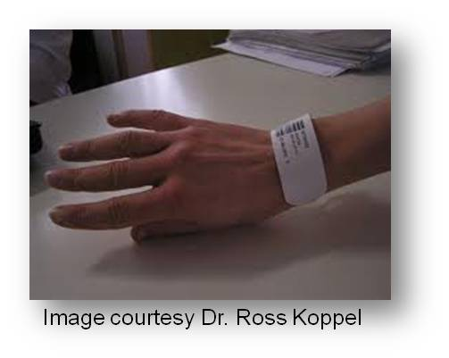
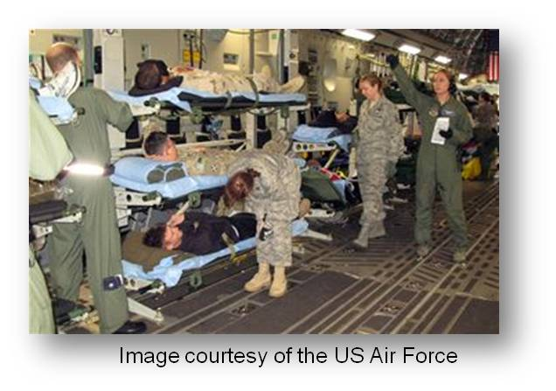
What Happens?
User satisfaction declines & frustration increases
Increase resistance – failure to adopt
Workarounds
Unintended consequences
Notes:
What happens when users are forced to use a system with poor usability?
As mentioned before, user satisfaction declines and frustration increases. Safety-critical environments, like healthcare, the cockpit of an airplane, or a nuclear reactor control room, are no place for systems that engender dissatisfaction and frustration in users.
Users are generally “good eggs,” they’ll usually try to adapt when a system first comes out, but eventually systems with poor usability will result in user resistance to use—or worse yet—an out and out staff mutiny. Much of the current literature is pointing to the low usability of currently available Health IT systems as a significant cause of low adoption rates.
As we discussed in Lecture a, poorly designed Health IT results in workarounds. The example used comes from the Koppel article, where nurses created extra copies of bar-coded medication labels to avoid having to push the heavy and awkward COWS into a patient room. The staff then scanned the extra labels from their pockets to avoid having to push that COW into the room. Think about all of the lightweight and mobile technologies that are available today—why design a 70-pound COW and make it part of the medication administration process? Of course people are going to find workarounds. Wouldn’t you?
Of course, scanning the extra bar code label that the staff created and put in their pockets defeats the purpose of bar code scanning in the first place. The bar code should be on the medication and on the patients arm band so that the label and the drug can be scanned and matched. That is a safety feature to assure that the right drug is being given to the right patient. “Extra” labels in the pocket are just an accident waiting to happen. We see that a lack of a full user-centered approach—including deep evaluation with the user base—to the design of the “solution” has created new problems. This is where we start to see the unintended consequences of health IT designed—with good intent—but with insufficient evaluation.

Slide 4
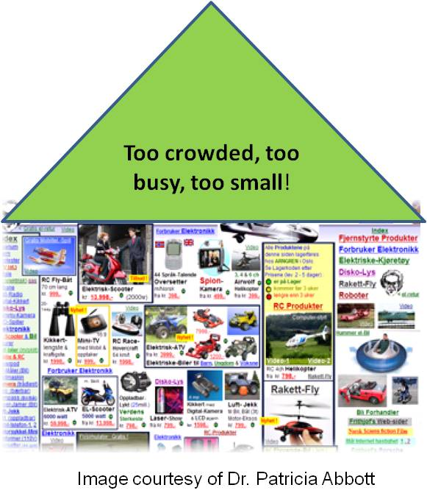
Examples of Poor HIT Usability
Overly cluttered
Poor use of screen space
Inconsistency in design
Unsortable lists
Hard to read or annotate
Lack of safeguards
Not intuitive
Notes:
There are many issues related to poor Health IT usability that can be observed in most, if not all, EHRS systems on the market today.
Examples include overly cluttered screen design, like the web page example you see on this slide, poor use of available screen space, and inconsistencies in screen design. A busy user does not have the time to interpret a jammed screen of data, particularly if it is not arranged well on the screen and/or if the layout changes with every screen switch.
A good example may be when you are moving through a series of computer screens where you are required to click a “NEXT” button at the bottom of the screen. All well and good—until you get to the next screen and you go to the bottom to hit the “NEXT” button again—and it has moved now to the top of the screen on the left-hand side instead of the right-hand side. Users want to find the NEXT button in nearly the same area each and every time so that they don’t have to take their eyes off of the screen to look at the mouse, to maneuver the mouse to the other side of the screen to hit the “NEXT” button.

Slide 5
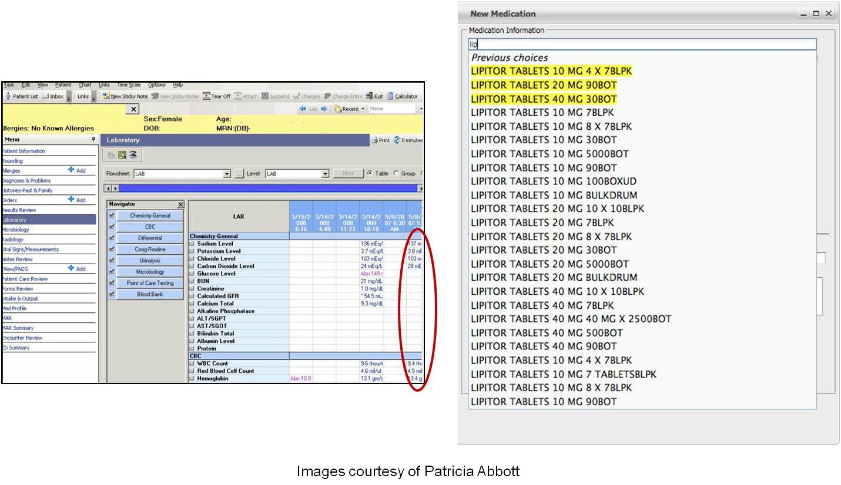
Examples of Poor HIT Usability
Notes:
What you’ll see in this illustration are several examples of sub-optimal screen designs. Look at the image on the left—this is an example of an electronic health record. If a clinician opens the tab where the lab values can be found—the values that she wants to see or the data that is important to her—show up far right and down—the values circled in red. All the rest of that stuff is relatively unimportant. Look at all of that screen space that is wasted. Maybe we could suggest that the values being queried be presented front and center?
Now look at the screen on the right. Notice that Lipitor tablets in a 10 milligram dose (10 MG) are scattered throughout the display- at the top, in the middle, and then at the bottom. This could lead someone to choose the wrong medication from the list.

Slide 6
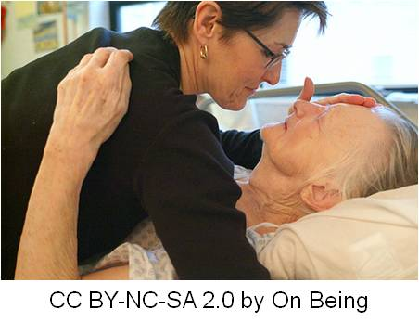
Why It Matters
HIT intent is to increase ease of use, safety, efficiency and reduce error
Increasing pressure
Rushing towards meaningful use
“Quicker and Sicker”
The “Graying of America”
Notes:
Why does usability really matter? The intent of Health IT is to increase ease of use, improve safety and efficiency, and reduce error—yet the literature is showing us that sometimes it does just the opposite. It matters because we should not support nor buy products that run counter to the objectives.
It will matter more and more as Health IT continues to roll out and users become more and more savvy. The pressure to produce highly usable systems will increase. We cannot get to the desired state of automated records if they are unusable or if they continue to spawn new classes of errors.
In the rush to qualify for meaningful use of EHRS and to obtain the incentives—usability may not be the foremost thing on an administrators mind—until the user satisfaction plummets, errors begin to rise, and the efficiency gains that money was spent on the system to improve in the first place, are not realized.
As the patient acuity in hospitals continues to rise (something we call the “quicker and sicker” phenomenon) there is a pressing need for usable systems that support efficient workflow. Shorter lengths of stay and complex patient presentations require very focused attention. There is no room for distracting systems that require additional cognition to figure out.
Aging populations (not only patients but the providers who are using the systems too) require special attention to the design of systems that are usable by those with weakening eyes and less fine motor control. Again, this points back to user-centered design. One size does not fit all. Adaptation is necessary.

Slide 7
Strategies for Bottlenecks
Know your user
Educate
Assure easy access to workstations/devices
Advocate for integrated systems
Prepare for process change & learning curves
Systems must support entire care team
Notes:
The final objective is to discuss strategies for dealing with Health IT usability bottlenecks.
First, you must know your user, watch your user, listen to your user. If you don’t understand the issues it will be impossible to work to improve them.
Your job is also to educate users on how to avoid buying and implementing systems that violate basic usability principles. Remember those 6 components of a usable system? Knowing those components can help you to help users. Is error recovery easy? Is the system easy to learn or is it so complex that every day the users will have to relearn what they did the day before? Does it do what the users need it to do—not what the vendor says they need to do?
Ensuring adequate access to usable workstations or devices is imperative. When computers are in short supply, competition for computers can be very, very high in busy clinical work areas, especially after morning rounds or at shift changes. This leads to workarounds, missed or forgotten documentation, and enhances the chance of a medical error.
Integrated systems that exchange data freely can reduce error. It is common place for users to have to log in to several disparate systems that contain just parts of a patient’s record. This increases the cognitive load of users – forcing them to remember numerous passwords, to go on an information-seeking trek to find bits and pieces of data that’s scattered across separate systems. This chaos ultimately increases the chance of error. This is a really big challenge in today’s world of HIT and may not be one that you will be able to solve. However, as an HIT professional, part of your responsibility is to be aware of the usability bottlenecks, to critically think about how to reduce or eliminate them, and to advocate for interoperable and usable Health IT.
Preparing for change and the learning curves that are inherent in systems implementation is also an important aspect of safety. For example, computerization of the ordering process can dramatically affect the care delivery process. The patterns of communication, cooperation, and collaborative work must shift as the technology shifts. These factors should be planned for and addressed before implementation. Productivity often improves over time in a well-designed system as users gain proficiency with the technology. It is going to be tough at the start, if it is well designed and you have planned for the change sufficiently, it will get better.
Finally, a system developed with user centered principles will model and support the workflow and support all groups of users. Remember, health and healthcare involves a variety of users, including the patient and his family; therefore recalling the principles of user-centered design and usable systems—studying, understanding, and modeling—the user base is the way to improve usability. The critical step is to evaluate, repeatedly, how the system is used in the “real-world”, discover those bottlenecks and redesign. A highly usable system will support the entire work process and the entire care team, not just a single user group. If it does not, then you must speak up. Someone's life may depend on it.

Slide 8
Einstein
“A new type of thinking is essential if mankind is to survive and move to higher levels.”
Albert Einstein; New York Times Magazine (23 June, 1946)
Notes:
Ultimately, usability is a large concern, from the way the cockpit of a jet is designed, all the way down to the way that your toaster works. What we have learned over years and years of producing less than optimally designed Health IT is that we must change the way we think about usability and how we design systems for health and healthcare. As Albert Einstein said, (in the New York Time Magazine June 23, 1946) “A new type of thinking is essential if mankind is to survive and move to higher levels.”
We have to approach usability of Health IT systems in a new way. It’s no longer an afterthought. Poor usability in safety critical health care environments may be a matter of life or death.

Slide 9
Fundamentals of Usability in HIT Systems—What Does it Matter? Summary—Lecture b
Define usability and its relationship to HIT systems.
Explain the impact of HIT usability on user satisfaction, adoption, and workarounds including error rates and unintended consequences.
Provide alternatives to HIT usability bottlenecks.
Notes:
This concludes Fundamentals of Usability in HIT Systems—What Does it Matter? In summary, let’s take a look back at the objectives. We defined usability and we related usability principles to Health IT. We also discussed why it matters, and some strategies for identifying, and reducing or eliminating Health IT bottlenecks.
We also discussed how Health IT usability impacts user satisfaction, adoption, and workarounds. Finally, we covered how poor usability can contribute to error rates and/or spawn unintended consequences.

Slide 10
Unit Title References – Lecture x
References
Campell, E.M., Guappone, K.P., Sittig, D.F., et al. Computerized Provider Order Entry Adoption: Implications for Clinical Workflow. J Gen Intern Med 2009; 24(1) 21-26. Available from: http://www.ncbi.nlm.nih.gov/pmc/articles/PMC2607519/
Ergonomic Requirements for Office Work with Visual Display Terminals (VDTs) – Part 11 Guidance on Usability. ISO/IEC 9241 - 11:1998 (E). Geneva, Switzerland. 1998.
Guappone, K.P., Ash, J.S., Sittig, D.F. Field Evaluation of Commercial Computerized Provider Order Entry Systems in Community Hospitals. AMIA Annu Symp Proc 2008. Available from: http://www.ncbi.nlm.nih.gov/pmc/articles/PMC2655948/?tool=pubmed
HIMSS EHR Usability Task Force. Defining and Testing EMR Usability: Principles and Proposed Methods of EMR Usability Evaluation and Rating. 2009. Available from: http://www.himss.org/content/files/HIMSS_DefiningandTestingEMRUsability.pdf
Koppel, R., Wetterneck, T., Telles, J.L. Workarounds to Barcode Medication Administration Systems: Their Occurrences, Causes, and Threats to Patient Safety. Jour Amer Med Inform Assoc 2008; 15(4): 408-423. Available from: http://www.ncbi.nlm.nih.gov/pmc/articles/PMC2442264/?tool=pmcentrez
Usability Basics. Available from: http://www.usability.gov/basics/index.html
Notes:
No Audio. Ten seconds of silence.

Slide 11
Fundamentals of Usability in HIT Systems—What Does It Matter? References—Lecture b
Images
Slide 3: Image 1—Bar Code on Arm. Courtesy Dr. Ross Koppel, University of Pennsylvania
Image 2—Flying Trauma Unit. US Military. Available from: http://www.af.mil/photos/media_search.asp?q=medica%27
Slide 4: Example of Bad Webpage. Compiled image. Courtesy Dr. Patricia Abbott
Slide 5: EHR Screen Shots. Courtesy Dr. Patricia Abbott
Slide 6: Elderly woman and Caregiver. Courtesy On Being. Available from: http://www.flickr.com/photos/speakingoffaith/4911214966/sizes/m/in/photostream/
Attribution-NonCommercial-ShareAlike 2.0 Generic (CC BY-NC-SA 2.0)
Slide 7: Chessboard. Courtesy Jose Daniel Martinez. Available from: http://www.fotopedia.com/items/eksvav83iakf3-dZCIfV60qwA
Attribution-NonCommercial-ShareAlike 3.0 Unported (CC BY-NC-SA 3.0).
Slide 8: Albert Einstein. Photo from the US National Library of Congress. Public Domain.
Notes:
No Audio. Ten seconds of silence.

Slide 12
Working with Health IT Systems HIT Facilitated Error— Cause and Effect Lecture a
This material was developed by Johns Hopkins University, funded by the Department of Health and Human Services, Office of the National Coordinator for Health Information Technology under Award Number IU24OC00013. This material was updated in 2016 by The University of Texas Health Science Center at Houston under Award Number 90WT0006.
Notes:
No Audio.

