Slide 1
Working with Health IT Systems
Fundamentals of Usability in HIT Systems—What Does it Matter?
Lecture a
This material (Comp 7 Unit 5) was developed by Johns Hopkins University, funded by the Department of Health and Human Services, Office of the National Coordinator for Health Information Technology under Award Number IU24OC000013. This material was updated in 2016 by The University of Texas Health Science Center at Houston under Award Number 90WT0006.
This work is licensed under the Creative Commons Attribution-NonCommercial-ShareAlike 4.0 International License. To view a copy of this license, visit http://creativecommons.org/licenses/by-nc-sa/4.0/.
Notes:
Welcome to Working with Health IT Systems: Fundamentals of Usability in HIT Systems—What Does it Matter? This is Lecture a.
In this unit we will present the basic concepts of usability in general, and HIT usability specifically. Students will be exposed to usability bottlenecks and learn to identify examples of usability roadblocks in the example EHRS lab system, while hypothesizing potential downstream effects of poor usability. Students will be challenged to suggest solutions or alternative designs. This unit will also detail the relationships between usability, user satisfaction, and workarounds.

Slide 2
Fundamentals of Usability in HIT Systems—What Does it Matter? Learning Objectives – Lecture a
Define usability and its relationship to HIT systems.
Explain the impact of HIT usability on user satisfaction, adoption, and workarounds including error rates and unintended consequences.
Provide alternatives to HIT
usability bottlenecks.
Notes:
The Objectives for Fundamentals of Usability in HIT Systems—What Does it Matter? are to:
Define usability and its relationship to HIT systems
Explain the impact of HIT usability on user satisfaction, adoption, and workarounds including error rates and unintended consequences.
Provide alternatives to HIT usability bottlenecks
In this unit we will begin with general descriptions and definitions of usability, and then apply those concepts to Health IT systems.
Usability has a tremendous impact on the user experience and can also impact satisfaction and levels of acceptance of a system. Poor usability can also engender workarounds, increase error rates, and generate unintended consequences or effects that were unexpected. By the end of this unit, you will be able to explain how Health IT usability can effect each of these.
Finally, our goal is not only to increase your sensitivity to the challenges of Health IT usability, but to also help you to be able to suggest alternatives to Health IT usability bottlenecks. It is one thing to critique usability – but as a health IT professional, you should be able to suggest alternatives.

Slide 3
Usability Defined
“The extent to which a product can be used by specified users to achieve specified goals with effectiveness, efficiency and satisfaction in a specified context of use.” (ISO 9241-11)
(Ergonomic Requirements for Office Work with Visual Display Terminals (VDTs) – Part 11 Guidance on Usability. ISO/IEC 9241)
Usability is the study of the ease with which people can employ a particular tool or other human-made object to achieve a particular goal.
Notes:
Usability is defined by the ISO as “the extent to which a product can be used by specified users to achieve specified goals with effectiveness, efficiency, and satisfaction in a specified context of use.” You will note that the ISO is not talking about computer systems specifically. Usability is applied to any “product.”
For example, did you know performer John Denver’s plane crashed in the late 1990s because of a faulty design that required that he turn around, in the pilot’s seat, reach his right hand over his left shoulder, in order to either shut off his fuel lines or switch from an empty tank on one side to a full tank on the other? The way the aircraft was designed also required that he let go of the controls and reach behind his shoulder to find the valve and turn it.
As the National Transportation and Safety Board (NTSB) discovered, it was difficult to do this without the pilot significantly bracing himself with his right foot to get the torque necessary to twist in the seat and reach the switch behind his shoulder. Unfortunately, the right foot area is where the rudder is located. And that's what killed John Denver. Flying at a low altitude over the ocean beach in California, he went to switch the fuel tank over, and braced himself with his right foot. It is hypothesized that he jammed his foot full down on the rudder, which explains why his plane was seen veering sharply to the right and plunging into the ocean. The eye witness reports were consistent with the NTSB's reconstruction.
Dictionaries define usability as the study of the ease with which people can employ a particular tool or other human-made object to achieve a particular goal. Obviously John Denver did not find the fuel tank switch over to be easy … with tragic consequences. The Denver tragedy illustrates an unintended consequence of poor design.

Slide 4
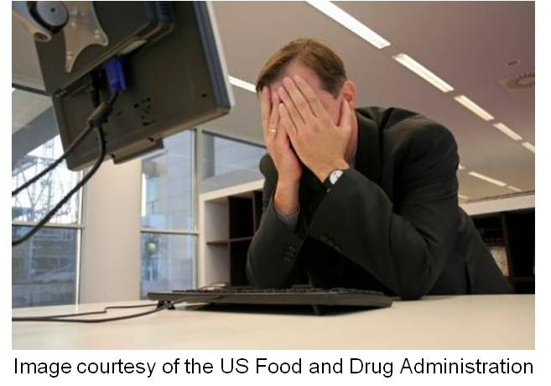
Jakob Nielsen
Usability—a quality attribute that assesses how easy user interfaces are to use
6 Components:
Learnability
Efficiency
Memorability
Errors
Satisfaction
Utility
Notes:
Jakob Nielsen, one of the foremost experts on usability, asserts that usability is a quality attribute that assesses how easy a user interface is to use. As noted earlier, an interface can be anything from the dashboard of a car, to the handles on a door, to the layout of a computer screen. We can all pull to mind, rather easily, examples of poor usability.
According to Usability.gov, usability is defined by five quality components, but Jakob Nielsen adds a sixth. The five start with Learnability.
Learnability is conceptualized as how easy is it for users to accomplish basic tasks the first time they encounter the design. In short, how easy is it to learn? How easy is it for a user to accomplish a basic task the first time she touches it?
Efficiency is related to the quickness (after learning the basic use of the system) that users can perform the tasks. Does ordering a medication take 6, 8, 10 clicks? If so, that may not be efficient.
The memorability concept is related to the ease experienced by a user returning to a system or a product after a period of not using it, and reestablishing proficiency. You’ve often heard once you’ve learned to ride a bike, you’ve learned to ride a bike. Memorability is very, very similar. If you have been away from the device for a while and you come back, how quickly can you pick back up your skills?
The fourth quality component is error and it is represented as observations, experiences, and measurements of how often, what kind, and when the users make errors while using the system. How severe are those errors? Are these life-threatening errors, or just a nuisance? How easily can a user recover from the error is another dimension of usability quality.
Satisfaction is a measure of how pleasant the design, the product or the system is to use.
The sixth piece—which is added by Dr. Nielsen—is utility, and that refers to the design's functionality. Does it do what the users need it to do? Usability and utility are equally important. It matters little
that something is easy to do if it's not what you need the system to do. It's also no good if the system can hypothetically do what you want, but you can't make it happen because the user interface is too difficult.

Slide 5
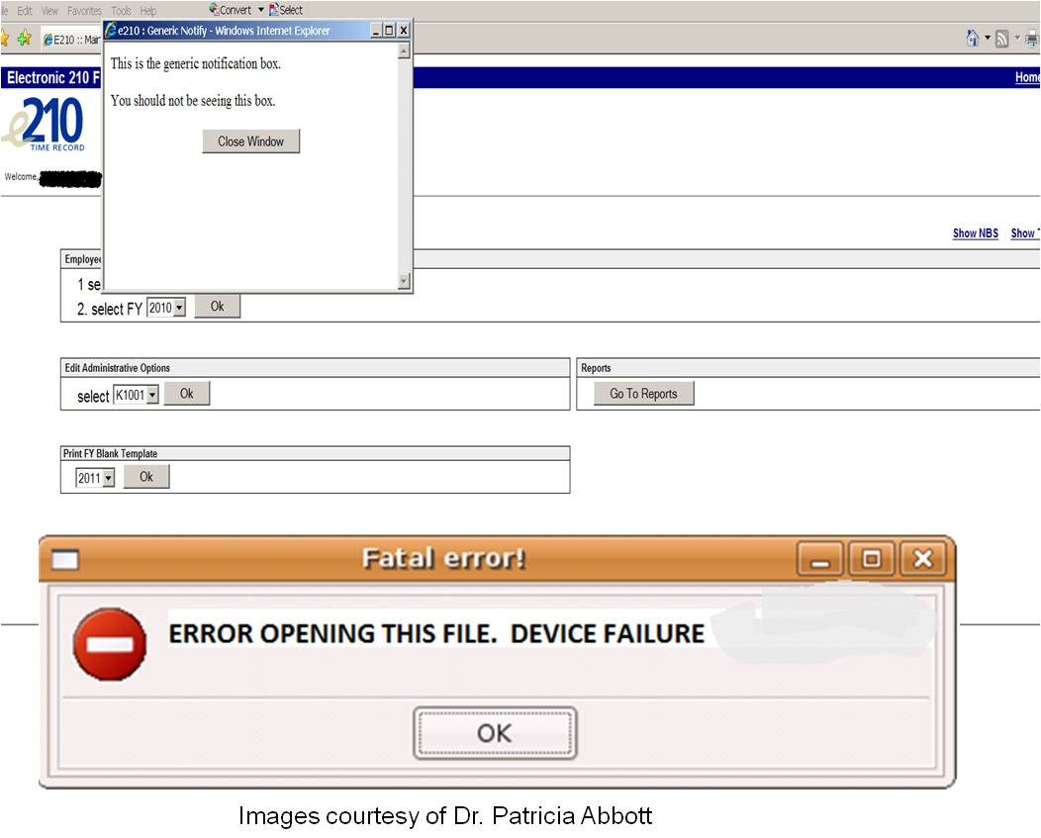
User-Centered Design
Notes:
Think about those 6 components. Let's take error recovery as an example. Are messages like these shown on the screen particularly helpful to a user? First off —in that display on the bottom of the slide—using the words “FATAL ERROR” may not be the best choice of words, but particularly in healthcare! Look at the error example at the top of the slide. Besides the fact that the error message is stupid, a well-designed system will give the user instructions of what to do next, which, other than “Close Window,” the example at the top fails to do. What the message does tell the user is that this is “the generic notification box”—and then informs the user “You should not be seeing this box.” What would be your response if you were the user who received this message?
Between the nonsense messages and the dead end in regards to how to proceed, this type of message is what frustrates users. A good error message instructs the user how to recover from the error, or how to prevent it from occurring again and gives the user a message that can be interpreted. When usability decreases, frustration increases. With increased frustration comes many other “side effects” that can increase error and reduce willingness to adopt health IT.
More about this shortly. Let’s return to the ISO.

Slide 6
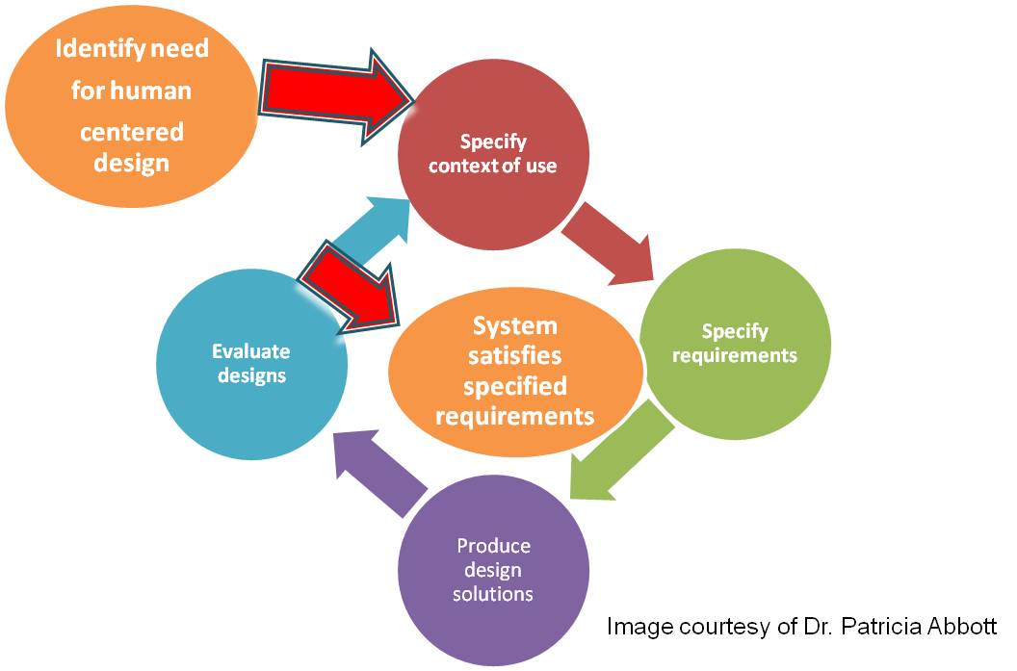
User-Centered Design ISO 13407:Human-Centered Design Process
Notes:
The ISO standard 13407 specifies the human-centered design process and specifies that it is an approach to design that grounds the process in information about the people who will use the product. User-Centered Design (UCD) processes focus on users throughout the planning, design, and development of a product. Therefore, user-centered design helps one to achieve a better level of usability. Understanding your user base, how they think and how they work is absolutely critical. Unfortunately in Health IT, this has not been the way that many systems were designed. Thankfully this is beginning to change.
The process begins with the critical understanding of the NEED for human-centered design in the first place. Unfortunately, people don’t know what they don’t know. Once it is acknowledged that there is a need, the first step is to specify the context of use, then to specify requirements, produce design solutions, and then evaluate those design solutions. At that point, if the evaluations are good, then the red arrow points to the end of that stage of design —in that what was built satisfies the specified requirements. If not, then the cycle repeats. One point that is critically important to make is the evaluation of the design solution must be done with the users AND you are not your user! When designs are evaluated by those who created them—instead of who is going to be using them—we end up with those unexpected consequences.

Slide 7
User Centered Design
Image courtesy of Dr. Mark Blatt
Notes:
So how can we take that abstract ISO model and translate it into the real-world of health and healthcare? It is a six-step iterative process, which really never ends. UCD requires that you study people in their own environments so you can understand how people deal with specific problems and tasks in the process of interacting with the system.
The third step is developing prototypes of new technology solutions or new ways of dealing with a process and then piloting—or field-testing—those prototypes, which is very important so that you can work with your users to see how the new approach works. This stage requires absolute humility—you must listen carefully to your user base and then iteratively redesign until an optimal design is achieved.
Now remember, do not confuse optimal with perfect! There are limitations and the best way to please nobody is by trying to please everybody. The prototype is redeveloped into the next version, deployed, evaluated—and then the whole process starts over again. It is an iterative cycle—particularly in the world of HIT.

Slide 8
Iteration in Design
There is nothing permanent except change.
-- Heraclitus
https://commons.wikimedia.org/wiki/File:Utrecht_Moreelse_Heraclite.JPG
(Heraclite, 1630)
Notes:
Change, change, change, change. The philosopher Heraclitus said, “There is nothing permanent except change.” In this world of HIT change is just constant. You are either part of the future or you are history, so just get used to designing, listening, fixing—then designing all over again, listening all over again, and fixing all over again. User Centered Design requires it.

Slide 9
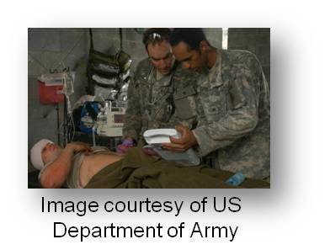
Usability in HIT
Understanding the user base
Mobile workers
Highly disruptive & stressful situations
Cognitive overload
Restriction of physical space–portability important
Time compression
Frequent turnover (patients & providers)
Workarounds are common
Notes:
Let’s go a bit deeper in regards to usability and its relationship with Health IT. Think back to that graphic on user-centered design a few slides ago. Remember, we must first study and try to understand the user base (those were the first two steps).
Stepping into healthcare—what do we know about our user base in regards to clinical computing? Well first we know that docs, nurses, pharmacists, other members of the team are highly mobile workers who are operating in highly disruptive and stressful conditions. They are distractible and in intense cognitive overload. We know from the literature, public press, and common sense that overload, interruptions, and distractions increase the chance of all types of error. The knowledge of the impact of distraction on human error is one of the reasons that many states have outlawed talking on cell phones that are not hands-free and prohibit texting while driving.
Further complicating the lives of our users, the Health IT users, are the restrictions of physical space and restricted freedom of movement. Crowded rooms, impeding furniture, visitors, equipment, these things all make maneuvering very much of a challenge in health care. This is what contributes to the importance of non-intrusive portable or mobile technology for busy clinicians. Interruptions in workflow that are encouraged by fixed computing devices located in areas not convenient to the user base—such as at the nurses’ station—contribute to efficiency losses, workarounds, and higher error rates. The “I’ll chart later phenomenon” results in latency of important data being available to guide care. Even portable devices such as computers on wheels (COWS or cows) are not a panacea. Studies are showing that cumbersome COWS are frequently left in hallways or nursing stations so that they can be plugged in for a recharge, are too heavy and clumsy to push and take into a patient room, or are too time consuming to disinfect between patient rooms. Usability is a real challenge in healthcare!
Also, the rate of turnover is really high—of both patients and staff—particularly in teaching institutions where students are rotating constantly. This is an incredible challenge in keeping people trained and competent as new versions of the software are released, and the staff is constantly full of new faces. This calls for (remember back to those 6 components of a usable system from a few slides ago) a system that is easy to learn, easy to remember, error tolerant, helpful, and so on.
We also know from the literature that workarounds circumvent built-in safety features—therefore we end up with results like in an article from Ross Koppel and colleagues where the bar code administration system—purchased to reduce medication errors—actually facilitated new types of medication administration hazards. As Koppel et al. stated, we need to “understand how BCMA systems are actually used in the challenging reality of hospital practice, why BCMA workarounds are so common, and what hospitals can do to find them and to address their causes and unintended consequences.” That comment is from page 421 of the Koppel article that you will find referenced at the end of this unit.

Slide 10
Fundamentals of Usability in HIT Systems—What Does it Matter? Summary—Lecture a
Consequences of poor usability
Six quality attributes of usability
ISO’s User-Centered Design
Challenges of clinical computing and how usability relates
Knowing the principles, designing with the user in mind & testing designs are critical
Notes:
This concludes Lecture a of Fundamentals of Usability in HIT Systems—What Does it Matter? In summary, we defined usability and we discussed several consequences of poor usability such as workarounds, error propagation, and unexpected and unintended consequences.
The six quality attributes of usability (Learnability, Efficiency, Memorability, Errors, Satisfaction, and Utility) were presented and described. Can you recall the differences between each of them? Can you reflect on what relationship each of these terms has to usability?
The ISO’s representation of UCD was provided as a model and the point was made that UCD requires the study of people in their own environments. This, in turn, deepens the designer’s understanding of how people deal with specific problems and tasks as they interact within the work context. In relation to UCD, the importance of field-testing, observing, listening, and then redesigning was emphasized.
Finally, the challenges faced by busy clinical users such as cognitive overload, constant mobility, stress, and frequent interruption were presented, emphasizing the importance of usability and applying several of the six quality attributes of usability.
Important points from this lecture are that the principles of usability are relatively straight-forward and understandable—yet many systems today continue to be built ignoring them. When poor usability is combined with busy and distracted clinical users, error is bound to occur. Having knowledge of these basic principles, designing with the user in mind, and then testing and rebuilding until the product
is optimized are crucial to health IT that is both usable and safe.

Slide 11
Fundamentals of Usability in HIT Systems—What Does it Matter? References—Lecture a
References
Ergonomic Requirements for Office Work with Visual Display Terminals (VDTs) – Part 11 Guidance on Usability. ISO/IEC 9241.
Jakob Nielson: useit.com: Jakob Nielsen's Website. Available from: http://www.useit.com/
Koppel, R. P., Wetterneck, T. M., Telles, J. L., & Karsh, B.-T. (2008). Workarounds to Barcode Medication Administration Systems: Their Occurrences, Causes, and Threats to Patient Safety. Journal of the American Medical Informatics Association, 408-421.
National Transportation Safety Board Executive Summary of its final report into the Denver crash. January 26, 1999. Available from: http://www.avweb.com/news/safety/183015-1.html
Nielsen, Jakob. Definition of Usability. Available from: http://www.useit.com/alertbox/20030825.html
Notes:
No Audio. Ten seconds of silence.

Slide 12
Fundamentals of Usability in HIT Systems—What Does it Matter? References—Lecture a
Images
Slide 2: Door Alarm. Available from: http://www.flickr.com/photos/brettlider/5615190034/sizes/m/in/photostream/
Attribution—Share Alike 2.0 Generic (CC BY-SA 2.0) Brett L.'s Photostream.
Slide 4: Man in Front of PC Screen, Face in Hands. Courtesy Federal Drug Administration(FDA). Available from: http://www.accessdata.fda.gov/scripts/cdrh/cfdocs/psn/printer.cfm?id=497
Slide 5: Image 1—Notification window: "This is a generic notification box. You should not be seeing this box.”
Image 2—Error message : Error opening this file. Courtesy Dr. Patricia Abbott
Slide 6: User-centered Design. Adapted from ISO standard 13407 by Dr. Patricia Abbott
Slide 7: Image 1—The Six Iterative Steps of User-Centered Design.
Image 2—Older Asian Woman. Courtesy Mark Blatt, M.D. (HIMSS Presentation; MCA; 2009)
Slide 8: Image of Heraclitus: https://commons.wikimedia.org/wiki/File:Utrecht_Moreelse_Heraclite.JPG
Slide 9: Doctors and Medics in a Makeshift Field Hospital During a Mass-Casualty Exercise on Fort Bragg, N.C.
Courtesy US Army. Available from: http://Army.mil.images
Notes:
No Audio. Ten seconds of silence.

Slide 13
Working with Health IT Systems HIT Facilitated Error— Cause and Effect Lecture a
This material was developed by Johns Hopkins University, funded by the Department of Health and Human Services, Office of the National Coordinator for Health Information Technology under Award Number IU24OC00013. This material was updated in 2016 by The University of Texas Health Science Center at Houston under Award Number 90WT0006.
Notes:
No Audio.

