Slide 1
Working with Health IT Systems
The Effective HIT System
Lecture 4
This material (Comp 7 Unit 4) was developed by Johns Hopkins University, funded by the Department of Health and Human Services, Office of the National Coordinator for Health Information Technology under Award Number IU24OC000013. This material was updated in 2016 by The University of Texas Health Science Center at Houston under Award Number 90WT0006/01-00.
This work is licensed under the Creative Commons Attribution-NonCommercial-ShareAlike 4.0 International License. To view a copy of this license, visit http://creativecommons.org/licenses/by-nc-sa/4.0/.
Notes:
Welcome to Working with Health IT Systems: The Effective HIT System.

Slide 2
The Effective HIT System Learning Objectives
Identify characteristics of an effective HIT system.
Define and provide examples of how evidence-based practice can be supported in HIT systems.
Define and cite examples of usability, configurability, scalability, and reliability in HIT systems.
List and contrast different types of reports/queries (predefined vs. ad hoc) required for internal and external reporting.
Notes:
The Objectives for The Effective HIT System are to:
Identify characteristics of an effective HIT system.
Define and provide examples of how evidence-based practice can be supported in HIT systems.
Define and cite examples of usability, configurability, scalability, and reliability in HIT systems.
List and contrast different types of reports or queries (predefined vs. ad hoc) required for internal and external reporting.
Unit 4 is designed to emphasize the aspects of HIT that contribute to effectiveness and meaningful use. The concepts of usability, consistency, and reliability in regards to HIT systems and how each contributes to, or detracts from, effectiveness will be presented. Definitions of evidence-based practice and guideline-enhanced care will be covered in addition to how HIT can support effective, safe, and efficient patient-centered care.
To meet the goals of this unit, the following objectives will be addressed:
We will identify several characteristics of an effective HIT system and how they can contribute to meaningful use. In the process, we will also discuss evidence-based practice and how HIT can facilitate its application.
Configurability, reliability, usability, and scalability will be defined and their relationship to effective HIT will be articulated.
By the end of this unit you will be able to list and contrast different types of reports frequently requested of HIT systems for both internal and external reporting requirements.

Slide 3
Effective HIT
Integrated/Interactive exchange
Patients, providers, government agencies, insurers
Increase of overall quality, safety, efficiency, decreased costs, & increased patient access
Improved public health
Early detection of outbreaks
Tracking & evaluation in chronic disease
Post-marketing surveillance of medications
Evaluation/reimbursement based on value
Notes:
[From the article “Health Information Technology: A New World for Pharmacy” by Webster and Shapiro in the Journal of the American Pharmacy Association, March/April 2010, we find a description of the effective HIT system. These authors assert that HIT is expected to provide integrated electronic health care with interactive exchange among patients, providers, government agencies, and insurers, resulting in an increase in the overall quality, safety, and efficiency of health care delivery with fewer medical errors, increased administrative efficiency, decreased health care costs, and expanded patient access to affordable health care.
In addition to the benefits to individual patient care, public health benefits include early detection of infectious disease outbreaks, improved tracking and evaluation of chronic disease management, improved post marketing surveillance of medications, and evaluation, and reimbursement of health care services based on value.

Slide 4
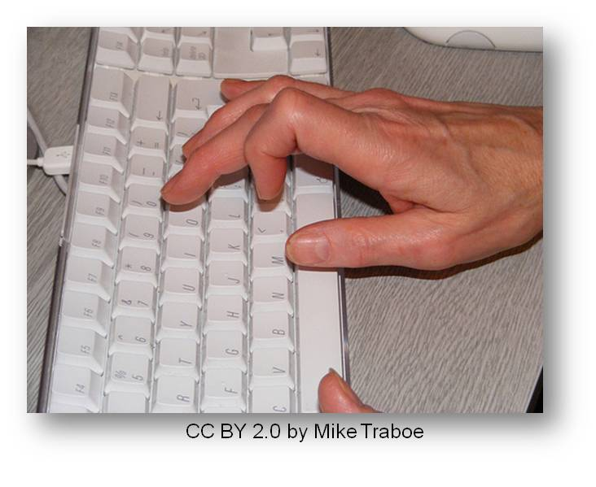
Characteristics of Effective HIT
Flexible
Adaptable
Configurable & Agile
Dependable/Reliable
Useable
Scalable
Notes:
The core characteristics of effective HIT systems are actually quite similar to the core characteristics of any technology. For example, these are the same characteristics that I look for when I am buying my new cell phone, a camera, or a computer.
A flexible, adaptable, configurable and agile, dependable and reliable EHRS is essential in the healthcare industry, where regulations change and new software and technologies emerge daily. A rigid EHRS that is difficult (or impossible) to modify to meet changing business requirements and user needs will reach obsolescence very rapidly. In safety critical environments, dependability is non-negotiable. An unreliable system is untenable.
Usability is the art and science of designing systems or products that are effective, efficient, engaging, error tolerant, and easy to learn. The poor usability of many HIT systems is cited as one reason that the use of HIT in healthcare is lagging and has elevated Federal attention to improving the usability of HIT.
Dictionaries define scalability as the ability of a computer application or product (hardware or software) to continue to function well when it (or its context) is changed in size or volume to meet a user need. HIT that is scalable supports upsizing and downsizing—important considerations in an uncertain healthcare marketplace.
Ultimately, these characteristics may dictate the success or failure of any HIT implementation, and it is not sufficient to have a system that excels in one area while ignoring another. Having the most easy to use system in the world is of little consequence if it is unreliable.

Slide 5
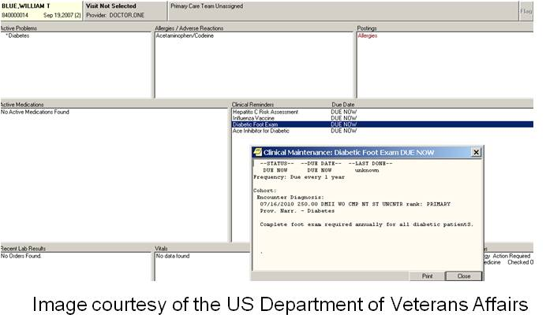
Facilitates “Best Practices”
Evidence Based Practice (EBP)
“the integration of best-researched evidence and clinical expertise with patient values.” (Crossing the Quality Chasm, 2001)
Guideline-enhanced Care
http://www.guideline.gov/
Notes:
What are the particular aspects of Health IT that contribute to effectiveness and meaningful use? The first to discuss is Health IT that facilitates best practices—or said in another way, making the right thing to do the easiest thing to do.
For example, syndromic surveillance—or the collection and submission of case reports to the public health department from —let’s say an emergency room— should be easy and automatic—not requiring “finding the time” or being viewed as “another thing to do.” Automatic reporting of early outbreaks of disease presenting in clinics or emergency departments by Health IT is an example of making the right thing to do the easiest thing to do.
What exactly is Evidence Based Practice (EBP)? The Institute of Medicine (IOM) defines evidence-based practice as the integration of best-researched evidence and clinical expertise with patient values, pointing again to the patient at the center of health and healthcare. This is all well and good, but don’t we have this now? Yes, but most of the time it is not available at the moment of need—pointing to an area where Health IT can benefit. Making automated access to EBP resources easier helps to drop one of the biggest barriers to its adoption into practice. Where is it when you need it?
Beside the obviousness of making the world “easier”—why else do we care? The IOM identified a “chasm” in our health care system between the quality of care delivered and the quality of care patients should expect to receive based on the best scientific knowledge. This has also been referred to as the “know-do” gap—meaning what we know and what we do are often disconnected. Health IT can be used to bridge that gap—or cross the chasm by bringing vetted, high quality, and patient-centric information to the moment of need—be it at the bedside, in the lab, at the policy-making table, at the dining room table, or in the health department. The true transformation of our health system is reliant upon closing this chasm and effective Health IT is an important tool.
Guideline-enhanced care—albeit at times controversial—is supported by much of the literature as an effective mechanism for improving health. A guideline should be viewed as just that—it offers guidance, but does not mandate adherence. An example of a guideline in Health IT may be that based on the entry of a diagnoses into an EHR, a guideline appears that suggests additional actions that are demonstrated, by the evidence, to result in better outcomes. For instance, in the demo EHR system, there are “clinical reminders” that appear based on diagnoses and the presence or absence of certain orders or results. The URL here in the slide refers you to the Guideline.gov site where numerous guidelines exist.
EBP & Guideline enhanced care are geared toward improving the quality of care and outcomes of people who are ill. Achieving this goal requires understanding the current evidence regarding effectiveness of quality improvement efforts, and finding better ways to quickly and effectively translate knowledge into practice for both patients and healthcare providers.
The immediate challenges ahead for improving guidelines utilization are to convert what we know from guidelines’ implementation, quality improvement, and health care systems research into useful tools, processes, and pathways that are integrated into Health IT.

Slide 6
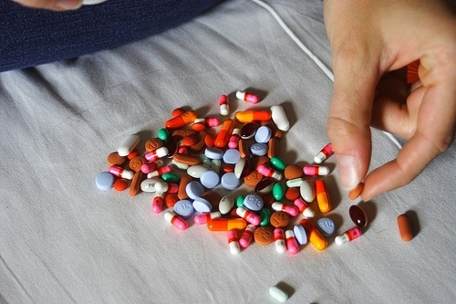
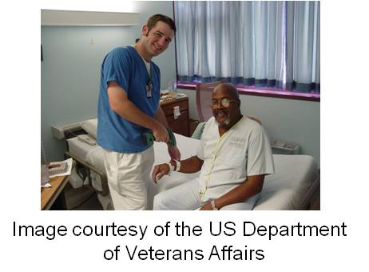
Medication Reconciliation
Process of determining what medications patient is taking
Med errors
Admissions
Transfers
Discharge
Polypharmacy
Bar Code Medication Administration (BCMA) & e-MAR
E-prescribing & digital medication records
CC BY-NC-ND 2.0 by Laura
Notes:
How else can Health IT support effective, safe, and efficient patient-centered care? Medication reconciliation is another important process that is facilitated and optimized by Health IT in both inpatient and outpatient settings.
This process of identifying the most accurate list of all medications the patient is taking and using that list to provide correct medications for patients anywhere within the healthcare system will be more efficient and exact when all medication information is shared electronically in real time. This will reduce the medication errors that are common to the medication reconciliation process that frequently occur when a patient is admitted to, transferred within, or discharged from a healthcare facility.
Polypharmacy -- defined by the Merriam-Webster dictionary as “the practice of administering or using multiple medications especially concurrently (as in the treatment of a single disease or of several coexisting conditions)” (http://www.merriam-webster.com/dictionary/polypharmacy) -- is common when medication records are not shared between providers and healthcare facilities. Evidence of polypharmacy is commonly found in the medicine cabinets of the elderly or chronically ill, where various prescriptions from disconnected providers can be found, some which are contraindicated when taken together, and often many are out of date. The lack of a consolidated medication record contributes to this open door to medication error and waste.
Bar-coded medication administration (BCMA) and electronic medication administration record (e-MAR) are two terms that are frequently used in relation to medications and Health IT. A patient’s armband has a bar code, and the medication has a bar code as well—the two are matched with the order that exists in the e-MAR—thereby demonstrating another effective use of Health IT. Verifying the order, verifying the drug, automating the documentation of administration is designed, in theory, to improve efficiency.
Ultimately, an integrated EHR with digital medication records and e-prescribing would provide anytime, anywhere access to legible patient information with legible prescriber orders and signature on a real-time basis. The availability of real-time information would alert providers to the patient’s medical history, current medications, CDS options, including drug-drug and drug-allergy alerts, and formulary/drug benefit plan coverage at the point of care. The cost savings would be marked and the proportion of the meaningful use criteria related to e-prescribing is high.

Slide 7
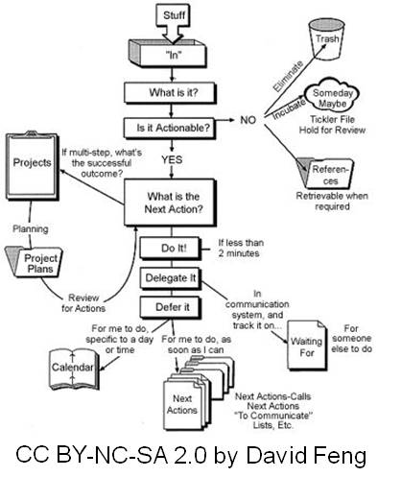
Supporting Workflow
HIT – organizes work, integrates knowledge, supports decision-making
Decreased memory demands
Routing and prioritizing
Notes:
What is workflow? The National Institute of Standards or NIST defines workflow as “a set of tasks, grouped chronologically into processes, and the set of people or resources needed for those tasks that are necessary to accomplish a given goal.” [Lowry, S. Z., Ramaiah, M., Patterson, E. S., Brick, D., Gurses, A. P., Ozok, A., ... & Gibbons, M. C. (2014, March). Integrating Electronic Health Records into Clinical Workflow An Application of Human Factors Modeling Methods to Ambulatory Care. Retrieved from http://nvlpubs.nist.gov/nistpubs/ir/2014/NIST.IR.7988.pdf] The Agency for Healthcare Research and Quality applies this definition to healthcare in this way: “Workflow is defined as a series of steps, frequently performed by different staff members and often dependent on related workflows, that accomplishes a particular task. Workflows represent how work actually gets done, not the protocols that have been established to do the work.” [Module 5. Mapping and Redesigning Workflow. May 2013. Agency for Healthcare Research and Quality, Rockville, MD. http://www.ahrq.gov/professionals/prevention-chronic-care/improve/system/pfhandbook/mod5.html]
Effective Health IT supports—not thwarts—workflow. Point of service, or POS, Health IT helps to organize work by including clinical knowledge and clinical decision support to provide guidance and feedback on the processes or the process being undertaken. An example may be that if the data being put into an EHR system indicates a high risk of skin breakdown, an automatic order is generated to the central supply department to send skin protectors to the patient’s room and a consult for a skin specialist is generated. Taking it one step further, an area for documenting additional details related to the skin condition is automatically generated in the EHR. This function of the effective EHR system is becoming increasingly important as payers begin restricting reimbursement for certain conditions that may be caused during a hospital stay (such as pressure ulcers, falls, medication errors, etc.). Having the Health IT automatically generate orders, reminders, and additional documentation reduces the reliance on a busy user to remember to do it. Decreasing memory demands leaves less to chance.
Routing and prioritizing messages helps to decrease cognitive load on busy users. Although a clinic or an office or a ward in a hospital is inherently busy, efforts to reduce the clamor and interruptions are important. Instead of loudspeaker announcements blaring across an entire unit, diverting and directing calls, and messages using smart phones, pagers, and the like, supports workflow and reduces the distraction factor of irrelevant communications and interruptions.

Slide 8
Automating Workflow
Automates tedious aspects
Effective use of resources – balancing supply and demand
Notes:
Other aspects of Health IT support for the workflow includes automation of tedious aspects of job functions, effectively balancing supply and demand, facilitating easy data extraction and reporting, and the considerations of user-centered design.
Similar to bar-coding in the grocery store—where an automatic inventory reveals not only how many cans of tomatoes were sold in a day, but also re-orders them by comparing what was sold with what should be on hand—effective Health IT can support workflow by automating the tedious low value aspects of practice. Pulling a qualified provider away from the patient care activities to order IV tubings, bandages, and other supplies is extremely inefficient. Automated supply dispensing machines help to capture utilization, manage re-ordering, and generate charge slips that free users up to tend to higher order functions.
The effective use of resources is another aspect of Health IT support for workflow. Disjointed and inefficient process creates bottlenecks that impede subsequent action—for example, the inability to locate a wheelchair to discharge a patient, results in that bed being unavailable for a transfer from the emergency department—and the bed in the ED then is closed to a new admission, therefore the ambulances go on “red alert,” meaning they bypass the ED for another hospital where a bed exists. Patient flow is crucial to practice efficiency and capacity—which in turn affects revenue and provider and patient satisfaction.
If we take this example to a provider office, we can see how improving patient access to the provider increases timeliness of care and may positively impact outcomes. Reducing the time between when a patient calls for an appointment and when he is seen can enhance early detection of diseases or declining conditions—helping to better manage chronic conditions. This is sort of like a Health IT “stitch in time saves nine.” How is the time period reduced? The required reading for this unit asserted that by reducing “no shows, ”the efficiency of the office or clinic is improved. How did Health IT do that? By allowing patients to schedule their own appointments on line. According to the article, this reduced the number of patients who were no shows, because they scheduled the appointment themselves at a time that worked better with their personal schedule. Fewer no shows equaled more efficiency, which subsequently reduced the amount of time that patients had to wait to get an appointment with their provider. Balancing supply and demand is inherently more efficient.

Slide 9
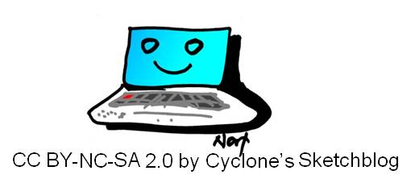
Extracting Data
Data extraction & reporting
Ad hoc & pre-defined
User centered design
“a design and evaluation process that pays particular attention to the intended users, what they will do with the product, where they will use it, and what features they consider essential” (ISO 13407)
Notes:
Data extraction and reporting is a critical attribute of Health IT effectiveness. One of the major complaints about Health IT is the inability to extract data from the repository, which of course is a major issue. As referred to earlier—the ability to create standard or pre-defined reports—such as those needed for regulatory reasons, quality improvement, utilization review, etc. is a fundamental requirement of HIT, and one that many HIT vendors can support. At the same time, the ability to easily run ad-hoc queries, without major outlay of time and resources, is similarly vital. We cannot manage what we cannot measure—and data locked in a repository beyond the reach of the user base cripples transformative actions in health and healthcare. The long and short of it is that reporting on achievement of “quality measures” is a required component of the meaningful use criteria.
The final aspect, which will be covered in much greater detail in subsequent units, is that of user-centered design. How does user-centered design intersect with the effective Health IT system? Why is user-centered design a hallmark of an effective Health IT system? The definition provided above, from the International Standards Organization or ISO—points out the importance of designing for the users, where they will use it, what they will do with it, and what aspects are considered essential to them. So, having the most robust Health IT, jammed packed with the most current scientific evidence does little good if the users cannot understand it, or if it contains data that they perceive to have little value. In healthcare, stories abound of poorly designed Health IT that causes users to reject it, or use it and generate new classes of medical errors that were unanticipated by the designers. A system that does not support the users—be it a patient, a policy-maker, or a clinician—cannot be viewed as an effective application of Health IT.

Slide 10
The Effective HIT System Summary
Identify characteristics of an effective HIT system.
Define and cite examples of usability, configurability, scalability and reliability in HIT systems.
Define and provide examples of how evidence-based practice can be supported in HIT Systems.
List and contrast different types of reports/queries (predefined vs. ad hoc) required for internal and external reporting.
Notes:
This concludes The Effective HIT System.
In summary, we discussed the aspects of Health IT that makes it effective, covering dimensions of usability, workflow support, flexibility, reliability, and other ways that HIT can support effective, safe, and efficient services. Evidence-based practice and guideline-supported care were presented as adjuncts to human decision-making and examples of how such approaches can be incorporated into HIT were provided. Finally, the point was made that data in health and healthcare is collected for several purposes—from quality improvement to reimbursement—and that the ability to extract data from HIT for both internal and external reporting is a critical attribute of effective Health Information Technology

Slide 11
he Effective HIT System References
References
Crossing the Quality Chasm: A New Health System for the 21st Century. (2001). Institute of Medicine of the National Academies. Available from: http://www.iom.edu/Reports/2001/Crossing-the-Quality-Chasm-A-New-Health-System-for-the-21st-Century.aspx
Dennison J, Eisen S, Towers M, & Clark CI. (2006). An Effective Electronic Surgical Referral System. Annals of The Royal College of Surgeons of England. 88(6): 554-556 Available from: http://www.ncbi.nlm.nih.gov/pmc/articles/PMC1963768/?tool=pubmed
Gibbons R, Antman E, & Smith S. (2010). Has guideline development gone astray? No. British Medical Journal, 340:c343.
ISO 13407. (1999). Human Centered Design Processes for Interactive Systems. Available at: http://www.iso.org/iso/catalogue_detail.htm?csnumber=21197
National Guideline Clearinghouse. Agency for Healthcare Research and Quality. Available from: http://www.guideline.gov/
Webster L, & Shapiro R. (2010). Health information technology: A new world for pharmacy. Journal of the American Pharmacists Association. 2010 April; 50(2): e20-e34. Available from: http://japha.metapress.com/openurl.asp?genre=article&id=doi:10.1331/JAPhA.2010.09170
Lowry, S. Z., Ramaiah, M., Patterson, E. S., Brick, D., Gurses, A. P., Ozok, A., ... & Gibbons, M. C. (2014, March). Integrating Electronic Health Records into Clinical Workflow An Application of Human Factors Modeling Methods to Ambulatory Care. Retrieved from http://nvlpubs.nist.gov/nistpubs/ir/2014/NIST.IR.7988.pdf
Module 5. Mapping and Redesigning Workflow. May 2013. Agency for Healthcare Research and Quality, Rockville, MD. http://www.ahrq.gov/professionals/prevention-chronic-care/improve/system/pfhandbook/mod5.html
Definition of polypharmacy. http://www.merriam-webster.com/dictionary/polypharmacy.
Notes:
No Audio. Ten seconds of silence.

Slide 12
The Effective HIT System References
Images
Slide 3: U.S. Public Health Service Logo. Available from: http://www.usphs.gov/
Slide 4: Hands on Keyboard. Creative Commons Image Source . CC BY 2.0 by Mike Traboe. Available from: http://www.flickr.com/photos/mtraboe/3553065659/sizes/m/in/photostream/
Slide 5: Personal Screenshot. Available from: http://www.iom.edu/Reports/2001/Crossing-the-Quality-Chasm-A-New-Health-System-for-the-21st-Century.aspx
Slide 6: Image 1: Pills. Available from: http://www.flickr.com/photos/silverlinedwinnebago/1405216080/sizes/m/in/photostream/
Attribution-NonCommercial-NoDerivs 2.0 Generic (CC BY-NC-ND 2.0) SilverlinedWinnebago
Image 2: Arm Band. Veterans Administration. Available from: http://www.houston.va.gov/pressreleases/news_20020910a.asp
Slide 7: Workflow Diagram. Available: http://www.flickr.com/photos/fenng/32621244/sizes/m/in/photostream/
David Feng. Attribution-NonCommercial-ShareAlike 2.0 Generic (CC BY-NC-SA 2.0)
Slide 8: Balancing Rocks. Available: http://www.flickr.com/photos/preef/269412566/ .
Tony Roberts Attribution-NonCommercial-ShareAlike 2.0 Generic (CC BY-NC-SA 2.0)
Slide 9: Happy Computer. Available: http://1.bp.blogspot.com/_aVKglbYugv4/SGCZi7FPoKI/AAAAAAAAAuo/
qvcEPbaIcMY/s1600-h/happy+computer.jpg. CC BY-NC-SA 2.0 by Cyclone's Sketchblog.
Notes:
No Audio. Ten seconds of silence.

Slide 13
Working with Health IT Systems The Effective HIT System
This material was developed by Johns Hopkins University, funded by the Department of Health and Human Services, Office of the National Coordinator for Health Information Technology under Award Number IU24OC00013. This material was updated in 2016 by The University of Texas Health Science Center at Houston under Award Number 90WT0006.
Notes:
No Audio.

