Slide 1
Working with Health IT Systems
Under the Hood
Lecture b
This material (Comp 7 Unit 2) was developed by Johns Hopkins University, funded by the Department of Health and Human Services, Office of the National Coordinator for Health Information Technology under Award Number IU24OC000013. This material was updated in 2016 by The University of Texas Health Science Center at Houston under Award Number 90WT0006.
This work is licensed under the Creative Commons Attribution-NonCommercial-ShareAlike 4.0 International License. To view a copy of this license, visit http://creativecommons.org/licenses/by-nc-sa/4.0/.
Notes:
Welcome to Working with Health IT Systems: Under the Hood. This is Lecture b.
In the first part of this unit we discussed the generic inpatient and outpatient care processes. In this final segment of Unit 2 we will delve into how HIT can and must support care regardless of location.

Slide 2
Under the Hood Learning Objectives – Lecture b
Identify the health IT functions that support a generic ambulatory patient care process.
Identify the health IT functions that support a generic inpatient care process.
Notes:
The Objectives for Under the Hood are to:
Identify the health IT functions that support a generic ambulatory patient care process.
Identify the health IT functions that support a generic inpatient care process.
In the first part of this unit we discussed the generic inpatient and outpatient care processes. In this final segment of Unit 2 we will delve into how HIT can and must support care regardless of location.

Slide 3
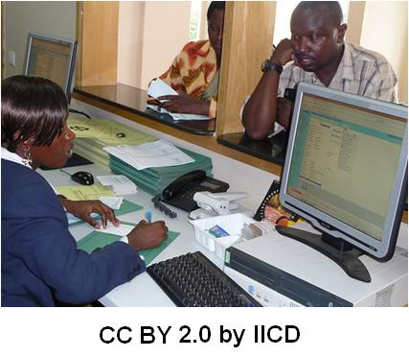
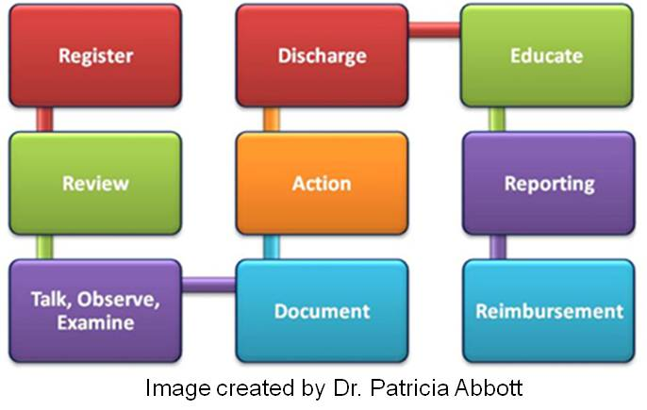
Care Processes: HIT Registration
Registration
Admission, Discharge Transfer Systems (ADT)
Bed Management Systems (BMS)
Unique Identifier – i.e. Medical Record Number (MRN)
Notes:
The following slides are going to be presented as a general overview and also presented in relation to the processes that we just discussed in the prior slides.
The boxes displayed here are the generic representation of a care process that we have already discussed. Let’s go back to that first step. What sort of HIT might be used to support the registration process? Two of the most common types of systems in registration are admission discharge and transfer systems, or ADT, and bed management systems, or BMS, which is sometimes also called a bed management dashboard.
Now let’s recall the example of the emergency room and the goal to quickly move patients out of the emergency department beds to prevent the ambulances from having to go to another hospital (called going on bypass). An ADT system is the system that manages patient admissions, discharges, and transfers. If a patient enters the system and no record exists, a medical record number, also called an MRN, or a unique identifier, is assigned. If it is a returning patient, prior records are pulled up for review.
Linking the ADT system to the BMS is logical because you can’t admit someone to a bed that is already occupied, and clerks need a way to be able to identify an open bed from the ED in order to admit a patient into it. The BMS is used to keep track of patients in beds, the status of each bed, and the availability of beds. Many BMS’ use a color-coded scheme in the application that allows the user, at a quick glance, to see the status (so empty bed, dirty bed, arrived bed, isolation bed, pending admit bed, pending transfer bed, pending discharge bed, discharge for death, closed, out of service, etc.). The registration process is a critical area for re-engineering as one considers the need to be able to coordinate and move patients within the system. Maybe you could think of certain airlines in the United States that have mastered the tracking and fast-turn around game to competitive advantage? This concept is very similar to ADT and bed management.

Slide 4
Care Processes: HIT Support
Reviewing Patient Information
Retrieve patient record
Verifying demographics, etc.
Past medical history, etc.
Talking, Observing, Examining
Notes:
Reviewing information (if it exists) is simplified by the EHRS – but again, only if it exists and it is accessible. The Medical Record Number, or MRN, is a unique identifier – meaning that only one patient in that hospital has that exact MRN. It is not a social security number, and unfortunately it can change from institution to institution. This MRN is attached to every piece of data in the patient record, so that the results are matched – one to one – with a single patient. This enables a collective view of the patient’s electronic data, which is certainly more efficient than trying to assemble numerous sheets of paper and match them to the correct patient. Unfortunately the “paper chase” still characterizes too many healthcare encounters.
Integrated, accessible and available patient data delivered by an EHRS allows the entire healthcare team to begin with a holistic view of the patient “story” and, if well designed, helps them to ask the right questions, gather more complete and focused data, and opens an avenue for the next stages of talking, observing and examining.
Talking, observing, and examining benefits in many ways from HIT applications. Digital devices such as the automatic blood pressure cuff, or blood glucometers for blood sugar readings (where the patient pricks his finger and puts the blood on a little strip of paper and inserts it into a reader device), oxygen saturation measurement devices for those of you unfamiliar with this device – it resembles a clothespin that maybe you have seen on a patient’s finger, and so on. All of these devices - and many others - can be designed (and should be designed) to feed digital data directly into an EHRS. Why? Because an automatic relay of data from one digital device to another reduces manual labor and (very importantly) it also reduces the error that frequently accompanies manual transcription of data from one source to another.
Health IT can also be used to guide the examination. This is not to imply that a provider would robotically follow a list! However, studies show that a novice benefits from guides, similar to following a map in an unfamiliar neighborhood and even expert practitioners make mistakes and/or forget things. Prompts delivered by Health IT systems can stimulate additional considerations and critical thinking by users, and can remind clinicians about needed tests or supplemental questions that should be asked at the very moment in time that they are most beneficial. As an example of a computer generated prompt – when assessing a new patient - the patient answers yes to the question of “are you a current smoker.” A prompting system could generate a series of additional questions that are required to determine the pack history or remind the provider to provide smoking cessation advice. HIT during this phase can be extremely helpful - but we must also weigh the level of obtrusiveness into the interaction. Again, Health IT is not a panacea, it is a balancing act.

Slide 5
Care Processes: HIT Documentation
Documentation
Copious
Pick lists, voice recognition, structured notes, integrated records, patient-centered, kiosks, PHRs …
Knowledge Resources & Decision Support
Notes:
There are many things that get documented in a patient encounter, such as the Chief Complaint, History of Present Illness, Past Medical History, Medications, Habits and Risk Factors, Family Medical History, Social History, Patient Profile, Review of Systems, Physical Exam, and on and on. Documentation is vital, but at the same time it is tedious and time consuming. So HIT can support this phase via the use of pick lists, using voice recognition instead of requiring providers to type, collecting data in a structured form that encourages completeness, creating an integrated record with the patient at the center – where the entire team involved in the care of the patient documents in an integrated record. For example, we should not have a medical problem list and a nursing problem list and a physical therapy problem list – it should be an integrated PATIENT problem list shared across the team.
Other avenues to consider are the use of patient kiosks and a patient’s personal health record as a source of data for inclusion in the record. This is an occasional source of disagreement, and one currently with no “correct” answer – whether patient entered data should be part of an EHRS. However, as the “patient as partner” movement starts to grow and the shared decision-making concepts continue to grow, this issue will become more prominent and one that you, as an HIT specialist, may encounter.
As alluded to earlier during the documentation phase, a user may also access knowledge resources and clinical decision support mechanisms to supplement her knowledge level or to consider alternatives.
HIT can also provide links to vetted information and evidence, such as the Cochrane Library, also access to institutional policies, and present alternatives courses of action.

Slide 6
Care Processes: Taking Action
Performing/Ordering/Reviewing
CPOE – Computerized Prescriber Order Entry
E-prescribing, Consults, Treatments, Diets, Labs, Tests…
Guideline based Care: http://www.guideline.gov/
National Quality Measures Clearinghouse: http://www.qualitymeasures.ahrq.gov/
Notes:
The taking action step is iterative as discussed earlier. An action is performed or a test is ordered, or an assessment completed – and depending on results, it continues to cycle. Computerized Prescriber Order Entry, or CPOE, is one of the most well known HIT support mechanisms for the care processes. The P however does not stand for Physician – because as we have emphasized over and over again – health and healthcare are provided by teams, not by a single member of a team. A dietician can order a specialized diet, and many nurses – such as nurse practitioners, have prescriptive authority (meaning they can write drug prescriptions), and a therapist can order a consult. The P is tied to who can prescribe something – and that is far from being limited to physicians. Remember, CPOE stands for Computerized Prescriber Order Entry. You may also hear it described as Computerized Provider Order Entry.
The latest version of the meaningful use phase 2 criteria issued in 2014 requires that e-prescribing (which is the ability to send an accurate and understandable prescription directly to a pharmacy) for medication orders must be used at least 50% of the time. [source: https://www.cms.gov/Regulations-and-Guidance/Legislation/EHRIncentivePrograms/downloads/Stage2_EPCore_2_ePrescribing.pdf ]
CPOE is a high value step in the care process that HIT can support.
Guideline-based care is the use of clinical practice guidelines to assist patient and practitioners with decisions about appropriate healthcare for specific circumstances. The URL that you see on this slide will take you to the National Guideline Clearinghouse of the Agency for Healthcare Research and Quality or AHRQ. Its sister site is the National Quality Measures Clearinghouse. This is part of the movement towards meaningful use, particularly when we talk about the quality measures clearing house.
The URL in the bottom left of the slide links to a “toolbox” at the AHRQ called the Healthcare Innovations Exchange. This is where you can find decisions aids and tools to support shared decision making and guideline based care documents. It’s a good idea to bookmark these powerful resources.

Slide 7
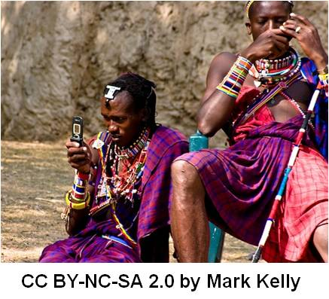
Care Processes: Discharge and Education
Pre-Discharge/Discharge
Ties into ADT, bed management, discharge planning …
Education
Notes:
Pre-Discharge or Discharge Planning links to many other Health IT supported activities as we discussed earlier. Pre-discharge planning is an essential aspect of continuity of care that actually starts on the day of admission – particularly as inpatient stays get shorter and shorter. Systems that are pre-programmed to help with the eventual discharge process can provide guidelines created to optimize the transition back to the home and activate the services that may be necessary to help the patient and families deal with physical, emotional, social, and financial needs after discharge. In addition, the meaningful use criteria require that hospitals provide patients with an electronic copy of their discharge instructions and procedures at the time of discharge, upon request.
Health IT in the way of ADT systems (recalling that the D in ADT stands for discharge) coordinates bed assignments, and it notifies numerous people that a patient is being discharged. So housekeeping is alerted to the room that is ready to be vacated so that they can come to clean it. The ED or the emergency department may be notified that a bed has opened. The nursing administration is alerted so they can be aware of potential changes in staffing needs and so on. Again, we see that a single action of discharging a patient when automated and connected, results in actions by numerous others. The ripple effect moves outward.
Education is supported by Health IT in many ways, from providing reminders, guidelines, and educational nuggets, to a user at the moment of need as we discussed on a prior slide. Items such as links to medication resources embedded on a screen, such as this link to the Federal Drug Administration drugs and medication database is helpful to patients and providers alike. Many systems also include auto-generated patient education guides that can be printed out and sent home with the patient. More and more health systems are including patient portals and handing out “information prescriptions” encouraging patients and families to learn more about their disease (or to adopt new and more healthy lifestyles). Increasingly, patients are being directed to interactive health education sites. An example may be “Patients Like Me” an online patient portal or social networking site for the sharing of personal health experiences and knowledge acquisition.
As we have seen in our demo system that we are using with Working with HIT Systems, a clinical reminder is automatically issued based on the patient’s diagnoses. Health IT support in this fashion blends in with the workload and makes the right thing to do the easiest thing to do. Again, supporting workflow and decision-making is a way by which Health IT can support education, best practices, and higher quality care.
Finally, we also have the use of Telehealth and these efforts are really being expanded, particularly in light of the work by the Federal Communications Commission and the rural broadband act, to increase the amount of access to the internet in disconnected areas – or what they call the “last mile” projects. Geography becomes irrelevant. We can educate with HIT by connecting remote providers and patients with resources necessary to improve the quality of care. In many cases – this “link” is viewed as a lifeline for providers and communities who are far away from urban settings.

Slide 8
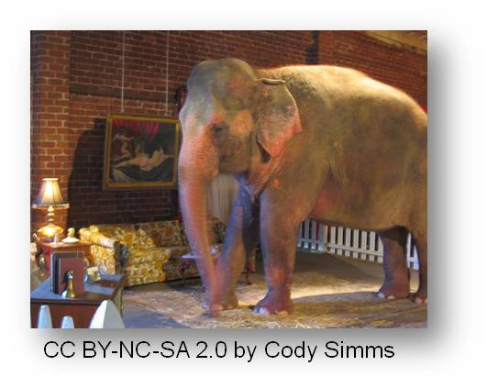
Care Processes: Reporting
Reporting & Reimbursement
External (CDC, Immunization Registries, CMS, etc.) & Internal (Practice Improvement, Trending, etc.)
$$$
Notes:
The final aspect is in regards to how HIT can support reporting and reimbursement. The meaningful use regulations require that hospitals report quality measures to the Center for Medicare and Medicaid Services, or CMS, or to the states, that they have the capability to provide electronic syndromic surveillance data to public health agencies.
The ability of a hospital lab to submit lab results to public health agencies, through the hospital’s EHR, will improve case reporting and response and provide a more complete picture of the occurrence of infectious disease locally and nationally for more accurate and timely surveillance and pandemic preparedness and response. Two way communications between clinicians and national, state, and local public health entities can bring critical laboratory information and treatment history (such as vaccine registries) to the clinician’s desktop.
Internally, practice improvement is supported by the ability to run both ad-hoc and pre-set queries on the available data. So questions may emerge such as:
How many of our diabetics are receiving recommended care?
Who are the “no shows” to the clinic or office? And is there a pattern and why does that happen?
How many patients were seen in the office or admitted to the hospital in the last three months and why?
The ability to “get at” your data is critically important and there are few things more frustrating to users than to put data in and not be able to get it back out easily. The final point is how HIT supports reimbursement, in both the inpatient and in the ambulatory environment. Auto generation or auto submission of claim forms has markedly changed the jobs of clerical professionals. Being able to automatically check eligibility for services, to obtain a pre-approval, and the like simplify many previously tedious tasks. Of course the “elephant in the room” is the link between reimbursement and the meaningful use of EHRS.

Slide 9
Under the Hood Summary—Lecture b
HIT support for care processes are similar and dissimilar depending on setting.
Core functions remain static.
Emerging sites of care & transformation of healthcare point to needs for information exchange/interoperable systems.
Teams
Patients at the core
Shift away from acute to ambulatory
HIT—pathway to safety/quality/effectiveness
Notes:
This concludes Lecture b of Under the Hood. In summary, we focused on inpatient and ambulatory (or otherwise known as outpatient) situations and how HIT can support both. While the patient is at the center of both types of encounters (both inpatient and ambulatory) providers and support staff may rely on different functions of HIT based on the location. Because care is provided in a variety of settings, there can be no one size that fits all; but at the same time there is core functionality that must be present regardless of where care is rendered.
Discussing HIT in both settings is important as the process of healthcare delivery evolves and changes in the US. The increase in services provided in ambulatory care settings is very notable and those new “emerging sites of care” are proliferating and show no sign of slowing down.
Healthcare has numerous stakeholders and HIT must support the entire team with patients at the core. As the US population ages and our hospitals strain to care for all who need it, more and more services will move out to the home and to the community and to ambulatory care settings. HIT can and must support all of the players across a variety of settings to improve the quality, efficiency, and safety of health and care.

Slide 10
Under the Hood References – Lecture b
References
Centers for Medicare and Medicaid Services. (2014). Eligible Professional Meaningful Use Core measures Measure 2 of 17. Washington D.C. Retrieved from https://www.cms.gov/Regulations-and-Guidance/Legislation/EHRIncentivePrograms/downloads/Stage2_EPCore_2_ePrescribing.pdf
National Center for Research Resources. Electronic Health Records: An Overview. 2006. Available from: http://www.ncrr.nih.gov/publications/informatics/EHR.pdf
Images
Slide 3: Image 1—Man at Counter. International Institute for Communication and Development (IICD ) The Hague, Netherlands (2008) . Available from: http://www.flickr.com/photos/iicd/5349100062/sizes/m/in/photostream/ Attribution—NonCommercial-NoDerivs 2.0 Generic (CC BY-NC-ND 2.0)
Image 2—Process Diagram. Courtesy Dr. Patricia Abbott
Slide 4: Image 1—Computer Screen with Patient Data. Lucas Pettinati, Brazil Available from: http://www.flickr.com/photos/lpettinati/3345788276/sizes/m/in/photostream/ Attribution—NonCommercial-NoDerivs 2.0 Generic (CC BY-NC-ND 2.0)
Image 2—Process Diagram. Courtesy Dr. Patricia Abbot
Slide 6: Image 1—AHRQ website. Available from http://www.innovations.AHRQ.gov.
Image 2.—Care Processes. Courtesy Dr. Patricia Abbot
Notes:
No Audio. Ten seconds of silence.

Slide 11
Under the Hood References – Lecture b
Images
Slide 7: Image 1—Two African Tribal Men Using Cell Phones . Mark Kelley. Available from: http://www.flickr.com/photos/markkelley/1022720488/ Attribution—NonCommercial-NoDerivs 2.0 Generic (CC BY-NC-ND 2.0)
Image 2—Federal Drug Administration: Available from: http://www.fda.gov/Drugs/DrugSafety/ucm085729.htm
Slide 8: Elephant in the Room. Available from: http://www.flickr.com/photos/jcodysimms/246023851 Attribution—NonCommercial-ShareAlike 2.0 Generic (CC BY-NC-SA 2.0)
Image 2—Process Diagram. Courtesy Dr. Patricia Abbott
Notes:
No Audio. Ten seconds of silence.

Slide 12
Working with Health IT Systems Under the Hood Lecture b
This material was developed by Johns Hopkins University, funded by the Department of Health and Human Services, Office of the National Coordinator for Health Information Technology under Award Number IU24OC00013. This material was updated in 2016 by The University of Texas Health Science Center at Houston under Award Number 90WT0006.
Notes:
No Audio.

