Slide 1
Working with Health IT Systems
Under the Hood
Lecture a
This material (Comp 7 Unit 2) was developed by Johns Hopkins University, funded by the Department of Health and Human Services, Office of the National Coordinator for Health Information Technology under Award Number IU24OC000013. This material was updated in 2016 by The University of Texas Health Science Center at Houston under Award Number 90WT0006.
This work is licensed under the Creative Commons Attribution-NonCommercial-ShareAlike 4.0 International License. To view a copy of this license, visit http://creativecommons.org/licenses/by-nc-sa/4.0/.
Notes:
Welcome to Working with Health IT Systems: Under the Hood. This is Lecture a.
This unit will focus on how systems are actually being used in healthcare and how they support – and frankly how sometimes they thwart – the processes of care.

Slide 2
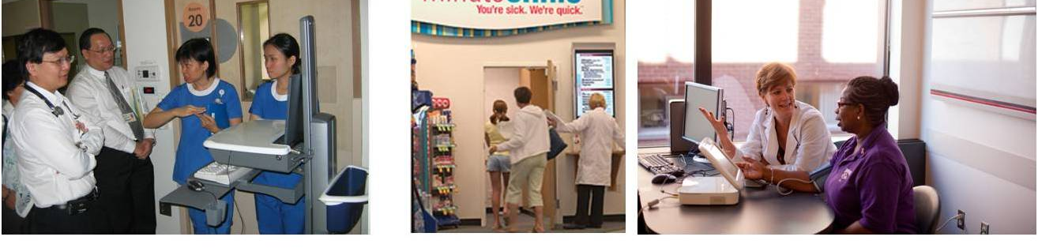
Under the Hood
Learning Objectives — Lecture a
Identify the health IT functions that support a generic ambulatory patient care process.
Identify the health IT functions that support a generic inpatient care process.
Images Courtesy of Dr. Patricia Abbot.
Notes:
The Objectives for Under the Hood are to:
Identify the health IT functions that support a generic ambulatory patient care process.
Identify the health IT functions that support a generic inpatient care process.
In unit two, we are going to focus upon both inpatient and ambulatory—otherwise known as outpatient—situations and how Health IT can support both. We will briefly discuss the patient care process and how location can change how Health IT is used. Although the patient is at the center of both types of encounters (both inpatient and ambulatory) providers and support staff may rely on different functions of Health IT based on the location. Because care is provided in a variety of settings—there can be no one size fits all—but at the same time, there is core functionality that must be present regardless of where care is rendered.
Discussing Health IT in both settings is important because the process of healthcare delivery evolves and changes in the US. The increase in services provided in ambulatory settings is notable—and new emerging sites of care are proliferating, and it is likely that this trend will continue. Community pharmacies are transforming into sites of care for patients, with an increase in the number of Minute Clinics and the like appearing within large pharmacy chains or large retail stores. Walk-in clinics where nurse practitioners and physician assistants work alongside a pharmacist, wellness clinics in the workplace, convenient care being provided to patients in their homes through telehealth, and even medical tourism where patients travel to foreign countries for high quality procedures at lower total cost, are all areas where data capture and data coordination with the larger healthcare system is required.
In this unit, we will identify the health IT functions that support a generic ambulatory care process. And we will also identify the health IT functions that support a generic inpatient care process. The word generic is emphasized because the processes may vary. So both of these are provided to just give you a general idea of how processes roll out and how HIT can support both.

Slide 3
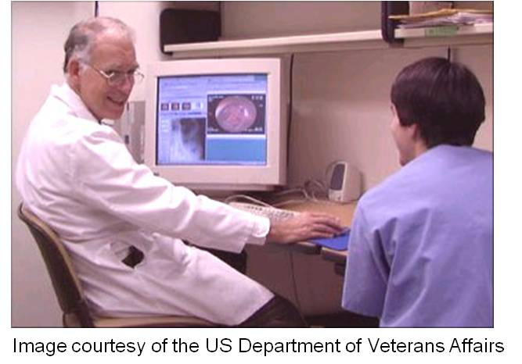
Inpatient vs. Ambulatory Processes: Comparing and Contrasting
How do they differ?
  Inpatient 4 phases
    Initial evaluation
    Ongoing Management
    Pre-discharge
    Discharge
  Ambulatory
    Episodic
    Coordination across providers and locations
    Monitoring/treatment chronic & acute
Notes:
So how do inpatient and ambulatory differ?
The process of inpatient care can be conceptualized, very generally, as having four phases: initial evaluation (that usually occurs within the first 24 hours of care), ongoing management, pre-discharge, and discharge phases.
The ambulatory care process differs in that it is episodic, may require coordination among providers at different locations using different records, and may address the monitoring and treatment of ongoing chronic conditions in addition to the acute ones.
So each of these encounter types require that Health IT be applied in different ways but fundamentally there is still much in common.

Slide 4
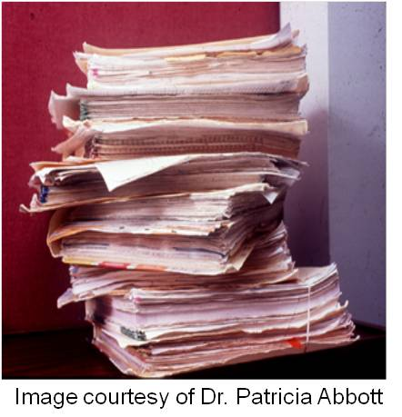
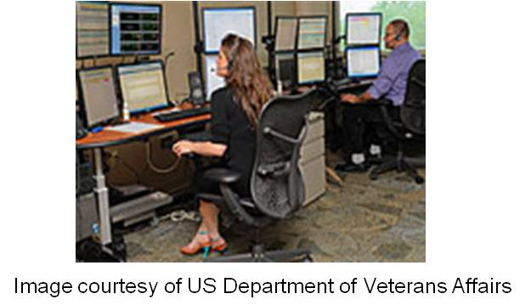
Supporting Care Processes with HIT
Facilitate filtering, organizing, &
access
Thoroughness and currency
imperative
Reviewing & Documenting
Planning
“Doing” – ordering
Educating
Notes:
Let’s start by discussing the ways in which EHRs support the care processes – both inpatient and ambulatory. Health IT facilitates the filtering, organization of, and access to information.
Thoroughness in gathering the patient's history, reviewing findings from the physical examination, reviewing the results from tests and procedures is critical – and of course so is currency. Data is not like wine – it doesn’t necessarily improve with age. Lab values, for example, can change drastically and quickly – and clinicians are making decisions based on the data at hand. You can probably see where this is heading. Looking at the picture on the slide of a stack of paper charts may give you an idea of what a clinician faces and why moving away from paper is not elective. The use of HIT becomes even more imperative in the ambulatory setting where ready access to data is often complicated by geographic distances.
Using an electronic system makes the retrieval and review of patient information much simpler and can substantially improve the clinicians' knowledge about the patient; this is true whether we are talking inpatient or ambulatory care. And of course EHR is not a panacea – it cannot retrieve nor process any information that is either not available or uninterruptable. This brings us around again to integrated and interoperable systems. Conversely, as all of the data become integrated and accessible, the resultant electronic data collections in healthcare have become exceedingly large, often surpassing the capacity of a busy clinician to make sense of it all.
Interestingly, the problem faced by health care professionals is changing from not enough patient data to review to one of what we sometimes classify as called “drowning in data.” Presenting clinicians with unfocused and excessive amounts of data in an EHR often ends up exceeding the cognitive capacity of the provider and it increases cognitive load and can actually facilitate medical error. The moral of the story here is that more data is not necessarily better. There is a balance that must be struck.
Striking that balance requires that system designers develop systems that are capable of gathering, displaying, and extracting information from a user-centered perspective. Perhaps a clinician prefers to look at values from a test displayed as a graph instead of numeric values; or maybe a public health professional requires a view of aggregated data from an entire community or from a city; or maybe an administrator really just wants a view of census data, etc, and etc.
We know that doctors, nurses, managers, pharmacists, occupational therapists, and so on, have many common, and divergent, information needs. Situation-specific views of focused and pertinent data will assist a busy user in focusing on the issue at hand. Moreover, well designed HIT can actually help a user do a better job by providing guidance and support during the process of care.
For example, well-designed HIT can help improve care and support best practices, by offering reminders of tests to be ordered and alerts when contraindicated medications are ordered. It also can automatically generate documentation templates to enhance the ease of documentation requirements and can offer alternatives to clinicians and patients to support decision making. As seen in the image, HIT can also be used to educate or advise at the moment of need.

Slide 5
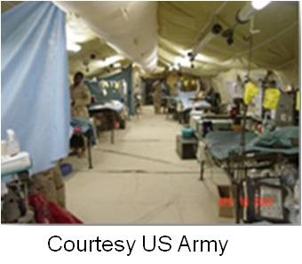
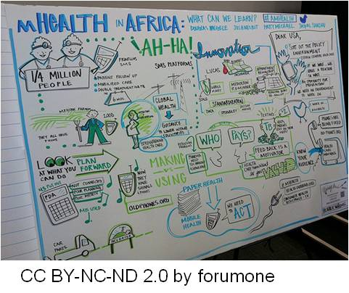
Supporting Care Processes with HIT
Communicating
  High risk, high stress
  Teams – working independently but with constant information exchange
  Moving patients, moving providers, rapidly changing situations
Notes:
Finally, HIT can support care processes by enhancing communication. As pointed out by Vincent in his 2006 book, Patient Safety from Elsevier, in high-risk settings such as aviation and nuclear power, where they share similar issues of work complexity, high stress, and frequent interruptions, communication between the team members has frequently been identified as a causal factor in major incidents that have resulted in large losses of life.
Patient care is provided by individuals, who seldom, if ever, meet as a group – yet they must be in constant communication with one another. Each team member is caring for multiple patients, managing multiple tasks, interacting with a multitude of people (both other professionals, staff, families, patients). There are many information transfers and communication handoffs that have to occur in a timely and accurate fashion for patient care to be safe, reliable, and coordinated. Think about smart phones and RFID tags (the radio frequency identification tags) that help to track people and materials where ever they are located in a hospital. Especially think about putting RFID tags on wandering patients so that you can find them. Think about mobile technologies that support mobile clinicians – both in a hospital and in a public health clinic in a rural locale.
HIT plays a critical role in helping to support the communication process in healthcare.
As stated in the objectives, we want to spend some time talking about the commonalities and differences of HIT application in inpatient and ambulatory settings. Our goal in the next few slides will be to walk you through the inpatient clinical process encounter and an outpatient (or ambulatory) encounter while offering ideas of how HIT can (or is) being used to support the process.

Slide 6
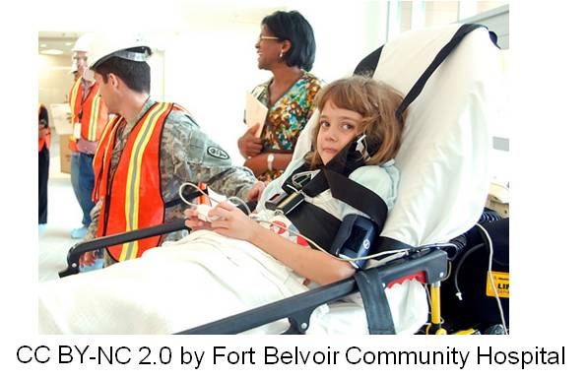
Inpatient Processes
Register
Review Patient Info
Talk, Observe, Examine
Document
    *H&P, PMH, Signs/Symptoms, etc.
Take Actions “Orders”
    *Meds, Labs, Procedures, Consults, Admit, Next Appt.
Discharge
Patient Education (could occur anywhere in the process)
Health Data Reporting
Link to Reimbursement
Notes:
What is the general process when a patient enters an inpatient setting?
This question could be the start of a whole series of debates about how this process should flow; a myriad of personal stories come to mind regarding some of the more interesting deviations observed over the years in the healthcare business, but here is a general framework from a clinical perspective. This example starts in the Emergency Department or ED, with a patient who walks in and is not brought in by an ambulance.
The patient presents and he is registered by the staff member at the check-in desk. A medical record is either started (if the patient is new) or an old record retrieved (if the patient has been seen previously at the particular hospital).
Next the patient’s data is reviewed by a variety of personnel – the administrative staff wants to verify demographic information, insurance coverage, next of kin, and the like. And so for any of you that have been through a trip to the emergency room, this will be familiar to you. An administrative clerk may begin looking for a bed assignment, because in the emergency department the goal is to move patients quickly out of the ED (so to either send them home or get them to a unit) to free up space in the emergency room. Because if the hospital’s emergency beds are filled, then the ambulances are forced to bypass that particular emergency room and head to other hospitals or your competition down the street. So the clerk may begin to look for available beds just to get an idea of how quickly people can move through the ED.
The clinicians then quickly review any relevant patient data that is available such as prior admissions, test results, past medical histories, and the like.
Then the next step for a clinician is to talk with the patient, to ask questions, assess answers, all the while observing and examining the patient.
After talking to, observing, and examining the patient, the next step is the cognitive aspects of the diagnosing process, like planning next steps, and then documenting findings such as the physical history, social history, medical history, signs and symptoms, and so on.
The clinician will then take an action, usually in the form of an order. This could be for medications, lab tests, x-rays, procedures, consultations, or scheduling a follow up appointment. In some severe cases, the clinician might immediately perform a procedure alone, or with the assistance of other emergency department staff.
If the patient is admitted, then the process cycles repeatedly from reviewing information through taking action as tests come back and additional information becomes available. Eventually, a patient is discharged from the inpatient setting, sometimes to another facility, sometimes to home.
But anywhere along the way, patient education and shared decision-making are included if appropriate. Of course if a patient is unconscious, unstable, or demented, decisions are made by a family member or a guardian, providing the patient previously completed a living will or other type of advanced directive document.
Steps 8 and 9 are actually going on in the background, so their position at the end of this list is not exactly correct, although some of the data flowing from the inpatient encounter may be reported in the aggregate, and submitting insurance claims and bills often happen after the fact.

Slide 7
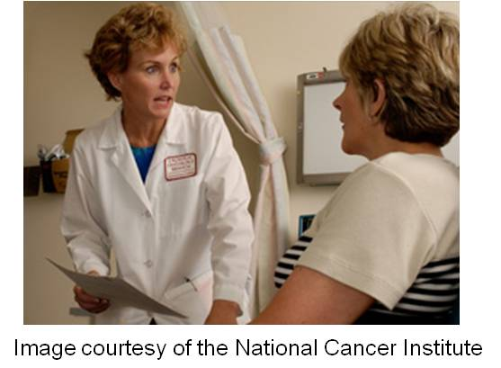
Ambulatory Processes
Check-in
  Verify Appointment; Update Info; Pull Medical Record
Move to exam room
  Vital Signs; Review Reason for Visit; Document
  Examination; Discussion of Findings; Plan; Order; Documents
Check-out
  Schedule appointment
  Payment
After the fact
  Complete Documentation/Dictate
  Code Visit & File Insurance Claim
Notes:
Now, let’s look at an ambulatory care visit. Just as before, there are many variations, so we will use as our example a follow-up to the physician’s office after the patient has been discharged from the hospital.
A patient walks in to a physician’s office (hence the name “ambulatory”) and checks in for the appointment with the clerical staff, who verifies the appointment, confirms or updates the patient’s contact and insurance information, and then retrieves the medical record (most likely a paper chart) from the files.
The patient is then brought into an exam room where a staff member takes vital signs and possibly performs some part of the assessment—depending on the qualifications of the staff person. The reason for the visit is determined and the information is documented, often by the office nurse or an assistant.
The examination occurs with the provider, findings are discussed, the provider is analyzing, thinking, and planning, and then may write an order for a new medication, or another test. The doctor will often complete the documentation of the encounter immediately, but sometimes will choose to delay the completion of the encounter note until later that day in order to see the next patient more quickly. Some providers are still using dictation services.
Then the patient checks out with the clerical staff, schedules another appointment, and may make a payment. The provider may continue to complete any necessary documentation, and either she or the clerical staff will complete the insurance forms, and file the record.
Dr. Blackford Middleton from Harvard notes, “In routine primary care ambulatory clinical practice a provider may expect to see anywhere from 20-45 or more patients in a single day. For each of these, a clinical encounter note must be written, and typically a bill is generated. For most patients one or more prescriptions are written, for many a lab test is ordered, and for a fraction a referral will be made, or a consultant’s report created.”
Dr. Middleton points out, “this equates to about 20,000 forms per year, not including other billing paperwork which is usually done by administrative staff.”

Slide 8
What Is Different?
Access to systems & data
Challenges of geography
8 out of 10 physicians now have an EHR
Patient Load
Episode of Care
Coordination, Communication, Consultation
Notes:
What is different? As alluded to earlier there are aspects of the care episode that are the same, regardless of location. There is still a need to document and to generate enough information to support the reimbursement or billing process. Ordering occurs, and reviewing results occurs no matter where a provider is. Records are maintained, contact and insurance information is updated, and so on.
However, depending on circumstance, a clinician in an inpatient setting generally has ready access to systems such as radiology, the lab, decision support or guidelines, and the pharmacy, whereas a clinician in an outpatient or ambulatory care setting may not. This is potentiated in rural areas where geographic distances add further complications to access and assembly of health data.
According to Jamoom et. al, as of 2014, 1010 physicians had adopted an EHR.
Now, remember from the prior slide that the patient load in an ambulatory setting is often much higher than inpatient. When 20-45 or more patients are seen in a single day in an average provider office, the time to spend with each patient is compressed. Combine this fact with frequently incomplete data, and the quality of the encounter can decline markedly, while the frustration of the provider and the patient goes up. Additional resources must be diverted to the “paper chase” distracting from patient care.
So what else is different? Wel,l the episode of care is different between settings. In the inpatient setting the patient has a definite admission and discharge point, and usually received a set course of circumscribed treatments. Not so in ambulatory, where patients present with numerous problems requiring ongoing treatment and monitoring. In the ambulatory setting there are usually far fewer providers interacting with the patient at any one visit, yet the need for coordination, communication, and consultation across organizations and providers can be much higher.
What we see in this comparison is that ultimately health care information systems and health care processes are tightly linked. The data from one encounter or one system must feed into another to support high quality efficient, safe, and effective care – particularly as our healthcare delivery system changes and these new sites of care emerge. The growth of ambulatory care will continue to expand – and to reach meaningful use will require marked adoption of electronic health.

Slide 9
Under the Hood
Summary—Lecture a
Ambulatory and Inpatient processes can be supported by Health IT.
Core functionality is similar, but different settings and visit types influence functionality and use.
Presentation of data is specific to user and site of care.
Linkage and data exchange are critical.
Notes:
This concludes Lecture a of Under the Hood. In summary, in this unit, we discussed how Health IT can and must support both ambulatory and inpatient processes. The point was made that – in general – the core functionality of health IT is similar, but that because of differences in the focus of ambulatory and inpatient encounters – systems can look different, perform differently, and are used differently.
In unit 2a - we reviewed the generic flow of a patient within both types of settings.
Health IT facilitates the filtering, organization of, and access to information. We talked about how important it is that system designers develop systems that are capable of gathering, displaying, and extracting information from a user-centered perspective. That perspective is influenced by the site of care – for example in ambulatory settings, resources, data, and consultations can be complicated by geographic distances. The point is made therefore that linkages and data exchange are critical to safe and efficient patient care – regardless of whether the patient is being seen in a busy urban setting or a frontier community.
This completes the first half of the slide deck for unit 2. In the final segment of unit 2, we will delve into how HIT can be used to support care processes.

Slide 10
Under the Hood
References – Lecture a
References
Jamoom E, Yang N, Hing E. Percentage of office-based physicians using any electronic health records or electronic medical records, physicians that have a basic system, and physicians that have a certified system, by state: United States, 2014 (table). 2015, retrieved from https://www.healthit.gov/sites/default/files/briefs/oncdatabrief28_certified_vs_basic.pdf
Middleton, B., Gandhi, T.K., Bates, D.W. Patient Safety: The Role of Information Technology. In: Memel DS; editor(s). Effective Management of Healthcare Information: Leadership Roles, Challenges, and Solutions. Chicago, IL: Healthcare Information & Management Systems Society; 2003. Retrieved from: http://www.partners.org/cird/StaffPrj.asp?cBox=Pubs
Heisey-Grove, D., & Patel, V. (September 2015) Any, Certified, and Basic: Quantifying Physician EHR Adoption. ONC Data Brief, no. 28. Office of the National Coordinator for Health Information Technology: Washington DC. Retrieved from: https://www.healthit.gov/sites/default/files/briefs/oncdatabrief28_certified_vs_basic.pdf
Vincent, C. Patient Safety. First Edition. Elsevier, New York, 2006.
Notes:
No Audio.

Slide 11
Under the Hood
References – Lecture a
Images
Slide 2: Composite Image. Courtesy Dr. Patricia Abbott
Slide 3: Clinician Discusses Medical Test Results. Available from: http://www.flickr.com/photos/59632563@N04/6104068209/sizes/m/in/photostream/
  Attribution 2.0 Generic (CC BY 2.0)
Slide 4: Image 1—Paper Chart Pile. Courtesy Dr. Patricia Abbott
Image 2—Woman Monitoring Patient Data. Courtesy VA. Available from: http://www.minneapolis.va.gov/features/thumbnail_photos_180x130/thumb_20110826_teleicu.jpg
Slide 5: Image 1—Army field hospital. Courtesy US Army. Available from: http://www.cs.amedd.army.mil/
Image 2—Poster. Available from:
http://www.flickr.com/photos/forumone/5520757618/sizes/m/in/%20photostream/
Attribution-NonCommercial-NoDerivs 2.0 Generic (CC BY-NC-ND 2.0)
Slide 6: Patient Being transported. Fort Belvoir, VA—Fort Belvoir Community Hospital. Available from: http://www.flickr.com/photos/belvoirhospital/5863738177/sizes/m/in/photostream/
Attribution-NonCommercial 2.0 Generic (CC BY-NC 2.0)
Notes:
No Audio.

Slide 12
Under the Hood
References – Lecture a
Images
Slide 7: Courtesy of United States Navy. (2003). Hospital Corpsman Wade Henry gives passdown to the night shift in the Intensive Care Unit (ICU) about USNS Comfort (T-AH 20). https://commons.wikimedia.org/wiki/File:US_Navy_030423-N-6967M-235_Hospital_Corpsman_Wade_Henry_gives_a_passdown_to_the_night_shift_in_the_Intensive_Care_Unit_(ICU)_aboard_USNS_Comfort_(T-AH_20).jpg
Notes:
No Audio. Ten seconds of silence.

Slide 13
Working with Health IT Systems
Under the Hood
Lecture a
This material was developed by Johns Hopkins University, funded by the Department of Health and Human Services, Office of the National Coordinator for Health Information Technology under Award Number IU24OC000013. This material was updated in 2016 by The University of Texas Health Science Center at Houston under Award Number 90WT0006.
Notes:
No Audio.

