Slide 1
Working with Health IT Systems
Introduction & Overview:
Components of HIT Systems
This material (Comp 7 Unit 1) was developed by Johns Hopkins University, funded by the Department of Health and Human Services, Office of the National Coordinator for Health Information Technology under Award Number IU24OC000013. This material was updated in 2016 by The University of Texas Health Science Center at Houston under Award Number 90WT0006/01-00.
This work is licensed under the Creative Commons Attribution-NonCommercial-ShareAlike 4.0 International License. To view a copy of this license, visit http://creativecommons.org/licenses/by-nc-sa/4.0/.
Notes:
Welcome to Working with Health Information Technology (HIT) Systems: Introduction & Overview: Components of an HIT System.
In this unit, we will be introducing several of the common applications of HIT systems, and we will also be introducing some of the vocabulary and concepts related to health IT.
This unit is composed of two parts. The first part is the lecture material that you are obtaining via this presentation.
The second part of this unit is the application of the lecture material from this presentation in a series of hands-on interactive Electronic Health Record exercises. Electronic Health Records, a common reference that you may hear in this unit, is often shortened to “EHR” and occasionally “CPRS,” which stands for Computerized Patient Record Systems.

Slide 2
Introduction & Overview:
Components of HIT Systems
Learning Objectives
  Define a system and relate systems concepts to HIT.
  Discuss specific examples of settings where Health IT is used (acute, rural, public health, clinic, office, patient home, etc.).
  Identify common components of a clinical HIT system.
  Demonstrate beginning level competency in maneuvering the demonstration Electronic Health Record System (EHRS).
Notes:
The Objectives for Introduction & Overview: Components of HIT Systems are to:
Define a system and relate systems concepts to HIT.
Discuss specific examples of settings where Health IT is used (acute, rural, public health, clinic, office, patient home, etc.).
Identify common components of a clinical HIT system.
Demonstrate beginning level competency in maneuvering the demonstration Electronic Health Record System (EHRS).
The goal of unit 1 of Working with Health IT Systems is to provide you with the fundamentals of Health IT systems, while also providing an environment where you can apply those fundamentals in an example electronic health record system, or EHRS.
By the time you have completed Unit 1, you will be able to define a system, and then relate systems concepts to health IT.
In this unit, we will be talking about the use of health IT in a variety of settings, from a rural or urban clinic, to a public health setting, into a patient’s home, acute care facility, and so on. At the completion of this unit, you should be able to discuss examples of settings where health IT is being used.
Finally, you should be able to identify the common components of a clinical Health IT system and we expect that you will be able to demonstrate beginning level competency in maneuvering the electronic health record system that accompanies this unit.
The EHRS referred to in this unit (also known as the laboratory or “lab system”) is provided to give the hands-on experiences necessary to obtain practical exposure to working with an EHRS. The lab system we are using here is the VistA computerized patient record system. VistA is also referred to as “the CPRS” within Veterans Affairs circles, so note that the abbreviations CPRS and EHRS are used interchangeably.

Slide 3
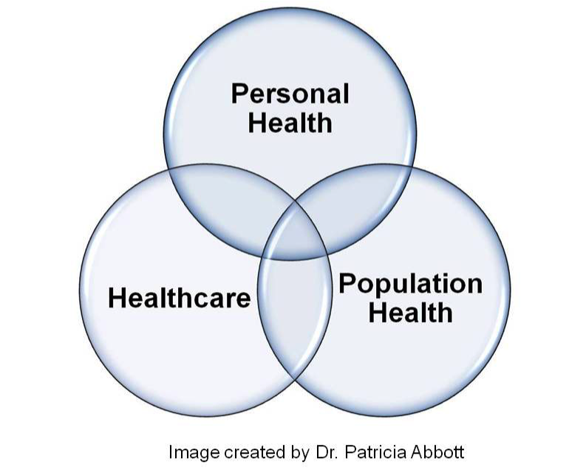
Conceptualizing HIT Use
Notes:
To begin, we need to think about where HIT is used. In general, this can be represented in three overlapping circles of personal health, healthcare, and population health.
In speaking about the use of HIT in healthcare, one can conceptualize this as applications used by care providers, assisting them to provide high quality, safe, and efficient care. These applications might include things such as clinical decision support systems, filmless radiology systems (also known as PACS or picture archiving and communication systems) filmless radiology, provider order entry systems (CPOE), and many others that we will cover in the course of learning about HIT Systems.
Now, moving to the next circle, applying HIT to personal health—we think about those applications used by consumers. So, evidence-based practice requires that healthcare decisions be consistent not only with the best available research evidence, but also with the values and preferences of the informed patient. To achieve this goal, HIT can be used in the personal health circle to educate (or to help create that “informed” patient in the first place) such as directing patients to learn more about their disease by accessing reliable and high quality health information websites. Another example of HIT in personal health may be the use of decision aids—which can be used by clinicians and patients alike—to prepare patients for decision making or help clinicians assist patients in participating in making decisions that impact their own health. Other examples may be systems that help people track down their own health data, such as personal health records.
The third circle, population health, is where HIT is used to aggregate data about individuals to support public health, research, and quality improvement.
The take away from this slide is that health and healthcare are two different things, but HIT spans across both of those concepts. HIT can support personal and population health and it can also be used to improve the actual delivery of healthcare.

Slide 4
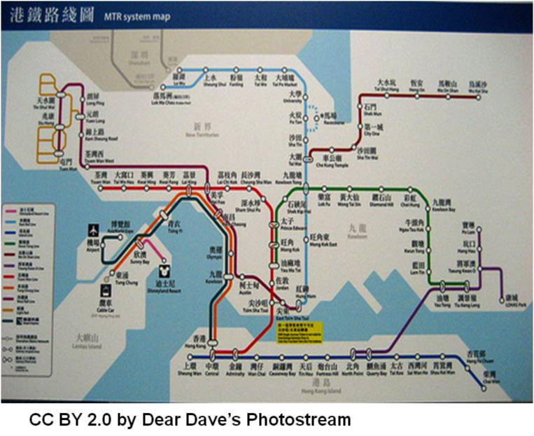
Concepts of General Systems
Organization of functionally interactive units for the achievement of a common goal
Inputs, outputs, and feedback
Working to maintain a basic level of equilibrium
Notes:
So, now that we understand how health IT spans the three circles, let’s review the foundations of “systems” in general.
What is a system? It is an organization of functionally interactive units for the achievement of a common goal.
All systems have inputs, outputs, and feedback, and they work to maintain a basic level of equilibrium, as can be seen in this illustration of the Hong Kong subway system. One system feeds into another: there are inputs that can be thought of as entrances to the subway, and outputs, which are the exits from the subway. The goal is to move people as efficiently and safely as possible from one place to another. What this system also illustrates is the incredible complexity, the expanding complexity of a system. It also demonstrates a need for the different lines to be able to interoperate or integrate, and there also needs to be a way to transfer between the different lines.
A transfer between the lines commonly occurs where the systems interface, for example at a subway station so people coming in on one independent line can get to another independently operating line. Also, think a little deeper about how one system interfaces with another system—particularly how it interacts with other transportation systems that are related to, but not a core function of, the subway system itself, such as airports and train depots.
As we progress through this unit, you will come to appreciate that a system is a system is a system — whether we are talking about the Hong Kong subway line or the HIT system with which you interact. Refer to the subway example as you think about HIT: the complexity, the multitude of users, the various on and off ramps, the need for interfacing to smooth the transfer from one line to another, and so on.

Slide 5
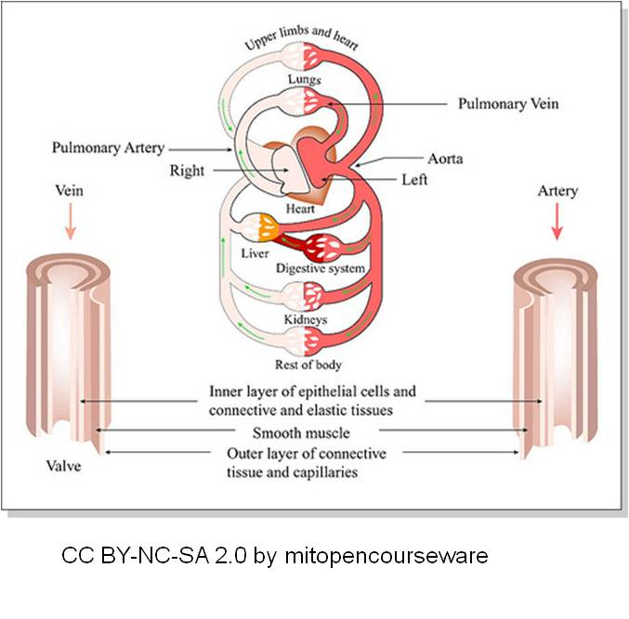
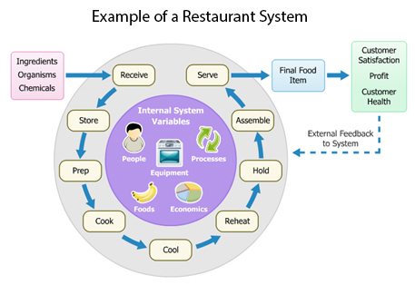
Concepts of General Systems -2
MIT Open Courseware CC BY-NC-SA 2.0
Environmental Health Service (2012).
Notes:
In summary, a system is a group of interacting, interrelated, or interdependent elements forming a complex whole with specific goals in mind, whether you are talking about subways, your circulatory system, or a food delivery service.

Slide 6
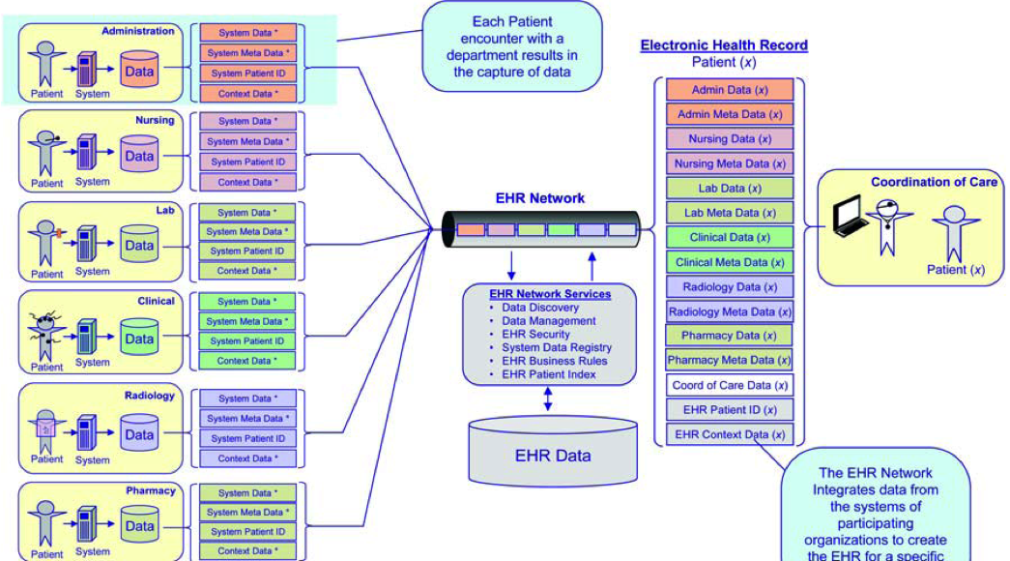
Electronic Health Record
Notes:
Taking the concept of a system into Health IT, those “interacting, interrelated, or interdependent elements,” when linked together and used as an “integrated whole,” can contribute to higher quality and more efficient patient outcomes.
This conceptual overview of the EHR begins to illustrate some of the complexity of systems and interchanges in HIT. Look closely at this image; you are going to see different elements of an HIT system in acute care.
Look at the left-hand side of the screen. You will see different systems, such as administration, nursing, the lab, clinical, radiology, and so on. Each patient encounter with a department results in the capture of data. You will see that all these systems are originating from a single patient, yet flowing into a separate data collection. At this point, the data is not integrated.
In theory all these data collections then feed into a central node, the EHR network. The EHR network services are processing the incoming data interchanging—bi-directionally—data with a much larger and consolidated EHR data repository.
Look over to the right to see a consolidated view of a single patient’s health record. The EHR network has integrated data from the systems of participating organizations to create the electronic health record for a specific patient.
As with every system there are goals; in this case we see the goal or outcome as improved coordination of care for a patient. In reality, there are many goals of an
EHR such as improved efficiency, reduction of medical error, improved management of patients and populations —the list goes on and on. This particular diagram, however, is focused upon improved coordination of care.
This very busy picture shows many systems, many intersections, and a very large need for data interchange if we ever expect to get to the goal of improved coordination of care. As mentioned earlier, we can’t have interchange of data without standards.

Slide 7
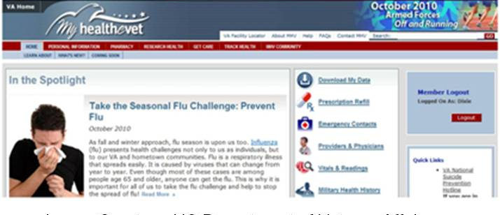

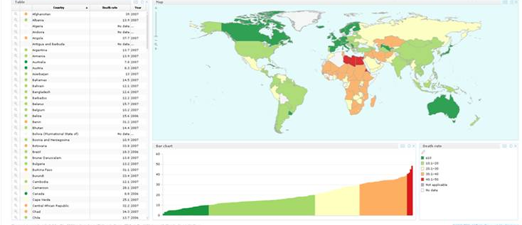

HIT Systems
Image Courtesy of U.S. Department of Veteran’s Affairs.
Image Courtesy Dr. Patricia Abbott.
Image Courtesy of the World Health Organization.
Image Courtesy Dr. Patricia Abbott.
Notes:
Of course HIT systems are not just for acute care. HIT systems are being used in public health, home care, and on the web for social networking and health information exchange. My Healthe-Vet from the US Department of Veterans Affairs, shown in the upper-left hand corner is an excellent example of patient centered care – where the model is “patient as partner.” This system allows patients to schedule appointments, refill prescriptions, learn more about their diseases, view their labs, and much, much more. This HIT system is based on the belief that an informed patient is a stronger patient and more likely to have better outcomes.
There are also HIT systems in public health – although in Public Health environments, you may hear this “Don’t call this a healthcare information technology project. Because in public health we practice health NOT healthcare.” So be prepared for this sort of semantics! Remember we talked earlier that HIT supports health and healthcare. On the bottom left of the screen, there is an example of a public health care system from the World Health Organization. This very, very limited snapshot belies the complexity and the use of HIT in public health—but what it illustrates is that collecting large scale population data related to health can reveal many things not immediately visible “up close.” Another interesting example of this is Google Flu Trends, which we will explore later in this unit. But if you have an interest and you have a moment, look up “GOOGLE Flu Trends” online and read about it. It is quite fascinating. What Google Flu Trends does is illustrates the power of linked data from many different sources and how it can help us to improve the health of patients, families, and communities.
In the bottom right-hand side of this slide you will see an image that reflects a website called “PatientsLikeMe,” another application of health IT outside the clinical environment. There are thousands of patients interacting in that portal, exchanging information and learning about their disease. Finally, telehealth in the homes of patients is another area of rapid health IT growth – as the movement to keep patients in the home and out of the hospital takes hold.
In short, the “H” in HIT does not stand solely for healthcare. It also stands for health—and health is practiced in many more areas than in a nurse practitioner’s office, a clinic, or in a hospital.

Slide 8
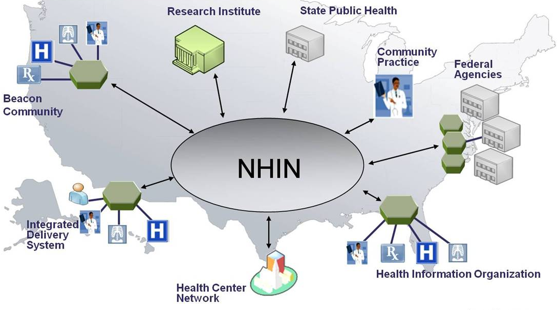
The “BIG Picture” of HIT Systems
Image Courtesy U.S. Department of Health and Human Services.
Notes:
Taking a look at the “big picture” of HIT systems and moving out of the clinical care or patient level settings, we see that systems concept rising to the surface again. This graphic, from the Office of the National Coordinator at Health and Human Services, takes us from the simple to the complex.
The NHIN (in the middle) stands for the Nationwide Health Information Network. You will see that the NHIN takes from, and feeds into, other networks. You see the linkages that facilitate health information exchange, another component of the meaningful use criteria. An important aspect to point out about the NHIN is that the NHIN is NOT a giant database where everybody’s health data is stored! This is a popular misconception. The NHIN is a network that allows information to flow from one place to another in a very secure and protected manner. The data does not live there. Instead, your data may “live” in the Beacon Community, or in a Federal Agency, or in a Practice Community, or in your own personal PHR that you carry around on a secure thumb drive. The NHIN is a network that supports the secure exchange of protected health information (also referred to as “PHI”).
Again, this is a very simple representation of a very complex structure—however what it does illustrate is systems, linkages, and information exchange. The idea of standards comes up again, because there must be standards to get from the health center network there in Texas up to the Research Institute in Montana. If a person is injured in Florida while on vacation, and the medical records are in Washington State, there must be a mechanism for transferring the data that may be necessary to save the patient’s life. The NHIN is an ATM-like network for the exchange of PHI instead of cash!

Slide 9
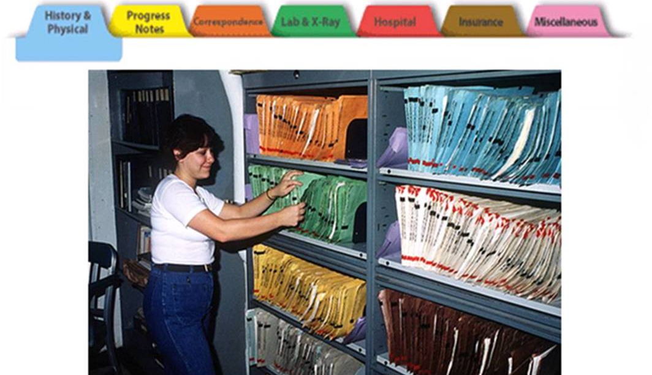
Common Aspects of Clinical
HIT Systems
Image Courtesy of the U.S. Army.
Notes:
Now we will move on to the final lecture objective for this unit, which is to identify the common components of a clinical HIT system.
For those of you who are still working with paper charts, this will be old news. For those of you who are unfamiliar with a paper medical record, we hope that you will soon be able to consider this just a history lesson.
The illustration shows what a standard paper medical record used to (and unfortunately in many cases still does) look like. You will see the tabs that separate the different sections of a paper chart. The example here is a blue tab where the history and physical can be found, or the green tab where the Labs and X-ray reports are located, or the yellow tab where progress notes are stored, and so on.

Slide 10
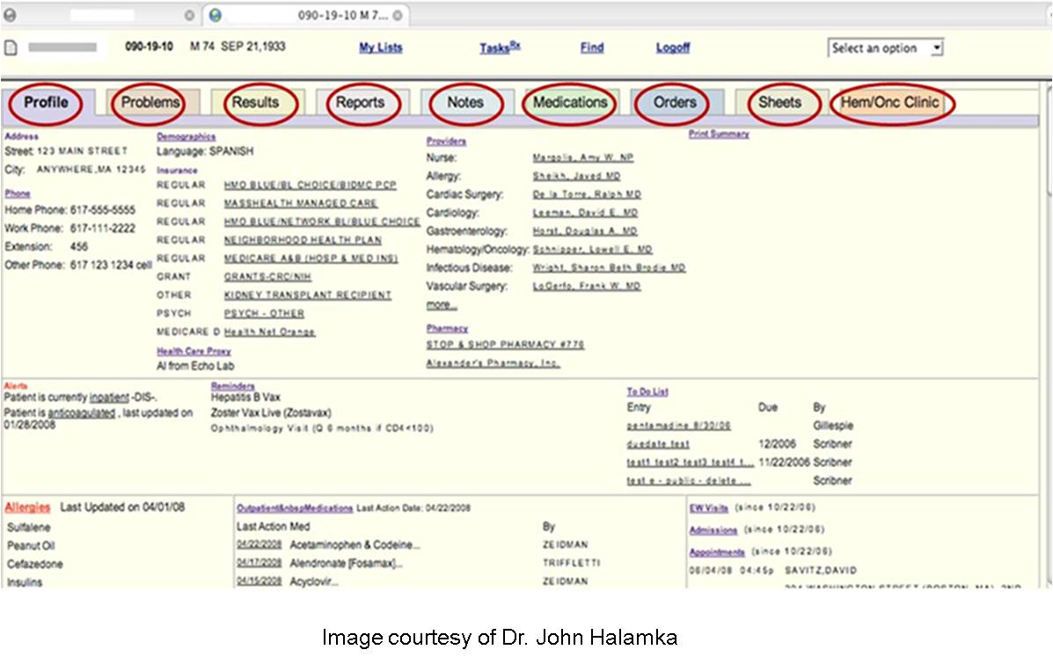
Common Aspects of Clinical
HIT Systems -2
Image Courtesy of Dr. John Halamka
Notes:
There are similarities and differences between the paper medical record and the electronic record.
Shown is an example of a generic electronic clinical record. Note the similarities – there are still those “tabs” at the top. You will see that there are different areas of the chart where a provider could find specific information such as the problem list, the results of tests, reports, notes, medications, orders, and so on.
This generic record represents some of the common aspects of clinical HIT systems. Similar to a paper chart, the electronic record consolidates and organizes patient data for ease of use and retrieval using a common metaphor that clinicians are very used to—the tab metaphor.
What is different – and a critically valuable aspect of an electronic record is instantiated in this image as the profile – is the first red circle to the left. The profile (sometimes called a clinical summary or something similar) pulls data from all the tab areas to give the provider an instant snapshot of the patient at that moment in time. This is a real differentiator and one of the aspects of clinical HIT that users assign great value to.
Health IT affords many benefits to providers—and to be fair, a measurable amount of pain as well—particularly if the Health IT system is poorly designed or implemented.
As you embark on your Health IT journey, remember the aspects that we covered in the past few slides, because you will encounter them again and again. They may look a little different as you move from one EHRS product to another, but most EHRS resemble one another in one way or another.

Slide 11
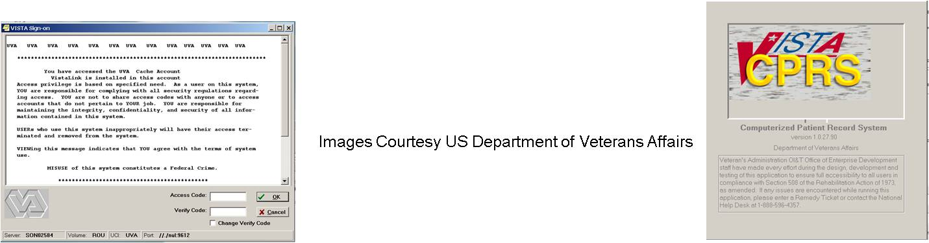
Part 2: Hands-on Application of HIT Concepts
Exploring the VistA CPRS (short videos)
  VistA Interface
  Exploring the Coversheet
  Exploring the Tabs
  Exploring the Tabs – Part 2
  Reports Tab & Scavenging
  How to do the Scavenger Hunt
Notes:
But wait – you are not done yet!
For part 2 of unit 1, you will use the VistA CPRS system to experience, firsthand, the application of the concepts that you learned in the prior slides.
Your assignment for Unit 1 is to gain familiarity with the layout and some of the functions of the VistA CPRS and to complete the Scavenger Hunt assignment.
We have created a series (there are about 6 total) of these very short video demonstrations of the VA CPRS interface, how to maneuver around in it, and how to complete the first assignment. Your instructor will guide you to where you can access these videos.
Really the best way to learn how to work with Health IT systems is to get inside and explore on your own. Therefore, after you have watched the short movies, you can access the CPRS, explore, hunt, “kick the tires,” get your hands dirty and then settle down to complete your scavenger hunt assignment. Your instructor will direct you to where to access the CPRS system and will give you instructions on how to obtain the username and password that will allow you to log in.
Watch the orientation movies to the CPRS before entering the site so you can refer to these movies at any time for assistance or guidance. There is also some help within the CPRS system that you can find by clicking the help button in the upper toolbar once you have logged in to the CPRS system. You can also use the VistA CPRS User Guide that is included with the “Working with HIT Systems” material.
These videos are fully transcribed and the script accompanies this unit’s materials. We have made all reasonable efforts to make these resources as accessible as possible for all students.

Slide 12
Introduction & Overview:
Components of HIT Systems :
Summary
We defined a system and related the concepts to HIT
We provided examples of HIT in a variety of settings
  The “H” does not stand only for healthcare
  Standards are paramount for information exchange
We identified common components of a clinical HIT system
  Similarities and differences between paper and electronic records
Notes:
This concludes Introduction & Overview: Components of HIT Systems.
In summary, we have covered systems in general and we related the concepts that we learned to Health IT. Remember the similarities of the subway system and Health IT systems. We provided examples of Health IT in a variety of settings, in public health, in the home, in social networking sites, and so on.
A major take away from this objective is that the “H” doesn’t stand only for healthcare, and health and healthcare are two different things.
And although we did not delve deeply into standards and interoperability, the point was made that standards are paramount for information exchange.
Finally, we identified common components of clinical Health IT systems and how the EHRS (well, in most cases) have been structured to mimic the “tab Metaphor” that clinicians are so familiar with. We examined the similarities and differences between paper and electronic records – at least on the surface. We will be digging deeper into this particular aspect as we learn more about working with HIT systems.

Slide 13
Introduction & Overview:
Components of HIT Systems
References
References
HealthIT.gov. Nationwide Health Information Network. Retrieved 24 June 2016 from:https://www.healthit.gov/policy-researchers-implementers/nationwide-health-information-network-nwhin
Google Flu Trends. Retrieved 24 June 2016 from: http://www.google.org/flutrends/
Images
  Slide 3: Venn Diagram of Healthcare. Created by Dr. Patricia Abbott.
  Slide 4: Hong Kong Subway system. Courtesy of "Dear Edward's Photostream" (Creative Commons Attribution). E. Russell (1984). Available from: http://www.flickr.com/photos/erussell1984/
  Slide 5: Image 1: MIT OpenCourseWare. Available from: http://www.flickr.com/photos/mitopencourseware/3693490067
Image 2: Example of a Restaurant System. Courtesy of Centers for Disease Control. Available from: http://www.cdc.gov/nceh/ehs/ehsnet/system-theory.htm
Slide 6: Concept Overview of an Electronic Health Record—National Institutes of Health. Available from:
http://s3.amazonaws.com/rdcms-himss/files/production/public/HIMSSorg/Content/files/Code 180 MITRE Key Components of an EHR.pdf
Notes:
No Audio. Ten Seconds of Silence.

Slide 14
Introduction & Overview:
Components of HIT Systems
References - 2
Images
Slide 7: Image 1: My HealthVet Website. Veterans Administration. Available from: https://www.myhealth.va.gov/mhv-portal-web/anonymous.portal?_nfpb=true&_nfto=false&_pageLabel=mhvHome
Image 2: Clinician and Patient. Courtesy Dr. Patricia Abbott.
Image 3: World Heath Organization. Available from: http://gamapserver.who.int/gho/interactive_charts/road_safety/road_traffic_deaths2/atlas.html.
Image 4: Girl and Patients Like Me. Courtesy Dr. Patricia Abbott.
Slide 8: The Big Picture of Health Care. Available from: http://healthit.gov
Slide 9: Nurse Filing Medical Records. Courtesy U.S. Army. US Army Korea-IMCOM http://www.flickr.com/photos/imcomkorea/
Slide 10: A single Record of Patient Data. Courtesy Dr. John Halamka
Slide 11: VA Vista system. Courtesy US Department of Veterans Affairs
Notes:
No Audio.

Slide 15
Working with Health IT Systems
Introduction & Overview:
Components of HIT Systems
This material was developed by Johns Hopkins University, funded by the Department of Health and Human Services, Office of the National Coordinator for Health Information Technology under Award Number IU24OC000013. This material was updated in 2016 by The University of Texas Health Science Center at Houston under Award Number 90WT0006.
Notes:
No Audio.

