Slide 1
History of Health Information Technology in the U.S.
History of CPOE and E-Prescribing
Lecture b – History of E-Prescribing
This material (Comp 5 Unit 8) was developed by the University of Alabama at Birmingham, funded by the Department of Health and Human Services, Office of the National Coordinator for Health Information Technology under Award Number 90WT0007.
This work is licensed under the Creative Commons Attribution-NonCommercial-ShareAlike 4.0 International License. To view a copy of this license, visit http://creativecommons.org
Notes:
Welcome to History of Health Information Technology in the U.S., History of CPOE (pronounced C-P-O-E) and E-Prescribing. This is lecture b History of E-Prescribing (pronounced E-prescribing). This lecture will discuss the history of electronic prescribing or e-prescribing.

Slide 2
History of CPOE and E-Prescribing
Learning Objectives
Explain how the evolving capabilities of CPOE systems impact quality and patient safety in the hospital setting
Explain how the evolving capabilities of
e-prescribing systems impact quality and patient safety in the ambulatory setting
Notes:
The Objectives for this unit, History of CPOE and E-Prescribing are to discuss the evolving capabilities of CPOE and e-prescribing systems and to discuss the impact of these systems on patient safety and quality.

Slide 3

Electronic Prescribing
Source: (Burt & Schappert, 2004)
Photo by Nir Menachemi
Notes:
The building of momentum for CPOE in the inpatient setting got the concept of electronic prescribing “rolling” into the outpatient setting. As mounting evidence of the benefits of CPOE in the inpatient setting was circulating, the outpatient setting became of increasing interest as an area to automate.
It has been estimated that two thirds of encounters in the outpatient setting result in a prescription. Furthermore, given that 75% of all physicians practice in small group settings, for the national goals of quality improvement to be realized, e-prescribing must permeate into the medical practice setting.

Slide 4
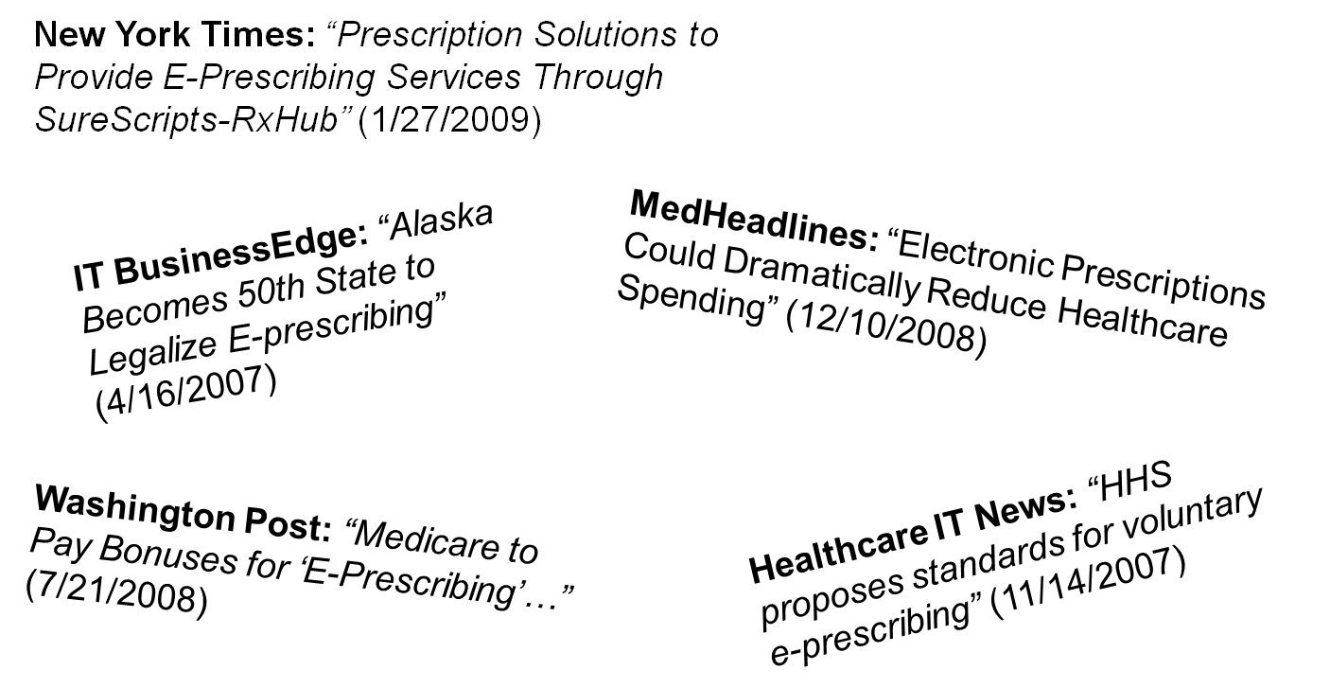
Electronic Prescribing 2
Notes:
Compared with the growing scholarly literature of CPOE in inpatient settings, articles on e-prescribing in outpatient settings were far more rare... but the media and trade press helped generate a lot of attention to this technology.

Slide 5
E-Prescribing
Electronic Rx
  Entered electronically, then printed?
  Transmitted electronically, then printed (e.g., fax)?
  Received electronically?
Notes:
So what exactly do we mean by e-prescribing?
Some have considered a prescription entered electronically, but then printed, to be “e-prescribing” but that’s probably not getting to exactly what e-prescribing is.
What about electronically-ordered prescriptions that are transmitted electronically but then printed? That’s probably not e-prescribing either.

Slide 6
E-Prescribing 2
E-Prescribing is more than the mere electronic transmission of a prescription
  Encompasses the secure real-time electronic delivery to providers and pharmacists of patient-specific information:
    Eligibility
    Benefits
    Drug interactions
    Warnings
    Dosage adjustments
    Medication history
    Availability of generics
Notes:
E-prescribing is more than the mere electronic entry or transmission of a prescription.
It encompasses the secure real-time electronic delivery to providers, and pharmacists, of patient specific information. The information may include a patient’s insurance eligibility or what benefits they are entitled to, or whether or not there are drug interactions with a prescription being ordered, any warning or dose adjustments that are recommended, and it may include medication history, and the availability of generic medications.

Slide 7
Stand alone vs. EHR integration
Integration into EHR
  Ideal way to take advantage of decision support by utilizing other clinical information available in EHR
Stand alone systems
  Less complex to install
  Cheaper
  Was seen as a way to “slowly” move physician practices into EHR systems
Notes:
There are two main types of e-prescribing systems: those that are stand alone, or those that are integrated into an electronic health record.
Those that are stand alone are typically less complex to install. They typically cost less, and originally they were seen as a way to slowly move physicians into full EHR systems.
E-Prescription systems that are a part of the Electronic Health Records systems are really the ideal way to take advantage of the decision support by utilizing other clinical information available in the electronic health record, for effective safe and high quality prescribing.

Slide 8
History of E-Prescribing
1977: Levit and Garside report on the development of an outpatient prescription system
Sources: (Sittig & Stead, 1994)
(Levit & Garside, 1977)
Notes:
Researchers Dean Sittig (pronounced Sit-ig) and William Stead (pronounced Sted like instead) published a key article that summarizes the history of e-prescribing before the mid-90s.
They report that 1977 was the advent of the first e-prescribing system. It was described in an article by Levit and Garside. The first such system was relatively basic compared to today’s standards. The system was developed to capture prescriptions entered in coded form. For example, a physician could enter in the first two letters of a common drug name, followed by T for tablets, S for solution, or C for cream. Next, the dose was entered as a number. A basic prescription order that included a drug name, number of tablets, and strength could be entered very rapidly with only a few key-strokes.
As you can imagine, this approach was a time-saver for expert or experienced users; but most novice users found the system confusing or hard to learn.

Slide 9
History of E-Prescribing 2
1985: Brown et al reports on a new system that requires only 5 keystrokes to enter a detailed e-Rx
Source: (Brown, et al., 1985)
Notes:
Several years later, in 1985, Brown and colleagues published an article about a new system that could handle very detailed electronic prescriptions very efficiently. This system allowed doctors to scroll through a list of drug names, doses, and routes, very quickly using “arrow keys.” While such a system seems intuitive to us now, back then it was a very innovative approach given the early development of computer-user interfaces.
By the late 1980s a concern had developed among physicians that automation would result in quote unquote “cook book” medicine. The term “cook-book medicine” was a negative term describing how doctors would follow computerized “recipes” of how to treat patients. This approach was viewed negatively as an erosion of the art and science of medicine.

Slide 10
History of E-Prescribing 3
1990s: Decision support features begin appearing
Notes:
In the early 1990s, decision support features began appearing in CPOE and e-prescribing systems. Decision support systems were very basic at the time. For example, the computer may have reminded the physicians to check for “pregnancy” if the patient was female and of reproductive age.

Slide 11
History of E-Prescribing 4
1999: Estimated 2% of outpatient prescriptions are captured electronically
2000: Estimated 5% of physicians prescribed electronically
2003: 19% of “tech savvy” docs e-prescribe; more likely to be generalists practicing in academic centers
Sources: (Rabinowitz, 1999, Institute for Safe Medication Practices, 2001, Pizzi, et al., 2005)
Notes:
During the 1990s, several isolated implementations of e-prescription systems continued, mostly in academic settings. By the end of the 1990s an estimated 2 percent of outpatient prescriptions were captured electronically.
A year later, at the turn of the century, an estimated 5 percent of physicians prescribed electronically.
And several years after that, in 2003, only really teach-savvy physicians were e-prescribing somewhat regularly, but still at a relatively low rate of only 19 percent. Those that were e-prescribing were more likely to be generalists practicing in an academic center.

Slide 12
History of E-Prescribing 5
2003: Medicare Modernization Act (MMA) encourages e-prescribing starting in 2006
2004: 5-18% of physicians e-prescribe
2005: Vast majority of pharmacies able to receive e-Rx
Sources: (Bell & Friedman, 2005)
(Sarasohn-Kahn & Holt, 2006)
Notes:
In 2003, the US Congress passed the Medicare Modernization Act or MMA (pronounced M-M-A) which sought to encourage doctors to e-prescribe by 2006. When the MMA passed, there still wasn’t much scientific evidence on the impact of e-prescribing (especially compared to CPOE where much more evidence was present). Nevertheless, the research evidence that did exist on e-prescribing generally demonstrated a sizeable positive effect.
By 2004, more doctors overall were e-prescribing, but rates were still fairly low and in the range of 5-18 percent. Over time, advances in computer and communication technologies made the need to “synch (pronounced sink) devices in a cradle” unnecessary. Synching refers to the pre-wireless Internet need to synchronize handheld devices by connecting them to Internet connected desktop computers so that updated information can be loaded to the portable device. The advent of wireless Internet connections, contributed to increasing e-prescribing adoption rates, because many physicians used hand held computers, or palm devices to e-prescribe.
Importantly, by 2005, the vast majority of pharmacies were able to receive electronic prescriptions, especially the large chain pharmacies.
When Hurricane Katrina hit the Gulf Coast in 2005, electronic prescription data stored in pharmacy computers were accessible to doctors and pharmacists who were treating patients displaced from their homes into neighboring states.

Slide 13
History of E-Prescribing 6
2008: 26.9% of doctors in Florida indicate they e-prescribe (avg. 62% of all prescriptions)
2009: HITECH Act specifies e-prescribing as a component of “meaningful use” incentives
Source: (Au, et al., 2011)
(Heisey-Grove & Patel, 2015)
Notes:
As available technologies made it easier and easier for doctors to afford e-prescription systems, adoption rates began to pick-up. A study using 2008 data found that almost 27% of doctors in Florida were using e-prescription systems. Furthermore, those with such systems reported that the majority of their prescriptions were entered into the computers they had.
Seeking to further encourage doctors to e-prescribe, the HITECH (pronounced High-tech) Act of 2009 represented the largest federal commitment to promote this technology. Specifically, the Act makes bonus payments available to physicians who “meaningfully use” health information technologies. E-prescribing was included in the definition of “meaningful use.” By 2014, as a result of the meaningful use incentives, 86% of physicians were doing e-prescribing.

Slide 14
History of CPOE and E-Prescribing
Summary
CPOE and e-prescribing have been around for more than 30 years
Electronic order entry benefits
Planning and implementing such systems
We will continue to learn more as adoption of CPOE and e-prescribing has risen as a result of federal incentives
Notes:
This concludes History of CPOE and E-Prescribing.
In summary, CPOE and e-prescribing have been around for more than 30 years (indeed, almost 40 years for CPOE).
The industry has learned a lot about the numerous benefits of electronic order entry, as well as the potential drawbacks. More importantly, we have learned much more about how to plan for, and properly implement, such systems.
We will likely continue to learn additional best practices now that the adoption of CPOE and e-prescribing has risen in response to recent federal incentives.

Slide 15
History of CPOE and E-Prescribing References – Lecture b
References
  Au DW, Menachemi N, Panjamapirom A, Brooks RG. The influence of payer mix on electronic prescribing by physicians. Health Care Manage Rev. 2011 Jan-Mar;36(1):95-101.
  Bell DS, Friedman MA. E-prescribing and the Medicare Modernization Act of 2003. Health Affairs. 2005; 24(5): 1159-69.
  Brown CS, Allen SI, Songco DC. A computerized prescription writing program for doctors. Meth Inform Med. 1985; 24:101-5.
  Burt C, Schappert S. Ambulatory care visits to physician offices, hospital outpatient departments, and emergency departments: United States, 1999– 2000. National Center for Health Statistics. Vital Health Stat. 2004;13(157).
  Institute for Safe Medication Practices. A call to action: eliminate handwritten prescriptions within 3 years. Huntington Valley (PA): ISMP. 2001.
  Levit F, Garside DB. Computer-assisted prescription writing. Comput Biomed Res. 1977;10: 501-10.
  Pizzi LT, Suh DC, Barone J, Nash DB. Factors related to physicians’ adoption of electronic prescribing: results from a national survey. Am J of Med Q. 2005;20(1):22-32.
  Rabinowitz E. Will palm-sized computers make electronic prescribing happen? Managed Care. 1999;8: 59-61.
  Sarasohn-Kahn J, Holt M. The prescription infrastructure: Are we ready for e-prescribing? Oakland: California HealthCare Foundation; 2006.

Slide 16
History of CPOE and E-Prescribing References 2 – Lecture b
References
  Sittig DF, Stead WW. Computer-based Physician Order Entry: The state of the art. J Am Med Inform Assoc. 1994 Mar-Apr;1(2):108-23.
  Heisey-Grove D, Patel V. Any, Certified, or Basic: Quantifying Physician EHR Adoption. ONC Data Brief, No. 28. Office of the National Coordinator for Health Information Technology: Washington DC.,, September 2015. www.healthit.gov . Accessed May 21, 2016
Images
  Slide 3: Nir Menachemi, Personal Collection.

Slide 17
History of Health IT in the US
History of CPOE and E-Prescribing Lecture b
This material was developed by the University of Alabama at Birmingham, funded by the Department of Health and Human Services, Office of the National Coordinator for Health Information Technology under Award Number 90WT0007.
Notes:
No Audio.

