Slide 1
History of Health Information Technology in the U.S.
History of CPOE and E-Prescribing
Lecture a – History of CPOE
This material (Comp 5 Unit 8) was developed by the University of Alabama at Birmingham, funded by the Department of Health and Human Services, Office of the National Coordinator for Health Information Technology under Award Number 90WT0007.
This work is licensed under the Creative Commons Attribution-NonCommercial-ShareAlike 4.0 International License. To view a copy of this license, visit http://creativecommons.org.
Notes:
Welcome to History of Health Information Technology in the U.S., History of CPOE (pronounced C-P-O-E) and E-Prescribing (pronounced E-prescribing) . This is lecture a, History of CPOE. This lecture presents the history of computerized physician order entry systems or CPOE. We will begin by talking about CPOE, which is most commonly found in the hospital setting.

Slide 2
History of CPOE and E-Prescribing
Learning Objectives
Discuss the evolving capabilities of CPOE and e-prescribing systems
Discuss how CPOE and e-prescribing impact patient safety and quality
Notes:
The Objectives for this unit, History of CPOE and E-Prescribing are to discuss the evolving capabilities of CPOE and e-prescribing systems and to discuss the impact of these systems on patient safety and quality.

Slide 3

Life in Medieval Times
Atlas by Govard Bidloo/Courtesy US National Library of Medicine
Notes:
Before we begin thinking about the history of CPOE (we will define this term later in this lecture) let’s briefly consider what life was like during medieval times. The Middle Ages, as they are sometimes called, were more than 500 years ago.
Life was very different. Certainly, there were no computers and no Internet connections.

Slide 4
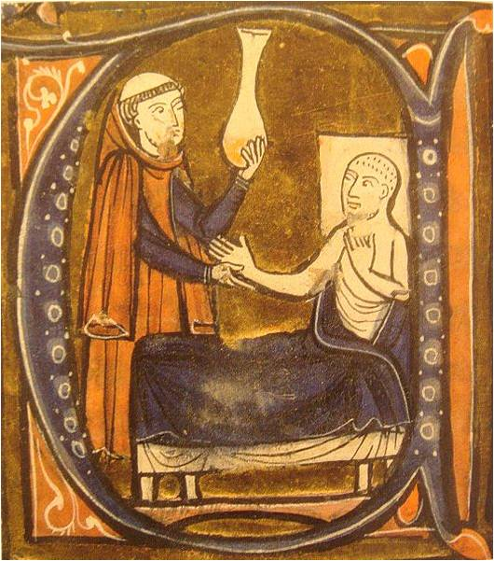
Life in Medieval Times 2
Gerardus Cremonensis "Recueil des traités de médecine" 1250-1260.
Reproduction in "Inventions et découvertes au Moyen-Âge", Samuel Sadaune
Notes:
Patients during that time would seek the care of a physician who might have decided that a prescription compound (such as a medication, an herb, or some other concoction) was warranted.

Slide 5


Life in Medieval Times 3
Gerardus Cremonensis "Recueil des traités de médecine" 1250-1260.
Reproduction in "Inventions et découvertes au Moyen-Âge", Samuel Sadaune
Photo by Mr. Mo-Fo
Notes:
The patient would then have to travel across the village in order to present the doctor’s prescription to a chemist...

Slide 6
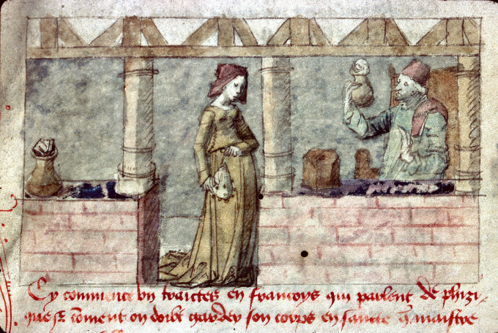
Life in Medieval Times 4
Source: Wikimedia Commons/culture.gouv.fr
Notes:
The chemist and the doctor were literate. Thus the chemist could decipher the written note from the physician. Chances are, the patient could not.
The chemist needed to prepare the physician’s order to exact specifications, and frequently had to mix a variety of compounds. Any error in interpreting the doctor’s notes, such as misreading the type of “medicine” ordered, the amount prescribed, or the frequency of ingestion, could potentially harm the patient.

Slide 7
Modern Prescribing
Not much change until recently
  Mostly handwritten
  Latin abbreviations
  Penmanship difficult to read
Notes:
Strangely enough, in many ways this process hasn’t changed much in modern times. Certainly, there is a lot more science underpinning the practice of medicine and pharmacy, but certain facts still remain. For example, until very recently, prescriptions were still written using Latin abbreviations which many patients do not understand. Second, the pharmacist still needed to quote, unquote “decode” the physician’s handwriting -- which at times could be difficult because legible penmanship is not something that’s taught in medical schools.

Slide 8

Isordil or Plendil?
Intended as Isordil
Misread as Plendil
After taking medication (q 6 hrs), patient suffered MI and died a few days later
Physician, pharmacist, and pharmacy sued
Source: (Institute for Safe Medication Practices)
Notes:
The image on your screen is an example of the sort of prescription that has been written in modern times that has caused harm to patients. In this particular case, a drug called Isordil (pronounced EYE-sore-dill) (which is a nitrate used for angina (pronounced Ann—gin—uh)) was prescribed. The pharmacist filled the medication as Plendil (pronounced Plen-dill ) (a calcium channel blocker used for hypertension). After taking the medication every 6 hours as instructed the patient suffered a heart attack and later died. By the way, “q6 hours” (pronounced Q-6- hours) is the Latin abbreviation for “every 6 hours”).
Needless to say, the physician was sued because it was very difficult to interpret what his intention was when he wrote that prescription. The pharmacist was also sued because he dispensed Plendil at more than the maximum dose of 10 milligrams, and the pharmacy was sued because its computer system did not catch the excessive dose.
All three errors made by the physician, the pharmacist, and the pharmacy could have been prevented with the use of CPOE... so now let’s define it.

Slide 9
Definition of CPOE
CPOE is a system enabling physicians (or other providers of care) to enter orders (for tests, medications, services, etc.) through a computer system.
Computerized Physician Order Entry
Computer-based Provider Order Entry
Care Provider Order Entry
Notes:
CPOE is a system enabling physicians to enter orders through a computer system.
“Orders” include prescribing drugs (like we have already discussed) but can also include ordering lab tests or radiology tests (such as X-rays or CAT scans) and ordering services such as physical therapy sessions that a patient may require. Technically, orders could also include referrals to other physicians or locations of care.
The acronym CPOE is used collectively to refer to several terms meaning roughly the same thing. The “C” in CPOE can stand for “Computerized,” “Computer-based,” or “Care” as in “Care” provider. Likewise, the “P” can refer to “physician” or “provider,” to acknowledge the fact that non-physician caregivers are able to request orders for patients as well.
Generally speaking, all three terms are used somewhat interchangeably.

Slide 10
Traditional Ordering
Telling nurse what orders are needed
Transcribing dictated instructions
Conversation with another provider
Hand written prescriptions or order slips
Note in the patient’s chart
Designed to maximize doctor’s efficiency
Source: (Charles et al. 2015)
Notes:
As we will see, before 2008, use of CPOE systems were used in less than 10% of hospitals. By 2014 three out of four hospitals used CPOE for medication orders, although much less are using CPOE for other types of orders. The traditional, non-computerized way of placing orders sometimes involves a doctor verbally instructing a nurse or someone else on the healthcare team what orders are needed. Sometimes a unit clerk transcribes a doctor’s voice recording of instructions. Sometimes a hand written note (such as a prescription) may be used to communicate an order. Other times, a telephone conversation between two providers results in an order. Indeed, many times a note hand written directly into the patient’s chart is how a physician or provider may order a needed service for a patient.
Traditionally, the process of placing orders has developed to be as convenient for the doctor as possible. Physicians who round on patients need to be efficient. Their workflows have evolved to maximize the amount of time they spend seeing patients. When CPOE is introduced -- which requires them to directly enter their orders into a computer system -- it can be very disruptive to their routines. Nevertheless, there are many benefits to CPOE.

Slide 11

Prescription for Errors
The above prescription was misinterpreted and dispensed as
Haldol ® 5mg instead of 0.5mg as the prescriber had intended.
Notes:
By the way, here is another example of the sort of prescription that can cause harm to a patient. While this prescription may be more legible than the last one we saw, there is still a serious problem..
If not caught, this prescription could result in a severe overdose to the patient. In this case, the prescription was intended to be at the strength of 0.5 (pronounced zero point five) milligrams instead of five milligrams.
A nurse or pharmacist working a busy schedule (which they all are!) may misread the order as 5 milligrams, resulting in the patient receiving an overdose of ten times the ordered dose.

Slide 12
Automation of the
Ordering Process
Eliminates illegible handwriting
Eliminates incomplete (or lost) information
Forces prescriber to indicate
  A precise dose
  Route
  Frequency
Makes prescription traceable to the provider
Can be coupled with more complex systems, such as clinical decision support systems
Sources: (Bates et al., 1998)
(Bates et al., 1999)
Notes:
So what are the benefits of automating the ordering process?
First, it makes poor penmanship completely irrelevant. All orders are entered into a computer and are therefore typed. When printed or read, legibility is not an issue.
Second, unlike with a hard copy, the electronic order cannot be misplaced or submitted with incomplete information. An important bit of information frequently left off handwritten prescriptions is a patient’s weight. This can be a problem for pediatric or geriatric patients who may need medicines formulated for their weight for maximum benefit and safety.
Lastly, the order can be traced back to the provider very easily through the CPOE system. In hospitals, where constant shift changes make it more difficult to determine which physician ordered a given test or drug, CPOE systems can reliably log exactly who ordered what and when. In a very well cited article by Dr. David Bates and colleagues, a simple CPOE system was found to reduce drug errors by 55%.
CPOE systems can be coupled with more “complex systems” such as clinical decision support systems. These more complex systems can help intercept inappropriate doses, flag harmful drug-drug interactions, or flag an allergy that a particular patient has. These more sophisticated systems were found to reduce drug errors by 83% by the research team led by Dr. David Bates.

Slide 13
Automation of the
Ordering Process 2
Computerized Physician Order Entry (CPOE)
  Inpatient setting
  Involves pharmacy, laboratory, and radiology orders
E-Prescribing
  Outpatient setting
  The term refers to pharmacy orders only, but outpatient systems can also include laboratory and radiology orders
Notes:
So again, just to review, CPOE is something that you would find in a hospital inpatient setting. CPOE systems can handle all physician orders, not just medication orders.
On the other hand, e-prescribing (pronounced E-prescribing) systems are used for drug order entry systems that are used in physician offices or in outpatient settings. The term “e-prescribing” generally refers to pharmacy orders only, mainly because these are the most common type of orders in the outpatient setting. But it is important to note that outpatient information systems used by physicians can also include electronic capabilities to request other types of orders.

Slide 14
History of CPOE
1971
  El Camino Hospital in Mountain View, CA
  Rolls out first CPOE system
  Fully operational in 1973
  Source: (Sittig & Stead, 1994)
Notes:
Now, to the history of CPOE...
The first CPOE system was a system called MIS (pronounced M-I-S) or Medical Information System. This was developed by Lockheed Martin and installed at El Camino (pronounced el-kah-meen-o) hospital in California. Implementation of the system started in 1971 and took two years to complete. Once operational, physicians were able to order medications quickly with a few simple clicks.
Interestingly, the MIS system eventually became the basis for the CPOE product sold by Eclipsys (pronounced E CLIPS sis ) Corporation, which has since merged with Allscripts.
Early studies of this system found that it reduced the number of incomplete prescriptions to almost zero, and significantly increased the number of radiology orders that included complete information such as clinical indications.

Slide 15
History of CPOE 2
1984
  Wishard Memorial Hospital in Indianapolis, IN
  Implements Regenstrief Institute’s CPOE
Source: (Sittig & Stead, 1994)
Notes:
Despite the success of MIS in 1971, over a decade passed before more organizations began experimenting with CPOE installations.
In 1984, an early pioneer was Wishard (pronounced WISH erd ) Memorial Hospital in Indianapolis. Wishard Memorial installed a CPOE system developed by the Regenstrief (pronounced REE gen (like again) streef) Institute. This CPOE system included an early clinical decision support system that triggered reminders or alerts when a physician would order a test or drug. Given that computers of this era were very slow compared to their modern counterparts, using the system required more time than using the traditional paper method because the slow computers needed to process a lot of information to provide decision support.

Slide 16
History of CPOE 3
1986
  NYU Hospital in New York City
  Modifies version of software used in El Camino
Source: (Sittig & Stead, 1994)
Notes:
Several years later, in 1986, the New York University Hospital installed an upgraded version of the MIS system originally used in El Camino Hospital.
Studies of the system at NYU confirmed earlier studies demonstrating a reduction in incomplete orders and added some findings regarding faster turn-around times for pharmacy and laboratory orders.

Slide 17
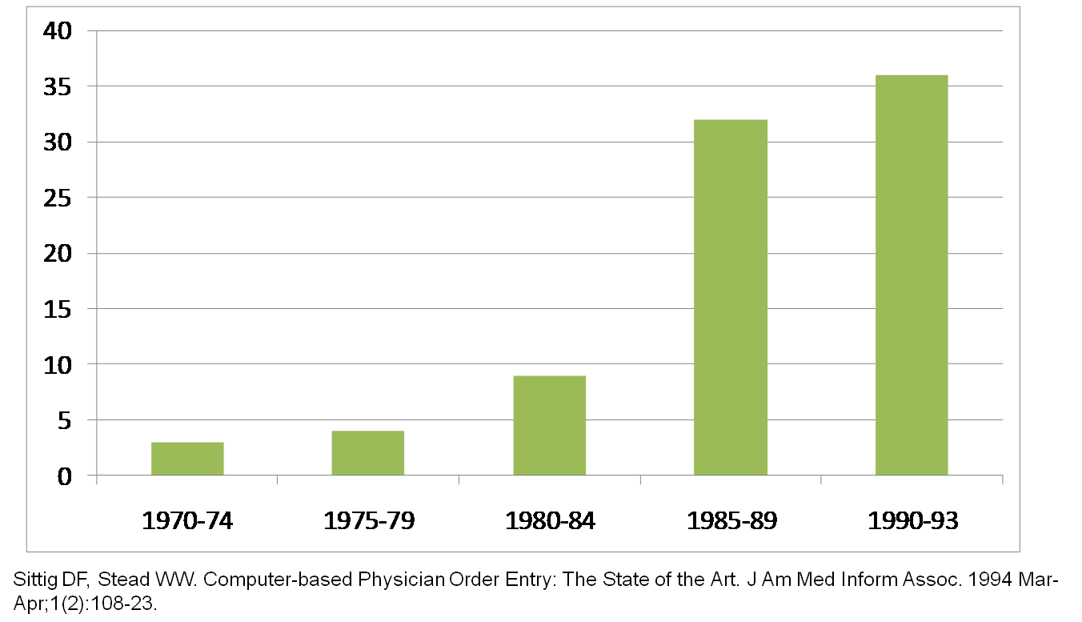
Published Scientific
Articles on CPOE
Notes:
Much of the history discussed thus far was summarized in a 1994 article by Sittig (pronounced SIT ig) and Stead (pronounced Sted (like instead)). In their article, they reviewed all the published studies about CPOE through the early 1990s.
This graph is an analysis of their bibliography. As can be seen, the number of published articles about CPOE was small in the 1970s. By the mid-to-late 1980s, however, a great deal of scholarly activity was developing around CPOE. Many of these studies tried to answer research questions about the impact of different implementation strategies for CPOE.

Slide 18
Focus of Early CPOE Research
Roll out in phases or all at once?
Is there a need for new institutional policies that govern CPOE?
Notes:
Some of the research studies tried to address such questions as: should CPOE systems be rolled-out all at once? Or in phases? Should all CPOE functions come online at the same time, or should a bare-bones version be used first so that users can more slowly adapt to the new system?
What institutional policies should be developed when CPOE is implemented?
For example, if doctors are required to enter all orders themselves, what happens when a physician telephones an order (which is frequently the case)? Hospitals need to think through the changes that occur as a result of CPOE, and come up with policies that make sense for their institutions.

Slide 19
Focus of Early CPOE Research 2
How to achieve end-user buy-in?
How to adequately train end-users?
What is the best method of entering data?
Notes:
How does an organization secure end-user buy-in when implementing such a costly system?
Many early implementations, and even some today, were met with dissatisfaction with the system, especially among physician groups. Over the past thirty years, we have collectively learned a great deal about how to appropriately plan for CPOE, implement it, and support users, especially in the critical transition period.
What is the best method for entering data?
Early systems used hardwired computers centrally located, usually in nurses’ stations. More modern systems utilize handheld devices or tablets which seem to be less disruptive to workflows.
Ultimately, the lessons learned are very similar to any “best practices” we now know for many software development projects.

Slide 20
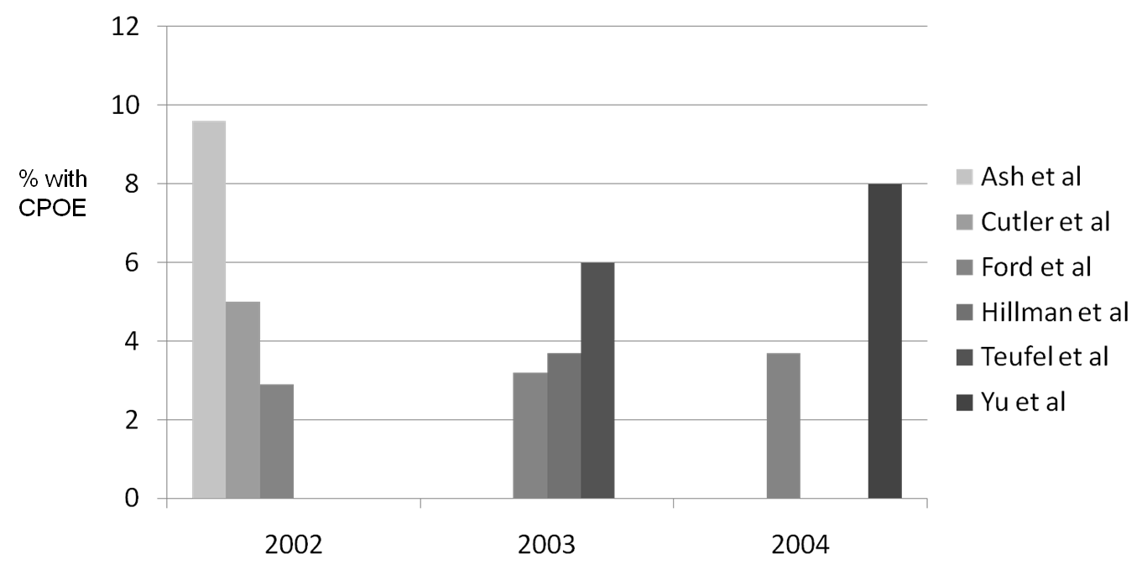
Hospital CPOE Adoption Rates as Reported by Different Studies
Notes:
Estimating CPOE adoption rates, at any point in time, has been a challenge. There are few routinely collected data sources that tell us which hospitals have CPOE and which hospitals do not. Depicted in this graph, are results from various data sources, published by different authors, that reported CPOE adoption by hospitals in 2002, 2003, and 2004.
Common to all surveys is the fact that FULL CPOE adoption at this point was still pretty rare with less than 10% of hospitals having it (even under the most generous estimation).
Compounding the unreliability of national estimates of CPOE adoption is the fact that each researcher was using data that defined CPOE adoption slightly differently. For example, a given hospital can have a full CPOE system installed, but only in one wing of the hospital. Depending on how a question is asked on a survey, respondents may give different answers. Hence, you see the wide variability, even in the same year, when hospitals are surveyed about their CPOE status. It is also worth mentioning that while adoption is consistently low during this time frame, the number of hospitals considering implementation or who have partial systems implementations was much higher.

Slide 21
The Department of
Veterans Affairs
The VA has long been an innovator in the area of Health IT
Between 1997-2002 the VA rolled out CPOE as part of their computerized patient record system (CPRS) nationwide
Source: (Brown, et al., 2003)
Notes:
Before we get back to our historical timeline, it is worthwhile to mention an important innovator namely, the U.S. Department of Veterans Affairs or VA (pronounced V-A). The VA provides healthcare benefits to US military veterans and their families. The VA system includes over 160 hospitals and more than 800 community clinics.
The VA has a long and marked history with health IT in general. The system began nationwide adoption of CPOE between 1997 and 2002. The VA’s computerized patient record system, or CPRS, (pronounced C-P-R-S) supports physician order entry and electronic note entry. By 2002, providers nationwide at VA hospitals and clinics entered over 90% of all pharmacy orders electronically.
Today, the VA’s system is among the “most wired” and has served as an exemplar on how such a system can be deployed on a national level.

Slide 22
History of CPOE
1994-2004: Growth of commercial CPOE systems
2000: Leapfrog Group launches
Mid-late 2000s: Focus on evaluation and improvement of CPOE systems
Notes:
The period from 1994 to 2004 was a time of significant growth in commercial CPOE systems. Previously, almost all CPOE systems were developed in-house by researchers and experts, most commonly in academic health centers. In contrast, during this time period, many hospitals starting buying vendor-developed systems which were becoming increasingly available.
In 2000, an organization called Leapfrog was established. This organization, a conglomerate of large, fortune 500 companies, collectively buys health insurance for their employees. Those employees represent a sizeable proportion of Americans. Wanting to encourage hospitals to improve their quality, Leapfrog came up with a set of criteria that they wanted hospitals to follow in order to gain business from insurance companies representing Leapfrog-affiliated company employees. Adopting CPOE was among the suggested improvements. This was a concerted effort, using market forces, to encourage hospitals to engage in activities believed to improve quality. Hospitals were given credit for making “leaps” forward toward CPOE adoption with the use of decision support systems.
Lastly, in the mid-to late 2000s there was an increased focus on studying the benefits of CPOE and the lessons learned from the many installations occurring around the country.

Slide 23
Unintended Consequences of CPOE
2005 - “Role of Computerized Physician Order Entry Systems in Facilitating Medication Errors” in JAMA
  Received significant media attention
Subsequent editorials and expert commentaries in HIT journals
Source: (Koppel et al., 2005)
Notes:
2005 marked a milestone year for CPOE, but this one was negative.
In this year, a group of researchers from the University of Pennsylvania published an article suggesting that the CPOE implementation at their hospital was associated with an increase in medical errors. Unlike most of the home-grown systems appearing in the literature previously, this study examined a commercially available CPOE system and garnered much media attention.
The article triggered a set of editorials and expert commentaries in a variety of HIT (pronounced H-I-T) journals, by many of the leading CPOE experts in the country. The entire series of events reminded us that the mere presence of a CPOE system does not improve care. Instead, CPOE systems need to be consistently updated and refined to take full advantage of lessons learned from how the system is used. As it turns out, by the time the article by the University of Pennsylvania’s team was published, their own system had been upgraded and refined and was no longer believed to have the problems that led to their research conclusions.
Lastly, the attention received by this article resulted in the creation of a federal task force on “unintended consequences” with the Office of the National Coordinator for Health Information Technology.

Slide 24
Impact of HITECH Act
HITECH (2009) provided incentives for EHR adoption and use of CPOE
Basic and comprehensive EHR
By 2014, 76% of non-federal acute care hospitals had adopted at least a basic EHR
Over 34% of hospitals had adopted a comprehensive EHR by 2014
Source: (Charles et al. 2015)
Notes:
In addition to the push for CPOE from the Leapfrog Group, the HITECH Act that was part of the American Recovery and Reinvestment Act of 2009 included incentives for EHR adoption and use of CPOE as a part of the Meaningful Use requirements. This led to a dramatic increase in the adoption of CPOE. A distinction between what is called a basic and comprehensive EHR has been made. In regard to CPOE, a basic EHR includes use of CPOE for medications, while a comprehensive EHR includes use of CPOE for medications, laboratory reports, radiology tests, consultations, and nursing orders. A comprehensive EHR also includes the use of clinical decision support such as clinical guidelines and a variety of drug interaction rules, such as drug-drug, drug-allergy, drug –lab and drug dosing support.
Studies by the Office of the National Coordinator for Health Information Technology showed that by 2014 76% of hospitals had adopted at least a basic EHR and over 34% had adopted a comprehensive EHR.

Slide 25
History of CPOE and E-Prescribing
Summary – Lecture a
Explain how the evolving capabilities of CPOE systems impact quality and patient safety in the hospital setting
Notes:
This concludes Lecture a of History of CPOE and E-Prescribing.
In summary, we explained how the evolving capabilities of CPOE systems impact quality and patient safety in the hospital setting.

Slide 26
History of CPOE and E-Prescribing
References – Lecture a
References
  Ash J S, Gorman PN, Seshadri V, Hersh WR. 2004. Computerized physician order entry in U.S. hospitals: results of a 2002 survey. J Am Med Inform Assoc. 11(2):95-9.
  Bates DW, Leape LL, Cullen DJ, et al. Effect of computerized physician order entry and a team intervention on prevention of serious medication errors. JAMA. 1998 Oct 21;280(15):1311-6.
  Bates DW, Teich JM, Lee J, et al. The impact of computerized physician order entry on medication error prevention. J Am Med Inform Assoc. 1999;6(4):313–21.
  Brown SH, Lincoln MJ, Groen PJ, Kolodner RM. VistA- U.S. Department of Veterans Affairs national-scale HIS. Int J of Med Infor. 2003;69(2):135-6.
  Cutler DM, Feldman NE, Horwitz JR. U.S. adoption of computerized physician order entry systems. Health Aff (Millwood). 2005;24(6):1654-63.
  Ford EW, McAlearney AS, Phillips MT, Menachemi N, Rudolph B. Predicting computerized physician order entry system adoption in US hospitals: can the federal mandate be met? Int J Med Inform. 2008;77(8):539-45.
  Handwriting on the wall? Institute for Safe Medication Practices. Horsham (PA). Available from: www.ismp.org
  Hillman JM, Given RS. Hospital implementation of computerized provider order entry systems: results from the 2003 Leapfrog group quality and safety survey. J Healthc Inf Manag. 2005;19(4):55-65.
  Koppel R, Metlay JP, Cohen A, et al. Role of computerized physician order entry systems in facilitating medication errors. JAMA. 2005 Mar 9; 293(10):1197-1203.
Notes:
“No Audio”

Slide 27
History of CPOE and E-Prescribing
References 2 – Lecture a
References
  Sittig DF, Stead WW. Computer-based physician order entry: the state of the art. J Am Med Inform Assoc. 1994 Mar-Apr;1(2):108-23.
  Teufel RJ 2nd, Kazley AS, Basco Jr. WT. Early adopters of computerized physician order entry in hospitals that care for children: a picture of US health care shortly after the Institute of Medicine reports on quality. Clin Pediatr (Phila). 2009;48(4): 389-96.
  Yu FB, Menachemi N, Berner ES, Allison JJ, Weissman NW, Houston TK. Full implementation of computerized physician order entry and medication-related quality outcomes: a study of 3364 hospitals.” Am J Med Qual. 2009;24(4): 278-86.
  Charles D, Gabriel M, Searcy T. Adoption of Electronic Health Record Systems among U.S. Non-Federal Acute Care Hospitals: 2008-2014. ONC Data Brief, No.23. Office of the National Coordinator for Health Information Technology: Washington DC., April 2015. www.healthit.gov Accessed May 21,2016.
Notes:
“No Audio”

Slide 28
History of CPOE and E-Prescribing
References 3 – Lecture a
Images
  Slide 3: Govard Bidloo Available from: commons.wikimedia.org
  Slide 4: Available from: en.wikipedia.org
  Slide 5: Available from: en.wikipedia.org
  Slide 5: Mr. Mo-Fo CC BY-NC-ND 2.0 Available from: www.flickr.com
  Slide 6: Available from: en.wikipedia.org.
  Slide 8: Handwriting on the wall? Institute for Safe Medication Practices. Horsham (PA). Image used with permission. Available from: www.ismp.org
  Slide11: Derrick Wheeler, Personal Collection.
  Slide 17: Nir Menachemi based on Sittig and Stead, 1994, Personal Collection.
  Slide 20: Nir Menachemi, Personal Collection.
Notes:
No Audio

Slide 29
History of Health IT in the US
History of CPOE and E-Prescribing Lecture a
This material was developed by the University of Alabama at Birmingham, funded by the Department of Health and Human Services, Office of the National Coordinator for Health Information Technology under Award Number 90WT0007.
Notes:
No Audio.

