Slide 1
History of Health Information Technology in the U.S.
Evolution of Nursing Informatics and HIT Tools Used by Nursing
This material (Comp 5 Unit 5) was developed by the University of Alabama at Birmingham, funded by the Department of Health and Human Services, Office of the National Coordinator for Health Information Technology under Award Number 90WT0007.
This work is licensed under the Creative Commons Attribution-NonCommercial-ShareAlike 4.0 International License. To view a copy of this license, visit http://creativecommons.org.
Notes:
Welcome to History of Health Information Technology in the U.S., Evolution of Nursing Informatics and HIT Tools Used by Nursing. This lecture provides an overview of the history of nursing informatics. The overview intends to give the learner an appreciation for the evolution of nursing informatics. We will begin by briefly characterizing the nursing profession. Next, we will describe some of the key elements of the nursing process and discuss why these elements lend themselves well to automation. We will then trace the use of informatics in nursing practice through time.

Slide 2
Evolution of Nursing Informatics
Learning Objectives
Discuss how health IT (HIT) tools have evolved to support the practice of nursing
List common nursing HIT applications and describe how they have evolved over time
Describe the evolving role of nurse informaticists in healthcare organizations
Notes:
The objectives for this unit, Evolution of Nursing Informatics and HIT Tools Used by Nursing are to:
Discuss how health IT (HIT) tools have evolved to support the practice of nursing
List common nursing HIT applications and describe how they have evolved over time
Describe the evolving role of nurse informaticists in healthcare organizations

Slide 3
The Nursing Profession
2.9 million RNs practice in the US
Nation’s largest healthcare profession
Nurses practice in virtually all healthcare settings:
Inpatient
Outpatient
Long term care
Hospice
Public Health
Emergency
Notes:
Nurses represent the largest health profession. Nurses work in virtually all settings where patient care is received. This includes both in-patient and out-patient settings, as well as long-term care, hospice, public health, and emergency settings to name just a few.

Slide 4

The Nursing Process
Assessment
Diagnosis
Outcomes / Planning
Implementation
Evaluation
Each step supports:
  Actual delivery of patient care
  Management of each patient’s care
Source: (The nursing process)
(Photo by Poramaporn Niramon)
Notes:
In addition to providing direct nursing services, in a hospital setting, nurses by virtue of their training and responsibilities are the coordinators of each patient's care. The nursing process, a philosophy common to all nursing professionals, includes Assessment, Nursing diagnosis, Identification of expected outcomes and treatment planning, Implementation of treatment, and Evaluation of patient status.
Each of these steps of the nursing process supports physically interacting with the patient as well as managing the patient's needs. Thus, "information management" is integrated into everything that nurses routinely do. Moreover, documenting all these steps, and the patient’s response to all of these steps, is part of all of these functions.

Slide 5
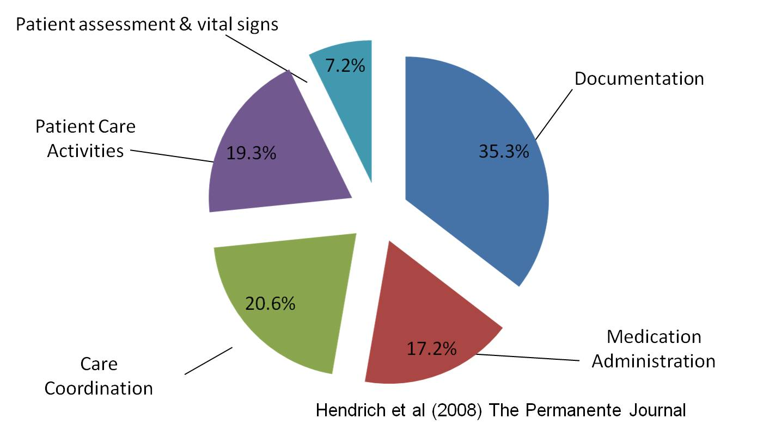
How Nurses Spend Their Time
Notes:
This chart, based on a study by Hendrich (pronounced Hen drick ) et al, shows how nurses spend their time. In addition to patient assessment, other important responsibilities of nurses include medication administration, care coordination, and patient care activities. However, as can be seen, the largest portion of a nurse’s time (more than 1/3 of her or his time) is spent on documentation.
Some even estimate that nurses spend as much as 50% of their time on documentation.

Slide 6
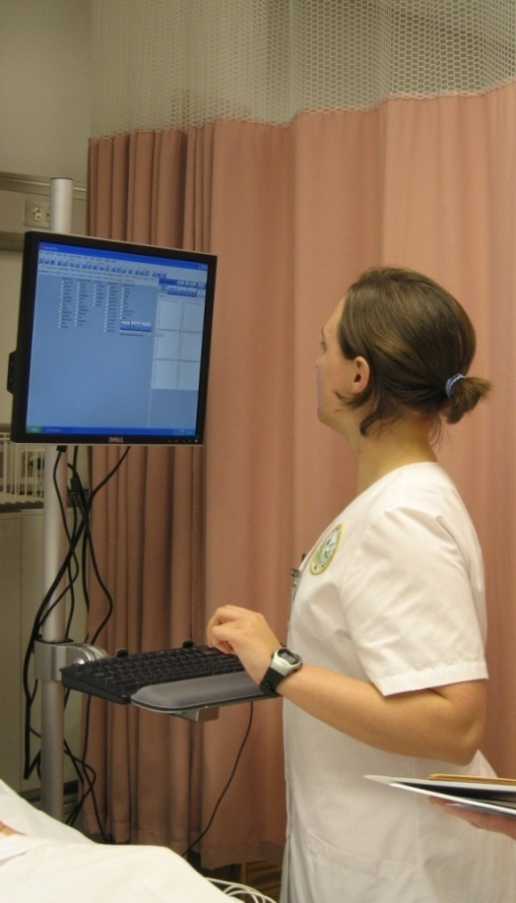
Nursing Informatics
(Courtesy of UAB School of Nursing)
Notes:
Many of these activities lend themselves well to automation. In fact, some of these activities, when automated, bring synergies to the nursing process.
For example, computerized nursing documentation allows nurses to better manage and track the care processes, focusing on improving outcomes by implementing appropriate nursing care for identified problems.

Slide 7
American Nurses Association
1994 Definition
“Nursing Informatics is the specialty that integrates nursing science, computer science, and information science in identifying, collecting, processing, and managing data and information to support nursing practice, administration, education, research and the expansion of nursing knowledge”
Notes:
Let's begin our study of the history of nursing informatics by tracking the definition of nursing informatics over time.
The American Nurses Association defined nursing informatics as "the specialty that integrates nursing science, computer science, and information science in identifying, collecting, processing, and managing data and information to support nursing practice, administration, education, research and the expansion of nursing knowledge.“
Underlined on the slide are the key words of this definition. Specifically, at the heart of this definition is identifying, collecting and processing of information. This definition is from 1994.

Slide 8
American Nurses Association
2001 Definition
“Nursing Informatics is the specialty that integrates nursing science, computer science, and information science to manage and communicate data, information, and knowledge in nursing practice. NI facilitates the integration of data, information and knowledge to support patients, nurses, and other providers in their decision-making in all roles and settings. This support is accomplished through the use of information structures, information processes, and information technology”
Notes:
By 2001, the American Nurses Association updated its definition to focus more on informatics for the "support of patients, nurses, and other providers in their decision making." You can see the expanded role nursing informatics was having by moving from "managing" data (per the 1994 definition)... to utilizing information for improved decision-making.

Slide 9
American Nurses Association
2008 Definition
“Nursing Informatics is the specialty that integrates nursing science, computer science, and information science to manage and communicate data, information, knowledge, and wisdom in nursing practice.”
Notes:
An even more recent definition from the American Nurses Association takes the role of nursing informatics one step further. Now, the focus is on managing and communicating data for improved information, knowledge and wisdom in the practice of nursing.

Slide 10
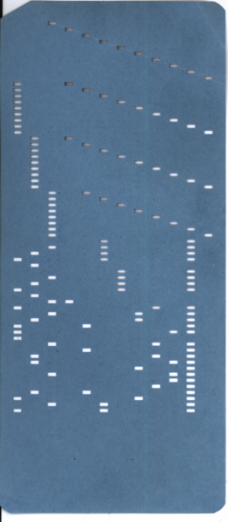
Evolution of Nursing Informatics
Nurses have been involved in “informatics” since the 1960s
San Jose Hospital (1965): Nurses recorded their observation on a check list which was then converted into punched cards for computer entry
Source: (Collen, 1995)
(Photo by Gwern)
Notes:
One can argue that nursing has always been in the business of processing information. In fact, in 1857 a pioneering nurse named Florence Nightingale compiled and processed data in an effort to advocate for appropriate nursing and medical protocols.
However, in more recent history, nurses have been involved in informatics since the 1960s. According to a textbook on the history of medical informatics by Collen (pronounced Col (NOT cole) in), nurses utilized computer-readable punch cards to check-off their observations of patients as early as 1965. The data from these cards were then read into computers at San Jose (pronounced san hose-ay) Hospital, which then served as an electronic record of patient care.

Slide 11
Evolution of Nursing Informatics 2
1966 Institute of Living in Hartford: Nurses used machine readable pencil “bubble sheets” to document patient status
Source: (Collen, 1995)
Notes:
In the following year,1966, nurses at the Institute of Living in Hartford used similar technology to document patient statuses. In this case, nurses used machine-readable bubble sheets similar to "scantron“ (pronounced scan tron (like on)) technology that can read penciled markings.

Slide 12
Evolution of Nursing Informatics 3
1974: Nursing research papers presented at an international medical informatics conference (MEDINFO)
  Four research papers on NI from the UK and one from US nurses adapting and implementing an information system at the NIH
Source: (Ozbolt and Saba, 2008)
Notes:
1974 marks the first time research presentations on nursing informatics were made at the international medical informatics conference called MEDINFO (pronounced Med-IN-fo). Here, a total of five such studies were presented, including one from US nurses who had implemented an information system at the National Institutes of Health.

Slide 13
Evolution of Nursing Informatics 4
1979: The Journal of Nursing Administration features a monthly column on “automation in nursing”
Notes:
By the late 1970s a prominent scholarly nursing periodical, the Journal of Nursing Administration, began featuring a monthly column related to nursing informatics.

Slide 14
Evolution of Nursing Informatics 5
1980: The term “Nursing Informatics” originated by Scholes and Barber
1992: NI approved as a nursing specialty by American Nurses Association (ANA)
1995: ANA credentialing exam
Notes:
Despite all the activity around nursing and computer-use for the support of nursing responsibilities, the term "nursing informatics" wasn't actually coined until 1980 by Scholes (pronounced shoals) and Barber.
Soon thereafter, in 1992, the American Nurses Association approved nursing informatics as a recognized specialty. A credentialing exam for nursing informatics was created in 1995.
Since the mid-1990s nursing informatics has virtually "exploded" as a discipline. This occurred concurrently with the development of the Internet and desktop computing advances.

Slide 15
Evolution of Nursing Informatics 6
According to Thompson (2005), three main shifts catalyzed NI:
  Moving from centralized data storage to decentralized data access
  Moving from paper charts to electronic health records
  Moving from relying on memory to continuously using information resources
  Source: (Thompson, 2005)
Notes:
According to Thompson, three main forces "catalyzed"(pronounced like analyzed)the evolution of nursing informatics.
These forces, which are societal and/or healthcare industry-related include:
the general shift from centralized data storage to decentralized data access,
(2) the shift from paper charts to electronic health records or EHRs, and
(3) the shift in nursing practice from relying on memory to one that continuously uses information resources.
Let's explore each of these trends more thoroughly...

Slide 16
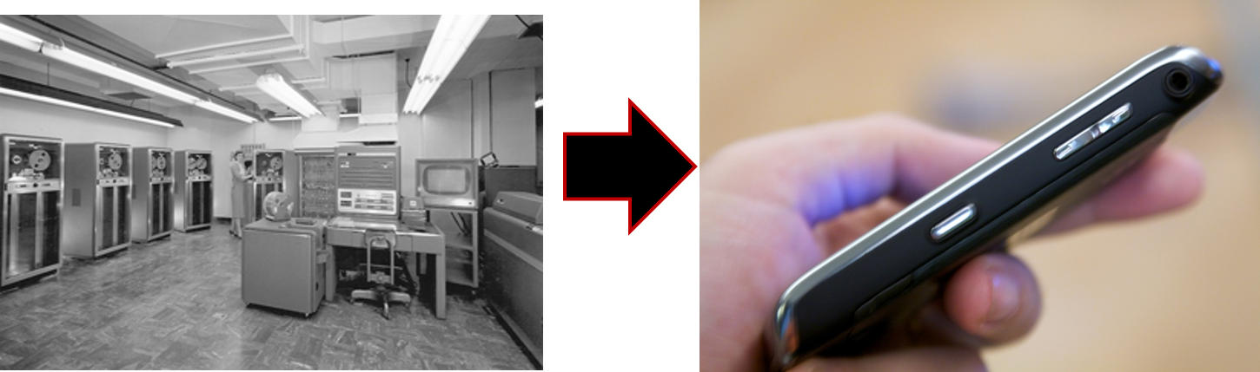
The shift from centralized data storage to decentralized data access
(Courtesy: Lawrence Livermore National Laboratory)
(Photo by Cheon Fong Liew)
Notes:
The shift from centralized data storage, which was done on large servers -- that would often fill entire rooms -- to decentralized access points such as desktop computers or handheld computers, liberated computerized information for access at the point of care.
If we consider that many of the key responsibilities of nurses are carried out in close proximity to the patient, leaving the bedside to go and access a mainframe computer is plainly not feasible. As data became accessible in nurses’ stations (such as on a desktop terminal), or even more conveniently on tablets and handheld devices, the feasibility of incorporating computerized nursing applications became more commonplace.

Slide 17
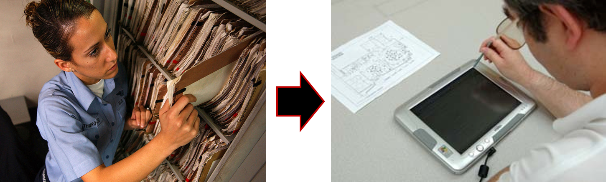
The shift from paper charts to electronic records
U.S. Navy photo by Photographer's Mate 3rd Class Jason T. Poplin
Photo by JISC
Notes:
Along the lines of decentralized access, for any bit of information to be available on a computer, it must first be digitized. Thus, the shift from paper charts to electronic records (which is on-going, by the way) was another important catalyst for the development of nursing informatics tools.
If data is not captured or stored electronically, there is limited use for that data. By digitizing patient information, it becomes easier to access, collect, and act upon data that can affect what a nurse does.

Slide 18
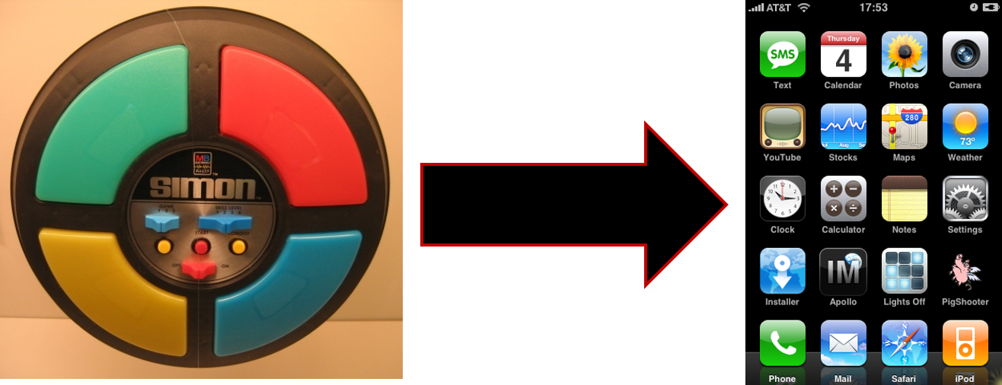
The shift from relying on memory to continuously using information resources
(Photo by Hempdiddy)
(Photo by Niels van Eck)
Notes:
Lastly, Thompson argued that nursing practice experienced a paradigm shift from relying on memory to relying on access to information resources.
Many of you may remember the "Simon Says" toy from the 1980s that flashed a pattern of lights for the user to then mimic back. With each increasingly more difficult level, the patterns of lights became more and more lengthy, requiring the successful user to remember lots of information.
This analogy reflects the increasingly complex nature of healthcare delivery. As medical and nursing science has become more and more sophisticated, so has the amount of information that a successful clinician needs to memorize. Given that it becomes more likely that errors will occur when we rely more on human memory, the nursing profession began a shift towards using information resources more actively. These resources include updated information about patients (for example, lab results) and updated information about the most effective treatment protocols (from the scientific literature). Nurses went from relying on memory to having to be more "wired" into the data worlds of their patients. The "wired" analogy is akin to what a sophisticated smart phone allows us to achieve in our personal lives.

Slide 19
Evolving Role of the Nurse Informaticist
Education and support of HIT users
System implementations
Workflow analysis
Notes:
Nurses with expertise in informatics are called nurse informaticists (pronounced IN-fer-maticists) As more and more computerized applications for nursing (and healthcare) were developed, the role of the nurse informaticist evolved.
Today, nurse informaticists play a significant role in educating and supporting users of Health Information Technology systems, assisting in system implementations, and planning for implementations (including the use of workflow analysis).

Slide 20
Evolving Role of the Nurse Informaticist 2
Playing the role of “champion” and garnering buy-in
Liaison between nursing and IT
Ensure that the nursing perspective is represented in organizational HIT decisions
Notes:
Nurse informaticists also frequently play the role of IT champions which involves building consensus among other nurses and garnering buy-in for decisions regarding major HIT purchases.
Lastly, an important role of the nurse informaticists is making sure that the nursing perspective is represented in organizational decisions pertaining to Health Information Technology. As the largest group of health professionals, nurses are the largest group of clinical end-users. Thus, nursing informatics specialists ensure HIT systems conform to the work flow and informational needs of nurses.
In short, nurse informaticists can be thought of as liaisons (pronounced lay-iz-ons) from clinical staff to the IT department on many levels: in system selection, in design, in education, during implementation, and post-implementation.

Slide 21
Evolving Role of the Nurse Informaticist 3
Leadership positions within healthcare organizations that go beyond IT
  Patient safety
  Change management
  Quality improvement
Notes:
Currently, more and more nurse informaticists are taking leadership roles that go beyond direct IT responsibilities. As organizations begin to realize that IT is a strategic resource that enables the pursuit of other important organizational goals, nurses with expertise in informatics become key personnel to assist in these tasks.
For example, the goals of improved patient safety and quality of care lend themselves well to the experience and expertise of nurse informaticists. Likewise, initiatives requiring effective change management become "natural fits" for nurses with an informatics background.
In light of the incentives embedded in the HITECH (pronounced high tech) portion of the 2009 American Recovery and Reinvestment Act regarding "meaningful use" of HIT for the purposes of patient safety and quality improvement, we can expect nurse informaticists to continue moving into leadership roles in this capacity.

Slide 22
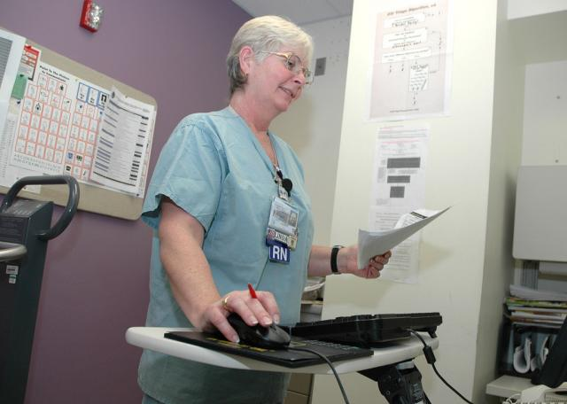
Types of Nursing HIT Applications
Automation of documentation
  Nurse rounding tools
(Photo: North Chicago VA)
Notes:
Let’s consider some types of nursing Health IT applications that have evolved in recent history.
First, automation of documentation is possible with nurse rounding tools. Every day, hospital nurses "round" on their patients and collect a myriad of information about the status of their patients -- at the bedside. Similar to the earliest nursing computer applications that relied on punch-cards, more modern versions of these software packages may include a tablet that allows a nurse to quickly document the status of each patient, at the patient’s bedside. By more quickly and accurately allowing a nurse to take care of responsibilities related to documentation, more time is afforded to the nurse to focus on direct patient care.

Slide 23
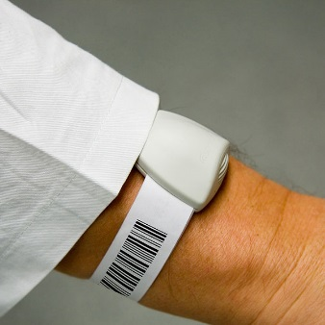
Types of Nursing HIT Applications 2
Bar-coded Rx management
(Photo Courtesy of Sonitor Technologies)
Notes:
Bar-code medication administration systems, referred to as BCMA (pronounced B-C-M-A) ensure that the right drug is given to the right patient at the right time. Earlier in this lecture we learned that nurses spend a significant amount of time on administering medications -- a process that if not carried out perfectly can result in errors that may be harmful to the patient.
BCMA systems assign a bar-coded tag to each medication and each patient for identification purposes. Just like the check-out counter at a grocery store, which can identify each product sold, barcode medication systems can be used to scan a patient’s arm bracelet and a drug that is about to be administered so that the system can document the delivery of the drug, and more importantly alert the nurse if the wrong drug or wrong patient has been inadvertently selected.

Slide 24
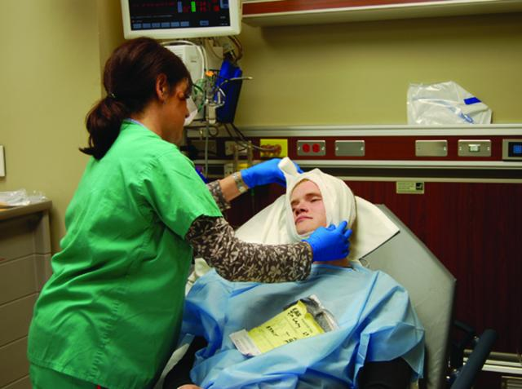
Types of Nursing HIT Applications 3
Nurse staffing systems
(Photo Courtesy of the US Army; Angie Thorne)
Notes:
Nurse staffing systems are computerized software systems that allow nurse managers to plan for an appropriate level of staffing in their departments. Individual nurses may have differing levels of experience and expertise. Additionally, each hospital department has different levels of patient acuity (pronounced uh-cue-ity). That is, some wings of the hospital are accustomed to seeing very sick patients, while others see less severe patients. In addition, the severity of illness in patients seen in any given unit may change from month to month or even week to week. Many changes are also associated with the season of the year (such as certain severe allergies that may occur most likely in the springtime).
Nurse staffing systems allow nurse managers to make decisions about what type and how many nurses are needed per shift for each unit. Many times, historical data about patients is analyzed in such a way as to make sure that appropriately skilled nurses are scheduled. These systems can be invaluable in assuring high quality care.

Slide 25
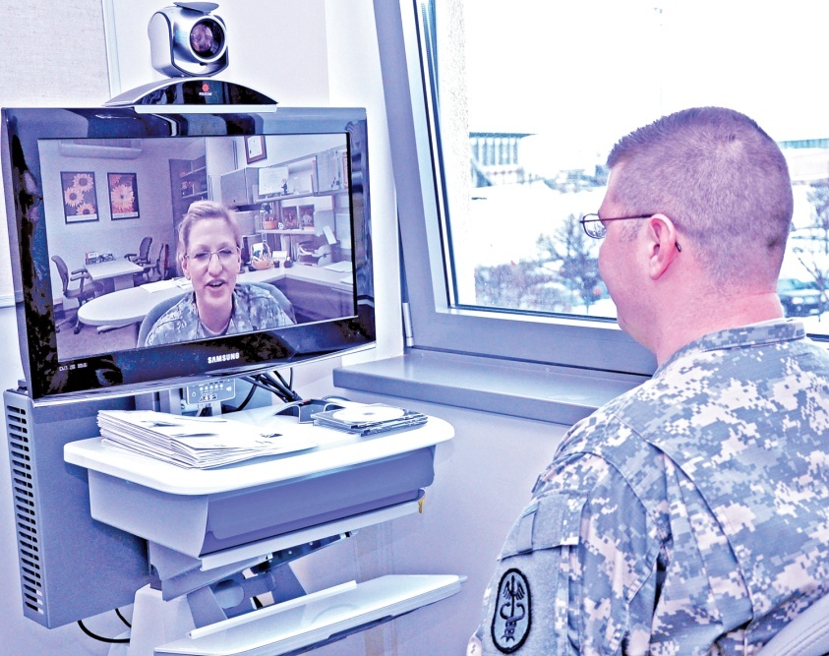
Types of Nursing HIT Applications 4
Telehealth
(Photo by Ms. Chrystal Smith (IMCOM))
Notes:
Telehealth (tele pronounced like in telephone) is a broad term that includes telemedicine. Telemedicine is the use of information and communication technologies to deliver, support, or enhance the delivery of health services. Many telemedicine systems connect remote patients with doctors and other specialists when geographic or other constraints do not allow for easy patient travel. Such systems typically involve video conferencing and other diagnostic devices including imaging and sound digitizers that allow physicians to examine patients virtually. For example, a telemedicine system can allow physicians to listen to heart and lung sounds, or examine a patient’s rash or sore throat from afar.
Nurses play a key role in facilitating the telemedicine interaction by being physically co-located with the patient and assuring that the equipment is properly utilized and achieves clinically reliable readings.
Nurses can also play a key role in obtaining patient histories and further coordinating the patient’s care as appropriate.

Slide 26
Evolution of Nursing Informatics Summary
The nursing profession has a strong commitment to the specialty of nursing informatics
Given their training and responsibilities, nurse informaticists play key roles in organizational efforts to adopt health IT
The demand for professional nurses with informatics backgrounds will likely continue to rise
Notes:
This concludes Evolution of Nursing Informatics and HIT Tools Used by Nursing. In summary, nursing informatics has a long and rich history of applying information technology to the enhancement of nursing practice. The American Nurses Association has been committed to the specialty of nursing informatics for almost two decades.
Given their key role on the healthcare team, nurses with experience and interests in nursing informatics have progressively been moving into leadership positions for their organizations on projects related to IT as well as patient safety, quality of care, and change management.
As the healthcare industry continues to move forward with HIT implementations designed to improve quality of care and patient safety, it is essential that nurses with expertise in informatics play a key role to enhance these initiatives.
Nurse informaticists will have to interface with Chief Information Officers, other executives, vendors, and other healthcare professionals while continuing to be advocates for their patients.

Slide 27
Evolution of Nursing Informatics and HIT Tools Used by Nursing
References
References
  Collen MF. A history of medical informatics in the United States 1950-1990. Bethesda (MD): AMIA;1995.
  Hendrich A. A 36-hospital time and motion study: how do medical-surgical nurses spend their time? The Permanente Journal [Internet]. 2008 Summer.
  Available from: xnet.kp.org
  HIMSS 2009 informatics nurse impact survey. Available from: www.himss.org.
  Nursing’s agenda for the future. American Nurses Association. 2002. Available from www.nursingworld.org
  Ozbolt JG, Saba VK. A brief history of nursing informatics in the United States of America. Nursing Outlook. 2008 Sep-Oct;56(5):199-205.
  The nursing process: a common thread amongst all nurses [Internet]. Silver Springs (MD): American Nurses Association; 2011. Available from: www.nursingworld.org
  Thompson BW. The transforming effect of handheld computers on nursing practice. Nurs Admin Q. 2005 Oct-Dec; 29(4): 308-14.
  U.S. Department of Health and Human Services, Health Resources and Services Administration, National Center for Health Workforce Analysis. The Future of the Nursing Workforce: National- and State-Level Projections, 2012-2025. Rockville, Maryland, 2014.
Notes:
“No Audio”

Slide 28
Evolution of Nursing Informatics and HIT Tools Used by Nursing
References 2
Images
  Slide 4: Niramon, Poramaporn, nurse with IV bag, CC BY-NC-ND 2.0, Available from: www.flickr.com
  Slide 6: Nurse typing on a computer, Source Name: UAB School of Nursing
  Slide 10: Photo by Gwern, punch card, Available from: commons.wikimedia.org
  Slide 16: Mainframe computer, CC BY-SA 2.0, Courtesy of Lawrence Livermore National Laboratory: Wikimedia Commons. Available from: en.wikipedia.org
  Slide 16: Liew, Cheon Fong, smart phone, Available from: www.flickr.com
  Slide 17: nurse looking at files, U.S. Navy photo by Photographer's Mate 3rd Class Jason T. Poplin. Available from: en.wikipedia.org
  Slide 17: tablet computer, Photo by JISC. CC BY-NC-ND 2.0, Available from: www.flickr.com
  Slide 18: Brown, Vincent J & Neils van Eck, Simon Says, Available from: en.wikipedia.org
  Slide 18: Van Eck, Neils, iPhone screen, CC BY-NC-SA 2.0, Available from: www.flickr.com
  Slide 22: Nurse documenting care on computer, U.S. Army. Available from: www.army.mil
  Slide 23: wrist and bracelet, CC BY 3.0, Available from: commons.wikimedia.org
  Slide 24: Thorne, Angie, nurse bandaging an army patient, U.S. Army. Available from: www.army.mil
  Slide 25: Ms. Chrystal Smith (IMCOM), telemedicine, U.S. Army. Available from: www.army.mil
Notes:
“No Audio”

Slide 29
History of Health IT in the US
Evolution of Nursing Informatics and HIT Tools Used by Nurses
This material was developed by the University of Alabama at Birmingham, funded by the Department of Health and Human Services, Office of the National Coordinator for Health Information Technology under Award Number 90WT0007.
Notes:
No Audio.

