Slide 1
History of Health Information Technology in the U.S.
Evolution of Public Health Informatics
This material (Comp 5 Unit 4) was developed by the University of Alabama at Birmingham, funded by the Department of Health and Human Services, Office of the National Coordinator for Health Information Technology under Award Number 90WT0007.
This work is licensed under the Creative Commons Attribution-NonCommercial-ShareAlike 4.0 International License. To view a copy of this license, visit http://creativecommons.org.
Notes:
Welcome to History of Health Information Technology in the U.S., Evolution of Public Health Informatics. This lecture focuses on the history and evolution of public health informatics.

Slide 2
Evolution of Public Health Informatics
Learning Objectives
Discuss how the sub-discipline of public health informatics has evolved over time
Describe how health IT (HIT) can be used to enhance public health practice
List potential ethical, social, and political issues associated with the development of HIT applications for public health purposes
Notes:
The objectives for this unit, Evolution of Public Health Informatics, are to:
Discuss how the sub-discipline of public health informatics has evolved over time
Describe how health IT (HIT) can be used to enhance public health practice
List potential ethical, social, and political issues associated with the development of HIT applications for public health purposes

Slide 3
Outline
What is Public Health?
What is Public Health Informatics (PHI) and how did it evolve?
  What do PHI professionals do and how did this change over time?
What were early PHI applications?
What are emerging and future PHI uses?
Notes:
First we will define “public health.” Next, we will define and discuss public health informatics (or PHI -- pronounced P-H-I). By describing the evolution of PHI, we will talk about what PHI professionals do, what early PHI applications were designed to do, and finally, we will describe both emerging and future PHI applications.

Slide 4
Public Health’s Mission
“Promote Physical and Mental Health and Prevent Disease, Injury, and Disability”
This is accomplished through 10 “essential public health services” organized under three main headings
  Assessment
  Policy Development
  Assurance
Source: (Public Health Functions Project, 2000.)
Notes:
The federal government describes the mission of public health as “to promote physical and mental health and prevent disease injury and disability.”
This mission is accomplished by ten essential services grouped under three main headings.

Slide 5
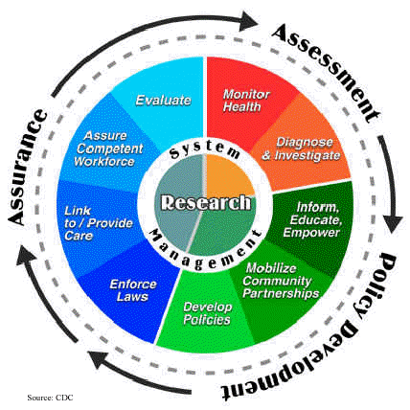
Essential Public Health Services
Monitor health status to identify community health problems
Diagnose and investigate health problems and health hazards in the community
Inform, educate, and empower people about health issues
Mobilize community partnerships to identify and solve health problems
Develop policies and plans that support individual and community health efforts
Source: (Public Health Functions Project, 2000)
Notes:
Assessment includes "monitoring health" and diagnosing or investigating health problems. Monitoring health involves collecting detailed information about the incidence and prevalence of a myriad of diseases. Investigating health problems includes such activities as following up after food borne outbreaks or identifying causes of cancer clusters in a given community.
Policy development includes bullets 3, 4, and 5. Specifically, public health is responsible for educating citizens about health issues; mobilizing community resources to identify and responding to health problems; and developing policies that support individual and community health efforts. An example of a public health policy may be the mandated use of seatbelts. This law supports the individuals’ health, and reduces community health burdens associated with morbidity and mortality from automobile crashes.

Slide 6
Essential Public Health Services 2
Enforce laws and regulations that protect health and ensure safety
Link people to needed personal health services and assure the provision of healthcare when otherwise unavailable
Assure a competent public health and personal healthcare workforce
Evaluate effectiveness, accessibility, and quality of personal and population-based health services
Research for new insights and innovative solutions to health problems
Source: (Public Health Functions Project, 2000)
Notes:
The last five essential services are part of public health's "assurance" responsibilities.
These include enforcing laws or regulations designed to preserve health or ensure safety; providing access to healthcare services as a last resort for individuals without access otherwise; training or providing continued professional education to the healthcare workforce, evaluating the accessibility and quality of population-based health services; and, finally, conducting research on population health problems so that new solutions can be discovered.

Slide 7
Public Health
Generally speaking, public health is:
  Focused on preventive rather than curative aspects of health
  Concerned with population-level, rather than individual-level health issues
Notes:
As can be seen by these ten essential services, public health is very concerned with preventive rather than curative aspects of health.
Moreover, public health is more concerned with issues that can affect communities or populations rather than individual-level health issues.

Slide 8
What is Public Health
Informatics (PHI)?
PHI came about when public health officials began leveraging HIT in systematic ways
PHI Definitions:
  “The science of applying information-age technology to serve the specialized needs of public health”
  “The systematic application of information and computer science to public health practice, research, and learning”
Sources: (Friede et al., 1995)
(Yasnoff et al., 2000)
Notes:
Now that we know a little about public health, let’s explore what PHI is.
PHI came about when public health officials began utilizing health information technologies to support what they do. The responsibilities of public health are collectively referred to as public health practice.
PHI as been defined by Friede (pronounced Freed ) et al (pronounced Ett All) as “the science of applying information-age technology to serve the specialized needs of public health. “
PHI has also been defined by Yasnoff (pronounced Yazz Noff (like off) ) as “the systematic application of information and computer science to public health practice, research, and learning.”

Slide 9
Public Health Informatics (PHI)
How is PHI different from other informatics disciplines?
  A focus on prevention in populations
  Use of a wide range of interventions to achieve its goals
  Constraint by operating in a governmental context
Source: (Yasnoff et al., 2000)
Notes:
There are several ways PHI is different from other informatics disciplines.
First, there is a focus on prevention and on populations. Second, given the broad nature of public health, there is a wide range of interventions that can be used to achieve the goals of PHI. Lastly, public health operates almost entirely in a governmental context (either federal, state, or local levels of government), so unlike related informatics disciplines, PHI could be constrained by this governmental context.

Slide 10
PHI Professionals
Trained in both information technology and public health
Utilize HIT applications to solve public health problems
Notes:
PHI professionals are usually individuals with backgrounds in both IT and public health. Typically, one requires a baseline amount of knowledge in both disciplines to take full advantage of PHI applications.

Slide 11
Evolution of
Public Health Informatics
1995: PHI was first described as a needed distinct discipline (Friede)
Late 1990s: The PHI “movement” gained momentum in the late 1990’s and early 2000’s
2001: Events of September 11 and subsequent anthrax attacks crystallized the need for key PHI applications
Notes:
Friede (pronounced Freed ), one of the authors that provided a definition for PHI that we just reviewed, first described the need for PHI as a distinct field in 1995.
While the PHI field gained some momentum in the late 1990's, it wasn't until 2001, with the events of 9/11 and the subsequent anthrax attacks, that the need for health IT applications specifically for public health purposes crystallized.

Slide 12
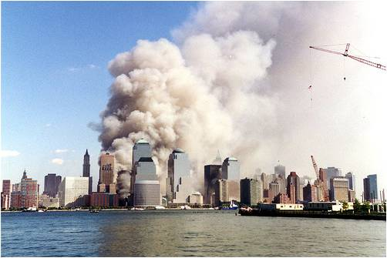
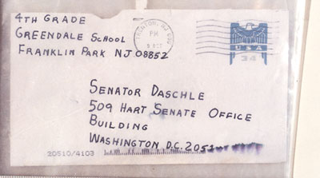
Bioterrorism
9/11
(Photograph by Wally Gobetz)
Anthrax Attacks
(Image of letter containing anthrax sent to Senator Tom Daschle)
Notes:
These two major events reminded us how vulnerable we are AND how important constant monitoring of "health trends" are to our ability to respond to bioterrorism. The US war on terror reminds us that individuals with the right expertise can use biological weapons to threaten the health of our nation’s citizens.
A major concern for public health practitioners in the US involved a scenario where a biological weapon causes an outbreak of a silently communicable disease. In such a case, officials wouldn't even know the attack was going on until it was too late.

Slide 13
Early PHI Applications
Syndromic surveillance
  Definition:
    Concerned with “the continuous monitoring of public-health related information sources and early detection of adverse disease events” (Yan et al., 2008)
  Utilizes information technology, statistical algorithms, data visualization techniques to identify trends warranting public health attention
Notes:
Not surprisingly, early PHI applications were designed to monitor health trends so that a sudden spike in certain ailments could be investigated as a possible early warning of a biological attack.
Such applications are referred to as syndromic (pronounced syndrome-ic) surveillance.
The definition of syndromic surveillance, according to Yan (pronounced Yann(like can) and colleagues is "the continuous monitoring of public-health related information sources and early detection of adverse disease events.”
More generally, syndromic surveillance utilizes computer systems, advanced statistical algorithms, and data visualization techniques to identify trends warranting the attention of public health officials.

Slide 14
Potential Data Sources for
Syndromic Surveillance
Sales of over the counter drugs
Visits to the emergency department for certain aliments
Absentee data from schools
Notes:
Some potential examples of possible data sources that can be used in syndromic surveillance include sales of over the counter drugs (for example, flu medications which may signify early signs of a biological agent) and visits to the emergency department for certain respiratory issues.
Non-clinical data can also be used to inform syndromic surveillance systems. For example, absentee data from schools -- especially if much higher than normal -- may provide clues alerting officials of a possible early warning sign of a potential biological attack in progress. Certainly, any single data source has many limitations, but the idea is to provide a mechanism to trigger public health investigation into a possible attack scenario that might otherwise go unnoticed.

Slide 15
Potential Data Sources for
Syndromic Surveillance 2
Physician office visits
Nurse hotline calls
Dead bird reports
Prescription pharmaceuticals
Internet searches (i.e. Google)
Notes:
Real-time, or near real-time, data from physician office visits or nurse hotline calls can also inform syndromic surveillance systems. In addition, it is possible that dead bird reports or prescription pharmaceutical activity can provide early warning as well.
Lastly, while over the counter drug sales can give a several day "head start" to officials over emergency department visits or physician office visits, online search terms used -- if captured anonymously for certain ailments -- may give an even greater time-advantage. For example, consumers may search for flu symptoms or remedies online far before they actually go to seek care.

Slide 16
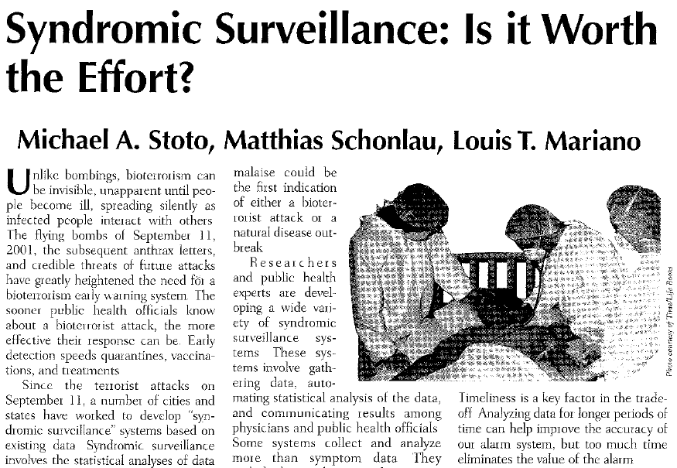
Syndromic Surveillance
2004 RAND study concludes that the benefits of syndromic surveillance are not clearly established
(Stoto et al., 2004)
Notes:
As you can imagine, given the example list of data sources, syndromic surveillance systems have to deal with trade-offs. On the one hand, many indicators may pick up serious health risks, but come with the trade off of identifying numerous false positives.
In 2004, the RAND (pronounced Rand (like sand)) Corporation, a respected research firm, released a report questioning the benefits of syndromic surveillance by providing an analysis of the drawbacks and benefits of such a system.

Slide 17
BioSense
BioSense is a national program intended to support early outbreak detection by conducting near real-time analysis of existing data from healthcare organizations across the country
  Ambulatory data
  Emergency room diagnostic and procedural information
  Clinical laboratory test orders and results
  Over-the-counter drug sales
Notes:
While there are many large syndromic surveillance projects in the US, one specific project worth describing in some detail is the BioSense (pronounced Bio (like biology) sense ) program developed by the Centers for Disease Control and Prevention.
BioSense is a nation-wide program that supports early detection of outbreaks by conducting near real-time analysis of existing data from health organizations around the country.
The system combines data from ambulatory (or outpatient) medical visits, emergency room diagnostic and procedural information, as well as clinical laboratory test orders and results and over-the-counter drug sales information.
BioSense then uses statistical algorithms to identify anomalies in the data that warrant investigation.
Like many syndromic surveillance systems, this system can compare current trends to historical means, moving averages, or seasonally-adjusted expected norms to detect a sudden "spike" in a given indicator.

Slide 18
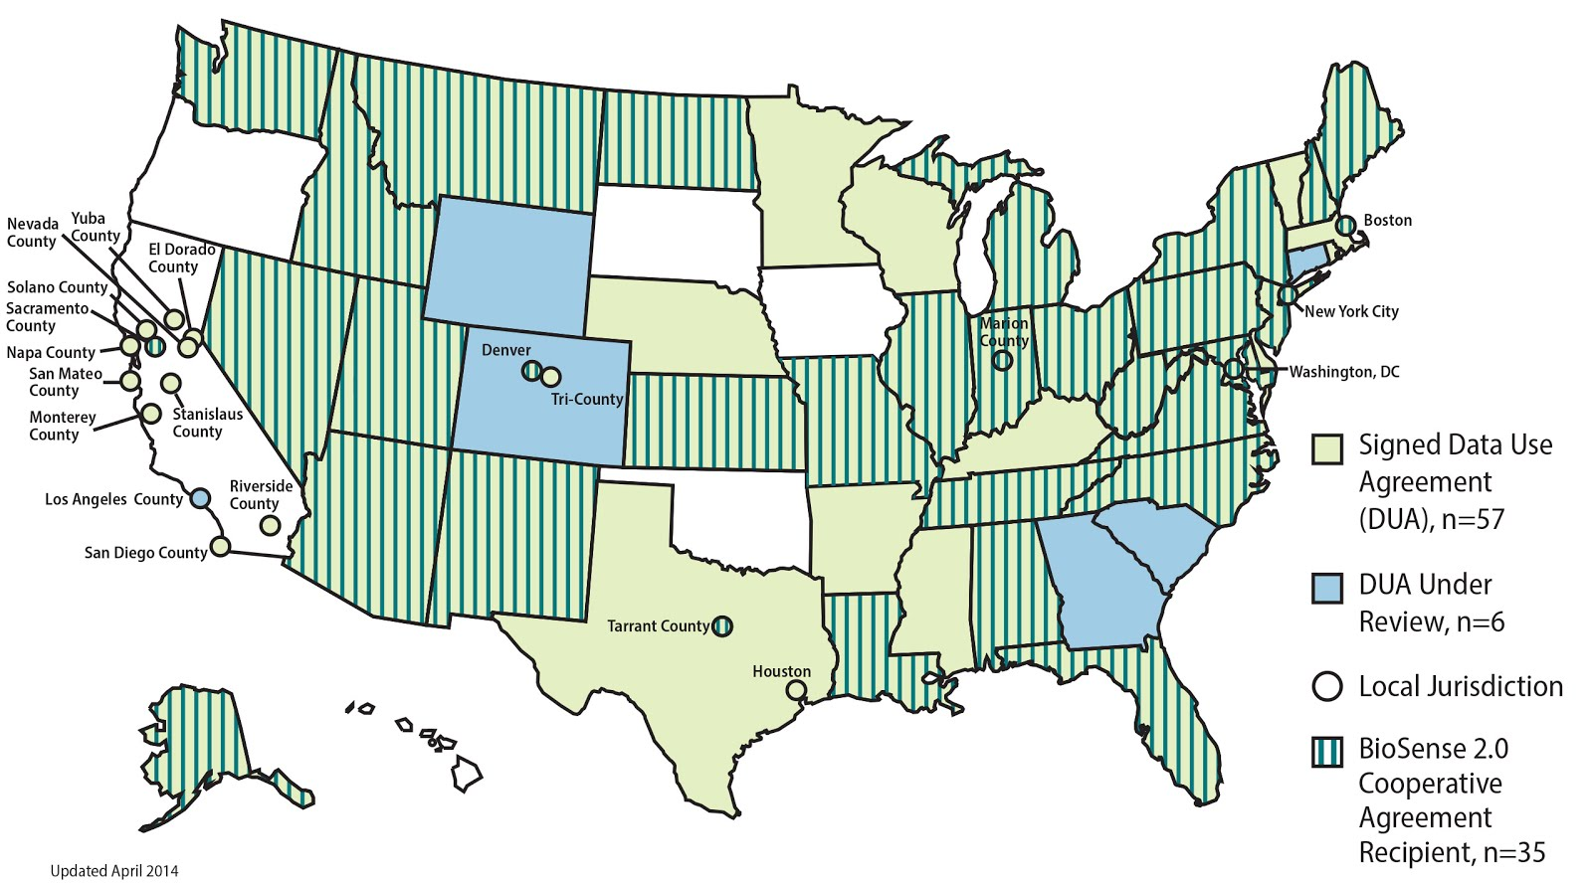
States Participating in BioSense
BioSense Community Forum BioSense Data Use Agreement Status. 2014.
Notes:
This map from the BioSense Community Forum displays information on the states that were participating in BioSense as of 2014.

Slide 19
History of BioSense
Launched in 2003 primarily focused on bioterrorism and related illnesses
By 2005: VA, DoD facilities, and some hospitals directly reporting to CDC
By 2006, state health department data
By 2007, anti-infective Rx data, and laboratory data (LabCorp and Quest)
Notes:
BioSense was launched in 2003, in the aftermath of 9/11 and the anthrax attacks – and as a result it had a primary focus on bioterrorism and related illnesses.
By 2005, BioSense was receiving data from hundreds of hospitals that are part of the Veterans Affairs systems, Department of Defense clinics, or local community hospitals.
By 2006, data from state health departments began interfacing with the BioSense program, and by 2007 data on anti-infective medication agents, as well as laboratory data from the two largest national laboratory chains, were added to BioSense in near real-time access.
Adding the lab data allowed for surveillance of such things as West Nile Virus.

Slide 20
BioSense and
California Wildfires
2007: Massive wildfires in California affect millions
BioSense was able to provide local authorities daily reports on health activity related to the fires
Source: (CDC at Work)
Notes:
One interesting case study involving BioSense occurred in the fall of 2007. Devastating wildfires affected 20 million people living in Los Angeles, San Diego, and surrounding areas.
Because BioSense was already collecting routine health data, it was able to prove very useful in assisting local authorities in making decisions.
While the fires burned, the CDC was able to provide local authorities daily reports on health activity related to the fires.

Slide 21
BioSense and
California Wildfires 2
Large increase in respiratory visits to hospitals
Helped determine impact of wildfire smoke on patients with chronic illnesses
Lessons learned very valuable
Source: (CDC at Work)
Notes:
For example, large increases in respiratory visits to hospitals were monitored -- especially visits for asthma and for visits involving difficulty with breathing. This helped determine the health impact of wildfire smoke on patients with chronic illnesses. More importantly, it allowed officials to direct patients to available services when one or more area hospitals became overwhelmed.
Lessons learned helped that situation, but also make us better prepared for the next time wildfires strike and other large scale exposures to environmental hazards occur.

Slide 22
BioSense and
California Wildfires 3
“Real-time” situational awareness
Source: (CDC at Work)
Notes:
In retrospect, this event allowed BioSense, for the first time, to demonstrate a very useful feature of the system. By providing real-time information to leaders on the ground, BioSense was a key tool in situational awareness which resulted in improved response to this disaster.

Slide 23

California Wildfire 2007
Notes:
Just to give you a sense of the magnitude of the wildfires of 2007, here are a few images of the event.

Slide 24
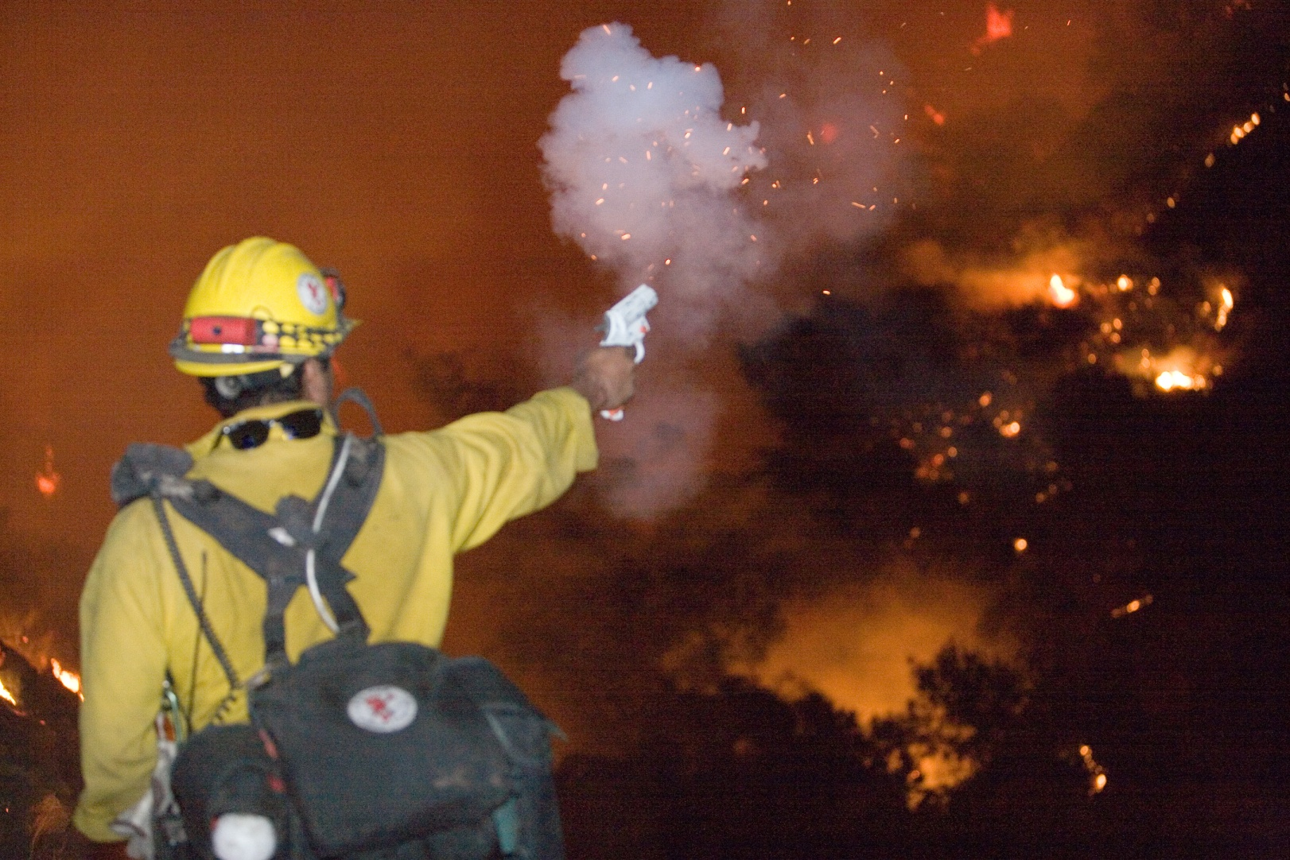
California Wildfire 2007 2
FEMA/Andrea Booher
Notes:
No Audio

Slide 25
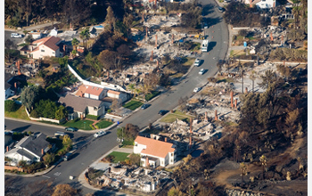
California Wildfire 2007 3
FEMA/Andrea Booher
Notes:
“No Audio”

Slide 26
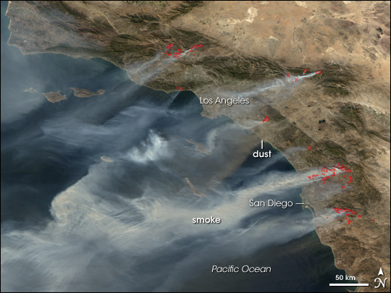
California Wildfire 2007 4
Photo by NASA’s Earth Observatory
Notes:
This is a satellite photo depicting the smoke plumes blowing west off the California coast.

Slide 27
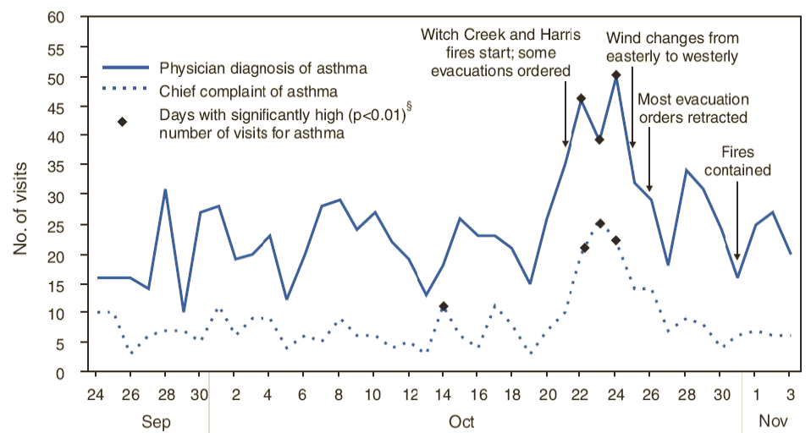
# of ED visits and
Diagnoses for Asthma
Sept 22 – Nov 17, 2007. Data from 6 Hospitals in San Diego, CA
Notes:
This graph, built with data from BioSense, charts the number of emergency visits with a chief complaint of asthma, and the corresponding physician diagnoses for asthma, that occurred during the time period of the wildfires.
The small diamonds on the trend lines represent days with statistically significant increases in detected events as flagged by the BioSense syndromic surveillance system.
The diamonds on the highest peaks of both trend lines correspond to soon after the fires at Witch Creek and Harris started. Incidentally, those days also correspond to when evacuations were ordered. A week or so later, as the rates came back down, wind changes blew the smoke out to sea and the fires were eventually contained.
This data highlights the usefulness of a syndromic surveillance system and how it is able to detect spikes in rates of disease. Further analysis of data can easily be done to investigate rates of disease by age group, gender, or time-period, as public health officials deem necessary.

Slide 28
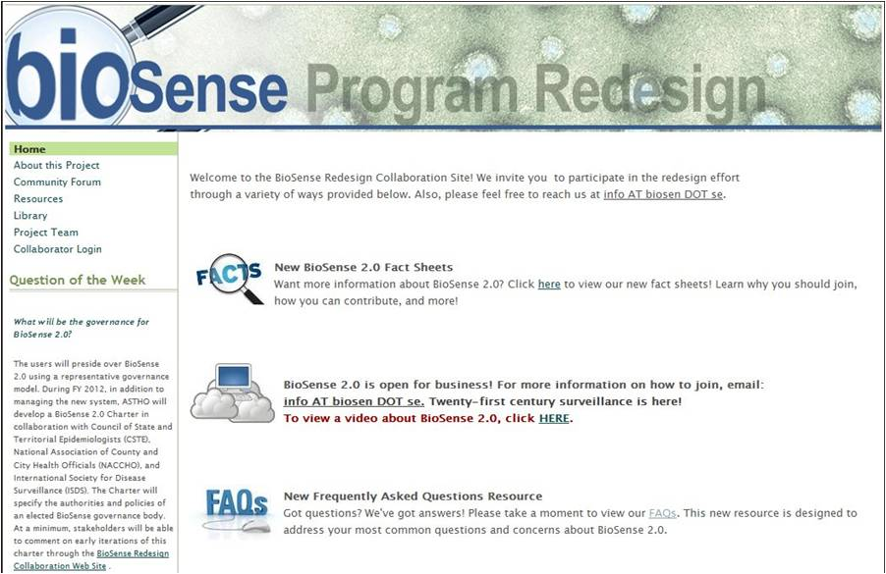
History of BioSense 2
Notes:
In late 2011, the CDC (pronounced C-D-C) launched a redesigned BioSense system dubbed “Biosense 2.0.”
The redesigned system builds on the capabilities of BioSense and includes additional features including a ‘cloud based’ computing architecture that allows state and local syndromic (pronounced syndrome-ic) surveillance data to interface with BioSense, better management tools that allow states to coordinate BioSense with their Health Information Exchanges, and other beneficial features to make the system more useful to local public health agencies.

Slide 29
Local and State Efforts
Many local syndromic surveillance systems have been implemented at the local, county, and state levels
Many focus on identifying trends indicating a possible bioterrorism attack
Anthrax
Botulism toxins
Small pox
Plague
Q-fever
Tularemia
Brucellosis
Hemorrhagic fever
Viral encephalitides
Staph. enterotoxin-B
Source: (Chen et al., 2010, p. 30.)
Notes:
While BioSense is one example of a national system, local systems exist as well. In a systematic review of studies reporting on syndromic surveillance systems, Chen (pronounced Chen – rhymes with hen) et al identified 20 such systems which have been implemented at the local, county, or state levels.
Many of these systems also focus on detecting one or more agents that may be used as part of a biological attack on US soil. Some agents that existing local systems screen for include anthrax, tularemia (pronounced tool-uh-reem—ee- uh), smallpox, and Q-fever among others.

Slide 30

Syndromic Surveillance for Special Events
Source: (Chen et al., 2010, p. 30.)
Notes:
Any time large crowds gather temporarily in a given locale, there are potential public health concerns. “The temporary and sudden surge of population density (at a local event) brings potential health hazards” including highly communicable diseases -- and makes for a potentially attractive target for bioterrorism.”
Therefore, public health officials have used syndromic surveillance system in conjunction with the Olympic Games.

Slide 31

Syndromic Surveillance
FIFA World Cup
Photo by Mjohn2101
Notes:
For use in World Cup soccer tournaments.

Slide 32
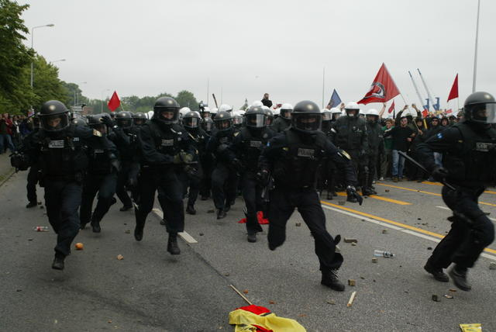
Syndromic Surveillance
Riots at G8 Summit
(Photo by Marek Peters / www.marek-peters.com)
Notes:
During G8 summits -- which have been associated with large demonstrations -- or, at times, riots.

Slide 33

Syndromic Surveillance
World Series
(Photo by Colin McCloskey)
Notes:
Or large sporting events such as baseball's World Series.

Slide 34

Syndromic Surveillance
Super Bowl
(Photo by Terry Bone)
Notes:
Football's Super Bowl.

Slide 35

Syndromic Surveillance
Kentucky Derby
(Courtesy Kentuckytourism.com)
Notes:
Or horseracing’s Kentucky Derby.

Slide 36
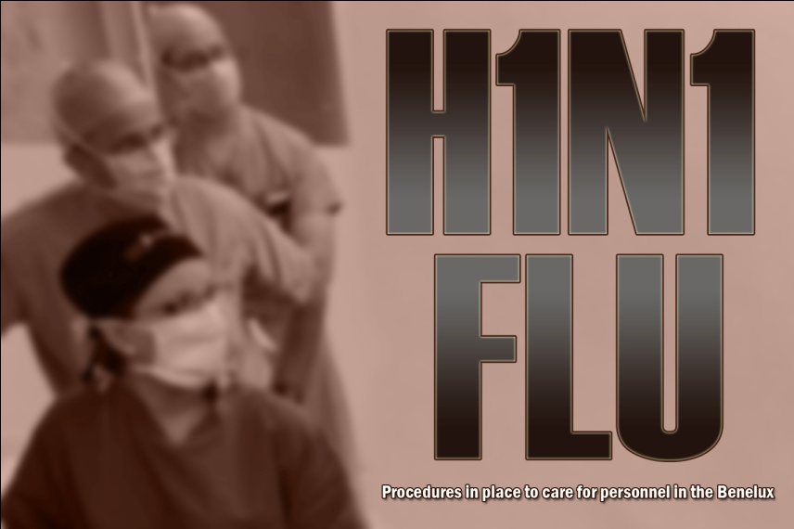
Syndromic Surveillance
H1N1 Pandemic
(Photo by Ms. Christie Vanover (IMCOM))
Notes:
Syndromic surveillance systems have also been used in pandemics such as the most recent H1N1 (pronounced H-1-N-1) flu outbreak.

Slide 37
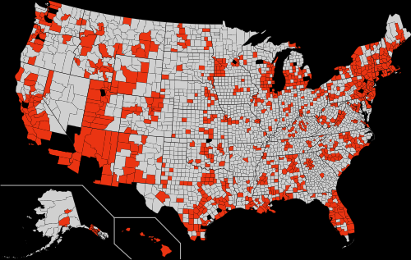
Syndromic Surveillance for H1N1 Pandemic
Swine flu infections and deaths by county June 2009
(Map by Mike Serfas)
Notes:
During the H1N1 pandemic, public health officials were able to chart important developments in how the disease was affecting US citizens. In this image, officials plotted deaths from H1N1 across the US map. This assisted public health decision makers with the development of strategies designed to save lives.

Slide 38
Future of Syndromic Surveillance
Take advantage of EHR data
Expand beyond “early detection” and provide data for:
  Situational awareness
  Other routine public health practices
    Electronic submission of “reportable” diseases
    MRSA occurrence tracking
Notes:
In the future, experts expect that syndromic surveillance systems will be able to make better use of clinical data captured by Electronic Health Records.
Moreover, as BioSense has shown us during the California wildfires, Public Health Informatics applications will play an increasingly important role in situational awareness and other routine public health practices such as submission of reportable diseases, and the tracking of deadly infections like MRSA (pronounced M-R-S-A). MRSA stands for Methicillin (pronounced Meth-ih-sillin) Resistant Staphylococcus (pronounced staff-ill-oh-cock-us) Aureus (pronounced oar-ee-us), a dangerous drug resistant infection.

Slide 39
Emerging PHI Applications
Geographic information system (GIS)
SMS Text messaging
Notes:
Even though the field of PHI evolved rapidly in response to the events of 9/11, many other PHI applications are easy to conceive. For example, geographic information systems , or GIS (pronounced G-I-S) and the use of short message services (otherwise known as “text messaging”) can play an informatics role in public health practice.

Slide 40
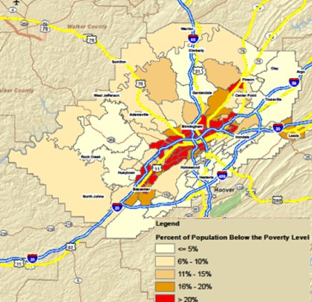
Geographic Information Systems
Source: (GIS Definition: Wikipedia)
(Courtesy Devon Taylor, Jefferson County, AL Dep't of Health)
Notes:
GIS is a mechanism that captures, stores, analyzes, manages, and/or presents data that are linked to location. Quite simply, it is the plotting of data points on a map so that trends can be examined by geographic location. GIS is a powerful tool that can be used to support the practice of public health.
In Birmingham, AL, for example, the Jefferson County Department of Health uses GIS to help make decisions about needed public health services. This image of Jefferson County displays data on poverty by region of the county. This, and other information, can help decision makers make optimal choices. For instance, when the Jefferson County Department of Health needed to assess the best placement of public health clinics, GIS specialists plotted the location of patients’ home addresses on the county map to determine the best places for clinics to exist. By taking into consideration minimum travel distances and convenience for patients, officials were able to analyze various scenarios of health center placement and its impact on patient coverage. Ultimately, GIS tools were used to more efficiently and conveniently affect access to care for county residents.

Slide 41
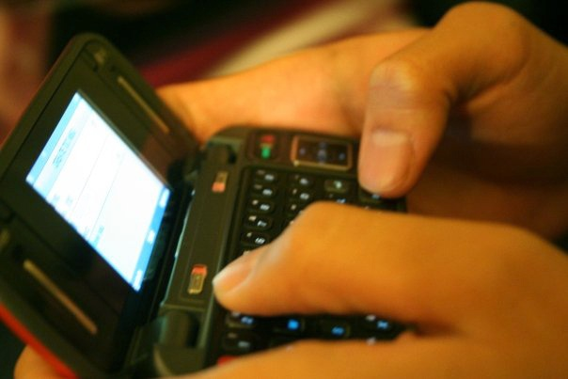
SMS Text Messaging
Has been used for public health purposes including:
  Behavior change support
  Disease prevention
(Photo by Alton)
Notes:
Several articles have been published that demonstrate how text messaging can be used for public health purposes.
One such study examined patients enrolled in a weight-loss program. Patients who received daily texts encouraging them to stay on schedule and eat healthy and exercise were able to lose more weight.
In a separate study, individuals travelling overseas and requiring certain immunizations were more likely to receive their second or third dose when reminded by text messaging to come in several months later when their follow-up visits were scheduled.

Slide 42
SMS Text Messaging 2
  Contact Tracing
  Health Education Campaigns
  Data Collection
(Photo by Alton)
Notes:
Several articles have been published that demonstrate how text messaging can be used for public health purposes.
One such study examined patients enrolled in a weight-loss program. Patients who received daily texts encouraging them to stay on schedule and eat healthy and exercise were able to lose more weight.
In a separate study, individuals travelling overseas and requiring certain immunizations were more likely to receive their second or third dose when reminded by text messaging to come in several months later when their follow-up visits were scheduled.

Slide 43
Future PHI Applications
EHR and HIE enabled PHI applications
Web 2.0 technologies including social networking systems
Notes:
In the future, one could expect PHI applications to be facilitated by access to EHR (pronounced E-H-R) data and information that is part of electronic health information exchange, or HIE (pronounced H-I-E) programs.
Likewise, one could also expect new and innovative PHI applications to take advantage of "so called" Web 2.0 (pronounced web two point oh) technologies such as social networking systems.

Slide 44
Evolution of Public Health Informatics Summary
The use of PHI applications may raise
  Ethical issues
  Social issues
  Political issues
Ongoing transparency and open debate will likely resolve many concerns and allow PHI to enable more efficient and effective public health practice
Notes:
This concludes Evolution of Public Health Informatics. In summary, the use of PHI raises some potential ethical, social, and political issues.
Ethically, PHI makes potentially private information about health available to public health officials and other decision-makers. Such instances as STD notification and even syndromic surveillance information, if tracked with patient identifiers, needs to be carefully considered and governed for the appropriate and legal use of such information.
Socially, members of society may not be aware that their information (for example, doctor’s visits) may be used for public health purposes. Even though federal laws allow for such uses, public health professionals may need to educate the public and be available to answer questions from concerned citizens.
At times, these concerns can become political issues when the nature of surveillance is misconstrued as “big brother” watching. As more and more PHI applications become commonplace, these issues will be debated and reconciled so that the practice of public health, supported by PHI, can be as efficient and effective as possible.

Slide 45
Evolution of Public Health Informatics References 1
References
  CDC at Work. BioSense is useful tool during California wildfires. CDC [Internet]. Available from: www.cdc.gov
  Chen H, Zeng D, Yan P. Infectious disease informatics: syndromic surveillance for public health and bio-defense. New York: Springer; 2010.
  Friede A, et al. Public health informatics: how information-age technology can strengthen public health. Annual Review of Public Health.1995;16:239-52.
  Geographic Information Systems. Wikipedia. [Internet]. Available from: en.wikipedia.org
  Public Health Functions Project [Internet]. [Updated 2000 Nov 28]. Available from: www.health.gov
  Stoto MA, Matthias S, Mariano LT. Syndromic surveillance: Is it worth the effort? Chance. 2004;17(1):19-24.
  Yan P, Chen H, Zeng D. Syndromic surveillance systems. Annual Review of Information Science and Technology. 2008;42:425–95.
  Yasnoff WA, O’Carroll PW, Koo D, Linkins RW, Kilbourne EM. Public health informatics: improving and transforming public health in the information age. J Public Health Manag Pract. 2000 Nov;6(6):67-75.

Slide 46
Evolution of Public Health Informatics References 2
Charts
  1.1 Chart: www.health.gov Courtesy: Public Health Functions Project
  1.2 Chart: Ginsberg M, Johnson J et al. Monitoring health effects of wildfires using the BioSense system – San Diego County, California, October 2007. MMWR 57: 741-747.
  www.cdc.gov Available from: www.cdc.gov Sept 22-Nov, 2007.
Images
  Slide 12: Gobetz, Wally, Twin Towers, CC BY-NC-ND 2.0, Available from: www.flickr.com
  Slide 12: Daschle letter, CC BY-NC-ND 2.0, Available from: en.wikipedia.org
  Slide 16: Newspaper article Available from: www18.georgetown.edu
  Slide 18: Map of the US, BioSense Community Forum BioSense Data Use Agreement Status. 2014. Available from: sites.google.com
  Slide 23: Labianco, Kevin, burning fires at night, Available from www.flickr.com
  Slide 24: Booher, Andrea, Firemen Fighting Fires, Available from: www.fema.gov FEMA
  Slide 25: Booher, Andrea, destroyed region, Available from: www.nsf.gov FEMA
Notes:
“No Audio”

Slide 47
Evolution of Public Health Informatics References 3
Images
  Slide 26: fires from sky, Available from: earthobservatory.nasa.gov, NASA
  Slide 28: biosense webpage Available from: sites.google.com CDC
  Slide 30: Olympic rings, Available from: commons.wikimedia.org
  Slide 31: soccer match, CC BY 2.0, Available from: www.flickr.com
  Slide 32: Peters, Marek, G8 Summit, Available from: de.wikipedia.org / http://www.marekpeters.com/
  Slide 33: McClosky, Colin, World series stadium, CC BY-NC-SA, Available from: www.flickr.com
  Slide 34: Bone, Terry, Superbowl halftime show (Rolling Stones), CC BY-SA 2.0, Available from: www.flickr.com
  Slide 35: Kentucky Derby, Available from: commons.wikimedia.org Courtesy Kentuckytourism.com
  Slide 36: Vanover, Christie, H1N1, Available from: www.army.mil
  Slide 37: Serfas, Mike, deaths by state, CC BY-SA 3.0, Available from: en.wikipedia.org
  Slide 40: geo info systems, Source Name: Courtesy Devon Taylor, Jefferson County, AL Dep't of Health
  Slide 41,42: Photo by Alton, smart phone, Available from: en.wikipedia.org
Notes:
“No Audio”

Slide 48
History of Health IT in the US
Evolution of Public Health Informatics
This material was developed by the University of Alabama at Birmingham, funded by the Department of Health and Human Services, Office of the National Coordinator for Health Information Technology under Award Number 90WT0007.
Notes:
No Audio.

