Slide 1
History of Health Information Technology in the U.S.
Evolution of Health IT: The Modern Era
Lecture b – Key Stakeholders
This material (Comp 5 Unit 2) was developed by the University of Alabama at Birmingham, funded by the Department of Health and Human Services, Office of the National Coordinator for Health Information Technology under Award Number 90WT0007.
This work is licensed under the Creative Commons Attribution-NonCommercial-ShareAlike 4.0 International License. To view a copy of this license, visit http://creativecommons.org.
Notes:
Welcome to History of Health Information Technology in the US, Evolution of Health IT: The Modern Era. This is Lecture B, Key Stakeholders. In the first part of this unit on the evolution of health information technology, we described the changes in the healthcare environment that have occurred beginning with the 1990s. In this second lecture, we will look at how those changes influenced both the key professional groups who worked within that environment as well as how the technology developed.

Slide 2
Evolution of Health IT:
The Modern Era
Learning Objectives
Discuss factors that led to increasing clinical use of computers from 1990 to the present, including the HITECH Act of 2009. and the Affordable Care Act of 2010
Discuss key influences on health IT developments including the Internet, HIPAA, and the Institute of Medicine reports
Discuss the focus of health IT in the late 90s up to the present
Discuss the role of health IT in clinical and translational research and precision medicine
Discuss why there is more receptivity to the use of health IT now than during the previous 50 years
Notes:
The Objectives for this unit, Evolution of Health IT: The Modern Era, are to:
Discuss factors that led to increasing clinical use of computers from 1990 to the present, including the HITECH Act of 2009. and the Affordable Care Act of 2010
Discuss key influences on health IT developments including the Internet, HIPAA, and the Institute of Medicine reports
Discuss the focus of health IT in the late 90s up to the present
Discuss the role of health IT in clinical and translational research and precision medicine
Discuss why there is more receptivity to the use of health IT now than during the previous 50 years.

Slide 3
Healthcare Organizations
Increase revenue and decrease costs
  Increase in use of administrative DSS
Notes:
For healthcare organizations, the interest in increasing revenues and decreasing costs has been a constant throughout the past fifty years. But beginning in the 1980s and continuing to the present, we have seen an increased interest in using information systems to assist with this goal. Over the past decade we see that there are more administrative decision support systems, or DSS (pronounced D-S-S), largely used for monitoring costs and related administrative issues. These are not the same as the clinical decision support systems, which were not getting as much use. The administrative systems have been used largely to make fiscal projections, but the use of health information technology also became more widespread.

Slide 4
Healthcare Organizations 2
Increase quality
  Quality improvement methods
  Outcomes analysis
  Guidelines, critical pathways, protocols
  Increase use of clinical DSS
Notes:
In the early 90s, hospitals began to use a variety of methods for overall quality improvement. In terms of use of information technology, computers were being increasingly used in quality improvement activities, including outcomes analysis, clinical guidelines, critical pathways, and protocols.
Outcomes analysis means there was more tracking of the impact of therapy on patient health outcomes.
Clinical guidelines were usually developed by expert consensus and/or based on evidence from research studies. The guidelines suggested what should be done to diagnose or treat a given condition.
Whereas physicians can decide whether to use these clinical guidelines, critical pathways and protocols are usually institutional procedures that are mandated for certain conditions. Often these are aimed at nurses and they tend to standardize the care a patient receives. Many of these did not originally involve computers, but they are more recently being computerized.
In addition, over the past twenty years, there has been growing use of clinical decision support, usually in the form of drug interaction alerts.

Slide 5
Healthcare Organizations 3
Chief Information Officer
Notes:
Starting in the 1990s, most hospitals had a chief information officer or CIO with a much broader role than simply directing the data processing function. The CIOs became responsible for both clinical and administrative information systems and often reported to the hospital CEO.

Slide 6
Healthcare Organizations 4
Chief Medical/Nursing Information Officer
Notes:
And to address the increased interest in using computers to support clinical care, the positions of Chief Medical Information Officer and Chief Nursing Information Officer have become more prominent. These clinicians serve in hospital settings as leaders in healthcare information technology and as liaisons between the other clinicians and the information technology staff.
Now we will move into our discussion of the key healthcare stakeholders.

Slide 7

Physicians
Group practice, salaried positions
More knowledgeable patients
Further decrease in physician authority
Source: (Cohen & Adams, 2009)
Notes:
In the 90s physicians were practicing more commonly in physician groups (rather than in solo practice) and many were in salaried positions. Patient use of the Internet had increased tremendously and so patients now approached their caregivers with more knowledge. There has been a further decrease in physician authority and autonomy.

Slide 8
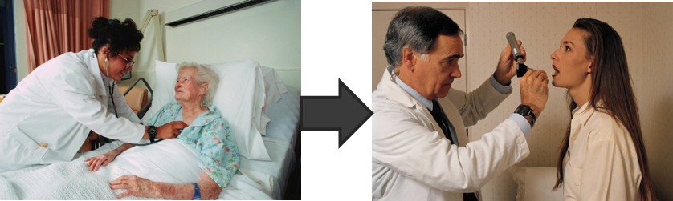
Physicians 2
Practice location shift
  Outpatient
  “Hospitalists”
Source: (Wachter & Goldman, 2002)
Notes:
There has been a move away from hospitals as the main location of care. Many procedures that used to occur in hospitals are now performed in the outpatient setting. While most doctors see their patients in the office as well as the hospital, we have seen the rise of a new medical specialty called ‘hospitalists’ who practice exclusively in the hospital, and oversee the patients’ diagnosis and treatment while the patient is in the hospital.

Slide 9
Physicians 3
Use of computer for information
Little use of the computer for information management until recently
Notes:
Since the middle of the 1990s we have also seen a steady growth in the use of computers for information… by physicians. That is, doctors are surfing the Web for medical information just like their patients are. However, outside of some innovative academic institutions, during the 1990s there was still very little direct clinical use of the computer at the point of care and very little use of the computer for information management. However, over the past ten years that also has been changing.

Slide 10
Physicians 4
Increased acceptance of standardization
Increase in clinical computing
Notes:
In many ways, the standardization and systematization of care has been increasingly accepted by physicians. Physicians are also much more comfortable with computers, and by end of the first decade of the 21st century, the children of the 80s (who were members of the first generation to grow up around computers) were just beginning to enter medical practice. That comfort along with the improvements in health information technology, has led to an increased acceptance of clinical computing.

Slide 11
Academic Physicians
Increased pressure for revenue generation
  Decreased time for teaching
    Computer to increase instructional efficiency
  Increase in business partnerships
Notes:
Like their counterparts outside of academia, medical school faculty members have continued to be pressured for revenue generation. As a result of these pressures, there has been decreased time for teaching. Consequently, there was an increase in computer use intended to increase instructional efficiency. There were growing examples of distance learning modalities. As the need to generate revenue increased, we saw more academic-business partnerships.

Slide 12
Academic Physicians 2
Evidence-based medicine
  Use of literature in practice
  Outcomes and comparative effectiveness research
Source: (Sackett et al., 1996)
Notes:
Within medical education, there has been a steady trend toward increased standardization of medical practice. The standardization began in the 70s with attempts to standardize the problem solving process. This was followed in the 80s by bringing more organization to the teaching of the physician-patient relationship.
In the 90s we saw the emphasis on further standardizing the art of medicine by teaching students how to analyze scientific studies. There was a new emphasis on the use of the results of a compilation of scientific studies in the medical literature known as evidence-based medicine, rather than encouraging reliance primarily on an individual physician’s clinical experience.
Some of the other aspects of increasing standardization of practice included more emphasis on outcomes and comparative effectiveness research. That type of research tries to identify which treatments produce measurable changes in patient health outcomes and which of several treatments provide the best outcomes in a cost-effective way. We are only beginning to see an increase in informatics teaching in medical schools.

Slide 13
Academic Physicians 3
Health services research on quality of care and information technology
Notes:
During this period there was more funding for health services research, but the emphasis was research on both cost and quality, and research that could produce the evidence for evidence-based practice. The Agency for Healthcare Research and Quality, known by the name of A-H-R-Q and pronounced “ark,” has been a major funding source for quality improvement, outcomes and comparative effectiveness and healthcare IT research. As a result of these developments, in the future we can expect the medical students will have more exposure to both computer-based instruction and informatics applications designed to improve patient care.

Slide 14
Academic Informaticians
Decision support systems
Computer-based patient records
Clinical repositories/warehouses
Standardized clinical vocabularies/terminologies
Source: (Humphreys et al., 1998)
Notes:
And what about the informaticians? During the 1990s, they continued to focus on a variety of clinical applications including decision support systems, electronic health records, and the development of clinical repositories and data warehouses. Their focus in the 90s was also on standardized clinical vocabularies such as the Unified Medical Language System, which has been under continuing development by the National Library of Medicine.

Slide 15
Academic Informaticians 2
Increased professional specialization
  Nursing, dental informatics, etc.
  Professional journals
  Training programs
  Sub-specialty certification in clinical informatics
Notes:
Moreover, there has been increasing professionalism within the field of informatics. For instance, nursing and dental informatics are new informatics specialties, and new professional journals have appeared. There are many more training programs and a growing interest in certification of professionals in informatics as well.

Slide 16
Academic Informaticians 3
Integration into healthcare delivery
Increased involvement with vendors
Notes:
One of the most significant developments we are now seeing involves integration of what had been purely academic pursuits into healthcare delivery. Healthcare informaticians, once isolated and operating by themselves without much recognition of their efforts from other faculty, are now receiving more recognition within academic settings and within the larger healthcare arena as well. Informatics experts are now working with vendors of information technology systems, serving on policy committees and providing leadership for the growing use of IT in healthcare.

Slide 17
Information Technology
More information needs
  Monitor cost, quality and patient satisfaction
  Influence clinical practice
Notes:
It should be obvious to you by now that all of the changes that have occurred over the last twenty years have led to both more information needs and better ways to manage them. These needs include monitoring healthcare cost and quality, as well as monitoring patient satisfaction. Healthcare organizations are now more interested in influencing clinical practice to improve quality as well as decrease costs.

Slide 18
Information Technology 2
Increased importance of information technology in healthcare
Notes:
We're currently seeing more routine use of information systems. Administrators of healthcare organizations want to use the technology to monitor the costs, quality and patient satisfaction. Information technology is becoming more and more important. Moreover, there is increased motivation to use it not only to monitor quality but also to improve quality and patient safety.

Slide 19
Information Technology 3
Greater recognition at the federal level
Notes:
There are still barriers to the widespread adoption of health information technology that need to be overcome, but there is greater motivation at the federal level to address them. It is very likely that the end of the first decade of the twenty-first century will be seen as a turning point in the use of health information technology.

Slide 20
Why Now?
Notes:
So, the question we started with was, why now, when many of the basic features of today’s health IT have been around for almost 50 years?

Slide 21
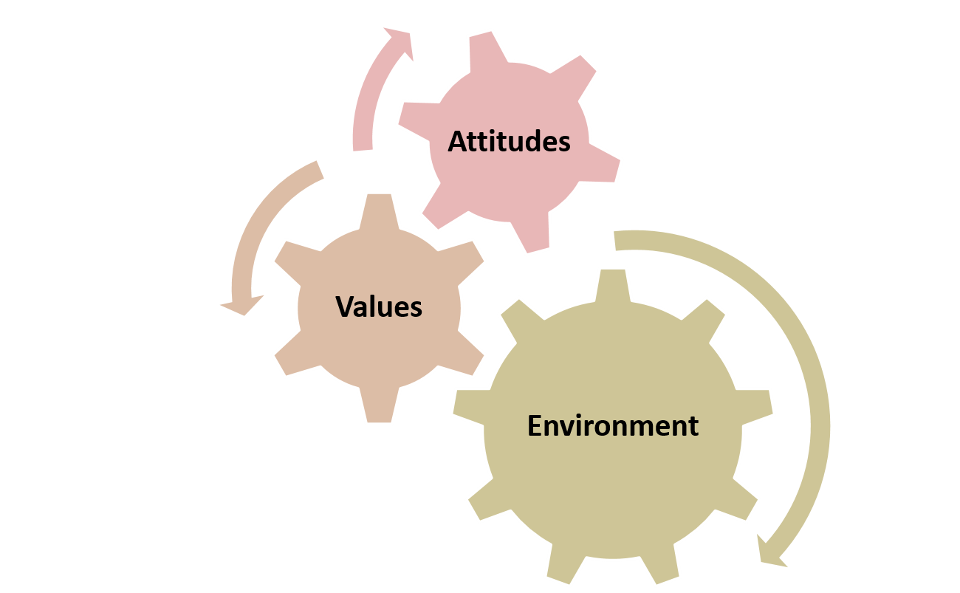
Changes led to
Notes:
What we have seen are changes in the environment, from the general environment, to the healthcare environment, and also to the educational environment, that have interacted with the attitudes and values of a variety of key players. This has led to

Slide 22
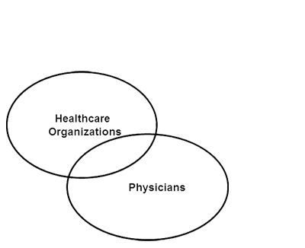
Convergence of Needs
Notes:
the convergence of needs of a number of groups.
These groups include the physicians and healthcare organizations,

Slide 23
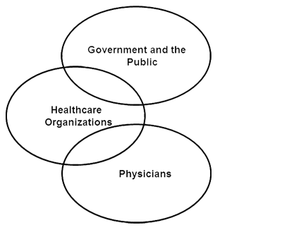
Convergence of Needs 2
Notes:
the government and the public,

Slide 24
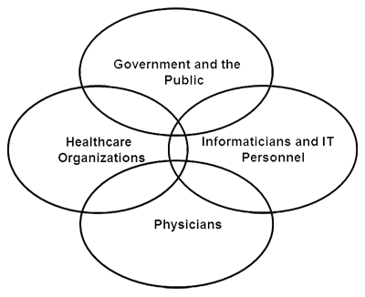
Convergence of Needs 3
Notes:
and the academic informaticians and IT personnel.
This convergence of needs has led to more commonality of focus of these groups than has been possible in the past. So, while many of the informatics tools and systems were developed over 50 years ago, they were really ahead of their time and probably because of that could not have been actively deployed then, even if we had had better technology.

Slide 25
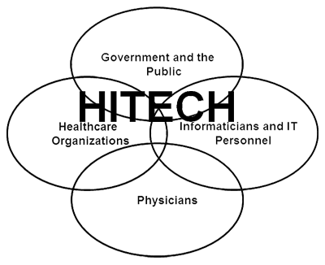
Convergence of Needs 4
Notes:
The HITECH act of 2009, which was part of the American Recovery and Reinvestment Act, represents the first time in history that there is reasonable funding to move us forward in this domain. And, in many ways, it can be seen as being made possible by the events of the last 50 years.

Slide 26
Evolution of Health IT:
The Modern Era
Summary
Changes in healthcare environment since the 1990s
Environmental influences on professional groups
Development of technology
More receptivity to health IT
Notes:
This concludes Evolution of Health IT: The Modern Era.
In summary, we described the changes in the healthcare environment that have occurred beginning with the 1990s, and we examined how those changes influenced both the key professional groups who worked within that environment as well as how the technology developed. We also showed why these factors led to more receptivity to Health IT.

Slide 27
Evolution of Health IT:
The Modern Era
References – lecture b
References
  Cohen RA, Adams PF. Use of the Internet for health information: United States, 2009. NCHS Data Brief Number 66. 2011 July. Available from: www.cdc.gov
  Humphreys BL, Lindberg DA, Schoolman HM, Barnett GO. The Unified Medical Language System: an informatics research collaboration. J Am Med Inform Assoc. 1998 Jan-Feb;5(1):1-11.
  Sackett DL, Rosenberg WMC, Gray JAM, Haynes RB, Richardson WS. Evidence based medicine: what it is and what it isn’t. BMJ. 1996;312:71.
  Wachter RM, Goldman L. The hospitalist movement 5 years later. JAMA. 2002;287(4):487-94.
Images
  Slides 7, 8, 20: Microsoft Clip Art. Used with permission of Microsoft.
Notes:
“No Audio”

Slide 28
History of Health IT in the US
Evolution of Health IT: The Modern Era Lecture b
This material was developed by the University of Alabama at Birmingham, funded by the Department of Health and Human Services, Office of the National Coordinator for Health Information Technology under Award Number 90WT0007.
Notes:
No Audio.

