Slide 1
History of Health Information Technology in the U.S.
Evolution of Health IT: The Early Years
Lecture c – The 1980s
This material (Comp 5 Unit 1) was developed by the University of Alabama at Birmingham, funded by the Department of Health and Human Services, Office of the National Coordinator for Health Information Technology under Award Number 90WT0007.
This work is licensed under the Creative Commons Attribution-NonCommercial-ShareAlike 4.0 International License. To view a copy of this license, visit http://creativecommons.org.
Notes:
Welcome to History of Health Information Technology in the US, Evolution of Health IT: The Early Years. This is Lecture C, the 1980s. This presentation will explore the changes and developments that occurred in health IT in the 1980s. Many of them are a direct result of events of the preceding decade.

Slide 2
Evolution of Health IT: The Early Years Learning Objectives
Discuss the impact that the cost containment focus of the 1980s had on the use of health information technology
Discuss the healthcare environment of the 1980s and its impact on the types of informatics applications developed during this time period
Discuss the increasing professionalization of informaticians and HIT professionals in the 1980s including training programs and professional organizations
Notes:
The Objectives for this lecture, The 1980s are to:
Discuss the impact that the cost containment focus of the 1980s had on the use of health information technology.
Discuss the healthcare environment of the 1980s and its impact on the types of informatics applications developed during this time period.
Discuss the increasing professionalization of informaticians and HIT professionals in the 1980s including training programs and professional organizations

Slide 3

General Environment -- 1980s
Empowerment
Personal computers
Computer users:
  Computer specialists
  Children
(Photo by Judy Baxter)
Notes:
What we see occurring in the 80s in the general environment was a general push for empowerment of women and minorities. The Civil Rights legislation of the 1960s continued to exert an influence and the women’s liberation movement was flourishing. The 1980s also saw the beginning of the era of personal computers. And who were the new computer users of the 80s?
Children. While we still had our computer specialists, now we also had children using computers. Early video games and the introduction of Apple 2 computers in school systems allowed kids to get very comfortable with the new technology.

Slide 4
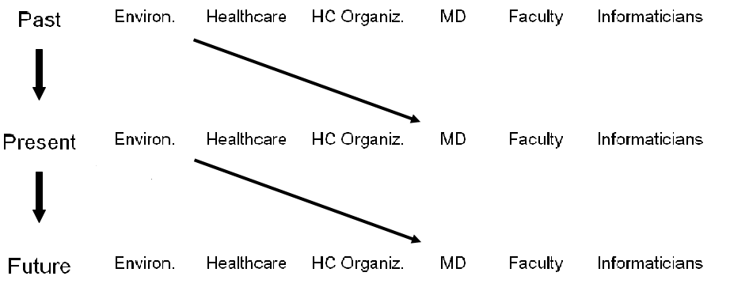
Influence Patterns
Source: (Tapscott, 1998)
Notes:
We have talked about how the different groups influence each other and how, within a group, the past influences the present, and the present influences the future. However, in looking at our question again (why is there more interest in, and use of, healthcare IT now?),let’s focus on other influences. The role of the physician is a key one for facilitating this use. And one of the influences on physicians is the environment in which they grew up. The younger physicians of today who were children in the 80s are going to be influenced by their experiences at that time. And as Don Tapscott in the book “Growing Up Digital” has said, those children born in the 1980s are the first generation for whom the computer was just an ordinary household appliance.

Slide 5
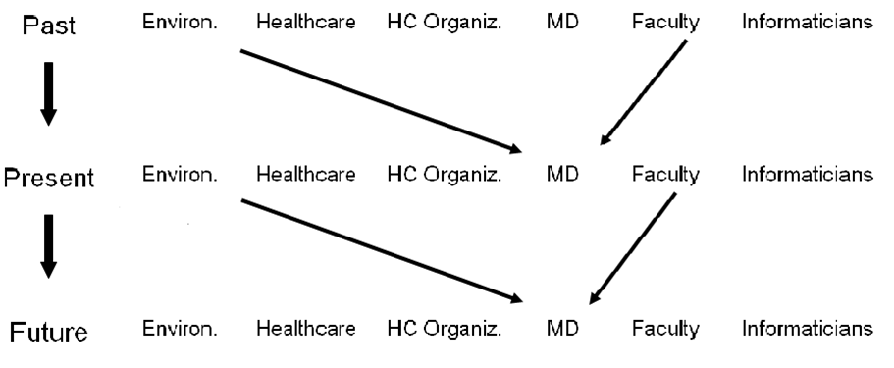
Influence Patterns 2
Notes:
Another key influence on physicians is the influence of the faculty or the medical education environment where they trained. As we have said, academic physicians of the 70s, who were training the physicians who entered practice in the 80s, were beginning to promote the idea of the scientific practice of medicine.
What you will see is that changes over time in the general environment and in the education of physicians have affected the receptivity to the use of information technology in healthcare. Let’s take a look at some of these changes.

Slide 6
Healthcare Environment – 1980s
Cost containment
  Prospective payment (DRGs)
  Increase in HMOs
Increase in physicians
More competition for NIH funding
Patient empowerment
Notes:
One of the most predictable effects of the expansion of technology, procedures, and reimbursement in the 1970s was that healthcare costs increased tremendously. In the 80s we see a focus on cost containment. DRGs (pronounced D-R-Gs), which stands for Diagnosis Related Groups, started in 1983 and represented a big change in how hospitals were paid for services. What this meant was that now Medicare would only pay a fixed amount for a given disease or diagnosis, no matter how much or how little was actually done.
In the 1980s we saw an increase in Health Maintenance Organizations, or HMOs (pronounced H-M-Os). Many of them had begun earlier but in the 1980s they began to become more prevalent. HMOs were seen as systems that might control some of these costs. In HMOs, the patient enrolls with the HMO and pays a fixed up-front fee, and the HMO provides all services a patient needs. With that model, there was no revenue to be gained from doing more or unnecessary procedures.
As has already been noted, the fear of a physician shortage led to an increasing number of physicians and an increasing number of academic physicians who were doing clinical research. This was a natural consequence of both the potential of, and the value placed on, science. There was more competition for NIH (Pronounced N-I-H) funding. There weren’t huge increases in funding, but there were certainly more people trying to get what there was.
And reflecting the general movements for empowerment, we began to see some patient empowerment at this time.

Slide 7
Healthcare Organizations
Increase revenue
Decrease costs
Notes:
Healthcare organizations continued to work on increasing their revenues, but now to maintain their viability at all, they had to work on decreasing costs.

Slide 8
Information Systems
Automated fiscal, data processing
  Use of information for cost containment
Automation of administrative, some clinical systems
“Information” added to HMSS = HIMSS
Director of Information Systems
Report to CFO
Minimal clinical concern
Source: (HIMSS Legacy Workgroup, 2007)
Notes:
And how did computers fit into this environment? While they still had a fiscal focus --billing and collections were still dominant -- now the information was being used to provide information for cost containment. The automation of ancillary clinical information systems, mainly those such as pharmacy, lab and radiology, became more common. One of today’s major healthcare IT organizations, HIMSS (Pronounced Hymns), was originally founded by industrial engineers whose focus was to improve the efficiency of healthcare. Interestingly, it was during the 80s that the word “information” was added to what, up until then, was the Healthcare Management Systems Society, which then became the Healthcare Information and Management Systems Society.
Hospitals usually had a director of information systems who ordinarily reported to a Chief Financial Officer. At this time, there was still very much a fiscal focus for computer use. Despite the invention of expert systems, reminding and alerting systems, and electronic medical records at a variety of places, hospital administrators stressed the need for decreasing costs, or length of stay. For the most part, however, they did not try to change the processes that clinicians followed or the basic way that medicine was practiced.

Slide 9
Physicians
Scientific practice of medicine
More group practices
Decreasing physician autonomy
  Cost containment pressure
  Increase in patient involvement
Little direct use of computers
Notes:
So we find in the 80s more value placed on the scientific practice of medicine. That was predictable given the trends that had started in academic settings in the 70s. We also find more group practices rather than solo physician practices and there was also decreasing physician autonomy. Part of that was due to environmental pressures: the cost containment pressures as well as the shifting in the relationship between the physician and the patient. Patients were becoming more involved in their own care. Although the use of hospital information systems for laboratory results reporting was becoming more common, for the most part, the physicians themselves were still not using computers very much in actual clinical practice.

Slide 10
Academic Physicians
Increased standardization of the “art” of medicine
Health services research
  Focus on cost
Research use of computers
Clinical research
Notes:
Our academic physicians at this time were continuing the increasing standardization of the Art of medicine. We began to see the focus on medical decision making formalized in the decision analysis approach. Remember, in the 70s we said academic physicians were applying science to physician’s thinking by teaching medical problem solving? Now in the 80s they began to formally teach how to have a good doctor-patient relationship. In fact, it was called “interpersonal skills.” Skills can be readily taught, relationships, not so easily.
But by emphasizing interpersonal skills, the idea that this could be standardized and taught gained traction. We could specify the skills; we could have check lists. Again, this is part of the same approach to standardizing and making the practice of medicine more scientific that we have discussed earlier.
We saw the development of health services research. Such research had begun earlier but began to flourish at this time. What was the focus? Healthcare costs. That is a slight exaggeration, since it was not the only focus, but clearly the issue of the escalating costs of healthcare engaged practitioners and academics alike.
Finally, at this time we began to see more use of computers for research. Medical faculty began to do MEDLINE (Pronounced med line) searches themselves for their research, rather than relying on librarians. MEDLINE, as you remember, was the system developed by the National Library of Medicine, for online access to the medical literature. Medical school faculty also used computers in their laboratories. There was more comfort with using personal computers, but not much, and they were certainly not used routinely in actual clinical care.

Slide 11
Medical Informaticians
Increased development of systems
  Diagnostic decision support systems
  Reminder and alerting systems
System evaluations begin
  Impact of computer use on reducing costs
Increased professionalization/specialization
  AMIA
  NLM training programs
  Specialized informatics fields
Source: (Miller & Masarie, 1986
Wilson et al., 1982)
Notes:
Meanwhile, our informaticians continued to develop new tools. We saw the shift from expert systems to diagnostic decision support systems to help promote the scientific practice of medicine. In addition to diagnostic decision support systems, there were also reminding and alerting systems. There will be an entire presentation focusing on the development of clinical decision support systems. These systems in many ways, reflected the attitude of the times in terms of empowerment.
Their purpose was to allow the physicians to make the decisions, but to provide information to assist in that process. Hence the name “decision support,” not “expert,” systems.
In the 80s, system evaluation began to emerge. We began to see research on the impact of computer use. And you can probably anticipate what the focus was -- reducing costs. In Indiana, at the Regenstrief (Pronounced REE gen streef) Medical Institute, where an electronic medical record had been developed a decade earlier, reminders and cost information on laboratory tests were added and the effects of these reminders on costs were examined. What they found was that when the lab test costs were displayed within the electronic medical record test ordering screen, physicians ordered fewer unnecessary tests.
In the 80s, the informatics community was also beginning to organize more into professional organizations. The American Medical Informatics Association or AMIA (Pronounced amy uh) was formed in 1988. The National Library of Medicine or NLM (Pronounced N-L-M) began to fund training programs in informatics that are today a major funding source for training research informaticians (Pronounced inform uh ticians). In addition, there were now specializations within informatics, such as Nursing Informatics.

Slide 12
Evolution of Health IT
Summary — 1980s
Healthcare costs increased
Efforts at cost containment
Continued ‘standardization’ of medical practice
Informatics applications to support systematic, scientific practice
Growing professionalism within informatics
Children began using computers in school
Notes:
This concludes Evolution of Health IT: The Early Years. In summary, as could be predicted from the expansion of healthcare without much control in the 1970s, during the 1980s the recognition that costs were getting out of control prompted both governmental and internal hospital efforts at cost containment. Within hospital settings, computers began to be used most commonly to provide data to better manage the costs.
Trends that had begun in the 1970s continued and there were more efforts to make both medical education and medical practice more standardized, and the informatics applications followed suit. And when these applications were evaluated, their impact on cost was an important outcome.
Within the field of informatics we saw a growing professionalism that was demonstrated in several ways. We saw some consolidation of smaller organizations into the larger American Medical Informatics Association, which included some of the newly developing subfields of informatics. And along with increased professionalism came formal training programs.
Finally, with the advent of the personal computer in the early 80s, we began to see computers used in the educational arena. In the next unit, we will examine the impact of these changes.

Slide 13
Evolution of Health IT
References – Lecture c
References
  HIMSS Legacy Workgroup. History of the Healthcare Information and Management Systems Society (formerly Hospital Management Systems Society) [Internet]. Chicago: Healthcare Information and Management Systems Society (HIMSS); 2007. Available from: www.himss.org
  Miller R, Masarie FE. Quick medical reference (QMR) for diagnostic assistance. MD Comput. 1986 Sep-Oct;3(5):34-48.
  Tapscott D. Growing up digital. New York: McGraw-Hill, 1998.
  Wilson GA, McDonald CJ, McCabe GP Jr. The effect of immediate access to a computerized medical record on physician test ordering: a controlled clinical trial in the emergency room. Am J Public Health. 1982 Jul;72(7):698-702.
Images
  Slide 3: Baxter, Judy , CC BY-NC-ND 2.0, Available from: www.flickr.com
Notes:
“No Audio”

Slide 14
History of Health Information Technology in the U.S.
Evolution of Health IT: The Early Years Lecture c
This material was developed by the University of Alabama at Birmingham, funded by the Department of Health and Human Services, Office of the National Coordinator for Health Information Technology under Award Number 90WT0007.
Notes:
No Audio.

