Slide 1
History of Health Information Technology in the U.S.
History of Health IT Organizations
Lecture a – Professional Organizations
This material (Comp 5 Unit 15) was developed by the University of Alabama at Birmingham, funded by the Department of Health and Human Services, Office of the National Coordinator for Health Information Technology under Award Number 90WT0007.
This work is licensed under the Creative Commons Attribution-NonCommercial-ShareAlike 4.0 International License. To view a copy of this license, visit http://creativecommons.org.
Notes:
Welcome to History of Health Information Technology in the US, History of Health IT Organizations. This is Lecture A, Professional Organizations. This lecture will review the history of the three major professional associations focused on health information technology. These organizations have been both affected by, and helped to shape, health IT policies in the US.

Slide 2
History of Health IT Organizations
Learning Objectives
Describe the background and original constituencies of AMIA, HIMSS, and AHIMA
Describe the changes in major interests that have occurred at AMIA, HIMSS, and AHIMA over time
Notes:
The Objectives for this lecture, Professional Organizations, are to:
Describe the background and original constituencies of AMIA, HIMSS, and AHIMA.
Describe the changes in major interests that have occurred at AMIA, HIMSS, and AHIMA over time.

Slide 3
Organizations
Professional Associations
  AMIA (American Medical Informatics Association)
  HIMSS (Health Information and Management Systems Society)
  AHIMA (American Health Information Management Association)
Notes:
The three professional associations are the American Medical Informatics Association, or AMIA (pronounced AIM=EE-Uh) , the Health Information and Management Systems Society or HIMSS (pronounce HIMZ), and AHIMA, the American Health Information Management Association. Some of you may already be familiar with one or more of these organizations. All three of these organizations have had a focus on health IT for at least fifteen years.

Slide 4
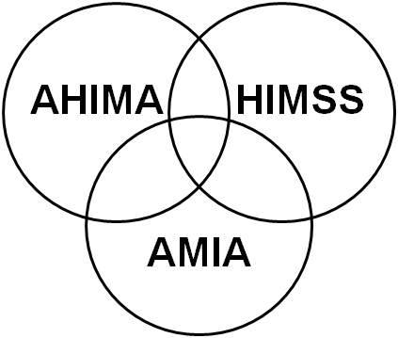
Professional Organizations
Electronic Health Records
Notes:
Today there is considerable overlap in the interests of these three organizations, revolving around issues connected with Electronic Health Records. But that was not always the case. In fact, the shared interest in electronic health records arose very differently in the three groups. Let’s look at their background. We will start with the history of AMIA.

Slide 5
AMIA
1960s and 1970s
  Engineering, computer science applied to medicine
  Physicians interested in computers
Notes:
Several organizations joined together to form the organization known as AMIA. In the 1960s and 70s clinical computing applications started to develop. The developers were either engineers or computer scientists who were trying to apply their background to medicine, or physicians who were interested in computers and how they could be applied to medicine. These individuals who were building clinical computing applications founded several organizations where like-minded individuals could meet and share ideas.

Slide 6
AMIA 2
1960s and 1970s
  International Medical Informatics Association
    Representatives from most European countries
Notes:
The International Medical Informatics Association was comprised of representatives from most European countries, but because there was no national American organization, there was no American representative.

Slide 7
AMIA 3
1960s and 1970s
  Society for Advanced Medical Systems
    500 members
  Society for Computer Medicine
    500 members
Notes:
What did exist at that time were two rather small societies of about 500 members each, with some overlap—the Society for Advanced Medical Systems and the Society for Computer Medicine.

Slide 8
AMIA 4
Symposium on Computer Applications in Medical Care (SCAMC)
    Non-membership organization
    Annual fall symposium, Washington DC
    Main source of information on US informatics
Notes:
There was also a non-membership organization known by its abbreviation as SCAMC (Scam-see). This was the annual symposium on computer applications in medical care. This large conference, held annually each fall in Washington, DC, was the main place where those individuals developing and evaluating clinical computing applications could share information on what they were doing. Some of these applications included the beginning development of electronic medical records, clinical decision support tools, and other clinical applications. SCAMC was the main source of information about the growing field of medical informatics.

Slide 9
AMIA 5
1980s
  American Association of Medical Systems and Informatics
    Merger of Society for Advanced Medical Systems (SAMS) and Society for Computer Medicine (SCM)
    Spring Congress
  SCAMC
    2000 attendees
Notes:
In the 1980s the two societies, SAMS and SCM, merged to form the American Association of Medical Systems and Informatics. Combined they had about 700 members and held a meeting each spring known as the Spring Congress. It usually took place on the west coast of the US.
Meanwhile, SCAMC continued to draw larger and larger crowds and by the mid 80s usually had about 2000 attendees at the Fall Symposium in Washington, DC.

Slide 10
AMIA 6
American College of Medical Informatics
    Recognition of experts in medical informatics
    Meets at spring Congress and fall Symposium
    Topic-related winter retreat
Notes:
Also in the mid 1980s another organization, the American College of Medical Informatics or ACMI, was formed as an honorary society for those individuals who had made significant contributions to the field of medical informatics. ACMI met at both meetings, the spring congress and the fall symposium and also held a winter retreat.

Slide 11
AMIA 7
1988 – Formation of AMIA
  Merger of SCAMC, AAMSI, ACMI
    Fall Symposium
    ACMI spring and fall meetings
Notes:
In 1988 the organization known as AMIA was formed by the merger of the three organizations—AAMSI, ACMI and the non-membership organization, SCAMC. It continued to hold a fall symposium. In fact, in the early years, the proceedings of the AMIA Fall symposium used to say “Formerly known as SCAMC.” ACMI has continued to be an honorary society but now was under AMIA’s auspices.
AMIA became America’s national informatics association and at this time was the only one of the three organizations to have the word informatics in its name and whose focus was clinical computing.

Slide 12
AMIA 8
1988 – Formation of AMIA
  Donald Lindberg, first president
  Marion Ball, first International Medical Informatics Association representative
1994 – Journal (JAMIA)
Notes:
Dr. Donald Lindberg, who was the head of the National Library of Medicine, became the first president. The National Library of Medicine had funded most of the informatics research projects at that time. And Dr. Marion Ball became the first American representative to the International Medical Informatics Association.
Within 6 years, AMIA had its own professional journal known as JAMIA, which in recent times has been the first- or second-highest ranked informatics journal.
We’ll look next at the organization known today as HIMSS.

Slide 13
Health Information and Management Systems Society (HIMSS)
1960s and 1970s
  Hospital Management Systems Society
  Focus: Management engineering
  Under American Hospital Association (AHA)
Source: (HIMSS Legacy Workgroup, 2007)
Notes:
The 1960s and 70s was a time that hospitals and their profits were growing from the expansion of healthcare. The Hospital Management Systems Society was a society within the American Hospital Association comprised mainly of industrial and management engineers with a focus on making hospital operations more efficient.

Slide 14
Health Information and Management Systems Society (HIMSS) 2
1980s
  “Information” added to the name and focus broadened
    Healthcare Information and Management Systems Society
Source: (HIMSS Legacy Workgroup, 2007)
Notes:
In the 1980s the effects of the hospital expansion were being felt in increased costs. As computers began to be used more in hospitals for financial and administrative purposes, the members of this society saw the potential for information technology to be used for improving efficiency and containing costs. In the mid 1980s the name was changed to the Healthcare Information and Management Systems Society to reflect the role of information technology and a broader mission beyond just hospitals.

Slide 15
Health Information and Management Systems Society (HIMSS) 3
1990s
  1993 – HIMSS separates from AHA
  1994 – Clinical systems added as a focus area for HIMSS
Notes:
During the 1990s two significant changes occurred—HIMSS became independent of AHA and toward the end of the 1990s began to develop an interest in clinical, not just administrative, computing. In part, this was a result of its membership being expanded to include not just management engineers but IT staff and in particular chief information officers who increasingly were responsible for the management of the clinical, as well as the administrative, systems. And the use of these clinical systems grew during the 90s.
Today there is a separate organization for chief information officers, and various vendor associations are also part of HIMSS. In addition, HIMSS has played a large role in the efforts to certify electronic health record systems. HIMSS has begun to develop programs for clinical professionals, in particular physicians and nurses who are involved with information technology, an audience that overlaps with AMIA’s core membership as well.

Slide 16
American Health Information Management Association (AHIMA)
Earliest of the organizations
  1928—American College of Surgeons established the American Record Librarians of North America
  1970—American Medical Record Association
  1991—AHIMA
    Focus on management of information.
    Broader than medical records
    Broader than hospital records
Source: (AHIMA History)
Notes:
AHIMA was the earliest of the three organizations to form. It was initially established by the American College of Surgeons and had several name changes before becoming independent and changing its name to the American Medical Record Association or AMRA.
With the name change it also signaled that it was not just hospital records that it was concerned about. However, remember that at this time the type of medical records that were the focus were paper records. In 1991 there was another broadening of the vision of the association, when it became the American Health Information Management Association. Now the focus was clearly on the management of information, not necessarily just medical records, and definitely not just hospital records.

Slide 17
AHIMA: Changes in Focus
Medical record quality and certification of practitioners
  Focus on accuracy and completeness of data
  Deep knowledge of medical terminology
Notes:
The quality of the data in the medical record was always a focus for AHIMA as was certifying practitioners who worked with the medical record. Credentialed health information managers focus on accuracy and completeness of data and they have a deep knowledge of medical terminology.

Slide 18
AHIMA: Changes in Focus 2
DRGs in the 1980s
  Importance of coding for reimbursement
  Involvement in new coding standards and terminology
Notes:
This focus became very important in the 1980s when new payment mechanisms known as DRGs were implemented and accurate coding for reimbursement became important. With that increased focus on coding what is in the medical record came involvement in new coding standards and terminology.

Slide 19
AHIMA: Changes in Focus 3
Privacy legislation 1970s to 1990s
Notes:
Beginning in the 1970s through the HIPAA legislation in 1990s and up to the present, there was more concern nationally about privacy. The health information managers saw themselves as the keepers of the medical records, and AHIMA was very active in the debates about the privacy legislation.

Slide 20
AHIMA: Changes in Focus 4
Beginning of focus on electronic information 1990s – Present
  EHRs and PHRs
  HIT Workforce
  Information governance
Notes:
With the focus on the privacy and security of electronic information beginning in the late 1990s, for the first time AHIMA began to prioritize management of electronic information. Today, AHIMA sees as its core focus electronic health records and also personal health records, or PHRs, for patients. Recognizing that the future of health information management is likely to be almost all electronic, AHIMA has also focused on developing the HIT workforce to fulfill a variety of new roles and more recently on information governance.
As the three groups’ interests began to coalesce, there were a variety of collaborative activities.

Slide 21
Joint Healthcare Information Technology Alliance (1997)
Three organizations initially
Goal: advance healthcare delivery through information technology
Influence legislation
  Computer-Based Patient Record
  HIPAA
  Privacy and confidentiality
  Security
Notes:
In 1997 the three organizations formed the Joint Healthcare Information Technology Alliance with a goal of influencing the policies and legislation that were being developed in response to the 1996 passage of HIPAA and the need for Congress to come up with privacy legislation.
Their goal was to advance healthcare through information technology and they focused on legislation related to the computer-based patient record, which was the terminology at the time, HIPAA, and other privacy and security legislative initiatives.

Slide 22
Other Collaborations
Joint certification exams
  Privacy and security certifications—HIMSS and AHIMA
Joint publications
  Workforce Roles—AMIA and AHIMA
Co-sponsorship of meetings and groups
  Alliance for Nursing Informatics—AMIA and HIMSS
Sources: (AHIMA & AMIA, 2006)
(AHIMA & AMIA, 2008)
Notes:
There have been other collaborations as well. The credentials and certification processes for privacy and security specialists were developed jointly by HIMSS and AHIMA.
There were two white papers on the HIT workforce that AHIMA and AMIA prepared.
And there continue to be some joint sponsorship of professional meetings and other groups. For instance, AMIA and HIMSS jointly sponsor the Alliance for Nursing Informatics.

Slide 23
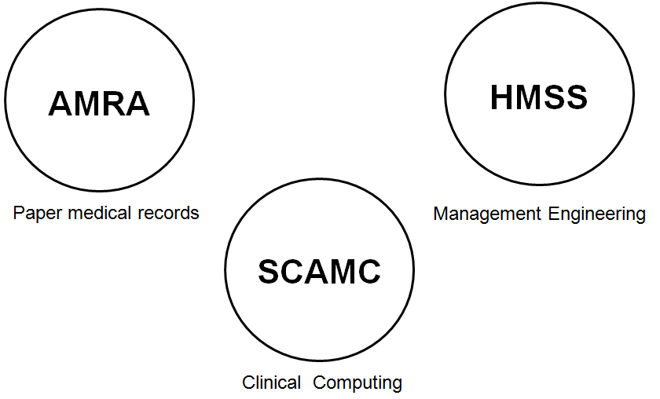
1970s
Notes:
The diagram in the slide summarizes the changes in the organizations we discussed. In 1970 the three organizations were very separate with virtually no overlap of members. AMRA was concerned with paper medical records. SCAMC and the other smaller professional societies were places where those with an interest in clinical computing could meet like-minded individuals and share ideas. And HMSS was mainly concerned with management engineering in hospital settings.

Slide 24
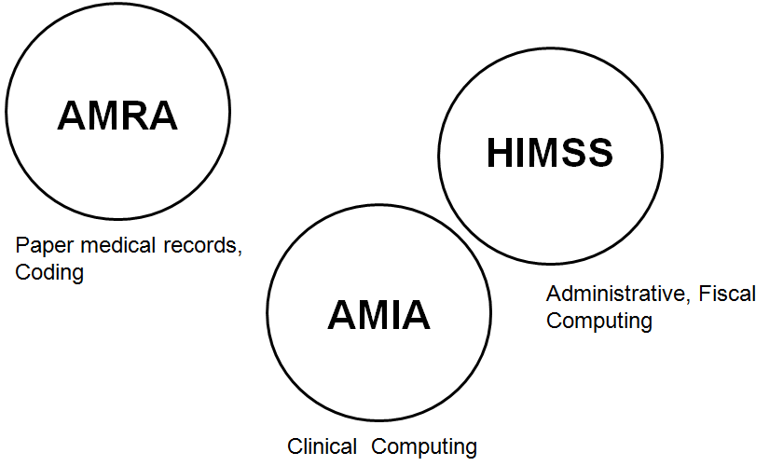
1980s
Notes:
By the 1980s there was a merger of SCAMC and the other smaller informatics societies into AMIA, and HIMSS had changed its name to address the importance of information technology. While it was closer to AMIA in that both were interested in information technology, AMIA’s focus was always clinical computing and HIMSS in the 80s focused on IT related to fiscal and administrative computing. AMRA was still focused on paper medical records.

Slide 25
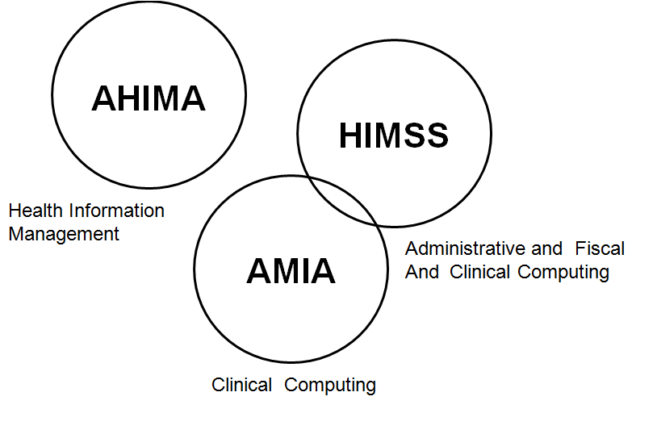
1990s
Notes:
By the early to mid 90s HIMSS’ interests began to incorporate clinical computing and AHIMA had broadened its focus to health information management, bringing it closer to the interests of the other two groups. By the end of the 90s, especially around the privacy and security area, the three groups were beginning to have more in common.

Slide 26
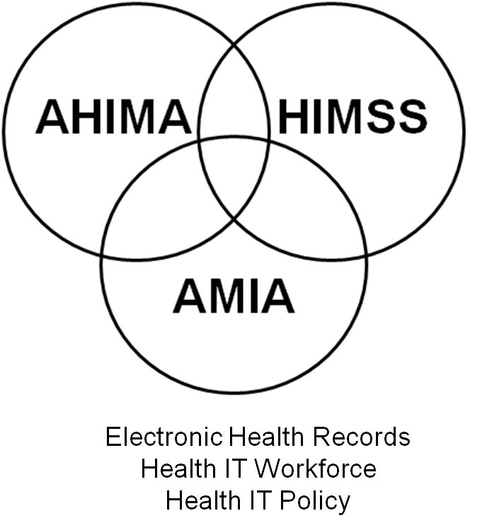
2000 to Present
Notes:
Beginning around 2000, all three groups were focused on their role in the growing use of electronic health records, the development of the workforce who could assist with EHR development, implementation, and management, and with health IT policy related to electronic health records. While all three groups are separate professional associations, it is likely that in the future there will be increasing commonalities in their interests.

Slide 27
History of Health IT Organizations
Summary – Lecture a
History of AMIA, HIMSS and AHIMA
Converging goals
Notes:
This concludes Lecture a of History of Health IT Organizations. In summary, the background and original constituencies of the three major health IT organizations today were varied. Changes in major interests have occurred at AMIA, HIMSS and AHIMA over time as the organizational goals converge.

Slide 28
History of Health IT Organizations
References – Lecture a
References
  AHIMA, AMIA, Building the Work Force for Health Information Transformation [Internet]. Chicago: American Health Information Management Association. 2006 Feb. Available from: www.amia.org
  AHIMA, AMIA. Health Information Management and Informatics Core Competencies for Individuals Working with Electronic Health Records [Internet]. Chicago: American Health Information Management Association. 2008 Oct. Available from: library.ahima.org
  AHIMA History [Internet]. Chicago: American Health Information Management Association. Available from: www.ahima.org
  HIMSS Legacy Workgroup. History of the Healthcare Information and Management Systems Society (formerly Hospital Management Systems Society) [Internet]. Chicago: Healthcare Information and Management Systems Society (HIMSS); 2007. Available from: www.himss.org
Notes:
“No Audio”

Slide 29
History of Health IT in the US
History of Health IT Organizations
Lecture a
This material was developed by the University of Alabama at Birmingham, funded by the Department of Health and Human Services, Office of the National Coordinator for Health Information Technology under Award Number 90WT0007.
Notes:
No Audio.

