Slide 1
History of Health Information Technology in the U.S.
History of Telemedicine
This material (Comp 5 Unit 13) was developed by the University of Alabama at Birmingham, funded by the Department of Health and Human Services, Office of the National Coordinator for Health Information Technology under Award Number 90WT0007.
This work is licensed under the Creative Commons Attribution-NonCommercial-ShareAlike 4.0 International License. To view a copy of this license, visit http://creativecommons.org.
Notes:
Welcome to History of Health Information Technology in the U.S., History of Telemedicine. Telemedicine is a medical discipline based strongly upon information technology and is steadily gaining importance in the field of health informatics. This presentation will review how telemedicine is defined as well as provide a basic history of telemedicine efforts in the United States. Finally, we will provide a brief summary of the current status of telemedicine.

Slide 2
History of Telemedicine
Learning Objectives
Define telemedicine
Describe the differences between telemedicine and telehealth
Discuss key developments in the history of telemedicine
Identify and describe at least two current applications of telemedicine
Notes:
The Objectives for this unit, History of Telemedicine are to:
Define telemedicine.
Describe the differences between telemedicine and telehealth.
Discuss key developments in the history of telemedicine.
Identify and describe at least two current applications of telemedicine

Slide 3
Telemedicine Definitions
“… the use of medical information exchanged from one site to another via electronic communications to improve a patient's health.”
“… at a minimum, audio and video equipment permitting two-way, real time interactive communication.”
Source: (CMS, 2009)
Notes:
First, let us define telemedicine. You can pause the slides if you need time to read the definition.
Telemedicine definitions range from the technical to the strategic. Perhaps the most detailed in regards to specification of technology is the definition used by the United States Centers for Medicare and Medicaid Services, or C-M-S. This definition states, along with a basic concept of telemedicine, that at minimum, telemedicine as defined by CMS must function to provide two-way, real-time communication between the patient and provider.

Slide 4
Telemedicine Definitions 2
“Telehealth is the use of electronic information and telecommunications technologies.”
“… to support long-distance clinical health care, patient and professional health-related education, public health and health administration.”
Source: (HRSA, 2010)
Notes:
A slightly different definition of telemedicine is the telehealth definition used by the United States Health Resources and Services Administration or HRSA (pronounced HERSA) Their definition is less specific regarding technical function, but includes a broader scope which includes clinical care, health education, public health and health administration.

Slide 5
Telemedicine Definitions 3
Concept of time- and place-independent care
(Joseph Kvedar MD, Harvard Medical School)
Source: (Kvedar, 2010)
Notes:
Perhaps the most succinct, and most comprehensive, definition of telemedicine is that offered by Dr. Joseph Kvedar (pronounced KVAYDAR) of Harvard Medical School, a longtime telemedicine practitioner and advocate. His statement shares that telemedicine is the delivery of medical care independent of time and location. While the least technically specific, it provides what may be the most meaningful definition of telemedicine, as it emphasizes the value to the patient, who is the ultimate direct beneficiary of all medical services.

Slide 6
Telemedicine or Telehealth?
Telemedicine is the practice of medicine via the electronic exchange of medical information
  Typically using two-way voice and/or visual communication by telephone, satellite or computer
  Connects patients to physicians and specialists when in-person visits are not possible
Telemedicine has become important for people living in rural, urban and other underserved areas
  For access to primary and specialized clinical care
  Also for patients to get treatment while remaining in their homes
Source: (UnitedHealth et.al., 2009)
Notes:
A frequent confusion exists between the terms telemedicine and telehealth.
We will address the term telemedicine in this slide and telehealth on the next one.
Telemedicine is most frequently applied to programs that supply clinical care through remote technologies, and is focused on the doctor-patient or other provider-patient interaction. Telemedicine programs of this type most frequently provide evaluations, diagnoses or prescriptive services for patients.

Slide 7
Telemedicine or Telehealth? 2
Telehealth is the broader term used to describe both the clinical and non-clinical services these technologies can provide to advance healthcare
The term telehealth includes the facilitation of services
  Remote medical education
  Research
  Health care administration
Source: (UnitedHealth et.al., 2009)
Notes:
Telehealth, on the other hand, more broadly applies to both clinical and non-clinical settings. Telehealth as a term is intended to include the areas of health related education, research, and administrative services in addition to clinical care. Under this taxonomy, telemedicine is a subset of the broader term telehealth.

Slide 8
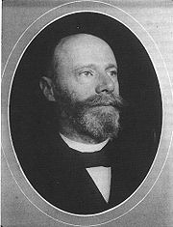
History of Telemedicine:
Early 20th Century
Performing medical examinations and evaluations through telecommunications is as old as the telephone
Method for transmitting his newly-discovered electrocardiogram
Einthoven in 1906
Source: (Wikimedia Commons)
Notes:
Now for the history of telemedicine as both concept and application.
The integration of telecommunications into clinical medicine is the defining factor of telemedicine, and its roots carry back to the earliest days of diagnostic technology. Most individuals are surprised to learn the Willem (WILL-EM) Einthoven (pronounced like Einstein combined with Beethoven) the discoverer of the original electrocardiogram or EKG, also inadvertently created what is identified as the world’s first telemedicine link. After being denied the ability to see his patients directly in the hospital as he developed the EKG, he devised a method to transmit the early EKG over newly installed telephone lines. This connection between the hospital and his research clinic functioned perfectly. His apparatus and its performance were published in a notable article in 1906.

Slide 9
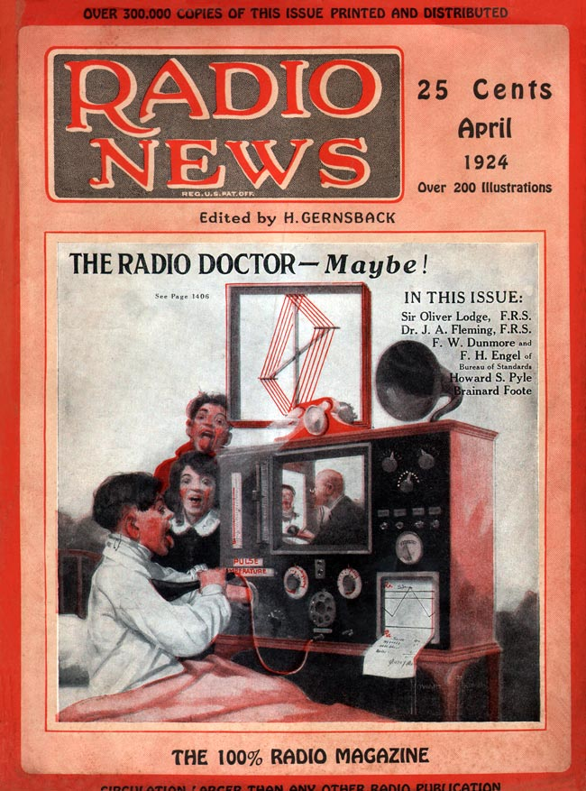
History of Telemedicine:
Early 20th Century 2
Hugo Gernsback – radio technology enthusiast & publisher
It is remarkably similar to today’s technologies
  Two-way video
  Electronic stethoscope
  Remote pulse monitor
  Facsimile printer for printing prescriptions
(MagazineArt.org/Artist:Howard V. Browne)
Notes:
As telecommunications technology developed and radio use became commonplace, the populist press began to visualize new applications for the nascent technology of radio. In 1924, a radio enthusiast magazine titled Radio News described and illustrated what it termed “The Radio Doctor” – a complete bedside unit that allowed a physician to remotely examine, diagnose, and treat a patient.
This whimsical system has surprising parallels to actual telemedicine units in use today – having two way sound and video, an electronic remote stethoscope, monitors for vital signs (NOTE: Do not emphasize the word vital. It is like they are one word—vitalsigns), and a method for printing prescriptions.
No evidence survives that it was ever built, even though a complete circuit diagram was included in the magazine. The writer of this article and publisher of the magazine, Mr. Hugo Gernsback, went on to notoriety as a publisher of popular science fiction through the coming decades and after his death, the Hugo award for science fiction literature was named in his honor.

Slide 10
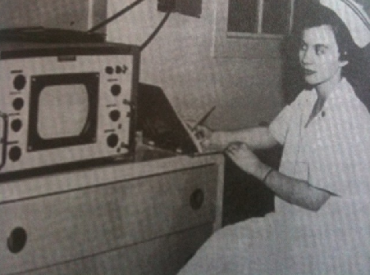
History of Telemedicine:
Mid 20th Century 3
Nebraska Psychiatric Institute
First to use closed circuit television and radio-transmitted records for treating psychiatric patients
Closed Circuit TV System in 1955
Source: (Nebraska Psychiatric Institute)
Notes:
Telemedicine by radio persisted until the mid-20th century, most frequently applied by doctors providing advice to ships at sea using maritime radio. As television emerged nationally beginning in the 1950’s, telemedicine applications were attempted using TV. In 1955, a Nebraska psychiatric institute created and operated a successful closed-circuit television system to a hospital over 100 miles away. The video was black and white TV, the standard for the time.

Slide 11
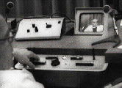
History of Telemedicine:
Mid 20th Century 4
Massachusetts General Hospital
Provided medical care to over 1000 patients 2.7 miles away at the Logan International Airport Medical Station
Medical Closed Circuit TV System in 1968
Source: (Massachusetts General Hospital)
Notes:
Television projects became the mainstay of telemedicine through the mid-20th century. An additional notable project once again used black-and-white closed circuit TV to link the medical clinic at Boston’s Logan International airport to Massachusetts General Hospital just across the bay. Concerns over Logan Airport’s limited road and train access led to the project, and a paper published after doctors had seen 1,000 patients over the link was the first positive evaluation of the diagnostic equivalency of a telemedicine link versus in-person care.

Slide 12
Telemedicine History Continues
Interactive television projects were the telemedicine focus circa 1970
Television pilot projects operated in many locations from 1970 to 1975
Notes:
Television remained the primary medium for telemedicine throughout the 1970s. Many pilot projects were undertaken across the United States, and most of these were funded by the United States government through agencies such as the Department of Health, Education, and Welfare or H-E-W, the Health Care Financing Administration known as HCFA (pronounced HICK-Fuh) or the Federal Communications Commission , the F-C-C..

Slide 13
Telemedicine History Continues 2
Interest waned between 1975 and1990
  127 Medline citations 1975-1982
  71 Medline citations 1982-1990
  44% decline
Notes:
During this time, interest in telemedicine waned as the high costs of the involved television systems limited development. As measured by MedLine citations, a premier online source for medical research, there was a 44% decrease in research literature activity related to telemedicine when one compares the like periods 1975-1982 versus 1982-1990.

Slide 14
Telemedicine History Continues 3
Interest re-energized with personal computing around 1990 and the decade following
Many projects using personal computers and custom software during this time
Notes:
With the 1990s came the advent and popularity of the personal computer. This spurred new interest and developments in many forms of telemedicine that were based upon personal computer software. These applications ranged widely in use across many medical specialties, but few found sustainable success.

Slide 15
Telemedicine History Continues 4
From 2000 on, significant expansion occurred in telemedicine due to:
  Availability of lower-cost, higher performing imaging devices
  Widespread acceptance of Internet for transmission of information
Notes:
Upon the millennium celebration in the year 2000, two factors began to drive a fast expansion and exploration of new telemedicine applications.
First of these was the development of low-cost solid state devices with high performance levels for both black-and-white and color imaging. Driven by the consumer video camera industry, the capabilities of what once were high cost imagers was now available widely. Ultimately this new generation of devices outperformed their predecessors in many ways, and at significantly lower cost.
Secondly, the widespread growth in the availability and popularity of the Internet offered new ways for computers to communicate and send digital files. With these two elements, a new generation of telemedicine systems and methods developed and began widespread application.

Slide 16
Telemedicine Report to
Congress 1997
Inventory of federal projects
Evaluation guidelines
Safety and standards issues reviewed, payment policies suggested
No clear conclusions
No specific recommendations
Notes:
Federal grant support for telemedicine continued from the early television explorations of the 1970’s through multiple grants awarded through the 1990’s via many different US government agencies.
Their number and complexity grew so great that Congress requested a review of this activity by the US Department of Commerce. The outcome of the review led to the 1997 Telemedicine Report to Congress. While it was a comprehensive review of the federal projects, and worked to apply a standardized evaluation framework, it resulted in no clear conclusions and made no specific recommendations, further muddying the already unclear waters regarding the value of telemedicine to national health care.

Slide 17
Telemedicine Report to
Congress (Updated in 2001)
Deeper analysis of issues and policy needs
Identified Issues
  Lack of reimbursement
  Legal issues
  Safety and standards
  Privacy and confidentiality
  Telecommunications infrastructure
Laid out definite plans for US government entities to synergize efforts for progress in these areas
Results have been mixed
Notes:
Through the undaunted efforts of telemedicine advocates, the Telemedicine Report to Congress was updated in 2001 under a new governance that included many telemedicine organizations and practitioners. This resulted in a deeper analysis and focus on policy needs from a governmental level.
The 2001 report identified five key focus areas for policy development. These were lack of reimbursement, legal issues, safety and related standards, patient privacy and confidentiality, and telecommunications infrastructure.
The 2001 report, unlike its predecessor, made concrete recommendations and developed action plans for specific governmental agencies for improving the policy issues. While many of these recommendations were implemented and are still ongoing, the results are mixed, but some areas have shown progress.

Slide 18
Current Major Applications
Tele-ICU and home monitoring
  Uses transmission of biomeasurements for medical decisions
  Allows improved services and better care management
Notes:
As we look at current major applications of telemedicine today there are key areas which one should be aware of.
First, technologies to obtain and securely share biometric data reliably have led to applications in remote Intensive Care Unit bed management (referred to as Tele-I-C-U) as well as home monitoring of chronic care conditions for post-discharge management and care improvement.

Slide 19
Current Major Applications 2
Teleradiology, telepathology, and teledermatology
  Uses transmission of digital images for diagnostics
  Allows improved services and better specialty access
Notes:
Second, advanced development of digital image processing has led to successful applications in radiology (referred to as Tele-radiology) as well as pathology and dermatology (referred to as Tele-pathology and Tele-dermatology, respectively). In each of these disciplines, patient images are obtained and transmitted to remotely located physicians for interpretation and diagnosis.

Slide 20
Current Major Applications 3
Tele-stroke, virtual visits, remote care, pre-surgical assessment and follow up
  Uses live video and examination cameras for medical visits
  Allows improved access and patient convenience
Notes:
Lastly, advances in live two-way video has led to telemedicine applications in remote stroke patient management during emergency room presentations (referred to as Tele-Stroke) as well as many programs providing ambulatory care visits in both primary care and specialist care.

Slide 21
Likely Future Developments
Continued healthcare system performance pressures plus patient service expectations will further the integration of telemedicine into medical care
Continued development of device and telecommunications technologies will improve
  Cost
  Performance
  Safety
Notes:
As we look to the future, telemedicine development is expected to continue.
Telemedicine’s flexibility and virtual encounter capabilities will assist us as continued pressure emerges on the United States health system for high levels of health outcomes, as well as rising patient expectations of access and convenience.
Additionally, continued progress in the development of microelectronics and telecommunications technologies will also further telemedicine’s future through lower technology costs, improved technical performance and technical range of applications, and through improved patient safety.

Slide 22
History of Telemedicine
Summary
Define telemedicine
Developments in the history of telemedicine
Current status of telemedicine
Notes:
This concludes History of Telemedicine. In summary, we define telemedicine. We also provided a basic history of telemedicine efforts in the U.S. and summarized the current status of telemedicine as it is today.

Slide 23
History of Telemedicine
References
References
  Kvedar J. Emotional automation: bonding with technology to improve health. The cHealth Blog [Internet]. Boston: Center for Connected Health. 2010 Oct 26. Available from: chealthblog.connected-health.org
  Telehealth [Internet]. US Health Resources and Services Administration, Rural Health. US Department of Health and Human Services [accessed 2010 March 15]. Available from: www.hrsa.gov)
  US Department of Commerce; US Department of Health and Human Services. Telemedicine report to Congress. 1997 Jan 31; Available from: www.ntia.doc.gov
  2001 Telemedicine Report to Congress. US Department of Health and Human Services. Health Resources and Services Administration. Office for the Advancement of Telehealth. 2001. Available from: www.hrsa.gov
  UnitedHealth Group, Cisco and Project HOPE Joint Briefing Event -- Washington, DC. 2009 July 15. [cited 2010 May 10]. Available from: www.connectedcareamerica.com; link no longer active)
  US Centers for Medicare and Medicaid Services – CMS (2009) [cited 2010]. Available from: www.cms.gov
Notes:
“No Audio”

Slide 24
History of Telemedicine
References 2
Images
  Slide 8: Einthoven Available from: commons.wikimedia.org
  Slide 9: Front Cover of Radio News, Available from: www.magazineart.org MagazineArt.org/Artist: Howard V. Browne
  Slide 10: Nurse with closed-circuit TV, Photo courtesy of UNMC Archives, Special Collections Department, McGoogan Library of Medicine, University of Nebraska Medical Center. Source Name: Nebraska Psychiatric Institute
  Slide 11: Man at console Source Name: Dr. Joseph Kvedar at Partner's Connected Health/ Massachusetts General Hospital
Notes:
“No Audio”

Slide 25
History of Health IT in the US
History of Telemedicine
This material was developed by the University of Alabama at Birmingham, funded by the Department of Health and Human Services, Office of the National Coordinator for Health Information Technology under Award Number 90WT0007.
Notes:
No Audio.

