Slide 1
History of Health Information Technology in the U.S.
History of Mobile Computing
This material (Comp 5 Unit 12) was developed by the University of Alabama at Birmingham, funded by the Department of Health and Human Services, Office of the National Coordinator for Health Information Technology under Award Number 90WT0007.
This work is licensed under the Creative Commons Attribution-NonCommercial-ShareAlike 4.0 International License. To view a copy of this license, visit http://creativecommons.org.
Notes:
Welcome to History of Health Information Technology in the U.S, History of Mobile Computing. This unit focuses on the evolution of mobile computing in the practice of medicine. In this presentation, we focus on the use of mobile devices by physicians. We recognize that other clinicians, and even patients, can benefit from using mobile devices to support care. However, for the most part, patients and other clinicians are outside the scope of this presentation.

Slide 2
History of Mobile Computing
Learning Objectives
Discuss the developments in mobile computing that have enabled portable computers to be used in healthcare settings
List the benefits of using mobile computers in the clinical setting, and discuss how these benefits have developed over time
Give examples of three applications for mobile computers in healthcare
Notes:
The Objectives for this unit, History of Mobile Computing, are to:
Discuss the developments in mobile computing that have enabled portable computers to be used in healthcare settings
List the benefits of using mobile computers in the clinical setting, and discuss how these benefits have developed over time
Give examples of three applications for mobile computers in healthcare

Slide 3
Miniaturization of Electronics
Cell phones
GPS units
Personal music players
Televisions
Laptops
Notes:
Gadgets are getting smaller. Practically all electronic devices we use today are smaller, lighter, and more mobile than their predecessors. Everything from cell phones, to GPS units, to personal music players, TV sets, and laptops are taking advantage of the miniaturization of electronic circuits, processors, and batteries.

Slide 4

Miniaturization of Computers
Easier to use in the healthcare setting
Notes:
Smaller, portable computers made it more possible to incorporate their use in clinical settings where providers are constantly on the “go.” Having to be tethered to a desktop computer makes using an electronic system very difficult at the point of care.

Slide 5
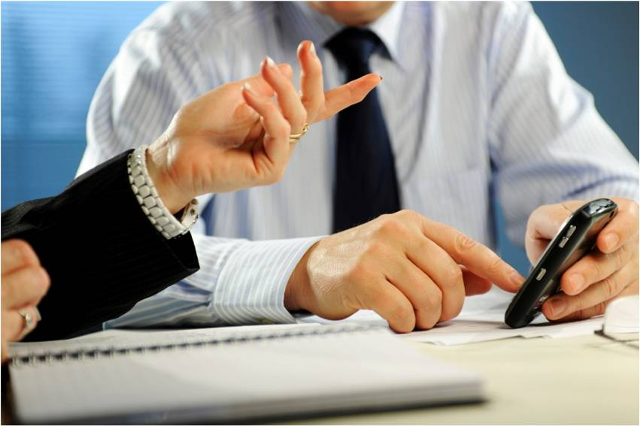
What are Mobile Devices
Notes:
In the context of this lecture, when we refer to mobile devices, we are talking about handheld computers, tablets, smart phones, etc. Basically, any device that allows doctors or nurses the ability to access information, or software applications, wherever they are.

Slide 6
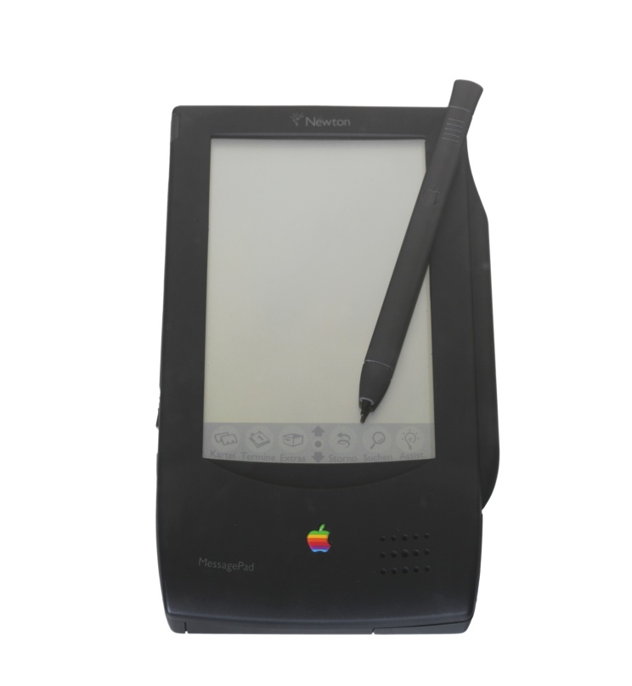
Growth in Use of Mobile Devices
1993: Apple launched the Newton Message Pad
Photo by P. Christopher Staecker
Notes:
In 1993, Apple corporation launched the Newton Message Pad. A device that was clearly ahead of its time – because it resembles the more popular devices in use today. Even though it wasn’t very popular, the Newton’s release marked the beginning of the mobile computing era.

Slide 7
Growth in Use of Mobile Devices 2
1993: Apple launched the Newton Message Pad
2002 to 2008: 17.8% annual increase in mobile devices being sold
Source: (“Worldwide PDA”, 2008)
Notes:
It took almost a decade until the growth of mobile devices, such as the original Newton, began selling at a significant pace. Devices including the Palm Pilot, the Sony Clie, and other popular devices of the early to mid 2000’s were experiencing 17.8% annual increases in sales.

Slide 8
Growth in Use of Mobile Devices 3
2008: 17 million mobile devices sold
Source : (“Worldwide PDA,” 2008)
Notes:
By 2009, 17 million mobile devices were being sold worldwide… annually. If I had to guess, many of you listening to this presentation probably own an iPhone, or some other similar device. Clearly, mobile devices are increasingly very common.

Slide 9
Software for Mobile Devices
Drug reference
Notes:
So, what type of software would be helpful on a physician’s mobile device?
The first, are drug reference programs. Considering the sheer number of medications that a provider may prescribe in a given day, and the sheer number of new drugs that keep coming to market, many physicians regularly check drug reference books. In the past, these books were dictionary sized manuals that were not convenient to carry around. With the advent of mobile devices, every doctor and nurse can have up-to-date information available at their finger tips.
Important information to look up may include the correct dose, route, or medical contraindications. Importantly, sometimes a given drug shouldn’t be given while a patient is already taking a different drug. In such a case, an interaction may occur. Looking up a possible drug interaction is something that is done with the help of a drug reference program.

Slide 10
Software for Mobile Devices 2
Medical reference
Notes:
Just like needing to look up drug information, doctors and nurses may need access to medical reference material about a given condition or symptom. This may include needing to look up the latest treatment recommendations for asthma, depression, or persistent cough.

Slide 11
Software for Mobile Devices 3
Medical calculators
Notes:
Another very useful purpose for mobile devices is the ability to perform medical calculations. Many drugs, especially for children or the elderly, need to be dosed according to the patient’s weight. In such cases, having a handy calculator function can reduce the chances of errors.

Slide 12
Software for Mobile Devices 4
Patient data (documentation and lookup)
Notes:
Being able to access or document patient information, or at least access information, is also very beneficial when “on the go.” Many times, patient lab reports or other information may not be physically available in the paper chart yet… but may be accessed electronically via a mobile device.

Slide 13
Software for Mobile Devices 5
Coding and billing
Notes:
Mobile devices can also provide guidance to clinicians about how to code a given patient encounter. Coding is important because, based on the level of difficultly, or amount of time a physician spends with a patient, a different code for billing purposes may be appropriate. Without some algorithm or computational assistance, it is possible for the provider to under-code… resulting in less reimbursement than they are entitled to.

Slide 14
Software for Mobile Devices 6
Calendar functions
Notes:
An obviously simple function available on a mobile device is the calendar feature. Physicians typically see many patients in a given day and being able to keep track of appointments is helpful. After all, many of us use our smart phones for the exact same purpose.

Slide 15
Software for Mobile Devices 7
Electronic prescribing
Notes:
Lastly, mobile devices can be used for clinical functions such as electronic prescribing. Clearly, many clinical functions lend themselves well to the handheld device platform, but electronic prescribing is particularly useful when “pull down menus,” and preselected lists of drugs make prescribing from the point of care effortless.

Slide 16
Mobile Devices in Medicine
1995: ~90% of physicians say they would consider carrying a mobile device
Source: (Ebell, et al., 1997)
Notes:
Now that we know some of the reasons that physicians may want to use mobile devices in health care settings, let’s examine their use of such devices.
In 1995, a small study of physicians in Michigan found that a high percentage of physicians would be interested in carrying a mobile device to support their clinical responsibilities.

Slide 17
Mobile Devices in Medicine 2
Physician users
1999: 15%
2001: 26%
    But higher rate among internists (47%)
    Even higher among residents (75%)
Sources: (Taylor & Leitman, 2001, ACP-ASIM, 2001,
Barrett, et al., 2004)
Notes:
A series of Harris Interactive surveys of US physicians, reported upon by Taylor and Leitman, found that the number of physicians using mobile devices increased from 15% in 1999 to 26% in 2001.
Several other studies of specific physician groups in 2001 found higher rates of mobile device use among internists (47%) and the highest rate among residents– that is, physicians in training (75%)

Slide 18
Mobile Devices in Medicine 3
2005: 37%
Source: (Menachemi & Brooks, 2006)
Notes:
By 2005, authors Menachemi and Brooks reported that 37% of physicians in Florida were using mobile devices to support clinical care.
Today, the overall rate is even higher. But we are certainly not at the level of interest in mobile devices reported in 1995.

Slide 19
Drawbacks of Early Devices
Early mobile computers
  Slow processors
  Little memory
  Short battery life
  Poor handwriting recognition made data entry difficult
Notes:
So the main disconnect between the 90% of doctors who in 1995 said they would consider using a mobile device– and the 37% in 2005 who actually did… has something to do with the drawbacks of early devices.
We take for granted the fact that, today, our smart phones fit neatly in our pockets. Earlier versions of these devices were not as sleek. They were relative large compared to today’s pocket-sized computers. In addition, early devices were slow and had little memory and ability to multitask… making them less desirable.
Another big issue was battery life. For a busy clinician to find maximum use from a device, it needed to last all day on a single charge. In the clinics, there is no time for the “down time” associated with needing to recharge batteries. Early devices only lasted an hour or two with continuous usage… clearly not acceptable for an 8-10 hour shift.
Lastly, before the evolution of functional keyboards and other input mechanisms, early devices relied on poor handwriting recognition for data input. This made early devices very cumbersome to use.

Slide 20
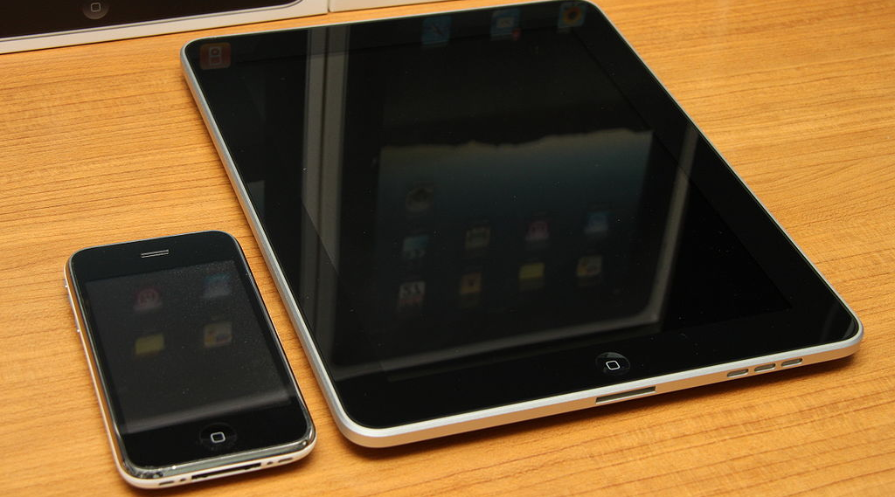
Modern Devices
Photo by Yutaka Tsutano
Notes:
Since then, modern devices have overcome most of the issues associated with slow processors, the inability to multi-task, insufficient battery life, and, of course, no longer relying on handwriting recognition.

Slide 21

Benefits of Using Mobile Devices
Cost savings
Source: (Lu et al., 2003)
Notes:
Once physicians started using mobile devices at higher rates, researchers began documenting the benefits of this use.
In a review article by Lu et al. several benefits of using mobile devices were outlined.
The first benefit was in terms of cost savings. Several researchers were able to calculate the cost savings associated with using mobile devices. In some cases, the cost savings were significant.

Slide 22

Benefits of Using Mobile Devices 2
Education effectiveness
Notes:
Several researchers have found that mobile devices, especially if equipped with decision support tools, help clinicians better practice (and learn) evidence-based medicine. It has also been shown that when clinicians incorporate the use of their mobile device with their patients (for example, showing the patient a diagram depicting their condition) patients are better able to understand what is wrong with them.

Slide 23
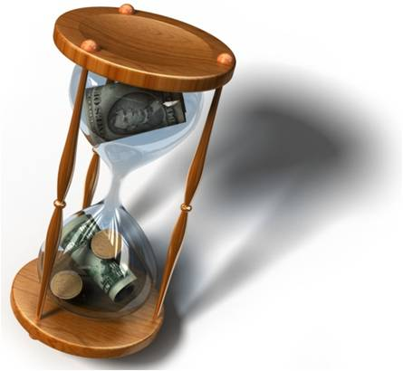
Benefits of Using Mobile Devices 3
Time savings
Notes:
Being able to access information without having to run back to a centralized location makes clinical decision-making more efficient. If you count up the times someone has to run back and forth from a desktop computer or to a reference library– that amount of wasted time could have been used to see another patient.

Slide 24

Benefits of Using Mobile Devices 4
Error reduction
Notes:
As discussed previously, utilizing medical calculators- or some other decision support tools such as pointing out drug interactions or contraindications can help prevent errors.

Slide 25

Benefits of Using Mobile Devices 5
Clinical impact
Notes:
Lastly, there is a growing body of literature that has found that the clinical outcomes of patients can be improved when their doctors have access to more, and more complete, information via a mobile device.

Slide 26

Physician Characteristics
What type of doctors traditionally use mobile devices?
  Young age
Source: (Garritty & El Emam, 2006)
Notes:
So what are some physician characteristics associated with the use of a mobile device in medical practice?
First, not surprisingly, younger doctors are more likely to use mobile devices. This is similar to the fact that younger people in society are more likely to use electronic gadgets in general.

Slide 27

Physician Characteristics 2
Students and residents
Source: (Garritty & El Emam, 2006)
Kevin McKidd Online
Notes:
Medical students and physician residents– doctors still in training– are also more likely to use mobile devices… but those in training tend to be younger as well.

Slide 28

Physician Characteristics 3
No difference by gender
Source: (Garritty & El Emam, 2006)
Notes:
Many studies also found that there were no differences by gender in terms of whether males or females are more likely to use mobile devices in medical practice.

Slide 29

Physician Characteristics 4
Primary care specialty
Source: (Menachemi, et al., 2006)
Notes:
In one particular study that focused on physicians in Florida, Menachemi and colleagues found that family physicians were not, overall, more likely to use a mobile device. However, when they did, they utilized a more robust set of features. This may be because primary care physicians see a wide-range of patients, and for the device to be useful, it needs to have a lot of capabilities.

Slide 30

Physician Characteristics 5
Urban physicians
Source: (Carroll & Christakis, 2004)
Notes:
Lastly, one study found that doctors in urban settings were more likely than doctors in rural settings to report using a mobile device. It is interesting to note that the relative inexpensiveness of mobile devices– and the lack of need for an IT infrastructure– makes the benefits of such a device applicable to rural and urban settings alike.

Slide 31
History of Mobile Computing
Summary
Mobile devices
  Cheap, easy to use, but also have more security vulnerabilities to loss and theft
    Need to be encrypted to prevent unauthorized access
  From stand alone units to networked computers
Notes:
This concludes the History of Mobile Computing.
In summary, mobile devices were originally seen as a way to get medical software and access to reference material in the hands of clinicians without the need for a robust health IT infrastructure. Mobile devices were cheap, easy to use, and as their screens got clearer, and their batteries longer lasting– many physicians began using them in the medical practice.
As our health care system moves to ubiquitous EHR systems and universal health information exchange, it is likely that mobile devices will become networked computers able to access real-time information enabling improved decision making in the clinics.

Slide 32
History of Mobile Computing
References
References
  ACP-ASIM survey finds nearly half of US members use handheld computers [Internet]. ACP-ASIM Press Release. 2001 Oct. Available from: www.acponline.org
  Barrett JR, Strayer SM, Schubart JR. Assessing medical residents’ usage and perceived needs for personal digital assistants. Int J Med Inform. 2004;73(1):25-34.
  Carroll AE, Christakis DA. Pediatricians' use of and attitudes about personal digital assistants. Pediatrics. Feb 2004;113(2):238-242.
  Ebell MH, Gaspar DL, Khurana S. Family physicians’ preferences for computerized decision-support hardware and software. J Fam Pract. 1997;45(2)137-41.
  Garritty C, El Emam K. Who's using PDAs? Estimates of PDA use by health care providers: a systematic review of surveys. J Med Internet Res. 2006;8(2):e7.
  Lu YC, Lee JK, Xiao Y, Sears A, Jacko JA, Charters K. Why don't physicians use their personal digital assistants? AMIA Annu Symp Proc. 2003:405-404.
  Menachemi N, Brooks RG. EHR and other IT adoption among physicians: results of a large-scale statewide analysis. Journal of Healthcare Information Management. 2006;20(3):79-87.
  Menachemi N, Perkins R, Van Durme D, Brooks R. Examining the adoption of EHR and PDA use by family physicians in Florida. Informatics in Primary Care. 2006;14(1):1-9.
  Taylor H, Leitman R. Physicians’ use of handheld personal computing devices increases from 15% in 1999 to 26% in 2001. Harris Interactive. 2001 Aug 15;1(25):1-4.
  Worldwide PDA & Smartphone Forecasts Report: 1998-2008. eTForecasts [Internet]. Arlington Heights, IL. Available from: www.etforecasts.com WebCite Cache
Notes:
“No Audio”

Slide 33
History of Mobile Computing
References 2
Images
  Slide 6: Staecker, P. Christopher. Newton message pad, Available from: commons.wikimedia.org
  Slide 20: Photo by Indiemon, cell phone, Available from: commons.wikimedia.org
  Slide 27: Courtesy of Dr. Lee Todd Miller. Available from: www.flickr.com
  Slide 28: Courtesy of DocPlanner. Available from amazonaws.com
  Slide 29: Available from wikispaces.com
  Slides 4, 5, 21, 22, 23, 24, 25, 26, 30: Clip Art, Available from: Microsoft clips online. Used with permission from Microsoft.
Notes:
“No Audio”

Slide 34
History of Health IT in the US
History of Mobile Computing
This material was developed by the University of Alabama at Birmingham, funded by the Department of Health and Human Services, Office of the National Coordinator for Health Information Technology under Award Number 90WT0007.
Notes:
No Audio.

