Slide 1
History of Health Information Technology in the U.S.
History of Privacy and Security Legislation
Lecture c – HITECH Privacy and Security Regulations
This material (Comp 5 Unit 10) was developed by the University of Alabama at Birmingham, funded by the Department of Health and Human Services, Office of the National Coordinator for Health Information Technology under Award Number 90WT0007.
This work is licensed under the Creative Commons Attribution-NonCommercial-ShareAlike 4.0 International License. To view a copy of this license, visit http://creativecommons.org.
Notes:
Welcome to History of Health Information Technology in the US, History of Privacy and Security Legislation. This is lecture c, HITECH Privacy and Security Regulations. This lecture will describe the changes that occurred in the HIPAA legislation as a result of the HITECH Act.

Slide 2
History of Privacy and Security Legislation Learning Objectives
Describe the major changes in privacy and security requirements as a result of HITECH and the reasons why the changes were needed
Notes:
The objectives for this lecture, HITECH Privacy and Security Regulations, are to describe the major changes in privacy and security requirements as a result of HITECH and the reasons why the changes were needed.

Slide 3
HIPAA 2003 to 2009
Confusion about requirements
  Protected Health Information (PHI)
Notes:
HIPAA introduced the concept of “protected health information” or PHI (pronounced P-H-I). This is health information that also includes identifiers that would allow someone to identify the person to whom the information belongs, such as the person’s name, Social Security number, photograph, etc.
When the HIPAA Privacy Rule first became mandatory, there was confusion on how strict it really was intended to be in its requirements to keep PHI confidential. Consultants and lawyers often painted a “worse case scenario,” frightening healthcare facilities about the possibilities of lawsuits if they did not make very strict policies. In fact, early on, there was talk about the need to soundproof all patient rooms so that conversations with patients would have no chance of being overheard. Over the years, most places realized that the regulations were intended to guide realistic, not extreme, methods of protecting the information.

Slide 4
HIPAA 2003 to 2009 2
Difficulties with enforcement
Notes:
However, there also were difficulties with enforcing the regulations. Originally, enforcement was divided between the Centers for Medicare and Medicaid Services or CMS (pronounced C-M-S) and the Office for Civil Rights or OCR (pronounced O-C-R). OCR handled privacy complaints, while CMS was responsible for the enforcement of the security regulations. This created inefficiencies. Even before HITECH was passed, OCR became responsible for both privacy and security enforcement, which improved the enforcement process. Today, OCR is responsible for both privacy and security enforcement.

Slide 5
HIPAA 2003 to 2009 3
Privacy advocates felt it was not strong enough
  Notice of privacy practices vs. consent
  No accounting of disclosures for “TPO”—Treatment, Payment and healthcare Operations
Notes:
In addition to the challenges of enforcement, other modifications over the years made many privacy advocates feel that the law was not strong enough.
For instance, patients had to be provided with a notice of privacy practices that the healthcare facility followed. Patients had to indicate that they received the notice, but did not have to provide explicit consent to the practices.
Privacy notices usually stated that the information could be shared for what is referred to as “T-P-O.” That is, information could be shared with doctors for Treatment (that’s the T), Payment (the P) to insurance companies, and for healthcare operations, such as quality improvement activities. Patients did not have to be notified when such sharing for TPO occurred.

Slide 6
HIPAA 2003 to 2009 4
Some well-publicized breaches
Notes:
Finally, over the years since 2003 there have been a number of breaches, that is, where the information security was compromised or the information was not kept secure.

Slide 7
Examples of Breaches
Medical records on the Web
Source: (Privacy Rights Clearinghouse, 2005)
Notes:
There was one case where medical records from a large university medical center somehow had been put on the Web and remained there for several months before it was discovered. There was no evidence that anyone had done anything with the information, but still, it was a major breach.

Slide 8
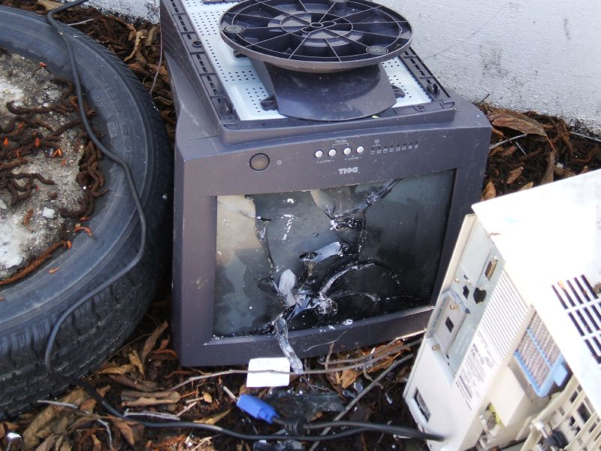
Examples of Breaches 2
Data on discarded computers
Photo by Daniel R. Blume
Notes:
There have been reports of medical records found on discarded computers or computers that were sold by hospitals as surplus.

Slide 9

Examples of Breaches 3
Lost or stolen
laptops
Photo by David Weiss
Notes:
There have also been reports of medical records being kept on portable devices such as external hard drives or laptops that have been lost or stolen.
The picture shows a notebook computer with a variety of portable storage devices. You can see that with the small size and easy portability of modern devices it would be very easy to have problems. As we discussed in the previous lecture, there are recommended best practices for security that include having clear policies, attending to physical security of the devices on which the information is stored, and encrypting all PHI. Unfortunately, in many of the cases of breaches, those practices were not followed.

Slide 10
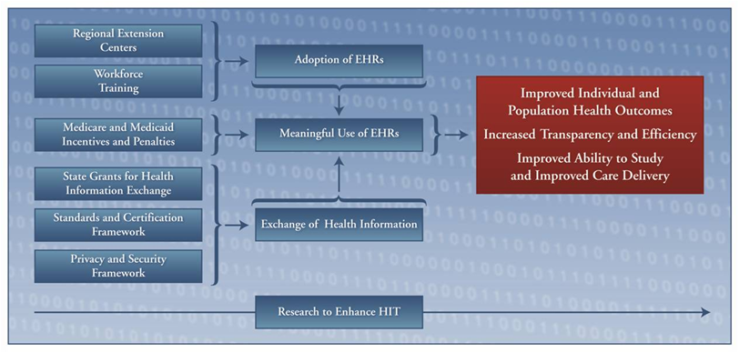
The HITECH Vision
Courtesy: Office of the National Coordinator for Health Information Technology
Notes:
As we said about the rationale behind the HIPAA rules and the philosophy embodied in the recommendations in “For the Record,” strong, but do-able, privacy and security recommendations are going to be needed to realize the vision embodied in the HITECH Act.
That is, a key part of HITECH is to promote the electronic exchange of health information and for the public and health professionals to be supportive of that exchange, there must be a good framework for privacy and security. The HITECH requirements embody the same rationale as the original HIPAA legislation, but the specifics will require significant changes in many current practices.
These specifics are determined by the government after review by key stakeholders. Initially there is a Notice of Proposed Rulemaking, where interested parties can comment on the plans for the actual rule before it is finalized. Often , as is the case with the HIPAA changes as a result of HITECH there is an Interim Rule in effect while the rules are being finalized.

Slide 11
HITECH Changes to HIPAA
Covered Entities
  Health plans, healthcare providers, and healthcare clearinghouses
Notes:
One of the changes in the HITECH Act relates to who is required to comply with the HIPAA rules. The term “covered entities” refers to organizations that are required to comply with the HIPAA rules. The original HIPAA rules considered covered entities to be health plans (for instance the insurance companies who pay the claims for a patient’s medical bills), healthcare providers (such as doctors, hospitals, pharmacies, et cetera) and healthcare clearinghouses, which often work with health plans or providers to facilitate billing, or provide other services.

Slide 12
HITECH Changes to HIPAA 2
Covered Entities
  Business Associates
Source: (Federal Register, 2010)
Notes:
There are other people who work with covered entities who are called business associates. Business associates could be, for instance, an outside IT vendor who works with the hospital on its EHR. Under the original HIPAA rules business associates were not directly covered, although hospitals had to draw up agreements with their business associates to assure that the rules would be followed. As described in the Notice of Proposed Rule-making related to the HITECH changes, “in the area of business associates, the Act makes a number of changes. First, section 13401 (pronounced 1-3-4-0-1) of the Act applies certain provisions of the Security Rule that apply to covered entities directly to their business associates and makes business associates liable for civil and criminal penalties for the failure to comply with these provisions. Similarly, section 13404 makes business associates of covered entities civilly and criminally liable under the Privacy Rule for making uses and disclosures of protected health information that do not comply with the terms of their business associate contracts. The Act also provides that the additional privacy and security requirements of subtitle D of the Act are applicable to business associates and that such requirements shall be incorporated into business associate contracts.”

Slide 13
HITECH Changes to HIPAA 3
Covered Entities
  Business Associates
    Subcontractors
      Subcontractors
        Subcontractors…..
Source: (Federal Register, 2010)
Notes:
When the final rule came out in January of 2013, it said that HIPAA will apply directly, not only to a covered entity’s business associates , but to the business associate’s subcontractors and the suboncontractors’ subcontractors and so on, all the way down the line.

Slide 14
HITECH Changes to HIPAA 4
Covered Entities
  Business Associates
    Health Information Exchanges (HIE)
    Regional Health Information Organizations (RHIOs)
    Personal Health Record (PHR) vendors
    E-prescribing Gateways
    Quality Monitoring Organizations
Notes:
The HITECH legislation also includes specific language that includes other entities as business associates. These include: Health Information Exchanges, that is, HIEs (pronounced H-I-Es), and regional health information organizations or RHIOs (pronounced Rio’s), Personal Health Record vendors, e-prescribing Gateways and Quality Monitoring organizations. They therefore now are responsible for compliance. The legislation also clearly states that all entities entering into a health agreement must have a business associates agreement. This would apply to physician practices as well as other healthcare entities.

Slide 15
HITECH Changes to HIPAA 5
Minimum necessary
Notes:
The original HIPAA regulations stated the covered entity must always use the “minimum necessary” amount of PHI to conduct a function or work task.
Under the HITECH act, this discretion will be limited by future rule making. Although the January 2013 rule did not clarify it any further, it is expected that future guidance will provide more clarification.

Slide 16
HITECH Changes to HIPAA 6
Accounting of Disclosures (AOD)
Notes:
HITECH places new restrictions and requirements on covered entities for accounting of disclosures. The accounting of disclosures would be a listing of any information that was released, to whom, and when it was released.
In the original regulations, covered entities had to provide an accounting of disclosures of patient information on demand. That is, they did not routinely do it, but if the patient requested it, they would give the information regarding to whom the patient’s information had been disclosed. However, previously those disclosures made for the purposes of T-P-O, or Treatment or Payment and Healthcare Operations did not have to be tracked or provided to the patient.

Slide 17
HITECH Changes to HIPAA 7
Accounting of Disclosures (AOD)
  Required for TPO
Notes:
Many privacy advocates felt that not reporting those TPO disclosures violated the principle of consumer control. Now new rules are being proposed for Accounting of Disclosures, or AOD (pronounced A-O-D). Under these proposed regulations, if there are disclosures through an electronic health record, the covered entity must track all disclosures, including the ones for TPO. The specific requirements related to AOD are not in the final rule, but a later guidance will provide clarification.

Slide 18
HITECH Changes to HIPAA 8
Accounting of Disclosures (AOD)
  Restrictions on disclosure
Notes:
In addition, in the original HIPAA regulations, covered entities had the choice to honor patient requests for certain restrictions. Under the new rules, as clarified by the HIPAA Omnibus rule, all covered entities must honor the individual’s request to restrict a disclosure to a health plan if the patient or the patient’s representative is paying out-of-pocket for treatment. Out-of-pocket means that the insurance company is not paying for the visit and the patient pays for the services themselves with cash, check, or credit card. The patient must make the request at time of presentation for treatment.

Slide 19
HITECH Changes to HIPAA 9
Patients’ rights to electronic copy of their PHI
Notes:
If a healthcare organization is using an electronic medical record, HITECH grants patients the right to request an electronic copy of their own information. This component of the legislation also states that, if the entity has that capability, the entity must transfer the information directly to other entities if requested to do so by the patient. The final rule presents details of how patients can receive an electronic copy of their record and how they may designate a third party to receive a copy.

Slide 20
Challenges
Tracking disclosure for TPO
Notes:
Accounting for some disclosures can be quite complex. Organizations with multiple electronic record systems will have an extremely difficult time complying with the requirement to track all disclosures related to TPO. These types of organizations typically have electronic medical records that are fed by complex independent systems (such as lab, radiology, etc.) making the tracking difficult.

Slide 21
Challenges 2
Restrictions on disclosure
Notes:
Restricting disclosure to insurance companies can also be difficult.
Consider an office practice that uses e-prescribing programs. With these programs, a physician enters the prescription into the system and typically, the prescription is sent electronically to the patient’s pharmacy.
What if the patient requests to pay in cash when they present at the doctor’s office and the physician writes an electronic prescription during the course of treatment?
Now two healthcare entities are involved. The pharmacy may proceed to “fill” the prescription and, in most cases, would probably use their computer to apply the cost to the patient’s insurance carrier, especially because they were not directly informed not to disclose. It is the patient’s responsibility to request a restriction to each covered entity for services for which they pay in full out of pocket.
This is only one example of the complexity of these restrictions and the final rule includes some very specific things that can and cannot be done in regard to this aspect of disclosure. Compliance with this new requirement will likely result in the complete re-evaluation of how work is done not only within, but between, healthcare providers.

Slide 22
Challenges 3
Providing patients with their information
  Must still be protected
  Patients should be educated
Notes:
Providing patients with electronic copies of their records requires that the healthcare organization comply with the appropriate safeguards for transferring this information. One way to do this is through a patient portal, where the patient can view and/or download the information to their computer or media of their choice. If the patient requests an unencrypted copy of their records, say by email or on a flash drive, the organization can provide it, but, before doing so, the organization needs to educate the patient regarding the risks of unencrypted PHI (pronounced P-H-I).

Slide 23
Challenges 4
Breach notification/reporting
  Unauthorized access to protected health information (PHI)
Notes:
Another challenging area in the new rule involves requirements for reporting breaches of information security. In the final rule, if there is unauthorized access to protected health information it is assumed to be a breach unless a risk assessment shows that there is a low probability that the protected health information has been compromised (or one of the other exceptions to the definition of breach applies).An example of a low probability that the data were compromised might be if patient information were sent to a wrong patient by mistake but the address was wrong so the mail was returned by the post office unopened. The new breach laws apply to both paper and electronic systems.

Slide 24
Breaches
Safe Harbor (not reportable)
  Secured PHI (Unreadable, unusable or indecipherable)
    Encryption
    Destruction
  Inadvertent access by authorized individuals
Unsecured information – notification
Notes:
Although the focus is on notification and reporting, there is also what is called a “safe harbor” for some information. That is, breaches of certain information do not need to be reported.
Breaches of secured information, that is, information that is unreadable, unusable or indecipherable to unauthorized individuals by either encryption or destruction, are not reportable. Also certain inadvertent breaches by authorized individuals are not reportable.
The major challenges are in the notification requirements for unsecured information.

Slide 25
Breach Notification
Notification requirements
  Individual
  Media (>500)
  DHHS
    500 or more—automatic posting on DHHS website
Increase in potential penalties
Interim final rule effective September 23, 2009
Notes:
The notification requirements are quite strict. Not only must individuals be notified promptly, but if more than 500 individuals are affected, the institution must notify the media serving that state or jurisdiction (and you can just imagine how a healthcare provider will feel to see their information security problems on the front page of the local paper!).
In addition they must maintain a log of breaches and report them annually to the government, specifically the Department of Health and Human Services or DHHS (pronounced D-H-H-S), as it is abbreviated. However, if a breach involves 500 or more individuals, they must notify DHHS at the same time they are notifying the individuals and the media. These breaches will be posted automatically on the DHHS website.
Finally, there is also an increase in potential penalties.
The interim final rule was effective September 23, 2009 and it was expected that a final rule would be announced after a short comment period. In fact, DHHS had a final rule all prepared, but in 2010 they decided it needed more work. As with the original HIPAA regulation there were a huge number of comments and they were often conflicting. One major area where there was conflict was on how to deal with the idea of harm from the breaches.

Slide 26
Harm to Patients from Breaches
“Significant risk of financial, reputational or other harm”
Who decides? How much is significant?
Notes:
The interim rule stated that breaches needed to be reported if there was “significant risk of financial, reputational or other harm.” Healthcare facilities were expected to assess the degree of harm from any breaches, but there was disagreement as to whether they were the best people to make that decision.
Also, it is difficult to determine how much harm is “significant.”

Slide 27
Harm to Patients from Breaches 2
Differing views
  Healthcare organizations
  HHS
  Privacy advocates
  Congress
Notes:
There were many different views on those questions. Healthcare organizations already felt that the new rules were a burden. The Department of Health and Human Services felt that it might be a burden to patients to notify them every time a minor breach occurred especially one that clearly did not cause harm, while privacy advocates felt that the notification was very important. And Congress, which passed the HITECH Act, felt that their intent was to strengthen the existing laws and did not want changes to what they had passed without their involvement.

Slide 28
Data Compromise
Final Rule effective March 26, 2013
Data compromise rather than harm
Unauthorized use or disclosure assumed to be a breach unless low risk of compromise
Risk assessment
  Type and amount of PHI
  Who had access to the PHI
  Whether PI was actually viewed
  Risk mitigation
Notes:
When the final rule came out at the beginning of 2013, there was a major change to the standard for breach notification. Rather than focusing on the risk of harm to the patient, the focus is now on whether the data were compromised. The Final Omnibus Rule again calls for a risk assessment, as was included in the interim final breach notification rule, but now the risk assessment is to determine the likelihood that compromise had occurred and the rule specifies what type of information must be included in the risk assessment. The information includes the type and amount of PHI, including the identifiers and the risk of re-identification, who had access and the likelihood that they actually viewed the PHI, and finally what was done to mitigate the risk once the problem was discovered.
Like the original HIPAA regulations, it is likely there will be other clarifications and modifications over the years as we get more experience with the benefits and burdens of these new rules.

Slide 29
History of Privacy and Security Legislation
Summary
Confusion about some HIPAA rules
Breaches and other problems
Health Information Exchange needs strong privacy protections
HITECH clarified and expanded the HIPAA Privacy and Security Rules
Notes:
This concludes History of Privacy and Security Legislation. In summary, when the HIPAA regulations first became mandatory, there was confusion about the requirements, there were security breaches and there were some difficulties with enforcement of the rules. To make health information exchange safe, the HITECH Act expanded and clarified the privacy and security rules of HIPAA.

Slide 30
History of Privacy and Security Legislation
References
References
  Privacy rights clearinghouse. Chronology of data breaches; security breaches, 2005 – present [Internet]. San Diego (CA); 2005 Apr 20 [updated 2011 Dec 26]. Available from: www.privacyrights.org
  Federal Register, Department of Health and Human Services; 45 CFR Parts 160 and 164; modifications to the HIPAA Privacy, Security, and Enforcement Rules Under the Health Information Technology for Economic and Clinical Health Act; Proposed Rule; 2010. Available from: www.hhs.gov
  Federal Register, Department of Health and Human Services; 45 CFR Parts 160 and 164; modifications to the HIPAA Privacy, Security, and Enforcement , and Breach Notification Rules Under the Health Information Technology for Economic and Clinical Health Act and the Genetic Information Nondiscrimination Act; Other Modifications to the HIPAA Rules; Final Rule, 2013. Available from: www.gpo.gov
Images
  Slide 8: Daniel R. Blume CC BY-SA 2.0. Available from: www.flickr.com.
  Slide 9: David Weiss, Personal Collection.
  Slide 10: Courtesy of the Office of the National Coordinator for Health Information Technology. Available from: healthit.hhs.gov
Notes:
“No Audio”

Slide 31
History of HIT in the US
History of Privacy and Security Legislation Lecture c
This material was developed by the University of Alabama at Birmingham, funded by the Department of Health and Human Services, Office of the National Coordinator for Health Information Technology under Award Number 90WT0007.
Notes:
No Audio.

