Slide 1
History of Health Information Technology in the U.S.
History of Privacy and Security Legislation
Lecture a – Background of HIPAA
This material (Comp 5 Unit 10) was developed by the University of Alabama at Birmingham, funded by the Department of Health and Human Services, Office of the National Coordinator for Health Information Technology under Award Number 90WT0007.
This work is licensed under the Creative Commons Attribution-NonCommercial-ShareAlike 4.0 International License. To view a copy of this license, visit http://creativecommons.org.
Notes:
Welcome to History of Health Information Technology in the US, History of Privacy and Security Legislation. This is lecture A, Background of HIPAA (pronounced HIP-uh). As we move to keeping more and more healthcare information in electronic form, the issue of ensuring the security of that information becomes critical. This presentation will review key recommendations related to privacy and security of healthcare information. We begin this lecture with definitions of the key terms of privacy, confidentiality and security and move on to a discussion of the background for the HIPAA legislation and in particular the HIPAA Privacy and Security Rules. Many of you have heard the term HIPAA and we will discuss what it means later in this presentation but although it has had a huge impact, please note that, the legislation has one P and Two A’s, unlike the hippo which has two P’s.

Slide 2
History of Privacy and
Security Legislation
Learning Objectives
Explain the differences among the terms privacy, confidentiality and security
Discuss the reasons why the administrative simplification provisions were attached to the original HIPAA legislation.
Explain the five principles underlying the HIPAA privacy and security rules
Discuss the reasons why the privacy rule was an action of the executive, not the legislative, branch of the federal government
Notes:
The objectives of this lecture, Background of HIPAA, are to:
Explain the differences among the terms privacy, confidentiality and security
Discuss the reasons why the administrative simplification provisions were attached to the original HIPAA legislation.
Explain the five principles underlying the HIPAA privacy and security rules.
Discuss the reasons why the privacy rule was an action of the executive, not the legislative, branch of the federal government.

Slide 3
Definitions
Privacy
Confidentiality
Security
Notes:
Let’s begin with the definitions. As with any definitions, there are often differences in how different people use the same words. I am going to give you definitions that make clear distinctions between the concepts of privacy, confidentiality and security, but you will find that others sometimes have slight variations on these definitions or use the words interchangeably. What is important is that we attend to the concepts behind the terms.

Slide 4
Definitions 2
Privacy
  The right to be left alone
  The right to keep personal information secret
  The right to control personal information
Notes:
Privacy refers to the right to be left alone and to keep personal information secret. The focus is on the individual control of the information.

Slide 5
Definitions 3
Confidentiality
  Sharing or disseminating data only to those with a “need to know”
Notes:
Confidentiality relates to sharing information with a focus on sharing information only to those individuals who have a “need to know.” So in healthcare, the patient may share personal information with the physician, but the physician must keep that information confidential.

Slide 6
Definitions 4
Security
  Mechanisms to assure the safety of data and systems in which the data reside
Notes:
Security refers to the mechanisms to assure the safety of data and the systems in which the data reside. So if healthcare information must be kept confidential, mechanisms must be in place to assure that only those with the need to see it can access it. In the abstract, security does not only refer to electronic information, although as you will see, following the recommended security practices are sometimes much easier to implement and monitor with electronic information. In the HIPAA rules, there are very specific definitions of security, so the meaning may depend on the context. Let’s look now at the background of HIPAA to see how these principles are embodied in the HIPAA rules.

Slide 7
Health Insurance Portability and Accountability Act
Kennedy-Kassebaum bill (1996)
Public Law 104-191
Administrative Simplification and Privacy Provisions
Notes:
The acronym HIPAA stands for the Health Insurance Portability and Accountability Act, which is also known as the Kennedy-Kassebaum (pronounced CASS-uh-Bowm) Act, or K2 (pronounced Kay-2), and is officially known as Public Law 104-191. Some people think the entire HIPAA legislation deals with insurance portability issues, and others think it refers only to privacy of health information. Actually the main act does relate to portability issues, but there is a small provision known as the “administrative simplification provision” that deals with privacy.

Slide 8
HIPAA
Improve efficiency of healthcare
Standards for electronic transmission of healthcare information
Notes:
The purpose of this provision is to improve the efficiency of those transactions that are part of the larger legislation. If people are going to be able to transfer their health insurance, there has to be a way to efficiently transfer their health information as well. And we know that much of that transfer is going to be electronic. Standards, both technical and policies, can make this transfer more efficient and effective. So the original legislation was designed to refer to the transfer of electronic information.

Slide 9
HIPAA 2
Privacy of information must be assured
  Deadline (8/1999) for Congress to pass privacy/confidentiality legislation
    Defaults to Secretary of HHS to propose rule
    Secretary of HHS must report to Congress in 1997 on approach
Notes:
If that information is going to be kept and/or transferred in an electronic format, it is imperative that there be a means to assure that it is kept confidential and secure. Hence, the legislators knew that there also needed to be regulations relating to privacy, confidentiality, and security of the information. So they mandated that Congress pass laws relating to the privacy issue. Congress knew that these laws would be controversial and they knew if there were no privacy rules, the whole administrative simplification goals would not be able to be implemented.
Then Congress did an unprecedented thing. They gave themselves a deadline for the passage of these laws. They said that if they did not pass privacy legislation by August 1999 (three years from when the original legislation passed) the Secretary of Health and Human Services would be required to develop the rule, the same as for the other administrative simplification aspects. They also requested that the Secretary report to Congress in 1997 on the approach that such rule-making would take.

Slide 10
Privacy and Confidentiality
Pre-HIPAA
No national law for privacy/confidentiality of health information prior to HIPAA
Privacy Act of 1974
  Protected information held by the federal government
Joint Commission (accrediting agency for healthcare organizations)
  Information management standards include protection of confidential information
“Patchwork” of state laws
Notes:
You need to understand that prior to the implementation of the HIPAA Privacy Rule, there was no national law to protect your health information. There were ethical guidelines and accreditation guidelines, and state laws, but no national law that applied to all healthcare information.
The Privacy Act of 1974 only protected information held in federal government entities. This law did not apply to state or local governments.
The Joint Commission has information management standards that relate to protection of confidential information, but not all healthcare entities are covered by the Joint Commission and accreditation is a voluntary activity, so the standards are not laws.
The states have individual laws and the collection of laws has been referred to as a “patchwork” because the differences in the laws were like a patchwork quilt with all different “squares,” or laws, for each state.

Slide 11

State Laws
No comprehensive set of laws for access or disclosure
Condition-specific rules varied by state
Photo by Omaopio
Notes:
For instance, prior to HIPAA being enacted at the national level, many states did not have a comprehensive set of laws for access and disclosure of health information. They might have some condition-specific rules for sensitive conditions like cancer, sexually transmitted diseases or mental health information, but, like the quilt in the picture, there was little consistency across states.
So if we are talking about transmission of information across state lines, there really did need to be national standards. As requested by Congress, in 1997 the Secretary of Health and Human Services outlined the principles by which such standards should be developed.

Slide 12
Principles Underlying
HIPAA Privacy and Security Rules
Boundaries
Security
Consumer Control
Accountability
Public Responsibility
Source: (Shalala, 1997)
Notes:
Although the HIPAA Privacy and Security Rules that we know of today were not yet written, since this was 1997, the Secretary of Health and Human Services at the time, Donna Shalala (pronounced Sha-LAIL-la) outlined five principles that should guide the upcoming privacy legislation and that would underlie any government rules that might be written. The principles were Boundaries, Security, Consumer Control, Accountability, and Public Responsibility. Let me give you a brief overview of these principles.

Slide 13

Principles Underlying HIPAA Privacy and Security Rules 2
Boundaries
Photo by airunp
Notes:
Boundaries means that there should be boundaries around the uses of personally identifiable health information provided as part of a person’s seeking healthcare. Healthcare information should be disclosed and used for that purpose only. It can be disclosed to insurers since that allows the healthcare to be paid for, but should not be disseminated to others for purposes not directly connected to a person’s receiving healthcare. For instance, prior to HIPAA becoming operational there were lawsuits because some pharmacies had provided personal information about patients to pharmaceutical companies who used the information for advertising directly to the patients.

Slide 14
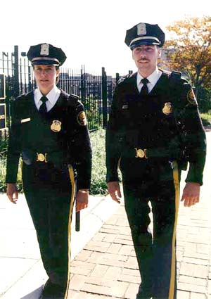
Principles Underlying HIPAA Privacy and Security Rules 3
Security
Notes:
The security principle requires that protected health information be safeguarded. This principle is now embodied in the HIPAA Security Rule that has detailed standards for protecting the confidentiality, integrity, and availability of information.

Slide 15
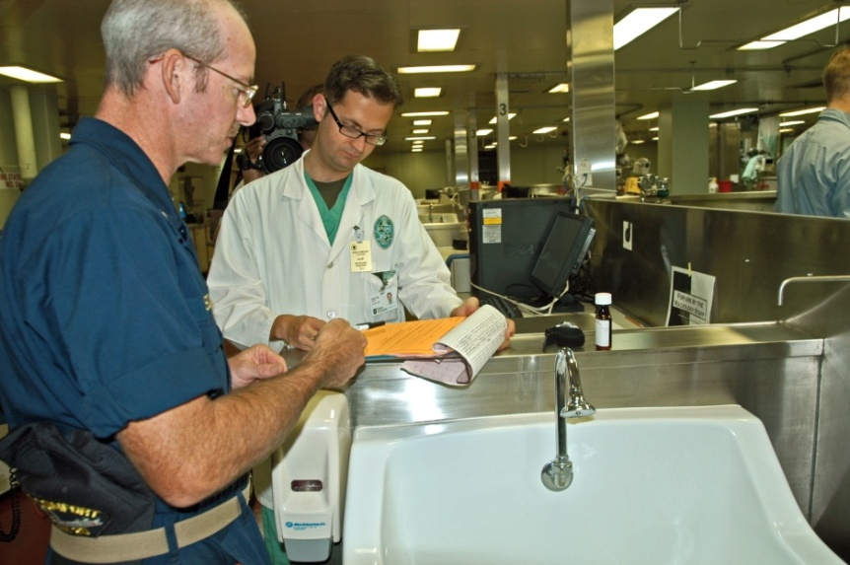
Principles Underlying HIPAA Privacy and Security Rules 4
Consumer Control
Photo by Win Henderson/FEMA
Notes:
Consumer control means that individuals should be able to know what is in their medical records, should be able to obtain copies of them, and should be able to correct errors if they discover them.

Slide 16
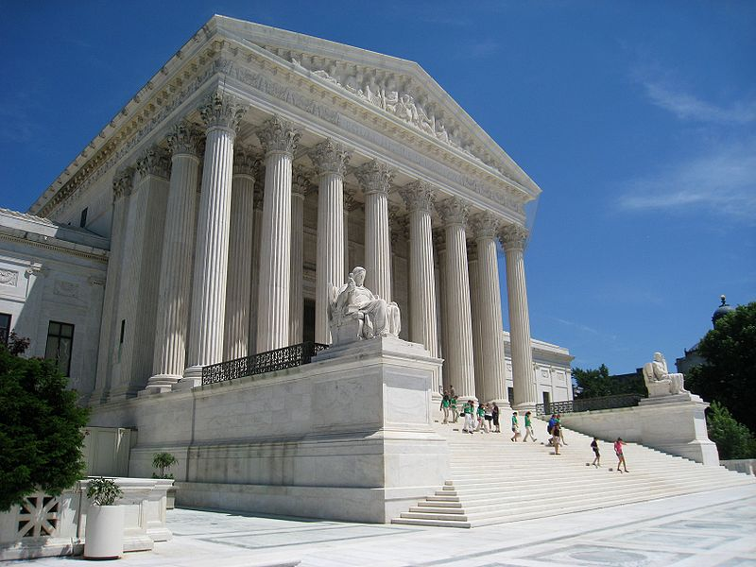
Principles Underlying HIPAA Privacy and Security Rules 5
Accountability
Photo by Daderot
Notes:
Accountability means that there should be punishments for violations of the rules. Most health professionals already have ethical guidelines relating to privacy and confidentiality, but if legislation is to be effective it has to have some teeth. And the proposed HIPAA sanctions that eventually came out indicated those teeth would be very strong.

Slide 17
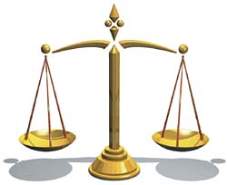
Principles Underlying HIPAA Privacy and Security Rules 6
Public Responsibility
Notes:
Finally, there needs to be a balance between the individual’s rights and the public’s needs. This is where much of the controversy in the legislation over the subsequent three years wound up, in terms of how to achieve that balance. Issues related to public health, fraud and abuse, monitoring quality of care, and research may need some of this information.
With that background, let’s look at what has happened with the privacy legislation.

Slide 18

HIPAA 1998 – Present
Controversies in privacy debate
  Floor or ceiling/floor
Source: (Tech Law Journal, 1999)
Photo by Jesse Loughborough
Notes:
First of all, Congress did not meet its own self-imposed deadline of August 1999 for passage of privacy legislation. Some of the areas where there was lack of agreement were on whether there needed to be a floor, or a ceiling and a floor, for the rules. A floor would mean that at a minimum, all states would have to follow the proposed legislation, but individual states were free to pass more stringent rules. They just could not pass less stringent rules. A ceiling and a floor means that not only were these essentially minimum rules, they were also the maximal amount of restriction that would be needed and states could not pass rules that were more strict.

Slide 19
HIPAA 1998 – Present 2
Controversies in privacy debate
  Patient consent restrictions
Notes:
Another controversial aspect related to patient consent for disclosure. Some of the proposed legislation said that any use of any patient data outside that needed for their direct health care would require consent. Other legislation brought in the principle of public responsibility and said there were some circumstances where that consent might be so impractical that research and quality improvement activities would be unable to be done.

Slide 20
HIPAA 1998 – Present 3
Congress failed to pass privacy legislation
Notes:
In part because of these debates, and because there were always two very strong constituent groups on opposite sides of the issues – privacy advocates and those such as pharmaceutical companies who wanted access to the information – Congress never passed any of the bills.

Slide 21
HIPAA 1998 – 2009
DHHS Privacy Rule Proposed— Fall, 1999
  Over 50,000 comments received
Source: (Tech Law Journal, 1999)
Notes:
Consequently, in the fall of 1999, the Department of Health and Human Services published its draft privacy rule for comments. And did they receive comments! Over 50,000 comments were received and possibly over 150,000, if you count multiple points being made by a single individual. All sides of the issue were heard from and it took quite a while to sort through those comments. Some of them were irate comments such as “Don’t mess around with my medical records” ostensibly from patients who didn’t realize that at the time there were much fewer privacy protections. Other comments were more thoughtful.

Slide 22
Privacy and Security Rules
Final Privacy Rule Published – December, 2000
  Modified several times
  Went into effect in April, 2003
Security Rule – 2005
Other changes over the years
Major changes in 2009 as a result of HITECH
Notes:
The final privacy rule was published in December 2000, underwent some modifications and went into effect April 2003. The HIPAA Security Rule went into effect in 2005. It embodies many of the information security best practices that came out of a 1997 report by the National Research Council. There have been several changes over the years since then, but a major change occurred when the HITECH Act was passed in 2009.

Slide 23
History of Privacy and Security Legislation
Summary – Lecture a
Differences among the terms privacy, confidentiality and security
Background of the administrative simplification provisions in the original HIPAA legislation
Five principles underlying the HIPAA Privacy and Security Rules
Passage of HIPAA Privacy and Security Rules
Notes:
This concludes lecture a of History of Privacy and Security Legislation. In summary, we have discussed the differences among the terms privacy, confidentiality and security and the background of the HIPAA legislation. This background includes administrative simplification provisions, the principles underlying the Privacy and Security Rules and the circumstances leading to the passage of these rules.

Slide 24
History of Privacy and
Security Legislation
References – Lecture a
References
  HHS announces proposed electronic medical records privacy regulations. Tech Law Journal [Internet]. 1999 Oct 30. Available from: www.techlawjournal.com
  Testimony on Health Insurance Portability and Accountability Act by the Honorable Donna E. Shalala
  Secretary, U.S. Department of Health and Human Services, before the Senate Committee on Labor & Human Resources. 1997 Sep 11. Available from: www.hhs.gov
Images
  Slide 11: Omaopio. Available from: commons.wikimedia.org.
  Slide 13: Airunp. Available from: commons.wikimedia.org.
  Slide 14: Available from: commons.wikimedia.org.
  Slide 15: Win Henderson/FEMA. Available from: commons.wikimedia.org.
  Slide 16: Dadero Available from: commons.wikimedia.org.
  Slide 17: Available from: commons.wikimedia.org.
  Slide 18: Jess Loughborough CC BY-NC-ND 2.0. Available from: www.flickr.com.
Notes:
“No Audio”

Slide 25
History of Health IT in the U.S.
History of Privacy and Security Legislation, Lecture a
This material was developed by the University of Alabama at Birmingham, funded by the Department of Health and Human Services, Office of the National Coordinator for Health Information Technology under Award Number 90WT0007.
Notes:
No Audio.

