Slide 1
Introduction to Computer Science
Information Systems
Lecture c
This material (Comp 4 Unit 8) was developed by Oregon Health & Science University, funded by the Department of Health and Human Services, Office of the National Coordinator for Health Information Technology under Award Number 90WT0001.
This work is licensed under the Creative Commons Attribution-NonCommercial-ShareAlike 4.0 International License. To view a copy of this license, visit http://creativecommons.org/licenses/by-nc-sa/4.0/.
Notes:
Welcome to Introduction to Computer Science: Information Systems. This ls lecture c.
The component, Introduction to Computer Science, provides a basic overview of computer architecture; data organization, representation and structure; structure of programming languages; networking and data communication. It also includes some of the basic terminology of computing.

Slide 2
Information Systems
Learning Objectives - 1
Define information system, explain its purpose, and provide examples
(Lecture a)
Describe the components of an information system (Lecture a)
Describe the process of information system development (Lecture b)
Notes:
The learning objectives for this unit, Information Systems are to:
Define an information system, how one is used and list examples
Describe the components of an information system
Describe the process for developing an information system

Slide 3
Information Systems
Learning Objectives - 2
Introduce specialized information systems (Lecture c)
Explain how information systems are used in health care (Lecture c)
Notes:
Describe specialized information systems
And explain how information systems are used in health care
This lecture focuses on specialized information systems and use of information systems in health care.

Slide 4
Specialized Information Systems
Knowledge Management
Expert Systems
Virtual Reality
Notes:
There are many specialized information systems employed by business, science, and medical institutions. Knowledge management systems attempt to generate and report knowledge in addition to data and information. An example of a knowledge management system would be a system collecting medical journal articles.
Expert systems use artificial intelligence and knowledge to provide solutions to problems.
Virtual reality systems perform simulations where users are immersed in the simulated, or virtual, environment. Virtual systems are widely used in health care for training, in surgery, and for telemedicine.

Slide 5
Expert Systems
Information system that makes decisions
Consist of
  Knowledge base
  Inference engine
  Interface
Notes:
Expert systems use user-provided rules and data to support decision making. They consist of three parts: a knowledge base, an inference engine, and an interface.
The knowledge base is the set of rules that the expert system knows.
The inference engine uses these rules to produce reasoning based on them. Often, the system needs additional input from the user during the reasoning process.
The user interface communicates information from and to the user.
Expert systems are used in medicine for diagnoses, prescribing medication, and for decision making. In order for computers to act intelligently, they must have access to extensive and easily retrieved knowledge.

Slide 6
Expert Systems in Health Care
Clinical decision support (CDS)
  Diagnosis
  Treatment
  Prescribing medications
IBM Watson is a good example
Notes:
There are numerous applications of expert systems in health care, where they are also known as clinical decision support, or CDS. They can provide support for medical decisions, such as diagnosis, treatment, and medication. When considering prescribing a medication, the system checks for allergies, drug interactions, and dosage recommendations.
A unique expert system is IBM Watson, IBM's intelligent computer system. It is being adapted to be an expert decision support system in health care. It analyzes massive amounts of up-to-date information such as journal articles, clinical studies, similar cases, and laboratory findings to help medical personnel make decisions.

Slide 7
Information Systems in Health Care
Many different types
Support business and practice of health care
Must be connected
  Internally
  Externally
Must be secure and private
Notes:
There are many different types of information systems used in health care settings today. A large hospital, for example, may have dozens of them. Some are very small and specific, such as those that support medical equipment like electroencephalograms, or EEGs. Others are large and broad such as the business financial systems. Together, they support and connect the different business operations, health care practices, and settings. The systems must be well connected within the institution, as well as externally, in order to communicate information outside the institution. Finally, because patient data is so sensitive, the information systems must be secure and private.

Slide 8
Goals of Health Care Systems
Support business operations
Support health care operations
Provide documentation
Provide communication
Improve patient care and safety
Provide security
Notes:
Information systems in health care have a variety of functions and goals. First of all, information systems such as human resources, financial operations, and inventory maintenance support the business operations of a hospital or health care institution.
Second, information systems support the operations related to health care such as scheduling, billing, reporting for accreditation, and physician ordering. They also provide clinical documentation through the use of electronic health records.
Communication is an important goal of health care systems and it encompasses different types of communication between providers, between patients and providers, and between institutions for communicating patient data and for supporting telemedicine.
Health care systems improve patient care and safety in a variety of ways. They provide services such as alerts and reminders for orders, pharmacy allergy and drug interaction checks, care management coordination, and monitoring systems in the operation room, to name a few.
Finally, information systems aim to provide security within the health care setting. This includes computer security and security of patient data, but it also includes things like controlling access to rooms or floors of a hospital and patient tracking.

Slide 9
Information Systems in Hospitals
Business Information Systems
Registration system
Scheduling systems
Master Patient Index (MPI)
Laboratory Information Systems (LIS)
Imaging Information Systems
Pharmacy information systems (PIS)
Biomedical equipment information systems
Clinical decision support systems (CDS)
Electronic health records (EHR)
Notes:
It is common for one hospital to support dozens of different information systems; all or many of them may be bundled together by a single vendor or each of the systems may be from a different company.
This slide shows a list of some of the information systems that can be found in a hospital.
The first is a hospital's business information systems. This includes the information systems needed to keep the hospital business running, such as the financial and human resource information systems.
Registration systems coordinate all inpatient and outpatient activities in the hospital. Registration systems send messages to other systems every time the patient signs in for an appointment, is admitted to the hospital, and when there are changes to a patient’s demographic or billing data. These are called Admit Discharge Transfer, or ADT, messages.
Scheduling systems manage patient appointments and are crucial for the functioning of different departments. The Master Patient Index, or MPI, assures that patients are identified across all systems in the hospital and different units of hospital systems.
Laboratory information systems, or LIS, help manage the data and processes within scientific laboratory settings. For example, hospitals have labs that can analyze patient blood draws or perform gene sequencing for research. Laboratory information systems are used for managing data within the lab and for processing orders and communicating results to and from other systems. A pathology reporting system is one type of LIS.
Imaging information systems manage the large amounts of image data collected electronically, such as x-rays and scans from magnetic resonance imaging systems, or MRIs, and from computerized axial tomography, or CAT scans. They must support PACS, the Picture Archiving and Communication System, which is used to store and access electronic images.
Pharmacy information systems, or PIS, can be complex and often involve robots. Pharmacies receive orders; check orders for problems with drug-to-drug interactions; make sure that the patient does not have allergies; mix IV fluid, often robotically; package and dispense to wards; manage billing and supplies; as well as manage communication with providers.
Biomedical equipment, such as electrocardiogram, or EKG machines, have their own information systems for managing and interpreting the data collected during monitoring. In addition, this equipment is used for monitoring patients’ heart rate, blood pressure and ventilator settings, to name a few.
Clinical decision support systems are often integrated with the electronic health record, or EHR. Alerts and reminders are common decision support tools and are often used for preventive health services. They also have many other uses, like suggesting ancillary orders, for example, or lab tests that should be performed when certain drugs are given. Drug-to-drug interaction and allergy checking are decision support tools that may be used by pharmacies or in the EHR when ordering medications. “Smart” order sets help providers make the right decisions when ordering labs and medications.
Finally, EHRs manage the data related to a particular patient. They are used to both collect data and to display data that is collected in other information systems such as labs, EKGs, etcetera.

Slide 10
Connectivity is Key
Requires
  Communication standards
  High bandwidth network
  Interface engine
Must be
  Secure
  Reliable
  Efficient
Notes:
Connecting between all these systems is crucial for successful operations. Communication standards were developed, such as the HL7 standards for medical data and the Digital Imaging and Communications in Medicine, or DICOM, standards for medical images. There must also be standards for terminology so that it is consistent across systems.
Next, there must be a high bandwidth network connecting the systems, particularly those that are sending and receiving large amounts of data, such as images.
Finally, different systems must communicate with each other using an interface. If each system has a separate interface to every other system, there would be many different interfaces within one enterprise. Instead, systems can be connected using an interface engine which handles interfaces between the systems.
Since health care data is highly sensitive, the connections must be secure. They must also be reliable, since health care systems must be up and running while the institution is open – and hospitals are open 24 hours a day, 7 days a week - and connections are crucial to all business and health care operations. This includes patient records, schedules, medications, as well as bio-equipment and life support systems that keep patients alive. Finally, the connections must be efficient and run as fast as possible.

Slide 11
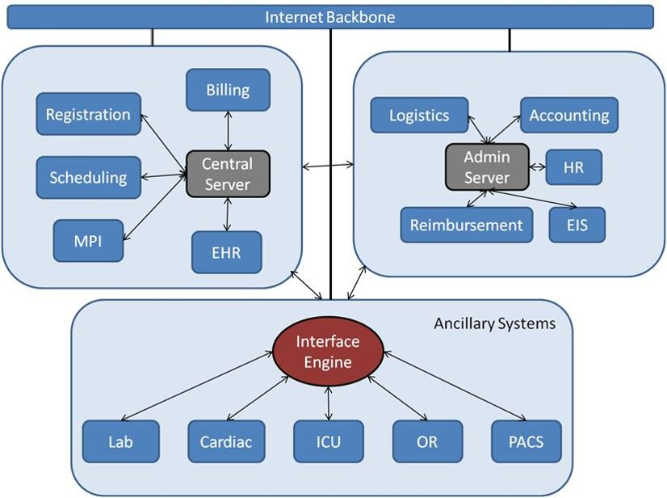
Hospital System
(Hribar, 2011, CC BY-SA 3.0)
Notes:
This slide shows a simplified diagram of the information systems at a hospital. In the upper left corner, there are the central health care systems: the EHR, the master patient index, or MPI, the scheduling system, the registration system, and the billing system. These typically connect to one central server. On the right are the administrative systems that support the hospital; these include everything from human resources, or HR, systems to the executive information systems, or EIS, to logistics systems to accounting and reimbursement systems.
Along the bottom are the many ancillary systems. These include laboratory information systems, systems used for monitoring and testing cardiac conditions, systems used in the intensive care unit, or ICU, and in operating rooms, or ORs, and the PACS systems used for imagining. There are many other systems that could be included in this category.
Because there are so many systems that need to interface with other ancillary systems and the other health care and administration systems, the ancillary systems commonly connect to an interface engine, which in turn connects to all the other systems.
Finally, all the groups of systems also connect to the Internet for external operations, such as communicating medical data to and from other institutions and connecting to outside systems for reimbursement.

Slide 12
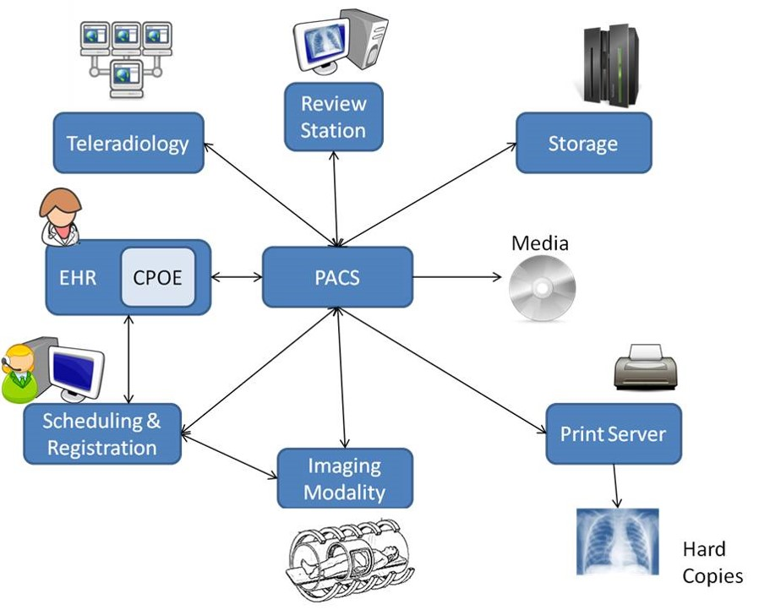
Imaging Information Systems
(Hribar, clker.com, wpclipart.com, 2009 – 2011, PD-US, CC BY-SA 3.0)
Notes:
One of the smaller pieces of an entire hospital information system is the imaging information system. At the center of the imaging information system diagram is the Picture Archiving and Communication System, or PACS. When an image is needed, the computerized physician order entry system, or CPOE, within an EHR places an order for the image to the scheduling and registration systems. These systems also interact with the imaging modality system and the PACS for coordination of the appointment information. Then, the PACS takes input images from different imaging modalities, stores them and communicates them to different entities. For example, there are PACS viewers like the review station in the diagram on this slide that will display the electronic images. These images can be archived and stored, transferred to media such as CDs and DVDs, printed, and communicated back to the EHR in the form of a report or communicated to external specialists for review.

Slide 13
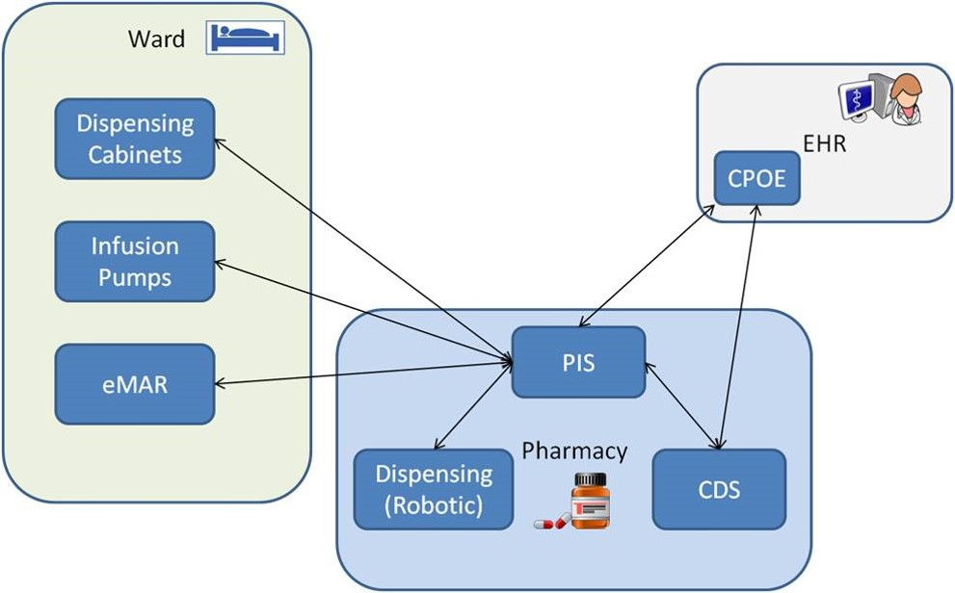
Pharmacy Information System (PIS)
(Hribar, clker.com, wpclipart.com, 2009 – 2011, PD-US, CC BY-SA 3.0)
Notes:
Another part of a hospital information system is the pharmacy information system, or PIS. The pharmacy information system is responsible for coordinating all the activities related to the pharmacy operations, including the management of prescriptions, maintenance of the inventory of medications, and the generation of reports. The pharmacy usually has a clinical decision support system, or CDS, that automatically checks for allergies and drug-to-drug interactions. In addition, the pharmacy may have electronic dispensing systems facilitated by robots.
The pharmacy information system communicates with the EHR and processes and manages orders received from the CPOE. The PIS also communicates with systems within the hospital related to patient care, such as the electronic medication administration record, or eMAR which keeps track of administered medications, electronically controlled infusion pumps, and dispensing cabinets.

Slide 14
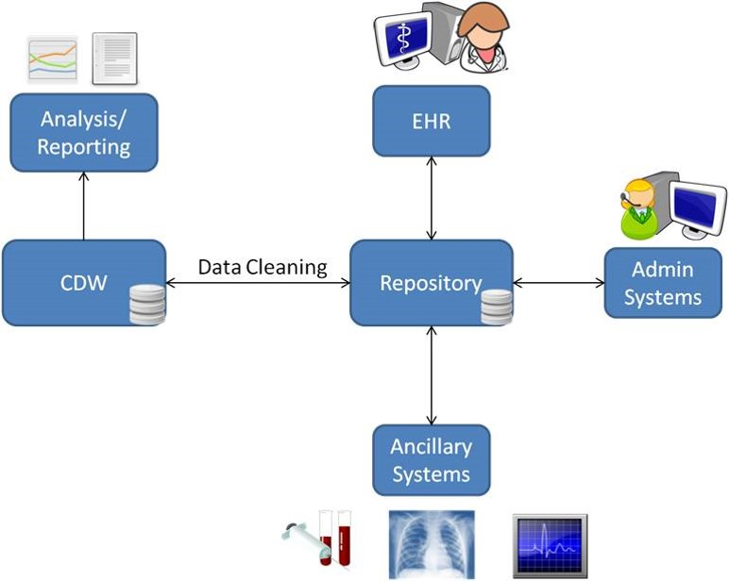
Data Warehouse System
(Hribar, clker.com, wpclipart.com, 2008 – 2011, PD-US, CC BY-SA 3.0)
Notes:
Another part of the information systems at a hospital is the data warehouse system. Data warehouse systems are a collection of data from across an institution. Queries and reports can be generated from the warehouse that can help discover knowledge related to the system. It is important to note that the queries and reports created from the data warehouse cannot be generated from individual systems. The data repository of a hospital warehouse system gathers data from all the other systems in the hospital: health care systems, administration systems and ancillary systems. After processing the data, which may include summarizing, reorganizing for easier queries, identifying and correcting erroneous information, the data is transferred to the data warehouse where queries and reports can be generated. Queries can be for operational purposes, such as "What are our revenues and expenses from the new cardiac laboratory?" or "What is the hospital-acquired infection rate for each unit compared with their staffing level?" or queries can be for research, particularly for identifying patients who are eligible for research, such as "What, and how many, patients have a diagnosis of diabetes with at least one hemoglobin A-1-C of greater than 8 as an outpatient in the last year and have been hospitalized more than once in the past year?"

Slide 15
Information Systems in Clinics
Registration system
Scheduling system
Billing system
Electronic health record
Interfaces to external systems
  Pharmacy
  Labs
  Imaging
Notes:
Information systems in clinics perform many of the same tasks that hospital systems do, but on a smaller scale. In a clinic, these systems may be separate or they may be combined into one system.
Similar to a hospital setting, in a clinic there are systems that register patients, schedule appointments, and manage billing. There is an EHR for collecting, managing, and displaying patient data. Clinic information systems need to communicate with systems outside the clinic, such as pharmacies, labs, and imaging services.

Slide 16
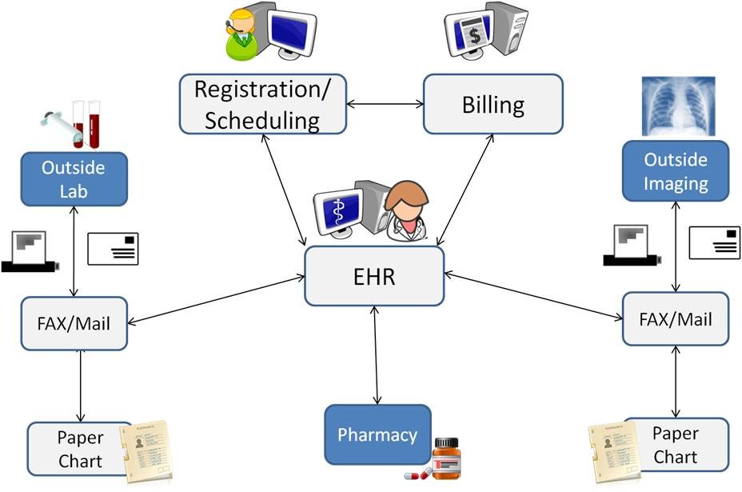
Clinic Information Systems
(Hribar, clker.com, wpclipart.com, 2008 – 2011, PD-US, CC BY-SA 3.0)
Notes:
This slide shows a diagram of a clinic information system operating independently, in other words, not being part of a hospital. Note that the light colored boxes represent parts of the clinic's system; the dark boxes are external systems. At the core of the clinic's system is the EHR, billing, and registration and scheduling systems. These can be separate systems or integrated together. This central system then connects to external systems such as outside labs, outside imaging, and outside pharmacies. While it is common for EHRs to be able to order medication, labs, or images from outside systems, it is less common for all results to be communicated back electronically, particularly images. Instead, the outside labs or imaging will fax or mail results and reports to the clinic where they can be scanned and imported to the EHR. They may also be printed and included in the patient's paper chart, which often still exist in clinics, even those with an EHR.
It is not surprising that clinic systems are far less complex than a system at a hospital. And while there may be electronic connections to outside systems, often-times clinics still rely on fax or mail for receiving reports from outside systems.

Slide 17
Information Systems
Summary – Lecture c
Specialized information systems for healthcare include knowledge management systems, expert systems, and virtual reality systems.
Information systems are used extensively in health care settings and cover virtually every business and treatment aspect of health care
Notes:
This concludes lecture c of Information Systems.
In summary, some types of specialized information systems used in health care include knowledge management systems, which attempt to generate and report knowledge in addition to data and information; expert systems, which use artificial intelligence and build on knowledge to provide decision making assistance, and virtual reality systems, which enable training in simulated environments.
Health care settings use information systems for numerous purposes including managing billing, financial data, laboratory data, and patient records.

Slide 18
Information Systems
Summary
Information systems combine technology, people and processes to produce and use information
The systems development process involves planning, analysis, design, implementation and support/security
Information systems are used extensively in health care
Notes:
This also concludes the unit on Information Systems.
In summary, information systems combine technology, people, and processes to produce and use information. Institutions rely on information systems for managing data and processes, providing knowledge, and for supporting communication and collaboration. New information systems are developed using a process that includes planning, analysis, design, implementation, and support and security. Information systems are used extensively in health care.

Slide 19
Information Systems
References – 1 – Lecture c
References
AI Overview. (2011, Nov 24). Retrieved Nov 29, 2011, from Association for the Advancement of Artificial Intelligence: http://aaai.org/AITopics/AIOverview
Barnett, G., Cimino, J., Hupp, J., & Hoffer, E. (1987). DXplain. An evolving diagnostic support system. JAMA , 258 (1), 67-74.
Clinical Information Systems. (2006, Aug 10). Retrieved Nov 20, 2011, from Biohealthmatics: http://www.biohealthmatics.com/technologies/his/cis.aspx
Electronic Health Record. (2011, Nov 16). Retrieved Nov 20, 2011, from Wikipedia: http://en.wikipedia.org/wiki/Electronic_health_record
Expert System. (2011, Nov 26). Retrieved Nov 29, 2011, from Wikipedia: http://en.wikipedia.org/wiki/Expert_systems
Hospital Information System. (2011, Sep 6). Retrieved Nov 20, 2011, from Wikipedia: : http://en.wikipedia.org/wiki/Hospital_information_system
IBM Systems and Technology. (2011, Oct 17). Watson--A System Designed for Answers. Retrieved Nov 11, 2011, from IBM Corporation: http://public.dhe.ibm.com/common/ssi/ecm/en/pow03061usen/POW03061USEN.PDF
Notes:
References slide. No audio.

Slide 20
Information Systems
References – 2 – Lecture c
References
Kennedy, J. (2011, Jun 28). Amount of data in 2011 equal to 57.5bn 32GB Apple iPads. Retrieved Nov 27, 2011, from Silicon Republic: http://siliconrepublic.com/strategy/item/22420-amount-of-data-in-2011-equa
Machine Learning. (2011, Nov 28). Retrieved Nov 29, 2011, from Wikipedia: http://en.wikipedia.org/wiki/Machine_learning
McCarthy, J. (1997, Nov 12). What is Artificial Intelligence? Retrieved Nov 29, 2011, from Stanford University: http://www-formal.stanford.edu/jmc/whatisai/whatisai.html
Mitchell, T. (1997). Does Machine Learning Really Work? AI Magazine , 18 (3), 11-20.
Mycin. (2011, Nov 8). Retrieved Nov 11, 2011, from Wikipedia: http://en.wikipedia.org/wiki/Mycin
ONC Health IT Tools. (2010, Feb 16). Retrieved Nov 20, 2011, from http://healthit.hhs.gov/portal/server.pt/community/healthit_hhs_gov__health_it_tools/1140
Piatetsky-Shapiro, G., & Parker, G. (2006). Data Mining Course. Retrieved Nov 29, 2011, from KD Nuggets: http://www.kdnuggets.com/data_mining_course
Notes:
References slide. No audio.

Slide 21
Information Systems
References – 3 – Lecture c
References
Picture Archiving and Communication System. (2011, Nov 16). Retrieved Nov 20, 2011, from Wikipedia: http://en.wikipedia.org/wiki/Picture_archiving_and_communication_system.
Images
Slide 11: ServerImage [image on the Internet]. [Updated 1/11/2009; cited 12/7/2011]. Available from: http://www.clker.com/clipart-mainframe-server.html (PD-US).
Slide 11: MRI Image [image on the Internet]. c 2011 [Updated 11/22/2011; cited 12/7/2011]. Available from: http://www.wpclipart.com/medical/testing/Magnetic_Resonance_Imaging__MRI.png.html (PD-US).
Slide 11: CD Image [image on the Internet]. [Updated 11/13/2007; cited 12/7/2011]. Available from: http://www.clker.com/clipart-1923.html (PD-US).
Slide 11: Internet Image [image on the Internet]. [Updated 5/5/2011; cited 12/7/2011]. Available from: http://www.clker.com/clipart-internet-5.html (PD-US).
Slide 11: Operator Image [image on the Internet]. [Updated 11/13/2007; cited 12/7/2011]. Available from: http://www.clker.com/clipart-2490.html (PD-US).
Notes:
References slide. No audio.

Slide 22
Information Systems
References – 4 – Lecture c
Images
Slide 12: Computer Image [image on the Internet]. [Updated 11/13/2007; cited 12/7/2011]. Available from: http://www.clker.com/clipart-1796.html (PD-US).
Slide 12: X ray Image [image on the Internet]. [Updated 7/28/2011; cited 12/7/2011]. Available from: http://www.clker.com/clipart-136616.html (PD-US).
Slide 12: Printer Image [image on the Internet]. [Updated 9/4/2008; cited 12/7/2011]. Available from: http://www.clker.com/clipart-inkjet-printer.html (PD-US).
Slide 13: Computer Image [image on the Internet]. [Updated 11/13/2007; cited 12/7/2011]. Available from: http://www.clker.com/clipart-1796.html (PD-US). Slide 12: Doctor Image [image on the Internet]. [Updated 5/9/2011; cited 12/7/2011]. Available from: http://www.clker.com/clipart-therapist.html (PD-US).
Slide 13: Medicine Image [image on the Internet]. [Updated 11/13/2009; cited 12/7/2011]. Available from: http://www.clker.com/clipart-41562.html (PD-US).
Slide 13: Bed Image [image on the Internet]. [Updated 9/8/2011; cited 12/7/2011]. Available from: http://www.clker.com/clipart-144257.html (PD-US).
Notes:
References slide. No audio.

Slide 23
Information Systems
References – 5 – Lecture c
Images
Slide 14: EKG Image [image on the Internet]. c 2011 [Updated 4/28/2011; cited 12/7/2011]. Available from: http://www.clker.com/clipart-ekg-monitoring.html (PD-US).
Slide 14: Graph Image [image on the Internet]. c 2008 [Updated 11/8/2008; cited 12/7/2011]. Available from: http://www.clker.com/clipart-24937.html (PD-US). Slide 13: Report Image [image on the Internet]. c 2010 [Updated 6/22/2010; cited 12/7/2011]. Available from: http://www.clker.com/clipart-text-x-generic.html (PD-US).
Slide 14: Database Image [image on the Internet]. c 2007 [Updated 11/18/2007; cited 12/7/2011]. Available from: http://www.clker.com/clipart-10756.html (PD-US).
Slide 14: Computer Image [image on the Internet]. c 2007 [Updated 11/13/2007; cited 12/7/2011]. Available from: http://www.clker.com/clipart-1796.html (PD-US).
Slide 14: Doctor Image [image on the Internet]. c 2011 [Updated 5/9/2011; cited 12/7/2011]. Available from: http://www.clker.com/clipart-therapist.html (PD-US). Slide 13: Laboratory Symbol Image [image on the Internet]. c 2007 [Updated 11/13/2007; cited 12/7/2011]. Available from: http://www.clker.com/clipart-3188.html (PD-US).
Notes:
References slide. No audio.

Slide 24
Information Systems
References – 6 – Lecture c
Images
Slide 14: X ray Image [image on the Internet]. c 2011 [Updated 7/28/2011; cited 12/7/2011]. Available from: http://www.clker.com/clipart-136616.html (PD-US).
Slide 14: Asclepius Rod Image [image on the Internet]. c 2011 [Updated 6/7/2011; cited 12/7/2011]. Available from: http://www.clker.com/clipart-rod-of-asclepius-upright.html (PD-US).
Slide 14: Operator Image [image on the Internet]. c 2007 [Updated 11/13/2007; cited 12/7/2011]. Available from: http://www.clker.com/clipart-2490.html (PD-US).
Slide 16: Operator Image [image on the Internet]. c 2007 [Updated 11/13/2007; cited 12/7/2011]. Available from: http://www.clker.com/clipart-2490.html (PD-US).
Slide 16: FaxImage [image on the Internet]. c 2007 [Updated 11/18/2007; cited 12/7/2011]. Available from: http://www.clker.com/clipart-9862.html (PD-US).
Slide 16: Bill Image [image on the Internet]. c 2011 [Updated 12/6/2011; cited 12/7/2011]. Available from: http://www.clker.com/clipart-dollar-5.html (PD-US). Slide 15: Computer Image [image on the Internet]. c 2007 [Updated 11/13/2007; cited 12/7/2011]. Available from: http://www.clker.com/clipart-1796.html (PD-US).
Notes:
References slide. No audio.

Slide 25
Information Systems
References – 7 – Lecture c
Images
Slide 16: Doctor Image [image on the Internet]. c 2011 [Updated 5/9/2011; cited 12/7/2011]. Available from: http://www.clker.com/clipart-therapist.html (PD-US).
Slide 16: Laboratory Symbol Image [image on the Internet]. c 2007 [Updated 11/13/2007; cited 12/7/2011]. Available from: http://www.clker.com/clipart-3188.html (PD-US).
Slide 16: Chart Image [image on the Internet]. c 2010 [Updated 2/15/2010; cited 12/7/2011]. Available from: http://www.centigrade.de/en/blog/article/free-medical-icons/
Slide 16: Asclepius Rod Image [image on the Internet]. c 2011 [Updated 6/7/2011; cited 12/7/2011]. Available from: http://www.clker.com/clipart-rod-of-asclepius-upright.html
Slide 16: X ray Imagehttp://www.clker.com/clipart-136616.html Image [image on the Internet]. c 2011 [Updated 7/28/2011; cited 12/7/2011]. Available from:
Slide 16: Mail Image [image on the Internet]. c 2007 [Updated 11/13/2007; cited 12/7/2011]. Available from: http://www.clker.com/clipart-2292.html (PD-US).
Slide 16: Medicine Image [image on the Internet]. c 2009 [Updated 11/13/2009; cited 12/7/2011]. Available from: http://www.clker.com/clipart-41562.html
Notes:
References slide. No audio.

Slide 26
Introduction to Computer Science
Information Systems
Lecture c
This material was developed by Oregon Health & Science University, funded by the Department of Health and Human Services, Office of the National Coordinator for Health Information Technology under Award Number 90WT0001
Notes:
No audio.

