Slide 1
Introduction to Computer Science
Networks
Lecture d
This material (Comp 4 Unit 6) was developed by Oregon Health & Science University, funded by the Department of Health and Human Services, Office of the National Coordinator for Health Information Technology under Award Number 90WT0001.
This work is licensed under the Creative Commons Attribution-NonCommercial-ShareAlike 4.0 International License. To view a copy of this license, visit http://creativecommons.org/licenses/by-nc-sa/4.0/.
Notes:
Welcome to Introduction to Computer Science: Networks. This is Lecture d.
The component, Introduction to Computer Science, provides a basic overview of computer architecture; data organization, representation, and structure; structure of programming languages; and networking and data communication. It also includes some basic terminology from the world of computing.

Slide 2
Learning Objectives - 1
Define what a communication network is (Lecture a)
Explain the purposes and benefits of a communication network. (Lecture a)
Explain the Internet and World Wide Web, their histories, and their structures. (Lecture a)
Describe different ways of connecting to the Internet. (Lecture a)
Notes:
The objectives for this unit on Networks are to:
Define what a communication network is,
Explain the purposes and benefits of a communication network,
Explain the Internet and World Wide Web, their histories, and their structures,
Describe different ways of connecting to the Internet,

Slide 3
Learning Objectives - 2
Explain the basics of network addressing
  Internet Protocol (IP) addresses
  Domain names
  Lease vs. purchase from an Internet service provider (Lecture b)
Introduce network classification by the coverage size. (Lecture b)
Notes:
Explain basics of network addressing: IP addresses and domain names, and how they can be leased or purchased from an Internet service provider.
Introduce network classification by the coverage size.

Slide 4
Learning Objectives - 3
Describe different network topologies. (Lecture c)
Outline different standards and protocols that govern wired and wireless communications. (Lecture c)
Notes:
Describe different network topologies.
Outline different standards and protocols that govern wired and wireless communications.

Slide 5
Learning Objectives - 4
Describe benefits and disadvantages of wireless communication and a typical wireless network setup. (Lecture d)
Describe network hardware. (Lecture d)
Introduce networking logical models and discuss Open Systems Interconnection (OSI) model. (Lecture e)
Notes:
Describe benefits and disadvantages of wireless communication and a typical wireless network setup.
Describe network hardware.
And, finally, to introduce networking logical models and discuss Open Systems Interconnection, or OSI model.

Slide 6
Wireless Communications
Wireless devices communicate without cabling
Signals sent via
  Infrared light: laptop to laptop
  Microwave: requires clear line of sight
  Radio frequency: most common method
Governed by IEEE 802.11 standard
Seems to be available everywhere!
Notes:
This lecture will discuss wireless communication and network hardware.
Wireless communication occurs without cabling. Signals are sent via infrared light, for example, from laptop-to-laptop;
by microwave, which requires a clear line of sight between the sending and receiving devices;
and by radio frequency, which is the most common method used today.
All signals are governed by the IEEE 802.11 standard.
Wireless communication is prevalent throughout the world, and its use is only going to continue to grow.

Slide 7
Wireless – The Good, The Bad, & The Ugly
Good
  Cleaner work environment
  Device portability
  Easy to connect
Bad
  Can be slower than wired networks
  Limited signal range
Ugly
  Security issues
Notes:
As with most technology, there are good, bad, and ugly aspects of wireless communication.
Wireless communication usage is ever increasing because cables are not needed to connect devices to a network. The benefits of not using cables include a cleaner physical work environment; portability—for example, anyone can carry a laptop around campus and connect to the Internet everywhere; and it is easy for users to connect to the network, if the network provides open connectivity.
The bad part about wireless is that signal interference and other factors can cause slower connection speeds than wired networks. For example, a signal may not have the ability to fully penetrate walls, which weakens the signal. Additionally, the signal range is often limited. In fact, the farther a wireless device moves from its wireless access point, the lower the throughput. Once the device moves outside of the wireless access point's effective range, no wireless communication can occur. In a typical home network, this is usually only about 50 feet, or approximately 15 meters.
The ugly part about wireless communication pertains to security issues. All wireless devices have the ability to view all wireless network traffic, using special software known as a sniffer. Network administrators must plan for this type of activity and prevent it. To ensure that users are able to use wireless communication without concern about whether their passwords and usernames and even data itself are stolen, administrators must be on guard against those who are going to try to sniff, or intercept, electronic communications.

Slide 8
How Does Wireless Function
Home wireless communication uses radio frequency
  Radio frequency bands are mapped to channels
  In North America, channels are 1-13 for 802.11 a/b/g
For typical home setup
  Computers need wireless NICs
  Network needs a wireless router (aka WAP)
  To get access, wireless router needs to connect to a wired device, such as cable modem router
Notes:
How does wireless communication happen?
Home wireless communication uses radio frequency. Wireless equipment uses different channels for communication, each channel representing a specific frequency band. Radio frequency bands map to specific wireless channel numbers. In North America, channels are one through 13 for the technologies that are governed by the IEEE 802.11A, B, and G standards.
The following equipment is necessary to set up wireless communication in a home:
Computers need wireless network interface cards, or NICs, to enable the connection to a wireless access point, or WAP, also known as a router.
The network also needs a wireless router.
The wireless router then connects to a wired device. For example, to obtain Internet access, the wireless router needs a wired connection to an ISP device, such as a cable modem router.

Slide 9
Wireless Network Setup
WAP
  SSID: name for wireless network
  Change WAP default password
  IP address and subnet mask
  Configure WPA2 and record the code/phrase
  Cable WAP so it somehow connects to ISP device
Each wireless client
  SSID configured same as WAP
  IP and subnet mask in same range as WAP
  Configure WPA2 using code/phrase from WAP
Notes:
When setting up a wireless network, it is very important that the WAP for secure communication be configured. One of the things to be set is the service set identifier, or SSID, this is the name for the wireless network. It is basically the same thing as the workgroup name in a wired network.
Next, change the WAP's default password; the default password of any wireless router can be found on the Internet.
After that, supply the WAP with an IP address and subnet mask. Ensure that the IP address and subnet mask are in the range of the computer and other devices that will connect to the wireless network.
Next, configure WPA2, a wireless security protocol. Write down the code or phrase you use; you’ll need it later when configuring wireless clients.
Next, attach the cable between the WAP and the ISP device.
You will need to configure each wireless client. One configuration is to ensure that the wireless client has the same SSID configured on the WAP. The wireless client also needs an IP address and subnet mask that is in the same IP address range as the WAP.
The WAP and client cannot have the same IP address, although they should have the same subnet mask.
Ensure that all devices are configured with unique IP addresses and the same subnet mask.
Finally, configure WPA2 using the code or phrase you wrote down when you configured the WAP.

Slide 10
Wireless Network Setup - 2
Standards are backwards compatible
  802.11g NICs work in 802.11 a/b device-controlled WLANs
Wireless RF channels
  WAPs and clients must use same channel
  Different channels cannot communicate
  Channel numbers correspond to an RF range
  Channels 1, 6, and 11 do not overlap
Notes:
It is important to keep in mind that standards are backwards compatible. In other words, IEEE 802.11G NICs work with IEEE 802.11A or B device-controlled wireless LANs.
WAPs and clients must also use the same channel. Remember, valid channels in North America are between 1 and 13. If a WAP is on channel 6 and a client is on channel 1, the two will not be able to communicate with each other. Again, channel numbers correspond to an RF range.
Note that channels 1, 6, and 11 do not overlap.
Therefore, in North America, it is good practice to use one of these channels. For example, channel 5 uses the radio frequency range of 2.421 through 2.443 gigahertz. Notice that channel 6 uses the radio frequency range of 2.426 through 2.448, which slightly overlaps the range of channel 5. This overlap can interfere with wireless communication for devices using both frequencies.

Slide 11
Network Hardware
Common components are:
  Networked devices
  NIC (wired and wireless)
  Switch
  Router
  ISP device
  Server
  Surge protector
  Uninterruptable Power Supply (UPS)
Notes:
Typical network hardware includes networked devices; a NIC, either wired or wireless; a switch; a router; an ISP device, if Internet access is required; a server, if managing a domain; a surge protector; and an uninterruptable power supply, which is known as a UPS.
Let’s look at each of these in more detail.

Slide 12
Network Hardware –
Networked Devices
Computers / Laptops with:
  Network-enabled operating system (OS)
  NIC to connect to switch/router
    Newer computers have a network interface built into the motherboard
  Cabling for wired network
Notes:
Network devices include computers, laptops, printers, and scanners that have a network enabled operating system. For example, a computer might be running Windows 10, Windows 8, or Windows XP. Each of these operating systems can provide the services required for network communication between applications installed on the computer and the network hardware. These devices need an installed NIC, which will allow them to connect to a switch or router, as well as cabling for a wired network.

Slide 13
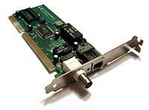
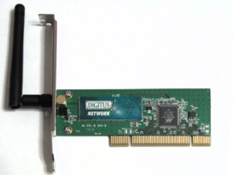
Network Hardware - NICs
  Required for network communication
    Hardware uses OS services to communicate on network
  Wired – requires cabling, jacks, switch/router
  Wireless – requires WAP and some wired device to communicate with wired devices
Vintage 10 Mbps Ethernet NIC for wired network. (Helix84, 2005, CC BY-SA 3.0)
54 Mbps Wireless LAN PCI Card (802.11g).
(Wheeler, 2007, CC BY-SA 3.0
Notes:
For a device to communicate on a network, it must have a NIC or network interface card. The hardware uses operating system services to communicate on the network. A service is a program that is part of the operating system and is always running.
A wired NIC requires cabling and jacks, and, ultimately, a switch and a router for network access and communication.
A wireless NIC requires a WAP and some wired device through which the WAP will communicate with other wired devices. The images on the screen illustrate a couple of NICs.
The image on the bottom left of the slide is a vintage 10-megabit per second Ethernet NIC for wired network communication. This old-style NIC has two connector types on it.
The connector type on the left side of the image is an old BNC connector type. The connector type on the right side of the image is what a user would use to plug in an RJ-45 jack Ethernet cable.
The image on the right side of the slide is a 54-megabit per second wireless PCI, peripheral component interconnect card, which relates to the IEEE 802.11G standard.

Slide 14
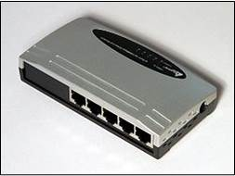
Network Hardware – Switch
Very important network component
Devices plug into switch to communicate with each other
Switch plugs into ISP device to provide Internet access
5-port Atlantis Ethernet switch.
(Sub, 2007, PD-US)
Notes:
One of the most important pieces of hardware in a network is the switch. Wired devices plug into the switch via an Ethernet cable to communicate with each other. In other words, if a computer has a wired NIC installed, then a user would plug a network cable’s RJ-45 jack into the NIC and then plug the RJ-45 jack on the other end of the cable into one of the ports shown on the switch. Then any other device that is plugged into that switch will be able to communicate with the computer. The switch then plugs into an ISP device to provide Internet access. The figure on the slide shows a five-port switch.
Switches allow communication only between hosts sharing the same IP address and subnet mask range. Switches forward traffic to devices in their network based on the MAC address of the devices. However, switches are programmed so that devices in different IP address ranges—different networks—are unable to communicate with each other unless the communication is permitted by a router through an access control list rule.
Switches are not routers. However, some of the more expensive routers perform the actions of switches and routers. Switches that can perform router operations are called Layer 3 switches.
A switch learns MAC addresses by reading traffic sent through all of its ports. Therefore, with a computer plugged into a switch port, when the computer communicates, the switch itself receives that information and reads the communication. Part of that communication includes the NIC’s MAC address, IP address, and subnet mask assigned to the computer.
If the switch receives traffic for a MAC address that it is familiar with, the switch sends that traffic to the switch port associated with that MAC address. If the switch receives traffic for an unknown MAC address, the switch forwards that traffic out of all of its other ports. That traffic will eventually make its way to a router, which will try to locate the destination network, and then route the traffic accordingly.

Slide 15
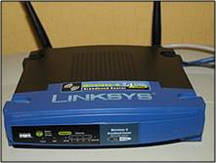
Network Hardware – Router
Defined by IP address and subnet mask numbers
Connects different IP networks so they can communicate with each other
Can be wired or wireless
ISP devices are routers
Cisco Linksys WRT54GL wireless router (Jackzor, 2008, PD-US)
Notes:
Another important piece of hardware in a network is the router. A network boundary is defined by IP addresses and subnet mask numbers. A router can connect different IP addressed networks so they can communicate with each other. Routers such as ISP devices and WAPs can be wired or wireless.
The image on this slide is a Cisco-Linksys wireless router, typically found in a small office/home office, or SOHO network. The blue Ethernet cable extending from the back, right of the router, connects this WAP to the wired network.
As mentioned previously, routers use IP addressing to route network traffic. Note that routers route, and switches forward traffic. Routers have routing tables so that they know where to route received traffic. Switches do not have routing tables; they just keep track of MAC addresses by switch port, and can send communication to its local area network, not to a remote network.
Routers are usually configured with a default route, which is the IP address of another router. In other words, if the router has no idea where a destination device is located, it sends that traffic to its default router.
If a router receives traffic for a destination not found in its routing table, the router sends that traffic to its default route. The hope is that the default router will know where to route this traffic. Ultimately, if the router does not have a destination route in its routing table and the router is not configured with a default route, the router drops that traffic. This means that the communication does not reach its destination. This might happen in a small office network, but it should never happen in a business network or on the Internet.

Slide 16
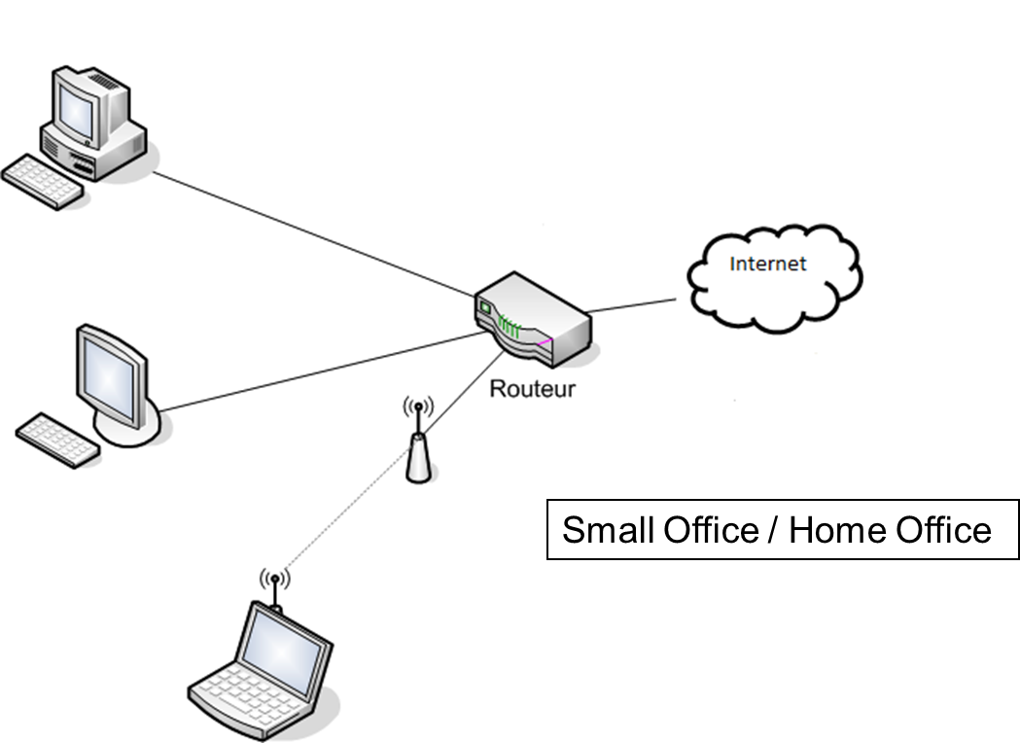
Routed Network Example
(Feval, 2006, CC BY-SA 3.0
Notes:
This image shows a small office network interconnected by an ISP router with switch ports. The ISP router connects the devices in the small home office to the Internet. Assuming correct IP addressing, the three home devices can communicate with each other and the Internet.

Slide 17
Network Hardware – ISP Device
Connects SOHO and Office networks to Internet
Usually has one Internet port to connect to a wall port
Usually has one switch port to connect one device using Ethernet cable
  Can use that port to connect to a switch
  All devices then share the one Internet connection
Notes:
An ISP device, for example, a cable modem router, connects either a home or an office network to the Internet. Users can lease these pieces of hardware from their ISP when they sign up for Internet service.
The ISP device usually has one Internet port, which can be connected to a wall port. The ISP will usually provide the necessary cabling and other supplies needed to connect to the ISP device. This device usually has one switch port to connect one office or home device via an Ethernet cable.
Users can decide to use that port to connect to a switch, which can then connect to other devices or even other switches to extend the network. There is no need to purchase or lease a more expensive device from an ISP to connect other devices to the network. In this case, all the devices share the one Internet connection, which is fine.

Slide 18

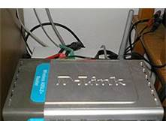
ISP Device Examples
Motorola cable modem
  Uses the ISP’s coaxial cable to provide Internet connectivity
(Larocomp, 2010, PD-US)
Wireless D-Link router/modem
  Uses the ISP’s Ethernet cable to provide Internet connectivity
(Macic7, 2007, CC BY 3.0
Notes:
Now we will examine some ISP devices. The top right image shows a Motorola cable modem router. This router uses the ISP's coaxial cable to provide Internet connectivity. The bottom right image is a wireless D-Link router modem, typically used as a residential DSL gateway. This router uses the ISP's Ethernet cable to provide Internet connectivity.

Slide 19
Network Hardware – Server – 1
Computer with specialized OS installed
  Windows Server 2008
  Ubuntu Server
  Novell Open Enterprise Server
Creates ‘gated community’ of devices and users
  Server maintains database of objects, restricts access and manages them
Notes:
Another network device is a server, which is a computer with a specialized operating system installed. Server examples are Windows Server 2008 or 2003, Ubuntu Server, and Novell's Open Enterprise Server.
A server creates what we refer to as a gated community of devices and users. A server maintains a database of its objects (objects being devices and users). It restricts access to the network to only authorized devices and users, and manages all of these objects. In other words, a server determines which users can log on to the network, if at all. A server can also enforce rules that determine who can print to a specific printer.

Slide 20
Network Hardware – Server – 2
Can provide various functions
  Domain controller
    Print server
  Domain Host Configuration Protocol (DHCP)
  Domain Naming System (DNS)
    File Server
    Certificate server
  Network Access Protection (NAP)
Notes:
Servers can provide a number of functions, including:
Taking on the role of domain controller, which is the guard of the gated community
A print server managing the printers that are part of the network
A DHCP or domain host configuration protocol, which is the server that provides IP addresses and other configurations to devices
A DNS, or domain naming system, server, so that device names can be translated into IP addresses
The file server, which might allow users to store their documents within specific folders on a hard drive of the server
A certificate server, which involves secure communications within a network and with other types of functionality
Finally, a NAP, or network access protection server, which acts to protect the network from devices without virus protection software.
These are just a few of the roles a server can fulfill in a domain.

Slide 21
Network Hardware –
Surge Protector
Protects devices from spikes in power
  Some power strips are also surge protectors
Devices need to be plugged in to gain protection
Power surge can destroy a devices circuitry
Protection rating
  Measured in Joules
  Amount of energy the protector can absorb without failure
Notes:
A device with a motherboard should be plugged into a surge protector, which is plugged into the wall.
Surge protectors protect devices from spikes in power, usually originating from the power company. Some power strips are also surge protectors. Carefully read the product information to differentiate between the two.
Devices need to be plugged into the surge protector to gain protection. If a power surge occurs and the device was not plugged into a surge protector, the motherboard circuitry might be destroyed. This means that if any microwave device, computer, iPod, iPhone, and other devices are plugged directly into a wall outlet that experiences a surge in power, the motherboard on any of those devices can be destroyed. Always use a surge protector for all electronic devices, but especially for computers, servers, printers, and portable devices.
Protection through the use of a surge protector is measured in joules. Protection rating is defined as the amount of energy the surge protector can absorb without failure.

Slide 22
Network Hardware – UPS
Uninterruptible power supply (UPS) provides emergency power to attached devices when power fails
Short battery power time (5-30 min)
  Computer and monitor – portable unit okay
  Whole building – need large (site) solution
Never plug laser printer into UPS
Important to read documentation
Notes:
To ensure that a device does not immediately shut down due to power loss, purchase and install an uninterruptable power supply or a UPS, which provides emergency power to attached devices when power fails.
A UPS provides short battery time, usually 5 to 30 minutes, depending on the devices that are attached to the UPS and the battery power provided by the UPS. Plug the computer and monitor directly into a UPS outlet. Then, if a power loss occurs, there will be time to safely shut down the computer rather than have it abruptly shut down due to a lack of power.
There are more robust solutions to protect a whole building or campus. For example, a UPS might be placed in a central location, with all electricity connected to the UPS. Call centers typically have this type of a setup.
Note that users should never plug a laser printer into a UPS. A laser printer will instantly drain all of the available UPS battery power. This means that if a computer, monitor, and a laser printer are plugged into the UPS, and power is lost, all of those devices will immediately shut down because the laser printer itself will drain all of the power in a matter of moments, rendering the UPS useless.
Always plug a laser printer into a surge protector, and then plug the surge protector into a wall outlet. Then, plug the computer or monitor and other devices into the UPS, and then plug the UPS into another wall outlet.
Finally, most UPS hardware devices also provide surge protection. It is important to read the documentation to understand specifically how each type of device protects your electronic equipment.

Slide 23
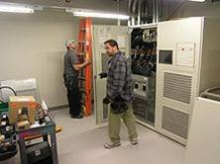
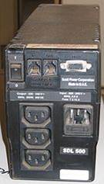
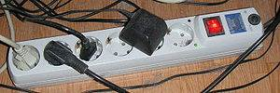
Surge Protector and
UPS Examples
(Cgxke, 2008, PD-US)
(Amakuru, 2006, CC BY-SA 3.0)
(Amakuru, 2006, CC BY-SA 3.0)
Notes:
The images on this slide show surge protectors and UPS devices.
The image on the top-left shows a large datacenter-scale UPS being installed by electricians. The size of this UPS device indicates that all devices within the building will retain power in the event of a power loss.
The bottom, left image shows a multi-outlet surge protector available for purchase from any hardware store. In this case, all of the devices plug into the surge protector, and then the surge protector plugs into the wall.
Finally, the image on the right shows a freestanding UPS. This unit has different types of connectors for input and output. Computers, monitors, printers, and other devices plug into the UPS, which plugs into a wall outlet.

Slide 24
Networks
Summary – Lecture d
Describe wireless communication
  advantages and disadvantages
  standards and modes of operation
  wireless network setup
Describe major network hardware components
Notes:
This concludes Lecture d of Networks.
In summary, this lecture discussed wireless communication and the major hardware components of a network.

Slide 25
Networks
References – 1 – Lecture d
References
Wikipedia. Medical Implant Communication Service. [Internet]. 2011 Jun [cited 2011 Nov 07]. Available from: http://en.wikipedia.org/wiki/Medical_Implant_Communication_Service.
Wikipedia. Wireless LAN. [Internet]. 2011 Jun [cited 2011 Nov 07]. Available from: http://en.wikipedia.org/wiki/Wireless_LAN.
Wikipedia. Network switch. [Internet]. 2011 Jun [cited 2011 Nov 07]. Available from: http://en.wikipedia.org/wiki/Network_switch.
Wikipedia. Surge protector. [Internet]. 2011 Jun [cited 2011 Nov 07]. Available from: http://en.wikipedia.org/wiki/Surge_protector.
Wikipedia. Uninterruptible power supply. [Internet]. 2011 Jun [cited 2011 Nov 07]. Available from: http://en.wikipedia.org/wiki/Uninterruptible_power_supply.
Notes:
References slide. No audio.

Slide 26
Networks
References – 2 – Lecture d
Images
Slide 13: Network Card[image on the Internet]. (Helix84, 2005, CC BY-SA 3.0) [cited 2011 Nov 07]. Retrieved Jan 2012 from: http://en.wikipedia.org/wiki/Network_interface_card. Licensed through Creative Commons Attribution-ShareAlike 3.0 Unported License
Slide 13: WLAN PCI Card [image on the Internet]. (Wheeler, 2007, CC BY-SA 3.0) [cited 2011 Nov 07]. Retrieved Jan 2012 from: http://en.wikipedia.org/wiki/File:WLAN_PCI_Card_cleaned.png. Licensed through Creative Commons Attribution-ShareAlike 3.0 Unported License
Slide 14: Network Switch [image on the Internet]. (Sub, 2007, PD-US) [cited 2011 Nov 07]. Retrieved Jan 2012 from: http://en.wikipedia.org/wiki/File:Ethernet_switch_Atlantis_A02-F5P_5_ports_backend.jpg. (PD-US, 2007)
Slide 15: Cisco Linksys Wireless Router [image on the Internet]. c2008 [cited 2011 Nov 07]. Retrieved Jan 2012 from: http://en.wikipedia.org/wiki/File:Linksys_WRT54GL.jpg. (PD-US, 2008)
Notes:
References slide. No Audio

Slide 27
Networks
References – 3 – Lecture d
Images
Slide 16: SOHO Wireless Network [image on the Internet]. (Feval, 2006, CC BY-SA 3.0) [cited 2011 Nov 07]. Retrieved Jan 2012 from: http://en.wikipedia.org/wiki/File:SPOF.png. (PD-US, 2006)
Slide 18: Motorola Cable Modem Router [image on the Internet]. (Larocomp, 2010, PD-US) [cited 2011 Nov 07]. Retrieved Jan 2012 from: https://commons.wikimedia.org/wiki/File:SBV6120E.jpg. (PD-US, 2010)
Slide 18: Router Dlink [image on the Internet]. (Macic7, 2007) [cited 2011 Nov 07]. Retrieved Jan 2012 from: https://commons.wikimedia.org/wiki/File:SBV6120E.jpg. (GNU)
Slide 23: Large UPS Device [image on the Internet]. (Cgxke, 20087, PD-US) [cited 2011 Nov 07]. Retrieved Jan 2012 from: http://en.wikipedia.org/wiki/File:500kVA-UPS.jpg. (PD-US, 2009)
Slide 23: Small UPS Device [image on the Internet]. (Amakuru, 2006, GNU) [cited 2011 Nov 07]. Retrieved Jan 2012 from: http://en.wikipedia.org/wiki/File:UPSRearView.jpg. (GNU)
Slide 23: Multi-outlet Surge Protector [image on the Internet]. (Amakuru, 2006) [cited 2011 Nov 07]. Retrieved Jan 2012 from: http://en.wikipedia.org/wiki/File:Surge_protector.jpg. (PD-US, 2008)
Notes:
References slide. No Audio

Slide 28
Introduction to Computer Science
Networks
Lecture d
This material was developed by Oregon Health & Science University, funded by the Department of Health and Human Services, Office of the National Coordinator for Health Information Technology under Award Number 90WT0001.
Notes:
No audio.

