Slide 1
Introduction to Computer Science
Computer Software
Lecture d
This material (Comp 4 Unit 3) was developed by Oregon Health & Science University, funded by the Department of Health and Human Services, Office of the National Coordinator for Health Information Technology under Award Number 90WT0001.
This work is licensed under the Creative Commons Attribution-NonCommercial-ShareAlike 4.0 International License. To view a copy of this license, visit http://creativecommons.org/licenses/by-nc-sa/4.0/.
Notes:
Welcome to Introduction to Computer Science: Computer Software. This is Lecture d.
The component, Introduction to Computer Science, provides a basic overview of computer architecture; data organization, representation, and structure; structure of programming languages; and networking and data communication. It also includes some basic terminology from the world of computing.

Slide 2
Computer Software
Learning Objectives - 1
Define computer software and major software types. (Lecture a)
Describe application software classification and provide examples, including those focused on health care (Lecture a)
Notes:
The learning objectives for this unit, Computer Software, are to:
Define computer software and major software types,
Describe application software classification and provide examples, including those focused on health care,

Slide 3
Computer Software
Learning Objectives - 2
Define what an operating system (OS) is (Lecture b)
Explain the features and functions of operating systems (Lecture b)
Classify operating systems (Lecture c)
Describe commonly used operating systems (Lecture c)
Notes:
Define what an operating system is,
Explain the features and functions of operating systems,
Classify operating systems,
Describe commonly used operating systems,

Slide 4
Computer Software
Learning Objectives - 3
Describe types and major attributes of files (Lecture d)
Explain the purpose of file systems (Lecture d)
Provide file management tips (Lecture d)
Identify different implementations of file systems (Lecture d)
Notes:
Describe types and major attributes of files,
Explain the purpose of file systems,
Provide file management tips,
And identify different implementations of file systems

Slide 5
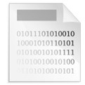
Files
Files are blocks of program instructions or data stored on a storage device
(mihi, 2010, PD-US)
Notes:
This lecture defines what a file is, identifies various file types and their attributes, provides tips for managing files, explains why file systems are important, and identifies several types of file system implementations.
A file is defined as a block of program instructions or data stored on some storage device.

Slide 6
File Types
Executable (machine code instructions)
Text file (collection of characters)
Special format
  Particular to an application
  (for example, Microsoft® Word, Excel)
  Format for storing images, videos, etc.
  Format for archives
(mihi, 2010, PD-US)
Notes:
There are many different file types. One example is executable files, which contain a software application that users run. An executable file is filled with a series of machine code instructions.
Another file type is a text file, which is merely a collection of binary representations of characters.
There are other types of files that may include other types of special formatting, such as types specific to an application like Microsoft Word or Excel. There are also specially formatted files for storing images and videos, and files that are formatted to be an archive.

Slide 7
File Names and Extensions
Every file must have a name
  Each operating system (OS) has its own naming rules
  Names may or may not be case-sensitive
File extension: a set of characters appearing after the dot in the file name
  Usually used to identify the file type
  May or may not be visible
  essay.docx
  winzip.exe
  budget.xlsx
  photo1.jpg
Notes:
Every file must have a name. Each operating system, or OS, has its own naming rules. For example, early releases of Microsoft Windows had a file name limit of eight characters.
Also, some operating systems have case-sensitive file names; others do not.
Part of the file name is the file's extension, which is a set of characters appearing after the dot in the file name. The extension usually identifies the file type, which in turn determines what a user can do with the file.
Depending on the settings of the file system, file extensions may or may not be visible in the user interface.
File extensions are somewhat up to the user to maintain correctly; an application that creates a file will automatically append the correct extension to the file name, but it may be changed later by a user or another application. Some examples of file names with extensions are: essay.docx, which is a Microsoft Word document named essay; budget.xlsx, which is a Microsoft Excel spreadsheet named budget; winzip.exe, is an executable program named winzip; and photo1.jpg, which is a jpg-formatted image named photo1.

Slide 8
File Permissions
Files have owners
Files have permissions
  Read (open)
  Write (save)
  Executed (if it’s an executable program)
Permissions may vary by user
  One user may only be able to read a file, another may be able to read and write
  Important security measure
Notes:
Files have owners; typically the owner is the person who created the file or last modified it. Operating systems also have utilities to change the ownership of a file. Not all operating systems store the file owner, particularly those operating systems that are simple and do not have extensive file security.
Files also have permissions that specify what a given user can do with the file: who can read the file, write to the file, and execute the file, in the case of an executable program.
Permissions are an important security feature, since they protect files from unauthorized access.

Slide 9
File Size
All files have a size
File size is measured in bytes, KB, MB, or GB
Size reflects the amount of data stored in the file:
  A file containing a long document will be larger than a file containing a short document
  HD video files will be larger than low resolution videos files
Notes:
All files have a size that is expressed in bytes; kilobytes, abbreviated as KB; megabytes, abbreviated as MB; or gigabytes abbreviated as GB.
The size of a file depends on the amount of data stored in the file. For example, a file that stores a long Microsoft Word document will be larger than a file that stores a short text-based document. A file containing a high-definition, or HD, video will be larger than a low-resolution video file of the same length.

Slide 10
File System
A way to organize and access files and their metadata on a storage device
Purposes:
  Provide an efficient and reliable data structure to store and access files
  Provide an interface for users and applications to create, modify, and save files
  Facilitate indexing for fast retrieval of files
Notes:
A file system is a way of organizing files and their metadata on a storage device. Metadata is information about the file, such as its author, its creation date, its subject matter, etc.
A file system:
Provides an efficient and reliable data structure to store and access files
Provides an interface used to create, modify, and save files
And, facilitates indexing for fast retrieval of files

Slide 11
File System Hierarchy - 1
Windows and Mac have folders
Unix® and Linux have directories
  Folders/directories contained within other folders/directories are called subfolders/subdirectories
A flat file system has only one large directory or folder
Notes:
Most file systems allow users to group files into some form of container. In Microsoft Windows and Mac OS, the containers are called folders.
In UNIX and Linux, the containers are called directories.
Folders or directories that are contained in other folders or directories are called subfolders or subdirectories.
There are also flat file systems that have only one large directory or folder, with all files being held within that single directory or folder.

Slide 12
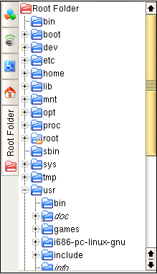
File System Hierarchy - 2
The nested folder/directory structure constitutes file system hierarchy
Top of the hierarchy is called the “root”
(Che, 2005, GNU-GPL)
Notes:
For file systems that are not flat, meaning there is more than just one large directory or folder, the nested subfolders or subdirectories contained on the computer form a hierarchical structure similar to that of a tree.
This screenshot shows nested folders and subfolders and the tree-like structure that results. The top of the hierarchy is called the root.

Slide 13
File Indexing
Finding a file can be challenging
Indexing system maintains a database of files
  Updated as files are created, modified, or removed
Indexing system enables users to search for a file based on all or part of a filename
Programs use unique index labels to retrieve and store information
Notes:
Due to the large volume of modern storage devices and the large number of stored files, finding a file can be challenging. Most file systems include an indexing system that enables users to search for a file based on all or part of a filename. The indexing system maintains a database that gets updated as files are created, modified, or removed. The indexing process is similar to file labeling in a file cabinet. Programs and databases use these unique index labels to retrieve and store information.

Slide 14
Deleting a File - 1
What happens when a file is deleted?
  File system removes file from index
  Identifies drive space as free
Can sometimes be recovered
  Must attempt recovery very soon after the deletion occurs, before the file’s drive space is overwritten
Notes:
When a file is deleted, the file system removes the file’s entry from the index and identifies the drive space where the file was stored as being free. However, a deleted file can be recovered if the recovery effort is undertaken quickly, before the file’s drive space is overwritten.

Slide 15
Deleting a File - 2
File shredder utilities overwrite the area where the deleted file was stored
In health care, old disks must be safely disposed
Notes:
Completely deleting a file requires using a file shredding utility to write over the freed space, so that the old data no longer exists.
For highly secure environments like health care settings, old disks must be safely disposed of in such a way that no one can recover data that was once stored on them.

Slide 16
File Management Utilities - 1
Operating systems provide utilities to manage files and folders/directories
  Microsoft Windows®: Explorer
  Mac OS X: Finder
  Unix: Line commands
  Linux: Line commands and file managers
Notes:
File systems and operating systems provide utilities to manage files and folders or directories.
In Windows it is called File Explorer.
In Mac OS and Mac OS X, it is called Finder.
In UNIX, a series of typed line commands provides this functionality.
And Linux, in addition to the command lines used in UNIX, offers graphical file managers; some of the currently popular ones are named Midnight Commander, Konqueror, Nautilus, and Dolphin.

Slide 17
File Management Utilities - 2
Allow you to:
  View files and their properties
  Find files
  Move files
  Copy files
  Rename files
  Create folders/directories
Notes:
File management utilities allow you to:
View files and their properties
Find files
Move files from one folder or directory to another
Copy and paste files or folders
Rename files or folders
And create folders and directories

Slide 18
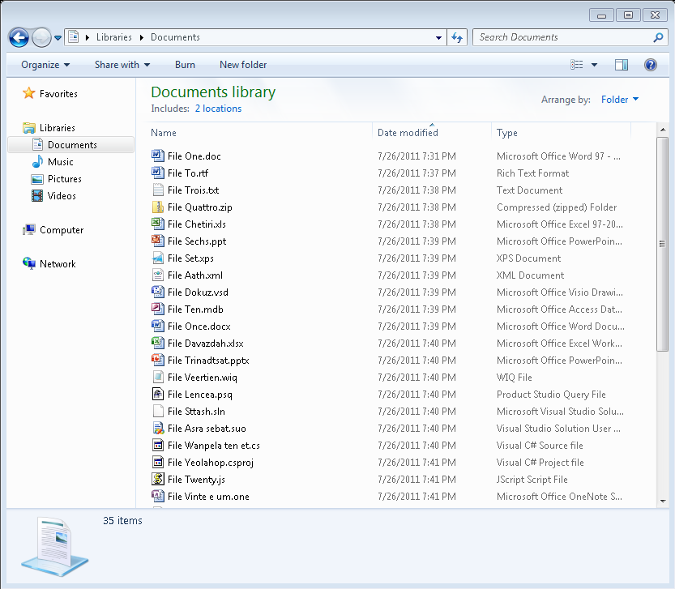
Microsoft Windows File Explorer
(Loera, 2017, © 2017 Microsoft)
Notes:
This is a screenshot of File Explorer in Microsoft Windows 7. Depending on the view selected from the Views menu, the user may or may not see the detailed properties about the files and folders.
This view is the detailed view. It shows the file’s name, including the file’s extension, the date the file was last modified, the file’s size, and the file’s type. There are other options in the menus at the top of the window and the links on the left, including search, quick links to other locations on the computer, and links to file and folder tasks.

Slide 19
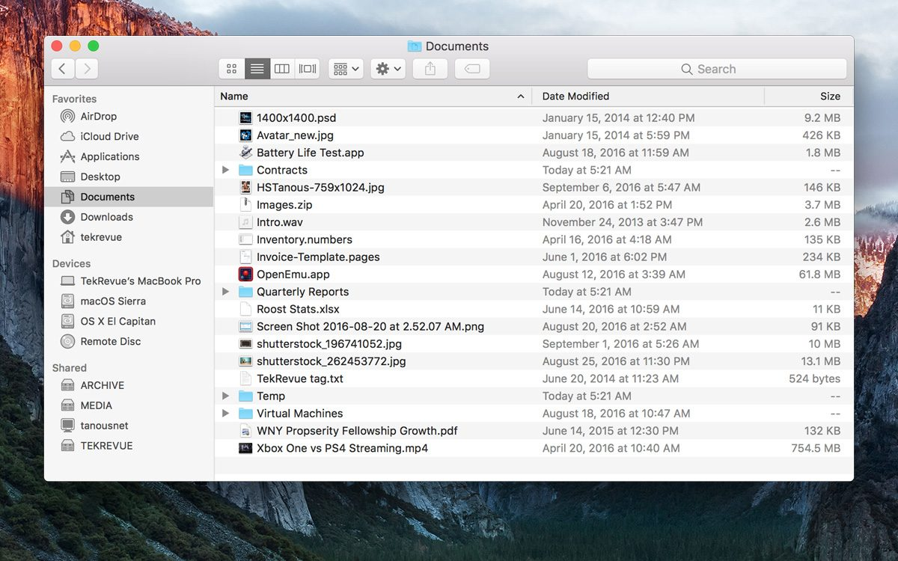
Mac OS X Finder
(Tanous/Apple Inc., 2016, © The Mac Observer, Inc.)
Notes:
This is a screenshot of Finder for Mac OS X 10.5. Once again, it shows details about the file, including the name, the date last modified, the size, and the type. The file extensions are not shown in this view.
There are buttons at the top that perform other actions, including a search, and links on the left to go to other locations.

Slide 20
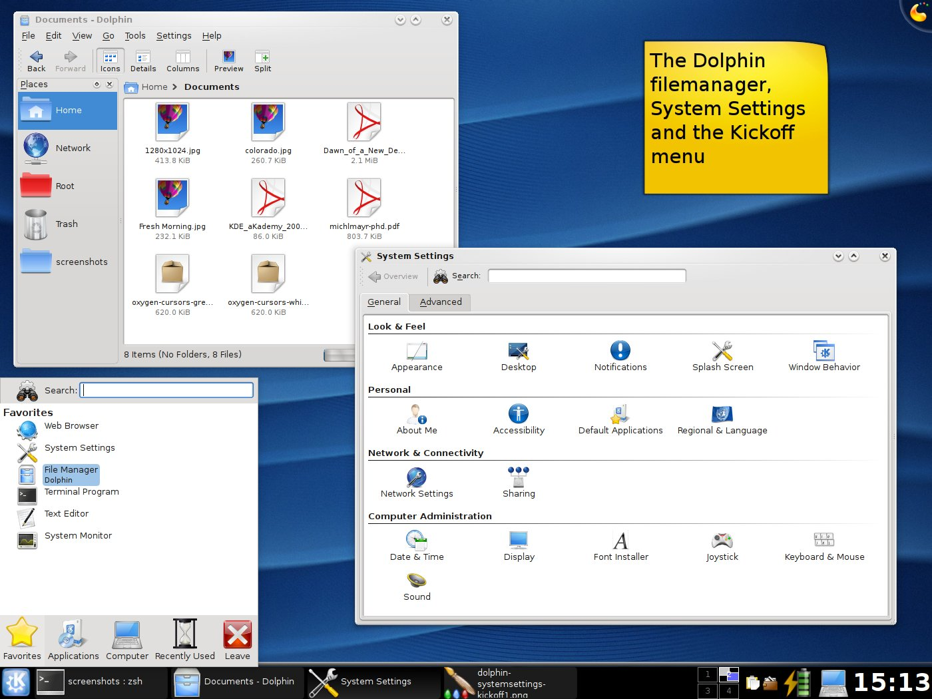
KDE Dolphin File Manager
(Gareth/KDE, 2008, GNU-GPL)
Notes:
There are several desktop environments available for Linux; one is KDE. Dolphin is the name of the file manager in the KDE environment; a view of Dolphin appears in the upper left corner of this screenshot.
Note that in the view shown, the files are represented by icons relating to the type of file, and the file extensions are shown along with the file’s size. No details about the date last modified are given here but they are available in the detailed view.
This file manager also provides links to other places, as shown on the left.

Slide 21
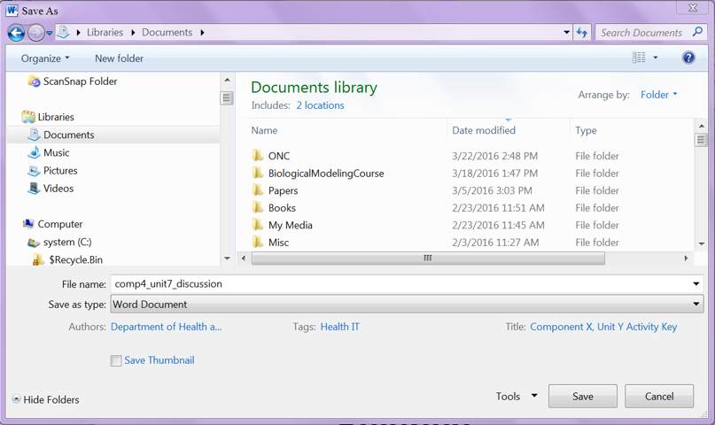
Application File Utilities
Available for use within applications
Facilitate moving, deleting, copying, opening, and saving files
(Baratt/Microsoft, 2016, © 2017 Microsoft)
Notes:
Application file utilities are available for use within applications. For example, in Microsoft Windows, selecting a file involves typing in a file name or clicking a Browse button to open a window, which allows navigation through folders to find the file needed. In the screenshot you see here, the window is performing a “Save As.”
Similar to File Explorer, the user selects the folder in which to save the file and types in the file name.

Slide 22



Other File Utilities
Search
File compression/archiving utilities
  Windows compression utilities
  WinZip
  Stuffit
Backup and restore utilities
Security utilities
File transfer utilities
(Allen, 2004, PD-US)
(Allen, 2004, PD-US)
(marricklip14, 2010, PD-US)
Notes:
The search file utility searches for files or folders on a disk, based on search criteria.
Utilities for file compression and archiving are available; some come with the operating system, like Windows-native compression utilities. Others are third-party software that needs to be installed, like WinZip for Microsoft Windows and Stuffit for Mac OS X and Microsoft Windows.
File compression and archiving utilities allow assembly of multiple files and folders into one archive file. Compression utilities use special algorithms to store files and folders in a compressed format, which is smaller than the uncompressed format. If a file is compressed, it must be uncompressed before it can be used. Often, archiving and compression are used together to conserve storage space on a hard drive. Archived files are sometimes referred to as “zipped” files.
Backup and restore utilities refer to programs that allow users to easily back up data and to restore the data from the backup. Backups can be regularly scheduled and can be done incrementally, meaning that only new or changed data is saved in the backup once a full backup exists. Most sensitive systems require regular backups, sometimes multiple backups, and often require that at least one backup resides off-site.
Security utilities are programs that help protect a computer from harmful files and unwanted access. These can include firewalls, anti-virus software, anti-spyware, and anti-malware.
For transferring files from one computer to another over a network, there are file transfer utilities. Depending on the network, transferring files may be the same as moving files from one folder to another. Other networks, such as the Internet, require using utilities to transfer files. One such utility is called file transfer protocol, or ftp. There are many Graphical User Interface, or GUI, applications built on top of this protocol to make transferring files easier. Searching the Internet for “ftp” and a specific operating system will return many file utility options.

Slide 23
File Management Tips
Use descriptive names for files and folders/directories
Maintain proper file extensions
Group similar files together
Organize folders/directories in a proper hierarchy
Delete or archive files you no longer need
Maintain enough free space (20%) on drive
Back up regularly!
Notes:
Before concluding, here are some tips for managing files:
Use descriptive names for files and folders or directories
Maintain proper file extensions
Group similar files together into folders or directories
Organize folders or directories in a proper hierarchy
Delete or archive files that are no longer needed
Maintain enough free space on the drive. How much is “enough” will vary.
And, finally, back up your files regularly!

Slide 24
Computer Software
Summary - Lecture d
Files are blocks of program instructions or data stored on a storage device
Main attributes of a file are name, size, type, and permissions
File system is a way of organizing and accessing files and their metadata
Operating systems provide file management utilities
Notes:
This concludes lecture d of the unit on Computer Software. This lecture defined computer files and described different file types and attributes. It defined and explained the role of the file system, provided an overview of file management utilities and file systems, and provided file management tips.

Slide 25
Computer Software Summary
Software is a set instructions for computer hardware
  System software directly operates the computer hardware while application software is an end-user program
  Operating systems coordinate applications and hardware and are present on every computer
  Files are basic blocks of programs and data. Files have attributes
File systems manage the storage and retrieval of files stored on a disk
Notes:
This also concludes the unit titled Computer Software. This unit defined software and explained two major software types: application software and system software. Application software is an end-user program. System software directly operates the computer hardware.
Applications include software tailored for business, multimedia, science, mathematics, communication, and health care, to name a few. Operating systems coordinate the applications and the hardware; they are the interface between the applications that the users run and the physical computer hardware. Operating systems are present on every computer. Files are basic blocks of programs and data. Files have attributes. File systems work with operating systems to manage the storage and retrieval of files stored on a disk.

Slide 26
Computer Software
References – 1 – Lecture d
References
Computer File. (2011). Retrieved 24 March 2011 from Wikipedia: http://en.wikipedia.org/wiki/Computer_file.
Evans A, Martin K, Poatsey MA. (2010). Chapter 5: Using System Software: The Operating System, Utility Programs and File Management. In: Technology in Action: Complete. 7th ed. New Jersey: Prentice Hall;.
File Allocation Table. (2011). Retrieved 24 March 2011 from Wikipedia: https://en.wikipedia.org/wiki/File_Allocation_Table.
File Systems. (2011). Retrieved 24 March 2011 from Wikipedia:. http://en.wikipedia.org/wiki/File_system.
Hard Disk Drive. (2011). Retrieved 24 March 2011 from Wikipedia: http://en.wikipedia.org/wiki/Hard_disk_drive.
HFS Plus. (2011). Retrieved 24 March 2011 from Wikipedia: http://en.wikipedia.org/wiki/HFS_Plus.
Hierarchical File System. (2011). Retrieved 24 March 2011 from Wikipedia: http://en.wikipedia.org/wiki/Hierarchical_File_System.
Notes:
References slide. No audio.

Slide 27
Computer Software
References – 2 – Lecture d
References
Microsoft Technet. (2011) Chapter 17: Disk and File System Basics. In Windows NT Workstation Resource Kit. Retrieved from: http://technet.microsoft.com/en-us/library/cc750198.aspx.
Morley, D. & Parker, CS. (2011) Chapter 6: System Software: Operating Systems and Utility Programs. In: Understanding Computers Today and Tomorrow. 12th ed. Boston: Course Technology.
NTFS. (2011). Retrieved 24 March 2011 from Wikipedia: https://en.wikipedia.org/wiki/NTFS.
Parsons, JJ. & Oja, D. (2011). Chapter 4: Operating Systems and File Management. In: New Perspectives on Computer Concepts 2011: Comprehensive. 13th ed. Boston: Course Technology.
Shelley, GB. & Vermaat, ME. (2011). Chapter 8: Operating Systems and Utility Programs. In: Discovering Computers 2011: Introductory. 1st ed. Boston: Course Technology.
Notes:
References slide. No audio.

Slide 28
Computer Software
References – 3 – Lecture d
Images
Slides 5-6: Binary File [image on the Internet]. mihi. (2010, April 21). Available from: https://openclipart.org/detail/49411/binary-file. This file has been released to the Public Domain.
Slide 12: Directory tree. [image on the Internet]. Che. (2005, September 3). Available from: https://wikimediafoundation.org/wiki/File:Directory_tree.png. Licensed under the GNU General Public License.
Slide 18: Explorer in Windows 7. [image on the Internet]. Microsoft® [software] and Loera, F. [image]. (2011, August 30). Retrieved February 25, 2017 from https://blogs.msdn.microsoft.com/mvplead/2011/08/30/improvements-in-windows-explorer/. Copyright © 2017 by Microsoft®.
Slide 19: Finder for Mac OS X El Capitan. [image on the Internet]. Apple Inc. [software], Tanous, J. & The Mac Observer [image]. Retrieved on February 25, 2017 from https://www.macobserver.com/wp-content/uploads/2016/09/finder-list-el-capitan.jpg. Copyright © The Mac Observer.
Notes:
References slide. No audio.

Slide 29
Computer Software
References – 4 – Lecture d
Images
Slide 20: Screenshot of KDE 4 Dolphin. [image on the Internet]. KDE [software] and User: Gareth [image]. (2008, August 2). Available from: https://en.wikipedia.org/wiki/File:KDE_4.0.png. Licensed under the GNU General Public License.
Slide 21: Microsoft Word ‘Save As’ screen. [image]. Microsoft® [software] and Baratt, A. [image]. (2016). Copyright © 2017 by Microsoft® [software].
Slide 22: Magnifying Glass “ftkappfinder”. [image on the Internet]. Allen, D. (2004, September 1). Retrieved November 8, 2011 from https://openclipart.org/detail/115435/ftkappfinder. This file has been released to the Public Domain.
Slide 22: Compress “ftark addfile”. [image on the Internet]. Allen, D. (2004, September 1). Retrieved November 8, 2011 from https://openclipart.org/detail/111691/ftark-addfile. This file has been released to the Public Domain.
Slide 22: Shield Icon. [image on the Internet]. User: marricklip14. (2010, September 19). Retrieved November 8, 2011 from https://openclipart.org/detail/85567/shield-icon. This file has been released to the Public Domain.
Notes:
References slide. No audio.

Slide 30
Introduction to Computer Science
Computer Software
Lecture d
This material was developed by Oregon Health & Science University, funded by the Department of Health and Human Services, Office of the National Coordinator for Health Information Technology under Award Number 90WT0001.
Notes:
No audio.

