Slide 1
Introduction to Computer Science
Computer Software
Lecture a
This material (Comp 4 Unit 3) was developed by Oregon Health & Science University, funded by the Department of Health and Human Services, Office of the National Coordinator for Health Information Technology under Award Number 90WT00001.
This work is licensed under the Creative Commons Attribution-NonCommercial-ShareAlike 4.0 International License. To view a copy of this license, visit http://creativecommons.org/licenses/by-nc-sa/4.0/.
Notes:
Welcome to Introduction to Computer Science: Computer Software. This is Lecture a.
The component, Introduction to Computer Science, provides a basic overview of computer architecture; data organization, representation, and structure; structure of programming languages; and networking and data communication. It also includes some basic terminology from the world of computing.

Slide 2
Computer Software
Learning Objectives - 1
Define computer software and major software types (Lecture a)
Describe application software classification and provide examples, including those focused on health care (Lecture a)
Notes:
The learning objectives for this unit, Computer Software, are to:
Define computer software and major software types,
Describe application software classification and provide examples, including those focused on health care,

Slide 3
Computer Software
Learning Objectives - 2
Define what an operating system (OS) is (Lecture b)
Explain the features and functions of operating systems (Lecture b)
Classify operating systems (Lecture c)
Describe commonly used operating systems (Lecture c)
Notes:
Define what an operating system is,
Explain the features and functions of operating systems,
Classify operating systems,
Describe commonly used operating systems,

Slide 4
Computer Software
Learning Objectives - 3
Describe types and major attributes of files (Lecture d)
Explain the purpose of file systems (Lecture d)
Provide file management tips (Lecture d)
Identify different implementations of file systems (Lecture d)
Notes:
Describe types and major attributes of files,
Explain the purpose of file systems,
Provide file management tips,
And, identify different implementations of file systems

Slide 5
Software
Set of instructions that direct a computer to perform specific tasks or operations
Three major types
  System software
    Operating system
    Utility programs
  Programming software
  Application software
Notes:
This lecture provides a definition of the term software, and describes the major types of software.
Broadly defined, software is a set of instructions that direct a computer to perform specific tasks or operations.
Software is what makes a computer usable.
There are three major types of software: system software, which includes the operating system and utility programs; programming software; and application software.

Slide 6
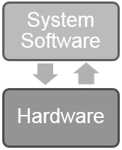
System Software
Directly operates the computer hardware
Provides a platform for running application software
Notes:
System software interacts directly with the computer’s hardware, making the computer run and serving as a layer between the application software and the hardware.
System software makes sure that the hardware does everything the applications want it to do, and helps coordinate the tasks that all the running programs need it to do.

Slide 7
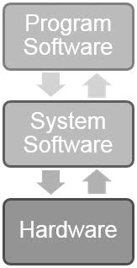
Programming Software
Provides software developers with a programming environment to create, debug, and maintain other programs
Notes:
Programming software provides software developers with a programming environment, which they use to create other programs.

Slide 8
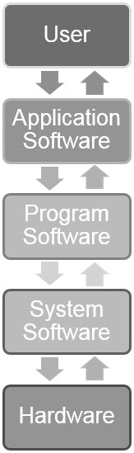
Application Software
End-user programs enable users to accomplish specific tasks
Notes:
Application software offers computer users productivity, entertainment, and communication tools.
This remainder of this lecture focuses on application software.

Slide 9
Software Components: Code
Programming statements/instructions that make a program work
  Example: the .exe file run by a user to install a program
Notes:
The basis of all application software is code. Code contains the programming statements, or instructions, that make a program work.

Slide 10
Software Components: Files
Set of computer instructions
  If the instructions are compiled, these files become a software program
Data stored on disk and used by a program
  .docx files used by Microsoft® Word
  .pdf files read by Adobe® Reader
Notes:
Files are a second software component. Files are either sets of compiled computer instructions - or - sets of data that may be created, retrieved, and used by software.
When we talk about files that are sets of compiled computer instructions, we’re talking about software programs, such as Microsoft Word or Adobe Reader.
When we talk about files that are sets of data that may be created, retrieved, and used by software, we’re talking about things such as a .docx file created using Microsoft Word or a PDF-formatted file that can be opened and read using Adobe Reader.

Slide 11
Software Components: Databases
Stores and retrieves data
  Example: Electronic Medical Records (EMRs) store data in a database
Notes:
Another software component is the database. Databases are optimized for storing and retrieving large amounts of data quickly, correctly, and securely. Databases may or may not be part of a software program.
An example of a database application is an electronic medical record, or EMR.

Slide 12
Application Software Categories
Business
Home/Personal Use
Science and Mathematics
Graphics and Multimedia
Communications
Artificial Intelligence
Health Care
Notes:
Listed here are seven categories of application software. Each category can be subdivided into smaller categories. These categories are not exclusive or distinct—some business applications can be used for home purposes as well. We’ll discuss each of these categories in more depth for the remainder of the lecture.

Slide 13
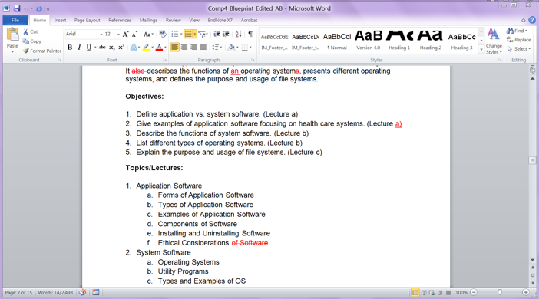
Business/Home Software:
Word Processing
Produces documents
Powerful features
  Auto-correct
  Spell-check
  Grammar-check
  Mail merge
  Tracking changes
  Tables
  Templates
  Web page development
Examples
  Microsoft® Word
  OpenOffice™ Writer
  Corel® WordPerfect ®
  Google Docs™
(software © Microsoft®)
Notes:
Business- and home-use applications often overlap. They include word processing software, spreadsheets, database applications, presentation software, project management software, and accounting applications, to name a few.
Word processing software is used for a variety of purposes, including composing, editing, formatting, sharing, and printing letters, flyers, pamphlets, legal documents, post cards, mailing labels, and much more.
Many word processing applications offer useful features such as auto-correction, spell-checking, grammar-checking, and change tracking for version control.
Examples of word processing applications are Microsoft Word, OpenOffice Writer, Corel WordPerfect, and Google Docs. Pictured is a screenshot from Microsoft Word.

Slide 14
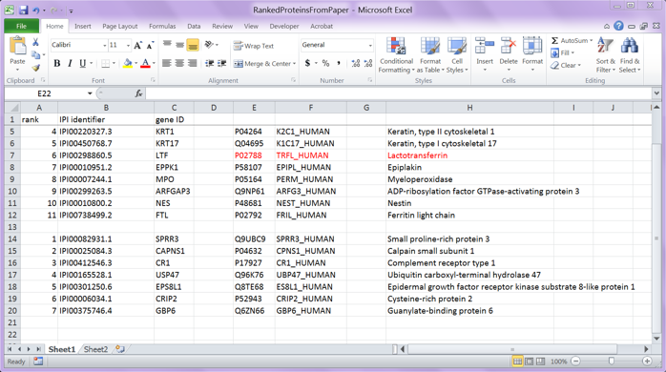
Business/Home Software:
Spreadsheets
Organizes data into columns and rows
Performs calculations on the data
Calculates using formulas and functions
Can generate graphs and charts of data
Examples
  Microsoft® Excel
  Corel® Quattro Pro
  Google Docs™
  Apache OpenOffice™ Calc
(software © Microsoft®)
Notes:
Spreadsheet applications are used for organizing data and performing calculations. These calculations can be performed using built-in functions and user-defined formulas. Also, spreadsheets can generate graphs or charts representing the data. Spreadsheets can be used for anything from tracking simple home expenses to performing complex, powerful calculations on very large datasets. Some examples of spreadsheet applications are Microsoft Excel, Lotus 1-2-3, Corel Quattro-Pro, Google Docs, and Apache OpenOffice Calc. Pictured is a screenshot from Microsoft Excel.

Slide 15
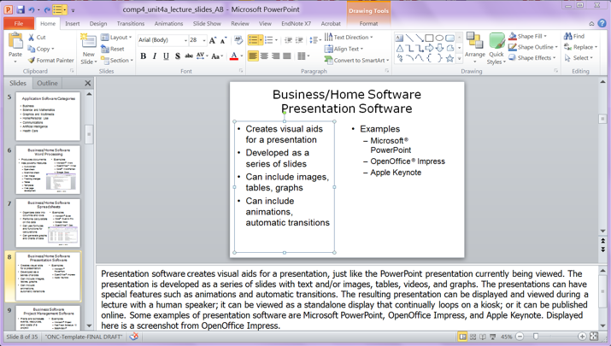
Business/Home Software:
Presentations
Creates visual aids for presentations
Developed as a series of slides
Can include images, tables, graphs
Can include animations, automatic transitions
Examples
  Microsoft® PowerPoint
  OpenOffice® Impress
  Apple Keynote®
(software © Microsoft®)
Notes:
Presentation software lets you design, create, and present demonstrations, simulations, and instructional courses, such as the PowerPoint presentation you’re experiencing right now.
The presentation is developed as a series of slides with text and/or images, tables, videos, and graphs. Presentations can have special features, such as animations and automatic transitions. The resulting presentation can be displayed and viewed during a lecture with a human speaker; it can be viewed as a standalone display that continually loops on a kiosk; or it can be published online. Some examples of presentation software are Microsoft PowerPoint, OpenOffice Impress, and Apple Keynote. Displayed here is a screenshot from Microsoft PowerPoint.

Slide 16
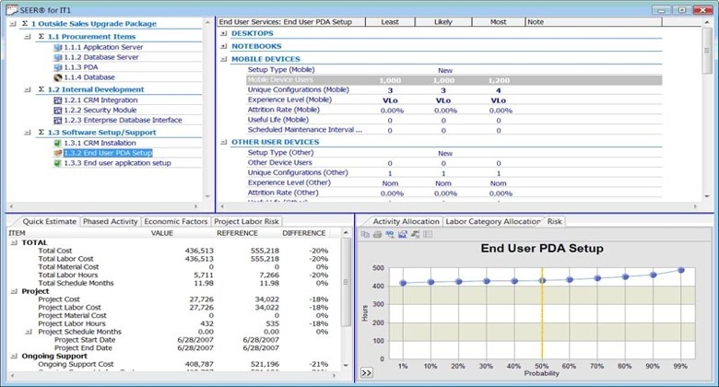
Business/Home Software:
Project Management
Plans and schedules events, resources, and costs of a project
Keeps track of deadlines and deliverables
Examples
  Microsoft®
  Project
  FastTrack
  Schedule 10
  SEER-SEM®
(© Galorath 2017)
Notes:
Project management software helps with planning and scheduling all types of projects. It keeps track of deadlines, deliverables, timelines, milestones, resources, and events.
For complex projects with many contributors, project management software is a must. One popular project management software application is Microsoft Project. Other examples are Fast Track Schedule and SEER-SEM.
This slide shows a screenshot from SEER-SEM. There are many other project management software products, some available as a free downloads online.

Slide 17
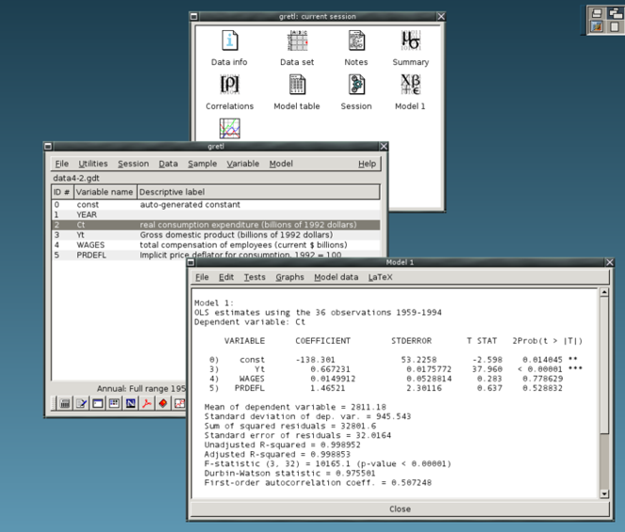
Science and Mathematics Software
Number-crunching software
Runs models and works with large amounts of data
Examples:
  IBM SPSS Statistics
  Gretl
  Matlab®
  Mathematica®
(Cottrell, A, et al. n.d., GNU GPL)
Notes:
There are many science and mathematical applications used for statistical analysis, mathematical modeling, and computational science.
These number-crunching applications are designed to work on large amounts of data.
These applications include statistical packages such as SPSS and Gretl. An open-source version of Gretl is pictured here.
Matlab offers both an interactive environment and high-level language for numeric and symbolic computation, visualization, and programming. It is extensively used in science, engineering, signal and image processing, communications, control systems, computational finance, and many other areas.
Mathematica software is another mathematical package; it provides computational support for engineering, science, and mathematical problems.

Slide 18
Graphics and Multimedia Software: Desktop Publishing
Professional software used to produce high-quality print documents such as textbooks, brochures, and catalogs
Assists with the layout, colors, and graphics
Produces very high resolution output that is suitable for printing
Adobe® PageMaker®, Adobe® FrameMaker®, Microsoft® Publisher, Scribus
Notes:
Graphics and multimedia applications are used to create and edit images, videos, audio, and even video games.
Desktop publishing software is professional-grade software used to produce high-quality print documents such as textbooks, brochures, and catalogs. It provides far more powerful formatting and higher-resolution output than a word processor can. There are several options available for this type of software, including Adobe PageMaker, Adobe FrameMaker, and Microsoft Publisher. Scribus is an open-source option.

Slide 19
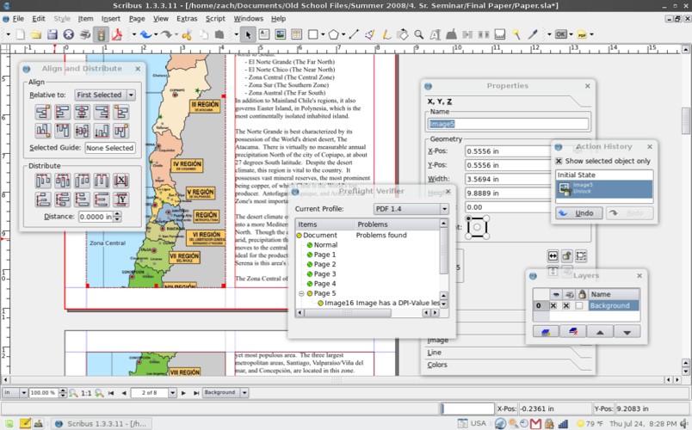
Desktop Publishing Example
(Chiefmanyrabbitguteat, 2008, GNU GPL)
Notes:
This is a screen shot of the desktop publishing software Scribus. Notice the complex formatting and layout tools. They are far more powerful and precise than the options available in a word processor.

Slide 20
Graphics and Multimedia Software: Images/Photos/Paint
Professional image-editing, photo-editing, and paint software
  Image-editing software adds the ability to modify existing images and pictures
    Photo-editing software is a type of image editing software that allows users to edit and customize digital photographs
      Adobe Photoshop®, GIMP, Inkscape
  Paint software allows graphic artists to draw pictures and shapes
Notes:
Professional versions of image-editing, photo-editing, and paint software are used in the workplace by graphic artists and designers.
Image-editing software allows users to edit existing images and photos.
Photo-editing software is a type of image-editing software specifically for digital photographs. This software can retouch photos and add or remove elements from a photo. Some examples are Adobe Photoshop, GIMP, and Inkscape.
Paint software is for drawing shapes and pictures.

Slide 21
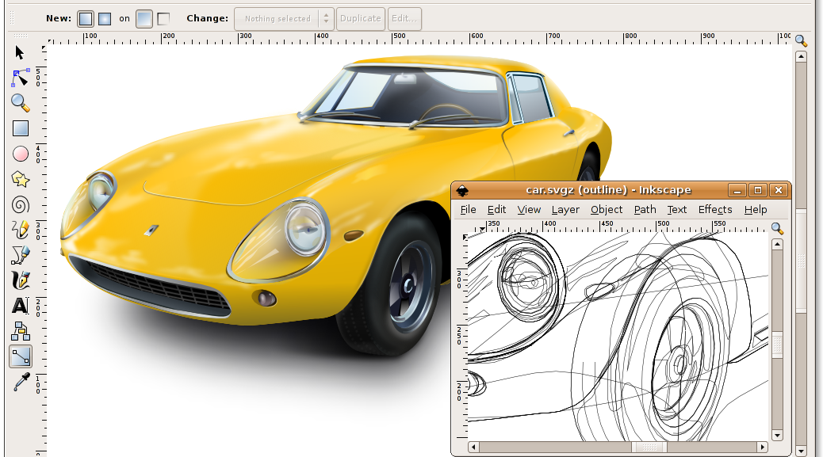
Image Editing Example
(Rotkevich, K., Inkscape. 2007, GNU GPL and Free Art License)
Notes:
This is a screenshot of Inkscape, an open-source image-editing application, and shows different effects applied to a single image.

Slide 22
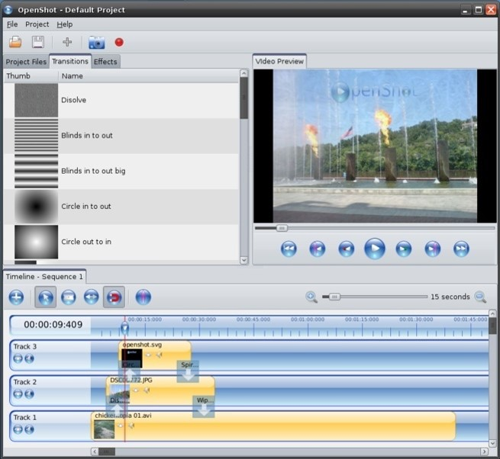
Graphics and Multimedia Software: Video Editing
Modify a video segment called a clip
Delete, reorder, add special effects to clips
Examples
  Adobe Premiere® Elements
  Pinnacle Studio™
  OpenShot Video Editor™
(JonOomp, 2009, GNU GPL)
Notes:
Video editing is another example of graphics and multimedia software. It breaks video into segments called clips. The user can then modify a clip, delete it, rearrange the order of several clips, and add special effects to the clips. Some examples are Adobe Premiere Elements, Pinnacle Studio, and OpenShot. Displayed is a screenshot from OpenShot.

Slide 23
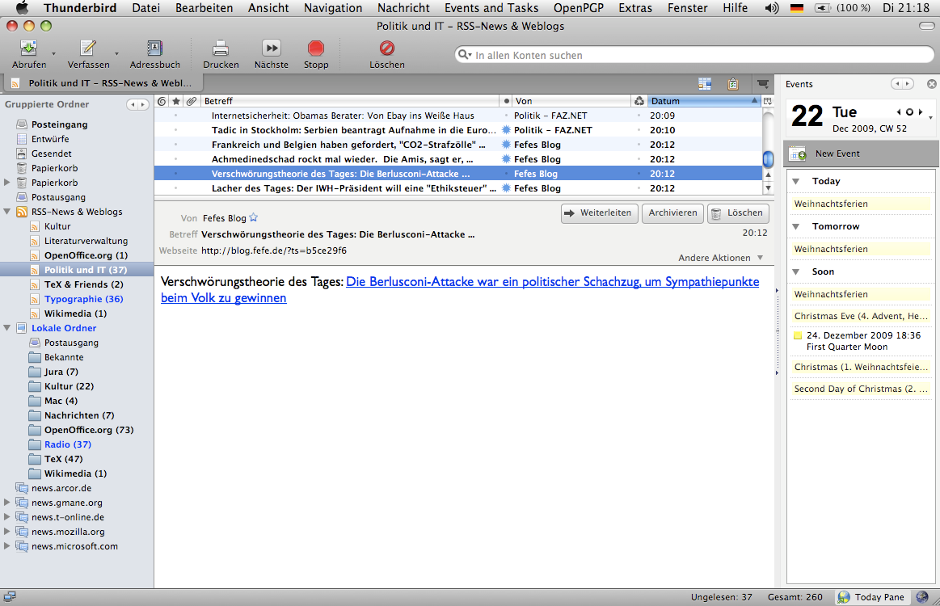
Communication Software
Many different types
  Email
  IM
  FTP
  Web browsers
  VoIP
  Blogs
  Wikis
(Fenn, J. 2009, CC BY 2.0)
Notes:
There are many types of communication software including email, instant messaging, file transfer using file transfer protocol, or FTP, web browsers, voice over internet protocol, or VOIP, blogs, and wikis.
Anything that allows users to communicate over a network would be considered communication software. The screenshot displayed is of Mozilla Thunderbird, an email application.

Slide 24
Artificial Intelligence (AI)
Uses computing to approximate human intelligence
Involves:
  Reasoning and Deduction
  Knowledge Representation and Retrieval
  Natural Language Processing
  Perception
  Learning
  Planning
  Motion
Notes:
Artificial intelligence, or AI, applications use knowledge, reasoning, learning, and other human characteristics for approximating human intelligence. Some examples are voice recognition software, automated online help, and expert systems, among others.
AI has several subareas, including:
Reasoning and deduction. Programming a computer to solve problems quickly is vital for AI.
Knowledge representation and retrieval. In order for computers to act intelligently, they must have extensive knowledge. This knowledge must be represented in a way that can be easily retrieved.
Natural language processing refers to computers being able to "read" and correctly interpret written text.
Perception is the ability to recognize different inputs. Some examples of perception are facial, spatial, and voice recognition.
Learning is the ability to add new knowledge based on existing knowledge.
Planning involves understanding the current state and predicting changes based on computer actions.
Motion is used by intelligent robots to interact with the physical world around them and to navigate and manipulate the environment.

Slide 25
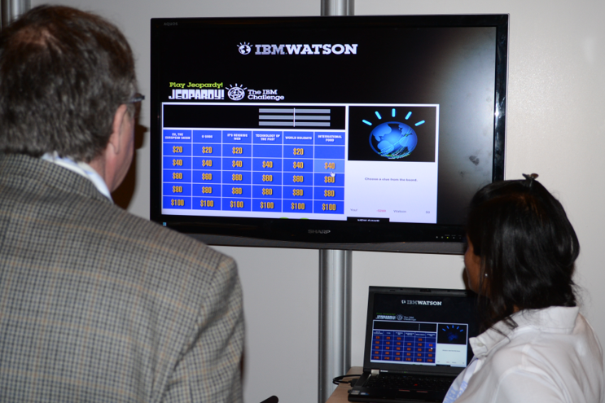
AI Applications
Expert systems
Voice recognition
Robots
Email spam filtering
Video games
Automated online help
(Raysonho, 2011, CC BY 3.0)
Notes:
Health care software includes electronic medical records, health care information systems, medical office management systems, imaging, and telemedicine.
There are many applications that use AI:
Expert systems use rules and directed input from the user to identify possible solutions to a problem. Expert systems are used in medicine for diagnoses, prescribing medication, and for decision making.
Voice recognition is used by many devices today, such as cell phones and Bluetooth wireless devices. Instead of typing commands into a computer or cell phone, you can interact with a computing device through voice recognition software just by talking to it.
Robots use AI to move, perform tasks, navigate, plan, and make decisions.
Even email spam filtering uses AI for identifying and learning which email is spam.
Video games use AI to program game behavior.
There is even automated online help for websites that replaces a human customer service representative. The AI helps find answers to users’ questions through a "conversation.”

Slide 26
Health Care Software
Electronic Health Records (EHRs) and Electronic Medical Records (EMRs)
Health Information Systems
Expert Systems/Decision Support Systems
Medical Office Management Systems
Patient Registries
Imaging
Telemedicine
Notes:
There are many different software applications available for health care. They include electronic health records, or EHRs, and electronic medical records, or EMRs, which both pertain to the medical and health information of an individual.
Health Information Systems are typically used in hospitals or large clinics; they often include an EMR as well as other features, such as physician ordering, medications, decision support, billing, and scheduling.
Expert systems and decision-support systems use AI to analyze knowledge and make decisions as a human expert would.
Medical office management systems also include management features such as scheduling and billing.
Patient registries are datasets relating to a particular medical issue or population that are used to track changes in patients over time. They often provide a more global view over all patients than EMRs can.
Imaging and telemedicine are technologies available in health care to improve care.
Let’s explore some of these applications in more detail.

Slide 27
Examples of EHRs
Epic’s EpicCare EHR system
  http://www.epic.com/software
General Electric’s Centricity EMR system
  http://www3.gehealthcare.com/en/products/categories/healthcare_it/electronic_medical_records/centricity_emr
The Veteran Administration (VA) VistA (Veterans Health Information Systems and Technology Architecture)
  http://www.ehealth.va.gov/EHEALTH/CPRS_demo.asp
Notes:
Displayed here are some examples of EHRs: EpicCare, GE's Centricity, and VistA. Included are URLs you can follow to get more information.

Slide 28
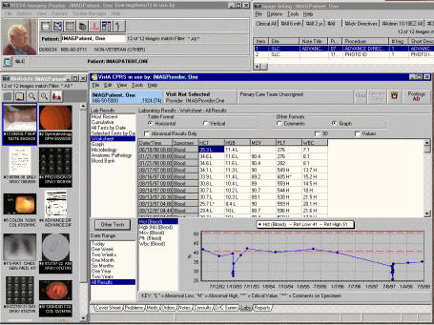
VistA Record Example
(US Department of VA, n.d., PD-US)
Notes:
VistA is one of the first health care information systems that included an EMR. VistA stands for Veterans Information Systems and Technology Architecture. VistA was developed by the U.S. Department of Veterans Affairs and is used by the Veterans Health Administration. This VistA screenshot shows lab result values graphed over time for a particular patient.

Slide 29
Expert Systems
Imitate the decision-making process of a human expert
IBM Watson can be used for decision making in health care
DxPlain (Massachusetts General Hospital) provides diagnosis support and disease reference
MYCIN (Stanford) provided support for bacteria identification and antibiotic recommendations
Notes:
An expert system is a computer system that imitates the decision-making process of a human expert. There are many expert systems used in health care; here are just few examples:
IBM Watson, IBM's intelligent computer system, is being adapted to be an expert decision support system in health care. It will analyze massive amounts of up-to-date information: journal articles, studies, similar cases, and clinical and laboratory findings, among other information, to help medical personnel make decisions about patient care.
For over two decades, DxPlain has provided doctors with diagnosis support in the form of case analysis and an electronic medical textbook. In a clinical setting, given a set of signs, symptoms, and laboratory values, DxPlain can provide a list of possible diagnoses along with explanations. As a medical textbook, it provides detailed information about over 2400 diseases.
MYCIN was developed at Stanford in the 1970s and was one of the first expert systems used in a medical setting. It was capable of identifying bacteria and recommending antibiotics and dosages for treatment.

Slide 30
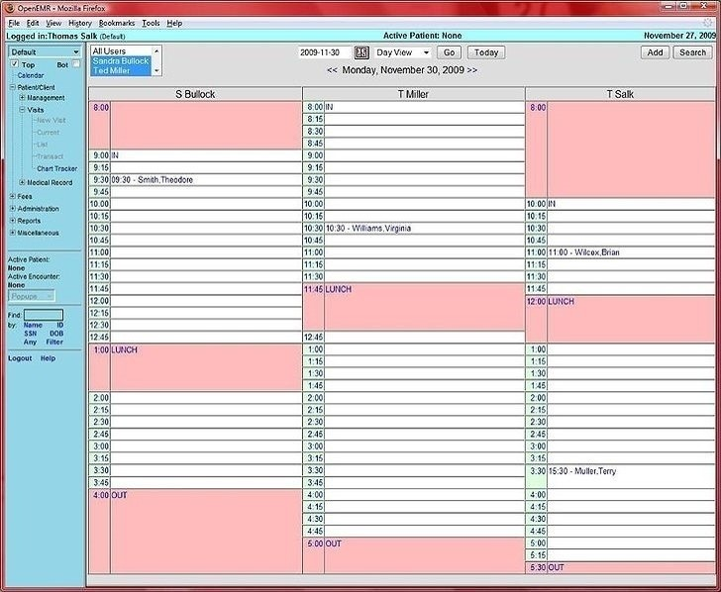
Medical Office
Management Systems
(Miller, 2009, GNU GPL)
Notes:
Medical office management systems provide scheduling and billing support. This is a screenshot from OpenEMR that demonstrates the scheduling feature of the software.

Slide 31
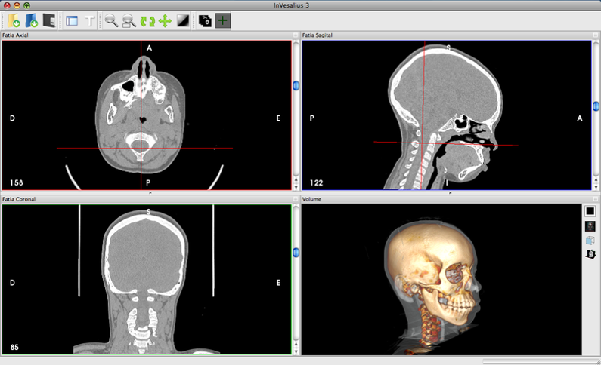
Medical Imaging
(Alchueyr, 2010, CC BY-SA 3.0)
Notes:
Medical imaging is just what it sounds like—capturing, storing, and viewing images of human structures. These images can be generated from diagnostic tools such as X-rays, MRIs, and CAT scans. The software then displays the images for viewing by medical personnel.

Slide 32
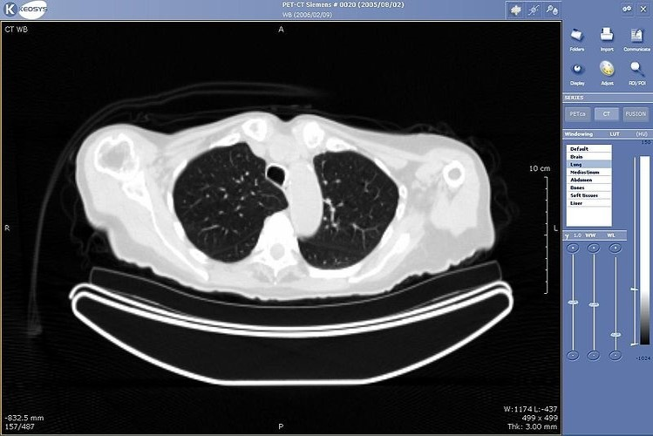
Telemedicine
Clinical medicine where consultations and procedures are managed remotely
(Mco44, 2008, PD-US)
Notes:
Telemedicine is the ability to consult or manage medical procedures remotely. Software that supports telemedicine is crucial—it must be able to display whatever is needed so that the remote work can be done. On the screen is an example of a chest scan used in teleradiology.

Slide 33
Computer Software
Summary - Lecture a
Software makes computers useful
Types of software
  System software
  Application software
  Program software
Application software is vast and varied
In health care application software is common and used for variety of purposes
Notes:
This concludes lecture a of the unit on Computer Software. In summary, this lecture covered software that makes a computer useful. There are three major types of software—application, system, and program software. There are many different types of application software. In health care, the use of application software is very common and it is used for variety of purposes.

Slide 34
Computer Software
References – 1 – Lecture a
References
Barnett GO, Cimino JJ, Hupp JA, Hoffer EP. (1987). DXplain. An evolving diagnostic support system. JAMA. 258(1), 67-74.
Evans A, Martin K, Poatsey MA (2010). Chapter 4: Application Software: Programs That Let You Work and Play. In: Technology in Action: Complete. 7th ed. New Jersey: Prentice Hall.
Gretl [Webpage]. [updated 2011 Oct 17; cited 2011 Nov 11]. Available from http://gretl.sourceforge.net/.
IBM Systems and Technology Group. Watson - A System Designed for Answers. (2011, February). Retrieved from http://www-03.ibm.com/innovation/us/engines/assets/9442_Watson_A_System_White_Paper_POW03061-USEN-00_Final_Feb10_11.pdf.
Inkscape [Webpage]. [cited 2011 Nov 12]. Available from: http://inkscape.org/.
Morley D, and Parker CS. (2010). Chapter 5: Application Software. In: Understanding Computers Today and Tomorrow. 12th ed. Boston: Course Technology.
Notes:
References slide. No audio.

Slide 35
Computer Software
References – 2 – Lecture a
References
Mozilla Thunderbird wiki [Webpage]. Available at: https://wiki.mozilla.org/Thunderbird:Home.
Mycin [Webpage]. [cited 2011 Nov 11]. Available at: https://en.wikipedia.org/wiki/Mycin.
OpenOffice.org: The Free and Open Productivity Suite. 2011; [cited 2011 Nov 11]. Available from: http://www.openoffice.org/.
Scribus [Webpage]. [cited 2011 Nov 12]. Available from: https://www.scribus.net/.
SEER-SEM [Webpage]. Cited 2011 Nov 12 as retrieved from http://www.galorath.com/index.php/products/software/C5/. [2017, Feb 22: Galorath website at http://galorath.com/.]
Shelley GB, Vermaat ME (2010). Chapter 3: Application Software. In: Discovering Computers 2011: Introductory. 1st ed. Boston: Course Technology.
OpenShot [Webpage]. [cited 2011 Nov 11]. Available from: http://www.openshotvideo.com/.
Notes:
References slide. No audio.

Slide 36
Computer Software
References – 3 – Lecture a
Images
  Slide 13: Microsoft Word screenshot image. Microsoft [software]. Copyright Microsoft®.
  Slide 14: Microsoft Excel screenshot image. Microsoft [software]. Copyright Microsoft®.
  Slide 15: Microsoft PowerPoint screenshot image. Microsoft [software]. Copyright Microsoft®.
  Slide 16: SEER - SEM [SEER for IT]. Galorath. Retrieved February 24, 2017 from http://galorath.com/wp-content/uploads/2014/08/seer-it-screenshot6-large.jpg. Accessed through SEER for IT page at http://galorath.com/products/it/SEER-software-estimation-IT-projects. Copyright 2017 Galorath.
  Slide 17: Gretl screenshot image. Cottrell, A., Lucchetti, R. on Gretl website. (n.d.). Retrieved from http://gretl.sourceforge.net/gretl_screen.html. Licensed under the GNU General Public License.
  Slide 19: Scribus screenshot. User: Chiefmanyrabbitguteat (2008). Retrieved November 8, 2011 from http://en.wikipedia.org/wiki/File:Scribus-1.3-Linux.png. Licensed under the GNU General Public License.
Notes:
References slide. No audio.

Slide 37
Computer Software
References – 4 – Lecture a
Images
  Slide 21: Inkscape screenshot. Rotkevich, K. [art] and Inkscape [software]. 2007. Retrieved Feb 22, 2017 from https://commons.wikimedia.org/wiki/File:Inkscape_0.46.png. Licensed under the GNU General Public License and Free Art License.
  Slide 22: OpenShot Video Editor screenshot. JonOomp (2009, June 19). Retrieved November 8, 2011 from: http://commons.wikimedia.org/wiki/File:Screenshot_of_OpenShot.png. Licensed under the GNU General Public License.
  Slide 23: Thunderbird 3.0 unter Mac OS X. Fenn, J. (2009, December 22). Retrieved May 4, 2016 from https://www.flickr.com/photos/juergenfenn/4206376731. Licensed under the Creative Commons Attribution 2.0 Generic License.
  Slide 25: IBM Watson image. Raysonho (2011, April 7). Retrieved November 8, 2011 from: http://en.wikipedia.org/wiki/File:IBMWatson.jpg. Licensed under the Creative Commons Attribution 3.0 Unported License.
Notes:
References slide. No audio.

Slide 38
Computer Software
References – 5 – Lecture a
Images
Slide 28: VistA screenshot showing lab result values graphed over time for a particular patient. U.S. Department of Veterans Affairs (n.d.). Retrieved November 8, 2011 from: https://www.va.gov/health/imaging/overview.asp. This image is in the Public Domain.
Slide 30: Screenshot of the OpenEMR scheduling calendar. Miller, B. (2009, November 28). Retrieved November 8, 2011 from: http://en.wikipedia.org/wiki/File:OpenEMR-Calendar.jpg. Licensed under the GNU General Public License.
Slide 31: InVesalius medical imaging software screenshot. Alchueyr, T. (2010, January 30). Retrieved November 8, 2011 from: http://en.wikipedia.org/wiki/File:Invesalius3_promed0446.png. Licensed under the Creative Commons Attribution-ShareAlike 3.0 Unported License.
Slide 32: CT viewer chest Keosys. Mco44 (2008, February 19). Retrieved November 8, 2011 from: http://en.wikipedia.org/wiki/File:CT_viewer_Chest_Keosys.JPG. This image is in the Public Domain.
Notes:
References slide. No audio.

Slide 39
Introduction to Computer Science
Computer Software
Lecture a
This material was developed by Oregon Health & Science University, funded by the Department of Health and Human Services, Office of the National Coordinator for Health Information Technology under Award Number 90WT0001.
Notes:
No audio.

