Slide 1
Terminology in Healthcare and Public Health Settings
Nervous System
This material (Comp 3 Unit 9) was developed by the University of Alabama at Birmingham, funded by the Department of Health and Human Services, Office of the National Coordinator for Health Information Technology under Award Number 90WT0007.
This work is licensed under the Creative Commons Attribution-NonCommercial-ShareAlike 4.0 International License. To view a copy of this license, visit http://creativecommons.org.
Notes:
Welcome to Terminology in Healthcare and Public Health Settings, The Nervous System. In this unit, we will review the nervous system.

Slide 2
Nervous System
Learning Objectives
Define, understand and correctly pronounce medical terms related to the nervous system
Describe common diseases and conditions with an overview of various treatments related to the nervous system
Notes:
The Objectives for this unit, Nervous System, are to:
Define, understand and correctly pronounce medical terms related to the Nervous System.
Describe common diseases and conditions with an overview of various treatments related to the Nervous System.

Slide 3
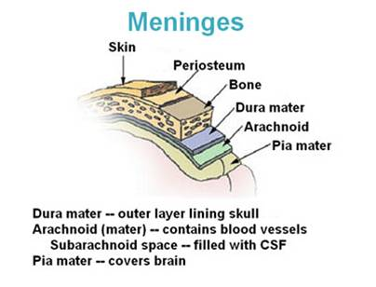
Nervous System Anatomy
Brain encased in the skull
  Protective coverings with three meninges
    Pia mater
    Arachnoid
    Dura mater
Spinal cord encased in the vertebral canal
Notes:
Let’s start with a brief overview of the anatomy of the nervous system. The nervous system is composed of two major divisions: the central nervous system and the peripheral nervous system.
The central nervous system is composed of the brain and the spinal cord. The brain is encased in the skull and the spinal cord is encased in the vertebral canal.
The brain has three protective coverings. These layers, or meninges (pronounced men-in-jeez), are the pia mater (pronounced pee-uh-mott-er), the arachnoid (pronounced uh-rack-noid), and the dura mater (pronounced dure-uh-mott-er).
The pia mater, the innermost layer, is a thin and delicate inside covering.
The arachnoid is the middle layer with subarachnoid space, which is filled with cerebrospinal (pronounced sir-reeb-ro-spinal) fluid.
The dura mater, or outer layer, lines the inner surface of the cranium, or skull.
The brain and spinal cord receive, store, and process the body’s sensory and motor data. They also control consciousness.

Slide 4
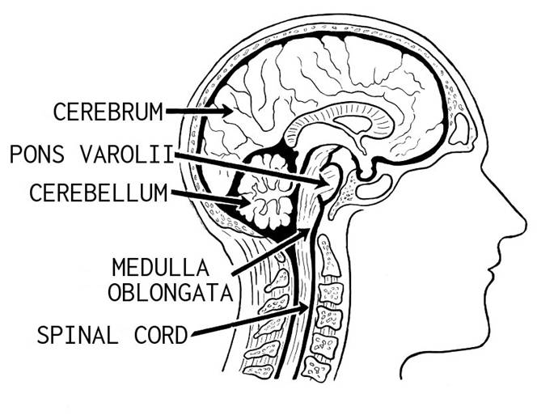
Nervous System Anatomy 2
Cerebrospinal fluid
  subarachnoid space
  spinal cord
  ventricles
Cerebrum – largest part of brain
    Divided into two hemispheres
    Cerebral cortex – primary motor and sensory areas
Notes:
There is also cerebrospinal fluid in the ventricles (pronounced VENT-trickles) of the brain and surrounding the spinal cord.
The largest part of the brain, the cerebrum (pronounced sir-REEB-rum), is divided into two major portions called hemispheres. Both hemispheres allow you to analyze sensory data, to perform memory functions, to acquire new information, and to allow decision-making.

Slide 5
Nervous System Anatomy 3
Hypothalamus
  Regulation of:
    appetite
    heart rate
    body temperature
    water balance
    Digestion
    sexual activity
Cerebellum
  Second largest part of brain
  Controls unconscious actions
Notes:
The hypothalamus assists in the regulation of appetite, heart rate, body temperature, water balance, digestion and sexual activity. It is located beneath the cerebral (pronounced sir-REEB-rill) hemispheres.
The cerebellum (pronounced ser-ruh-BELL-um) is the second largest part of the brain. It helps coordinate movement, including balance and muscle coordination. For example, it receives information from one of the sense organs in the ear that detects body position and sends these impulses to the muscles to assist in maintaining the body’s posture.
The medulla oblongata (pronounced muh-dull-uh-oblong-ott-uh) is the enlarged portion of the brain stem.
The pons (pronounced ponz (like ponds without the d) connects the cerebellum and the medulla oblongata with the upper portions of the brain.

Slide 6
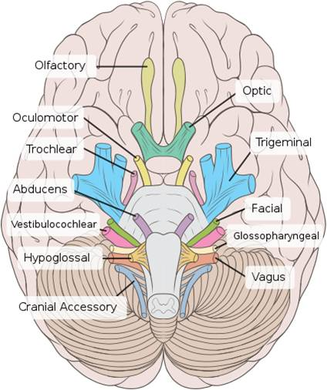
Cranial Nerves
I Olfactory
II Optic
III Oculomotor
IV Trochlear
V Trigeminal
VI Abducens
VII Facial
VIII Auditory
IX Glossopharygeal
X Vagus
XI Spinal Accessory
XII Hypoglossal
Notes:
The peripheral nervous system refers to all the nervous tissue that is outside the brain and spinal cord. The peripheral nervous system is composed of the cranial (pronounced crane-ee-uhl) nerves and the spinal nerves.
As you can see in this slide, there are twelve pairs of cranial nerves that carry messages to and from the brain. They are referred to using Roman numerals but also have a name associated with their function.

Slide 7
Cranial Nerve Functions
Cranial Nerve Major Function
Olfactory Smell
Optic Vision
Oculomotor Eyelid and eyeball movement
Trochlear Innervates superior oblique eye muscle
Trigeminal Chewing, face & mouth
Abducens Turns eye laterally
Facial Controls facial expressions
Auditory Hearing; equilibrium
Glossopharygeal Taste; senses carotid blood pressure
Vagus Senses aortic blood pressure; slows heart rate
Spinal Accessory Controls neck & shoulder muscles
Hypoglossal Controls tongue movements
Notes:
Familiarize yourself with this listing of the cranial nerves and their major functions.

Slide 8
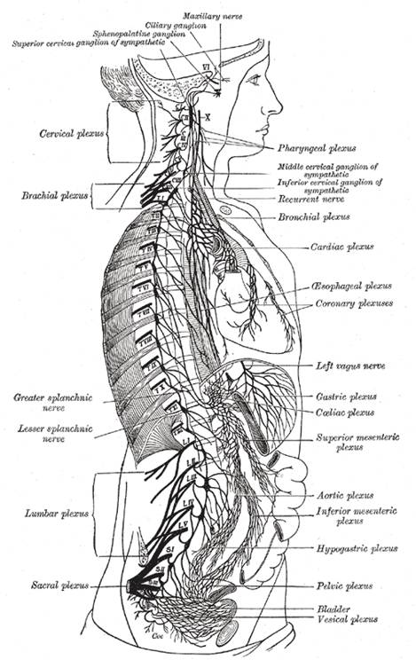
Spinal Nerves
31 pairs
Numbered according to the vertebra at which they exit the spinal column
    Spinal nerve T4, exits the spinal column through the foramen in the 4th thoracic vertebrae
Notes:
There are 31 pairs of spinal nerves which branch off from the spinal cord. The spinal nerves carry messages to and from the spinal cord.
In the cervical region of the spinal cord, the spinal nerves exit above the vertebrae (pronounced ver-tuh-bray) until the seventh cervical vertebra. At that point, the spinal nerves begin to exit below the equivalent numbered vertebrae.
The spinal nerves which leave the spinal cord are numbered according to the vertebra at which they exit the spinal column. For example, the spinal nerve that leaves at T4 (pronounced T four) exits the spinal column through the foramen (pronounced for-RAY-men) in the fourth thoracic (pronounced thor-ass-sick) vertebra.

Slide 9
Alzheimer’s Disease
Symptoms
  Dementia
Progressive
Treatment
  Medications
Notes:
Let’s move on to the various disorders and diseases of the brain.
Dementia is a brain disorder that seriously affects a person’s ability to carry out daily activities. Alzheimer’s disease is the most common form of dementia among older people. Alzheimer’s begins slowly by first involving the parts of the brain that control thought, memory and language. Over time, symptoms get worse. People may not recognize family members, forget how to brush their teeth, and eventually may become anxious or aggressive. Eventually, people with Alzheimer’s disease require assistance with all the activities of daily living. Alzheimer’s disease usually begins after age 60. No treatment can stop the disease; however, some drugs may help keep symptoms from getting worse for a limited time.

Slide 10
Brain Aneurysm
Symptoms
  Depend on location
Treatment
  Depends on
    location
    size
    presence of infection
    whether ruptured
Notes:
Another brain disorder involves an abnormal bulge or “ballooning” in the wall of an artery in the brain. This is called a brain aneurysm. Most brain aneurysms produce no symptoms until they become large and begin to leak blood, or rupture. Symptoms may depend on where in the brain the aneurysm is located. Symptoms could include a droopy eyelid, double vision or other changes in vision, pain above or behind the eye, a dilated pupil and numbness or weakness on one side of the face or body.
Treatment depends on the size and location of the aneurysm, if infection is present, or whether it has ruptured or not.

Slide 11
Brain Cancer
Primary versus metastatic
Symptoms
Notes:
There are two main types of brain cancer. Primary brain cancer begins to grow in the brain. Metastatic brain cancer starts somewhere else in the body and moves to the brain. Brain tumors can be benign, without cancerous cells, or malignant, with cancerous cells. Symptoms include headaches, nausea and vomiting; changes in your ability to talk, hear or see; problems with balance; problems with thinking; muscle jerking; and numbness or tingling in arms or legs. There is no known cause for brain cancer. Treatment depends on the type of cancer and how advanced the cancer is.

Slide 12
Epilepsy
Recurring seizures
  Brain injury
  Abnormal brain development
Diagnostic Tests
  Brain scans
Treatment
  Medicines
  Surgery
  Implanted nerve stimulators
Notes:
Another serious brain disorder is called epilepsy. Epilepsy is a brain disorder that causes people to have recurring seizures. The seizures occur when clusters of nerve cells, or neurons, in the brain send out the wrong signals. There are many possible causes of epilepsy, including illness, brain injury, or abnormal brain development. Sometimes the cause is unknown. Diagnostic tests include brain scans. There is no cure but medicines can control seizures for most people. Other treatments include surgery or implanted devices such as vagus (pronounced vague-us) nerve stimulators.

Slide 13
Parkinson’s Disease
Affects nerve cells that control muscle movement
  Failure of dopamine neurons
Symptoms
  Trembling
  Stiffness and Slowness
  Poor balance and coordination
Treatment
  No cure
  Medicines can help reduce symptoms
Notes:
Parkinson’s disease is a disorder that affects nerve cells in a part of the brain that controls muscle movement. In Parkinson’s, neurons that make a chemical called dopamine (pronounced dope-uh-meen) die or do not work properly. Dopamine normally sends signals that help coordinate movements. Symptoms include trembling of hands, arms, legs, jaw and face; stiffness of the arms, legs and trunk; slowness of movement; and poor balance and coordination. Parkinson’s usually begins around age 60 and it is more common in men than women. There is no cure, but a variety of medicines help reduce symptoms.

Slide 14
Stroke
Ischemic
Hemorrhagic
Transient ischemic attacks (TIAs)
Symptoms
  Sudden headache, weakness, numbness
  Trouble speaking, balancing, walking
Treatments
  Medicines
Notes:
A cerebrovascular (pronounced sir-reeb-ro-vascular) stroke occurs when blood flow to your brain stops. Within minutes, brain cells begin to die. There are two kinds of stroke. The more common kind is called ischemic stroke and is caused by a blood clot that blocks a blood vessel in the brain. The other kind, called a hemorrhagic (pronounced hem-or-agic (like magic) stroke, is cause by a blood vessel that breaks and bleeds into the brain. Transient ischemic attacks, or TIAs (pronounced T-I-A’s), occur when the blood supply to the brain is briefly interrupted. Symptoms include sudden numbness or weakness in face, arm, leg; sudden confusion; trouble speaking, seeing, or walking; dizziness; loss of balance; and severe headache with no known cause. Treatment includes drug therapy with blood thinners.

Slide 15
Arteriovenous Malformations (AVMs)
Description
  Snarled tangle of arteries and veins
Treatment
  Surgery
  Radiation
Notes:
Arteriovenous (pronounced ar-teer-ee-oh-venous) malformations or AVMs (pronounced A-V-M’s) are defects in your circulatory system. The circulatory system includes the arteries, veins and capillaries that carry blood to and from the heart. An AVM is a snarled tangle of arteries and veins. It interferes with the blood circulation in an organ. The cause of AVMs is unknown, though they develop during pregnancy or soon after birth. The greatest danger is hemorrhage. Treatment is in the form of prevention and can include surgery or focused radiation therapy.

Slide 16
Meningitis
Inflammation of meninges
  Viral
  Bacterial
Symptoms
  Sudden fever
  Severe headache
  Stiff neck
Treatment
  Medications
  Vaccination for prevention
Notes:
Meningitis is the inflammation of the meninges, (pronounced men-IN-jeez), the thin tissue that surrounds the brain and spinal cord. There are several types of meningitis. The most common is viral meningitis, which you develop when a virus enters the body through the nose or mouth and travels to the brain. Bacterial meningitis is rare, but can be deadly. Symptoms of meningitis include a sudden fever, a severe headache and a stiff neck. Treatment can prevent serious problems including death. Vaccines can prevent some of the bacterial infections that cause meningitis.

Slide 17
Multiple Sclerosis (MS)
Damage to myelin sheath
Visual disturbances
Sensory, muscle and balance problems
Thinking and memory problems
Medicines, physical and occupational therapy
Notes:
Multiple Sclerosis or MS is a nervous system disease that affects your brain and spinal cord. It damages the myelin sheath, the material that surrounds and protects your nerve cells. This damage slows down or blocks messages between your brain and your body. Symptoms can include visual disturbances, muscle weakness, trouble with coordination and balance, sensations such as numbness, prickling, and thinking and memory problems. The cause of MS is unknown. MS affects women more than men and usually begins between the ages of 20 and 40. There is no cure but medicines may slow it down and help control symptoms. Physical and occupational therapy may help also.

Slide 18
Bell’s Palsy
Temporary paralysis of face muscles
May be due to a viral infection
Most people recover in 3-6 months
Notes:
Bell’s Palsy is a condition where the muscles in your face become temporarily paralyzed. It usually affects just one side of the face. Symptoms appear suddenly. You cannot shut your eye and your mouth droops. Symptoms are usually worst about 48 hours after they start. Scientists believe that a viral infection makes the facial nerve swell or become inflamed. People who are pregnant, diabetic or sick with a cold or flu are more likely to have Bell’s Palsy. Patients usually improve with or without treatment within 2 weeks and most recover completely within 3 to 6 months.

Slide 19
Carpal Tunnel Syndrome
Also called median nerve entrapment
Nerve compression at the base of the hand
Symptoms
  Inability to grasp
  Pain
Treatment
  Splints
  Anti-inflammatory medicines
  Surgery
Notes:
The carpal tunnel is a narrow passageway of ligaments and bones at the base of your hand. It contains nerves and tendons. Sometimes the thickening of the tendon or swelling in the area narrows the tunnel and causes nerve compression. Symptoms include inability to grasp objects, and sharp pain through the wrist and up the arm. Causes vary but some are work-related. Women are three times more likely to have it. Treatment includes resting your hand, splints, anti-inflammatory medications and surgery.

Slide 20
Peripheral Nerve Disorders
Also called neuritis or peripheral neuropathy
Symptoms
  Numbness or tingling
  Pain or burning
  Muscle weakness
  Sensitivity to touch
Treatment
  Treat underlying problem
  Reduce pain and control symptoms
Notes:
Peripheral nerve disorders, also called neuritis (pronounced nure-eye-tiss)or peripheral neuropathy (pronounced nure-opp-uh-thee (like theory), interrupt the messages between the brain and the rest of the body. There are more than 100 kinds of peripheral nerve disorders and they can affect one nerve or many nerves. Some are the result of other diseases, like diabetic neuropathy. Others, like Guillain-Barre ( Pronounced gee (g like in again) ann bar-ray) syndrome, happen after a virus infection. Still others, like carpal tunnel syndrome, occur due to nerve compression. Symptoms include numbness, pain, burning or tingling, muscle weakness and sensitivity to touch. Treatments aim to treat the underlying problem, reduce pain and control symptoms.

Slide 21
Neurofibromatosis
Recklinghausen’s (or von Recklinghausen’s) Disease
Type 1
  Skin changes and deformed bones
Type 2
  Hearing loss, ringing in ears, poor balance
Type 3
  Schwannomatosis
  Intense pain
Treatment
  Surgery, radiation, medications
Notes:
Neurofibromatosis is a genetic disorder of the nervous system. It mainly affects how nerve cells form and grow. It causes tumors to grow on nerves. You can get neurofibromatosis genetically, from your parents, or it can happen because of a mutation (or change) in your genes. Once you have it, you can pass it along to your children.
There are three types of neurofibromatosis:
Type 1 causes skin changes and deformed bones, and usually starts at birth.
Type 2 causes hearing loss, ringing in the ears and poor balance, and often starts in the teen years.
The third type, schwannomatosis (pronounced shwan-oma-tosis), causes intense pain. It is the rarest type.
There is no cure for neurofibromatosis. Treatment is directed at controlling symptoms. Depending on the type of disease and how bad it is, treatments may include surgery to remove tumors, radiation therapy and medicines.

Slide 22
Nervous System Combining Forms
Word Part | Meaning | Key Terms
Cerebell/o | Cerebellum | Cerebellar
Cerebr/o | Cerebrum | Cerebral
Crani/o | Cranium | Cranioclasis
Mening/o | Meninges | Meningioma
Myel/o | Marrow | Myelitis
Plegia | Paralysis | Quadriplegia
Thalam/o | Thalamus | Thalamotomy
Notes:
Here are some additional key word parts for the nervous system along with their meanings. In the third column you can see some of the medical terms that we can create by combining word parts.
You should return to the online medical dictionary to hear the pronunciation and become familiar with the meaning of the created terms.

Slide 23
Tell me, Detective . . .
The patient presents urgently to the Emergency Department with complaints of double vision, pain behind the eye, and numbness on the side of the face. The physician notes a dilated pupil and a droopy eyelid. Based on the symptoms, what is a likely diagnosis to investigate?
Notes:
And finally, use your detective skills to study the case described on the slide and see if you can come up with a diagnosis.
Did you guess an aneurysm? A brain aneurysm is an abnormal bulge or “ballooning” in the wall of an artery in the brain. They are sometimes called “berry aneurysms” because they are often the size of a small berry. Most brain aneurysms produce no symptoms until they become large, begin to leak blood, or rupture.
The symptoms associated with an aneurysm can include:
Droopy eyelid
Double vision or other vision changes
Pain above or behind the eye
A dilated pupil
Numbness or weakness on one side of the face or body

Slide 24
Nervous System
Summary
Define, understand and correctly pronounce medical terms related to the nervous system
Describe common diseases and conditions with an overview of various treatments related to the nervous system
Notes:
This concludes the Nervous System.
In summary, you should be able to describe and pronounce medical terms related to the nervous system. In addition, you should be able to describe common diseases and conditions, with an overview of various treatments, related to the nervous system.

Slide 25
Nervous System
References
References
  MedllinePlus [Internet]. Brain and nerves. Bethesda (MD): National Library of Medicine (US); [updated 2011 Jul 27]. Available from: www.nlm.nih.gov
Images
  Slide 4, 5: Available From: commons.wikimedia.org
  Slide 6: Available From: commons.wikimedia.org
  Slide 8: Available From: en.wikipedia.org
Notes:
“No Audio”

Slide 26
Terminology in Health Care and Public Health Settings
Nervous System
This material was developed by the University of Alabama at Birmingham, funded by the Department of Health and Human Services, Office of the National Coordinator for Health Information Technology under Award Number 90WT0007.
Notes:
No Audio.

