Slide 1
Terminology in Healthcare and
Public Health Settings
Endocrine System
Lecture b – Other Organs in the Endocrine System
This material (Comp 3 Unit 7) was developed by the University of Alabama at Birmingham, funded by the Department of Health and Human Services, Office of the National Coordinator for Health Information Technology under Award Number 90WT0007.
This work is licensed under the Creative Commons Attribution-NonCommercial-ShareAlike 4.0 International License. To view a copy of this license, visit http://creativecommons.org.
Notes:
Welcome to Terminology in Healthcare and Public Health Settings, Endocrine System. This is lecture b, Other Organs in the Endocrine System.

Slide 2
Endocrine System
Learning Objectives
Define, understand and correctly pronounce medical terms related to the endocrine system
Describe common diseases and conditions with an overview of various treatments related to the endocrine system
Notes:
The objectives for the Endocrine System are to:
Define, understand and correctly pronounce medical terms related to the endocrine system.
Describe common diseases and conditions with an overview of various treatments related to the endocrine system.

Slide 3
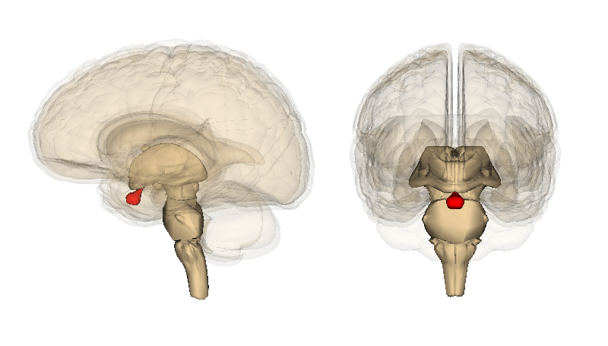
Pituitary Gland – Overview
Also known as the “hypophysis”
Located on the underside of the brain in a depression at the base of the skull
About the size of a pea or 1 centimeter in diameter
Connected to the brain by a slender stalk-like projection referred to as the “infundibulum
Known as the “master gland”
Source: (Pituitary, 2010)
Notes:
The pituitary gland, also known as the “hypophysis” (pronounced high-POFF-ih-sis), is a small gland about one centimeter in diameter located at the base of the skull in a depression of the sphenoid (pronounced sphee-noid) bone known as the sella turcica (pronounced terse-ick-uh).
The gland is connected to the hypothalamus of the brain by a slender stalk called the infundibulum (pronounced in-fund-DIBB-you-lum).
The pituitary gland is also known as the “master gland” because it produces or secretes a variety of hormones that are transported through the body and direct other glands to produce their hormones.

Slide 4
Pituitary Gland Hormones
Prolactin
Growth Hormone (GW)
Adrenocorticotropin (ACTH)
Thyroid-stimulating hormone (TSH)
Notes:
The following is a list of hormones produced in the pituitary gland along with a brief description of their functions.
Prolactin is responsible for the development of breasts in females and lactation after birth.
Growth hormone or GH (pronounced G-H) is responsible for generating the growth and development of bones and other tissues in our body.
Adrenocorticotropin or ACTH (pronouced A-C-T-H) promotes the release of cortisol, another hormone, which is produced by the adrenal glands.
Thyroid-stimulating hormone or TSH (pronounced T-S-H) promotes the release of hormones from the thyroid gland and assists in the regulation of metabolic processes in our body.

Slide 5
Pituitary Gland Hormones 2
Antiduretic hormone (ADH)
Luteinizing hormone (LH)
Follicle-stimulating hormone (FSH)
Notes:
Antidiuretic hormone or ADH assists with the regulation of water absorption preventing us from losing excessive amounts of water in urination.
Luteinizing (pronounced Loot-tee-in-izei-ing) hormone or LH assists in the regulation or secretion of the hormone estrogen in females and testosterone in males.
Follicle-stimulating hormone--or FSH--assists the reproductive organs--the testes and ovaries--in the production of sperm in males and ova in females.

Slide 6
Pituitary Gland Disorders
Growth Disorders
  Growth Hormone (GH) in the pituitary gland stimulates the growth of bone and other tissues
  Too little GH results in dwarfism
    A person of short stature, under 4’10’’, as an adult
      Achondroplasia causes about 70% of all dwarfism
  Too much GH results in gigantism
    Children – bones and body grow too much
    Adults – acromegaly (hands, feet and face are larger than normal)
Notes:
With pituitary disorders, you often have too much or too little of one of your hormones. Injuries can cause pituitary disorders, but the most common cause is a pituitary tumor.
As we have learned, the pituitary gland makes growth hormone, which stimulates the growth of bone and other tissues. Children who have too little of it may be very short. A dwarf is a person of short stature - under 4 feet 10 inches as an adult. More than two hundred different conditions can cause dwarfism. A single type, achondroplasia (pronounced A-con-dro-PLAY-zhuh), is responsible for approximately seventy percent of all dwarfism. Dwarfism is NOT a disease. Treatment with growth hormone can stimulate growth. With proper medical care, most people with dwarfism have active lives and live as long as other people.
Individuals can also have too much growth hormone. Usually the cause is a pituitary tumor, but not a cancerous one. Too much growth hormone can cause gigantism (pronounced Gi (like giant)-GAN-tism) in children, where their bones and their body grow too much. In adults, too much GH results in acromegaly (pronounced ACK-ro-MEG-uh-lee), in which the hands, feet, and face are larger than normal.

Slide 7
Pituitary Gland Disorders 2
Diabetes insipidus (DI)
  Symptoms
    Frequent urination
    Extreme thirst
  Less common than DM
  Result of a problem with the pituitary gland or kidneys
  Treatment depends on the cause of the disorder
    Medications may be helpful
Notes:
Diabetes insipidus (pronounced in-SIP-ih-dus) or DI (pronounced D-I), causes frequent urination. A person becomes extremely thirsty and drinks. The drinking results in frequent urination and a cycle of drinking and urinating can prevent adequate sleep and even encourage bed wetting. The body produces large volumes of urine, almost all water.
DI is different from diabetes mellitus which is abbeviated DM (pronounced D-M). DM is related to the lack of production and/or the body’s use of insulin. While the symptoms can be similar, DI is related to how your kidneys handle fluids in the body. It is less common than DM.
Diagnostic tests on urine and blood can determine which condition you have.
Usually, DI is caused by a problem with your pituitary gland or your kidneys. Treatment depends on the cause of the problem. Medicines can often help.

Slide 8
Pituitary Gland Tumors
Pituitary tumors are fairly common
  1 in 10,000
Characteristics
  Grow slowly
  Do not spread
  Usually not cancerous
Most common tumors produce hormones and may result in conditions such as:
  Cushing’s Syndrome
  Hyperthyroidism
Notes:
Pituitary tumors are fairly common; statistics indicate that about one in 10,000 persons will develop a pituitary tumor.
Pituitary tumors grow slowly, do not spread, and are usually not cancerous.
The most common type of pituitary tumor produces hormones and affects the balance of the hormones in the body. This type of tumor may result in conditions such as: Cushing’s Syndrome and hyperthyroidism.
Symptoms of pituitary tumors include vision problems, nausea and vomiting, and other problems caused by the overproduction of hormones.
Pituitary tumors are generally curable. Treatment is often surgery to remove the tumor. Other treatment options include medications, radiation, or radiosurgery.

Slide 9
Pituitary Gland Diagnostic Tests
Diagnostic Tests
  Adrenocorticohormone Test
  Aldosterone and Renin Tests
  Follicle-stimulating Hormone Test
  Growth Hormone Test
  Insulin-like Growth Factor-1 Test
  Lutenizing Hormone Test
  MRI of the Head
Source: (Pituitary, 2010)
Notes:
Physicians conduct (pronounced con-DUCT) a variety of clinical tests to diagnose pituitary disorders and diseases. Examples of these tests include Adrenocorticohormone (pronounced Uh-DREEN-o-COR-tick-oh-hormone).
Aldosterone (pronounced Al-DOSS-terone) and Renin (pronounced Rennin) Test, Follicle-stimulating Hormone Test, Growth Hormone Test, Insulin-like Growth Factor 1 Test, Luteinizing Hormone Test, and Magnetic Resonance Imaging or MRI of the head, which is a radiological examination.

Slide 10
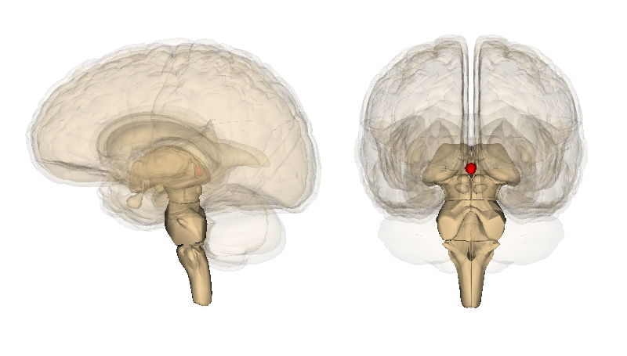
Pineal Gland
Pineal Gland
  Also called the pineal body or epiphysis cerebri
  Small cone-shaped structure attached to a portion of the brain (cerebrum) by a stalk
Notes:
Let’s move now to the pineal (pronounced pine-knee-uhl) gland. The pineal gland, also called the pineal body or epiphysis cerebri (pronounced epi-FIE (like die)-sis sir-REEB-rye), is a small cone-shaped structure that extends posteriorly from the third ventricle of the brain

Slide 11
Pineal Gland Structure
Neurons
Neuroglial cells
Pinealocytes, specialized secretory cells
    Secrete the hormone melatonin into the cerebrospinal fluid, which carries it into the bloodstream
    Melatonin affects reproductive development and daily physiologic cycles
Notes:
The pineal gland consists of portions of neurons, neuroglial (pronounced new-ro-glee-uhl) cells, and specialized secretory cells called pinealocytes (pronounced pine-KNEE-uhl-oh-sites).
The pinealocytes synthesize the hormone melatonin (pronounced mell-uh-TONE-in) and secrete (pronounced see-CREET) it directly into the cerebrospinal fluid, which takes it into the bloodstream. Melatonin affects reproductive development and daily physiologic cycles.

Slide 12
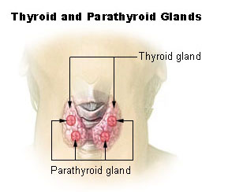
Thyroid Gland – Overview
Located in the front of the neck on either side of the trachea
Consists of two lobes
Connected by a band of tissue called the “isthmus”
Source: (Thyroid, 2010)
Notes:
The fifth gland that we will study in this lecture is the thyroid gland. The thyroid is a very vascular organ that is located in the neck on either side of the trachea (pronounced TRAKE-ee-uh). It consists of two lobes, just below the larynx or voice box. The two lobes are connected by a narrow band of tissue called the isthmus (pronounced ISS-muss ).

Slide 13
Thyroid Gland – Overview 2
Helps the body generate energy from the food we eat
Parathyroid glands -- located on the thyroid gland – secrete parathyroid hormone
Notes:
The thyroid gland helps set your metabolism -- how your body gets energy from the foods you eat.
Parathyroid glands are four small masses of epithelial (pronounced epi-THEE (like theory)—lee-uhl) tissue embedded in the connective tissue capsule on the posterior surface of the thyroid glands. The parathyroid glands secrete parathyroid hormone or parathormone (pronounced para-THOR-mone). Parathyroid hormone is the most important regulator of blood calcium levels. When the blood calcium level is low, the hormone is secreted or released to increase those levels.

Slide 14
Thyroid Gland – Overview 3
Follicles that produce chemicals or hormones that contain iodine
  Thyroxine – 95%
  Triiodothyronine – 5%
Both require the presence of iodine to be synthesized
Thyroid hormone is also produced in response to another hormone released in the pituitary gland
Simple goiter or iodine deficiency goiter
Source: (Endocrine system, 2010)
Notes:
Internally, the thyroid gland consists of follicles, which produce thyroxine (pronounced thigh-ROCKS-sin) and triiodothyronine (pronounced TRY-eye-oh-dough-THIGH-row-neen) hormones. These hormones contain iodine.
About 95% of the active thyroid hormone is thyroxine, and most of the remaining 5% is triiodothyronine. Both of these require iodine for their synthesis.
If there is an iodine deficiency, the thyroid cannot make sufficient hormone. This stimulates the anterior pituitary to secrete thyroid-stimulating hormone (TSH), which causes the thyroid gland to increase in size in an attempt to produce more hormones. But it cannot produce more hormones because it does not have the raw material, iodine. This type of thyroid enlargement is called simple goiter or iodine deficiency goiter.

Slide 15
Thyroid Diseases
Four main types of disease
  Hyperthyroidism
  Hypothyroidism
  Benign (non-cancerous) thyroid disease
  Thyroid cancer
Source: (Thyroid, 2010).
Notes:
Millions of people in the US have thyroid diseases. Most of them are women. If you have a thyroid disease, your body uses energy more slowly or more quickly than it should.
There are four main types of thyroid disease:
If your thyroid is too active, it is called hyperthyroidism. Your thyroid makes more thyroid hormones than your body needs. Symptoms include: weight loss, increased heart rate and sensitivity to heat.
A thyroid gland that is not active enough results in a condition called hypothyroidism. Symptoms include weight gain, fatigue and difficulty with cold temperatures.
There are many causes for both of these conditions.
Treatment involves trying to reset your body’s metabolism to a normal rate.
The two other main diseases are benign, which means non-cancerous, thyroid disease and thyroid cancer.

Slide 16
Thyroid Diseases 2
Four main types of disease
  Hyperthyroidism
  Hypothyroidism
  Benign (non-cancerous) thyroid disease
  Thyroid cancer
    Risk factors
    Symptoms
    Treatments
      Surgery, radioactive iodine, hormone treatment, radiation therapy or chemotherapy, or a combination
Source: (Thyroid, 2010)
Notes:
The risk factors for thyroid cancer include: being between 25 and 65; being a woman, being Asian, having a family member who has had thyroid disease, and having radiation treatment to your head and neck. Symptoms include a lump or swelling in your neck. Tests can be ordered to see if you have cancer. Treatment, depending on the type and how far the cancer has spread, might include surgery, radioactive iodine, hormone treatment, radiation therapy or chemotherapy. Some patients receive a combination of treatments.

Slide 17
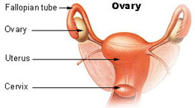
Reproductive Organs
Endocrine Function – Overview
Ovaries
  Produce female sex hormones
  Part of the female reproductive organs
  Secondary sexual characteristics at puberty from estrogens include:
  Other hormone functions from progesterone include:
Notes:
Now let’s look at the endocrine organs of the reproductive system. We will start with the ovaries.
Two groups of female sex hormones are produced in the ovaries: estrogen and progesterone (pronounced pro-JEST-terone). These steroid hormones contribute to the development and function of the female reproductive organs and the development of the secondary sexual characteristics.
At the onset of puberty, estrogen promotes the development of the breasts, distribution of fat evidenced in the hips, legs, and breasts, and maturation of reproductive organs such as the uterus and vagina.
Progesterone causes the uterine lining to thicken in preparation for pregnancy. Together, progesterone and estrogen are responsible for the changes that occur in the uterus during the female menstrual cycle.

Slide 18
Female Reproductive System
Disorders/Treatments
Amenorrhea
Premature Ovarian Failure (POF)
Premenstrual Syndrome
Dysfunctional Uterine Bleeding
Notes:
Examples of disorders in the female reproductive system include:
Amenorrhea (pronounced A (like bay) –men-o-ree-uh)
Premature Ovarian Failure
Premenstrual Syndrome
Dysfunctional uterine bleeding
Ectopic pregnancy
Polycystic ovary syndrome
Uterine fibroids
Amenorrhea occurs when a women does not begin menstruation by age 16 or she experiences an absence of menses for three months and is not pregnant. Amenorrhea is not a disease but a symptom of a disorder.
In ovarian failure a woman’s ovaries stop producing hormones before she is age 40. This disorder results in infertility. There is no treatment that will restore normal ovarian function when this disorder occurs. However, estrogen replacement therapy may allow women to have regular periods and lower the risk for osteoporosis.
Premenstrual Syndrome, also referred to as PMS, is a group of symptoms that start one to two weeks before a female begins her period. Most women have at least some symptoms of PMS, and these symptoms usually go away after their period begins. Treatments include over-the counter pain relievers, exercising, getting enough sleep, and avoiding salt, caffeine, and alcohol.
Dysfunctional uterine bleeding is abnormal uterine bleeding that is not associated with a physical lesion (such as a tumor), inflammation, or pregnancy. Treatment will depend on several factors: the cause of the bleeding, your age and if you want to have children. Hormones may be prescribed. Diagnostic tests may include ultrasound, endometrial biopsy, hysteroscopy (pronounced hiss-ter-OSS-cope-ee), dilation (pronounced dye-lay-shun)and curettage (pronounced cure-et-tazh), and laparoscopy (pronounced lap-uh-ROS(as in Roscoe)-kuh-pee) to determine the exact cause.

Slide 19
Female Reproductive System
Disorders/Treatments 2
Ectopic pregnancy
Polycystic Ovary Syndrome
Uterine fibroids
Notes:
An ectopic pregnancy occurs when gestation (pronounced jest-ation) takes place elsewhere than in the uterus (such as the fallopian tube or in the peritoneal (pronounced per-it-tone-knee-uhl) cavity. Ectopic pregnancies require surgery to remove the pregnancy to save the mother’s life.
Polycystic Ovary Syndrome is a disorder that is marked by amenorrhea which is the absence of menstruation. Other symptoms include obesity, infertility, ovarian enlargement, and hirsutism (pronounced HER-suit-ism) which means excessive growth of hair. It usually begins with an elevated level of luteinizing (pronounced loot-tee-in-ize-ing) hormone, androgen, or estrogen which results in an abnormal cycle of gonadotropin released by the pituitary gland. This is also referred to as polycystic ovary disease or Stein (pronounced Stine)-Leventhal syndrome. Treatment recommendations include weight loss, medications such as birth control pills or progesterone, and medications that increase the body’s sensitivity to insulin.
Uterine fibroids are the most common, non-cancerous tumors in women of childbearing age. Treatment may include medications for pain relief but in some cases surgical treatment of the fibroids may be indicated.

Slide 20
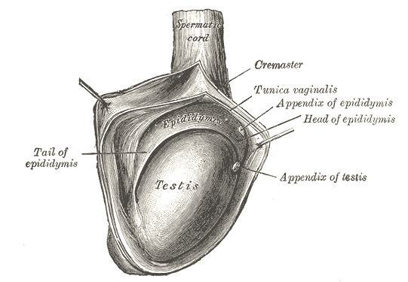
Reproductive Organs
Endocrine Function – Overview 2
Testes
  Male sex hormones
  Testosterone is main hormone secreted by the testes and its production
  Begins during fetal development
  Responsible for
    Skeletal and muscular growth
    Enlargement of the larynx
    Body hair
    Sexual drive
Notes:
The testes (pronounced test-tees) function as an endocrine gland. The testes are where the male sex hormones are produced. These hormones are referred to as “androgens.”
Testosterone is the main hormone secreted by the testes. The testes begin to secrete testosterone during fetal development. At puberty, testosterone is responsible for the growth and development of male reproductive structures, increased skeletal and muscular growth, enlargement of the larynx, growth and distribution of body hair and increased male sexual drive.

Slide 21
Male Reproductive System Disorders/Treatments
Anorchia
Hypogonadotropic hypogonadism
Reifenstein syndrome
Notes:
Anorchia (pronounced an-ORK-ee-uh) is the absence of both testes at birth. Symptoms include the failure to begin puberty at the correct time and the lack of secondary sex characteristics. Treatments include artificial testicle implants, male hormones and psychological support.
Hypogonadotropic (pronounced hypo-go-nad-uh-trope-ick) hypogonadism (pronounced hypo-go-nad-ism) is absent or decreased function of the male testes. It is considered a form of secondary hypogonadism, which means the condition is due to a problem with the pituitary or hypothalamus gland. Symptoms include the absence of secondary sex characteristics such as pubic (pronounced pew-bic), facial, and underarm hair, inability to smell, delayed development at puberty, underdeveloped testicles and, in some cases, short stature. Treatment depends on the cause of the disorder, but may include injections of testosterone, slow-release testosterone skin patch, GnRH (pronounced G-N-R-H) injections and testosterone gels. With the correct hormone treatment, the patient can begin puberty.
Reifenstein (pronounced rife-en-stine) syndrome is one of a group of diseases in which the body is unable to respond appropriately to the male sex hormones, which include testosterone. Symptoms include abnormal male genitals, breast development in males at the time of puberty, infertility, and decreased body hair and beard, but normal pubic and armpit hair. Treatment with testosterone improves the chance that the patient will have a normal and healthy lifespan with the potential to have children.

Slide 22
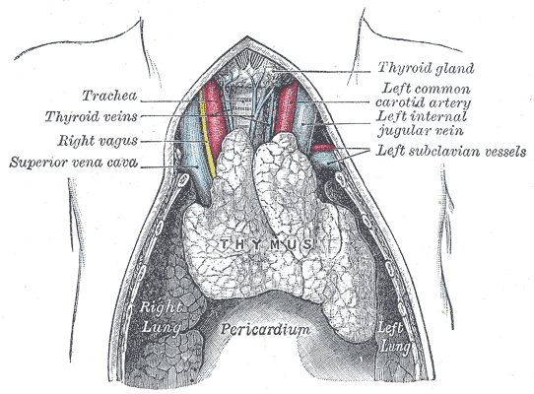
Thymus Gland – Overview
Location
  Small organ under your breastbone
Function
  Before birth and during childhood, helps make a type of white blood cell, lymphocytes
Hormone
  Produces thymosin
  Development of the body’s immune system
Notes:
In addition to the major endocrine glands, other organs have some hormonal activity as part of their function. One of these is the thymus (pronounced THIGH-muss) gland.
The thymus is a small organ in your upper chest, under your breastbone. Before birth and during childhood, the thymus helps the body make a type of white blood cell. These cells help protect you from infections.
The thymus gland produces thymosin (pronounced THIGH-mo-sin), a hormone that plays an important role in the development of the body’s immune system.

Slide 23
Diseases of the Thymus
Cancer of the thymus is rare
  Symptoms include:
    Persistent cough
    Chest pain
    Trouble breathing
  Treatment
    Surgery to remove the tumor
    Radiation and hormone therapy
Notes:
Cancer of the thymus is rare. You are more likely to develop it if you have other diseases such as myasthenia gravis (pronounced my-ass-THEEN-ee-uh GRAV (like gravity)-iss ), lupus (pronounced LOOP-us) or rheumatoid arthritis. Sometimes there are no symptoms. Other times, thymus cancer can cause a cough that doesn’t go away, chest pain, or trouble breathing.
The most common treatment is surgery to remove the tumor. Other options include radiation and hormone therapy.

Slide 24
Endocrine System
Combining Forms
Word Part | Meaning | Sample Term
Adrenal/o | Adrenal gland | Adrenalectomy
Oophor/o | Ovary | Oophoritis
Orchi/o | Testis | Orchitis
Pancreat/o | Pancreas | Pancreatectomy
Pituitar/o | Pituitary gland | Hypopituitarism
Thym/o | Thymus gland | Thymoma
Thyroid/o | Thyroid gland | Thyroidectomy
Notes:
Here are some key word parts for the endocrine system along with their meanings. In the third column you can see some of the medical terms that we can create by combining word parts. You should return to the online medical dictionary to hear the pronunciation and become familiar with the meaning of the created terms.

Slide 25
Tell me Detective…
A patient is referred by her primary care physician to the Endocrine Clinic because she has recent weight loss, an increased heart rate and has noticed that she is very sensitive to heat. Which of the disorders of thyroid gland should he test for?
Notes:
Now see if you can use what you learned. A patient is referred by her primary care physician to the Endocrine Clinic because she has recent weight loss, an increased heart rate and has noticed that she is very sensitive to heat. Which of the disorders of thyroid gland should he test for?
(NOTE: Pause about 3 seconds here.)
Did you guess Hyperthyroidism?
Hyperthyroidism occurs when your thyroid is too active. It makes more thyroid hormones than your body needs. That condition is referred to as hyperthyroidism. The symptoms include: weight loss, increased heart rate and sensitivity to heat.

Slide 26
Endocrine System
Summary
Define, understand and correctly pronounce medical terms related to the endocrine system
Describe common diseases and conditions with an overview of various treatments related to the endocrine system
Notes:
This concludes the Endocrine System. In summary, we have discussed the medical terms related to the endocrine system and described common diseases and conditions and an overview of various treatments related to the endocrine system.

Slide 27
Endocrine System
References – Lecture b
References
  Endocrine system. SEER Training Modules, Anatomy & Physiology. U.S. National Institutes of Health, National Cancer Institute; [updated 2010 Jun 27]. Available from: www.nlm.nih.gov
  MedlinePlus [Internet]. Endocrine system. Bethesda (MD): National Library of Medicine (US); [updated 2011 Jun 27]. Available from: www.nlm.nih.gov
  Pituitary. SEER Training Modules, Anatomy & Physiology. U.S. National Institutes of Health, National Cancer Institute; [updated 2010 Jun 27]. Available from: training.seer.cancer.gov
  Thyroid. SEER Training Modules, Anatomy & Physiology. U.S. National Institutes of Health, National Cancer Institute; [updated 2010 Jun 27]. Available from: training.seer.cancer.gov
Images
  Slide 2, 9: Images are generated by Life Science Databases (LSDB). CC-BY-SA-2. Available From: commons.wikimedia.org
  Slide 11, 12: Available From: commons.wikimedia.org
  Slide 16: Available From: commons.wikimedia.org
  Slide 19: Available From: commons.wikimedia.org
  Slide 21: Available From: commons.wikimedia.org
  Slide 25: Microsoft clip art. Used with permission from Microsoft.
Notes:
“No Audio”

Slide 28
Terminology in Healthcare and Public Health Settings
Endocrine System Lecture b
This material was developed by the University of Alabama at Birmingham, funded by the Department of Health and Human Services, Office of the National Coordinator for Health Information Technology under Award Number 90WT0007.
Notes:
No Audio.

