Slide 1
Terminology in Healthcare and Public Health Settings
Endocrine System
Lecture a – Overview of the Endocrine System: Adrenal Glands and Pancreas
This material (Comp 3 Unit 7) was developed by the University of Alabama at Birmingham, funded by the Department of Health and Human Services, Office of the National Coordinator for Health Information Technology under Award Number 90WT0007.
This work is licensed under the Creative Commons Attribution-NonCommercial-ShareAlike 4.0 International License. To view a copy of this license, visit http://creativecommons.org.
Notes:
Welcome to Terminology in Healthcare and Public Health Settings, Endocrine System. This is lecture A, Overview of the Endocrine System, Adrenal Glands and Pancreas. In this lecture, we will be studying the endocrine (pronounced END-oh-crin) system. A doctor who treats diseases of the endocrine system is called an endocrinologist.

Slide 2
Endocrine System
Learning Objectives
Define, understand and correctly pronounce medical terms related to the endocrine system
Describe common diseases and conditions with an overview of various treatments related to the endocrine system
Notes:
The objectives for the Endocrine System are to:
Define, understand and correctly pronounce medical terms related to the endocrine system.
Describe common diseases and conditions with an overview of various treatments related to the endocrine system.

Slide 3
Endocrine System – Overview
Composed of eight endocrine glands
Functions in the regulation of our body’s activities
Glands are in various locations in body
Acts through chemical messengers called “hormones”
Source: (Endocrine, 2010)
Notes:
The endocrine system is composed of eight endocrine glands that assist in regulating our body’s activities. The endocrine glands are found in various locations throughout our body as we will see in a minute. The actions of the endocrine glands also have effects throughout the body.
All endocrine glands secrete “hormones,” or chemical messengers, directly into the bloodstream where they are transported to cells that are waiting for their messages.
These hormones help your body respond to stress, regulate your blood pressure, and regulate your water and salt balance.

Slide 4
Endocrine System – Overview 2
The eight endocrine glands are:
  Adrenal glands
  Pancreas (Islets of Langerhans)
  Pituitary gland
  Pineal gland
  Ovary(ies)
  Testicle(s)
  Thyroid gland
  Thymus gland
Notes:
The eight endocrine glands include the adrenal (pronounce uh-DREEN-uhl) glands, the pancreas (pronounced PANK-ree-us)(specifically the Islets (pronounced eyelets) of Langerhans ( pronounced Langer (like hanger)- hans), the pituitary (pronounced pit-TOO-ih-terry) gland, the pineal (pronounced Pine-EE-uhl) gland, the ovaries, the testes (pronounced test-tees), the thyroid gland and thymus (pronounced Thigh-muss) gland. Some of the endocrine glands also have additional functions, in addition to producing hormones. Examples are the pancreas, the testes and ovaries.

Slide 5
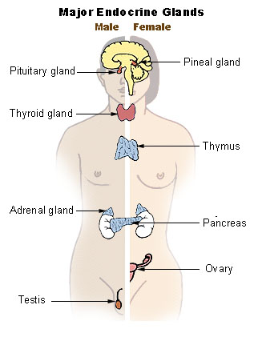
Endocrine Glands
Thyroid gland
Thymus
Adrenal gland
Testis
Ovary
Pineal gland
Pituitary gland
Pancreas
Notes:
The slide shows the various locations of the following endocrine glands throughout your body.
The thyroid gland is in the neck. The thymus gland is in the middle of the chest. The adrenal gland is right on top of the kidney. The pancreas is between your two kidneys. The ovaries and testes are in the lower part of the abdomen.

Slide 6
Endocrine System – Hormones
Act as messengers
Travel in our bloodstream to tissues or organs
Can act in varying amounts of time (minutes, hours or even weeks)
Affect our body’s processes and functions
  Growth and development
  Metabolic processes
  Sexual function
  Reproduction
  Mood
Notes:
Hormones are natural chemicals produced and released by the endocrine glands. Hormones are thought of as our body’s chemical messengers. The eight endocrine glands secrete hormones into our bloodstream.
In the bloodstream, these chemical messengers go to various organs and tissues to generate a specific reaction by the body. The organs and tissues are affected by their presence. The presence of hormones results in changes such as growth and development of our bodies. Hormones can act in minutes, hours or even weeks. Hormones also affect metabolic (pronounced met-uh-boll (like doll)-ic) processes, digestion, blood pressure regulation, reproduction and sexual function and even our moods.

Slide 7
Hormone Disorders
Levels too high
Levels too low
Other factors
  Stress
  Infections
  Changes in levels of blood and body fluids
When your body does not respond as it should to the presence of the hormone
Diabetes
Notes:
Hormones are powerful. Having too little or too much of a hormone causes various hormone disorders. The level of hormones that is secreted into our bloodstream can be affected by factors such as stress, infections, and changes in the levels of our blood’s fluids causing disturbances such as electrolyte (pronounced elec-tro-light) imbalances.
When your body does not respond to hormones the way it is supposed to, hormone diseases can occur. One of the most common endocrine diseases in the United States is diabetes. We will learn more about diabetes when we discuss the endocrine gland known as the pancreas.

Slide 8
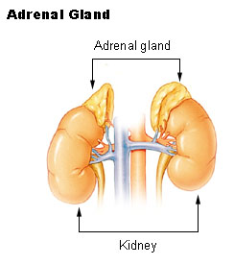
Adrenal Gland – Overview
Adrenal gland(s)
  also called the “suprarenal” gland
  located above your kidneys
  paired organs
  composed of two layers
    Outer cortex
      Three hormones
    Inner medulla
      Two hormones
Notes:
An adrenal gland is located near the top of each kidney, which is why the adrenal glands are also referred to as the “suprarenal” (pronounced soup-ruh-reen-uhl)) glands.
Each gland has two layers: an outside layer called the adrenal “cortex,” and the inner layer referred to as the “medulla” (pronounced med-OOL-uh).
The adrenal cortex secretes three types of hormones that are referred to as “corticosteroids” (pronounced CORT-ick-oh-steroids). Each one affects the body in a different way.
One helps the body to regulate the metabolism and level of glucose.
Another hormone, aldosterone (pronounced Al-DOSS-ter-own – like owner ), assists the body in maintaining an electrolyte (pronounced electro-light) balance.
The last type of hormone produced by the adrenal cortex contributes to the development of secondary sexual characteristics and are essential for reproduction.
The adrenal medulla secretes two hormones that are responsible for physiological changes that enable us to respond to, and react to, stress.

Slide 9
Adrenal Gland Diseases
Addison’s Disease
  Symptoms
  Diagnostic Tests
  Treatment
Notes:
One example of an adrenal gland disorder is Addison’s Disease. This is also called adrenal insufficiency, adrenocortical hypofunction (pronounced uh-dreen-oh-cort-ick-uhl hype-oh-function) and hypocortisolism (pronounced hype-oh-CORE-tiss-sole-ism). Addison’s disease occurs if the adrenal glands don’t make enough of the hormones that help your body respond to stress, regulate your blood pressure and regulate your water and salt balance.
How does someone get Addison’s Disease? Sometimes, when people have problems with their immune system, and it attacks their own tissues, damage to the adrenal glands can occur.
Symptoms of Addison’s Disease include weight loss, muscle weakness, fatigue that increases over time, low blood pressure and patchy or dark skin.
Diagnostic tests such as ACTH (pronounced A-C-T-H) or cortisol (pronounced CORE-Tiss-sole) tests are examples of laboratory tests that help in the diagnosis of Addison’s Disease.
The treatment is to take hormone medication for the remainder of your life.

Slide 10
Adrenal Gland Cancers
Adrenal Gland Cancers
  Adrenocortical carcinoma
  Neuroblastoma
  Pheochromocytoma
Source: (Pancreas, 2010)
Notes:
A number of diseases can affect the adrenal glands, including several types of cancer. Examples include: adrenocortical (pronounced uh-DREEN-oh-CORE-tick-uhl) carcinoma which is cancer in the outer part of the gland, neuroblastoma (pronounced neuro (like neurologist) blast-TOME-uh), a type of childhood cancer, and pheochromocytoma (pronounced FEE-oh-CHROME-oh-site-TOME-uh), which is a tumor of the medulla that causes hypertension, weight loss, and personality changes in the patient.
Fortunately, adrenal gland cancers are uncommon. Most tumors of the adrenal glands are non-cancerous adenomas (pronounced AD-en-OME-uhs) and usually do not result in symptoms that would lead to treatment.
Possible treatments that a physician could consider in the treatment of these types of cancers of the adrenal gland include surgery, chemotherapy, and radiation therapy.

Slide 11
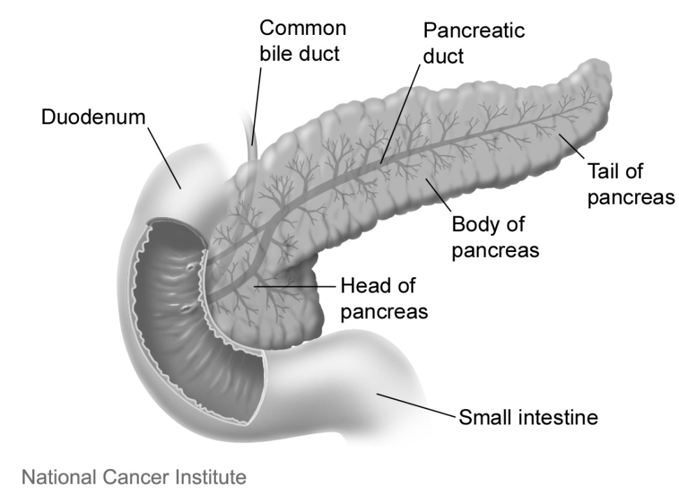
Pancreas – Islets of Langerhans
Soft organ
Located transversely in front of the spine
Exocrine and endocrine function
Pancreatic islets
  alpha cells secrete glucagons
  beta cells secrete insulin
Notes:
The pancreas is a long, soft organ that lies behind your stomach and in front of your spine. As one of the endocrine glands, it is responsible for making insulin and producing or secreting enzymes or chemicals that assist the body in the digestion of food.
Because this gland releases digestive enzymes that are carried through a duct to the duodenum (pronounced due-oh-deen-um), it is also referred to as an exocrine (pronounced ex-oh-crin) gland, which is defined as a gland that produces and sends its chemicals using a tube or duct.
The endocrine function takes place in the pancreatic (pronounced pank-ree-at-ic) islets (pronounced eyelets) that secrete glucagon (pronounced GLUE-kuh-gon – rhymes with John) and insulin. More specifically, the alpha cells secrete the hormone glucagon in response to a low level of glucose (pronounced glue-cose) in the blood. Insulin, the hormone produce by the beta (pronounced bait-uh) cells in the pancreatic islets, is produced in response to a high level of glucose in the blood.

Slide 12
Diabetes
Symptoms
Diagnostic tests
Treatments
  Type 1
    Insulin
    Islet Cell transplantation
  Type 2
    Exercise and weight control
    Oral medications
Notes:
Diabetes is a disorder that is identified when your blood glucose or blood sugar level remains above the normal levels. With Type 1 diabetes, your pancreas does not make insulin. Insulin is a hormone that helps glucose be absorbed into your cells to allow them to create energy. Without insulin, too much glucose stays in your blood. With this excess insulin, damage can occur to your heart, eyes, kidneys, nerves and even the gums and teeth.
Symptoms of Type 1 diabetes include:
Being very thirsty
Urinating frequently
Feeling very hungry or tired
Losing weight without trying
Having sores that heal slowly
Having dry, itchy skin
Losing the feeling in your feet or having tingling in your feet
Having blurry eyes
A blood test can determine if you have diabetes. If you are diagnosed with Type 1 diabetes, then you will probably have to take insulin for the rest of your life. There is a new experimental treatment which transplants the islet cells from an organ donor to the body of another person. The islet cells contain beta cells, which makes the insulin that our body needs and the transplant would provide a natural source of insulin.
Type 2 is the more common type of diabetes. With Type 2 diabetes your body does not make enough insulin or the insulin it makes is not used well. While some people have no symptoms, others have fatigue, thirst, weight loss, blurred vision and frequent urination. A blood test can be used to diagnose Type 2 also. The treatment may include exercise, weight control and sticking to a diabetic diet, as well as monitoring your glucose level and taking oral medications. Some patients with Type 2 diabetes also have to take insulin.

Slide 13
Pancreatitis
Definition
  Acute pancreatitis
  Chronic pancreatitis
Notes:
As you recall, the pancreas is also considered an accessory GI organ. Pancreatitis (pronounced PANK-ree-uh-TIGHT-iss), or inflammation of the pancreas, is a disease that occurs when digestive enzymes start digesting the pancreas and nearby tissues. It can be categorized as either acute or chronic.
Acute pancreatitis means “inflammation” of the pancreas and can occur suddenly. It has to be treated urgently since it can be life-threatening and cause complications. The most common cause of pancreatitis is a gallstone that causes the inflammation as it passes through the common bile duct. Other causes include, heavy alcohol use, abdominal trauma, medications, tumors or other infections.
Chronic pancreatitis refers to an inflammation of the pancreas that does not improve and progressively worsens until organ damage occurs. The most common cause is heavy alcohol use which occurs over a number of years. A number of other diseases and medicines can also cause chronic pancreatitis.

Slide 14
Pancreatitis 2
Symptoms
  Acute pancreatitis
    Swollen, tender abdomen
    Nausea and vomiting
    Fever
    Rapid pulse
  Chronic pancreatitis
    Nausea and vomiting
    Weight loss
    Diarrhea and oily stools
Notes:
Symptoms for acute pancreatitis include:
Swollen and tender abdomen
Nausea and vomiting
Fever
A rapid pulse
Symptoms for chronic pancreatitis include some of the same symptoms but have additional ones also.
Nausea
Vomiting
Weight loss
Diarrhea
Oily stools

Slide 15
Pancreatitis 3
Diagnostic tests
  Ultrasound
  CT scan
  Endoscopic ultrasound
  MRCP
Notes:
A variety of procedures can be used to diagnose both acute and chronic pancreatitis. For example:
Abdominal ultrasound
Computerized tomography also known as a CT scan
Endoscopic ultrasound or (EUS)
Magnetic resonance cholangiopancreatography or MRCP (pronounced magnetic rez-oh-nense coal-angie-oh-pank-ree-uh-tog-raphy or M-R-C-P)

Slide 16
Pancreatitis 4
Treatment
  IV fluid
  Antibiotics
  Pain medication
  ERCP
Notes:
Treatments for acute pancreatitis include:
Intravenous fluid
Antibiotics
Pain medications
Therapeutic Endoscopic Retrograde Cholangiopancreatography or ERCP (pronounced E-R-C-P)
Treatment for chronic pancreatitis may require the patient to be hospitalized for some of the same treatments such as IV fluid or pain management. In addition, these patients may require nutritional support with nasogastric (pronounced naze-oh-gastric) feedings.

Slide 17
Cystic fibrosis
Definition
Symptoms
Diagnostic tests
Treatment
Notes:
Cystic fibrosis or CF is a genetic disorder in which thick, sticky mucus can block the tubes in your pancreas, as well as other locations in the body. CF is an inherited disease of the mucus and sweat glands. It affects mostly your lungs, pancreas, liver, intestines, sinuses and sex organs. CF causes your mucus to be thick and sticky. The mucus clogs the lungs, causing breathing problems and making it easy for bacteria to grow. This can lead to problems such as repeated lung infections and lung damage.
The symptoms and severity of CF vary widely. Some people have serious problems from birth. Others have a milder version of the disease that doesn't show up until they are teens or young adults.
Diagnostic tests include:
CF Gene Mutation Test
CF Respiratory Screen: Sputum (pronounced SPEW-tum)
Sweat (like perspiration)Test
Trypsin and Chymotrypsin Tests
Trypsinogen Test
Although there is no cure for CF, treatments have improved greatly in recent years. Until the 1980s, most deaths from CF occurred in children and teenagers. Today, with improved treatments, people with CF live, on average, to be more than 35 years old.

Slide 18
Pancreatic Cancer
Location of tumors
  Exocrine cells
  Endocrine
Risk factors
  Smoking
  Diabetes
  Chronic pancreatitis
  Hereditary
Notes:
Both the endocrine and exocrine cells in the pancreas can form tumors. However, tumors more commonly occur in the exocrine cells of the pancreas. These are referred to as “adenocarcinomas” (pronounced AD-en-oh-car-sin-OH-muhz) which indicates the cancer has started in the gland. While some tumors are benign (or non-cancerous), the majority are malignant (or cancerous). Cancer of the pancreas is the fourth-leading cause of cancer death in the US. Some risk factors for developing pancreatic cancer include:
Smoking
Long-term diabetes
Chronic pancreatitis
Certain hereditary disorders

Slide 19
Pancreatic Cancer - 2
Symptoms
  Yellowing of skin and eyes
  Abdominal or back pain
  Weight loss
  Fatigue
Diagnostic tests
Treatment
  Surgery
  Radiation and chemotherapy
Notes:
Pancreatic cancer is hard to catch early. It doesn't cause symptoms right away. When you do get symptoms, they are often vague or you may not notice them. They include yellowing of the skin and eyes, pain in the abdomen and back, weight loss and fatigue. Also, because the pancreas is hidden behind other organs, healthcare providers cannot see or feel the tumors during routine exams. Because it is often found late, and it spreads quickly, pancreatic cancer can be hard to treat.
Each type of tumor has different symptoms, and each is diagnosed by using different diagnostic tests. The treatment options and survival rates vary depending on the type of tumor identified.
Possible treatments include surgery, radiation and chemotherapy. Treatment is determined by the stage of the cancer. Staging refers to how far the cancer has progressed.

Slide 20
Tell me, Detective . . .
A neonatologist is called to the newborn nursery to evaluate a baby. What is a likely diagnosis given the following facts?
  Baby is a Caucasian male
  Baby experienced no bowel movements in the first 24-48 hours, abdomen bloated
  Physician orders a sweat chloride test
Notes:
A neonatologist is called to the newborn nursery to evaluate a baby. What is a likely diagnosis given the following facts?
Baby is a Caucasian male
Baby experienced no bowel movements in the first 24-48 hours, abdomen bloated
Physician orders a sweat chloride test
Did you guess cystic fibrosis?
Cystic fibrosis is caused by a defective gene which causes the body to produce abnormally thick and sticky fluid, called mucus. This mucus builds up in the breathing passages of the lungs and in the pancreas, and the intestines.
Symptoms related to the bowel function include:
Abdominal pain
Increased bloating
No bowel movements in first 24 to 48 hours of life
Diagnostic Tests include:
CF Gene Mutation Test
CF Respiratory Screen: Sputum
Sweat Test, or Sweat Chloride Test
Trypsin and Chymotrypsin Tests
Trypsinogen Test

Slide 21
Endocrine System
Summary – Lecture a
Overview of Endocrine System
Adrenal Glands
Pancreas
Notes:
This concludes Lecture a of the Endocrine System. In summary, we covered the adrenal glands and pancreas, and a general overview of the endocrine system.

Slide 22
Endocrine System
References
References
  Endocrine glands. SEER Training Modules, Anatomy & Physiology. U.S. National Institutes of Health, National Cancer Institute; [updated 2010 Jul 27]. Available from: training.seer.cancer.gov
  MedlinePlus [Internet]. Endocrine system. Bethesda (MD): National Library of Medicine (US); [updated 2011 Jul 27]. Available from: www.nlm.nih.gov
  Pancreas. SEER Training Modules, Anatomy & Physiology. U.S. National Institutes of Health, National Cancer Institute; [updated 2010 Jul 27]. Available from: training.seer.cancer.gov
Images
  Slide 5: Available From: commons.wikimedia.org
  Slide 8: Available From: commons.wikimedia.org
  Slide 11: Available From: commons.wikimedia.org
  Slide 20: Microsoft clip art. Used with permission of Microsoft.
Notes:
“No Audio”

Slide 23
Terminology in Healthcare and Public Health Settings
Endocrine System Lecture a
This material was developed by the University of Alabama at Birmingham, funded by the Department of Health and Human Services, Office of the National Coordinator for Health Information Technology under Award Number 90WT0007.
Notes:
No Audio.

