Slide 1
Terminology in Healthcare and
Public Health Settings
Digestive System
This material (Comp 3 Unit 6) was developed by the University of Alabama at Birmingham, funded by the Department of Health and Human Services, Office of the National Coordinator for Health Information Technology under Award Number 90WT0007.
This work is licensed under the Creative Commons Attribution-NonCommercial-ShareAlike 4.0 International License. To view a copy of this license, visit http://creativecommons.org.
Notes:
Welcome Terminology in Healthcare and Public Health Settings, Digestive System. In this unit, we will discuss the digestive system. Doctors who treat disorders of the digestive system are called gastroenterologists (pronounced gastro-en-ter-ologists).

Slide 2
Digestive System
Learning Objectives
Define, understand and correctly pronounce medical terms related to the digestive system
Describe common diseases and conditions with an overview of various treatments related to the digestive system
Notes:
The objectives for the Digestive System are to:
Define, understand and correctly pronounce various medical terms related to the digestive system.
Describe common diseases and conditions with an overview of various treatments related to the digestive system.

Slide 3
Digestive System 1
Also called gastrointestinal system (GI)
Function
  Digestion of food
  Absorption of nutrients
  Elimination of solid wastes
Source: (Digestive anatomy, 2010)
Notes:
The digestive system is also called the gastrointestinal system or GI (pronounced G-I) system. Its main functions deal with the digestion of food, the absorption of nutrients and the elimination of solid wastes. Solid wastes are primarily made up of undigested materials.

Slide 4
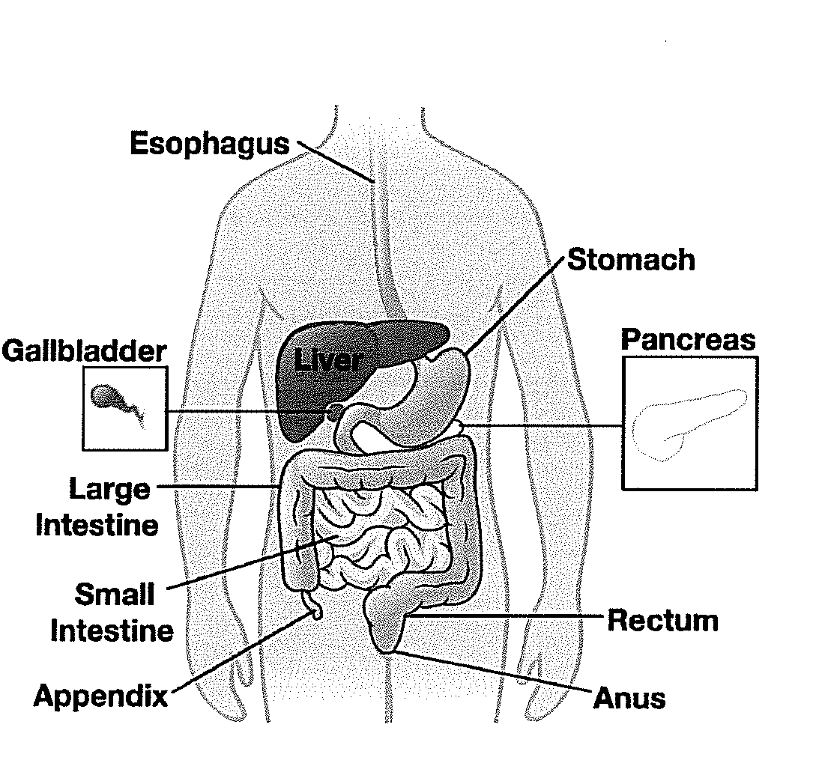
Digestive System 2
Organs of the gastrointestinal tract
  Oral cavity
  Pharynx
  Esophagus
  Stomach
  Small intestine
  Colon
Source: (Digestive regions, 2010)
Notes:
On this slide, you will see a diagram of the digestive system. Let’s take a look at the anatomy of this system. The gastrointestinal system begins at the mouth, continues through the thoracic (pronounced thor-ass-sick) cavity and fills much of the abdominopelvic (pronounced ab-domino-pelvic) cavity. The upper gastrointestinal system includes the structures from the mouth through the stomach. The lower gastrointestinal system includes the structures from the small intestine through the anus. The primary organs include the oral cavity, the pharynx (pronounced fa (like fat)-rinks), the esophagus, the stomach, the small intestine, and the colon.

Slide 5
Digestive System 3
Accessory Organs
  Pancreas
  Liver
  Gallbladder
  Salivary glands
Source: (Digestive regions, 2010)
Notes:
The digestive system also includes a variety of accessory organs which include the pancreas, the liver, the gallbladder, and the salivary glands.
These accessory organs contribute to the process of digesting food.

Slide 6
Digestive System 4
Oral Cavity
  Digestion begins when food enters mouth
  Saliva
    Contains digestive enzymes
    Lubricates
Pharynx
  Common pathway
    Digestion
    Respiration
  Directs food into the esophagus
Source: (Digestive regions, 2010)
Notes:
Now, let’s discuss how each of the organs of the digestive system aids in achieving the functions we have previously discussed.
The first step of digestion occurs in the oral cavity. When food enters the mouth, it mixes with saliva. Saliva contains digestive enzymes and helps in lubricating the food as it begins its journey through the digestive system.
The second step occurs in the pharynx. The pharynx is a common pathway for both digestion and respiration. The pharynx is therefore part of both the digestive and respiratory systems. Its purpose in the digestive system is to direct food into the esophagus.

Slide 7
Digestive System 5
Esophagus
  Food enters from pharynx
  Delivered to stomach
  Propelled along by wavelike muscular movements
Stomach
  Collects and churns food
  Mixes it with hydrochloric acid (HCl)
  Forms chyme
    Watery mix of food and digestive juices
Source: (Intestine, 2010)
Notes:
The esophagus is essentially the conduit for food from the pharynx to the stomach. The esophagus moves the food along through wavelike, muscular movements.
The stomach is where the food is collected and churned. The food is mixed with hydrochloric acid in the stomach. This in turn forms chyme (pronounced kime (rhymes with time), which is a watery mixture of food and digestive juices.

Slide 8
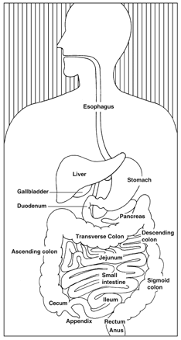
Small Intestine
Completion of digestion
Majority of absorption
Divided into three sections
  Duodenum (first section) Approximately 10-12” long
  Jejunum (second section) Approximately 8’ long
  Ileum (third section) Approximately 12’ long
Source: (Intestine, 2010)
Notes:
After an hour or so, the chyme leaves the stomach and enters the small intestine or small bowel. The small intestine is where digestion is completed and the majority of nutrient absorption occurs. The small intestine is divided into three sections: the duodenum (pronounced due-oh-deen-um), the jejunum (pronounced je-june-um) and the ileum (pronounced ill-ee-um).
The duodenum is the first section. It is about 10-12 inches long. It is shaped like a “c” and begins at the stomach and ends at the jejunum.
The jejunum is the second section and is about 8 feet long. The jejunum repeatedly twists and turns in the abdominal cavity. Digestion continues in the jejunum. The chyme is slowly moved along for several hours.
The ileum is the third section. It is about 12 feet long. It is in this portion of the small intestine that the absorption of nutrients is completed. The remaining undigested materials or waste, and water, move into the large intestine.

Slide 9
Colon
5’ long
Receives fluid that remains after digestion and absorption
  Most is water and is reabsorbed into the body
Feces is left over solid waste
  Evacuated in bowel movements
Source: (Intestine, 2010)
Notes:
After the small intestine comes the large intestine or large bowel. The large intestine includes the colon, which is approximately 5 feet long. Any fluid that remains after digestion and absorption enters the colon. The fluid is mostly water and is reabsorbed into the body. The solid waste that is left over is called feces (pronounced fee-sees) and is evacuated from the body by bowel movements.
The colon is the longest part of the large intestine. It travels through all four quadrants of the abdomen. The various sections of the colon include the ascending colon, the transverse colon, the descending colon and the sigmoid colon.

Slide 10
Rectum and Anus
Rectum
  Storage of feces
Anus
  External opening at end of digestive system
  Evacuation of feces
Source: (Intestine, 2010)
Notes:
The rectum is the storage area for feces. The rectum leads to the anus, which is the external opening at the end of the digestive system. Feces are evacuated through the anus.

Slide 11
Accessory Organs
Produce substances necessary for the breakdown of food
Organs
  Salivary glands
  Liver
  Gallbladder
  Pancreas
Source: (Digestive regions, 2010)
Notes:
Generally, the function of the accessory organs of the digestive system is the production of substances necessary for chemical breakdown of food. As mentioned earlier, the accessory organs include the salivary glands, the liver, the gallbladder, and the pancreas. Now let’s take a look at the specific functions of each of these organs.

Slide 12
Salivary Glands
Location
  Oral cavity
Function
  Produce saliva
    Allow food to be swallowed without choking
  Saliva + food = bolus
    Contains amylase
      Aids in digestion of carbohydrates
Source: (Salivary, 2010)
Notes:
You probably already know that the salivary glands produce saliva. Saliva allows food to be swallowed without choking. Each saliva and food mixture is called a bolus (pronounced bowl-us). The bolus also contains amylase (pronounced AM-ill-ace) which is a chemical that begins the digestion of carbohydrates.

Slide 13
Liver
Location
  Upper right quadrant of abdomen
Functions
  Processes nutrients
  Detoxifies harmful substances
  Produces bile
    Emulsification
Source: (Liver, 2010)
Notes:
The liver is located in the right upper quadrant of the abdomen. The liver processes nutrients, helps in the detoxification of harmful substances and produces bile. Bile aids in breaking up large fat globules into smaller droplets. This process is called emulsification.

Slide 14
Gallbladder
Location
  Under liver
Function
  Stores bile produced by liver
Ducts
  Hepatic duct
  Common bile duct
  Cystic duct
Source: (Gallbladder, 2010)
Notes:
The gallbladder is another one of the accessory organs of the digestive system. It is located under the liver. It stores the bile that is produced by the liver. The hepatic (pronounced heh-pat-ick) duct carries the bile from the liver into the common bile duct. The common bile duct in turn conveys bile to the duodenum. The cystic duct is the short duct that joins the gallbladder to the common bile duct.
The presence of fatty chyme in the duodenum causes the gallbladder to contract, sending bile into the duodenum to digest the fats.

Slide 15
Pancreas
Location
  Under the stomach
Function
  Production of digestive juices
    neutralize acidic chyme
    digest carbohydrates, lipids, and proteins
Notes:
The pancreas is a long, soft organ that lies behind the stomach and anterior to the spine. The location is also referred to as retroperitoneal (retro-per-it-ton-e-uhl). The pancreas, an endocrine organ, is also an accessory gastrointestinal organ. The pancreas produces various digestive juices that not only help to neutralize the acidic chyme, but also help to digest carbohydrates, lipids, and proteins.

Slide 16
Peptic Ulcer
A sore in the lining of the stomach or duodenum
Most common symptom
  Burning stomach pain
Cause
  Digestion acids damage the walls of the stomach or duodenum
Treatment
  Medicines to block stomach acids
  Antibiotics to kill ulcer-causing bacteria
Notes:
Now that we know a little bit about the digestive process, let’s focus on the various conditions that might affect this body system.
The first condition of the digestive system that we’ll discuss is peptic ulcer. A peptic ulcer is also referred to as a gastric ulcer, or stomach ulcer. A peptic ulcer is a sore in the lining of your stomach or your duodenum. Remember that the first part of your small intestine is called the duodenum. A burning stomach pain is the most common symptom. This pain may come and go for a few days or weeks. It may also bother you more when your stomach is empty. The pain usually goes away after you eat.
Peptic ulcers happen when the acids that help digest food damage the walls of the stomach or duodenum. Peptic ulcers will get worse if they are not treated. Treatment may include medicines to block stomach acids, or antibiotics to kill ulcer-causing bacteria.

Slide 17
Cholelithiasis (Gallstones)
Symptoms
  Nausea
  Vomiting
  Pain in the abdomen, back, or just under the right arm
Most commonly affects
  Older adults, women, overweight people, Native Americans and Mexican Americans
Treatment
  Surgical removal of the gallbladder
Notes:
The next digestive system condition that we’ll discuss is gallstones. Gallstones are also called cholelithiasis (pronounced ko-leh-lith-THIGH-uh-sis). Gallstones form when substances in the bile harden. Gallstone “attacks” usually happen after you eat. Signs of a gallstone attack may include nausea, vomiting, or pain in the abdomen, back, or just under the right arm.
Gallstones are most common among older adults, women, overweight people, Native Americans and Mexican Americans. The most common treatment is removal of the gallbladder. Fortunately, the gallbladder is an organ that you can live without. Bile has other ways to reach your small intestine.

Slide 18
Crohn’s Disease
Regional enteritis or ileitis
Inflammation of the digestive system
Often affects the lower part of the small intestine
Common symptoms include
  Pain in the abdomen and diarrhea
  Bleeding from the rectum, weight loss, joint pain, skin problems and fever
  Intestinal blockage and malnutrition
Treatment
  Medicines, nutrition supplements, surgery or a combination
Notes:
The third digestive system disorder we’ll discuss is Crohn’s (pronounced crone’s) disease. Crohn’s disease is also called regional enteritis (pronounced enter-right-tiss) or regional ileitis (pronounced ill-ee-eye-tiss). Crohn’s disease causes inflammation of the digestive system. It can affect any area of the GI tract from the mouth to the anus. It most commonly affects the lower part of the small intestine called the ileum. However, it is common for other parts of the GI tract to be initially affected (for example, 25% of the patients experience disease in their colon or large intestine). Crohn's disease seems to run in some families. It is also associated with other secondary autoimmune (pronounced auto-immune) disorders.
Crohn’s disease can occur in people of all age groups, but is most often diagnosed in young adults. Common symptoms include pain in the abdomen and diarrhea. Bleeding from the rectum, weight loss, joint pain, skin problems and fever may also occur. Other problems include intestinal blockage and malnutrition. Treatment for Crohn’s involves medicines, nutrition supplements, surgery or a combination of these options.

Slide 19
Ulcerative Colitis
Similar symptoms to Crohn’s Disease
Often involves entire colon
Patients at risk for colon cancer
Treatment
  Drugs
  Surgery
Notes:
Another closely associated disorder is ulcerative colitis. Patient experience similar symptoms to Crohn’s disease, but ulcerative colitis often involves the entire colon. Patients with this disorder may be at risk for colon cancer. Treatment for ulcerative colitis includes drugs and surgical removal of a portion of the colon.

Slide 20
Digestive System Combining Forms
Word Part | Meaning | Sample Term
An/o | Anus | Anal
Chol/e | Bile, gall | Cholelithiasis
Cholecyst/o | Gallbladder | Cholecystitis
Col/o | Colon | Colostomy
Enter/o | Small intestine | Enteritis
Esophag/o | Esophagus | Esophageal
Notes:
Here are some key word for parts of the digestive system along with their meanings. In the third column you can see some of the medical terms that we can create by combining word parts.
You should return to the online medical dictionary to hear the pronunciation and become familiar with the meaning of the created terms.

Slide 21
Digestive System Combining Forms 2
Word Part | Meaning | Sample Term
Gastr/o | Stomach | Gastritis
Hepat/o | Liver | Hepatitis
Jejun/o | Jejunum | Jejunal
Lapar/o | Abdomen | Laparotomy
Lith/o | Stone | Cholelithiasis
Or/o | Mouth | Oral
Proct/o | Anus and rectum | Proctologist
Pylor/o | Pylorus | Pyloric
Rect/o | Rectum | Rectal
Notes:
Here are some additional key word parts for the digestive system along with their meanings. In the third column you can see some of the medical terms that we can create by combining word parts.
You should return to the online medical dictionary to hear the pronunciation and become familiar with the meaning of the created terms.

Slide 22
Tell me, Detective . . .
Jane is 25 and is having abdominal pain, diarrhea and rectal bleeding for the last several days. In talking with her doctor, she tells him that there is a family history of having digestive problems. These symptoms are indicative of:
    Peptic Ulcer
    Cholelithiasis
    Crohn’s Disease
Notes:
Now that you know a great deal about the digestive system, can you make a correct diagnosis in the following case?
Tell me, Detective…
Jane is 25 and is having abdominal pain, diarrhea and rectal bleeding for the last several days. In talking with her doctor, she tells him that there is a family history of having digestive problems. Are these symptoms indicative of:
A peptic ulcer
Cholelithasis, or gallstones
Or Crohn’s Disease?
Did you guess Crohn’s Disease?
Crohn’s disease can run in families. As many as 20 percent of people with Crohn’s disease have a relative with Crohn’s disease or another inflammatory bowel disease. It is most common in people between the ages of 20 and 30. Both men and women can have Crohn’s disease. Crohn’s disease symptoms can be different for each person. The most common symptoms of Crohn’s disease are abdominal pain and diarrhea. Some people have bleeding in the rectum, which is the lower end of the G-I tract, just before the anus. Rectal bleeding can be serious and may not stop without medical help. Bleeding can lead to anemia, meaning the body has lost too many red blood cells. Anemia makes a person feel tired. People can also have weight loss, skin problems, and fevers.

Slide 23
Digestive System
Summary
Define, understand and correctly pronounce medical terms related to the digestive system
Describe common diseases and conditions with an overview of various treatments related to the digestive system
Notes:
This concludes the digestive system. In summary, we covered various medical terms related to the digestive system, and described common diseases and conditions with an overview of various treatments related to the digestive system.

Slide 24
Digestive System
References
References
  Digestive anatomy. SEER Training Modules, Anatomy & Physiology. U.S. National Institutes of Health, National Cancer Institute. [Updated 2010 Jun 27]. Available from: training.seer.cancer.gov
  Digestive regions. SEER Training Modules, Anatomy & Physiology. U.S. National Institutes of Health, National Cancer Institute.[Updated 2010 Jun 27]. Available from: training.seer.cancer.gov
  Gallbladder. SEER Training Modules, Anatomy & Physiology. U.S. National Institutes of Health, National Cancer Institute. [Updated 2010 Jun 27]. Available from: training.seer.cancer.gov
  Intestine. SEER Training Modules, Anatomy & Physiology. U.S. National Institutes of Health, National Cancer Institute. [Updated 2010 Jun 27]. Available from: training.seer.cancer.gov
  Liver. SEER Training Modules, Anatomy & Physiology. U.S. National Institutes of Health, National Cancer Institute. [Updated 2010 Jun 27]. Available from: training.seer.cancer.gov
  MedlinePlus [Internet]. Digestive system. Bethesda (MD): National Library of Medicine (US): [updated 2011 Jul 27]. Available from: www.nlm.nih.gov
  Salivary. SEER Training Modules, Anatomy & Physiology. U.S. National Institutes of Health, National Cancer Institute. [Updated 2010 Jun 27]. Available from: training.seer.cancer.gov
Images
  Slide 4, 5: Available From: www.nlm.nih.gov
  Slide 8, 9, 11, 13, 14, 15: Available From: training.seer.cancer.gov
  Slide 22: Microsoft clip art; Used with permission from Microsoft.
Notes:
“No Audio”

Slide 25
Terminology In Health Care and Public Health Settings
Digestive System
This material was developed by the University of Alabama at Birmingham, funded by the Department of Health and Human Services, Office of the National Coordinator for Health Information Technology under Award Number 90WT0007.
Notes:
No Audio.

