Slide 1
Terminology in Healthcare and Public Health Settings
Cardiovascular System
This material (Comp 3 Unit 5) was developed by the University of Alabama at Birmingham, funded by the Department of Health and Human Services, Office of the National Coordinator for Health Information Technology under Award Number 90WT0007.
This work is licensed under the Creative Commons Attribution-NonCommercial-ShareAlike 4.0 International License. To view a copy of this license, visit http://creativecommons.org.
Notes:
Welcome to Terminology in Healthcare and Public Health Settings, Cardiovascular System.

Slide 2
Cardiovascular System
Learning Objectives
Define, understand and correctly pronounce medical terms related to the cardiovascular system
Describe common diseases and conditions with an overview of various treatments related to the cardiovascular system
Notes:
The objectives for this unit, Cardiovascular System are to:
Define, understand and correctly pronounce medical terms related to the Cardiovascular System.
Describe common diseases and conditions with an overview of various treatments related to the Cardiovascular System.

Slide 3
Cardiovascular System
Also referred to as the circulatory system
Functions
  Distribution of blood to all areas of body
  Delivery of needed substances to cells
  Removal of wastes
  Source: (Introduction to the cardiovascular system)
Notes:
The cardiovascular system is also referred to as the circulatory system. Its primary functions include distributing blood to all areas of body, delivering needed substances to cells, and removing wastes.

Slide 4
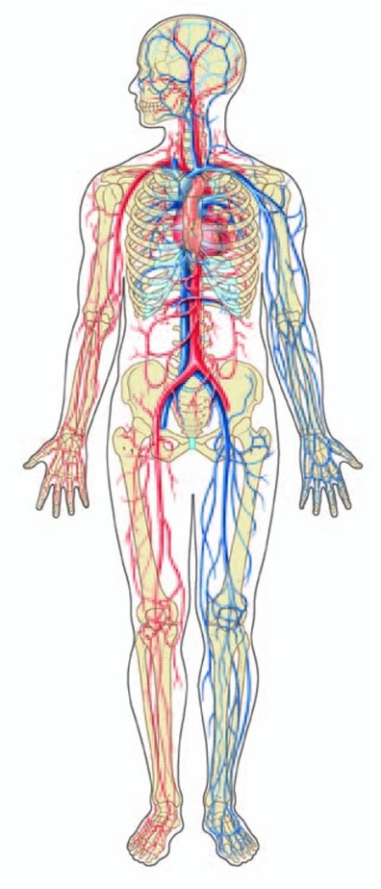
Cardiovascular System 2
Organs of the cardiovascular system
  Heart
  Arteries
  Capillaries
  Veins
Notes:
This slide shows the anatomy of the cardiovascular system. As you can see, the organs of this system include the heart, the arteries, the capillaries and the veins. A variety of specialists treat diseases of the cardiovascular system. Cardiologists treat diseases of the heart, vascular surgeons treat some diseases of the arteries and veins, and neurologists treat strokes.

Slide 5
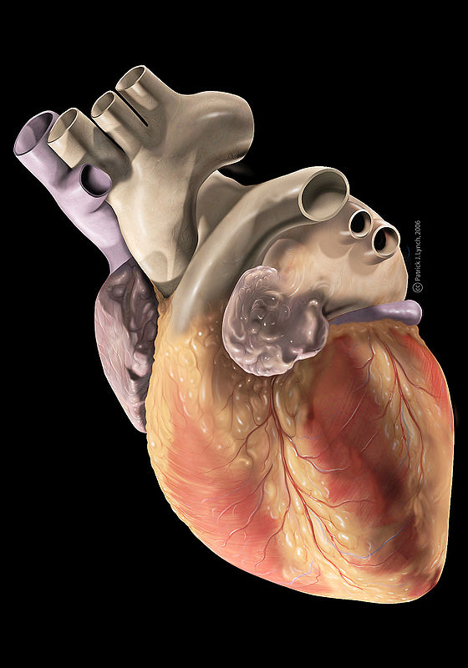
Heart
Located in the mediastinum
  On left side of chest
  Directly behind sternum
Fist-sized
Shaped like upside-down pear
Source: (Introduction to the cardiovascular system)
Notes:
The heart is located in the mediastinum (pronounced media-stine-um) which is located to the left side of the chest and directly behind the sternum, which is the breast bone. The heart is about the size of a fist, and is shaped like an upside-down pear.

Slide 6
Heart Anatomy
Divided into four chambers
  Two atria
  Two ventricles
Septum
  Wall that divides the heart into right and left sides
  Source: (Structure of the heart)
Notes:
The heart has a right and left side. The heart is divided into its right and left sides by a wall called the septum. The right side of the heart delivers blood to the lungs where carbon dioxide (CO₂) is exchanged for oxygen. The left side of the heart then pumps oxygenated blood to body.
The heart is divided into four chambers – two atria (pronounced ate-tree-uh) and two ventricles. The two atria are known as the left and right upper chambers. Blood returns to the atria in the heart through the venous systems.
The two ventricles are known as the left and right lower chambers. They are the pumping chambers, meaning they pump blood away from the heart. Blood exits the ventricles into arteries to be circulated throughout the body.

Slide 7
Blood Vessels
Circulate blood through body
Three types:
  Arteries
  Capillaries
  Veins
  Source: (Classification)
Notes:
You might want to think about blood vessels as the pipes that circulate blood through the body. Blood vessels are divided into three categories – arteries, capillaries and veins.

Slide 8
Blood Vessels 1
Arteries
  Large, thick-walled vessels which can dilate or constrict
  Carry blood away from heart
Notes:
Arteries are large, thick-walled vessels which can dilate (pronounced die-late) or constrict. Arteries carry blood away from the heart to the rest of the body or to the lungs. All arteries carry bright red blood that contains a high level of oxygen.

Slide 9
Blood Vessels 2
Capillaries
  Network of tiny, thin-walled blood vessels
  Connecting unit between arteries and veins
  Oxygen and nutrients diffuse out of the blood
  Carbon dioxide and wastes diffuse into the blood
Notes:
Capillaries are a network of tiny, thin-walled blood vessels. They form the connection between arteries and veins. Capillaries reach each cell in the body. It is in the capillaries that oxygen and nutrients diffuse out of the blood, and carbon dioxide and wastes diffuse into the blood.

Slide 10
Blood Vessels 3
Veins
  Carry blood towards the heart
    From either the lungs or the cells and tissues of body
Notes:
Veins carry blood back towards the heart from either the lungs or the cells and tissues of the body. All veins carry dark red-purple blood that has a low level of oxygen.

Slide 11
Atherosclerosis
Disease in which plaque builds up inside arteries
Plaque
  Sticky substance made up of fat, cholesterol, calcium, and other substances found in the blood
  Builds up inside your arteries
Can lead to
  Coronary artery disease
  Carotid artery disease
  Peripheral arterial disease
Notes:
The first major condition of the cardiovascular system that we will discuss is atherosclerosis (pronounced ath (like path) er-row-sclerosis). Atherosclerosis is a disease in which plaque builds up inside your arteries. Plaque is a sticky substance made up of fat, cholesterol, calcium, and other substances found in the blood. Over time, the plaque hardens and causes narrowing of your arteries. This, in turn, limits the flow of oxygen-rich blood to your body and can lead to serious problems. These problems include coronary artery disease, carotid (pronounced ker-ROT-id) artery disease, and peripheral arterial disease.

Slide 12
Atherosclerosis 2
Coronary artery disease
  Occurs when arteries that supply blood to your heart are blocked
  Angina or a heart attack
Carotid artery disease
  Occurs when arteries that supply blood to your brain are blocked
  Stroke
Peripheral arterial disease
Notes:
In coronary artery disease, the arteries that supply blood to your heart become blocked. When blocked, you can suffer angina (pronounced ANN-gin-uh ), which is the medical term for chest pain. You could even have a heart attack.
If you have carotid artery disease, the arteries that supply blood to your brain become blocked. When they are blocked, you can suffer a stroke.
And if you have peripheral arterial disease, the arteries in your arms, legs and pelvis become blocked. When they are blocked, you can suffer from numbness, pain and sometimes infections.

Slide 13
Atherosclerosis 3
Diagnosis
  Physical examination
  Imaging
  Other diagnostic tests
Treatments
  Medicines
  Medical procedures
  Surgery
  Lifestyle changes
Notes:
Atherosclerosis usually doesn't cause symptoms until it severely narrows or totally blocks an artery. Doctors use physical examination, imaging and other diagnostic tests to see if you have it. Treatments for atherosclerosis include medicines, and medical procedures or surgery.
Lifestyle changes can also help. These include following a healthy diet, getting regular exercise, maintaining a healthy weight, quitting smoking, and managing stress.

Slide 14
Stroke
Blood flow to your brain stops
  Medical emergency
  Early action important to minimize damage
Treated or prevented by controlling risk factors
Risk factors
  High blood pressure
  Smoking
  High cholesterol
Notes:
The next cardiovascular condition that we’ll discuss is a stroke. A stroke occurs when the blood supply to part of your brain is interrupted or severely reduced, depriving brain tissue of oxygen and food. Within minutes, brain cells begin to die. A stroke is a medical emergency. Prompt treatment is crucial. Early action can minimize brain damage and potential complications.
The good news is that strokes can be treated and prevented, and many fewer Americans now die of stroke than was the case even 15 years ago. Better control of major stroke risk factors — high blood pressure, smoking and high cholesterol — is likely responsible for the decline.

Slide 15
Types of Stroke
Ischemic stroke
  Caused by a blood clot that blocks or plugs a blood vessel in the brain
Hemorrhagic stroke
  Caused by a blood vessel that breaks and bleeds into the brain
Notes:
There are two kinds of stroke, ischemic (pronounced iss-KEEM-ick) and hemorrhagic. Almost 90 percent of strokes are ischemic strokes. They occur when the arteries to your brain are narrowed or blocked, causing severely reduced blood flow called ischemia (pronounced iss-KEEM-ee-uh). Lack of blood flow deprives your brain cells of oxygen and nutrients, and cells may begin to die within minutes.
The other kind of stroke is called a hemorrhagic stroke. Hemorrhage is the medical term for bleeding. Hemorrhagic stroke occurs when a blood vessel in your brain leaks or ruptures. Brain hemorrhages can result from a number of conditions that affect your blood vessels, including uncontrolled high blood pressure (hypertension) and weak spots in your blood vessel walls (aneurysms).

Slide 16
Transient Ischemic Attacks (TIAs)
Blood supply to the brain is briefly interrupted
  Many last less than five minutes
  Caused by clot or debris
  Do not usually cause permanent damage
Notes:
"Mini-strokes,” also known as transient ischemic attacks or TIAs (pronounced T-I-As), occur when the blood supply to the brain is briefly interrupted. Many TIAs last less than five minutes.
Like an ischemic stroke, a TIA occurs when a clot or debris (pronounced duh-bree) blocks blood flow to part of your brain. Unlike a stroke, however, which involves a more prolonged lack of blood supply and causes permanent tissue damage, a TIA doesn't usually leave lasting effects because the blockage is temporary.

Slide 17
Stroke 2
Symptoms:
  Sudden onset
  Numbness or weakness of the face, arm or leg
  Confusion, trouble speaking or understanding speech
  Trouble seeing in one or both eyes
  Trouble walking
  Severe headache with no known cause
Treatment
  Drug therapy
  Rehabilitation
Notes:
There are numerous symptoms which occur when you are having a stroke. Strokes can result in a variety of neurologic deficits, such as sensory, motor, cognition. For example, you may experience symptoms such as sudden numbness or weakness of the face, arm or leg (especially on one side of the body). You may have sudden confusion, trouble speaking or understanding speech. In addition, you may have sudden trouble seeing in one or both eyes. You may also have sudden trouble walking, dizziness, loss of balance or coordination. And finally, you may have a sudden severe headache with no known cause.
Treatment is completely dependent upon the cause and type of stroke. Strokes can be traumatic, ischemic, hemorrhagic, etc.
Drug therapy with blood thinners is the most common treatment for ischemic and hemorrhagic stroke.
Rehabilitation therapy helps individuals overcome disabilities that result from stroke damage.

Slide 18
Hypertension
“Silent killer”
High blood pressure can cause
  Kidney problems
  Stroke
  Heart failure
  Blindness
  Heart attacks
Controlling high blood pressure
  Healthy lifestyle habits
  Medication
Notes:
Hypertension is the next cardiovascular condition that we’ll discuss. Hypertension is often referred to as high blood pressure. Hypertension results in damage to organs by consistently causing high blood pressure in vessels of individual organs.
It is typically called a "silent killer" because many people have it but don't know it. Hypertension can cause life-threatening illnesses like kidney problems, stroke, heart failure, blindness, and heart attacks.
You can control high blood pressure through healthy lifestyle habits and taking medication, if needed.

Slide 19
Hypertension 2
Blood pressure readings
  Systolic blood pressure
  Diastolic blood pressure
Usually written one above the other
  Systolic on top; diastolic on bottom
Ranges
  120/80 or lower = normal blood pressure
  140/90 or higher = high blood pressure
  Pre-hypertension = systolic between 120 and 139 or diastolic between 80 and 89
Notes:
The diagnosis of hypertension is based upon your blood pressure readings. Blood pressure readings use two numbers, the systolic (pronounced sis-TAL-ick ) and diastolic (pronounced die-ass-TAL-ick) pressures.
Systolic blood pressure is the pressure when the heart beats while pumping blood. Diastolic blood pressure, in contrast, is the pressure when the heart is at rest between beats. The resulting pressure readings are usually written one above or before the other. A reading of 120 over 80 or lower is considered a normal blood pressure.
A reading of 140 over 90 or higher is considered a high blood pressure.
A reading between 120 and 139 for the top number, or between 80 and 89 for the bottom number, indicates you have pre-hypertension.

Slide 20
Myocardial Infarction
Symptoms include
  Chest discomfort
  Shortness of breath
  Discomfort in the upper body
  Nausea, vomiting, dizziness, lightheadedness, sweating
Arrhythmia
  Irregular heartbeat
  Severe decrease in the pumping function of the heart
Notes:
You may be wondering, “When are we going to talk about heart attacks?” A heart attack is called a myocardial infarction and abbreviated as MI (pronounced M-I). Heart attacks are one of the most well-known and common medical problems. In fact, someone in the United States has a myocardial infarction every 34 seconds.
The symptoms of an MI include chest discomfort, such as feeling pressure, squeezing, or pain. Sometimes people experience shortness of breath and discomfort in the upper body, either in the arms, shoulder, neck, or back. Another symptom of a heart attack is nausea accompanied by vomiting, dizziness, lightheadedness, and sweating.
Most heart attacks happen when a clot in the coronary artery blocks the supply of blood and oxygen to the heart. Myocardial infarction is caused by the heart receiving too little oxygenated blood supply which results in organ damage. A blockage that is not treated within a few hours causes the affected heart muscle to die.
Sometimes, a myocardial infarction leads to an irregular heartbeat – called an arrhythmia (pronounced A-rhyth (like in rhythm)-me-uh) – that causes a severe decrease in the pumping function of the heart. Treatment for cardiac arrhythmias include medications, a variety of cardiac devices and cardiac ablation.

Slide 21
Cardiovascular Combining Forms
Word Part | Meaning | Sample Term
Angi/o | Vessel | Angioplasty
Aort | Aorta | Aortic
Arteri/o | Artery | Arterial
Ather/o | Fatty substance | Atherectomy
Atri/o | Atrium | Interatrial
Cardi/o | Heart | Cardiomegaly
Phleb/o | Vein | Phlebitis
Notes:
Here are some key word parts for the cardiovascular system along with their meanings. In the third column you can see some of the medical terms that we can create by combining word parts.
You should return to the online medical dictionary to hear the pronunciation and become familiar with the meaning of the created terms.

Slide 22
Tell me, Detective . . .
David is rushed to the doctor after complaining of having a really bad headache. His wife also tells David’s doctor that her husband is feeling confused, having trouble speaking and has numbness of the left side of his face. These symptoms are indicative of:
    Atherosclerosis
    Stroke
    Myocardial Infarction
Notes:
David is rushed to the doctor after complaining of having a really bad headache. His wife also tells David’s doctor that her husband is feeling confused, having trouble speaking and has numbness of the left side of his face. These symptoms are indicative of:
Atherosclerosis
Stroke
Myocardial infarction
(NOTE: Pause for about 3 seconds)
Did you guess…stroke? Remember that the symptoms of a stroke include
Sudden numbness or weakness of the face, arm or leg (especially on one side of the body)
Sudden confusion, trouble speaking or understanding speech
Sudden trouble seeing in one or both eyes
Sudden trouble walking, dizziness, loss of balance or coordination
Sudden severe headache with no known cause

Slide 23
Cardiovascular System
Summary
Defined medical terms related to the cardiovascular system
Described common diseases and conditions with an overview of various treatments related to the cardiovascular system
Notes:
This concludes Cardiovascular System. In summary, we defined medical terms related to the Cardiovascular System, and we described common diseases and conditions with an overview of various treatments related to the Cardiovascular System.

Slide 24
Cardiovascular System
References
References
  Classification and structure of blood vessels. SEER Training Modules, Anatomy & Physiology. U.S. National Institutes of Health, National Cancer Institute [Internet]. [cited 2010 Jun 27]. Available from: training.seer.cancer.gov
  Introduction to the cardiovascular system. SEER Training Modules, Anatomy & Physiology. U.S. National Institutes of Health, National Cancer Institute [Internet]. [cited 2010 Jun 27]. Available from: training.seer.cancer.gov
  MedlinePlus [Internet]. Blood, heart and circulation. Bethesda (MD): National Library of Medicine (US); [updated 2011 Jul 27]. Available from: http://www.nlm.nih.gov/
  Structure of the heart. SEER Training Modules, Anatomy & Physiology. U.S. National Institutes of Health, National Cancer Institute [Internet]. [cited 2010 Jun 27]. Available from: training.seer.cancer.gov
Images
  Slide 4: Available from: en.wikipedia.org
  Slide 5: Patrick J. Lynch, medical illustrator; C. Carl Jaffe, MD, cardiologist. Available from: en.wikipedia.org
  Slide 22: Microsoft clip art; Used with permission from Microsoft.
Notes:
“No Audio”

Slide 25
Terminology in Health Care and Public Health Settings
Cardiovascular System
This material was developed by the University of Alabama at Birmingham, funded by the Department of Health and Human Services, Office of the National Coordinator for Health Information Technology under Award Number 90WT0007.
Notes:
No Audio.

