Slide 1
Terminology in Healthcare and
Public Health Settings
Musculoskeletal System
This material (Comp 3 Unit 3) was developed by the University of Alabama at Birmingham, funded by the Department of Health and Human Services, Office of the National Coordinator for Health Information Technology under Award Number 90WT0007.
This work is licensed under the Creative Commons Attribution-NonCommercial-ShareAlike 4.0 International License. To view a copy of this license, visit http://creativecommons.org.
Notes:
Welcome to Terminology in Healthcare and Public Health Settings, Musculoskeletal (pronounced musk-cue-lo-skeletal) System.

Slide 2
Musculoskeletal System
Learning Objectives
Define, understand and correctly pronounce medical terms related to the musculoskeletal system
Describe common diseases and conditions with an overview of various treatments related to the musculoskeletal system
Notes:
The objectives for this unit, Musculoskeletal System, are to:
Define, understand and correctly pronounce various medical terms related to the musculoskeletal system
Describe common diseases and conditions with an overview of various treatments related to the musculoskeletal system

Slide 3
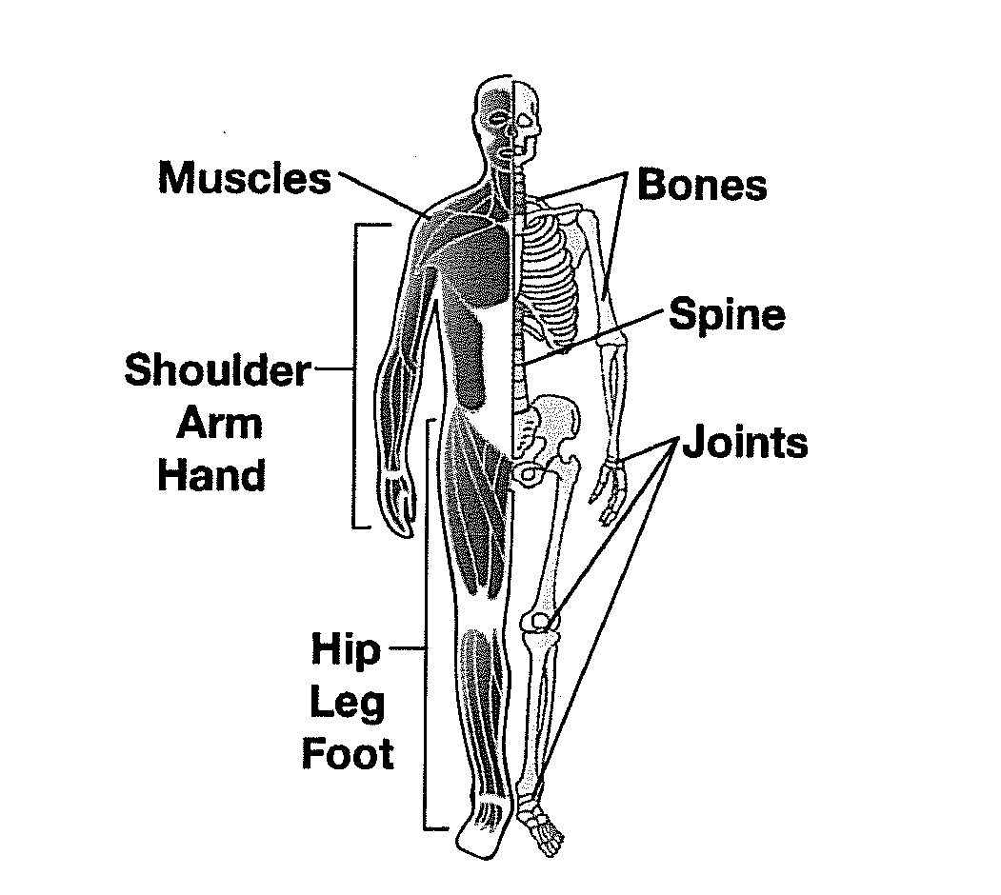
Musculoskeletal
System Overview
Muscular components
  Muscles
Skeletal components
  Bones of the skeleton
  Joints
Source: (MedlinePlus, 2011)
Notes:
Let’s start with an overview of the human musculoskeletal system.
Sometimes the musculoskeletal system is broken down into two different systems – the muscular system and the skeletal system. The muscular components are primarily the muscles of the body, while the skeletal components include the bones and joints.

Slide 4
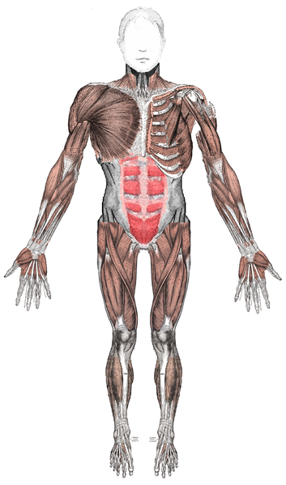
Musculoskeletal System
Functions
  Internal framework of body
  Supports body
  Protects internal organs
  Produces body movement
Source: (MedlinePlus, 2011)
Notes:
The musculoskeletal system has four main functions. It provides the internal framework for the body. It helps support the body. It protects the internal organs. Moreover, the musculoskeletal system enables body movement.

Slide 5
Musculoskeletal System 2
Bones are connected to each other to form the skeleton
  Framework for the body
  206 bones
Joints
  Places where two bones meet
  Held together by ligaments
  Give flexibility to skeleton
Muscles are connected to the skeleton
Notes:
The bones are connected to each other to form the skeleton. The skeleton comprises the framework for the body. There are approximately 206 bones throughout the body.
Another component of the musculoskeletal system is its joints. Joints are the place where two bones meet. Ligaments at the joints hold the bones together. This arrangement gives flexibility to the skeleton.
Muscles are connected to the skeleton. Your muscles help you move and help your body work. Different types of muscles have different jobs.

Slide 6
Myopathy
Can cause weakness, pain or even paralysis
Some causes include
  Injury or overuse, such as sprains or strains, cramps or tendinitis
  Genetics, such as muscular dystrophy
  Some cancers
  Inflammation
  Diseases of nerves that affect muscles
  Infections
  Certain medicines
Notes:
Muscle disorders are also referred to as myopathies (pronounced my-OPP-uh-thees). Remember that “myo” (pronounced my-oh) means muscle and “pathy” (pronounced path-ee) means disease. There are many problems that can affect the muscles. Muscle disorders can cause weakness, pain or even paralysis. While there may be no known cause for a muscle disorder, some of the common causes of myopathy include
Injury or overuse, such as sprains or strains, cramps or tendinitis (pronounced ten-din-ite-iss)
Genetics, such as muscular dystrophy
Some cancers
Inflammation, such as myositis (pronounced my-oh-site-iss)
Diseases of nerves that affect muscles
Infections
Certain medicines
Treatments for myopathies depend on the disease or condition and specific causes. Supportive and symptomatic treatment may be the only treatment available or necessary for some disorders. For example, a minor ankle sprain may require applications of ice and restricted activity. Treatment for other disorders may include drug therapy, such as immunosuppressives (pronounced immune-oh-suppressives), physical therapy, bracing to support weakened muscles, and surgery.
The prognosis for individuals with a myopathy varies. Some individuals have a normal life span and little or no disability. For others, however, the disorder may be progressive, severely disabling, life threatening, or fatal.

Slide 7
Myositis
Inflammation of your skeletal muscles
Common causes: injury, infection or autoimmune disease
  Polymyositis
    muscle weakness, usually in the muscles closest to the trunk of your body
  Dermatomyositis
    muscle weakness, plus a skin rash
  Both diseases are usually treated with prednisone, a steroid medicine, and sometimes other medicines
Notes:
Myositis (pronounced my-oh-site-iss) is the inflammation of your skeletal muscles, which are also called the voluntary muscles. These are the muscles you consciously control to help you move your body. An injury, infection or autoimmune disease can cause myositis. For example:
Polymyositis (pronounced polly-my-oh-site-iss) causes muscle weakness, usually in the muscles closest to the trunk of your body.
Dermatomyositis (pronounced der-MAT-o-MY-oh-site-iss) causes muscle weakness, plus a skin rash.
Both diseases are usually treated with prednisone (pronounced PRED-nih-zone), a steroid medicine, and sometimes other medicines.

Slide 8
Myositis 2
Diagnosing – complicated and lengthy
  Conventional blood tests
  Muscle and skin biopsies
Notes:
Diagnosing myositis is often a complicated and lengthy process. Doctors may use one or more of the following tests to help confirm a specific diagnosis:
Conventional blood tests where the doctors look for elevated levels of muscle enzymes in a patient’s blood samples.
Muscle and skin biopsy where small samples of muscle tissue show abnormalities in muscles, including inflammation, damage, and abnormal proteins. For those with skin symptoms, doctors often biopsy a piece of skin to study.

Slide 9
Myositis 3
Diagnosing
  Electro-diagnostic tests
  Antibody testing
Treatment
  Varies from patient to patient
  Combination of drugs, physical therapy, dietary supplements
Notes:
Electro-diagnostic tests such as magnetic resonance imaging scans or MRI (pronounced M-R-I) might reveal inflammation in muscles and electromyograms (pronounced electro-my-oh-grams) or E-M-Gs might detect changes in muscles’ electrical patterns that indicate muscle disease and indicate which muscles are affected.
Antibody testing which looks for antibodies. These more detailed blood tests confirm a diagnosis and provide insight into the possible course of the disease as well as potential complications.
Treatment for myositis varies tremendously from patient to patient, and no one treatment works for everyone. Physicians may use a combination of drugs, physical therapy or dietary supplements to treat the patient.

Slide 10
Muscular Dystrophy
Causes muscle weakness and muscle loss
Muscles get weaker over time
No cure
Treatments
  Physical and speech therapy
  Orthopedic devices
  Surgery
  Medications
Notes:
Muscular dystrophy refers to a group of more than 30 inherited diseases that cause muscle weakness and muscle loss. Some forms appear in infancy or childhood, while others may not appear until middle age or later.
All forms of muscular dystrophy grow worse as the person's muscles get weaker. Most people eventually lose the ability to walk. There is no cure for muscular dystrophy. Treatments include physical and speech therapy, orthopedic devices, surgery and medications. Some people with muscular dystrophy have mild cases that worsen slowly. Other cases are disabling and severe.

Slide 11
Muscular System
Combining Forms
Word Part | Meaning | Sample Term
Muscul/o | Muscle | Muscular
My/o | Muscle | Myopathy
Myocardi/o | Heart muscle | Myocardium
Tend/o | Tendon | Tenoplasty
Notes:
Here are some key word parts for the muscular system along with their meanings. In the third column you can see some of the medical terms that we can create by combining word parts.
You should return to the online medical dictionary to hear the pronunciation and become familiar with the meaning of the created terms.

Slide 12
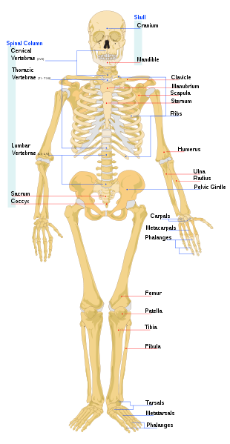
The Spinal (Vertebral) Column
Divided into five sections
  Cervical
  Thoracic
  Lumbar
  Sacrum
  Coccyx
(Author: LadyofHats)
Notes:
Now let’s look at the various components of the skeleton. The spine or backbone is a vertical column of bones. It supports the weight of the head, neck, and trunk of the body and protects the spinal cord.
It is also known as the spinal or vertebral (pronounced ver-TEEB-bruhl) column and is divided into five sections – cervical (pronounced serve-ickle), thoracic pronounced thor-ASS-ick), lumbar (pronounce lum-barr), sacrum(pronounced sake-rum), coccyx (pronounced cocks-six). The cervical vertebrae (pronounced VERT-ih-bray) are in the neck. The thoracic vertebrae are in the chest. The lumbar vertebrae are in the lower back. The sacrum is a group of five fused vertebrae. The coccyx, or tailbone, is a group of several small, fused vertebrae.

Slide 13
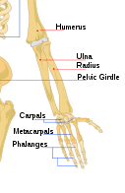
Upper Extremity
Arm
  Humerus – upper arm
  Ulna – part of forearm
  Radius – part of forearm
  Carpals – wrist bones
  Metacarpals – hand bones
  Phalanges – finger bones
(Author: LadyofHats)
Notes:
We commonly refer to the arm as our upper extremity. The arm consists of a variety of bones. The humerus (pronounced HUME-er-us) is the long bone in the upper arm. The ulna (pronounced ULL-nuh) is one of two bones in the forearm and lies on the little finger side of the forearm. The other bone in the forearm is called the radius; it lies on the thumb side of the forearm. Carpals (pronounced CAR-pulls) are our wrist bones, while metacarpals (pronounced metta-car-puls) are our hand bones. Our phalanges (pronounced full-ANJ-eez) are the bones of the fingers.

Slide 14
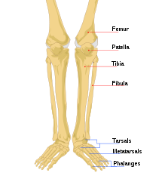
Lower Extremity
Leg
  Femur – thigh bone
  Patella – knee cap
  Tibia – shin bone
  Fibula – lower leg bone
  Tarsals – ankle bones
  Metatarsals – foot bones
  Phalanges – toe bones
(Author: LadyofHats)
Notes:
We commonly refer to the leg as the lower extremity. The leg consists of numerous bones as well. These include the femur (pronounced fee-mer) or thigh bone which is the long bone in the upper leg. The knee cap is the patella (puh-TELL-uh). The tibia (pronounced TIB-ee-uh), or shinbone, is the large bone on the medial (pronounced meed-ee-uhl) side of the lower leg. The fibula (pronounce FIB-you-luh) is the very thin bone of the lower leg. The femur and tibia are the primary weight bearing bones.
The bones of the ankle and foot include tarsals (pronounced TAR-sulls), which are the ankle bones, metatarsals which are the bones of the foot and phalanges, which are the bones of the toes.

Slide 15
Fractures
Types of fractures
  Open or compound fracture
  Closed facture
  Stress fracture
Common causes
  Car accidents
  Falls
  Sports injuries
  Osteoporosis, which causes weakening of the bones
Notes:
The most common of the bone conditions are fractures. We sometimes refer to fractures as having a broken bone.
Fractures are categorized according to how the bone breaks. If the broken bone punctures the skin, it is called an open or compound fracture. If the broken bone DOES NOT puncture the skin, it is referred to as a closed fracture.
A fracture that is caused by force or torsion (pronounced tor-shun) during an accident or sports activity is a stress fracture. Stress fractures are very small cracks in the bone. Fractures commonly happen because of car accidents, falls or sports injuries. Another cause is osteoporosis (pronounced oss-tee-oh-por-oh-sis), which causes weakening of the bones.

Slide 16
Fracture Symptoms
Misshapen limb or joint
Swelling, bruising or bleeding
Intense pain
Numbness and tingling
Limited mobility
Notes:
Symptoms of a fracture are
An out-of-place or misshapen limb or joint
Swelling, bruising or bleeding
Intense pain
Numbness and tingling, and
Limited mobility or inability to move a limb

Slide 17
Arthritis
Joint inflammation
  Pain
  Swelling
  Inflammation
  Stiffness
Types
  Osteoarthritis
  Rheumatoid
  Juvenile rheumatoid
  Infectious arthritis
Notes:
Arthritis literally means “joint inflammation.” Although it describes a symptom or sign rather than a specific diagnosis, the word arthritis is often used to refer to any disorder that affects the joints. Arthritis is characterized by pain, swelling, inflammation, and stiffness.
One type of arthritis, osteoarthritis (pronounced OSS-tee-oh-arthritis), is often related to aging or to an injury. Other types occur when your immune system, which normally protects your body from infection, attacks your body's own tissues. Rheumatoid (pronounced room-uh-toid) arthritis is the most common form of this kind of arthritis. Juvenile rheumatoid arthritis is a form of the disease that happens in children. Infectious arthritis is an infection that has spread from another part of the body to the joint.

Slide 18
Osteoporosis
Makes your bones weak and likely to break
Common in older women
Risk factors include
  Getting older
  Being small and thin
  Having a family history of osteoporosis
  Taking certain medicines
  Being a white or Asian woman
  Having osteopenia (low bone mass)
Notes:
Another bone condition that we often hear about is osteoporosis (pronounced OSS-tee-oh-pore-oh-sis). This condition is the abnormal thinning of the bone structures due to loss of calcium and phosphorus. Osteoporosis makes your bones weak and more likely to break. Anyone can develop osteoporosis, but it is more common in older women. As many as half of all women and a quarter of men older than 50 will break a bone due to osteoporosis. Risk factors include:
Getting older
Being small and thin
Having a family history of osteoporosis
Taking certain medicines
Being a white or Asian woman
Having osteopenia, which is low bone mass

Slide 19
Preventing, Stopping or
Slowing Osteoporosis
Calcium
Vitamin D
Exercise
Medications
Notes:
Although there is no cure for osteoporosis, there are steps one can take to prevent, slow or stop its progress. In some cases, you may even be able to improve bone density and reverse the disorder to some degree. Getting enough calcium and vitamin D, as well as appropriate exercise, are essential to the bone health of everyone. Often times, a medication may be prescribed.

Slide 20
Skeletal System
Combining Forms
Word Part | Meaning | Sample Term
Arthr/o | Joint | Arthritis
Carp/o | Wrist | Carpal
Cervic/o | Neck | Cervical
Crani/o | Skull | Craniotomy
Oste/o | Bone | Osteopathy
Thorac/o | Chest | Thoracic
Vertebr/o | Vertebra | Intervertebral
Notes:
Here are some key word parts for the skeletal system along with their meanings. In the third column you can see some of the medical terms that we can create by combining word parts.
You should return to the online medical dictionary to hear the pronunciation and become familiar with the meaning of the created terms.

Slide 21
Tell me, Detective . . .
Mary is an 84-year-old white female. She recently fell and fractured her femur. The doctor ordered a test which showed loss of bone density. This fracture was probably due to:
  Stress
  Arthritis
  Osteoporosis
Notes:
How can you use the information on the musculoskeletal system to help make a diagnosis in the case on this slide? Mary is an 84 year old white female. She recently fell and fractured her femur, which is the large bone in the thigh. The doctor ordered a test which showed loss of bone density. This fracture was probably due to:
Stress
Arthritis
Osteoporosis
Did you guess osteoporosis? Remember that this condition is the abnormal thinning of the bone structures due to loss of calcium and phosphorus. Osteoporosis makes your bones weak and more likely to break.

Slide 22
Musculoskeletal
System Summary
Define, understand and pronounce medical terms
Describe common diseases and conditions
Describe laboratory and diagnostic procedures
Identify procedures and medications
Notes:
This concludes the Musculoskeletal System.
In summary, you should be able to define, understand and correctly pronounce various medical terms related to the musculoskeletal system. You should also be able to describe common diseases and conditions and recognize various treatments related to the Musculoskeletal System .

Slide 23
Musculoskeletal System
References
References
  MedlinePlus [Internet]. Bones, joints and muscles. Bethesda (MD): National Library of Medicine (US); [updated 2011 Jul 27]. Available from: www.nlm.nih.gov/medlineplus
Images
  Slide 3: Available From: www.nlm.nih.gov/medlineplus
  Slide 4: Available From: commons.wikimedia.org
  Slide 12, 13, 14: Author: LadyofHats Available From: commons.wikimedia.org
Notes:
“No Audio”

Slide 24
Terminology in Healthcare and Public Health Settings
Musculoskeletal System
This material was developed by the University of Alabama at Birmingham, funded by the Department of Health and Human Services, Office of the National Coordinator for Health Information Technology under Award Number 90WT0007.
Notes:
No Audio.

