Slide 1
Notes:
No audio. Recording preparation.

Slide 2
The Culture of Health Care
Ethics and Professionalism
Lecture b
This material (Comp 2 Unit 8) was developed by Oregon Health & Science University, funded by the Department of Health and Human Services, Office of the National Coordinator for Health Information Technology under Award Number IU24OC000015. This material was updated in 2016 by Bellevue College under Award Number 90WT0002.
This work is licensed under the Creative Commons Attribution-NonCommercial-ShareAlike 4.0 International License. To view a copy of this license, visit http://creativecommons.org/licenses/by-nc-sa/4.0/.
Notes:
Welcome to The Culture of Health Care: Ethics and Professionalism. This is Lecture b.
The component, The Culture of Health Care, addresses job expectations in health care settings. It discusses how care is organized within a practice setting, privacy laws, and professional and ethical issues encountered in the workplace.

Slide 3
Ethics and Professionalism
Learning Objectives
Discuss foundational concepts in medical ethics and professionalism (Lecture a).
Examine the relationships among ethical ideals, professionalism, and legal duties (Lecture a, b).
Apply the general principles of ethics and professionalism to specific topics (Lecture c, d).
Examine ethical issues in health informatics (Lecture d).
Notes:
The objectives for Ethics and Professionalism are to:
Discuss foundational concepts in medical ethics and professionalism
Examine the relationships among ethical ideals, professionalism, and legal duties
Apply the general principles of ethics and professionalism to specific topics
Examine ethical issues in health informatics

Slide 4
Ethical Standards and
Legal Standards
Sometimes they are the same
  Example: Both law and ethics prohibit harmful surgery on a healthy patient
Sometimes they overlap or interact
  Example of overlap: State and federal laws set standards for the practice of medicine
  Example of interaction: Failure to meet professional standards can create legal liability (malpractice case)
Sometimes they conflict
  Example: Court orders disclosure of patient information
Notes:
This lecture discusses ethical and legal standards and how they interact. People in the medical profession are required to meet both ethical standards and legal standards. Sometimes these standards are one and the same. For example, it would be both an ethical violation and a crime to perform disabling surgery on a healthy person. Sometimes, ethical standards and legal standards overlap or interact, and they are subject to interpretation by both legal authorities and professional oversight committees. In other cases, ethical and legal standards may conflict. For example, even though a physician has an ethical duty to maintain patient confidentiality, a court may order the release of a patient’s medical records for use in a lawsuit.
In recent decades, two new academic fields—bioethics and health and human rights—have begun addressing ethical issues in medicine. Bioethics is the study of the ethical and moral implications of medical advances, research, and practice at the intersection of the law and the human rights of the patient. Examples include genetic engineering and drug research. Health and human rights examines a vast array of ethical concerns around such issues as health care inequities, vulnerable populations, reproductive and sexual health, death and dying, and more.

Slide 5
AMA Opinion
Ethical values and legal principles are closely related
Ethical obligations typically exceed legal duties
Sometimes the law mandates unethical conduct
Generally, physicians should obey current laws and work to change unjust laws
In rare cases, ethical responsibilities should take priority over unjust laws
Even if a legal proceeding finds a physician to be innocent, he or she may have acted unethically
Notes:
The American Medical Association has made a very clear statement about the relationship between ethics and law. It says:
[quote] “Ethical values and legal principles are usually closely related, but ethical obligations typically exceed legal duties. In some cases, the law mandates unethical conduct. In general, when physicians believe a law is unjust, they should work to change the law. In exceptional circumstances of unjust laws, ethical responsibilities should supersede legal obligations. The fact that a physician charged with allegedly illegal conduct is acquitted or exonerated in civil or criminal proceedings does not necessarily mean that the physician acted ethically.” [end quote]

Slide 6
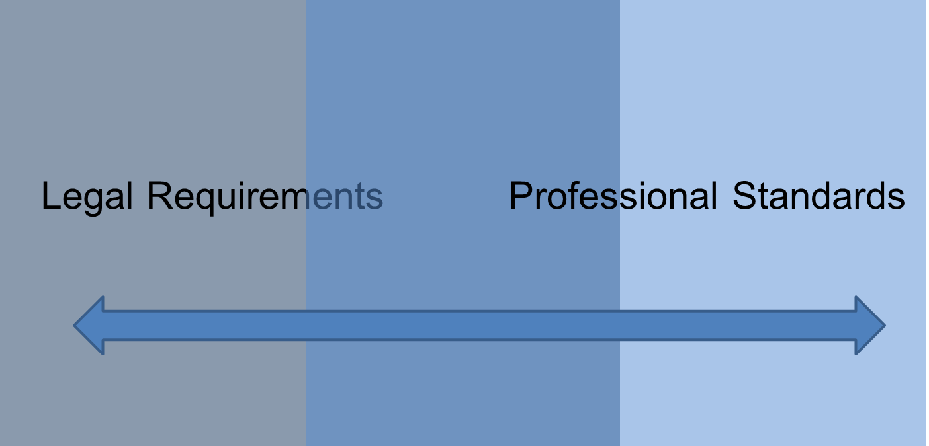
Standards of Professionalism
8.4 Figure: Standards of professionalism (CC BY-NC-SA 3.0, 2012).
Notes:
The relationship between professionalism and law is a two-way street. The law sets standards for professionalism, and standards set by a profession can provide a basis for legal responsibility. State medical practice laws are a primary source of legal standards of professionalism, but other state and federal laws also apply.
Courts sometimes decide that a health care professional did not meet the bottom-line standard for professionalism. In other words, health care professionals are sometimes found legally liable for actions that are not specifically prohibited by law.

Slide 7
State Medical Practice Law
Defines the practice of medicine within the state
Establishes a state medical board
Governs testing and licensing of physicians
Specifies procedures for investigation, enforcement, and discipline of physicians
Notes:
A state medical practice law defines the physician’s practice of medicine and establishes a state medical board. In addition, the law specifies the method for testing medical school graduates who want to be admitted as a physician to the practice of medicine, and it sets requirements for physician licensing. The law also establishes procedures for enforcing professional standards, investigating complaints against physicians, and disciplining doctors where appropriate.
A group called the Federation of State Medical Boards has written a model state medical practice law. However, the states are not required to follow it, so the laws governing medical practice vary from state to state.
Similar laws in each state govern other health care professions, such as nursing, pharmacy, and dentistry. Many states also regulate allied professions such as physical therapy.
The next two slides look at physician medical practice laws; however, it’s important to remember that similar laws apply to dentists, nurses, and many other health care professionals in each state. The point is that in the culture of health care, the law plays a large role in the professional standards that must be met.

Slide 8
State Medical Board
The majority of the members are physicians, but should also include non-physicians
Writes rules and regulations
Gives examinations and awards medical licenses
Investigates complaints, holds hearings
Administers disciplinary actions
Evaluates medical education programs
Notes:
Although legislators decide the medical practice law in each state, the state medical board is in charge of the nuts-and-bolts governance of the medical profession for physicians. In some states, the board is an independent entity, whereas in other states it’s part of a larger organization, such as the state department of health.
A state medical board is usually made up of non-physician members of the community as well as physicians. However, the Federation of State Medical Boards recommends that physicians should be the majority and should have primary responsibility for overseeing the board’s licensing and education responsibilities.
The typical powers and responsibilities of a state medical board include the ability to write rules and regulations based on the state medical practice law. For example, the board evaluates medical schools. It gives examinations to graduates who want to enter medical practice, and it investigates complaints against physicians. It’s responsible for disciplining physicians it finds to be in violation of professional standards. In addition, the board deals with any individuals who are practicing medicine without a license.
Other health care professions may also have a state board, such as a state board of nursing or a state board of pharmacy. These operate in a manner similar to the medical board for physicians.

Slide 9
Unprofessional Conduct
Investigators gather information
Board determines whether unprofessional conduct has occurred
Board imposes sanctions
  Fines
  Mandatory medical education
  Mandatory medical treatment
  Suspension or revocation of license
Notes:
When a state medical board receives information suggesting that a physician has violated professional standards, it initiates an investigation. If sufficient evidence is found in the investigation, the board holds a hearing or some other procedure to determine whether a violation has occurred. This process must be conducted in a way that is fair and that protects the basic rights of the physician.
If a violation is found to have occurred, the board can impose a penalty. In a professional setting, a penalty is usually called a sanction. Although a sanction is a punishment in a practical sense, it’s not intended to punish the individual physician. Rather, the purpose of a sanction is to protect the public from substandard medical practices. The sanction might be a monetary fine. If the physician’s violation involved substandard skills, the board may order him or her to seek additional medical education. If the violation involved a medical condition, such as drug addiction, the board might order the physician to submit to medical treatment. For serious violations, the board might also suspend or revoke the physician’s medical license.
Setting professional standards through medical practice laws is one example of how ethics, professionalism, and law interact. The next two slides discuss another way in which these concepts interact: malpractice liability.

Slide 10
Investigation vs. Malpractice
State medical board investigation
  Addresses physician’s responsibility to the medical profession
Malpractice lawsuit
  Addresses physician’s liability to patient
The same act or situation may result in both an investigation and a lawsuit
Notes:
An investigation by a state medical board addresses the responsibility of the physician to the medical profession. A malpractice case is different in that it addresses the liability of a physician regarding the treatment of an individual patient. A physician might face both a board investigation and a malpractice lawsuit for the same act or situation.

Slide 11
Four Basics of Malpractice
Health care provider had a duty to the patient
Minimum standards of care were not met
The failure to meet standards of care caused an injury
The injury resulted in damages (harm)
Notes:
There are four parts to proving a claim of medical malpractice. The first is that the health care provider had a duty to the patient who is bringing the case. This is an example of where malpractice law and ethics interact. When does a specific health care professional have a duty to a specific patient?
The second element of malpractice is that the minimum standards of care were not met in some way. Perhaps a surgeon performed an operation for which he or she was not properly trained, or a physician did not fully inform a patient about the risks of a treatment. This second element of malpractice is closely intertwined with standards of professionalism.
The last two elements of a successful malpractice case are that the failure to meet the standard of care caused some kind of injury, and the injury resulted in damages, such as emotional distress or lost time from work. Lack of professionalism is not malpractice if it does not result in some injury and if the injury does not result in harm to the patient.
Malpractice law applies not only to doctors but also to other health care providers. Nurses, pharmacists, physical therapists, who can be sued successfully if the elements of a malpractice case are met.

Slide 12
Professionalism and the Culture of Health Care
Lofty goals can compete with fear of potential consequences
Prevailing attitudes in the health care culture can make it difficult to uncover ethical lapses
Notes:
Another way in which law, ethics, and professionalism intersect is in the self-regulation of the health care profession. On one hand, the health care profession holds itself to lofty ethical goals. On the other hand, the severity of the potential consequences can make it difficult for the profession to police itself.
Most health care professionals behave ethically, but sometimes, unethical acts or practices occur. General attributes of the culture of health care can make it difficult for people to report unethical behavior to their bosses or to outside authorities.

Slide 13
The Hidden Curriculum in Medical Education
The “culture” of a medical school can contradict formal medical ethics training
Students learn by:
  “Reading between the lines” of written institutional policies
  Observing standards used for evaluation of success
  Following the money
  Noticing the language an institution uses
Notes:
Children are often told, “Do as I say, not as I do.” But the lessons learned by example are very powerful. So far, this unit has outlined a strong set of ethical values that are formally taught in medical schools. However, many experts say that when it comes to prevailing ethical values, medical education contains a “hidden curriculum.” According to the widely discussed ideas of sociology professor Frederic Hafferty [haf-fur-tee], medical students acquire their ethical standards in a variety of ways, some of which make up the hidden curriculum.
The next slides explain how institutional policies, standards for evaluation, resource-allocation decisions, and institutional language can influence what medical students learn about ethics.

Slide 14
How the Hidden Curriculum
Is Taught
Institutional policies
  Statements about how much federal grant money the faculty is generating tell students that attracting money to the institution is an important value
Evaluation activities
  The attributes and behaviors of those who are promoted may be more influential than ethics statements
Notes:
Students learn about values from the policies of the institution. For example, if a medical school’s brochures feature statements about how much grant money its faculty members generate, this tells students that attracting money to the institution is an important internal value. How faculty are selected for promotion and what type of student is selected as chief resident also makes a statement about the values the organization embraces. The attributes and behaviors of those who are promoted may be more powerful indicators of institutional values than ethics policies or ethics classes.

Slide 15
How the Hidden Curriculum
Is Taught Continued
Resource-allocation decisions
  Office space
  Which programs are funded
Institutional language about money
Notes:
When students observe an institution’s environment, they form ideas about what is most valued by the institution and the profession based on things like the size of faculty offices and department facilities. In addition, the language that is used day to day sends a powerful message. Professor Hafferty observed that when the language of investment professionals becomes commonly used by medical professionals, that sends a message about the relative importance of the business aspects of practicing medicine.

Slide 16
Barriers to Disclosing
Unethical Behavior
Personal motivations
  Loyalty to the profession
Institutional motivations
  Fear of negative publicity associated with a scandal
Understandings about physician behavior
  Be confident and exercise independent judgment
  Do not raise concerns with others
Notes:
Two other experts examined several well-known cases in which institutions refused to acknowledge ethical lapses by doctors or researchers, even after extensive investigations. The problems were exposed only when the facts of these cases were investigated by outside authorities. The conclusion from the study was that learned institutional values in medicine can create a culture in which it’s difficult to report the ethical gaps of others.
The study identified three general types of barriers to disclosing unethical behavior: personal motivations, institutional motivations, and shared understandings of how physicians behave.

Slide 17
Whistleblowing and Health Care Ethics
Generally, about 6 out of 10 people who observe workplace misconduct will report it
The percentage may be even lower in the health care field
  Fewer than 5% of medical students in their last weeks of training said they would report unethical behavior
Notes:
All of this leads to another area in which law, ethics, and professionalism intertwine: whistleblowing. The term whistleblower refers to someone who reports illegal or unethical behavior to his or her superiors at work or to outside authorities. A wide range of activities have been described as health care whistleblowing, from telling a patient about an error to disclosing violations of professional conduct that are occurring throughout an entire institution.
Generally, about six out of ten people who observe workplace misconduct report it to their superiors or to outside authorities. The figure may be even lower in the health care professions. In one study, only about five of one hundred medical students who were in the last weeks of their training said they would report unethical behavior.

Slide 18
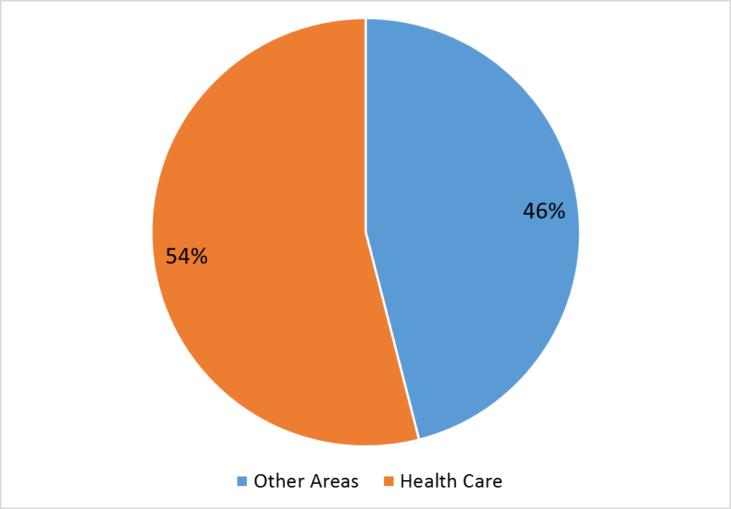
Funds Recovered Due to Whistleblowing in 2015
8.5 Chart: Health care fraud
Of the $3.5 billion recovered, $1.9 billion was related to health care fraud
Department of Justice, 2015
Notes:
Under a federal law called the False Claims Act, citizens who have evidence of fraud against federal government contracts and programs can sue, on behalf of the government, in order to recover the stolen funds. In compensation for their risk and effort, the whistleblowers may be rewarded with a portion of the funds recovered, typically between fifteen and twenty-five percent.
In fiscal year 2015, the federal government recovered $3.5 billion dollars from False Claims Act cases. Of the $3.5 billion dollars recovered, $1.9 billion dollars was related to health care fraud. Prominent examples of health care fraud are falsified claims for Medicare and Medicaid reimbursement.

Slide 19
Retaliation for Whistleblowing
About 15% of whistleblowers face retaliation
Can range from mild to severe, for example:
  Snubbed by coworkers
  Verbal abuse by supervisor
  Denied promotion or raises
  Property damage
  Physical assault
Notes:
About fifteen percent of employees who report workplace misconduct face negative consequences. According to research conducted by the Ethics Resource Center, sixty percent of whistleblowers who reported retaliation said they were given a cold shoulder by their coworkers. Furthermore, sixty-two percent experienced verbal abuse by a superior. In addition, forty-three percent said that as a consequence of their whistleblowing, they did not receive promotions or raises. At the most extreme end, four percent of whistleblowers reported physical harm to themselves or their property.

Slide 20
Protection of Whistleblowers
Federal Law | Example of When It Applies
False Claims Act | A false claim for payment has been made, such as Medicare fraud
Occupational Safety and Health Act | Practices that result in an unsafe workplace
Clean Air Act | Practices that contribute to air pollution
Solid Waste Disposal Act | Improper disposal of solid waste
8.6 Table: Protection of whistleblowers (CC BY-NC-SA 3.0, 2012).
Notes:
Many federal laws protect whistleblowers from retaliation, depending on the circumstances. For example, whistleblowers who disclose information about unsafe workplaces may be protected from job discrimination by the federal Occupational Safety and Health Act.
Unfortunately, it can be difficult to prove that a negative act, such as an employer’s failure to promote a whistleblower, is really retaliation for the whistleblowing.

Slide 21
Ethics and Professionalism
Summary – Lecture b
Health care professionals must meet both ethical and legal standards
  Sometimes these standards are the same, but not always
The sources of legal standards for health care professionals include state medical practices laws and malpractice law
The culture of health care includes expectations that may make it difficult to disclose illegal or unethical behavior or practices
Notes:
This concludes Lecture b of Ethics and Professionalism. In summary, health care professionals must meet both ethical standards and legal standards. Sometimes these are the same, but not always. Ethical standards may overlap or intersect with legal standards, and the two types of standards may even conflict. Just because something is legal does not mean it’s necessarily ethical.
One source of legal standards for physicians is each state’s medical practices law. It defines the practice of medicine within the state, establishes a state medical board, administers testing and licensing of physicians, and specifies procedures for investigation, enforcement, and discipline. The state medical board writes rules and regulations to carry out the law. There are similar state boards for other professionals—nursing, pharmacy, and dentistry, to name a few.
A source of legal standards for all health care professionals is each state’s malpractice laws. In order to bring a successful malpractice suit, the patient must prove that the health care provider had a duty to the patient, that minimum standards of care were not met, that the failure to meet the standards caused an injury, and that the injury resulted in damages.
Certain values in the culture of health care, such as the belief in doctors’ independence, make it difficult to disclose illegal or unethical behavior. The hidden curriculum in medical schools may teach students more about ethics than formal ethics training does. In 2011, a large amount of health care fraud was reported under the federal False Claims Act, showing that unethical behavior is more common in the health care professions than people might like to think.

Slide 22
Ethics and Professionalism
References – Lecture b
References
Aasland, O.G., & Forde, R. (2005). Impact of feeling responsible for adverse events on doctors’ personal and professional lives: The importance of being open to criticism from colleagues. Quality and Safety in Health Care, 14(1), 13–17.
American Medical Association. (2012). The AMA Code of Medical Ethics' Opinions on Confidentiality of Patient Information. Opinion E-5.05—Confidentiality. AMA Journal of Ethics. Retrieved from http://journalofethics.ama-assn.org/2012/09/coet1-1209.html
American Medical Association. (2016). AMA’s code of medical ethics. Retrieved from http://www.ama-assn.org/ama/pub/physician-resources/medical-ethics/code-medical-ethics.page
American Medical Association. (2016). Frequently asked questions in ethics. Retrieved from http://www.ama-assn.org/ama/pub/physician-resources/medical-ethics/code-medical-ethics/frequently-asked-questions.page
Benatar, D. (2006). Bioethics and health and human rights: a critical view. Journal of Medical Ethics, 32(1), 17–20. Retrieved from http://www.ncbi.nlm.nih.gov/pmc/articles/PMC2563274/
Bolsin, S., Faunce, T., & Oakley, J. (2005). Practical virtue ethics: Healthcare whistleblowing and portable digital technology. Journal of Medical Ethics, 31(10), 612–618.
Brock, L. V., & Mastroianni, A. (2013). Clinical ethics and law. University of Washington School of Medicine. Retrieved from https://depts.washington.edu/bioethx/topics/law.html
Center for Practical Bioethics. (n.d.). What is bioethics? Retrieved from https://www.practicalbioethics.org/what-is-bioethics
Notes:
No audio.

Slide 23
Ethics and Professionalism
References – Lecture b Continued
The Economist. (2014, May 31). The $272 billion swindle. Why thieves love America’s health-care system. Retrieved from http://www.economist.com/news/united-states/21603078-why-thieves-love-americas-health-care-system-272-billion-swindle
Ethics & Compliance Initiative. (n.d.). Ethics and compliance glossary. Retrieved from https://www.ethics.org/resources/free-toolkit/toolkit-glossary
Farnan, J. M., Sulmasy, L. S., Worster, B. K., Chaudhry, H. J., Rhyne, J. A., & Arora, V. M. (2013). Online medical professionalism: Patient and public relationships: Policy statement from the American College of Physicians and the Federation of State Medical Boards. Annals of Internal Medicine, 158(8), 620–627.
Federation of State Medical Boards. (2015). Essentials of a state medical and osteopathic practice act. Retrieved from http://www.fsmb.org/Media/Default/PDF/FSMB/Advocacy/GRPOL_essentials.pdf
Gillon, R., & Higgs, R. (2015). What is it to do good medical ethics? A kaleidoscope of views. Journal of Medical Ethics, 41(1), 1–4.
Grunwald H. W., Howard D. S., McCabe M. S., Storm C. D., & Rodriguez M. A. (2008) Misdiagnosis: Disclosing a colleague’s error. Journal of Oncology Practice, 4(3), 158–160.
Hafferty FW. (1998) Beyond curriculum reform: confronting medicine's hidden curriculum. Academy of Medicine, 73(4): 403–407
Notes:
No audio.

Slide 24
Ethics and Professionalism
References – Lecture b Continued 2
Hannawa, A. F. (2012). Principles of medical ethics: implications for the disclosure of medical errors. Medicolegal and Bioethics, 2, 1–1. Retrieved from https://www.researchgate.net/profile/ Annegret_Hannawa2/publication/232252062_Principles_of_medical_ethics_Implications_for_the_disclosure_of_medical_errors
Kesselheim, A. S., Studdert, D. M., & Mello, M. M. (2010). Whistle-blowers’ experiences in fraud litigation against pharmaceutical companies. New England Journal of Medicine, 362(19), 1832–1839. Retrieved from http://www.nejm.org/doi/full/10.1056/nejmsr0912039
Klaas, P. B., Berge, K. H., Klaas, K. M., Klaas, J. P., & Larson, A. N. (2014). When patients are harmed, but are not wronged: Ethics, law, and history. Mayo Clinic Proceedings, 89(9), 1279–1286.
Krause, J. H. (2013). Kickbacks, self-referrals, and false claims: The hazy boundaries of health-care fraud. CHEST Journal, 144(3), 1045–1050. Retrieved from http://journal.publications.chestnet.org/ article.aspx?articleid=1732168
Lyons, C. (2012). Medical malpractice apology law: “Don’t tell me what happened, tell me that you’re sorry.”. Health Law Outlook, 27. Retrieved from http://scholarship.shu.edu/cgi/viewcontent .cgi?article=1006&context=health_law_outlook#page=27
Macklin, R. (2015). Can one do good medical ethics without principles? Journal of Medical Ethics, 41, 75–78. Retrieved from http://jme.bmj.com/content/41/1/75.full
Mannion, R., & Davies, H. T. (2015). Cultures of silence and cultures of voice: The role of whistleblowing in healthcare organisations. International Journal of Health Policy and Management, 4(8), 503. Retrieved from http://www.ncbi.nlm.nih.gov/pmc/articles/PMC4529038
Notes:
No audio.

Slide 25
Ethics and Professionalism
References – Lecture b Continued 3
Outterson, K. (2012). Punishing health care fraud—Is the GSK settlement sufficient?. New England Journal of Medicine, 367(12), 1082–1085.
Pickler N. (2011, December 19). Justice reports record false claims recoveries. Yahoo Finance News. Retrieved from http://finance.yahoo.com/news/Justice-reports-record-false-apf-3660225829.html?x=0
Rhodes, R., & Strain, J. J. (2004). Whistleblowing in academic medicine. Journal of Medical Ethics, 30(1), 35–39.
U.S. Department of Justice (2015). Justice Department recovers over $3.5 Billion from False Claims Act cases in fiscal year 2015. Retrieved from https://www.justice.gov/opa/pr/justice-department-recovers-over-35-billion-false-claims-act-cases-fiscal-year-2015
Vincler, L. A. (2013). Ethics in medicine: Clinical ethics and law. University of Washington School of Medicine. Retrieved from http://depts.washington.edu/bioethx/topics/law.html
Wallace, I. M. (2015). Is patient confidentiality compromised with the electronic health record?: A position paper. Computers Informatics Nursing, 33(2), 58–62
Charts, Tables, Figures
8.4 Figure: Standards of professionalism (CC BY-NC-SA 3.0, 2012).
8.5 Chart: Health care fraud (CC BY-NC-SA 3.0, 2016).
8.6 Table: Protection of whistleblowers (CC BY-NC-SA 3.0, 2012).
Notes:
No audio.

Slide 26
The Culture of Health Care
Ethics and Professionalism
Lecture b
This material was developed by Oregon Health & Science University, funded by the Department of Health and Human Services, Office of the National Coordinator for Health Information Technology under Award Number IU24OC000015. This material was updated in 2016 by Bellevue College under Award Number 90WT0002.
Notes:
No audio.

