Slide 1
Notes:
No audio. Recording preparation.

Slide 2
The Culture of Health Care
Evidence-Based Practice
Lecture g
This material (Comp2 Unit 5) was developed by Oregon Health & Science University, funded by the Department of Health and Human Services, Office of the National Coordinator for Health Information Technology under Award Number IU24OC000015. This material was updated in 2016 by Bellevue College under Award Number 90WT0002.
This work is licensed under the Creative Commons Attribution-NonCommercial-ShareAlike 4.0 International License. To view a copy of this license, visit http://creativecommons.org/licenses/by-nc-sa/4.0/.
Notes:
Welcome to The Culture of Health Care: Evidence-Based Practice. This is Lecture g.
The component, The Culture of Health Care, addresses job expectations in health care settings. It discusses how care is organized within a practice setting, privacy laws, and professional and ethical issues encountered in the workplace.

Slide 3
Evidence-Based Practice
Learning Objectives
Define the key tenets of evidence-based medicine (EBM) and its role in the culture of health care (Lectures a, b).
Construct answerable clinical questions and critically appraise evidence answering them (Lecture b).
Explain how EBM can be applied to intervention studies, including the phrasing of answerable questions, finding evidence to answer them, and applying them to given clinical situations (Lecture c).
Describe how EBM can be applied to key clinical questions of diagnosis, harm, and prognosis (Lectures d, e).
Discuss the benefits and limitations to summarizing evidence (Lecture f).
Describe how EBM is used in clinical settings through clinical practice guidelines and decision analysis (Lecture g).
Notes:
By the end of this unit, Evidence-Based Practice, students will be able to:
Define the key tenets of evidence-based medicine (EBM) and its role in the culture of health care.
Construct answerable clinical questions and critically appraise evidence answering them.
Explain how EBM can be applied to intervention studies, including the phrasing of answerable questions, finding evidence to answer them, and applying them to given clinical situations.
Describe how EBM can be applied to key clinical questions of diagnosis, harm, and prognosis.
Discuss the benefits and limitations to summarizing evidence.
Describe how EBM is used in clinical settings through clinical practice guidelines and decision analysis.

Slide 4
Techniques for Specifying Recommendations
Clinical practice guidelines
Decision analysis
Notes:
In this lecture, we discuss in detail practice guidelines and decision analysis.

Slide 5
What Is a Clinical Practice Guideline?
Series of steps for providing clinical care
May consist of text/tables or algorithms
Algorithm steps (Ohno-Machado et al., 1998)
  Action: Perform a specific action
  Conditional: Carry out action based on criterion
  Branch: Direct flow to one or more other steps
  Synchronization: Converge paths back from branches
Notes:
What is a clinical practice guideline? It’s basically a series of steps, sometimes called an algorithm [al-guh-rith-uhm], that walks us through the provision of clinical care, either the work-up to reach a diagnosis or the steps of the treatment. Clinical practice guidelines can be provided in a number of ways. Sometimes they’re presented in a textual format or in tables that list steps to be taken in certain conditions. Often, they’re presented as an algorithm.
Algorithms [al-guh-rith-uhmz] have different types of steps. Action steps describe specific actions for us to perform. Conditional steps describe an action based on some criterion. In branch steps, the flow may be directed to one or more other steps. Finally, in synchronization steps, we come back from the branch steps to a single point.

Slide 6
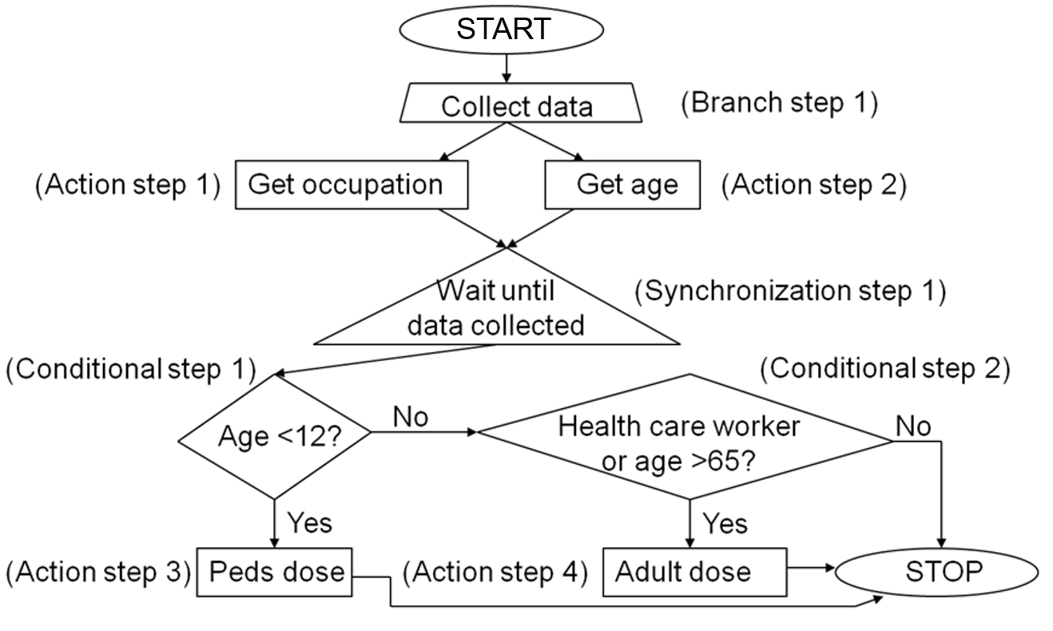
Example Guideline Algorithm
5.6 Chart: Example guideline algorithm for the flu shot (Hersh, 2010)
Notes:
This slide shows a very simple practice guideline that might be used, for example, to decide whether someone should get a flu shot. The recommendations on who should get a flu shot vary, but in this guideline, we see who they’re recommended for. Our first action step in the guideline is to collect some data. We branch because we need to get two pieces of data: the occupation of the individual and his or her age. We wait until we get both pieces of data, which is synchronization step one. We then reach conditional step one, where we ask if the age is less than twelve. According to this guideline, we should immunize everyone who is under the age of twelve and we should use the pediatric dosage that is modified for their weight and size. If they are older than twelve, we then ask if they are a health care worker or are older than age sixty-five. If either is true, we give the adult dosage. We go to that action step. Otherwise—which probably doesn’t reflect current practice—we don’t. This is a sample algorithm to show you the different kinds of steps that you might see in a clinical practice guideline.

Slide 7
Appraising a Clinical
Practice Guideline
(Richards, 2006)
Did the developers carry out a comprehensive, reproducible literature search within the last 12 months?
Is each of its recommendations both tagged by the level of evidence upon which it is based and linked to a specific citation?
Is the guideline applicable in a particular clinical setting? That is, is there
  High enough burden of illness to warrant use?
  Adequate belief about the value of interventions and their consequences?
  Costs and barriers too high for the community?
Notes:
How do we appraise a clinical practice guideline? In some ways it’s easier than appraising, say, a randomized control trial because we have fewer questions to ask. But a clinical practice guideline has many more steps that need to be appraised as opposed to just the major question that you look at in a randomized control trial. If we retrieve a clinical practice guideline and we’re thinking about putting it into practice, what questions do we ask? Essentially, there are three.
The first question is, Did the developers carry out a comprehensive, reproducible literature search within the last twelve months? In other words, are they up-to-date on their topic? If they are looking at diagnosis of a certain type of cancer, for example, or at treatment of diabetes, are they current on the latest evidence? Have they reviewed the literature comprehensively?
The second question is whether each of the recommendations is tagged by the level of evidence upon which it’s based and linked to a specific citation. If the practice guideline makes a recommendation for a test or treatment, what is the level of evidence to support that recommendation? Where can we find the published research?
The third question pertains to applicability. Is the guideline applicable in a particular clinical setting? Applicability raises some practical questions. For example, is there a high enough burden of illness to warrant use of the guideline in this particular setting? If the disease occurs rarely, then we probably don’t want to go to the trouble of changing workflow and other kinds of actions to implement the guideline. Is there adequate belief among the users of the guideline concerning the value of the interventions and their consequences? Have we convinced those who are going to implement the guideline that it’s worth doing so? And might the cost and barriers be too high for the community? If a certain type of diagnostic test or treatment is not readily available, might the barriers be too high for implementation, making the use of the guideline somewhat moot?

Slide 8
Should They Be Distributed on Paper or Electronically?
Hibble and coauthors (1998) found 855 guidelines had been disseminated to practices in an area of England
  Pile was 68 cm high and weighed 28 kg (27 inches high and 62 pounds)
Electronic dissemination, especially codified for EHRs, may be a better approach
  Can be encoded in decision logic
Notes:
One of the big questions with practice guidelines is whether it’s more effective to use them in paper or electronic form. The problem with paper guidelines is illustrated in this slide, showing the number of guidelines these particular practitioners had received. Hibble and his coauthors collected copies of all the guidelines that had been mailed over a one-year period to a sample of twenty-two practices in the Cambridge and Huntingdon Health Authority region of England. They found that each practice received eight-hundred-fifty-five guidelines, some a page or two long, some bound in booklet form, some in folders. When the guidelines were stacked, the pile was sixty-eight centimeters high and weighed twenty-eight kilograms or 27 inches high and weighing 62 pounds.
Clearly, it’s a challenge to use any particular guideline when it’s one among hundreds in a two-foot stack, and you aren’t sure whether it’s just a sheet of paper or a spiral-bound booklet. It may be better to electronically disseminate guidelines, especially if you can codify [kod-uh-fahy] the recommendations in the electronic health record, so that the recommendations come up automatically. Electronic health records, other clinical systems, and decision support systems can provide access to practice guidelines while the clinician is at the point of making clinical decisions. Some systems provide the capability for clinicians to import the guideline into the electronic health record so that it can be tailored to the specific patient.

Slide 9
Physicians Do Not Adhere to Guidelines
Cabana and colleagues (1999) found guidelines not used because physicians unaware of them, disagreed with them, or did not want to change existing practice (Kung, 2012; Manikam, 2015)
Physicians and nurses in highly regarded practices in UK rarely accessed or used research evidence, instead use “mindlines” (Gabbay & le May, 2004)
Lin and colleagues (2008) found lack of adherence to recommendation of major guideline on use of stress testing before percutaneous coronary intervention
  Diamond and Kaul (2008) attributes to financial incentives and advocates “evidence-based reimbursement”
Notes:
Research has shown that physicians often don’t adhere to guidelines. Cabana [kuh-bahn-uh] and his coauthors found that guidelines weren’t used by physicians for a variety of reasons. They were either unaware of them, they disagreed with them, or they didn’t want to change their existing practice. In some highly regarded practices in the United Kingdom, Gabbay and Le May found that physicians and nurses rarely accessed or used research evidence. Instead, they used what the authors described as mindlines that basically represented their rationale, which at times was at odds with research evidence. In other research, Lin found that there was a substantial lack of adherence to a guideline recommendation on the use of stress testing before percutaneous [pur-kyoo-tey-nee-uhs] coronary intervention. That is, according to the best evidence and the guidelines that incorporate this evidence, patients should not have percutaneous coronary interventions, such as coronary angioplasty [an-jee-uh-plas-tee] or stent placement, unless they have symptoms documented by stress testing. Yet many cardiologists skip the step of stress testing and move straight to the percutaneous coronary intervention. In an editorial, Diamond was concerned about this finding, and he attributes the situation to financial incentives for such intervention and advocates what he calls evidence-based reimbursement.

Slide 10
Limitations of Guidelines
May not apply in complex patients—for 15 common diseases, following best-known guidelines in elderly patients with comorbid diseases may have undesirable effects and implications for pay-for-performance schemes (Boyd et al., 2005)
Difficult to implement in EHRs—issues include precise coding of logic and integration into workflow (Maviglia et al., 2003)
May be influenced by pharmaceutical industry—87% of authors have ties to industry, 58% receive financial support for research, and 38% serve as employees or consultants (Choudhry, Stelfox, & Detsky, 2002; Norris, 2011)
Notes:
Practice guidelines certainly have limitations. One challenge for guidelines is that they are difficult to apply in complex patients. For example, a study by Boyd and colleagues looked at fifteen common diseases. They took the best known guidelines for those diseases and assessed them for use in elderly patients who had many comorbid or coexisting conditions. They reached the conclusion that following the guidelines to the letter would have undesirable effects because of the presence of these other conditions. In fact, if these guidelines were tied into pay-for-performance schemes, there may be some negative implications in that physicians who adhere to the letter of the guidelines may actually not be providing the highest quality of care.
Guidelines can be difficult to implement in electronic health records. In particular, it’s challenging to take the logic that is in guidelines and integrate it into the workflow. Some of the logic in guidelines is somewhat vague and may not fit into easy rules that can be implemented in a decision support system. A paper by Maviglia [mahv-ee-lya] and coauthors gives a number of examples of that challenge. Another problem with guidelines is the influence of the pharmaceutical industry: many individuals who work on developing clinical guidelines are also funded in part by the pharmaceutical industry. About eighty-seven percent of authors, at least in the survey that was done for this paper, have ties to industry. About fifty-eight percent of them received financial support for their research, and some of those individuals also serve as employees or consultants to pharmaceutical companies, raising questions of objectivity. Also, some services and care activities recommended in a guideline may not be covered by insurance companies or may not be approved by the insurance company for payment.

Slide 11
The Future of Guidelines
Many health care systems are convinced they help standardize and improve care and/or lower cost (Bristow, 2013)
Use will likely increase with proliferation of electronic health records and/or quality improvement efforts (Peleg, 2013)
Growing number are available from National Guidelines Clearinghouse (link at http://www.guideline.gov)
Notes:
What is the future of guidelines? Many health care systems are convinced of their value. They are convinced that clinical practice guidelines standardize and improve care and perhaps lower costs. The use of guidelines will likely increase with both the proliferation of electronic health records and the implementation of quality measures and pay-for-performance models. Guidelines are easily accessible. If you’re interested in guidelines, the National Guidelines Clearinghouse at www.guideline.gov has over a thousand in its database, most of which can be downloaded.

Slide 12
Decision Analysis
Applies a formal structure for integrating evidence about beneficial and harmful effects of treatment options with associated values and preferences
They can be applied to guide decision making of single patient or to inform decisions about clinical policy
Notes:
Now let’s look at decision analysis. Decision analysis applies a formal structure that allows the integration of evidence about both beneficial and harmful effects of treatment options with associated data use and preferences. Decision analysis enables us to explicitly lay out the factors that go into decision making and assign numerical values and calculate a value and quantitative measure to guide decision making. Decision analysis can be applied to the care of a single patient, but more commonly in recent years, decision analysis has been used to inform decisions about policy.

Slide 13
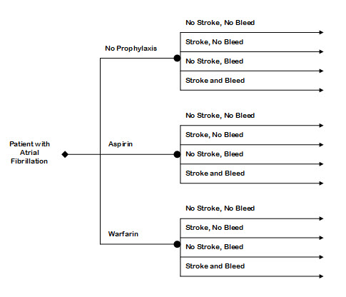
Decision Analysis for Anticoagulation in Atrial Fibrillation
Diamond is a decision node
Circles are chance nodes
5.7 Chart: Decision analysis for anticoagulation in atrial fibrillation. Adapted from Guyatt (2014).
Notes:
Here is an example of a simple decision analysis that revolves around the decision to use anticoagulation in a patient with atrial [ey-tree-uhl] fibrillation [fib-ril-lay-shun]. Atrial fibrillation is where the upper chamber of the heart fibrillates [fib-ri-lates], and blood can accumulate because it’s not properly pumped out of the atrium. This can form clots, and if the individual then goes back into a normal rhythm, the clot can be pushed forward out of the heart and pieces of it can potentially go up into the cerebral circulation and cause a stroke. There are basically three options for a patient with atrial fibrillation in whom we want to prevent stroke. We can do nothing, give no prophylaxis. We can use aspirin, which is a mild blood thinner. Or we can administer warfarin [wawr-fuh-rin], also known as Coumadin [koo-muh-din], which is a much more potent blood thinner. For each of these options we have two possibilities: the patient can either have a stroke or not have a stroke. And any one of these options will potentially lead to adverse bleeding. Because we have two possible options, we have four permutations: no stroke with no bleed, a stroke with no bleed, no stroke with bleeding, and a stroke with bleeding. Obviously, the best thing for the patient would be to have neither a stroke nor bleeding. We know from the medical literature than warfarin is more effective at preventing stroke, but it also has a higher rate of bleeding. We’d actually apply numbers into these different pathways through the decision analysis to make our decision. The circles are the chance nodes because with each of these treatments there’s a chance of any of those four outcomes; the diamond is the decision node for the decision that we’re trying to make.

Slide 14
Using a Decision Analysis
Elicit utility values for outcomes from patient, such as risk of adverse events from disease or treatment
Calculate probabilities of events based on best evidence
“Fold back” decision tree to calculate overall utility
Notes:
How do we actually use a decision analysis? Essentially, we have to put numerical values on the pathways through the decision tree. Some of those pathways involve incorporating utility values that the patient has. Patients may express preferences for adverse outcomes. They may be more tolerable of stroke or of bleeding. Sometimes in the cases of surgery patients, they may be more willing to tolerate the up-front risks of surgery than to risk the consequence of not having surgery and possibly having a longer-term worse outcome. So we plug evidence values and utility values into the tree, then we do a process called folding the tree back, where we basically determine the optimal pathway through the tree.

Slide 15
Limitations of Decision Analysis
Presents idealized situation that may not apply to a patient but give a framework for making decisions and/or deviating from standard approach
Decision analyses are time-consuming on individual level and may be dependent on quantification of values and fuzzy situations
Notes:
What are the limitations of decision analysis? Decision analysis may present an idealized situation that may not completely apply to a patient, although it does give a framework for making a decision or deviating from a standardized approach. The real challenge with decision analysis, particularly when we apply it to individual patients, is that it’s time consuming and very dependent on trying to quantify things that may not be quantifiable, such as how much risk to assign to one outcome versus another. Decision analysis has not had a major impact when used on the individual level, though for policy decisions, it’s actually been quite valuable.

Slide 16
Evidence-Based Practice
Summary – Lecture g
Two main approaches for making recommendations based on evidence
Clinical practice guidelines provide steps and decision points for providing clinical care
Decision analysis allows elucidation of a framework for making optimal decisions
Notes:
This concludes Lecture g of Evidence-Based Practice. In summary, there are two main approaches for making recommendations based on evidence: clinical practice guidelines and decision analyses. Clinical practice guidelines provide steps and decision points for providing clinical care. Decision analysis allows elucidation of a framework for making optimal decisions.

Slide 17
Evidence-Based Practice
Summary
EBM provides a set of tools and a disciplined approach to informing clinical decision making
Helps to find the best evidence to answer the four basic types of clinical questions: interventions, diagnosis, harm, and prognosis
Provides two approaches to making recommendations: clinical practice guidelines and decision analyses
Notes:
This also concludes Evidence-Based Practice. In summary, evidence-based medicine provides a set of tools and a disciplined approach to informing clinical decision making. It helps us to find the best evidence to answer the four basic types of clinical questions: interventions, diagnosis, harm, and prognosis. It also provides two approaches to making recommendations: clinical practice guidelines and decision analyses.

Slide 18
Evidence-Based Practice
References – Lecture g
References
Boyd, C., Darer, J., Boult, C., Fried, L., Boult, L., & Wu, A. (2005). Clinical practice guidelines and quality of care for older patients with multiple comorbid diseases: Implications for pay for performance. Journal of the American Medical Association, 294, 716–724.
Bristow, R. E., Chang, J., Ziogas, A., & Anton-Culver, H. (2013). Adherence to treatment guidelines for ovarian cancer as a measure of quality care.Obstetrics & Gynecology, 121(6), 1226-1234.
Cabana, M., Rand, C., Powe, N., Wu, A., Wilson, M., Abboud, P., & Rubin, H. (1999). Why don’t physicians follow clinical practice guidelines? A framework for improvement. Journal of the American Medical Association, 282, 1458–1465.
Choudhry, N., Stelfox, H., & Detsky, A. (2002). Relationships between authors of clinical practice guidelines and the pharmaceutical industry. Journal of the American Medical Association, 287, 612–617.
Diamond, G., & Kaul, S. (2008). The disconnect between practice guidelines and clinical practice—Stressed out. Journal of the American Medical Association, 300, 1817–1819.
Gabbay, J., & LeMay, A. (2004). Evidence based guidelines or collectively constructed “mindlines”? Ethnographic study of knowledge management in primary care. British Medical Journal, 329, 1013.
Guyatt, G., Rennie, D., Meade, M., & Cook, D. (2014). Users’ guides to the medical literature: Essentials of evidence-based clinical practice, 3rd ed. New York: McGraw-Hill.
Notes:
No audio.

Slide 19
Evidence-Based Practice
References – Lecture g Continued
References
Hibble, A., Kanka, D., Penchion , D., & Pooles, F. (1998). Guidelines in general practice: The new Tower of Babel? British Medical Journal, 317, 862–863.
Khodambashi, S., & Nytrø, Ø. (2015). Lessons Learnt from Evaluation of Computer Interpretable Clinical Guidelines Tools and Methods: Literature Review. Studies in health technology and informatics, 216, 980. Retrieved from https://www.researchgate.net/profile/Soudabeh_Khodambashi2/publication/281409241_Lessons_Learnt_from_Evaluation_of_Computer_Interpretable_Clinical_Guidelines_Tools_and_Methods_Literature_Review/links/55e5d7ac08aebdc0f58b88c0.pdf
Kung, J., Miller, R. R., & Mackowiak, P. A. (2012). Failure of clinical practice guidelines to meet institute of medicine standards: two more decades of little, if any, progress. Archives of internal medicine, 172(21), 1628-1633. Retrieved from http://archinte.jamanetwork.com/article.aspx?articleid=1384245
Lin, G., Dudley, R., Lucas, F., Malenka, D., Vittinghoff, E., & Redberg, R. (2008). Frequency of stress testing to document ischemia prior to elective percutaneous coronary intervention. Journal of the American Medical Association, 300, 1765–1773.
Manikam, L., et als. (2015). What drives junior doctors to use clinical practice guidelines? A national cross-sectional survey of foundation doctors in England & Wales. BMC medical education, 15(1), 1. Retrieved from http://bmcmededuc.biomedcentral.com/articles/10.1186/s12909-015-0510-3
Notes:
No audio.

Slide 20
Evidence-Based Practice
References – Lecture g Continued 2
References
Maviglia, S., Zielstorff, R., Paterno, M., Teich, J., Bates, D., & Kuperman, G. (2003). Automating complex guidelines for chronic disease: Lessons learned. Journal of the American Medical Informatics Association, 10, 154–165.
Norris, S. L., Holmer, H. K., Ogden, L. A., & Burda, B. U. (2011). Conflict of interest in clinical practice guideline development: a systematic review. PloS one, 6(10), e25153. Retrieved from http://journals.plos.org/plosone/article?id=10.1371/journal.pone.0025153
Ohno-Machado, L., Gennari, J., Murphy, S., Jain, N., Tu, S., Oliver, D., . . . Barnett, G. (1998). The GuideLine Interchange Format: A model for representing guidelines. Journal of the American Medical Informatics Association, 5, 357–372.
Peleg, M. (2013). Computer-interpretable clinical guidelines: a methodological review. Journal of biomedical informatics, 46(4), 744-763.
Richards, D. (2006). Guidelines and the killer B’s. Evidence-based Dentistry 7, 1–2.
Charts
5.6 Chart: Example guideline algorithm for the flu shot (Hersh, William, OHSU, 2010
  5.7 Chart: Decision analysis for anticoagulation in atrial fibrillation. Adapted from Guyatt, 2014
Notes:
No audio.

Slide 21
The Culture of Health Care
Evidence-Based Practice
Lecture g
This material was developed by Oregon Health & Science University, funded by the Department of Health and Human Services, Office of the National Coordinator for Health Information Technology under Award Number IU24OC000015. This material was updated in 2016 by Bellevue College under Award Number 90WT0002.
Notes:
No audio.

