Slide 1
Notes:
No audio. Recording preparation.

Slide 2
The Culture of Health Care
Evidence-Based Practice
Lecture b
This material (Comp 2 Unit 5) was developed by Oregon Health & Science University, funded by the Department of Health and Human Services, Office of the National Coordinator for Health Information Technology under Award Number IU24OC000015. This material was updated in 2016 by Bellevue College under Award Number 90WT0002.
This work is licensed under the Creative Commons Attribution-NonCommercial-ShareAlike 4.0 International License. To view a copy of this license, visit http://creativecommons.org/licenses/by-nc-sa/4.0/.
Notes:
Welcome to The Culture of Health Care: Evidence-Based Practice. This is Lecture b.
The component, The Culture of Health Care, addresses job expectations in health care settings. It discusses how care is organized within a practice setting, privacy laws, and professional and ethical issues encountered in the workplace.

Slide 3
Evidence-Based Practice
Learning Objectives
Define the key tenets of evidence-based medicine (EBM) and its role in the culture of health care (Lectures a, b).
Construct answerable clinical questions and critically appraise evidence answering them (Lecture b).
Explain how EBM can be applied to intervention studies, including the phrasing of answerable questions, finding evidence to answer them, and applying them to given clinical situations (Lecture c).
Describe how EBM can be applied to key clinical questions of diagnosis, harm, and prognosis (Lectures d, e).
Discuss the benefits and limitations to summarizing evidence (Lecture f).
Describe how EBM is used in clinical settings through clinical practice guidelines and decision analysis (Lecture g).
Notes:
The objectives for Evidence-Based Practice are to:
Define the key tenets of evidence-based medicine (EBM) and its role in the culture of health care.
Construct answerable clinical questions and critically appraise evidence answering them.
Explain how EBM can be applied to intervention studies, including the phrasing of answerable questions, finding evidence to answer them, and applying them to given clinical situations.
Describe how EBM can be applied to key clinical questions of diagnosis, harm, and prognosis.
Discuss the benefits and limitations to summarizing evidence.
Describe how EBM is used in clinical settings through clinical practice guidelines and decision analysis.

Slide 4
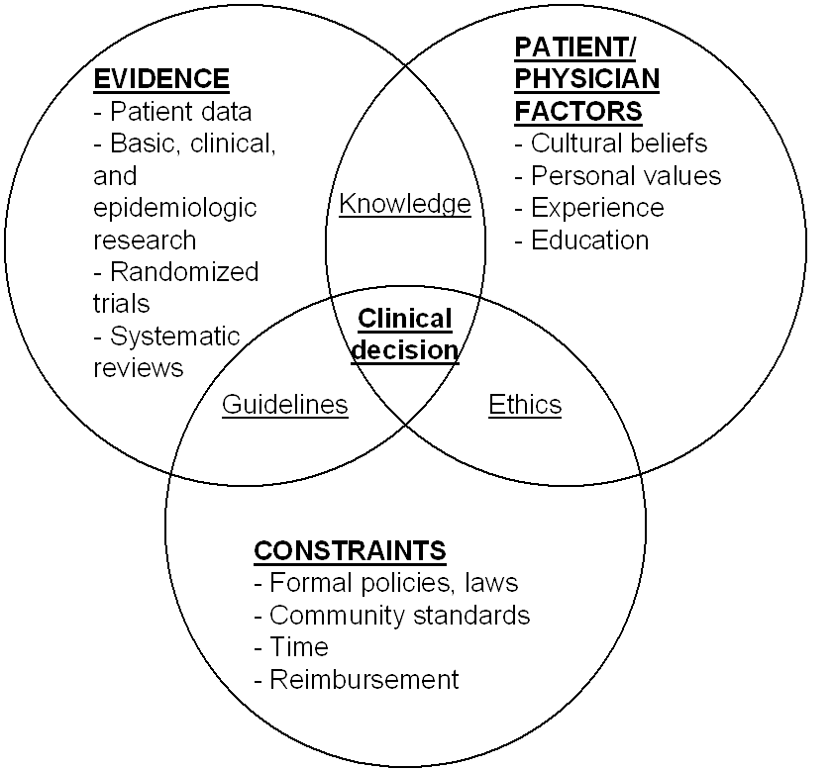
Making Evidence-Based Clinical Decisions (Mulrow, 1997)
5.1 Figure: Adapted from Mulrow, Cook, & Davidoff, 1997
Notes:
This lecture presents some definitions of evidence-based medicine and describes some of its applications. This diagram appeared in a paper by Mulrow [muhl-row] and colleagues in 1997. It puts the use of evidence in the proper context. Basically, evidence is one of three aspects of what goes into making a clinical decision. First, we need to know what the research shows: the results of studies such as randomized trials and systematic reviews. But there are other factors that go into making a clinical decision. A second aspect is factors about the patient and/or the physician, such as cultural beliefs, personal values, experience, and education. Patients may have preferences. In addition, the patient’s physical reaction to treatment and medications may also play a significant role in clinical decision making. Physicians may have limitations in their skills, particularly if they practice in rural areas or places where the entire spectrum of medical services is not available. The third aspect of making clinical decisions is constraints. Formal policies and laws as well as community standards may influence decisions. Time may also be a constraint—for example, if a patient is acutely ill, there may not be enough time to do what the absolute best evidence would support. Then, of course, reimbursement issues—such as what medications, treatments, and tests are covered by a patient’s insurance—present further constraints on clinical decision making.

Slide 5
Best Resources for EBM
Three major books:
  Evidence-Based Medicine: How to Practice and Teach It, 4th edition, Straus, Richardson, Glasziou, and Haynes (2010)
    Informally known as the “Sackett Book” for original author David Sackett
  Users’ Guides to the Medical Literature: A Manual for Evidence-Based Clinical Practice, 3rd edition, Guyatt, Rennie, Meade, and Cook (2015)
    Encyclopedic guide to principles and applications of EBM
  Users’ Guides to the Medical Literature: Essentials of Evidence-Based Clinical Practice, 3rd edition, Guyatt, Rennie, Meade, and Cook (2015)
    Handbook of the most clinically relevant content of the larger manual
Web sites:
  Centre for Evidence-based Medicine: http://www.cebm.net
  Centre for Health Evidence: http://www.cche.net
  http://www.nettingtheevidence.org.uk
Notes:
Many resources are available to support evidence-based medicine. They not only describe how to practice it but also demystify a lot of the ideas and techniques behind it. One of these is a book by Straus [strous] and colleagues, informally known as the “Sackett Book” because it was the original book on evidence-based medicine authored by David Sackett of McMaster University before he retired. Straus is now the editor of the book, which is in its fourth edition.
Two books by Guyatt and colleagues, including several authors from McMaster University, originated as a series of articles published in the Journal of the American Medical Association or JAMA [jam-uh] under the broad heading of “Users’ Guides to the Medical Literature.” In 2015, the third edition of these two books came out. The first, subtitled A Manual for Evidence-Based Clinical Practice, is an encyclopedic reference to the clinical applications of EMB. The second, subtitled Essentials of Evidence-Based Clinical Practice, is a condensed handbook that covers the most clinically relevant content of its parent manual.
Plenty of websites also offer information on evidence-based medicine, some of which are listed here:
http://www.cebm.net [H-T-T-P-colon-forward-slash-forward-slash-W-W-W-dot-C-E-B-M-dot-net]
http://www.cche.net [H-T-T-P-colon-forward-slash-forward-slash-W-W-W-dot-C-C-H-E-dot-net]
http://www.nettingtheevidence.org.uk [H-T-T-P-colon-forward-slash-forward-slash-W-W-W-dot-netting-the-evidence-dot-org-dot-U-K]

Slide 6
The Changing Nature of EBM
(Hersh, 1999)
Initial approach ( “first generation”) was for clinician to find and critically appraise evidence
  Too time consuming; clinicians lack expertise
More recent approach ( “next generation”) is synthesis and synopsis of evidence for clinician
  Access to online, up-to-date information makes easier
Slawson & Shaughnessy (2005) argue for more emphasis on teaching information management (seeking) than on techniques of EBM
Notes:
Evidence-based medicine has been evolving for nearly three decades. A paper in 1999 by Hersh observed this trend, referring to the initial approach to evidence-based medicine as “first-generation EBM.” The concept was that a clinician would actually find and critically appraise evidence as he or she was applying it in the clinical setting. The clinician would go out, find the article, critically appraise it, and then make the clinical decision. It became readily apparent, however, that the process took too much time, especially in the busy clinical setting, and that not all clinicians had the expertise to really understand study design, the nuances of statistics, and so forth. The more recent approach—the next generation of evidence-based medicine—focuses on synthesizing [sin-thuh-si-zing] and synopsizing [si-nop-si-zing] evidence and making it available to clinicians. The goal is to provide up-to-date information, accessible online, that assists the clinician in decision making. Slawson takes this a step further, arguing that we should not be discussing the different kinds of evidence and how to critically appraise it, but instead, we should put more emphasis on teaching clinicians better information management, or information-seeking skills.

Slide 7
Another Viewpoint Concerning Evidence (Haynes, 1999)
Can it work?
  Efficacy studies take place under “ideal” circumstances
  This unit looks mainly at such studies
Does it work?
  Effectiveness studies ascertain whether something works in the “real world”
  Sometimes called “outcomes research” (Clancy & Eisenberg, 1998)
Is it worth it?
  Cost-benefit or cost-effectiveness studies determine whether benefits worthwhile in relation to cost or other resources
Notes:
Another viewpoint concerning evidence comes from Brian Haynes, whose name you will see throughout this unit. The kinds of questions that we think about when we apply evidence or when we assess a treatment or a diagnostic test are Can it work? Does it work? and Is it worth it?
The first question we ask about a study is, Can it work? Studies that investigate whether something works are typically called efficacy [ef-i-kuh-see] studies. These studies take place under ideal conditions, such as in a randomized controlled trial. The participants are followed closely, and a great deal of data about them is collected. Efficacy studies help us determine whether tests or treatments work. Evidence-based medicine focuses primarily on those kinds of studies.
The next question is, Does it work? Often called effectiveness studies, these studies investigate whether something works in the real world when put in the hands of a much larger segment of the clinical provider population.
The final question in this framework is, Is it worth it? To answer this question, cost-benefit or cost-effectiveness studies are done to see whether the benefits are worthwhile in relation to the cost of a test or a treatment.

Slide 8
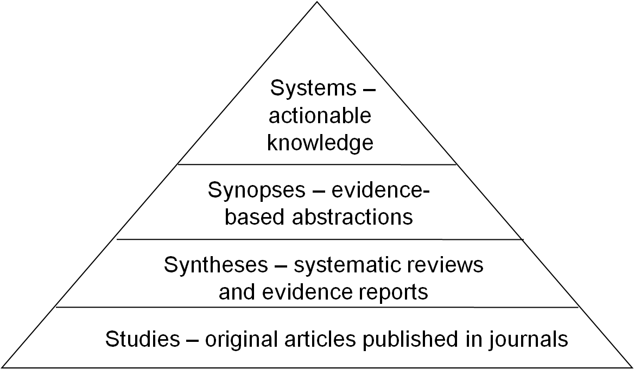
Hierarchy of Evidence—The 4S Model (Haynes, 2001)
Subsequently updated to 5S (Haynes, 2005) and 6S (DiCenso, 2009) models, but 4S is preferred
5.2 Figure: adapted from Haynes’s “4S” model of the Hierarchy of Evidence, 2001
Notes:
Another way to look at evidence is to look at the hierarchy of evidence. One approach shows the different types of evidence that clinicians use for decision making. This model was developed by Haynes and originally started as the “4S” model, the simplest version. He subsequently divided some of the levels into additional levels and updated the model to “5S” and then “6S,” but the basic 4S model is the most popular.
The foundation, or first level, of evidence is studies—original research that’s published in medical journals. For many topics, especially common diseases and common treatments, there are numerous studies, so we need to synthesize them. Thus the next level in the hierarchy is syntheses [sin-thuh-seez]. The best syntheses are systematic reviews. Also called evidence reports, they systematically review all of the evidence for a given clinical question.
Syntheses, however, can be quite lengthy, and a busy clinician usually needs to understand the gist of the evidence. Thus the next level in the hierarchy is synopses [si-nop-seez], which are sometimes called evidence-based abstractions, where key points are abstracted from comprehensive syntheses.
Finally, the highest level of evidence is systems, where there is actionable knowledge, or knowledge taken from the synopses that can be put into a logical form and used ideally by electronic systems to automatically guide decision making.

Slide 9
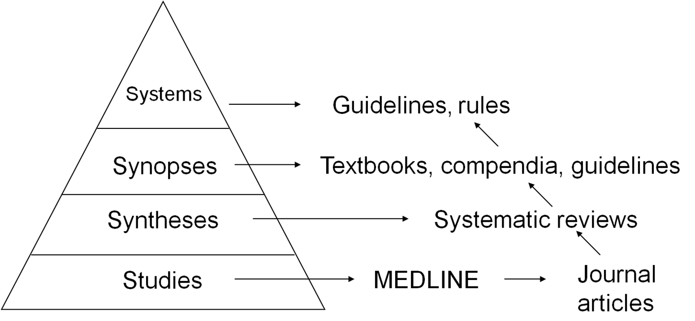
Where the Evidence Comes From
5.3 Figure: Adapted from Haynes’s “S4” model of the Hierarchy of Evidence, 2001 with types and sources of evidence
Notes:
Where does the evidence come from? Depending on the level, there are different types of evidence, and in the slides that follow we discuss a number of these in detail.

Slide 10
Studies
Accessed (usually) in literature databases such as Medline
  Most common and freely available system for accessing medical literature is PubMed, available at http://pubmed.gov
Retrieved from journals
  Many now available electronically
Application of critical appraisal and formulas
  For example, relative risk, number needed to treat, sensitivity, odds ratio
Notes:
Starting at the level of studies, this evidence generally comes from the medical literature, usually by accessing databases such as Medline, which contains bibliographic references to millions of journal articles. Medline can be accessed in many ways, but the most common way, which is freely available, is through PubMed [pub-med], which is maintained by the U.S. National Library of Medicine. Relevant studies are gathered from the literature and critically appraised. Various formulas, such as relative risk, sensitivity, number needed to treat, and odds ratio formulas, are used to derive specific information from the studies.

Slide 11
Syntheses
Systematic reviews
  Exhaustive, systematic review of data on a topic
    Not a simple literature review or overview of papers one knows about
  Application, where appropriate, of meta-analysis, the combination of results from multiple studies in a single analysis
    Studies must be appropriately similar, and there are methodological means to assess that
  Available in PubMed or in specialized Pubmed Health http://www.ncbi.nlm.nih.gov/pubmedhealth
Notes:
The syntheses [sin-thuh-seez], level typically consists of systematic reviews or sometimes evidence reports. These are exhaustive reviews of the data on a given topic. Where appropriate, meta-analysis is applied by combining the results of multiple, similar studies into a single analysis. The combined studies have to be appropriately similar for meta-analysis to be valid, and methodologic means can be used to assess whether studies are similar enough. For example, if there have been fifteen different clinical trials looking at surgery or medical treatment for back pain or a specific type of cancer, and they have similar interventions as well as similar patient groups, then we can combine them in a meta-analysis. Meta-analysis can be done not only for treatments but also for diagnostic tests, prognoses, and so forth. Systematic reviews are available in PubMed and in the specialized PubMed Health database, which is limited to systematic reviews.

Slide 12
Synopses and Systems
Synopses—Highly summarized information appropriate for clinical setting, such as
  Critically appraised topics (CATs)
  Clinical Evidence, InfoPOEMS, PIER
  Clinical practice guidelines
Systems—Decision support within electronic health record systems
  Best way to provide evidence to clinicians at point of clinical decision making
Notes:
Synopses, then, are summaries of information that is pertinent to the clinical setting. Synopses provide answers to specific questions. If a clinician in a busy clinical environment has a patient with low back pain, he or she wants to know what the evidence shows for available treatments. The clinician doesn’t necessarily want to know all of the many different studies that have been done or how those studies have been combined. Nor, when many studies have been conducted for a specific topic, does the clinician necessarily want the details of one individual study, because it would be inappropriate and less helpful to focus on only one.
Synopses are often written as critically appraised topics, or CATs [katz] as they are sometimes called. They are available in publications such as the book Clinical Evidence. Other resources are online, such as InfoPOEMs (Patient-Oriented Evidence that Matters) and PIER [peer], which we will talk about when we discuss synopses in more detail. Clinical practice guidelines also fall into this synopses category.
The highest level in the hierarchy, systems, refers to decision support systems accessible through electronic health record systems. Clinical decision support systems are designed to facilitate the decision-making process at the point of care. These systems are most effective when clinicians access evidence-based information when they are making clinical decisions. This is the highest level -- knowing the context of patient care and providing the evidence to the clinician to use in providing clinical care.

Slide 13
Overview of the Application of EBM
Steps include
  Phrasing a clinical question that is pertinent and answerable
  Identifying evidence to address the question
  Critically appraising the evidence to determine whether it applies to the patient
Notes:
How is evidence-based medicine applied? The steps are listed on this slide. The first step is phrasing a clinical question that is pertinent and answerable. The second step is identifying the evidence to address the question. The third step is critically appraising the evidence to determine if it applies to the patient. We spend less time discussing critical appraisal, although we’ll go into more detail about it when we talk about interventions; however, all of the references listed earlier on slide 4 describe the process of critically appraising the evidence.

Slide 14
Phrasing the Clinical Question
Background vs. foreground questions
  Background questions ask for general knowledge about a disorder
    Usually answered with textbooks and classical review articles
  Foreground questions ask for knowledge about managing patients with a disorder
    Usually answered using EBM techniques
Notes:
The next few slides discuss phrasing the clinical question. One way to view clinical questions is to distinguish between background and foreground questions. Background questions are general kinds of questions that come up in the care of patients, and they are usually answered without using evidence-based medicine techniques. We look them up in a textbook or perhaps seek out a more classic review article rather than a systematic review. Foreground questions are those we ask when we need knowledge about managing patients with specific disorders and we’re contemplating a test or a treatment—these are the questions that are usually answered with evidence-based medicine techniques.

Slide 15
Background Questions
General information not specific to a given patient
Examples
  What causes pneumonia?
  When do complications of type I diabetes usually occur?
Distinction from foreground questions can be blurry
  New etiologies of disease
  Level of training (e.g., specialist vs. student)
Notes:
Let’s explore background questions further. Sometimes background questions ask for general information that is not specific to a given patient, such as
What causes pneumonia?
What are the usual causes of pneumonia, such as bacteria, viruses, sometimes chemical pneumonia; are there other possible causes?
At what stage of the disease do the complications of type 1 diabetes usually occur?
In what order do complications such as neuropathy, heart disease, and kidney failure generally occur in type 1 diabetes?
It turns out that the distinction between background and foreground questions is sometimes blurry. For example, there are new etiologies or causes of disease that you may want to know about either as background or foreground. Your level of training also may determine whether your questions are background or foreground questions. If you’re a sub-specialist, you may tend to ask more background questions, whereas if you’re a student, and nearly everything is new to you, your questions will tend to be foreground questions. Although the distinction is blurry, it is important to understand a clinical question and how to phrase a clinical question to find the best evidence.
This brings us to foreground questions.

Slide 16
Foreground Questions
Have three or four essential components (PICO)
  Patient and/or problem
  Intervention
  Comparison intervention (if appropriate)
  Outcomes
Example
  In an elderly patient with congestive heart failure, are beta blockers helpful in reducing morbidity and mortality without excess side effects?
Notes:
Foreground questions have three or four essential components. One way to remember these components is the PICO [pee-koh] acronym. A complete foreground question has a patient and/or a problem (P). It also has an intervention (I), such as a treatment or a diagnostic test. If applicable, it includes a comparison intervention (C). And then it includes an outcome (O). If the question asks about a treatment, for example, it presents a patient (or patient group) with a specific disease and examines administration of a specific treatment—or intervention. If we are looking for evidence, we try to do a randomized control trial that compares that treatment with a control or a placebo group. Finally, the question searches for some kind of outcome. The treatment is either more effective or less effective than the control or placebo. With a diagnostic test, we may look at how accurate the test is, so we compare against a generally accepted gold standard. If we are investigating prognoses—how patients do—we may not necessarily have a comparison, in which case we follow the natural history of a disease. Here is an example of a foreground question:
In an elderly patient with congestive heart failure where the heart is not pumping as strongly as it could, are beta blockers, which are a type of drug, helpful in reducing morbidity and mortality without excess side effects?

Slide 17
Four Categories of Foreground Questions
Intervention (or therapy)—Benefit of treatment or prevention
Diagnosis—Test diagnosing disease
Harm—Etiology or cause of disease
Prognosis—Outcome of disease course
Notes:
Most clinical questions fall into one of four major categories of foreground questions: intervention, diagnoses, harm, and prognosis. The first category is called an intervention, although many textbooks call it therapy. This category looks at the benefits of an intervention, such as treatment or prevention of disease. Diagnosis is when we look at some way of diagnosing disease, typically with a test. The tests we commonly think of are blood tests, but any type of maneuver on a physical examination is also a diagnostic test, as is an x-ray. Often we want to know what caused a disease, which is sometimes called the etiology of the disease. In the evidence-based-medicine category, this is usually called harm. What causes harm to a patient? Sometimes harm is caused to a patient in the form of an intervention, and we may do studies to look at that. And finally, the last question category is prognosis. What is the outcome of the disease course?

Slide 18
Questions to Ask about the Results from Any Study
Are the results valid?
Are the results important?
Can the results be applied to patient care?
Specific sub-questions depend on type of question and study
Notes:
When we find a piece of evidence, a study, we ask three questions:
Are the results of the study valid?
Are the results important—that is, do the results show that some treatment or test is efficacious [ef-i-kay-shus]? And,
Can the results be applied to patient care?
We also have to determine whether the results of a study can be applied to a specific patient. If the study was done with a different age group or a different gender, the results may or may not be applicable. We may ask many sub-questions within these three broad categories, depending on the type of the main question, such as whether it is an intervention, diagnosis, or harm question. We also may ask different questions based on the type of study we are looking at. We may have a systematic review, for example, or we may have a randomized controlled trial. In the next few lectures, we examine the different types of clinical questions, how we look at studies, and how we appraise evidence that answers the clinical questions.

Slide 19
Evidence-Based Practice
Summary – Lecture b
There are many easily accessible resources for EBM
Approach has changed over the years
Can be best viewed from the 4S model demonstrating the hierarchy of evidence, based on a foundation of studies, brought together where possible by syntheses, summarized in synopses, and implemented in systems that make it actionable
When seeking evidence, it is critical to appropriately phrase the clinical question
Notes:
This concludes Lecture b of Evidence-Based Practice. In summary, there are many easily accessible resources for EBM. The approach has changed over the years and is best viewed from the 4S model demonstrating the hierarchy of evidence, based on a foundation of studies, brought together where possible by syntheses, summarized in synopses, and implemented in systems that make it actionable. When seeking evidence, it is critical to appropriately phrase the clinical question.

Slide 20
Evidence-Based Practice
References – Lecture b
References
Centre for Evidence-Based Medicine. (n.d.). Retrieved from http://www.cebm.net
Centre for Health Evidence. (n.d.). Retrieved from http://www.cche.net
Clancy, C., & Eisenberg, J. (1998). Outcomes research: Measuring the end results of health care. Science, 282, 245–246.
DiCenso, A., Bayley, L., & Haynes, R. (2009). ACP Journal Club. Editorial: Accessing preappraised evidence: Fine-tuning the 5S model into a 6S model. Annals of Internal Medicine, 151(6), JC3-2, JC3-3.
Netting the Evidence. (2009, November 11). [Web blog]. Evidence-based medicine. Retrieved from http://www.nettingtheevidence.org.uk
Guyatt, G., et al. (2015). Users’ guides to the medical literature: A manual for evidence-based clinical practice, 3rd ed. American Medical Association
Guyatt, G., et al. (2015). Users' guides to the medical literature: Essentials of evidence-based clinical practice, 3rd ed. New York: McGraw-Hill.
Haynes, R. (1999). Can it work? Does it work? Is it worth it? British Medical Journal, 319, 652–653.
Haynes, R. (2001). Of studies, syntheses, synopses, and systems: The "4S" evolution of services for finding current best evidence. ACP Journal Club, 134, A11–A13.
Haynes, R. (2006). Of studies, syntheses, synopses, summaries, and systems: The "5S" evolution of information services for evidence-based healthcare decisions. Evidence-Based Medicine, 11, 162–164.
Notes:
No audio.

Slide 21
Evidence-Based Practice
References – Lecture b Continued
References
Hersch, W. (2009). Information retrieval: A health and biomedical perspective. New York: Springer Verlag.
Mulrow, C., Cook, D., & Davidoff, F. (1997). Systematic reviews: Critical links in the great chain of evidence. Annals of Internal Medicine, 126, 389–391.
Slawson, D., & Shaughnessy, A. (2005). Teaching evidence-based medicine: Should we be teaching information management instead? Academic Medicine, 80, 685–689.
Straus, S., & Glasziou, P. (2011). Evidence-based medicine: How to practice and teach it, 4th edition. Edinburgh: Elsevier Churchill Livingstone.
U.S. National Library of Medicine. (n.d.). PubMed Health. For Researchers. Retrieved from https://www.ncbi.nlm.nih.gov/pubmedhealth/researchers/
U.S. National Library of Medicine. (n.d.). PubMed. Retrieved from http://www.ncbi.nlm.nih.gov/pubmed
Notes:
No audio.

Slide 22
Evidence-Based Practice
References – Lecture b Continued 2
Charts, Tables, Figures
  5.1 Figure: Adapted from Mulrow, C., Cook, D., & Davidoff, F. (1997). Systematic reviews: Critical links in the great chain of evidence. Annals of Internal Medicine, 126, 389–391.
  5.2 Figure: Adapted from Haynes’s “4S” model of the Hierarchy of Evidence: Haynes, R. (2001). Of studies, syntheses, synopses, and systems: The "4S" evolution of services for finding current best evidence. ACP Journal Club, 134, A11–A13.
  5.3 Figure: Adapted from Haynes’s “4S” model of the Hierarchy of Evidence with types and sources of evidence: Haynes, R. (2001). Of studies, syntheses, synopses, and systems: The "4S" evolution of services for finding current best evidence. ACP Journal Club, 134, A11–A13.
Notes:
No audio.

Slide 23
The Culture of Health Care
Evidence-Based Practice
Lecture b
This material was developed by Oregon Health & Science University, funded by the Department of Health and Human Services, Office of the National Coordinator for Health Information Technology under Award Number IU24OC000015. This material was updated in 2016 by Bellevue College under Award Number 90WT0002.
Notes:
No audio.

