Slide 1
Notes:
No audio. Recording preparation.

Slide 2
The Culture of Health Care
Health Care Settings—The Places Where Care Is Delivered
Lecture b
This material (Comp 2 Unit 3) was developed by Oregon Health and Science University, funded by the Department of Health and Human Services, Office of the National Coordinator for Health Information Technology under Award Number IU24OC000015. This material was updated in 2016 by Bellevue College under Award Number 90WT0002.
This work is licensed under the Creative Commons Attribution-NonCommercial-ShareAlike 4.0 International License. To view a copy of this license, visit http://creativecommons.org/licenses/by-nc-sa/4.0/.
Notes:
Welcome to The Culture of Health Care: Health Care Settings—The Places Where Care Is Delivered. This is Lecture b.
The component, The Culture of Health Care, addresses job expectations in health care settings, the organization of patient care within a practice setting, privacy laws, and professional and ethical issues encountered in the workplace.

Slide 3
Health Care Settings—
The Places Where Care Is Delivered
Learning Objectives
Differentiate the range of care delivery organizations, including primary care, specialty care, tertiary care, hospitals, clinics, the medical home, home health, hospice, and long-term care facilities. (Lecture a)
Analyze the organization of health care delivery from the perspective of a continuum of care, including outpatient services, inpatient services, home care services, long-term care, and end-of-life care. (Lecture a)
Evaluate the similarities and differences of community hospitals, teaching hospitals, specialty hospitals, and community health clinics. (Lecture a)
Notes:
The objectives for this unit, Health Care Settings—The Places Where Care Is Delivered are to:
Differentiate the range of care delivery organizations, including primary care, specialty care, tertiary care, hospitals, clinics, the medical home, home health, hospice, and long-term care facilities
Analyze the organization of health care delivery from the perspective of a continuum of care, including outpatient services, inpatient services, home care services, long-term care, and end-of-life care
Evaluate the similarities and differences of community hospitals, teaching hospitals, specialty hospitals, and community health clinics

Slide 4
Health Care Settings—
The Places Where Care Is Delivered
Learning Objectives Continued
Describe the various departments and services offered by an outpatient clinic, community hospital, academic medical center, and long-term care facility. (Lecture b)
Explain the ways in which different outpatient and inpatient departments interact and how their services relate. (Lecture b)
Describe ways data and information are created and used by people in different outpatient and inpatient departments. (Lecture b)
Describe ways in which medical and information technology have improved interdepartmental communication and, consequently, the patient experience. (Lecture b)
Notes:
Additional objectives for this unit are to:
Describe the various departments and services offered by an outpatient clinic, community hospital, academic medical center, and long-term care facility
Explain the ways in which different outpatient and inpatient departments interact and how their services relate
Describe ways data and information are created and used by people in different outpatient and inpatient departments
Describe ways in which medical and information technology have improved interdepartmental communication and, consequently, the patient experience

Slide 5
Structure and Function of Health Care Organizations
Departments and functions of health care organizations
How these organizations interact
Types and use of data by the departments
Technology’s impact on interdepartmental communication and patient experiences
Notes:
This lecture provides an overview of departments and services offered by health care organizations. It takes a generic approach by describing typical organizational structures and functions of departments and identifies specific differences between organization types. Examples are provided within each of the broader departments that describe how departments interact, types of data used by the departments, and how health IT facilitates interdepartmental communication and the patient experience.

Slide 6
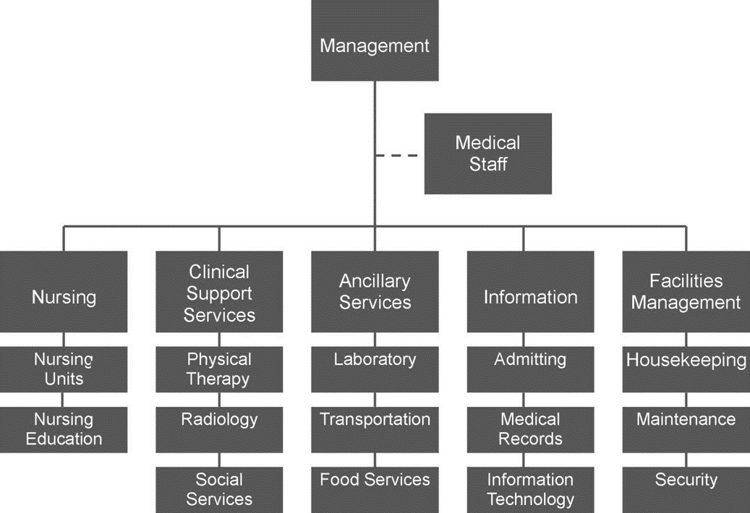
Health Care Provider
Organizational Chart
3.3 Chart: Example of a health care organizational structure. Hickman, 2012. CC-BY-NC-SA.
Notes:
This organizational chart displays an example of a simple health care provider structure representing commonly found divisions with their corresponding departments. This chart is not intended to be exhaustive. The first box, management, links to every division. Before it reaches the divisions in the third row, it connects by a dotted line to medical staff, a quasi-autonomous division that usually reports to the chief medical officer or the chief executive officer. The five divisions and example departments within those divisions are
Nursing (with nursing units and nursing education departments);
Clinical support services (with physical therapy, radiology, and social services departments);
Ancillary (with laboratory, transportation, and food services departments);
Information (with admitting, medical records, and information technology departments); and
Facilities management (with housekeeping, maintenance, and security departments).
Health care organizational charts can vary from this depiction. For example, the laboratory department might be part of the clinical support services division in some organizations, since a large part of the laboratory’s function is directly related to patient care. As another example, information technology may be designated as a division instead of as a department under a division. Many departments have functions that cross divisions.
Large providers, such as integrated delivery systems, large specialty hospitals, and academic medical centers, typically require complex organizational charts. Smaller organizations, such as small community hospitals, may use an organizational chart similar to our example. Some providers, such as independently owned ambulatory facilities, outpatient clinics, physician office practice groups, and home health agencies, usually have simpler charts than the one displayed here.

Slide 7
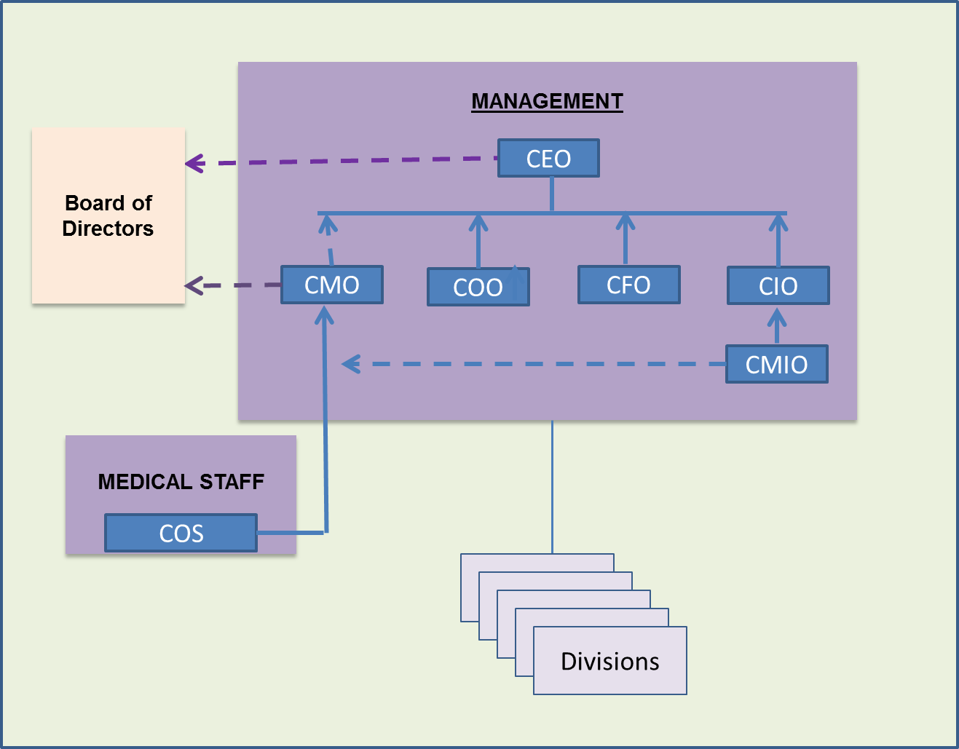
Roles and Responsibilities
3.4 Chart: Example of a chief medical information officer reporting structure. CC BY by Jan Kraus
Read more:
http://www.businessdictionary.com/definition/human-resources-manager.html#ixzz41Nif3jNZ
Notes:
The chief executive officer (CEO) leads the organization and usually reports to a board of directors. In large health care organizations, such as integrated delivery networks, the CEO may report to a system-level president or chief operating officer. Staff who report to the CEO typically include the:
Chief operating officer (COO),
Chief financial officer (CFO),
Chief medical officer (CMO),
Chief information officer (CIO), and
Chief medical information officer (CMIO)
The COO is responsible for the day-to-day operations of the health care organization.
The CFO manages the fiscal aspects of the organization, including the operating budget, contracting, income and expenditures, billing, employee compensation, revenue cycle, and in some cases financial data analytics.
The CMO is a physician who serves as a liaison to the medical staff and the rest of the health care organization. The CMO is involved in or has direct responsibility for clinical care, quality improvement, and sometimes, graduate medical education.
The CIO has gained prominence with the evolution of technology in medical instrumentation, implementation of electronic health records (EHRs), expansion of clinical systems, and the implementation of more complex business administration and financial systems. The CIO is responsible for all information systems and services of the organization, including software, network, hardware, and end-user support. The CIO may also be responsible for telephony services.
In larger organizations, the CMIO may report to the CIO. In other organizations, this position may report directly to the CMO or to the head of similar departments. The CMIO serves as a liaison between the medical staff and the information technology department to ensure effective and efficient deployment of clinical information systems and integration of these systems with the physician’s workflow and clinical practice. Similar position titles found in provider organizations may include chief clinical information officer or chief health information officer. Again, the reporting structure may vary across provider organizations.

Slide 8
Additional Leadership Roles
Vice president of human resources
Chief nursing officer (CNO)
Chief nursing information officer (CNIO)
Chief analytics and data officer
Chief security officer (CSO)
Chief compliance officer (CCO)
Chief legal officer (CLO)
Notes:
Other executive leadership roles commonly report to the CEO but are not depicted in the example organizational chart.
The vice president of human resources typically reports to the CEO and is responsible for overall processes and procedures [quote] “for hiring new employees, supervising employee evaluations, management of employee benefits, mediation between employees and supervisors as necessary, and general oversight of the personnel department” [end quote].
The chief nursing officer (CNO), typically a master’s-prepared register nurse, is responsible for the nursing staff providing direct patient care. In some organizations, the CNO may be responsible for other patient care departments, such as surgery and the emergency department, as well as non–patient care departments, such as patient case management and social services. The CMO and CNO, with their respective areas, work closely together to ensure effective patient care delivery activities.
In large organizations, specific roles such as the chief nursing information officer (CNIO) may focus on informatics. As with the CMIO, this position may report to the information technology department or may report through nursing. In addition to being the liaison for their respective area and the information technology department, the CMIO and CNIO also work in tight collaboration with each other for effective deployment and use of clinical systems.
With the importance of data for both business and patient care delivery, some organizations have a chief analytics and data officer who is responsible for the organization’s analysis and use of data, which includes clinical, business administrative, and financial data. This position typically reports to the CEO or may report to the COO and in some cases the CIO.
Because of cybersecurity threats and breaches, organizations may employ a chief security officer (CSO). This position commonly reports through the information technology reporting to the CIO, but many CSOs report directly to the COO or CEO.
A chief compliance officer (CCO) may report directly to the CEO or the COO in large organizations. This position is a corporate official in charge of overseeing and managing compliance requirements and managing compliance issues.
Also, a chief legal officer (CLO) may be a full-time position in large organizations, and this person reports either directly to the CEO or through the organization’s compliance office. The CLO provides expert guidance and direction to help the organization minimize legal risks and advises the organization’s officers and board members on major legal and regulatory issues, including litigation risks. Legal advisors serving the same function may be secured through contractual retainers for smaller organizations.

Slide 9
Medical Staff
Typically has an elected chief of staff
Chief of staff and CMO manage
  Physician privileges
  Medical polices
  Governance of medical staff
  Continuing medical education
  Quality and patient safety initiatives
VP of quality & patient safety
Notes:
The medical staff is the governing body of the physicians and sometimes may include other clinicians. Typically, the chief of staff is elected. Reporting varies, since the medical staff and hospital administration used to be parallel management structures. The chief of staff and the CMO manage physician privileges and accreditation issues (sometimes including physician extenders), medical policies, governance of the medical staff, and, where applicable, continuing medical education.
Large organizations may have a vice president (VP) of quality and patient safety who reports to the CMO. This position leads a diverse, multidisciplinary approach across all departments with activities focused on improving patient care quality and safety as well as quality outcomes throughout the continuum of care. In some organizations, this position may be a separate department or could report to the CNO.

Slide 10
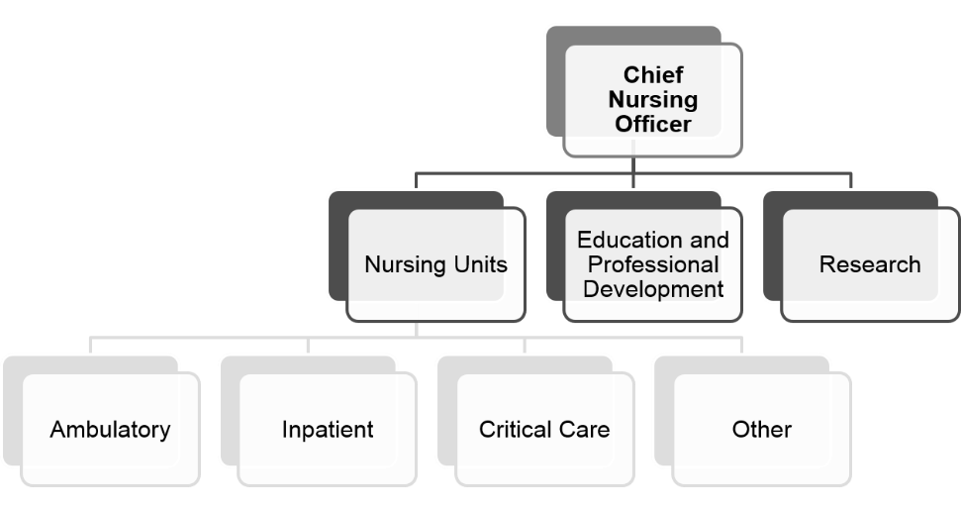
Nursing
3.5 Chart: Example of nursing department organization chart. CC BY by Vivian Todhunter
University of Rochester Medical Center, 2011
Notes:
The nursing division is typically headed by the CNO who reports to the CEO. Nursing is responsible for managing and staffing all the nursing units, including inpatient nursing departments. With the ongoing shift from inpatient services to outpatient and ambulatory services, nursing responsibilities may include the growing number of outpatient and ambulatory departments as well as primary care clinics and specialty clinics.
Patients who are admitted to a hospital are managed and given care through inpatient nursing units. These units usually include pediatrics [pee-dee-at-triks], medicine, surgery, and obstetrics-gynecology [uhb-stet-triks–gahy-ni-kol-uh-jee], but they may also include subspecialties such as orthopedics [or-thu-pee-diks], oncology [on-kol-uh-jee], and rehabilitation. Critical care units typically include cardiac intensive care, surgical intensive care, medical intensive care, pediatric intensive care, and neonatal [nee-oh-nay-tal] intensive care but may include more specialized units in academic or specialized hospitals. Other types of units include the emergency department, labor and delivery, and surgery (operating rooms and the postanesthesia [post-an-es-thee-zha] care unit).
The nursing division is also usually responsible for nursing education and professional development training. This sometimes includes training all hospital personnel in areas such as cardiopulmonary [kar-dee-oh-pul-mon-err-ee] resuscitation [ree-sus-si-tay-shun]. In academic hospitals, there may be ambulatory or inpatient units that function as research units.

Slide 11
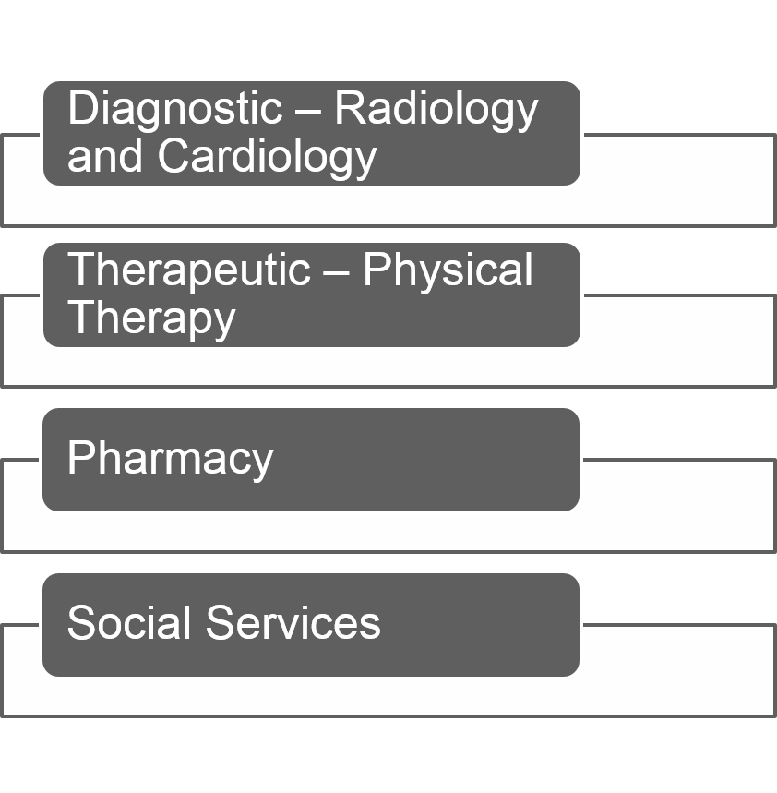
Clinical Support Services
3.6 Figure: Support services grouping. CC BY by Vivian Todhunter
Notes:
The management structure of clinical support services (also called allied health) varies depending on the health care organization. Some have a management-level officer who reports directly to the CEO; some combine clinical support services and ancillary services and divide it into diagnostic and therapeutic divisions; and in others, the managers of individual allied health departments report directly to the COO or designate. Clinical support service departments support the diagnosis and treatment of patients in specialized areas. Examples of diagnostic allied health include radiology, which is responsible for x-rays, magnetic resonance [rez-uh-nəntz] imaging, and computerized tomography [tuh-mog-ra-fee]. Radiology departments also support therapeutic procedures, often termed interventional radiology. Another example is cardiology, responsible for diagnostic studies such as electrocardiograms [ee-lek-tro-kar-dee-o-grams], stress tests, and echocardiograms [ek-o-kard-dee-o-grams]. Cardiology also supports more invasive diagnostic and interventional studies such as cardiac catheterization [kath-eh-ter-eh-zay-shun]. Allied health departments that provide therapeutic treatment include physical therapy, which provides care for patients with physical limitations from injuries or disease. Pharmacy is responsible for the acquisition, storage, and dispensing of medication. Social services is an example of a department that provides patient and family support and counseling, assessment of financial assistance, and discharge planning.
As mentioned, the reporting structure can vary from this example within health care organizations. For example, laboratory services may be included under clinical support services in some organizations and social services might report to nursing.

Slide 12
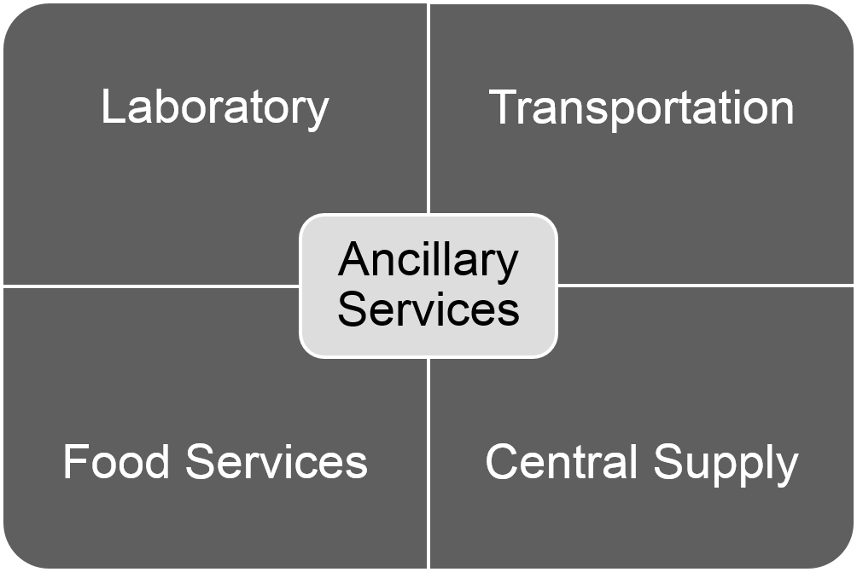
Ancillary Services
3.7 Figure: Ancillary services grouping. CC BY by Vivian Todhunter
Notes:
The management structure of ancillary services varies depending on the health care organization. Some have a management-level officer who reports directly to the CEO; some combine clinical support services and ancillary services and divide it into diagnostic and therapeutic divisions; in others the managers of individual ancillary departments report directly to the COO or designate. Examples include the laboratory responsible for the collection, analysis, and reporting of laboratory tests. As noted previously, laboratory crosses functions with clinical support services due to the training required to run the analysis of many types of laboratory tests. Another example is transportation, which is responsible for transporting patients within the hospital. This may include transporting patients from admitting to an inpatient unit or from the inpatient unit to a diagnostic service or surgery. Food services is the department charged with preparing and delivering food to patients. They also provide cafeteria services to staff, family members, and visitors. The central supply department is responsible for managing inventory and supplying all departments in the organization with supplies necessary to complete daily operations, including providing patient care.

Slide 13
Information
Management varies
Examples
  Admitting
  Medical records
  Information technology
United Hospital Fund, 2008; Medicare Payment Advisory Committee, 2004
Notes:
The management structure of information departments varies depending on the health care organization. Some have a management-level officer who reports directly to the CEO; in others, the managers of individual ancillary departments have a department director who reports to the COO or designate.
Admitting is responsible for obtaining initial information from the patient, including demographic data, payer information, and reason for admission. They obtain general consent for admission to the hospital and agreement to pay for services not covered by the payer. This department also obtains acknowledgment that the patient has received information about the Health Insurance and Portability and Accountability Act (HIPAA). Admitting may also ask patients if they have or would like to complete an advanced directive for care.
Medical records departments provide oversight and overall management of the patient’s record, ensuring all compliance and legal requirements are maintained. In the past, the patient’s medical record was in a paper format. Today, provider organizations are shifting from paper to an electronic format, which allows easy access and retrieval of the patient record for immediate patient care activities as well as post-care activities such as billing, audits, and research. Although the basic function of the medical records department has remained constant, the staff skill set has transitioned to meet the needs of working with electronic data. Medical records works closely with the information technology department with the oversight and maintenance of the electronic patient record as well as with deployment of these systems.

Slide 14
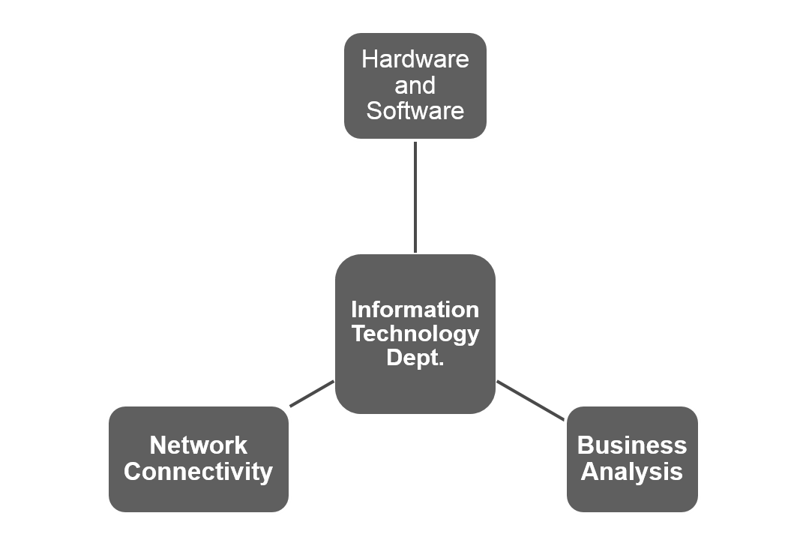
Information Technology Department
3.8 Figure: Example of IT department relationships. CC BY by Vivian Todhunter
Notes:
The information technology department is responsible for the organization’s technological infrastructure—hardware, software, and network connectivity, including physical security of the data. The department’s responsibilities also entail acquisition, implementation, and ongoing support of the systems and infrastructure. With implementation of EHRs, clinical systems, more complex administrative and billing systems, medical device–sourced data integration and mobile devices, the department has evolved into health information systems and technology. Today’s information systems and technology department has expanded beyond the technology to include business analyst functions that focus on integration of operational workflows and business processes with the technology and systems to gain the most effective deployment, adoption, and ongoing use of these systems. In addition, the use of data from these systems has resulted in data analytics activities in which clinical, business administrative, and financial data collected from these information systems are transformed into actionable information for both clinical and business decision making purposes. Regardless of size and provider type, the goal of this department is to provide technology systems and infrastructure that support the organization’s business goals and operational services in the most efficient and effective manner possible.

Slide 15
Facilities Management
Senior manager
Examples
  Housekeeping
  Maintenance
  Security
Notes:
The facilities management division is often led by a senior manager who reports to the COO. The departments are largely involved in managing the facility as a whole, which may include structures and grounds. The housekeeping department is responsible for cleaning and may include laundry services. Maintenance involves day-to-day repairs and replacement but also includes complex maintenance such as electrical, backup generators, and heating and cooling. Security is often included in facilities management and is responsible for security issues such as parking control, identification badges, and securing patient belongings when patients are admitted.

Slide 16
Organizational Structure by Institution
Core functions
Size
Type
Notes:
All health care organizations have certain core functions required to deliver health care—management, medical staff, nursing, clinical support, ancillary support, information, and facilities management. How these functions are manifested have to do with the size and type of the organization. A small community health clinic may be administered by the senior physician and an office manager. The medical staff may consist of only a few providers. Nursing staff may include a single nurse and several medical assistants. The medical assistants also provide limited clinical support and ancillary services (office laboratory tests or simple diagnostic procedures). The office manager and receptionist may provide much of the registration, billing, referral, and medical records. Facilities management may be a combination of the office staff and contracted cleaning and maintenance. In very small organizations, information technology support may be contracted to a consultant or other third party. Facilities management may be conducted by a combination of the office staff and contracted cleaning and maintenance. As facilities grow, these functions tend to require more personnel and personnel with additional training and eventually require whole divisions with multiple departments. Community health clinics do not perform complex diagnostic or treatment procedures. Community hospitals and academic hospitals may have similar organizational structure for clinical care. Academic hospitals add the need for two new functions—teaching and research. These can be substantial undertakings that require divisions and personnel to accomplish these tasks.

Slide 17
Patient Clinical Data Types
Narrative, textual
Numerical measurements
Recorded signals
Drawings
Photographs and images
Shortliffe & Barnett, 2006
Notes:
Several types of data are used to gather and record information. Much of the observational data—such as patient history, results of physical examination, and procedure and surgery reports—are recorded as narrative data. Numerical measures include weight, vital signs, and volumes. Recorded signals are increasingly digital and can be transferred directly to EHRs. These signals include electrical activity (electrocardiograms) and pressures generated from a variety of monitoring devices, such as blood pressure and other measures of cardiac pressures. Many devices, such as intravenous fluid administration devices and ventilators [vent-ul-ay-terz] now have the ability to directly input data into EHRs. Drawings, produced either by hand or with software, provide a record of an observation made to aid in documenting or following the progress of a wound, surgery, injury, and so on. Photographs and images are becoming more common in digital format and allow clinicians to record abnormal findings or wound at admission to better follow the progress. Many health care organizations now record all x-rays and imaging in digital format.

Slide 18
Communication
Verbal
Paper
Film/analog
Notes:
Data can be transmitted verbally either in person or by phone. This has the advantage of direct communication but usually has no permanent record. Even audio recordings may be less than satisfactory, because they require the user to listen to the entire recording. Paper medical records have been the mainstay of communication, but they present challenges such as with legibility, access, and consistency. With paper, patient information can be accessed by only one person who physically has the paper. Also, multiple versions of the patient record may exist across various departments. Test results and images that are recorded on film or in an analog format (electrocardiograms, laboratory results, x-rays, for example) can be stored in patient charts or in a central location. these mediums present the same availability problems as paper records.

Slide 19
Digital Communication
Digital
  Electronic health record
  Patient sourced information
  Personal health record and portals
Definitions:
  https://www.healthit.gov/providers-professionals/faqs/what-personal-health-record
  https://www.healthit.gov/providers-professionals/faqs/what-patient-portal
Notes:
Electronic or digital records eliminate many challenges of paper records within an organization and across multiple organizations. Electronic records can provide a single record that is accessible at any time by multiple users with appropriate security access. Electronic records support improved data consistency and quality while avoiding duplicate data entry. The benefits of electronic records are realized in patient care with the provider having quick and efficient access to the patient record. Also, organizations allow inclusion in the EHR of patient records from other providers—from a retail clinic, for example, or from an out-of-network provider. This shared information is vital to giving the clinician a complete picture of the patient and his or her plan of care as well as to ensuring appropriate coordination of care across other provider organizations in the care continuum. Each provider organization typically has a process and procedure for inclusion of additional information sourced from other providers into the patient’s EHR.
With patient and family engagement in the care process, patient-sourced data is critical and must be accessed by the physician and all clinicians. The deployment of electronic personalized health records has driven the use of electronic information exchange efforts not only among clinicians but between clinicians and patients. A personal health record (PHR) is [quote] “an electronic application used by patients to maintain and manage their health information in a private, secure, and confidential environment” [end quote]. With the advancement of security technology, many clinicians and patients may use a secured email platform to communicate. Other provider organizations offer a patient portal that is used by all clinicians and patients. A patient portal is [quote] “a secure online website that gives patients convenient 24-hour access to personal health information from anywhere with an Internet connection. Using a secure username and password, patients can view all their health information” [end quote].

Slide 20
Patient Experience
History
Testing
Data quality
Information access
Notes:
Patient satisfaction increases when patients experience effective communication among and between health organizations with the use of EHRs.
One of the benefits of EHRs to patients is that they don’t have to provide the same information every time they visit a new provider or a hospital department for the first time. EHRs have enabled all departments within a health care organization to access the results of every test or visit of a patient, which eliminates the need for the patient to explain the purpose of the visit and eliminates the need to request records across departments within a provider organization.
EHRs relieve patients of the burden of keeping track of their information and providing it with every visit, especially information that doesn’t change often, such as demographics, health insurance, current medications, allergies, and details of past illnesses. The electronic record also proves to be very beneficial in patient treatment activities when the patient is not in a condition to share basic information with providers, such as in the case of an accident or trauma.
The EHR can reduce costs and increase efficiencies across multiple provider organizations by enabling the sharing of test and x-ray results across these providers, thus reducing test duplications.

Slide 21
Health Care Settings—The Places Where Care Is Delivered
Summary – Lecture b
The following were discussed in this lecture:
  Range and continuum of care
  Unique types of health care organizations and relationships between organization
  Organizational structure and function
  Relationships and communication between departments
  Effect of technology on the patient experience
Notes:
This concludes Lecture b of Health Care Settings–The Places Where Care Is Delivered. The lecture described divisions, departments, and services that commonly comprise outpatient clinics, community hospitals, academic medical centers, and long-term care facilities and discussed interactions between departments and the services they deliver. The lecture also discussed data and information concerns and described how information technology has affected interdepartmental communication and improved the patient experience.

Slide 22
Health Care Settings—The Places Where Care Is Delivered
Summary
This unit
  Differentiated range of care delivery organizations
  Analyzed the organization of health care delivery from the perspective of a continuum of care
  Evaluated similarities and differences of community hospitals, teaching hospitals, community health clinics
  Described departments and the services they offer
  Explained how departments and services interact
  Discussed data and information
  Described the impact of medical and information technology
Notes:
This also concludes Health Care Settings—The Places Where Care Is Delivered. The unit provided a summary of the range of health care organizations, including those that provide primary, secondary, and tertiary care. It described some of the unique health care organizations and relationships between them as well as the general organizational structure of health care organizations. Each division was discussed, and examples were given of departments that are typically a part of those divisions. Finally, the unit described the effects of technology on both interdepartmental communication and the patient experience.

Slide 23
Health Care Settings—The Places Where Health Care Is Delivered
References – Lecture b
References
HealthIT.gov. (2013). What is a personal health record? Retrieved from https://www.healthit.gov/providers-professionals/faqs/what-personal-health-record
HealthIT.gov. (2015). What is a patient portal? Retrieved from https://www.healthit.gov/providers-professionals/faqs/what-patient-portal
Longnecker, D. E., Patton, M., & Dickler, R. M. (2007). Roles and responsibilities of chief medical officers in member organizations of the Association of the American Medical Colleges. Academic Medicine, 82(3), 258–263. Retrieved from http://mobile.journals.lww.com/academicmedicine/_layouts/15/oaks.journals.mobile/articleviewer.aspx?year=2007&issue=03000&article=00009
Medicare Payment Advisory Committee. (2004). Information technology in health care. In Report to the Congress: New approaches in Medicare, chapter 7. Retrieved from http://qio.ipro.org/wp-content/uploads/2012/12/june04_entire_report.pdf
Scribd. (2011). Organizational structure of a hospital. Retrieved from http://www.scribd.com/doc/20884108/Organizational-Structure-of-a-Hospital.
Shortliffe, E. H., & Barnett, G. O. (2006). Biomedical data: Their acquisition and use. In E. H. Shortliffe & J. J. Cimino (Eds.), Biomedical computer applications in health care and biomedicine, 3rd ed., pp. 403–443. New York: Springer.
United Hospital Fund. (2008). Family care giver guide. Hospital admission: How to plan and what to expect during the stay. Retrieved from http://www.nextstepincare.org/uploads/File/ Hospital_Admissions.pdf
Notes:
No audio.

Slide 24
Health Care Settings—The Places Where Health Care Is Delivered
References – Lecture b Continued
University of Rochester Medical Center. (2007). Strong Memorial Hospital organizational chart. Retrieved from http://www.urmc.rochester.edu/strong-nursing/about/documents/NursingOrgChart.pdf
WebFinance. (2016). Human resources manager. In BusinessDictionary.com. Retrieved from
http://www.businessdictionary.com/definition/human-resources-manager.html#ixzz41Nif3jNZ
Charts, Tables, Figures
3.3 Chart: Example of a health care organizational structure (Hickman 2012, CC BY-NC-SA 3.0).
3.4 Chart: Example of a chief medical information officer reporting structure. CC-BY by Jan Kraus.
3.5 Chart: Example of a nursing department organization chart. CC BY by Vivian Todhunter.
3.6 Figure: Support services grouping. CC BY by Vivian Todhunter.
3.7 Figure: Ancillary services grouping. CC BY by Vivian Todhunter.
3.8 Figure: Example of IT department relationships. CC BY by Vivian Todhunter.
Notes:
No audio.

Slide 25
The Culture of Health Care
Health Care Settings—The Places Where Care Is Delivered
Lecture b
This material was developed by Oregon Health & Science University, funded by the Department of Health and Human Services, Office of the National Coordinator for Health Information Technology under Award Number IU24OC000015. This material was updated in 2016 by Bellevue College under Award Number 90WT0002.
Notes:
No audio.

