Slide 1
Notes:
No audio. Recording preparation.

Slide 2
The Culture of Health Care
Health Care Settings—The Places Where Care Is Delivered
Lecture a
This material (Comp2 Unit 3) was developed by Oregon Health & Science University, funded by the Department of Health and Human Services, Office of the National Coordinator for Health Information Technology under Award Number IU24OC000015. This material was updated in 2016 by Bellevue College under Award Number 90WT0002.
This work is licensed under the Creative Commons Attribution-NonCommercial-ShareAlike 4.0 International License. To view a copy of this license, visit http://creativecommons.org/licenses/by-nc-sa/4.0/.
Notes:
Welcome to The Culture of Health Care: Health Care Settings—The Places Where Care Is Delivered. This is Lecture a.
The component, The Culture of Health Care, addresses job expectations in health care settings, the organization of patient care within a practice setting, privacy laws, and professional and ethical issues encountered in the workplace.

Slide 3
Health Care Settings–
The Places Where Care Is Delivered
Learning Objectives
Differentiate the range of care delivery organizations, including primary care, specialty care, tertiary care, hospitals, clinics, the medical home, home health, hospice, and long-term care facilities. (Lecture a)
Analyze the organization of health care delivery from the perspective of a continuum of care, including outpatient services, inpatient care, home care services, long-term care, and end-of-life care. (Lecture a)
Evaluate the similarities and differences of community hospitals, teaching hospitals, specialty hospitals, and community health clinics. (Lecture a)
Notes:
The objectives for this unit, Health Care Settings—The Places Where Care Is Delivered are to:
Differentiate the range of care delivery organizations, including primary care, specialty care, tertiary care, hospitals, clinics, the medical home, home health, hospice, and long-term care facilities
Analyze the organization of health care delivery from the perspective of a continuum of care, including outpatient services, inpatient services, home care services, long-term care, and end-of-life care
Evaluate the similarities and differences of community hospitals, teaching hospitals, specialty hospitals, and community health clinics

Slide 4
Health Care Settings—
The Places Where Care Is Delivered
Learning Objectives Continued
Describe the various departments and services offered by an outpatient clinic, community hospital, academic medical center, and long-term care facility. (Lecture b)
Explain the ways in which different outpatient and inpatient departments interact and how their services relate. (Lecture b)
Describe ways data and information are created and used by people in different outpatient and inpatient departments. (Lecture b)
Describe ways in which medical and information technology have improved interdepartmental communication and, consequently, the patient experience. (Lecture b)
Notes:
Additional objectives for this unit are to:
Describe the various departments and services offered by an outpatient clinic, community hospital, academic medical center, and long-term care facility
Explain the ways in which different outpatient and inpatient departments interact and how their services relate
Describe ways data and information are created and used by people in different outpatient and inpatient departments
Describe ways in which medical and information technology have improved interdepartmental communication and, consequently, the patient experience

Slide 5
Patient Care Settings or Organizations
Patient care settings
Patient care levels
Patient continuum of care
Unique functions and interrelationships between health care provider organizations
Notes:
This lecture examines the various aspects of health care provider organizations: the type of care settings or organizations, the level of care provided by these organizations, and the role they serve in the patient continuum of care.
[quote] “The patient continuum of care is a concept involving an integrated system of care that guides and tracks the patient over time through a comprehensive array of health services spanning all levels of care intensity” [end quote]. One goal of the continuum of care concept is to provide a framework for delivery of optimum health care to patient populations across all provider care facilities. The continuum of care can be described as the array of care services provided from birth to end of life.
All health care provider organizations—hospitals, physician clinics, outpatient clinics, home health providers, hospice services, the medical home, and more—participate in the patient continuum of care.
Throughout this presentation, the unique functions of various health care organizations are highlighted. The presentation also provides examples of relationships between health care organizations.

Slide 6
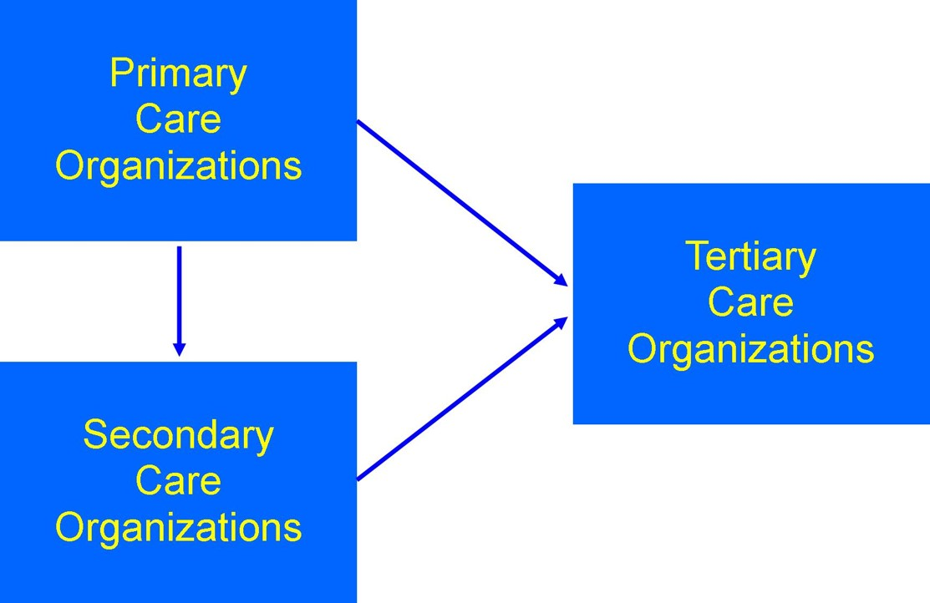
Range of Care Delivery
3.1 Figure: Represents the range of care delivery and the referral patterns between the types of care of delivery organizations. Hickman, 2012. CC-BY-NC-SA.
Notes:
The best way to get a broad picture of the types of care delivery organizations is to look at the range of services that they provide. Primary care organizations are usually the entry point for health care services. Secondary care is most often specialty care. Tertiary [ter-shee-er-ee] care organizations offer diagnostic and treatment options that are not available at most health care organizations. The graphic shows that primary care organizations may refer patients to either secondary care or tertiary care (indicated by an arrow from the Primary Care Organization text box to both the Secondary Care and Tertiary Care text boxes). Secondary care organizations also may refer directly to tertiary care organizations (indicated by an arrow from the Secondary Care Organization text box to the Tertiary Care Organization text box).

Slide 7
Primary Care Organization
“Primary care is the provision of integrated, accessible health care services by clinicians who are accountable for addressing a large majority of personal health care needs, developing a sustained partnership with patients, and practicing in the context of family and community” (Donaldson et al., 1996)
Main function is to provide screening, prevention, education, diagnosis, and treatment for acute and chronic health problems
Examples: physician office, health clinics
Notes:
This quote describes how primary care addresses the majority of personal health care needs. It is ideally easily accessible and sustained. It is often the entry point into health care and includes screening, prevention, diagnosis, and treatment for acute and chronic health problems.
Physician practices and physician clinics are the most common types of primary care organizations. Primary care services are also provided through public health clinics and community health clinics for some patient populations.

Slide 8
Secondary Care Organization
May be known as specialty care organizations
Provides most types of specialty diagnoses and treatment
Examples: freestanding ambulatory facilities, community hospitals, academic medical centers, specialty hospitals, home health services, extended care facilities
Notes:
Secondary care organizations represent more specialized care and are also called specialty care organizations. They can provide many types of specialty care, such as surgery, cardiology, physical medicine, and burn care.
Examples of the wide range of organizations considered secondary care providers include
Ambulatory care facilities, such as outpatient surgery centers and other freestanding ambulatory facilities or rehabilitative facilities
Community hospitals and academic hospitals
Specialty hospitals, such as cancer-focused hospitals
Home care and hospice services
Extended-care facilities, such as nursing homes and skilled nursing facilities

Slide 9
Tertiary Care Center
“A tertiary care center is a medical facility that receives referrals from both primary and secondary care levels and usually offers tests, treatments, and procedures that are not available elsewhere. Most tertiary care centers offer a mixture of primary, secondary, and tertiary care services so that it is the specific level of service rendered rather than the facility that determines the designation of care in a given study” (Kane, 2011)
Notes:
Tertiary care centers provide care that is not available at other health care organizations. In many cases, a new procedure is perfected in only a few organizations, and that is the only place the procedure can be obtained. Examples include complex facial reconstruction, many types of organ transplants, or specialized burn care. This quote also makes a point that bears repeating: Many organizations provide multiple levels of care.
Large, integrated delivery systems or academic hospital systems are sometimes referred to as tertiary care centers because of the highly skilled patient care services they provide and the highly skilled clinicians and physicians who practice in such hospitals.

Slide 10
Integrated Health Care Delivery
Provides a full range of care
Informal association between practitioners, ambulatory facilities, hospitals, and academic medical center
Formal organizations that provide facilities under a single management structure to manage primary, secondary, and tertiary care services
Notes:
Many organizations seek to provide a broad range of patient care services by developing an integrated health care delivery network or system. An integrated network can be as simple as an informal association between primary care providers with local hospitals or medical centers. A more common approach is to establish a formal organization in which primary, secondary, and tertiary services are managed by a single organization supporting their community and other targeted geographic locations. These services can be provided in a central location, or the facilities can span across a specific geographic location—which could include nationwide and even international locations.

Slide 11
The Continuum of Care
Definition
  Care provided until patient “returns to usual function” or care is no longer needed
  Care from birth to death
All providers participate in the continuum of care. The primary care provider typically functions as the coordinator and refers to additional providers
Two definitions:
  http://www.ncbi.nlm.nih.gov/pubmed/10293297
  http://www.himss.org/ResourceLibrary/genResourceDetailPDF.aspx?ItemNumber=30272
Notes:
As previously discussed, the patient continuum of care concept involves numerous types of health care provider organizations that participate in providing the required patient services. The patient’s medical condition directs the specific type of providers and medical services required at any point in time with the main goal of returning the patient to the usual function of daily living or until services are no longer required. This concept has also been described as “care from birth to death.”
As an example, consider the continuum of care involved for a patient who sustained severe injuries in a motor vehicle accident. Numerous services are required, from emergency care to stabilize the patient to surgery to repair the injuries to rehabilitation to return the patient to normal function. If an integrated health care delivery network is accessible, the patient may be able to minimize the number of provider organizations involved in her care. For example, a network may offer orthopedic surgery as well as inpatient and ambulatory postoperative rehabilitative services, whereas other hospitals may not have ambulatory rehabilitative services, and the patient would have to seek out a separate provider to obtain these services.
Two very good definitions of the patient care continuum can be found at the links on this slide.

Slide 12
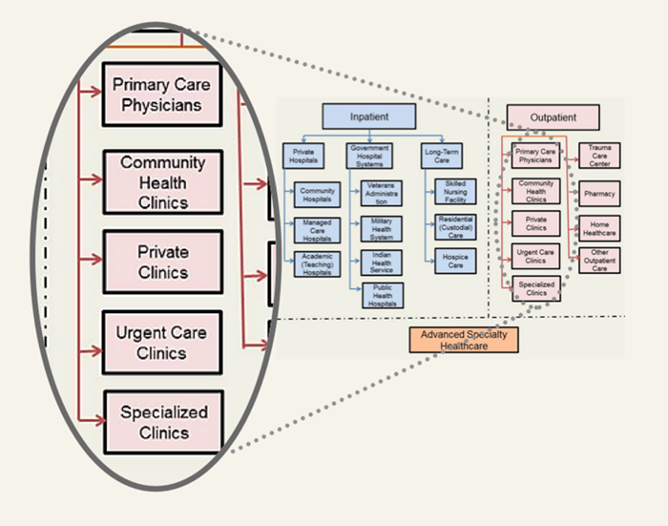
Ambulatory or Outpatient Service Organizations
Non-hospital care, outpatient care
Primary care services
  Physician offices
  Clinics
Specific services
  Surgery centers
  Rehabilitation
  Lab and radiology
Retail clinics
Public health clinics
CC-BY by Jan Kraus
Notes:
Ambulatory [am-byu-luh-tor-ee] services (also known as outpatient care) are provided to nonhospitalized patients. A wide range of services are offered by ambulatory care providers, including primary care, which is often provided in a doctor’s office or a clinic. Specialty medicine services are also provided in ambulatory settings.
Examples of various type of services provided through an ambulatory care organization include the following:
Outpatient surgery,
Sports medicine,
Sleep diagnostic laboratories,
Physical and occupational rehabilitative services,
Laboratory services, and
Radiology services, including magnetic resonance [rez-uh-nəntz] imaging and computerized tomography [tuh-mog-ra-fee].
Some organizations have set up wellness centers that provide prevention, education, and wellness patient services. Recently, the industry has seen the emergence of retail clinics that provide basic patient care, flu immunizations, and nonemergency care services onsite at retail stores. Examples are clinics located in pharmacy chains and other retail stores. These can be owned and operated by the retail chain, or the services can be provided through a collaboration between the retail store and the local health care system. Additionally, many public health service offerings through the state and at the local level may provide services through their clinics.

Slide 13
Patient Medical Home Model for Primary Care Services
Primary care approach to patient-centered, comprehensive, team-based, coordinated care
Focus on patient care quality and safety
Emphases on patient care
  In the right place
  At the right time
  In manner that best suits patient and family
Primary care physicians are at the center of coordinating care in the medical home model
Notes:
The patient medical home model is a primary care approach to patient-centered, comprehensive, team-based, coordinated, and accessible care [quote] “focused on quality and safety. It has become a widely accepted model for how primary care should be organized and delivered throughout the health care system and encourages providers and care teams to meet patients where they are. The medical home is not a final destination; instead, it is a model for achieving primary care excellence so that care is received in the right place, at the right time, and in the manner that best suits a patient’s needs” [end quote]. Benefits of this model include improved patient care quality and safety as well as a tight integration of the patient and family with the providers and care activities and decisions.

Slide 14
Precision Medicine or
Personalized Medicine
Approach to disease prevention and treatment that takes into account differences in people’s genes, environments, and lifestyles
Example
  Demonstrated results in patients with cancer or family cancer history
  Improved survival rates with reduced treatment side effects
FDA, 2016
Notes:
Most medical treatments are designed for the average patient as a one-size-fits-all-approach. This approach is [quote] “successful for some patients but not for others. Precision medicine, sometimes known as personalized medicine, is an innovative approach to disease prevention and treatment that takes into account differences in people’s genes, environments, and lifestyles” [end quote].
[quote] “Advances in precision medicine have already led to powerful new discoveries and several new FDA-approved treatments that are tailored to specific characteristics of individuals, such as a person’s genetic makeup or the genetic profile of an individual’s tumor” [end quote]. For example, [quote] “patients with a variety of cancers routinely undergo molecular testing as part of patient care, enabling physicians to select treatments that improve chances of survival and reduce exposure to adverse effects” [end quote].

Slide 15
Community Health Clinic
“Health centers are community-based and patient-directed organizations that serve populations with limited access to health care” (HRSA, 2011)
Type examples:
  Grant-supported federally qualified health centers
  Lookalikes
  Tribal operated
  Others
Notes:
Community health clinics are community-based health centers providing care to underserved populations. Federally qualified health centers (FQHCs) must meet specific qualifications to receive federal funding. They include community health centers, migrant health centers, health care for the homeless programs, and public health primary care programs. Lookalike health clinics do not receive the same grant funding but do receive many of the same benefits as FQHCs. Lookalikes must be certified as meeting the definition of a health center. Those operated by tribal organizations usually receive funding from the Indian Health Services. In addition, many community health centers are owned and operated by nonprofit organizations as well as by county and city health departments.

Slide 16
School-Based Health Centers
(School-Based Health Alliance)
Located in schools
Range of services:
  Screening, preventive, and limited acute care
  Behavioral care
  Counseling
Linkage with other local health care providers
Notes:
School-based health centers are located in schools and offer a wide range of services depending on state and local policy. They often provide screening, preventive care, and limited acute care such as treatment of minor injuries or colds. Some may offer behavioral and other forms of counseling. They often have either formal or informal relationships with local health care organizations for referrals when patients need additional or specialized care.

Slide 17
Employer-Based Health Clinics
Primary and urgent care
Occupational health, preventive care and wellness, chronic disease management
Aimed at containing health care costs
  Employer retains utilization decisions
  Shifts emphasis from illness care to preventive
Trend anticipated to continue for employers to provide clinics for their employees
Healthcare Strategy Group, 2011
Notes:
Employer-based health clinics have expanded their roles in the last few decades. The original focus was on occupational health and injury prevention. These clinics have expanded into preventive care, screening, wellness, and chronic disease management. They may be located in an office at the employer’s facility or have a mobile clinic that can serve several facilities. For the employer, these clinics have the advantage of providing control over health care cost. It allows patients to receive health care without taking time off.
Employers are anticipated to continue to provide clinics to their employees to assist in overall cost reduction and increase productivity. From a recent survey, worksite clinics are offered at twenty-nine percent of organizations with more than five thousand employees in 2015, which was up from twenty-four percent in 2013.

Slide 18
Hospital or Inpatient Care Services
Admission for more than 24 hours
Range of services
  Emergency, trauma services such as accidents, heart attacks
  Acute care medical and surgical services such as appendicitis
  Highly specialized care services
  Chronic care such as diabetes
  Mental health care
  Ancillary services such as lab and radiology
Notes:
Inpatient care is health care that requires admission to a hospital for more than 24 hours. [quote] “Hospital services is a term that refers to medical and surgical services and the supporting laboratories, equipment and personnel that make up the medical and surgical mission of a hospital or hospital system” [end quote]. This slide provides examples of hospital services.

Slide 19
Types of Hospitals
Community hospitals
  “Community hospitals are defined as all nonfederal, short-term general, and other special hospitals”
Teaching hospital (academic hospital)
  Usually associated with a university or medical school
  Major role in clinical training of health professionals
Specialty hospitals
  Focus on a specific population or disease state
  Examples include children’s hospitals, orthopedic and spine hospitals, and cancer-focused hospitals
AHA, 2016
Notes:
There are two general types of hospitals. Community hospitals are non–federally funded hospitals but may be nonprofit or for profit. They consist of local hospitals that provide short-term, general care but may also include specialty hospitals that focus on obstetrics [uhb-stet-triks], gynecology [gahy-ni-kol-uh-jee], orthopedics [or-thu-pee-dik], or rehabilitation. Teaching hospitals are usually associated with a university or medical school. Also termed academic hospitals, they have a major role in training health professionals. The range of clinical care provided by community and teaching hospitals may be the same.
There are also hospitals that focus solely on a specific population or disease state. These hospitals may be part of a larger integrated delivery network or have a working relationship with the larger provider. However, they may be owned and operated as an independent organization that is for profit or nonprofit.

Slide 20
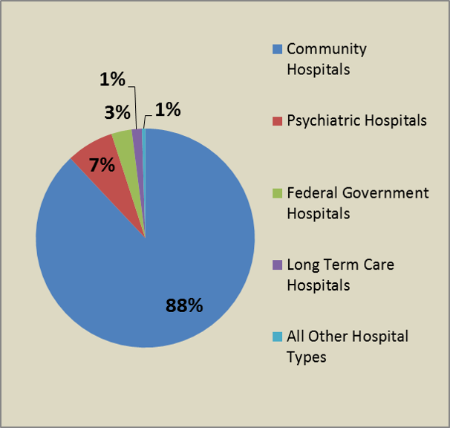
Most Hospitals Are Community Hospitals
3.2 Chart: Most hospitals are community hospitals. CC-BY by Jan Kraus
Notes:
Most U.S. hospitals are privately funded community hospitals that offer acute care and are not affiliated with the federal, state, or local governments. The United States also has a substantial number of psychiatric hospitals and hospitals that are funded by the federal government. For patients who must stay in a hospital for more than 25 days, long-term care hospitals and facilities can accommodate their needs.

Slide 21
Long-Term Care
Adult day care
  Meals and activities limited during the day
Independent living
  Retirement community
  Per-service options
Assisted living
  Apartment or room
  Personal care, medication, meals, housekeeping
Notes:
Long-term care facilities are health care organizations that provide assistance to aging adults and to clients with chronic illness. A variety of types of institutions serve different needs. Adult day care provides meals and activities during the day. Independent living situations are retirement communities that generally have separate condos or apartments. Residents can typically purchase options, such as meals and housekeeping services, individually. Assisted living can be an apartment or individual room where a number of services such as personal care, medication administration, meals, and housekeeping are part of the package.

Slide 22
Long-Term Care Continued
Skilled nursing facilities
  Full medical care
  Assistance with activities of daily living
  Meals
Long-term care hospitals (CMS, 2015)
  Acute care hospitals
  Average stay greater than 25 days
  Expect patients to return home
Notes:
Skilled nursing facilities provide full medical care; they also provide assistance with activities of daily living, such as meals, personal care, housekeeping, and laundry. Long-term care hospitals are a special category in which the facility manages the transition from acute illness or injury to return to home. Many community hospitals have long-term care units that serve that purpose. The average patient’s stay in long-term care units or hospitals is greater than 25 days.

Slide 23
Home Health
Wide range of health care services provided in patient’s home
Examples:
  Wound care
  Education
  Intravenous and nutrition therapy
  Medication administration
  Health status monitoring
  Physical and rehabilitation therapy
Medicare, 2016
Notes:
Home health care provides a wide range of services in the patient’s home for an illness or injury. Home care is usually less expensive, more convenient, and may be an effective care alternative. The goal of home care is to treat the illness or injury and assist the patient in becoming self-sufficient as soon as possible.
Examples of home health services include:
Wound care for pressure sores or a surgical wound,
Patient and caregiver education,
Intravenous and nutrition therapy,
Medication administration and injections,
Monitoring serious illness and unstable health status, and
Physical and rehabilitation therapy.

Slide 24
Hospice and Palliative Care
Model for providing quality and compassionate care for those facing a life-limiting illness or injury
Variety of hospice settings available to patient and families
NHPCO, 2016
Notes:
Hospice is the model for quality, compassionate care for people facing a life-limiting illness or injury. Hospice care involves a team-oriented approach to expert medical care, pain management, and emotional and spiritual support expressly tailored to the patient’s needs and wishes. Support is provided to the patient’s loved ones as well. At the center of hospice and palliative care is the belief that each of us has the right to die pain-free and with dignity and that our families will receive the necessary support to allow us to do so.
Hospice services can be obtained through a variety of provider settings, including hospitals, ambulatory settings, or in the patient’s home.

Slide 25
Federally Funded Health Care Institutions
Veterans Health Administration (VA hospitals)
Military Health System
Indian Health Service
Notes:
There are three main federally funded health care institutions in the United States: the Veterans Health Administration, Military Health System, and the Indian Health Service.

Slide 26
Veterans Health Administration
“The Veterans Health Administration is home to the United States’ largest integrated health care system consisting of 152 medical centers, nearly 1,400 community-based outpatient clinics, community living centers, Vet Centers, and Domiciliaries” (Department of Veterans Affairs, 2011)
  Primary care
  Specialty care
  Tertiary care
Notes:
The Veterans Health Administration (VA) is the largest integrated health system in the United States, consisting of one hundred fifty-three medical centers and fourteen hundred community-based outpatient facilities. The VA also includes community living centers, Vet centers (for outreach), and domiciliaries [dom-uh-sil-ee-er-ees] to care for patients with long-term medical conditions in a home-like atmosphere. As with any integrated health system, the VA provides primary, secondary, and tertiary care.

Slide 27
Military Medicine
Part of the U.S. Department of Defense Military Health System
  Ensures worldwide delivery of health care
  Facilities for each branch of military
TRICARE partnership network ensures accessibility of care
  Military facilities
  Supplemented by private-sector services
Health.mil, 2011
Notes:
The Military Health System is part of the U.S. Department of Defense. It provides services to service members, retirees, and their families. Each branch of the armed forces has its own network of hospitals and health care facilities. TRICARE is a health care program that ensures care worldwide. This includes military facilities and is supplemented by civilian health care providers, organizations, and pharmacies.

Slide 28
Indian Health Service
Agency within the U.S. Department of Health and Human Services
  Provides health services for American Indians and Alaska Natives
  Goals are to ensure access to health services and reduce health disparities
Indian Health Service, 2015
Notes:
The Indian Health Service is an agency that is part of U.S. Department of Health and Human Services. It provides health care to American Indians and Alaskan natives. The main goals are to provide access to care and to reduce health disparities.

Slide 29
Indian Health Service Continued
Federal IHS system includes 28 hospitals, 63 health centers, 31 health stations, and 34 urban projects
American Indian tribes and Alaska Native corporations independently administer 17 additional hospitals, 263 health centers, 92 health stations, and 166 Alaska village clinics
Additional services are contracted through private providers
Indian Health Service, 2015
Notes:
The Indian Health Service consists of a federal system and health care organizations managed independently by American Indian tribes and Alaska Native corporations. Additional services are provided by contract with private providers. The federal system is divided into twelve physical areas of the United States; each area has a unique group of tribes that work with the system on a day-to-day basis. Services are provided through twenty-eight hospitals, sixty-three health centers, thirty-one health stations, and thirty-four urban projects. American Indian tribes and Alaska Native corporations administer seventeen additional hospitals, two hundred sixty-three health centers, ninety-two health stations, and one hundred sixty-six Alaska village clinics. Like most systems, the Indian Health Service offers primary and secondary care. Some areas have tertiary care capabilities or contract with private providers for these services.

Slide 30
Health Care Settings—The Places Where Care Is Delivered
Summary – Lecture a
Discussed the range of health care organizations: primary care, secondary care, and tertiary care
Defined organizations by type of services that they provide in the continuum of care: the care a patient receives from entry into the system until care is no longer needed
Described some of the unique health care organizations and relationships between organizations
Notes:
This concludes Lecture a of Health Care Settings—The Places Where Care Is Delivered. This lecture discussed the range of health care organizations, including those that provide primary care, secondary care, and tertiary care. The lecture defined the types of service that are provided in the continuum of care—the care a patient receives from entry into the system until care is no longer needed. This lecture also described some of the unique health care organizations and the relationships between them.

Slide 31
Health Care Settings—The Places Where Health Care Is Delivered
References – Lecture a
References
Adameg. (2016). Hospital services. In Encyclopedia of Surgery. Retrieved from http://www.surgeryencyclopedia.com/Fi-La/Hospital-Services.html
AMA (American Medical Association). (n.d.). AMA Glossary of medical terms. Retrieved from http://file.lacounty.gov/dmh/cms1_159358.pdf
American Hospital Association. (2016). Fast facts on US hospitals. Retrieved from http://www.aha.org/research/rc/stat-studies/fast-facts.shtml
CMS (Centers for Medicare and Medicaid Services). (2015). What are long-term care hospitals? Retrieved from https://www.medicare.gov/Pubs/pdf/11347.pdf
Colorado Community Health Network. (2013). How to start a CHC. Retrieved from http://cchn.org/how-to-start-a-chc
Department of Veterans Affairs. (2011). About VHA (Veterans Health Administration). Retrieved from http://www.va.gov/health/aboutVHA.asp
Donaldson, M. S., Yordy, K. D., Lohr, K. N., & Vanselow, N. (Eds.). (1996). Primary care: America’s health in a new era. Washington, DC: National Academies Press.
Evashwick, C. (1989). Creating the continuum of care. Health Matrix, 7(1), 30–39.
Health Resources and Health Administration (HRSA). (n.d.). What is a health center? Retrieved from http://bphc.hrsa.gov/about/what-is-a-health-center/index.html
Health.mil. (n.d.). Access, cost, quality, and safety. Retrieved from http://health.mil/Military-Health-Topics/Access-Cost-Quality-and-Safety
Notes:
No audio.

Slide 32
Health Care Settings—The Places Where Health Care Is Delivered
References – Lecture a Continued
Healthcare Strategy Group. (n.d.). Employer health clinics-threat and opportunity. Retrieved from http://www.healthcarestrategygroup.com/newsletters/article.php?show=employer_health_clinics___threat_and_opportunity
HIMSS HIE Committee. (2014). Definition: Continuum of care. Retrieved from http://www.himss.org/ResourceLibrary/genResourceDetailPDF.aspx?ItemNumber=30272
Indian Health Service. (2015). Indian Health Service: quick look. Retrieved from http://www.ihs.gov/newsroom/factsheets/quicklook
Indian Health Service. (n.d.). Locations. Retrieved from https://www.ihs.gov/locations.
Japson, B. (2015, October 9). More employers turn to on-site clinics despite Obamacare’s Cadillac tax. Forbes. Retrieved from http://www.forbes.com/sites/brucejapsen/2015/09/10/more-employers-turn-to-on-site-clinics-despite-obamacares-cadillac-tax/#6dcb1ed33289
Kane, R. L. (2011). Finding the right level of posthospital care: “We didn’t’ realize there was any other option.” JAMA, 305(3), 284–293.
Medicare.gov. (n.d.). What’s home health care and what shall I expect? Retrieved from https://www.medicare.gov/what-medicare-covers/home-health-care/home-health-care-what-is-it-what-to-expect.html
Mercer. (2015). Employers continue to launch worksite clinics despite ACA uncertainties—Mercer survey. Retrieved from http://www.mercer.com/newsroom/employers-continue-to-launch-worksite-clinics-despite-aca-uncertainties.html
Notes:
No audio.

Slide 33
Health Care Settings—The Places Where Health Care Is Delivered
References – Lecture a Continued 2
National Hospice and Palliative Care Organization. (n.d.). Choosing a hospice. Retrieved from http://www.nhpco.org/resources/choosing-hospice
National Hospice and Palliative Care Organization. (2015). Hospice care. Retrieved from http://www.nhpco.org/about/hospice-care
Patient Centered Primary Care Collaborative. (2015). Defining the medical home. Retrieved from https://www.pcpcc.org/about/medical-home
School-Based Health Alliance. (n.d.). About school-based health centers. Retrieved from http://www.sbh4all.org/school-health-care/aboutsbhcs
U.S. Food and Drug Administration.(2013). Paving the way for personalized medicine: FDA’s role in a new era of medical product development. Retrieved from http://www.fda.gov/downloads/ ScienceResearch/SpecialTopics/PersonalizedMedicine/UCM372421.pdf
U.S. Food and Drug Administration. (2016). Precision medicine initiative. Retrieved from http://www.fda.gov/ScienceResearch/SpecialTopics/PrecisionMedicine/default.htm
Charts, Tables, Figures
3.1 Figure: Represents the range of care delivery and the referral patterns between the types of care of delivery organizations. Hickman, 2012, CC BY-NC-SA.
3.2 Chart: Most hospitals are community hospitals. CC-BY by Jan Kraus.
Images
Slide 11: Healthcare facilities: Outpatient. CC-BY by Jan Kraus.
Notes:
No audio.

Slide 34
The Culture of Health Care
Health Care Settings—The Places Where Care Is Delivered
Lecture a
This material was developed by Oregon Health & Science University, funded by the Department of Health and Human Services, Office of the National Coordinator for Health Information Technology under Award Number IU24OC000015. This material was updated in 2016 by Bellevue College under Award Number 90WT0002.
Notes:
No audio.

