Slide 1
Notes:
No audio. Recording preparation.

Slide 2
The Culture of Health Care
Health Professionals—The People in Health Care
Lecture a
This material (Comp2 Unit 2) was developed by Oregon Health & Science University, funded by the Department of Health and Human Services, Office of the National Coordinator for Health Information Technology under Award Number IU24OC000015. This material was updated in 2016 by Bellevue College under Award Number 90WT0002.
This work is licensed under the Creative Commons Attribution-NonCommercial-ShareAlike 4.0 International License. To view a copy of this license, visit http://creativecommons.org/licenses/by-nc-sa/4.0/.
Notes:
Welcome to The Culture of Health Care: Health Professionals—The People in Health Care. This is Lecture a.
The component, The Culture of Health Care, addresses job expectations in health care settings, the organization of patient care within a practice setting, privacy laws, and professional and ethical issues encountered in the workplace.

Slide 3
Health Professionals—The People in Health Care
Learning Objectives
Define terms used in health care and in health professionals’ education and training, including clinician, patient/consumer, disease, and syndrome. (Lecture a)
Describe the education, training, certification, licensure, and roles of physicians, including those in primary care and other specialties. (Lecture a)
Describe the education, training, certification, licensure, and roles of nurses, advanced practice nurses, licensed practical nurses, medical assistants, and medication aides. (Lecture b)
Describe the education, training, certification, licensure, and roles of physician assistants, pharmacists, therapists, and allied health professionals. (Lecture c)
Describe the education, training, certification, licensure, and roles of paramedics, emergency medical technicians, dental professionals, mental health professionals, and social workers. (Lecture c)
Notes:
The objectives for Health Professionals—The People in Health Care are to:
Define terms used in health care and in health professionals’ education and training, including clinician, patient/consumer, disease, and syndrome.
Describe the education, training, certification, licensure, and roles of physicians, including those in primary care and other specialties.
Describe the education, training, certification, licensure, and roles of nurses, advanced practice nurses, licensed practical nurses, medical assistants, and medication aides.
Describe the education, training, certification, licensure, and roles of physician assistants, pharmacists, therapists, and allied health professionals.
Describe the education, training, certification, licensure, and roles of paramedics, emergency medical technicians, dental professionals, mental health professionals, and social workers.

Slide 4
Terminology
(Merriam-Webster Medical Dictionary, Medline Plus, 2010)
Health professional:
  Provides care to the sick and injured in pre-hospital, hospital, outpatient, home, extended-care facilities, and other settings
  Supports preventive care, wellness services, and patients’ self-managed care
Patient/consumer:
  Anyone seeking preventive care services, wellness services, assistance with self-managed care, or medical services
Notes:
This lecture introduces key terms used to describe health care professionals and their education, including education, training, certification, and licensure.
Many health professionals provide care to the sick and injured in various settings. They deliver pre-hospital care, such as at accident scenes; inpatient care in hospitals and extended or long-term care facilities; outpatient or ambulatory care, such as in physician offices and clinics; home care; and more. Health professionals also support patients or consumers with preventive care, wellness services, and self-managed care. The emphasis of this unit is on the roles of various health professionals, but remember that most health care is delivered using a team approach. A patient or consumer is anyone who seeks preventive care, wellness care, self-managed care, or medical services.

Slide 5
Terminology Continued
Clinician: An individual qualified in the clinical practice of medicine, psychiatry, or psychology as distinguished from one specializing in laboratory or research techniques or in theory
Notes:
The term clinician separates those qualified to provide clinical care in medicine, psychiatry, or psychology from those specializing in laboratory research techniques or in theory.
Clinician typically means a physician, but clinician may also be used to describe other licensed medical professionals, such as physician assistants, nurse practitioners, and nurses. Allied health professionals, such as radiology technicians, laboratory technicians, pharmacists, and medical assistants, also serve key roles in providing patient services.

Slide 6
Terminology Continued 2
Disease: An impairment of a specific structure or function of the body that produces symptoms and physical findings; usually attributable to a specific cause, such as a specific type of bacteria causing pneumonia
Syndrome: A combination of symptoms and physical findings not easily attributable to a specific cause. An example is carpal tunnel syndrome, which is pain, burning, and numbness in the hand
Notes:
A disease is an impairment of a specific structure or function of the body, which produces symptoms or physical findings. Symptoms are part of the story patients tell about their illness, including specific complaints such as the location of the pain, how often the pain occurs, and the duration of the pain. Physical findings are what the physician or other health professional determines by observation and physical examination. For example, a physician may observe swelling in the ankle and determine the area of most tenderness using maneuvers that increase or lessen the pain. Diseases usually have a specific cause. For example, bacterial pneumonia is caused by a specific type of bacteria. A syndrome is a combination of symptoms and physical findings not easily attributable to a specific cause. An example of a syndrome is carpal tunnel syndrome, which causes pain, burning, and numbness in the hand.

Slide 7
Terminology Continued 3
Education:
  Formal lecture and learning activities, including simulation and patient contact
  Depending on the health profession, may be on-the-job training, a certificate, associate’s degree, bachelor’s degree, master’s degree, or doctoral degree
Training:
  Supervised clinical practice; often has increasing level of responsibility with time
Notes:
Each lecture in Unit 2 describes the sequence that various health professionals go through to become educated, trained, and eligible to practice. Professional health education is a formal program that usually presents lectures and other learning activities, including simulation and patient contact. Depending on the health profession, it may be on-the-job training, a certificate, or an associate, bachelor’s, master’s, or doctoral degree. Health professions training is typically supervised clinical practice with an increasing level of responsibility over time.

Slide 8
Terminology Continued 4
Certification has several meanings:
  Education/training certificate program typically 1 year for medical assistants
  National health profession organization certification typically requires completion of an accredited program and an exam, such as with radiologic technologists
  Physician board certification in a specialty or subspecialty requires an approved residency/fellowship and a board exam
State licensure is mandatory for many practicing professionals, such as physicians and nurses
Notes:
Certification has several meanings. One definition is a short education or training program, usually lasting one year or less, such as a medical assistant certificate program. Certification by a national health profession organization usually requires completion of an accredited program and an exam. A radiologic [rey-dee-uh-loj-ihk] technologist, for example, is a certified health professional. Physicians may elect to obtain board certification in a medical specialty or subspecialty by completing an approved residency or fellowship and a board exam. In addition to certification, state licensure is required for many health professionals, including physicians, physician assistants, nurses, and pharmacists. State licensure is regulated by the state and may employ a variety of mechanisms for regulating clinical practice, one of which is certification.

Slide 9
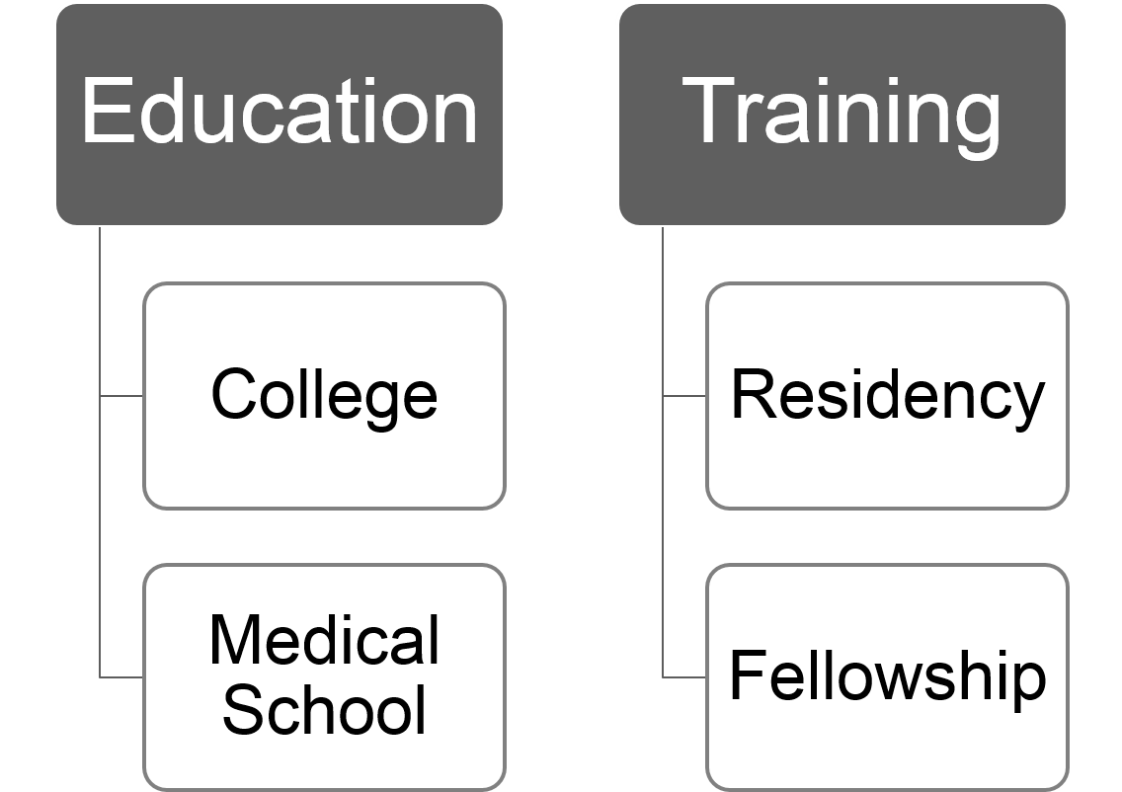
Physician
2.1 Figure: Hickman, 2010. Retrieved from Author. Used with Permission.
Notes:
Education for a physician typically includes four years of college and four years of medical school. The medical school can be either allopathic [al-uh-path-ik] (medical doctor) or osteopathic [os-tee-uh-path-ik] (doctor of osteopathy [os-tee-op-ath-ee]). After medical school, physicians typically pursue three to five years of training in a specialty. Fellowship training provides an additional one to three years of study to gain expertise in a subspecialty.

Slide 10
Physician Continued
Certification
  Completion of an approved residency or fellowship program
  Must have a valid state medical licenses to practice
  Must complete a written and/or practical exam in that specialty or subspecialty
  Maintenance of certification
State licensure
  Reciprocity among states
Notes:
Physician specialty certification requires successful completion of an approved residency or fellowship program, a valid license to practice medicine, and completion of a written and/or practical exam that varies by specialty and subspecialty.
Maintenance of certification is required in many specialties. It often includes specific continuing medical education requirements, quality improvement activities, patient surveys, and periodic specialty exams.
In addition to certification, physicians are required to maintain an active state license in order to practice medicine. Some states allow reciprocity [res-uh-pros-ih-tee], which honors a valid license between states; however, there are usually minimal additional requirements to apply for a license in another state.

Slide 11
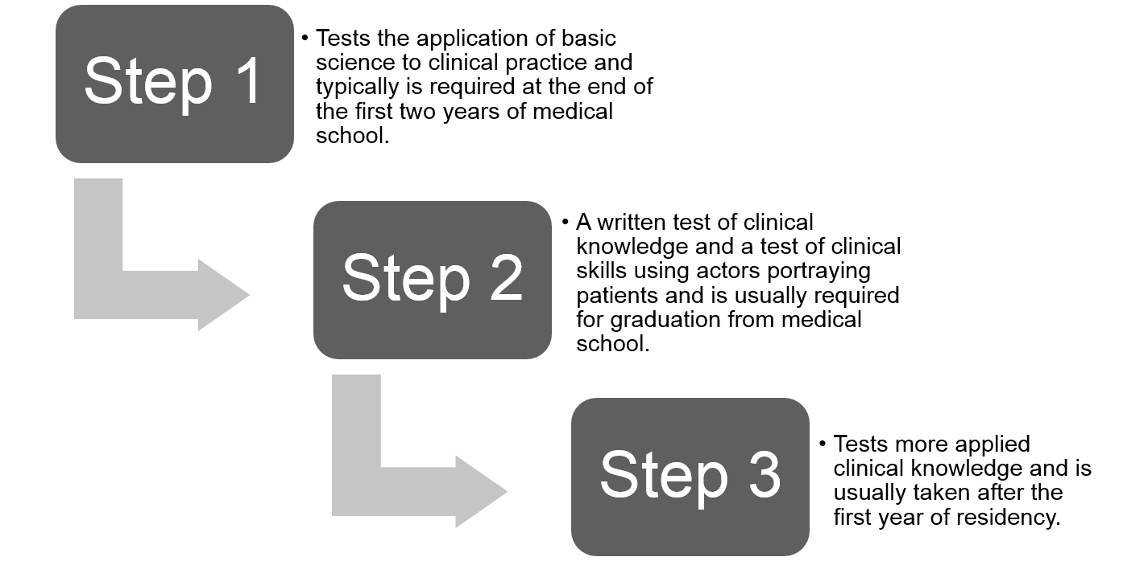
Steps of the USMLE
Travis Nimmo CC-BY
Notes:
Licensure is regulated by each state and requires successful completion of the United States Medical Licensing Examination or USMLE [U-S-M-L-E] (although exam requirements may vary from state to state).
The USMLE is a nationally administered exam with three steps. Step one tests the application of basic science to clinical practice and typically is required at the end of the first two years of medical school. Step two is divided into two parts—a written test of clinical knowledge and a test of clinical skills using actors portraying patients. This test is usually required for graduation from medical school. Step three tests more applied clinical knowledge and is usually taken after the first year of residency.

Slide 12
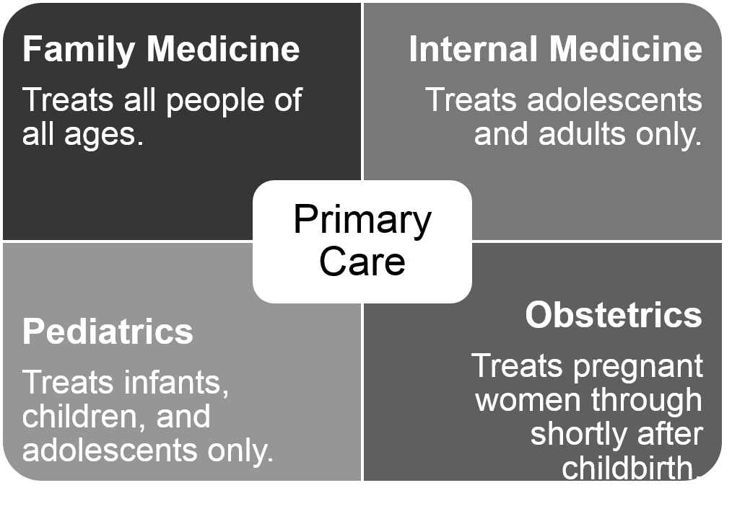
Primary Care Roles
Travis Nimmo CC-BY
Notes:
Primary care includes specialties that provide routine care to a patient on a continuous basis; it includes acute care, health maintenance, wellness, preventative care, and management of chronic disease not requiring a specialist. The primary care physician also serves as the gatekeeper and coordinator of additional care when needed by a subspecialist. Primary care specialties are
Family medicine, which provides care for the entire family, including infants, children, and adults. Some family medicine physicians also provide obstetrical care.
Internal medicine, which provides care to adolescents and adults.
Pediatrics, which provides care to infants, children and adolescents.
Obstetrics [uhb-stet-triks] and gynecology [gahy-ni-kol-uh-jee], or OB/GYN [O-B-G-Y-N], which provides services to women, including during pregnancy and childbirth. OB/GYN specializes in the female reproductive system, but because many women obtain primary care services from their obstetrician [ob-sti-trish-uhn] or gynecologist [gahy-ni-kol-uh-jist], it’s often considered a primary care specialty.
If a patient does not have a primary care physician, he or she may seek primary care in a hospital’s emergency facility, in a free-standing urgent care center, or from a specialist that the patient sees on a frequent basis. The decreasing number of primary care physicians in the workforce has exacerbated this practice.

Slide 13
Common Internal Medicine Specialties and Subspecialties
Cardiology
Endocrinology
Gastroenterology
Geriatric medicine
Hematology and oncology
Infectious disease
Nephrology
Pulmonary disease and critical care medicine
Rheumatology
Genomic specialists
Notes:
Subspecialties focus on a specific organ system, population, or disease, and they are very similar for both internal medicine and pediatrics. A sampling of the many subspecialties found in today’s health care field is shown below:
Cardiology focuses on cardiovascular disease, or diseases of the heart and blood vessels.
Endocrinology [en-doh-kruh-nol-uh-jee] focuses on organs that secrete hormones, which often control biological functions and other organs. Endocrinologists [en-doh-kruh-nol-uh-jists] treat diabetes and metabolism disorders, for example.
Gastroenterology [gas-troh-en-tuh-rol-uh-jee] treats diseases of the esophagus, stomach, and intestines.
Geriatric [jer-ee-at-trik] medicine provides care for patients who are 65 years or older.
Hematology-oncology [hee-muh-tol-uh-jee – ong-kol-uh-jee] focuses on diseases of the blood, such as anemia, and on cancer.
Infectious disease specialists provide treatment for diseases caused by viruses, bacteria, and other microorganisms.
Nephrology [nuh-frol-uh-jee] treats diseases of the kidneys and urinary tract.
Pulmonary disease and critical care medicine is a broad subspecialty with a focus on diseases of the respiratory system as well as on the needs of patients in critical care units.
Rheumatology [roo-muh-tol-uh-jee] focuses on the diseases of the joints, muscles, and ligaments.
Genomic specialists provide a diagnostic service and genetic counseling for individuals or families with, or at risk for, conditions that have a genetic basis, such as Down syndrome and cystic fibrosis.

Slide 14
Surgical Subspecialties
Cardiovascular surgery
Colon and rectal (colorectal) surgery
Neurosurgery
Orthopedic surgery
Otolaryngologic surgery
Pediatric surgery
Plastic surgery
Urologic surgery
Notes:
A general surgeon treats common surgical problems in a variety of anatomic [an-uh-tom-ick] locations. Many surgical subspecialists must first complete a residency in general surgery before pursuing a career as a specialty surgeon. This slide lists several examples of surgical subspecialties.
Cardiovascular surgery is performed on the heart and blood vessels.
Colon and rectal surgeons work with surgical problems in the lower intestinal tract.
Neurosurgery deals with surgical problems of the brain, spinal cord, and nervous system.
Orthopedic surgeons treat sports injuries and disease of the bones and joints.
Otolaryngology [oh-toh-lar-ing-gol-uh-jee] surgeons specialize in ear, nose, and throat disorders.
Pediatric surgery is surgery on infants, children, and adolescents.
Plastic surgery includes cosmetic and reconstructive surgery.
Urology [yoo-rol-uh-jee] surgeons specialize in the kidneys and urinary tract.

Slide 15
Other Specialties
Radiology
  Diagnostic
  Neuroradiology
  Interventional
  Pediatric
  Radiation oncology
  Nuclear radiology
Notes:
Radiology is the use of imaging techniques for diagnosis, for guiding procedures and biopsies, and for the use of radiation to treat diseases. A diagnostic radiologist is the most general radiologist who interprets regular x-rays, CT scans, and MRI scans and performs some diagnostic procedures. There are many radiology subspecialties.
Neuroradiologists focus on the brain and spinal cord.
Interventional radiologists perform procedures such as inserting catheters into blood vessel to use dyes to characterize the anatomy of blood vessels and the organs. They may use a variety of imaging modalities to guide the insertion of biopsy needles to collect tissues for diagnosis.
Pediatric radiologists interpret images of and perform invasive procedures on infants, children, and adolescents.
Radiation oncologists [ong-kol-uh-jists] use various types of radiation to treat diseases, especially cancer.
Nuclear radiologists use imaging techniques that measure uptake of radioactive-labeled substances typically injected into a vein.

Slide 16
Pathology
Blood banking/transfusion medicine
Cytopathology
Forensic pathology
Laboratory medicine
Pediatric pathology
Notes:
A general pathologist [pa-thol-uh-jist] conducts autopsies and uses a microscope to examine slides of tissues to look for abnormalities. There are several specialty areas within laboratory services, including the overall management of a medical laboratory.
Blood banking/transfusion medicine is a branch of pathology that supervises the collection of blood donations and identifies the complex number of blood types for compatibility between the donor and the potential recipient of a transfusion.
A cytopathologist [sahy-toh-pa-thol-uh-jist] examines slides, often of surgical samples, to look at abnormalities in cells, for example, to rule out or confirm a cancer diagnosis.
A forensic [fuh-ren-sik] pathologist, or medical examiner, looks for causes of death in patients who die suddenly or violently.
Laboratory medicine is the science of operating a medical laboratory that includes chemistry, hematology, and microbiology.
Pediatric pathologists specialize in the pathology [pa-thol-uh-jee] of infants, children, and adolescents.

Slide 17
Nonclinical Roles of Physicians
Administration
Teaching
Research
Public health
Publishing
Check out the video link for physician nonclinical roles: http://youtu.be/w4_FkP2ihx0
Notes:
There are a growing number of nonclinical roles for physicians in today’s health care industry. Some are full-time positions, and others may be part time, allowing the physician to continue working in the clinical setting.
Many physicians are involved in administration of hospitals, medical schools, clinics, and private practices.
Teaching can be a full-time or part-time job; the clinician-teacher role is one that is being more widely recognized and rewarded.
Research either in the laboratory or in clinical settings is another frequent role of physicians.
Public health, including environmental health, epidemiology [ep-i-dee-mee-ol-uh-jee], and health promotion/disease prevention, is another option for physicians.
With the large number of medical journals and medical books, physicians also assume the role of author and editor.
The URL on this slide leads to an informative video on nonclinical roles for physicians.

Slide 18
Nonclinical Roles for Physicians
Clinical or health informatics
  Focused on effective use of clinical systems in patient care delivery processes
  Certifications are available in informatics for clinicians
  Physicians with an informatics background can serve in a variety of roles
Notes:
Physicians have many opportunities in the clinical informatics field, which focuses on the effective use of clinical information systems in patient care delivery to drive improved patient care quality and safety. Qualified and experienced physicians are in high demand in this nonclinical area. Also, physicians may serve in an informatics position either part time while practicing medicine or full time. Certification is not required but typically is highly desired by the employer. Physicians may also serve in a variety of roles with consulting firms, software development firms, and governmental agencies. Examples of job titles for physician informatics positions include chief medical information officer (CMIO), vice president of informatics, chief health information officer, and vice president/medical director of analytics.
Qualified and experienced physicians are in high demand in this nonclinical area, which appears to be expanding as providers continue to implement clinical information systems.

Slide 19
Physicians in 2025
Physician demand will grow faster than supply
By 2025, physician demands are projected to exceed supply by a range of 46,000 to 90,000
  A shortfall of between 12,500 and 31,100 primary care physicians
  A shortfall of between 28,200 and 63,700 non–primary care physicians
Association of American Medical Colleges, n.d.
Notes:
In March 2015, IHS Incorporated, an economic modeling and forecasting firm, released a study, “The Complexities of Physician Supply and Demand: Projections from 2013 to 2025,” which was prepared for the Association of American Medical Colleges.
The findings showed that by 2025, the physician shortage is projected to range from 46,000 to 90,000 doctors. The study examined several scenarios likely to occur in the next decade—among them, increased use of advanced practice nurses, greater use of alternative settings such as retail clinics, and delayed physician retirement—and determined that the physician shortage will nonetheless persist.

Slide 20
Physicians in 2025 Continued
Solving the shortage requires a multipronged approach that involves
  Innovation in care delivery
  Effective use of technology
  Efficient use of all health professionals on the care team
Association of American Medical Colleges, n.d.
Notes:
Addressing the shortage of physicians will require a multi-pronged approach, including innovation in delivery, greater use of technology, and improved as well as efficient use of all health professionals on the care team. The study’s results confirm that it will require multiple solutions to overcome the physician shortage.

Slide 21
Health Professionals—The People in Health Care
Summary – Lecture a
Some useful health care terminology was explained
Education, training, certification, and licensure of physicians were described
Primary care roles of physicians were described
We examined some of specialty, subspecialty, and nonclinical roles of physicians
Notes:
This concludes Lecture a of Health Professionals—The People in Health Care. In summary, this lecture provides descriptions of terminology used in health care and in the education of health professionals. It also briefly describes the education, training, certification, and licensure of physicians. This unit provides an overview of primary care physicians and common specialties and subspecialties and outlines some of the nonclinical roles physicians may assume either full or part time.

Slide 22
Health Professionals—The People in Health Care
References – Lecture a
References
AAMC (Association of Medical Colleges). (n.d.). Physician supply and demand through 2025: Key findings. Retrieved from https://www.aamc.org/download/426260/data/physiciansupplyanddemandthrough2025keyfindings.pdf
Accreditation Council for Graduate Medical Education. (n.d.). Accreditation. Retrieved from http://www.acgme.org/What-We-Do/Accreditation
American Board of Medical Specialties. (n.d.). Board certification and maintenance of certification. Retrieved from http://www.abms.org/board-certification
American Medical Association. (n.d.). Becoming a physician. Retrieved from http://www.ama-assn.org/ama/pub/education-careers/becoming-physician.page
American Medical Association. (n.d.). Obtaining a medical license. Retrieved from http://www.ama-assn.org/ama/pub/education-careers/becoming-physician/medical-licensure.page
Andrews, J. (2013). Clinical informatics critical to reform. Retrieved from
http://www.healthcareitnews.com/news/clinical-informatics-underpins-reform
Anonymous. (2011). Life works: Explore health and medical science careers. NIH MedlinePlus, the Magazine. Summer. Retrieved from https://medlineplus.gov/magazine/issues/summer11/articles/summer11pg24-25.html
CAST. (2013). Nonclinical roles of physicians [video file]. Retrieved from http://youtu.be/w4_FkP2ihx0
Notes:
No audio.

Slide 23
Health Professionals—The People in Health Care
References – Lecture a Continued
Explore Health careers.org. (n.d.). Career explorer. Retrieved from http://explorehealthcareers.org/en/home
HRSA (Health Resources and Services Administration) Health Workforce. (n.d.). Health Workforce Data. Retrieved from https://bhw.hrsa.gov/health-workforce-analysis/research
MedlinePlus. (n.d.). Health occupations. Retrieved from https://medlineplus.gov/healthoccupations.html
MedlinePlus.(2011). Life works: Explore health and medical science careers. Retrieved from https://medlineplus.gov/magazine/issues/summer11/articles/summer11pg24-25.html
MedlinePlus. (n.d.). Medical dictionary. Retrieved from http://www.nlm.nih.gov/medlineplus/ mplusdictionary.html
National Association of Advisors for the Health Professions. (n.d.). Health professions links. Retrieved from http://www.naahp.org/PublicResources/HealthProfessionsLinks.aspx
U.S. News. (n.d.). Best health care jobs. Retrieved from http://money.usnews.com/careers/best-jobs/rankings/best-healthcare-jobs
Charts, Tables, Figures
2.1 Figure: Hickman, Tim, MD. University of Missouri, Kansas City (2010). Retrieved from author, used with permission.
Images
Slide 10: Steps of the USMLE. CC-BY by Travis Nimmo.
Slide 11: Primary Care Roles. CC-BY by Travis Nimmo.
Notes:
No audio.

Slide 24
The Culture of Health Care
Health Professionals—The People in Health Care
Lecture a
This material was developed by Oregon Health & Science University, funded by the Department of Health and Human Services, Office of the National Coordinator for Health Information Technology under Award Number IU24OC000015. This material was updated in 2016 by Bellevue College under Award Number 90WT0002.
Notes:
No audio.

