Slide 1
Notes:
No audio. Recording preparation.

Slide 2
The Culture of Health Care
An Overview of the Culture of Health Care
Lecture a
This material (Comp 2 Unit 1) was developed by Oregon Health & Science University, funded by the Department of Health and Human Services, Office of the National Coordinator for Health Information Technology under Award Number IU24OC000015. This material was updated in 2016 by Bellevue College under Award Number 90WT0002.
This work is licensed under the Creative Commons Attribution-NonCommercial-ShareAlike 4.0 International License. To view a copy of this license, visit http://creativecommons.org/licenses/by-nc-sa/4.0/.
Notes:
Welcome to The Culture of Health Care: An Overview of the Culture of Health Care. This is Lecture a.
The component, The Culture of Health Care, [quote]“addresses job expectations in health care settings. It discusses how care is organized within a practice setting, privacy laws, and professional and ethical issues encountered in the workplace.”[end quote]

Slide 3
An Overview of the Culture of Health Care
Learning Objectives
Distinguish between disease and illness (Lecture a)
Discuss the relationship between health and the health care system (Lecture a, b)
Define culture in the classic sense, as well as in the modern sense of the term, and what it means for culture to be partial, plural, and relative (Lecture a, b)
Explain the concept of cultural competence (Lecture a)
Compare the concepts of culture, cultural safety, and safety culture in the context of a health care organization (Lecture a)
Describe the impact of multiple cultures in health care delivery interactions (Lecture a, b)
Define acculturation and how it relates to working in health care (Lecture a)
Discuss the role of culture in health informatics (Lecture a, b)
Ebright, 2014
Notes:
The Objectives for An Overview of the Culture of Health Care are:
Discuss the relationship between health and the health care system.
Define culture in the classic sense, as well as in the modern sense of the term, and what it means for culture to be partial, plural, and relative.
Explain the concept of cultural competence.
Compare the concepts of culture, cultural safety, and safety culture in the context of a health care organization.
Describe the impact of multiple cultures in health care delivery interactions.
Define acculturation in the context of a health care organization
Discuss the role of culture in health informatics.

Slide 4
Culture of Health Care
This lecture: What is meant by the word culture when we talk about health care and health care professionals?
Next lecture: Why is this important? What can we learn from it?
Notes:
Welcome to the first of two lectures which serve as an introduction to the culture of health care and health care professionals. This is meant as the first of a multi-unit set of curriculum materials on the culture of health care covering the people who work in health care, the settings in which health care is delivered, the practices and processes of health care delivery, some of the professional values, beliefs, and ethics which drive that behavior, and how health information technologies interact with health care professionals in their work. In this first lecture we’ll discuss what’s meant by the word “culture” when we talk about health care and health care professionals. In a second lecture, we’ll discuss why this is important and how we can learn more about it.

Slide 5
Defining Terms: Health
The World Health Organization (WHO) adopted a definition of health that has not been amended since 1948: “Health is a state of complete physical, mental and social well-being and not merely the absence of disease or infirmity.”
Harris, Puskarz, & Golab, 2016
Notes:
We talk a lot about health care, health care professionals, health information technology, but what do we mean by these terms?
To begin to understand these terms, we need to begin with the term “health.” Although health is often thought of as the absence of disease, the World Health Organization’s definition suggests that health is determined by factors that include, but go beyond, the body’s physical state.
The WHO [W-H-O] is an agency of the United Nations (UN) that’s concerned with international public health. It was established on April 7, 1948, with headquarters in Geneva, Switzerland, and is a member of the United Nations Development Group. Its predecessor, the Health Organization, was an agency of the League of Nations.

Slide 6
Defining Terms: Health Continued
Other definitions correlate health and personal satisfaction in determining Health (Marandi, 2008)
WHO also identified the main determinants of health (2011)
  social and economic environment,
  physical environment,
  person's individual characteristics and behaviors
Notes:
Additional definitions of health may include other factors such as health status and personal satisfaction. According to the World Health Organization, the main determinants of health include the social and economic environment, the physical environment, and the person's individual characteristics and behaviors. Now let’s examine the term “disease,” which can be described as the opposite of “health.”

Slide 7
Defining Terms: Disease and Illness
Disease: malfunction or maladaptation of biologic or physiologic processes.
Acute Illness: temporary interruption of health
  Goal: restore complete health
  examples: common cold, simple fracture
Chronic illness: stable disability or symptoms
  Goals: minimize symptoms, maximize function
  examples: diabetes, asthma, back pain
Notes:
Disease and illness are not the same. Arthur Kleinman [kline-mihn], in an often cited 1978 article, emphasized the distinction between disease and illness. According to Kleinman [kline-mihn], when we talk about “disease”, we’re referring to malfunction or maladaptation of biologic or physiologic processes. This is the traditional focus of physicians when they diagnose and treat disease. But Kleinman [kline-mihn] emphasizes the importance of “illness” by referring to the individual experience of the person who's suffering personal, interpersonal, and cultural reactions to disease or discomfort. While disease is determined mainly by biologic and physiologic processes, illness is shaped by cultural factors that govern perception, labeling, explanation, and valuation of the experience.
It’s also important to understand the difference in health care between acute illness and chronic illness. With an acute illness most of us expect that our symptoms will be short-lived and that eventually we will be restored to our previous “normal” health. Examples are things like a common cold, a mild infection, or a simple fracture. On the other hand, with chronic conditions such as high blood pressure or diabetes, we expect the condition will last indefinitely. In these situations, the goal cannot be to restore “normal” health. Rather, the goal of patient and clinician alike is to maintain the highest level of function and the lowest degree of symptoms that can be obtained. Problems can arise when we confuse these, for example when a person with a chronic illness thinks of it as an acute illness and expects to be cured and restored back to their normal state. Part of the management process in these situations is to help a person change their thinking and revise their expectations. For many people with chronic conditions such as diabetes, high blood pressure or asthma, health means that things are pretty stable, symptoms are not too troublesome, and the person is able to get on with their life and function normally, even if this requires medication.

Slide 8
Defining Terms: Health Care
Health: is a product of broad social and environmental factors, not just health care
  Food, sanitation, housing, lifestyle
Health care: actions principally and explicitly directed at maintaining, restoring health and promoting health
  Actions by patient, family, etc. (70-90%)
  Actions by health care system
Health care system: collection of structures and actions directed at delivering health care
Notes:
Now that we understand a little more about health, disease, and illness, we can think about what we mean by health care. When we look at health in the broadest sense, it’s not just the result of health care or a health care system, it’s the product of broader cultural and social factors.
For example, think of the effects of food, sanitation, and housing, and how these have impacted our life expectancy and quality of life in the last century or so.
Furthermore, if we think of health care as actions that are principally and explicitly directed at maintaining or restoring health, then it’s still true that most health care happens outside of the health care system with actions taken by the patient, by family members, or by caregivers constituting between 70% and 90% of the health care that people receive. Thus, most illness episodes never enter the domain of professional care. For health informatics professionals, one implication of this is that health information technologies need to reach beyond the conventional health care system and health professionals to patients and families if they are to reach their full potential.
Finally, we can think of the health care system as a collection of structures and actions directed at delivering health care services to the patient regardless of their location. The location can be in a health care provider setting such as a hospital, clinic or physician’s office, as well as the patient’s home.
Finally, we can think of the healthcare system as a collection of structures and actions directed at delivering healthcare services to the patient regardless of their location. The location can be in a healthcare provider setting such as a hospital, clinic or physician’s office as well as the patient’s home.

Slide 9
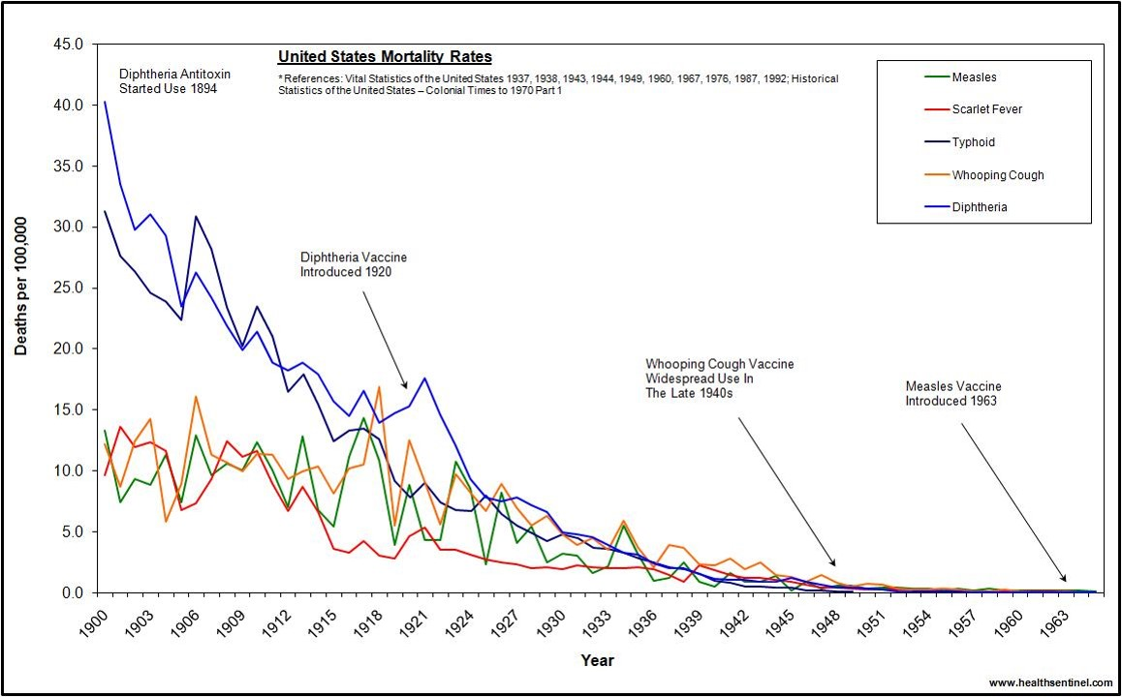
Infectious Disease Deaths Controlled With Broad Social Improvements: Food, Housing, Sanitation
1.1 Chart: Health Sentinel, n.d. Used with Permission.
Notes:
This slide illustrates what we've been talking about. The chart shows the United States mortality data for the period between 1900 and 1963 for diseases including measles, scarlet fever, typhoid, whooping cough, and diphtheria. In modern times, all of these are illnesses for which we have specific vaccines or medications to prevent or treat them. However, if you look at the graph, most of the improvement in mortality for these diseases happened before our modern treatments were available.
Consider typhoid fever. It appears as a very dark blue line in the chart. Today we treat this disease with antibiotics and can prevent it with an oral vaccine, but antibiotics only became available in the mid-20th century and as you can see from the chart, typhoid fever mortality declined about tenfold before antibiotics were ever available. The improvements were mainly due to improvements in sanitation, water supply, and housing. Even today, most of the deaths in persons who get treated are in those who are malnourished or otherwise in a weakened state. Similarly, mortality from measles fell substantially before the measles vaccine became available in the 1960s; mortality from scarlet fever also fell dramatically before antibiotics became available in midcentury.
The point here is that broad social and cultural factors, such as improved sanitation, improved nutrition, and reduced overcrowding, were the major contributors to reducing mortality due to these serious infectious diseases. Modern treatments delivered through the health care system have continued to improve things. Most of what we call “health”, in terms of longer life expectancy and better quality of life, is the result of other factors.

Slide 10
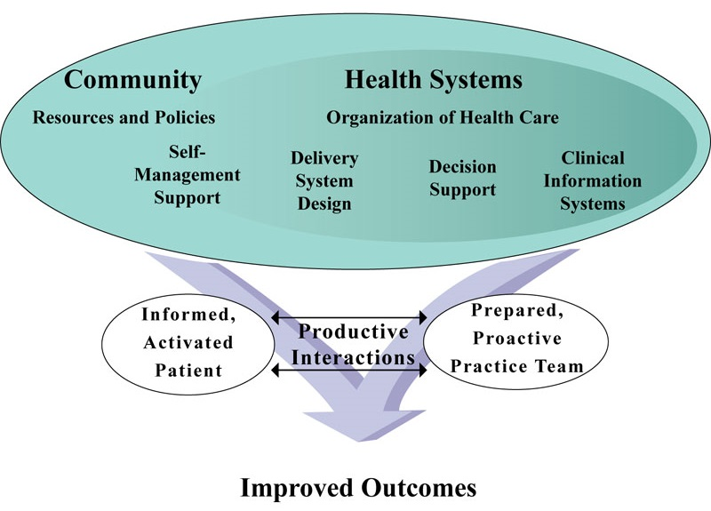
Chronic Care Model Coordinates Community Resources with Health System to Enable Interaction Between Team and Patient
1.2 Figure: Wagner, 1998. Used with Permission.
Notes:
This graphic makes a somewhat similar point about the care of chronic conditions. There is no question that the care of chronic conditions depends on the existence of modern health care technologies: insulin and other medications for diabetes, antihypertensive [an-tee-hy-per-ten-siv] medications for blood pressure, surgical or other interventions for hardening of the arteries. However, our contemporary understanding of how people with chronic conditions can achieve the best social and clinical outcomes is based on some variant of the chronic care model articulated by Wagner in 1998. In this model, the existence of treatments is important, but to take best advantage of them requires coordinated action that incorporates community-based resources and policies, organized and accessible health care services, support for individual self-management, information systems, and decision support to assist clinicians and patients. All of these factors working together are needed to produce productive interactions between an informed and active patient in a prepared and proactive practice team. You can see that this chronic care model requires much more than a simple prescription or treatment based on an individual clinician-patient interaction. The graphic reminds us that health is not solely the product of the health care system but the result of broader community and social factors brought to bear on individual conditions
Recent chronic care delivery models continue to expand the intersection point of the traditional hospital based health care system with broader community participants who provide medical and health services benefiting both the individual patient and the community population. Health information technology is necessary to support the success of the chronic care delivery model and facilitate effective patient care activities ---- for both long term disease management and short term episodic treatment.

Slide 11
Defining Terms: Culture
“Culture refers to integrated patterns of human behavior that include the language, thoughts, communications, actions, customs, beliefs, values, and institutions of racial, ethnic, religious, or social groups.” (U.S. HHS Office of Minority Health, 2005)
“A collective expression for all behavior patterns acquired and socially transmitted through symbols. Culture includes customs, traditions, and language.” (National Library of Medicine MeSH, 2011)
Notes:
Finally we need to identify a definition of “culture.” We’ll refine our thinking about the concept of culture in a subsequent lecture, but for now we can use the definition provided by the Office of Minority Health in the Department of Health and Human Services. According to their definition, [quote]“culture refers to integrated patterns of human behavior that include the language, thought, communications, actions, customs, beliefs, values, and institutions of racial, ethnic, religious, or social groups.” [end quote] This is considered the conventional and historic definition that, until recently, most people have worked with.
Another useful definition is this one from the Medical Subject Headings index of the National Library of Medicine. According to this definition, “culture” is [quote]“a collective expression for all behavior patterns acquired and socially transmitted through symbols. Culture includes customs, traditions, and language.”[end quote] Both these definitions help us think about what we must pay attention to if we are to study and understand “health care culture.”

Slide 12
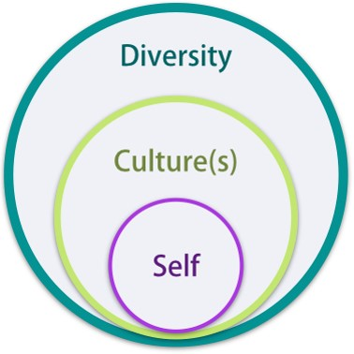
Culture and Diversity
CC-BY by CAST
Notes:
Culture can be defined as a pattern of learned beliefs and behaviors that are shared by individuals of a group. Culture can affect styles of communication, interpersonal relationships, and customs. Some examples of cultural groups include those based on race or ethnicity, gender, and nationality. Cultural differences arise from people’s identification with various groups.
While culture refers to the beliefs and customs of a single group or society, diversity refers to differences on a broader scale. Diversity encompasses a wide range of differences beyond cultural and ethnic, such as differences in gender, age, education, religion, sexual orientation, and any other unique quality by which humans tend to categorize each other. From an organizational standpoint, an institution that employs males and females of different races and from different cultures may be said to be diverse.

Slide 13
Defining Terms: Culture of
Health Care
Patterns of human behavior that include the language, thoughts, communications, actions, customs, beliefs, values, and institutions of the health care system. (U.S. HHS Office of Minority Health, 2005)
Behavior patterns in the health care system acquired and socially transmitted, including customs, traditions, and language. (National Library of Medicine MeSH, 2011)
Notes:
If we adapt those definitions to the health care system, we come up with these definitions of “the culture of health care.”
Using the Department of Health and Human Services definition, it would be [quote]“patterns of human behavior that include the language, thoughts, communications, actions, customs, beliefs, values, and institutions of the health care system.” [end quote]
Using the National Library of Medicine definition, it would be [quote]“behavior patterns in the health care system which are acquired and socially transmitted, including customs, traditions and language.” [end quote]
So this includes not only the customs, traditions, and language of doctors, nurses, and therapists, but those of patients and families, and the other individuals who work within the many settings of our health care system.

Slide 14
Culture of Health Care
Main Themes in Current Literature
Patient diversity: caring for people from diverse backgrounds: national, ethnic, racial, religious
Workplace diversity: working with people from diverse backgrounds: national, ethnic, religious
Organizations and culture: safety culture, organizational culture, measuring culture
Health professional culture: nurses and physicians, medical and surgical, traditional and alternative
Notes:
A brief survey of what’s retrieved when searching Google, Google Scholar, and the National Library of Medicine's MEDLINE database using the search terms “culture of health care” returns four basic themes.
First is the culture of patients. There is a great deal of discussion about the cultural diversity of patients cared for in the health care system, and the need to consider each patient’s ethnic, national, racial, and religious backgrounds when providing their health care.
Second is the culture of the health care workforce. There is discussion of workplace diversity and the need to collaborate effectively with others of diverse national, ethnic, and religious backgrounds.
Third is the culture of organizations, including discussion of safety culture, organizational culture, a culture of innovation, measuring culture, and the like.
Fourth is the culture of professions, including the professional culture of nurses, physicians, surgeons, traditional and alternative healers, and other health care providers.

Slide 15
Culture of Patients
Impact of patient’s culture: inequities in care
Language, Concepts, Models of Illness
Cultural competence, culturally sensitive care
Specific cultures and our health care system
  Geographic: SE Asian
  Religious: Christian Science, Islam
  Language: Spanish, Telugu
  Ethnic: Romani, Turkic, Ukrainian
Special groups: deaf culture, street culture, adolescent culture
Notes:
When we talk about the culture of patients, most of the contemporary literature discusses either problems with the inequities in health care received by persons of specific cultures, or the need to understand and adjust to the beliefs and values of specific cultures whose members encounter the health care system.
Inequities in health care are the result not only of social economic factors which make health care less accessible, but also the result of differences in language and the concepts and models of illness. Individuals dealing with our health care system who come from another culture and speak another language have a potential problem of understanding that reaches deeper than just language. In many cases, their concepts of illness and the cause of diseases are fundamentally different, so the translation of language alone is not sufficient. These differences can mean that clinicians may not understand the patient and the patient may not understand the clinician, with the result that the appropriateness or effectiveness of care may be threatened.
Much is being written about cultural competence and the need for culturally sensitive care. Large organizations such as health care systems must train their workforce in order to deliver appropriate and culturally sensitive care to all who present themselves. Modern urban hospitals amid the great cultural diversity of cities are not the only institutions that must address these issues. Many small or critical access hospitals and small clinics in rural areas are also likely to encounter significant cultural diversity in their patient and workforce populations, although the resources available to address these may be fewer.
There are many categories of these differences and cultural variations that can lead to problems with effective communication and appropriate care. Some are based on geography, such as Southeast Asian; some are based on religious differences such as Christian Science or Islam; others are based on differences of language such as spoken Spanish (including geographic variations in Spanish), or Telugu [tel-uh-goo]; or ethnic or cultural differences such as the Romany [rawm-uh-nee] (or Gypsy) Turkic, or Ukrainian people; and there are also other special groups whose beliefs and values must be considered, such as deaf culture, street culture, adolescent culture, and the like.

Slide 16
Cultural Competence
Awareness and respect for cultural differences
Approach every person as an individual
Examples
  Traditional beliefs re: transfusion, vaccines
Application to HIT workforce
  Assumptions built into HIT including new technology drivers and development
  Stereotypes about HIT interest or proficiency of health professionals.
Notes:
Each of the groups that we’ve mentioned may have specific beliefs, values, or practices that must be understood when encountered in our health care system if we are to deliver effective health care. We refer to this as “cultural competence,” or an awareness of and respect for cultural differences. It’s especially important in this regard to avoid cultural stereotypes that may or may not apply to a given individual, and not to assume that because a person belongs to a particular cultural group, that they uniformly share and adhere to some stereotype about that group’s beliefs. Some specific issues that need to be considered include things like traditional beliefs about transfusions or vaccines.
The bottom line is each person has to be approached as an individual - there is no cookie-cutter approach.
We can adopt this same notion of cultural competence in our dealings with other groups in the health care system. When we think about the health care workforce, it’s easy to bring with us stereotypes about different health professionals and their behaviors.

Slide 17
Culture of Health Care Workforce
Cultural diversity in workgroups, e.g. within a nursing unit
Physician gender, race, ethnicity
Impact or role of health professional culture on patient care
Just culture
Notes:
A second theme found in surveying health care deals with the culture of the health care workforce. This includes issues such as cultural diversity of work groups including nursing, issues relating to the culture of physicians, especially gender, race, and ethnicity and the impact of the culture of these health professionals on patient care. In this brief lecture, there is not time to discuss all of these issues, though many of them may become apparent or important as your study of the culture of health care continues in other units.
One area that’s receiving increasing attention with the current emphasis on medical errors and patient safety is the concept of just culture.

Slide 18
Just Culture
  Blame Culture
Organizational rigidity
Emphasis on compliance with existing practices
Fear of punishment
Risk avoidance
Distrust
Silence as the predominant response to error, near misses
    Just Culture
Members believe they can question existing practices, etc.
Management openness to worker input
Overall commitment to quality
Uninhibited reporting of problems
Extensive information sharing about problems
Organizational response to problem, e.g. staff training, etc.
Notes:
This concept of just culture is more easily understood when contrasted with the blame culture that sometimes exists in organizations and that can interfere with organizational learning and improvement. What we refer to as the blame culture is characterized by a high degree of organizational rigidity and an emphasis on strict compliance with existing practices. The result for members of such organizations is fear of punishment, a tendency to avoid risk, and distrust. The predominant response to an error or near miss becomes silence, because workers are afraid to come forward.
Contrast this with the just culture, which is characterized by an organizational learning culture, by an environment in which members believe it’s okay to question existing practices and where management expresses openness to worker input. Such environments have an overall commitment to quality. Ideally this culture will lead to uninhibited reporting of problems, extensive information sharing about problems, and organizational response that follows up with remediation directed not at removing offending individuals, but on improving processes or execution through staff training and the like.
In health care, a just culture means that health care workers believe they are safe to report problems and question practices, and that they are invested in quality improvement.

Slide 19
Organizational Culture
Desirable properties in organizations
  Culture of innovation
  Culture of health (employee wellness)
  Culture of privacy
  Culture of cost effective care
Safety culture
  Organizational correlates of safety
Measurement of culture
Culture change
Notes:
A third common theme in the literature on culture and health care is concerned with the culture of organizations. Much is being written about desirable properties in organizations, such as a culture of innovation or a culture of health, as in employee wellness. In health care settings, organizational culture is often concerned with maintaining a culture of privacy with regard to patient health information, a culture of cost-effectiveness, and a culture of safety. This interest in organizational culture has led to a great deal of research on understanding and measuring culture in particular, measuring for the presence of a safety culture and understanding the process of culture change, which is obviously relevant to the introduction of major disruptive changes such as new health information technology.

Slide 20
Features of Safety Culture
Defined at the group level or higher, which “refers to the shared values among all the group or organization members.”
Concerned with formal safety issues in an organization, and “closely related to, but not restricted to, the management and supervisory systems.”
Emphasizes the contribution from everyone at every level of an organization.
Has an impact on its members’ behavior at work.
Reflected in the contingency between reward systems and safety performance.
Reflected in an organization’s willingness to develop and learn from errors, incidents, and accidents.
Relatively enduring, stable, and resistant to change.
Reese, 2016
Notes:
Safety culture has received a great deal of attention, as it relates so strongly to not only workforce safety (such as fewer needle sticks and other on-the-job injuries), but also because it’s so important for patient safety. This slide lists some features of a safety culture in an organization. First, safety culture is a concept defined at the group level, referring to shared values among all members of the group. Second, safety culture is concerned with formal safety issues in the organization, including its management and supervisory systems. Third, safety culture emphasizes the contribution from everyone at every level of the organization. And fourth, safety culture has an impact on members' behavior at work, and is usually reflected in a relationship between reward systems and safety performance. Safety culture, as we discussed in a previous slide, is reflected in an organization's willingness to develop and learn from errors, incidents, and accidents. Finally safety culture, when present, should be relatively enduring, stable, and resistant to change.

Slide 21
What Works?
A Climate of Safety
Many elements, working together:
Management commitment
Safety practices and behaviors
Safety knowledge and training
Safety communication
Safety equipment and supplies
Notes:
In health care, evidence suggests that a climate of safety exists when many elements are working together including management commitment to safety; explicit safety practices and behaviors in the organization; safety knowledge and training programs among the membership; safety communication; and safety equipment and supplies. These factors are indicators that the climate of safety exists, and when working together, can improve patient safety.

Slide 22
Health Professional Culture
Western biomedicine compared to alternatives
  Allopathic medicine, osteopathic medicine
  Complementary and alternative medicine
    Chinese medicine and acupuncture traditions
    Naturopathic and homeopathic
Nursing culture, physician culture
  Nursing as a holistic, caring profession
  Physicians as disease focused, benign paternalism, autonomy,
Provider setting
  Hospitals: surgery, medicine, ICU, OR, ER cultures
  Other: Physician offices, clinics, home health, long-term care
Notes:
The fourth major theme in literature on the culture of health care is the culture of health professions or the beliefs, values, and practices of the professions themselves. Much of the literature discusses comparisons of western biomedicine or allopathic medicine to other traditions such as osteopathic medicine, as well as to complementary and alternative medicines such as traditional Chinese medicine and acupuncture, and naturopathic or homeopathic practice. These health care practice traditions differ not only in the treatments and interventions they provide, but in the underlying belief systems about the causes and consequences of illness on which those treatments are based. Also prominent in the literature on health care culture are discussions of the cultures which are specific to individual professions such as nursing culture or physician culture. Nursing may be characterized, for example, as a holistic and caring profession. Physicians may be characterized as being focused on diseases, expressing a benign paternalism, and placing great importance on autonomy. Closer examination reveals that the culture of health professionals is often more fine-grained than that, with differences found within provider settings. There are cultural differences within a hospital setting such as with a surgical unit compared to a medical unit, or differences among the distinct cultures of critical care units, operating rooms, and emergency rooms. The culture found in a hospital setting is different from the culture found in other provider settings such as physician office practices, outpatient clinics, home health providers, or even long term care. The closer we look at the “culture of health care” the more cultures we find.

Slide 23
An Overview of the Culture of Health Care
Summary – Lecture a
Culture has many meanings that are relevant to health care and health IT
Health care takes place in a complex mix of cultures: professional, organizational, etc.
Culture is not apparent from within–taken for granted
We work more effectively when we are aware of the differences–cultural competence applied to health IT as well as to management and patients
One job of informatics professionals is to bridge these cultures and translate across boundaries
Notes:
This concludes Lecture a of The Culture of Health Care: An Overview of the Culture of Health Care. In summary, the main points of this lecture are:
Culture, as it’s used in relation to health care, has many meanings that are relevant to health care and health information technology.
Health care takes place in a complex mix of cultures including professional and organizational.
Culture is not apparent from within as it’s taken for granted by its members, though differences may be obvious to outsiders and we can work more effectively when we are made aware of these differences.
And finally, cultural competence can be applied not only to the interaction of health professionals with their patients, but also to the interactions between IT professionals and the health care system.
It becomes evident that one job of biomedical informatics professionals is to bridge these cultures and translate across the boundaries. We can do this by learning more about the health care culture, which is the subject of the second lecture in this introduction to health care culture.

Slide 24
An Overview of the Culture of Health Care
References – Lecture a
References
Bateson, M. C. (1989, November). Health as artifact. Journal of Professional Nursing 5(6), 322–325.
Ebright, P. (2014). Culture of safety part one: Moving beyond blame [tutorial]. University of California, Multimedia Educational Resource for Learning and Online Teaching (MERLOT). Retrieved from https://www.merlot.org/merlot/viewMaterial.htm;jsessionid=466422CC99BC642BA2BE3A6494541093?id=357170
Harris, D., Puskarz, K., & Golab, C. (2016). Population Health: Curriculum Framework for an Emerging Discipline. Population Health Management 19(1), 39–45.
Kleinman, A., Eisenberg, L., & Good, B. (1978). Culture, illness, and care—Clinical lessons from anthropologic and cross-cultural research. Annals of Internal Medicine 88(2), 251–258.
National Center for Biotechnology Information, U.S. National Library of Medicine. (2011). MeSH Descriptor Data: Culture. Retrieved from http://www.ncbi.nlm.nih.gov/mesh/68003469
Reese, C. (2015). Occupational health and safety management: A practical approach. Boca Raton, FL: CRC Press.
Taylor, S., & Marandi, A. (2008). Social determinants of health and the design of health programmes for the poor. British Medical Journal (Clinical Research Ed.) 337 (7664), 266–269.
U.S. Department of Health & Human Services. (2005). What is cultural competency? Retrieved from http://www.cdc.gov/nchhstp/socialdeterminants/docs/what_is_cultural_competency.pdf
Wagner, E. H. (1998). Chronic disease management: What will it take to improve care for chronic illness? Effective Clinical Practice 1(1), 2–4.
WHO (World Health Organization). (2011). The determinants of health. Geneva, Switzerland: WHO.
Notes:
No audio.

Slide 25
An Overview of the Culture of Health Care
References – Lecture a Continued
Charts, Tables, Figures
1.1 Chart: United States Disease Death Rates (n.d.) Retrieved January 10, 2017 from Health Sentinel website:http://www.healthsentinel.com. Chart retrieved from http://www.healthsentinel.com/joomla/index.php?option=com_content&view=article&id=2654:united-states-disease-death-rates&catid=55:united-states-deaths-from-diseases&Itemid=55. Used with permission.
1.2 Figure: Wagner, E. H. (1998). Chronic disease management: What will it take to improve care for chronic illness? Retrieved from http://ecp.acponline.org/augsep98/cdm.pdf. Used with permission.
Images
  Slide 11: Culture and Diversity. Graphic created by CAST. CC-BY by CAST.
Notes:
No audio.

Slide 26
The Culture of Health Care
An Overview of the Culture of Health Care
Lecture a
This material was developed by Oregon Health & Science University, funded by the Department of Health and Human Services, Office of the National Coordinator for Health Information Technology under Award Number IU24OC000015. This material was updated in 2016 by Bellevue College under Award Number 90WT0002.
Notes:
No audio.

