Slide 1
Introduction to Health Care and Public Health in the U.S.
Public Health, Part 1
Lecture b
This material (Comp 1 Unit 7) was developed by Oregon Health & Science University, funded by the Department of Health and Human Services, Office of the National Coordinator for Health Information Technology under Award Number 90WT0001.
This work is licensed under the Creative Commons Attribution-NonCommercial-ShareAlike 4.0 International License. To view a copy of this license, visit
http://creativecommons.org/licenses/by-nc-sa/4.0/.
Notes:
Welcome to Introduction to Health Care and Public Health in the U.S.: Public Health, Part 1. This is Lecture b.
This component, Introduction to Health Care and Public Health in the U.S., is a survey of how health care and public health are organized and how services are delivered in the U.S.

Slide 2
Public Health, Part 1
Learning Objectives - 1
Discern the main differences and similarities between public and private health (Lecture a)
Delineate the historic timeline and achievements of public health in the U.S. (Lecture a)
Define and discuss key terminology of public health (Lecture b)
Notes:
The Objectives for Public Health, Part 1, are to:
Discern the main differences and similarities between public and private health
Delineate the historic timeline and achievements of public health in the U.S.
Define and discuss key terminology of public health

Slide 3
Public Health, Part 1
Learning Objectives - 2
Illustrate the general organization of public health agencies and public health data flow (Lecture b)
Evaluate and explain the impact and value of public health (Lecture c)
Notes:
Illustrate the general organization of public health agencies and public health data flow
Evaluate and explain the impact and value of public health

Slide 4
Selected Public Health Terminology - 1
Endemic – Disease native to an area or population
Epidemic – Disease affecting numerous people at the same time
Epidemiology – Study of incidence, distribution, and control of disease in a population
Notes:
This lecture discusses Public Health terminology and organization.
This slide shows a selection of key terminology for public health, including definitions.
Endemic – disease native to an area or population.
Epidemic – disease affecting numerous people at the same time.
Epidemiology – study of incidence, distribution, and control of disease in a population.

Slide 5
Selected Public Health Terminology - 2
Incidence – The number of new events/cases in a population. Requires a specified time period and a defined population.
Intervention – In public health, refers to an action/program that is meant to benefit the health of a population. Examples might include legislation, education, or service delivery.
Notes:
Incidence – the number of new events or cases in a population. Requires a specified time period and a defined population.
Intervention – in public health, refers to an action or program that is meant to benefit the health of a population. Examples might include legislation, education, or service delivery.

Slide 6
Selected Public Health Terminology - 3
Morbidity – Proportion of disease/illness in a population; relative incidence of a disease
Mortality – Number, frequency, or proportion of deaths in a population
Outbreak – Sudden rapid development of a disease in a population
Notes:
Morbidity – proportion of disease or illness in a population; relative incidence of a disease.
Mortality – number, frequency, or proportion of deaths in a population.
Outbreak – sudden rapid development of a disease in a population.

Slide 7
Selected Public Health Terminology - 4
Pandemic – An extensive epidemic, affecting a very large region such as a country, continent, or the world
Prevalence – Proportion of a population with a specified condition/illness. Requires a specified time period or point in time.
Notes:
Pandemic – an extensive epidemic, affecting a very large region such as a country, continent, or the world.
Prevalence – proportion of a population with a specified condition or illness. Requires a specified time period or point in time.

Slide 8
Selected Public Health Terminology - 5
Relative risk
  Risk of an outcome in those exposed to a disease versus those not exposed
  The calculated odds ratio resulting from a study
Risk – Odds of an event occurring; as in, a one in one hundred chance, or risk, of dying
Notes:
Relative risk - risk of an outcome in those exposed to a disease versus those not exposed and the calculated odds ratio resulting from a study.
And finally, risk – odds of an event occurring; as in, a one in one hundred chance, or risk, of dying.

Slide 9
Public Health Perceptions
Often restricted to highly visible aspects
  Communicable disease programs
  Bioterrorism surveillance
Communicable disease surveillance is only a very small portion of the public health funding.
Notes:
While certain aspects of public health, such as communicable disease outbreaks and bioterrorism surveillance, tend to attract more media attention, this attention does not always represent the actual investment of public funding and efforts.

Slide 10
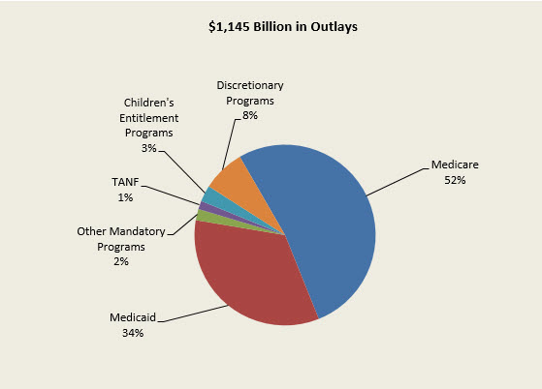
Public Health Expenditures
7.1 Chart: President’s FY 2017 Budget for HHS
Notes:
For example, as shown in the president’s budget chart for 2017 for the Department of Health and Human Services, Medicare and Medicaid actually consume the majority of budget expenditures. The Affordable Care Act provided insurance to an additional 18 million Americans through the expansion of Medicaid.

Slide 11
Core Areas of Public Health
Behavioral Science/Health Education
Biostatistics
Emergency Medical Services
Environmental Health
Epidemiology
Health Services Admin/Management
International/Global Health
Maternal and Child Health
Nutrition
Public Health Laboratories
Notes:
Some core areas of public health are:
Behavioral Science and Health Education
Biostatistics
Emergency Medical Services
Environmental Health
Epidemiology
Health Services Administration and Management
International and Global Health
Maternal and Child Health
Nutrition
Public Health Laboratories
This categorization emphasizes the public health focus on education and behavior modification, policy, monitoring and surveillance, and research. Also notable is the inclusion of public health laboratories, a vital link in the public health system.

Slide 12
Organization of Public
Health in the U.S.
Three general levels of public health:
local, state, federal
  Local health departments
  State health departments
  CDC and other federal agencies
Most states are associated with a network of local or county health departments.
Notes:
In general, there are three levels of public health in the U.S.: Local, state, and federal.
Local health departments may exist at the county level, or in some cases may represent more than one county. State health departments usually, but not always, are associated with a network of local health departments. The federal level is represented by the Centers for Disease Control and Prevention, or CDC, as well as other federal agencies.

Slide 13
Public Health Roles - 1
Public Health is multi-disciplinary, improving population health through many roles
Notes:
Public health assumes many roles in improving population health.

Slide 14
Public Health Roles - 2
Education – Promotion of healthy lifestyles
Policy – Advocating for legislative funding
Monitoring and surveillance – Tracking occurrences of communicable diseases or elevated blood lead levels
  Regulation – Mandating state reportable conditions for laboratories, health care providers, veterinarians
Notes:
Public health organizations promote healthy lifestyles through providing education. They advocate for legislative funding to enact policies in the interest of public health. They carry out monitoring and surveillance of numerous health threats; some examples include communicable diseases or elevated blood lead levels. Another role is regulation; state public health agencies mandate reporting of conditions by laboratories, health care providers, and veterinarians.

Slide 15
Public Health Roles - 3
Health care services – Such as public health nursing, clinics; providing vaccinations; maternal and child health care
Laboratory services – Public health laboratories provide sophisticated testing for biological and environmental samples
Notes:
Some health care services are directly provided by public health institutions, such as public health nursing clinics, vaccination clinics, and maternal and child health care. Public health services also include public health laboratories, where sophisticated testing of biological and environmental samples is performed.

Slide 16
Public Health Laws and Policies
Disease Reporting Regulations - 1
States mandate certain diseases and conditions to be reportable in their jurisdictions
  Laboratories, health care providers, and veterinarians are then required to report these conditions to public health agencies
Notes:
One of the very effective means by which public health gathers information is through disease reporting.
States have the authority to legislatively mandate the reporting of certain diseases and conditions by laboratories, health care providers, and veterinarians.

Slide 17
Public Health Laws and Policies
Disease Reporting Regulations - 2
Nationally Notifiable Diseases (NND)
  States and CDC together determine which diseases should be on this list
  Since 1961, CDC has collected and published NND data. Reporting is technically voluntary, but is quite complete.
NND are reported weekly to the CDC by means of the National Electronic Telecommunications System for Surveillance (NETSS)
Notes:
Certain diseases are termed Nationally Notifiable Diseases – these NNDs are determined through a collaboration of states and the CDC. Although reporting of NND data to the CDC is technically voluntary, states tend to be very good at reporting these.
The National Electronic Telecommunications System for Surveillance is the current means by which most NND data are sent to CDC.

Slide 18
Examples of Nationally
Notifiable Diseases, 2016
Infectious Conditions
  Anthrax
  Diphtheria
  Giardiasis
  Hepatitis
  Lyme disease
  Malaria
  Measles
  Zika Virus
Non-Infectious Conditions
  Cancer
  Elevated blood lead levels
  Pesticide-related illness
(CDC, 2016)
Notes:
Some examples of Nationally Notifiable Diseases are listed on this slide and include:
Anthrax
Hepatitis
Zika Virus
Cancer
And pesticide-related illnesses
Note that these are only a handful of the total infectious and non-infectious conditions which are NNDs.

Slide 19
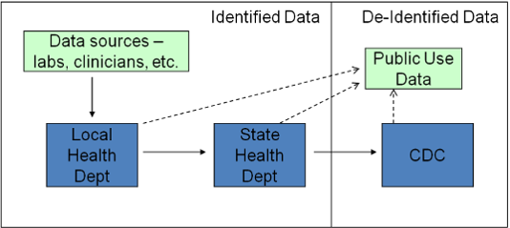
Generalized Public Health
Data Flow
7.2 Chart: The generalized flow of public health data.
Notes:
The generalized flow of public health data is illustrated in this slide. Because this is a generalization, there are some exceptions to this pattern. In most cases, the data originate from data sources such as clinicians and laboratories. The data are sent to Local Health Departments either directly, or they may be routed through the State Health Department. The State Health Department assumes the responsibility for reporting data to CDC. All levels of public health provide public use data - carefully screened to protect patient privacy. Both the CDC and the general public receive de-identified data, with patient identifiers removed to protect confidentiality.

Slide 20
Public Health, Part 1
Summary – Lecture b
Key terminology
Organization and funding in the U.S.
Roles
Notes:
This concludes lecture b of Public Health, Part 1.
In summary, this lecture defines some key terminology of public health and discusses the organization and funding of public health in the U.S. The roles of public health are discussed. One of these roles, disease reporting and surveillance, is described in detail.

Slide 21
Public Health, Part 1
References – Lecture b
References
Centers for Disease Control and Prevention. (2016). Nationally Notifiable Infectious Conditions - United States 2016. Retrieved January 30, 2017, from https://wwwn.cdc.gov/nndss/conditions/notifiable/2016/
Charts, Tables, Figures
  7.1 Chart: Advancing the Health, Safety, and Well-Being of Our People - FY 2017 President’s Budget for HHS. (2016). Retrieved January 30, 2017, from Department of Health and Human Services website: http://www.hhs.gov/about/budget/fy2017/budget-in-brief/index.html
  7.2 Chart: The generalized flow of public health data – Created by Magnuson, JA (2011).
Notes:
No Audio.

Slide 22
Introduction to Health and
Health Care in the U.S.
Public Health, Part 1
Lecture b
This material was developed by Oregon Health & Science University, funded by the Department of Health and Human Services, Office of the National Coordinator for Health Information Technology under Award Number 90WT0001.
Notes:
No Audio.

