Slide 1
Introduction to Health Care and
Public Health in the U.S.
Financing Health Care, Part 2
Lecture a
This material (Comp 1 Unit 5) was developed by Oregon Health & Science University, funded by the Department of Health and Human Services, Office of the National Coordinator for Health Information Technology under Award Number 90WT0001.
This work is licensed under the Creative Commons Attribution-NonCommercial-ShareAlike 4.0 International License. To view a copy of this license, visit http://creativecommons.org/licenses/by-nc-sa/4.0/.
Notes:
Welcome to Introduction to Health Care and Public Health in the U.S.: Financing Health Care, Part 2. This is lecture a.
The component, Introduction to Health Care and Public Health in the U.S., is a survey of how health care and public health are organized and how services are delivered in the U.S. It covers public policy, relevant organizations and their interrelationships, professional roles, legal and regulatory issues, and payment systems. It also addresses health reform initiatives in the U.S.

Slide 2
Financing Health Care, Part 2
Learning Objectives - 1
Describe the revenue cycle and the billing process undertaken by different health care enterprises. (Lecture a)
Explain the billing and coding processes, and standard code sets used in the claims process. (Lecture a)
Notes:
The learning objectives for Financing Health Care, Part 2 are to:
Describe the revenue cycle and the billing process undertaken by different health care enterprises
Explain the billing and coding processes, and standard code sets used in the claims process

Slide 3
Financing Health Care, Part 2
Learning Objectives - 2
Identify different fee-for-service and episode-of-care reimbursement methodologies used by insurers and health care organizations (HCOs) in the claims process. (Lecture b)
Review factors responsible for escalating health care expenditures in the United States. (Lecture c)
Discuss methods of controlling rising medical costs. (Lecture d)
Notes:
Identify different fee-for-service and episode-of-care reimbursement methodologies used by insurers and health care organizations, or HCOs, in the claims process
Review factors responsible for escalating health care expenditures in the U.S.
And discuss methods of controlling rising medical costs.

Slide 4
Health Care Revenue Collection
Describe the revenue cycle and the billing process
Review the use of code sets used in the claims process
Notes:
This lecture describes the processes that a health care organization uses to collect revenue from payors. This includes the revenue cycle in a health care organization, or the set of activities and events that produce income for the organization, and the terms and processes associated with medical billing and coding, including code sets.

Slide 5
The Business of Health Care - 1
Health Care Organizations:
  Receive payments from 3rd party
  Payment depends on:
    Codes entered on bill for type of service provided and diagnosis
    Formula determined by payor
      Formula is rarely transparent
Notes:
As with other business entities, health care organizations must receive income to pay expenses. Managing expenses in health care organizations is similar to any other business. However, health care is unique in the way in which it receives payment.
There are four features that make the business of health care different:
First, a third-party payor makes the majority of payments to someone other than the patient for services provided.
Second, the amount paid or reimbursed by an insurance plan depends entirely on codes entered on the bill or claim that indicate the type of service provided and the reason or diagnosis for the service or services and a formula determined by the payor. This formula for payment frequently is not transparent.

Slide 6
The Business of Health Care - 2
Health Care Organizations:
  May receive varying amounts from payor to payor for identical services
  Receive payment from the government for approximately 47% of all medical services rendered
Notes:
Third, payment amounts received for identical services may vary within a payor, and from payor to payor.
And fourth, health care organizations depend on payment from the government for approximately half of all health care expenses in the U.S.

Slide 7
The Revenue Cycle and Medical Billing
Revenue Cycle: Standard set of activities and events that produce revenue or income for a health care provider.
Medical Billing: Part of revenue cycle. The process of submitting claims to insurance companies in order to receive payment or reimbursement for services rendered by a health care provider.
Notes:
The revenue cycle is a standard set of activities and events that produce revenue or income for a health care organization or provider.
Medical billing, as part of the revenue cycle, is the process of submitting claims to insurance companies in order to receive payment or reimbursement for services rendered by a health care provider.

Slide 8
Reimbursement & Claims
Reimbursement: Compensation or payment for health care services already provided
  Fee-For-Service
  Episode-of-Care
Claim: Itemized statement and request for payment of the costs of health care services rendered by a health care provider or organization sent to third-party payor
Notes:
Reimbursement is the term used to describe payment by third-party payors to health care organizations for services provided. Third-party payors reimburse claims based upon one of two methodologies: fee-for-service or episode-of-care, both of which describe a unit of payment. Reimbursement methodology will be discussed at length later in this unit.
A claim is the health care organization’s itemized statement and formal request for payment from the third-party payor for the medical services provided to the patient or the insured.

Slide 9
Billing Definitions - 1
Charge Capture
  The process of documenting medical services in preparation of a claim
Charge Description Master
  Database of prices for services provided, used by HCOs during the billing process
Notes:
An additional definition associated with the billing and reimbursement is charge capture, which is the process of collecting and noting all services, procedures, and supplies provided during an encounter or patient care in preparation for submitting a claim to a third party payor.
The charge description master is the database of prices for services provided to patients and used by health care organizations during the billing process.

Slide 10
Billing Definitions - 2
Electronic Data Interchange (EDI)
  Transmission of data between organizations by electronic means
  Transaction set: an electronic model of a paper transaction or form
Notes:
Electronic data interchange, or EDI, is the structured transmission of data between organizations by electronic means. The Health Insurance Portability and Accountability Act, or HIPAA, of 1996 established national standards for electronic health care transactions. A transaction set used during an EDI is an electronic model of a paper transaction or form.

Slide 11
Revenue Cycle Overview
Appointment scheduled
Registration: Demographic and insurance info
Services provided
Charge capture
Coding
Claim submission: paper or electronic
Reimbursement received
Final settlement with patient
Notes:
The revenue cycle is a standard set of activities and events that produce revenue or income for a provider. Each organization determines the administrative and management tasks pertinent to their particular operational circumstances. The tasks for a serious case in the Emergency Department of a hospital will be handled differently than a direct admission to the hospital, as will the tasks in a physician’s office. In each situation, the process of the revenue cycle is the same.
The process begins with the patient or provider determining that health care services are needed, and scheduling an appointment.
At the health care facility, demographic information and insurance information are collected when the patient registers. The health care organization confirms the terms of the insurance coverage with the third-party payor, either electronically or by telephone. During this process, the provider obtains information about patient deductibles, copayments, and coinsurance.
The health care organization then provides services to the patient.
Documentation of the services furnished and the diagnosis associated with each service occurs during charge capture.
Subsequently, during coding, the diagnosis and services are converted into alphanumeric or numeric codes in a claim, and are submitted to the third-party payor for reimbursement. After processing by the third-party payor using the appropriate methodology, the provider receives a remittance advice, adjusts its accounts, and makes its final settlement on the account with the patient. The next slides examine select aspects of the medical billing process and the revenue cycle.

Slide 12
Registration
Hospital management software or practice management software
  Demographic information
  Health insurance information
Insurance information
  Confirm terms of coverage
  Determine deductibles, copayments, and coinsurance
  Accurate claim identification by third party payor
Notes:
Today, hospital management or practice management software accomplishes most billing tasks electronically. During the registration process, the software allows the accurate capture of patient demographic and health insurance information.
This allows the provider to confirm eligibility and enrollment in the health care plan, effective dates, benefits, and limitations and exclusions. It also permits the determination of deductibles, coinsurance, and copayments.
Acquiring the correct information ensures accurate reimbursement. Without accurate information, a third party payor may be unable to identify the patient or insured, resulting in a denial of payment for services provided.

Slide 13
Charge Capture
Process of collecting a list of services, procedures, supplies, and associated costs
Charge description master
  Database used by health care facilities
  Paper based forms
    Superbill, encounter form, or charge ticket
  Electronic capture
    Automatic – improved accuracy
Notes:
During the course of delivering health care, the charge capture process gathers descriptive data about the services provided during an encounter, including diagnosis, procedures, and tests, in order to establish an accurate representation of the services provided and the costs associated with them.
The actual fees charged to a patient account can be found in the organization's charge description master, a database used by a health care facility that stores the price list for all services provided to patients.
Smaller providers may use paper-based forms in the charge capture process, which may be called a super bill, encounter form, or charge ticket. Large organizations with sophisticated information systems can electronically capture charges using their management software. In addition, charges for services extrapolated from patient electronic records can automatically post to the patient's account, which improves accuracy.

Slide 14
Importance of Charge Capture
Ensures proper reimbursement for services provided
Permits reevaluation of episode of care reimbursement arrangements
Notes:
Charge capture is essential to ensure the health care organization or provider properly bills and receives reimbursement for the health care services provided. This becomes all the more important in what’s called episode of care reimbursement. Briefly, in episode of care reimbursement, a provider receives a single fee, no matter the services and the costs of providing the services. Since the cost of providing services may exceed the revenue received using this reimbursement method, providers must collect an accurate representation of the cost of providing the service using charge capture. In other words, providers must evaluate if they have taken on too much risk or cost in providing care in this reimbursement methodology.
By tracking charges, the provider may terminate or renegotiate the contract for reimbursement in the event that costs exceed revenue.
Episode of care reimbursement will be discussed at length later in this lecture.

Slide 15
Coding and Code Sets
Coding: Process of translating the written diagnosis and procedures relating to a patient encounter into a numeric classification or code sets
Code set: Group of numeric or alphanumeric codes used to encode descriptive data elements
  Tables of terms, medical concepts, diagnostic codes, or procedure codes
  Includes codes and descriptors of the codes
Notes:
After the services provided by a health care facility have been documented during charge capture, a claim can be prepared for submission to the third-party payor by coding the claim. Coding is the process of translating the descriptive or written diagnosis and procedures relating to a patient encounter into a standard numeric classification or code, accomplished by using code sets.
Code set refers to any table or group of codes used to encode data elements during the medical claims process. A code set may include a table of terms, medical concepts, medical diagnosis codes, or medical procedure codes. A code set includes the codes and the descriptors of the codes.

Slide 16
Update to ICD-9
ICD-10-CM
  Replaces ICD-9-CM Volumes 1 & 2
  Diagnosis codes increased from 14,025 to 69,823.
ICD-10-PCS
  Replaces ICD-9-CM Volume 3
  Procedure codes increased from 11,000 to 87,000
Compliance was set for October 1, 2015
Notes:
The International Classification of Diseases, 10th Revision, Clinical Modification, or ICD-10-CM, is the new diagnosis coding system developed as a replacement for ICD-9-CM, Volumes 1 & 2.
The International Classification of Diseases, 10th Revision, Procedure Coding, the ICD-10-PCS, is the new procedure coding system developed as a replacement for ICD-9-CM, Volume 3.
The compliance date for implementation of ICD-10-CM for diagnoses and ICD-10-PCS for inpatient hospital procedures was October 1, 2015.

Slide 17
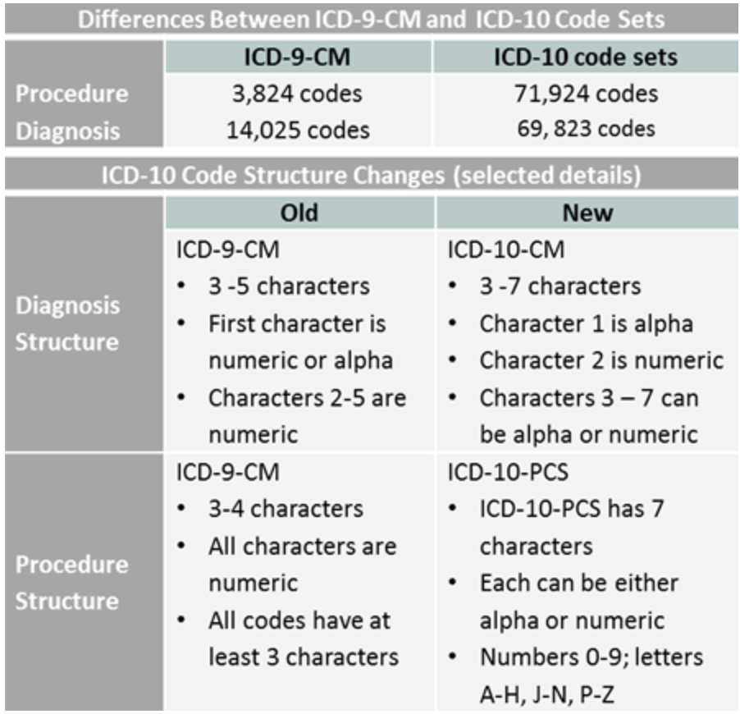
Code Set Differences
ICD-9 and ICD-10
Notes:
ICD-9-CM codes are very different from ICD-10-CM/PCS code sets. There are nearly 19 times as many procedure codes in ICD-10-PCS than in ICD-9-CM volume 3. There are nearly 5 times as many diagnosis codes in ICD-10-CM than in ICD-9-CM. ICD-10 has alphanumeric categories instead of numeric ones.

Slide 18
HIPAA Code Sets
ICD-10-CM (Diagnosis codes)
ICD-10-PCS (Procedure codes)
  NCHS & CMS respectively
Current Procedural Terminology (CPT)
  AMA
National Drug Codes (NDC)
  FDA and drug manufacturers
Code on Dental Procedures and Nomenclature (CDT)
  ADA
Notes:
The Health Insurance Portability and Accountability Act, or HIPAA, of 1996 requires that providers use specific code sets when submitting claims. This slide lists some of the code sets used to report medical services. The list also includes the organizations responsible for each code set.
Two of these deserve further discussion here, the ICD-10-CM and the current procedural terminology, or CPT.
ICD-10-CM is based on the World Health Organization's, or WHO’s International Classification of Diseases, Tenth Revision, or ICD-10. ICD-10-CM is the official system of assigning codes to diagnoses and procedures associated with hospital utilization in the U.S. The National Center for Health Statistics, or NCHS, and the Centers for Medicare and Medicaid Services, or CMS, are the U.S. governmental agencies responsible for overseeing all changes and modifications to the ICD-10-CM.
ICD-10-CM for medical diagnoses is based on WHO’s ICD-10. CMS also developed a new Procedure Coding System, ICD-10-PCS, for inpatient procedures. ICD-10-CM replaces ICD-9-CM, volumes 1 and 2, and ICD-10-PCS replaces ICD-9-CM, volume 3.
The Current Procedural Terminology, or CPT, code set is maintained by the American Medical Association through the CPT Editorial Panel. The CPT code set describes medical, surgical, and diagnostic services and is designed to communicate uniform information about medical services and procedures among physicians, coders, patients, accreditation organizations, and payors for administrative, financial, and analytical purposes.
The National Drug Codes, or NDC, are developed by the Federal Drug Administration, or FDA, and drug manufacturers. Also, the American Dental Association develops specific codes for dental procedures called the Code on Dental Procedures and Nomenclature, or CDT.

Slide 19
Code Sets by Provider
Physician: Inpatient and outpatient
Diagnosis: ICD-10-CM
Procedure: CPT
Hospital Facility: inpatient
  Diagnosis: ICD-10-CM
  Procedure: ICD-10-PCS
Hospital Facility: Outpatient
  Diagnosis: ICD-10-CM
  Procedure: HCPCS (CPT Level I and HCPCS Level II)
Notes:
HIPAA standards require the use of specific code sets for submitting claims, depending on the provider and the location where the service was delivered. The code sets for physicians and hospital facilities are listed here.
The ICD-10-CM is used to report all inpatient and outpatient diagnoses. The CPT is used to report physician inpatient and outpatient procedures; the ICD-10-PCS is used to report inpatient facility procedures; and the Healthcare Common Procedure Coding System, or HCPCS, is used to report outpatient facility procedures.

Slide 20
ICD-10-CM
Diseases of the circulatory system I00-I99
  I20-I25 Ischemic heart diseases
    I20 Angina pectoris
    I21 ST elevation (STEMI) and non-ST elevation (NSTEMI) myocardial infarction
    I22 Subsequent ST elevation (STEMI) and non-ST elevation (NSTEMI) myocardial infarction
    I23 Certain current complications following ST elevation (STEMI) and non-ST elevation (NSTEMI) myocardial infarction (within the 28 day period)
    I24 Other acute ischemic heart diseases
    I25 Chronic ischemic heart disease
Notes:
An example of the data available in the ICD-10-CM code set is illustrated on this slide. Under diseases of the circulatory system, ischemic heart disease is listed. Under that classification are the three-digit codes that describe an acute myocardial infarction. From there, the code for the specific type of myocardial infarction can be indicated. Note that this list is just a small sample of the codes available for ischemic heart diseases.

Slide 21
CPT Examples
Auditory System
  External Ear
    Incision
    69000 Drainage external ear, abscess or hematoma, simple
    69005 Complicated
    69020 Drainage external auditory canal, abscess
    69090 Ear piercing
Notes:
An example of CPT surgery codes for the external ear are listed on this slide.

Slide 22
Coding Examples
Diagnosis
  Upper respiratory infection = J06.9 (ICD-10-CM)
Service, procedure or test
  New patient, office visit, level II = 99202 (CPT)
  Biopsy of skin, subcutaneous tissue and/or mucous membrane(including simple closure), unless otherwise listed; single lesion = 11100 (CPT)
  Immune globulin 10 mg = J1564 (HCPCS Level II)
Notes:
Some examples of converting a diagnosis and procedure into codes for a physician are illustrated on this slide. The diagnosis of upper respiratory infection converts to J06.9 using the ICD-10-CM.
A level-two new patient office visit codes as 99202, using the CPT, and a skin biopsy converts to 11100.
Immune globulin ten milligrams, given as an injection, converts to J1564 using the HCPCS level two codes. It is important to have trained personnel who are knowledgeable about coding in order to properly code a claim.

Slide 23
Financing Health Care, Part 2
Summary
Revenue cycle
  Unique process
  Charge capture
    Services & diagnosis
  Claims coded
Notes:
This concludes lecture a of Financing Health Care, Part 2.
In summary, the revenue cycle for health care organizations is a unique process that requires submission of medical bills or claims describing the services provided. During the preparation of claims, information about the type of medical service, the diagnosis associated with the service, and the fee for the service is gathered and coded into a claim using standardized codes.
The final piece of the revenue cycle, submitting claims, is covered in the next lecture.

Slide 24
Financing Health Care Part 2
References – 1 – Lecture a
References
Buck, C. J. (2012). ICD-9-CM, for Physicians. In CPT Current Procedural Terminology (Professional ed., Vol. 1, 2). Chicago, IL: The American Health Information Management Association.
Code Sets Overview. (n.d.). Retrieved January 24, 2017, from https://www.cms.gov/Regulations-and-Guidance/Administrative-Simplification/Code-Sets/index.html
Coding & Billing. (n.d.). Retrieved January 24, 2017, from https://www.ama-assn.org/practice-management/coding-billing
Current Procedural Terminology. (n.d.). Retrieved January 24, 2017, from Wikipedia website: http://en.wikipedia.org/wiki/Current_Procedural_Terminology.
Definition of Health Insurance Terms. (2010, August 1). Retrieved January 24, 2017, from Bureau of Labor Statistics website: http://www.bls.gov/ncs/ebs/sp/healthterms.pdf.
Notes:
References slide. No audio.

Slide 25
Financing Health Care Part 2
References – 2 – Lecture a
References
National Center for Health Statistics. International Classification of Diseases (ICD-10-CM/PCS) Transition - Background. http://www.cdc.gov/nchs/icd/icd10cm_pcs_background.htm. Updated October 1, 2015. Accessed January 24, 2017.
Notes:
References slide. No audio.

Slide 26
Introduction to Health Care and Public Health in the U.S.
Financing Health Care, Part 2
Lecture a
This material was developed by Oregon Health & Science University, funded by the Department of Health and Human Services, Office of the National Coordinator for Health Information Technology under Award Number 90WT0001.
Notes:
No audio

