Slide 1
Introduction to Health Care and Public Health in the U.S.
Introduction to and History of Modern Health Care in the U.S.
Lecture a
This material (Comp 1 Unit 1) was developed by Oregon Health & Science University, funded by the Department of Health and Human Services, Office of the National Coordinator for Health Information Technology under Award Number 90WT0001.
This work is licensed under the Creative Commons Attribution-NonCommercial-ShareAlike 4.0 International License. To view a copy of this license, visit http://creativecommons.org/licenses/by-nc-sa/4.0/.
Notes:
Welcome to Introduction to Health Care and Public Health in the U.S.: Introduction to and History of Modern Health Care in the U.S. This is lecture a.
The component, Introduction to Health Care and Public Health in the U.S., is a survey of how health care and public health are organized and how services are delivered in the U.S. It covers public policy, relevant organizations and their interrelationships, professional roles, legal and regulatory issues, and payment systems. It also addresses health reform initiatives in the U.S.

Slide 2
Introduction to and History of Modern Health Care in the U.S.
Learning Objectives - 1
Define key terms in health care and public health (Lectures a, b, c, d)
Describe components of health care delivery and health care systems
(Lecture a)
Discuss examples of improvements in public health (Lecture b)
Notes:
The learning objectives for Introduction to and History of Modern Health Care in the U.S. are to:
Define key terms in health care and public health,
Describe components of health care delivery and health care systems,
Discuss examples of improvements in public health,

Slide 3
Introduction to and History of Modern Health Care in the U.S.
Learning Objectives - 2
Define core values and paradigm shifts in U.S. health care (Lecture c)
Describe the technology used in the delivery and administration of health care (Lecture d)
Notes:
Define core values and paradigm shifts in U.S. health care,
And describe the technology used in the delivery and administration of health care.

Slide 4
Some Definitions: Health
Often thought of as the absence of disease
World Health Organization (WHO)
  “…state of complete physical, mental and social well-being and not merely the absence of disease or infirmity”
“Illness” is a state of poor health
Notes:
This introductory lecture will provide a high level perspective as well as some important definitions.
We will begin by defining the term “health.” We often think of health as the absence of disease but this is a somewhat narrow description of the term. In 1946, representatives of 61 countries attended the International Health Conference in New York to ratify the Preamble to the Constitution of the World Health Organization, which is the specialized agency of the United Nations that deals with global health. The WHO definition of health is that health is the state of complete physical, mental, and social well being and not merely the absence of disease or infirmity. Thus, illness represents a state of poor health.

Slide 5
Health Care
The prevention and treatment of illness
Delivered by people from varied disciplines
  Medicine
  Dentistry
  Nursing
  Laboratory Science
  Pharmacy
  Other allied health professions
Work together as interdisciplinary teams to deliver care
Notes:
Let’s look at the term “health care.” Health care is the prevention and treatment of illness. It is delivered by people who are drawn from different and often disparate disciplines, including medicine, dentistry, nursing, laboratory science, pharmacy, and other allied health professions which may include anesthesia technologists, cardiovascular technologists, medical assistants, perfusionists or respiratory therapists. As you can see, these people have different backgrounds, and they have disparate training, but often work together as interdisciplinary teams in order to deliver care to patients.

Slide 6
Health Care Delivery
Delivered in different places
Inpatient facilities
  Hospitals
    Institutions for treating sick or injured people
    Historically places for shelter, almshouses
    Hospital Survey and Construction Act (also known as the Hill-Burton Act) passed in 1946
  Nursing and residential care
Outpatient facilities
Notes:
Health care is delivered in different places. In this unit, we are going to define and look at in-patient facilities, including nursing and residential care, and out-patient facilities.
When we think of in-patient facilities, we typically think of hospitals. Hospitals are institutions that treat patients who are sick or injured. Hospitals are physical structures that house patients during treatment and allow clinicians to conduct diagnostic tests and perform management interventions and specialized functions such as surgery or managing childbirth.
Historically, hospitals were places for shelter, or alms-houses for the poor. In 1946, the Hospital Survey and Construction Act was passed – this act was known as the Hill-Burton Act, since it was sponsored by Senator Lister Hill of Alabama and Senator Harold Burton of Ohio. This law provided federal grants to improve the physical infrastructure of hospitals and led to significant augmentation of the infrastructure of facilities that provided in-patient care in the United States.

Slide 7
Health Care Delivery - Hospitals
Types of hospitals:
    General medical and surgical
    Specialty (orthopedic, pediatrics, women’s services)
    Psychiatric
Publicly or privately owned
Patients can be admitted:
  Via emergency department
  Directly from physician’s office
Notes:
There are different types of hospitals. Hospitals can provide general, medical, and surgical care. But some hospitals may provide specialty services that focus on a particular aspect of care, such as orthopedics, pediatrics, or women’s services. Some hospitals focus on mental health, or psychiatric care.
Hospitals may be publicly or privately owned. Public hospitals may be administered by the city, county, state, or at a federal level. Privately owned hospitals may be not-for-profit, or may pursue profits like any other business.
Patients may be admitted to a hospital one of two ways. They may go into an emergency room where they are evaluated by a team of clinicians. If the clinicians feel that the person is sick enough, they may admit the person into the hospital for care. Patients may also be directly admitted to hospitals from physician’s offices.

Slide 8
Health Care Delivery – Nursing and Residential Care Facilities - 1
Short-term or long-term facilities
Long-term care classified by level of care
Skilled nursing facilities (nursing homes)
  Proliferated after amendment of the Social Security Act
  Originally part of the welfare system
  Now part of the health care system
Notes:
Let us now turn our attention to health care delivery in nursing and residential care facilities. These can be short-term facilities where it is anticipated that patients will stay for a brief period of time before returning home or to their residences, or long-term facilities where patients may stay for an extended or indefinite period of time.
An example of a short-term facility would be a post-surgical rehabilitation center. After surgery, it may be deemed that a patient is too frail to return home and may need to spend some time in a rehabilitation center before gaining enough strength to return home. An example of a long-term facility might be an Alzheimer’s unit in a nursing home. A patient with gradually progressive dementia may need to stay indefinitely in such a facility.
Long-term care is classified by the level of care. For example, a patient with relatively few health needs may reside in an assisted living facility, whereas a patient with profound and significant health needs may need the services of a nursing home.
Skilled nursing facilities, also called nursing homes, initially proliferated after an amendment of the Social Security Act. They were originally part of the welfare system and gradually shifted to become a part of the current health care system.

Slide 9
Health Care Delivery – Nursing and Residential Care Facilities - 2
1969 - Medicare drastically reduced coverage for nursing homes
1970 - Miller Amendment established a new standard, “intermediate care”
1990s - “Sub-acute care”
  Provided care for patients discharged from hospitals who briefly need a higher level of care “than is provided to the majority of patients in a skilled nursing facility.”
Notes:
In 1969, as the cost of Medicare increased, the then Department of Health and Human Services drastically reduced coverage for nursing homes. A year later, the Miller Amendment established a new standard called intermediate care. Intermediate care facilities didn’t require the same amount of skilled nursing or resources thus requiring reduced levels of reimbursement.
In the 1990s another standard, sub-acute care, was defined to provide care for patients discharged from hospitals who briefly needed a higher level of care than was provided to a majority of patients in a skilled nursing facility. These distinct levels of care have been delineated primarily from the cost-effectiveness perspective.

Slide 10
Health Care Delivery –
Outpatient Facilities – 1
Physicians offices
  Primary care
  Specialty care
  Single specialty or multispecialty
Dental offices
  General dentists
  Specialists
    Orthodontists
    Endodontist
    Oral Surgeons
Notes:
Let’s now spend some time talking about health care delivery in the outpatient setting. Outpatient facilities may be physicians’ offices, dental offices, medical and diagnostic laboratories, or other ambulatory health services. Physician’s offices may be focused on primary, family, or specialty care. Family practice typically includes family care, internal medicine, and pediatrics, but also may focus on a particular specialty. These specialty care offices may represent medical specialties, such as gastroenterology or cardiology; surgical specialties such orthopedics or neurosurgery; or may reflect mental health care in the outpatient setting.
These offices are physical structures and though they may be present in close proximity to inpatient facilities, many physicians’ offices exist in the communities they serve and some of them may be quite far from hospitals. These offices may be single-specialty, where all the physicians practicing in a single office are of the same field such as family practice or internal medicine, or they may be multi-specialty offices, where an internal medicine practitioner may share space with an orthopedic surgeon. Dental offices may be those of general dentists, or specialists such as orthodontists, endodontists, or oral surgeons.

Slide 11
Health Care Delivery –
Outpatient Facilities – 2
Medical and diagnostic laboratories
  X-rays
  CT Scans and MRIs
  Biologic Specimens
Other ambulatory health services
  Ambulance services
  Home health care
  Hospice
  Visiting Nurse Services
Notes:
When we think of laboratories, we think of medical and diagnostic laboratories. Diagnostic laboratories are typically involved with imaging: x-rays, C-T scans – also called Computerized Axial Tomography scans or CAT scans - Magnetic Resonance Imaging, or MRIs and mammograms.
Ultrasound imaging centers are examples of diagnostic laboratories. Medical laboratories usually deal with biologic specimens such as blood, cytology, or bacteriologic specimens.
Specialized medical laboratories include DNA testing laboratories, medical pathology laboratories, parasitology and mycology health laboratories, toxicology health testing, and facilities that deal with non-radiologic, non- x-ray testing services.
Examples of other ambulatory health services include ambulance services, home health care, blood and organ banks, hearing and vision screening facilities, smoking cessation programs, hospice services, and visiting nurse services.

Slide 12
The Health Care Industry
One of the largest industries in the U.S. and rapidly growing in employment
  2014 - 18.0 million jobs for wage and salary workers
  Estimated to grow to 21.9 million jobs by 2024
Top four fastest growing job categories
  Home health care services
  Outpatient care centers
  Offices of other health practitioners
  Other ambulatory health care services
Notes:
The health care industry is one of the largest industries in the U.S. In 2014, 18 million jobs for wage and salary workers came from this industry. This is estimated to grow to 21.9 million jobs by 2024. The top four fastest growing job categories include home health care services, outpatient care centers, offices of other health practitioners, and other ambulatory health care services.

Slide 13
Overviews of Health Care Systems
Askin (2014)
  Started by two medical students who are now physicians
  Overview of U.S. health care system, now in second edition, https://healthcarehandbook.wustl.edu
Reid (2010)
  Comparative overview of different models of health care around world assessed by Washington Post journalist
Notes:
Let’s take a look at health care systems. A book by Askin and Moore, The Health Care Handbook, started as an e-book by two medical students who wanted to better understand the U.S. health care system. Both are now physicians and they have continued to update the book. It gives an overview of the U.S. health care system. They describe all the different types of practitioners and organizations that are part of the U.S. health care system.
Another interesting book is one by TR Reid, The Healing of America: A Global Quest for Better, Cheaper, and Fairer Health Care. Reid is a journalist from the Washington Post who had some common chronic medical problems. He went across the world to experience different health care systems and his book provides a comparative overview of the various models of health care around the world.

Slide 14
Reid’s Four Systems and
Their U.S. Analogs (2010)
Name | Description | Countries | U.S. Analog
Beveridge | Provided and financed by government | Great Britain, Hong Kong, Cuba | Veterans Administration (VA)
Bismarck | Regulated private insurance – must cover all | Germany, France, Switzerland | Employer-provided health insurance
National health insurance | Private system with government-run insurance | Canada, Taiwan, South Korea | Medicare, Medicaid
Out-of-pocket | Pay as you go | Most poor countries | U.S. uninsured
Reid, 2010
Notes:
In his analysis of comparative health care systems, Mr. Reid comes up with four basic systems or models. He has names for these, describes them, points out the countries that use them, and shows that each of these models is used in different segments of the U.S. health care system.
The first of these is the Beveridge model, which was developed in Great Britain and has health care that is provided and financed by the government. We all know the British National Health Service. This approach is also used in Hong Kong, an example of a capitalist country, and in Cuba, an example of a socialist country. In the U.S., this model is used in the Veteran’s Administration, or VA system, where care is provided and financed by the government.
The second model is the Bismarck system. This is a system where there is highly regulated private insurance. There are usually rules that everyone must be covered and that pre-existing conditions must be covered as well. Often times, the coverage is tied into employment, and the major example of the Bismarck model is Germany, where Bismarck was from, although France, Switzerland, and many other European countries use this model. While we don't have this model exactly in the U.S., the employer-provided health insurance that most who are employed have is the closest example of the Bismarck model in the U.S.
The third model is the national health insurance model. This is a private health care system with government-financed insurance. Canada is probably the best known model of this approach, although other countries like Taiwan and South Korea use it. The closest analog in the U.S. is Medicare, and Medicaid to some extent.
The final model is out-of-pocket health care, where individuals pay as they go. Most poor countries around the world that cannot afford a comprehensive health care system use this approach, which basically ends up having those who have wealth being able to get health care and those who don't have wealth not being able to get it. There are many citizens in the U.S. who function under this model, namely those who lack health insurance.
One point that Reid wanted to make was that there are different models and the U.S. has within its system people who are covered by the approach of each of these four models.

Slide 15
Some Definitions of Care
Primary care: Initial and ongoing care, typically provided in an office or clinic
Secondary care: Specialty care provided in the community
Tertiary care: Highly specialized care usually provided by referral in a large, typically academic, medical center
Notes:
It is also important when talking about health systems to understand the different types of care: primary, secondary, and tertiary. Primary care is that initial and ongoing care that is typically provided in a physician’s office or in a clinic, and is sometimes provided by non-physician practitioners. But primary care is also the ongoing longitudinal care that may take place in a clinic or in an academic medical center. However, the type of care is characterized by an ongoing relationship between the patient and either a single or multiple health care providers.
Secondary care is the specialty care that is provided in the community, such as when a patient is referred for a test to a local specialist or hospitalized in their local community for a test or surgical procedure.
Finally there is tertiary care. This is highly specialized care that is usually provided by referral to some sort of large medical center. Often these large medical centers are academic medical centers but they don't necessarily need to be. The key of tertiary care is that the patient is away from the primary and secondary care that they've received initially. Sometimes primary and secondary care can be provided in academic medical centers and in hospitals, but tertiary care is that highly specialized care offered by many subspecialists who are not readily available in the patient's community.

Slide 16
Health Care System Stakeholders (the “p”s)
Patient: The one who gets health care, often called a consumer or citizen when they are well
Provider: Those who provide health care, e.g., physicians, nurses, allied health
Purchaser: Those who buy health care, usually employers or the government
Payor: Those who pay the health care system, i.e., the insurance companies and government
Public health: Protectors of the public’s health
Notes:
Another important aspect of health care systems is to understand the different stakeholders, all of whose names start with the letter “p.” First and foremost, obviously, is the patient, the one who gets health care. Sometimes this individual may be referred to as a consumer or citizen, especially when they are well, and not a patient seeking care in the health care system.
There are also providers, although some take issue with that term, but that is an umbrella term for all of those people and organizations who provide health care professionally. This includes physicians, nurses, allied health professionals, and others.
Purchasers are those who buy health care in the United States. For most people who are employed, the purchaser provides a health insurance benefit to the individual. Another big purchaser of health care in the United States is the government, through Medicare, Medicaid, and other government programs.
The payor actually pays the dollars for the health care. This is typically insurance companies, at least in the United States. Thus, the employer may purchase the health insurance, but then, the health insurer is the payor that pays for the care. Sometimes the government is the payor as well as the purchaser.
Finally, there is the public health system that aims to protect the public's health through activities such as clean water, food sanitation, clean air, preventive measures, and so forth.

Slide 17
How Health Care is Financed - 1
No matter who pays the cost (patient, employer, or government), most health care is financed on the notion of insurance
  Everyone pays some, those who need it use it
  Although modern system may be better described as “pre-paid” health care than insurance
Notes:
Another important aspect of understanding health care system is the financing of health care. People do not always understand the difference between paying for health care and paying for health insurance. The reality is that unless people are extraordinarily wealthy, they typically pay for insurance and not care. No matter which of the types of health care systems people live in, their care is financed by insurance. The notion of insurance is that everyone pays some and those who need it use it. However, we increasingly mandate that various things are paid for with insurance, so instead of being a pure insurance system we have moved to somewhat of a prepaid health care system, where essentially, we pre-pay for our health care.

Slide 18
How Health Care is Financed - 2
Payment methods
  Private fee-for-service
  Private managed care, a.k.a., HMOs
  Government-financed, a.k.a., single-payor
  Government-provided
Notes:
Different payment methods have evolved over the years. The predominant method in the United States in the last century was private fee-for-service insurance. In this approach, individuals who had insurance would go to the physician or the hospital. Whatever care was provided to them was paid for by the insurance company. Pure fee-for-service started to become unsustainable due to a move towards managed care, manifested in the 1990s by health maintenance organizations, or HMOs, or other types of models such as preferred provider organizations, or PPOs, where patients needed to get their care within a network. In PPOs, the physicians and hospitals that were part of the network would have some financial constraints put on them.
Another payment method is government-paid insurance. The most common approach is single-payor, where basically the individual gets health care and the government reimburses the physician or hospital.
Finally, there is government-provided care, were there are government owned and run physician offices, hospitals, and other parts of the health care system.

Slide 19
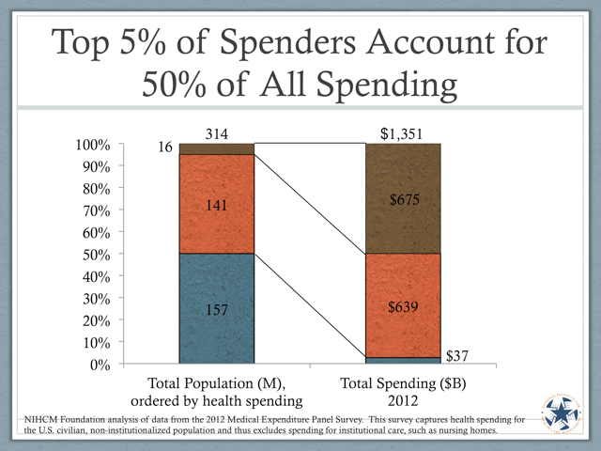
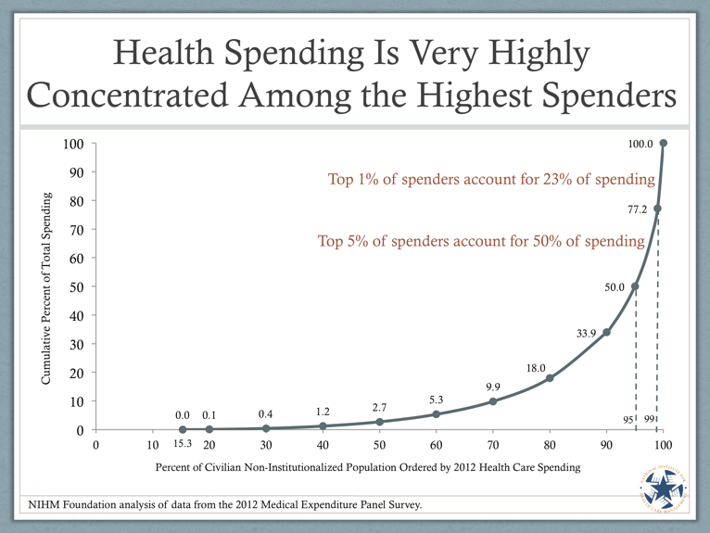
Insurance –
Some Use More Than Others
http://www.nihcm.org/concentration-of-health-care-spending-chart-story
http://www.nihcm.org/concentration-of-health-care-spending-chart-story
Notes:
As with all insurance, some people use more health care services than others. This is true of any type of insurance, whether auto insurance, homeowners insurance, or others. With health care, there are a small number of individuals who actually account for a large amount of the spending. If we look at some data from the United States, we see that the top 5% of spenders account for about 50%, or half, of all spending. The top 1% of spenders account for 23%, or about a quarter of all spending.

Slide 20
Brief History of
Health Care Finance - 1
Mid-20th century
  Introduction of health insurance
  Growth of “open-ended” spending
Late 20th century
  Efforts to control costs, culminating in managed care
  Empowerment of patients/consumers and growth of Internet
Notes:
Health care finance has evolved over the last half-century. Starting in the middle of the 20th century was when many medical technologies first came to the fore, and it became clear that people could not just pay for the services that they used. So in the middle of the 20th century, health insurance was introduced, with the notion that everyone paid into a pool, and those who needed it, used it. This was the beginning of what some call “open-ended spending” with the fee-for-service model, in which insurance would just pay the bills, with little restriction based on quality-ensuring criteria such as the cost-effectiveness or the evidence basis of treatments being offered. Towards the latter part of the 20th century, this system started to become increasingly expensive, with no ability to control costs. This led to efforts that aimed to control costs, and to what we now call managed care, where constraints are put on spending. At the same time, the late 20th century saw the empowerment of patients and consumers to play a more active role in health care, aided in part by the growth of the Internet, which made information more widely available.

Slide 21
Brief History of
Health Care Finance - 2
21st century
  Costs continued to rise well above inflation but have leveled off in recent years
  Still, are we on a collision course with increasing costs, aging baby boomers, more costly technology, etc.?
Notes:
Now, in the 21st century, costs have continued to rise, although they have leveled off some in recent years. But we are still on this collision course with increasing costs, aging baby boomers, more costly technology, and other aspects that will continue to make financing health care a challenge.

Slide 22
Major Health Care
Payors in U.S. - 1
Private health insurance: For most employed citizens and their dependents, except those in lower-paying jobs
Medicare: Government insurance for elderly and disabled
Medicaid: Government insurance for indigent
Notes:
Finally, with regards to health care systems, let's talk about health care payors in the U.S. Recall that payors are the entities that take money and pay health care provider organizations for care. The major type of payor in the U.S. continues to be private health insurance, particularly for most of those who are employed and their dependents, except those who are in lower paying jobs where health insurance is not provided as an employment benefit.
Medicare is government-financed insurance, where the federal government is the payor for insurance. Medicare is provided to elderly and disabled individuals.
Medicaid has historically been the government insurance program for the indigent, in other words, those who are poor. However, Medicaid is expanding substantially under the Affordable Care Act.

Slide 23
Major Health Care
Payors in U.S. - 2
State Children’s Health Insurance Program (S-CHIP): Government insurance for uninsured low-income children
Other expenses due to out-of-pocket, public health, and other expenditures
Notes:
There is also a government insurance program for low-income children called the State Children’s Health Insurance Program, or S-CHIP.
Finally, there are many other health care expenses that people have, either those who have no insurance or out-of-pocket expenses for those who do. There are also public health expenditures that are typically made by governments, whether federal, state, or local, and other kinds of expenditures on health-related items.

Slide 24
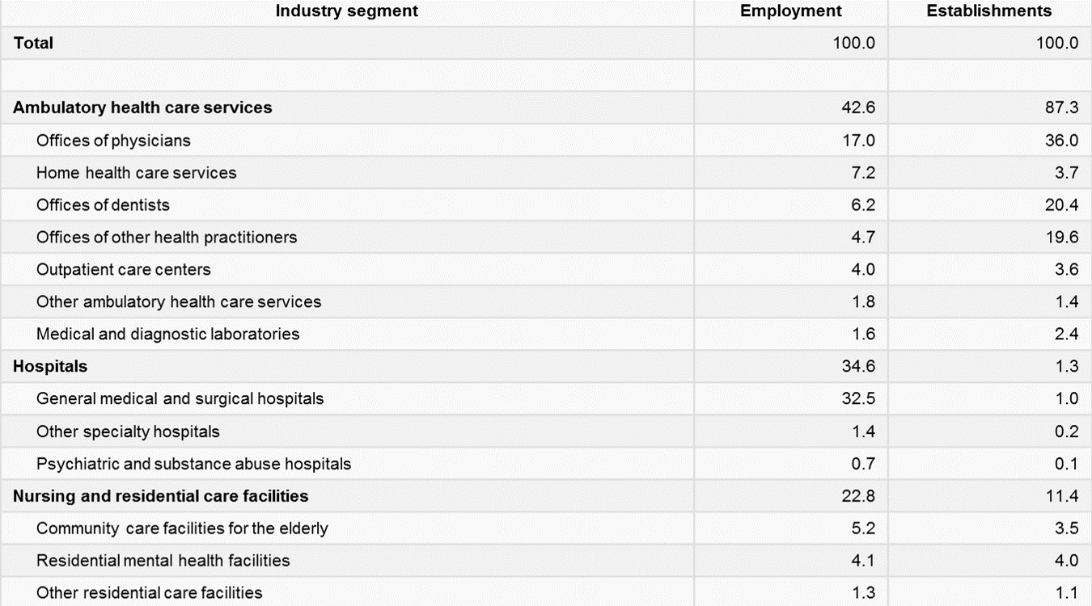
Organization of the
Health Care Industry
1.1 Table: Percent distribution of employment and establishments in health services by detailed industry sector, 2008.
Notes:
This table reflects the organization of the health care industry, and shows the percent distribution of employment in establishments in the health services sector in 2008. You can see that about eighty-seven percent of establishments and forty-two percent of employment are in ambulatory health care services. And you can see in this table that hospitals comprise one-point-three percent of establishments, but employ thirty-four-point-six percent of the people who work in the health care industry. Nursing and residential care facilities are about eleven percent of the establishment and employ about twenty-three percent of workers in the health services sector.

Slide 25
Introduction to and History of Modern Health Care in the U.S.
Summary – Lecture a
Important definitions
  Health
  Health care
  Health care systems
Different types of health care delivery
  Inpatient
  Outpatient
Different models that range from private to public funding – most are combination
Notes:
This concludes lecture a of Introduction to and History of Modern Health Care in the U.S.
In summary, this lecture has defined three important terms - health, health care, and health care systems.
There are many different types of health care delivery, ranging from in-patient facilities, which include hospitals, and short- and long-term care facilities, to out-patient facilities, where patients visit for specialty care and laboratory work.
Finally, health care systems vary greatly from country to country. Most systems are characterized by a combination of public and private funding.

Slide 26
Introduction to and History of Modern Health Care in the U.S.
References – 1 – Lecture a
References
Askin, E and Moore, N (2014). The Health Care Handbook - A Clear and Concise Guide to the United States Health Care System, Second Edition. St. Louis, MO, Washington University in St. Louis.
Definition of Healthcare. Preamble to the Constitution of the World Health Organization as adopted by the International Health Conference, New York, 19 June - 22 July 1946; signed on 22 July 1946 by the representatives of 61 States (Official Records of the World Health Organization, no. 2, p. 100) and entered into force on 7 April 1948.
A. (n.d.). Health Care Careers Directory 2012-2013. American Medical Association.
ISBN#: 978-1-60359-770-8.
Health Care and Social Assistance: NAICS 62, US Bureau of Labor Statistics, http://www.bls.gov/iag/tgs/iag62.htm.
Notes:
No Audio.

Slide 27
Introduction to and History of Modern Health Care in the U.S.
References – 2 – Lecture a
References
Henderson, R (2015). Industry employment and output projections to 2024. Monthly Labor Review, , Retrieved January 17, 2017, http://www.bls.gov/opub/mlr/2015/article/industry-employment-and-output-projections-to-2024.htm
Reid, TR (2010). The Healing of America: A Global Quest for Better, Cheaper, and Fairer Health Care. New York, NY, Penguin Books.
World Health Report 2000 - Health systems: improving performance. (2000). Retrieved January 20, 2017, from WHO website: http://www.who.int/whr/2000/en/ .
Charts, Tables, Figures
  1.1 Table: BLS Quarterly Census of Employment and Wages, 2008. (2008). Retrieved January 20, 2017, from US Bureau of Labor Statistics website: http://www.bls.gov/cew/.
Notes:
No Audio.

Slide 28
Introduction to Health Care and Public Health in the U.S.
Introduction to and History of Modern Health Care in the U.S.
Lecture a
This material was developed by Oregon Health & Science University, funded by the Department of Health and Human Services, Office of the National Coordinator for Health Information Technology under Award Number 90WT0001.
Notes:
No Audio.

